Slide 1
Sentiment Analysis IMDB Action Movies Reviews
Kevin Okiah
4/4/2019

Slide 2


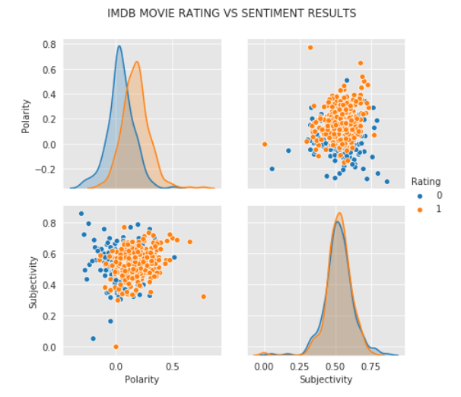
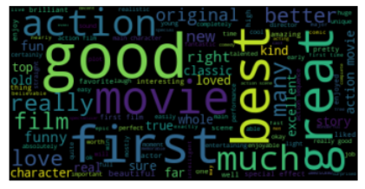
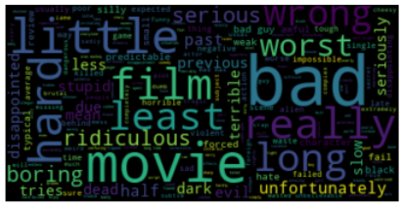
Sentiment Analysis
Data Set and Tools Used
Source: IMDB Action movies Reviews
Number of Movies: ~300 movies
Type: 1 Positive Review and 1 Negative Review per Movie
Data Collection Method: Web-Scrapping with Beautiful Soup, LXML,
Data Preprocessing Included: Tokenization, Changed to lower, contractions expanded, Stop words and punctuations removed, lemmatization, and vectorization using TF-IDF for Clustering.
Sentiment: TextBlob used for Polarity [-1,1] and Subjectivity [0,1] Sentiment calculations
Problem Statement: Can Sentiment Analysis be used to Isolate Positive and Negative Movie reviews?
Sentiment Analysis seeks to gauge opinions, feelings, Attitudes, or Emotions about a given subject from written or spoken language. Is it Positive or Negative.
Negative
Positive
Results
Results Interpretation and Conclusion
Word in Positive Sentiment
Sentiment Polarity: Positive Reviews (1) have a more positive polarity distribution compared to Negative reviews(0). Movie Rating is correlated to Sentiment Conveyed by reviewer. Positive Rating is directly related to Sentiment. See Fig. 1(A)
Sentiment Subjectivity: There is no difference in distribution of Subjectivity of Positive(1) and Negative(0) reviews. Fig. 1(B)
Positive Sentiment Words include ‘Good’, ‘best’, ‘great’ etc.
Negative Sentiment Words include ‘bad’, ‘worst’, ‘really’ etc
Conclusion: Sentiment Analysis can be used to Isolate Positive and Negative reviews
A
B
Words in Negative Sentiment
Fig. 1

