Slide 1



AIRNEST
Smart IoT Indoor Air Monitoring Station
Bachelor's thesis
Scientific coordinator:
Conf. dr. ing. Răzvan, Bogdan
Candidate:
Tudor-Alexandru MATEI

Slide 2

INTRODUCTION
The project presented today shows a smart indoor air quality station product. It is mostly destined for residential use and it lets the user easily visualize the data. This project meets the following requirements:
Real-time reading, processing and display of sensor read values
Real-time storage of read data in Cloud
Retrieval of data in Cloud
Data visualization through the website and mobile app
Predictions generated based on gathered and existing data
Download of raw data and mobile app

Slide 3
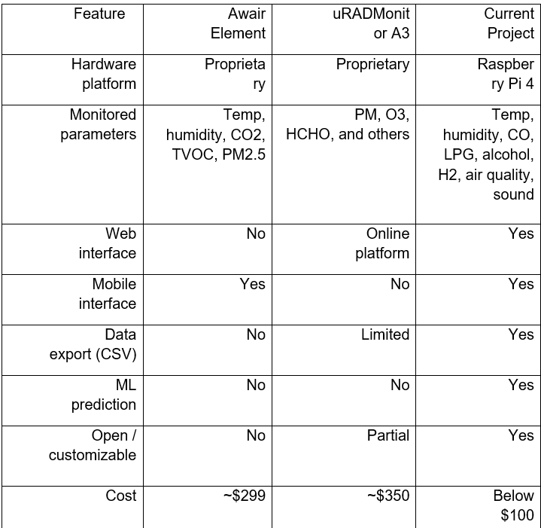
PREVIOUS WORKS

Slide 4
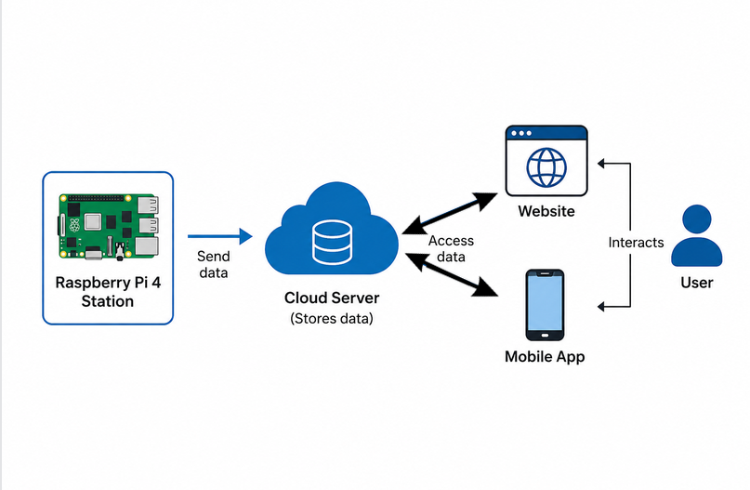
PROBLEM AND SOLUTION
Problem: lack of affordable and modifiable product options for indoor air quality monitoring.
Solution=> a product made after this project, which can be arranged in 3 parts:
Hardware part, having a Raspberry Pi as base
Website and mobile application (runs on android)
Cloud storage for data (AWS are used)

Slide 5
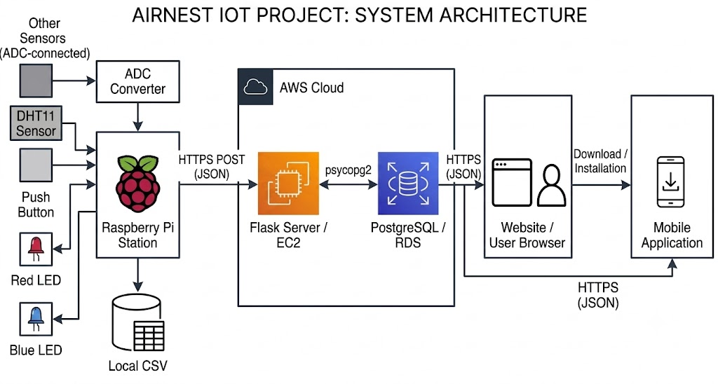

SYSTEM ARCHITECTURE

Slide 6
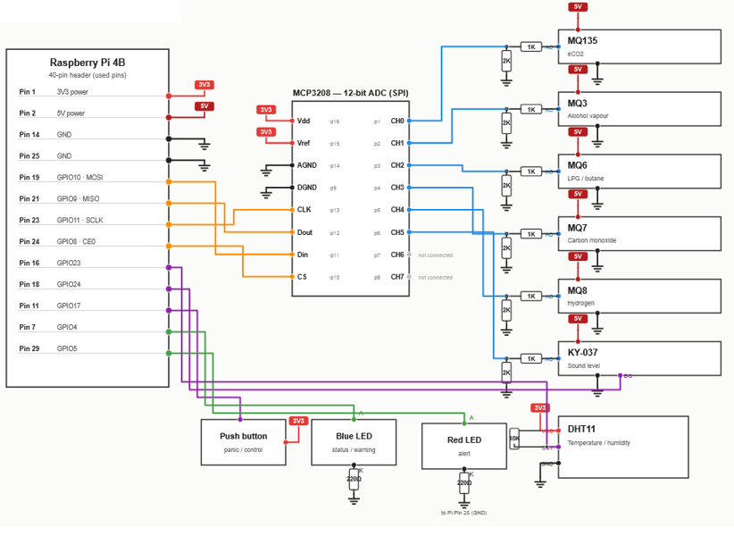
HARDWARE ARCHITECTURE

Slide 7
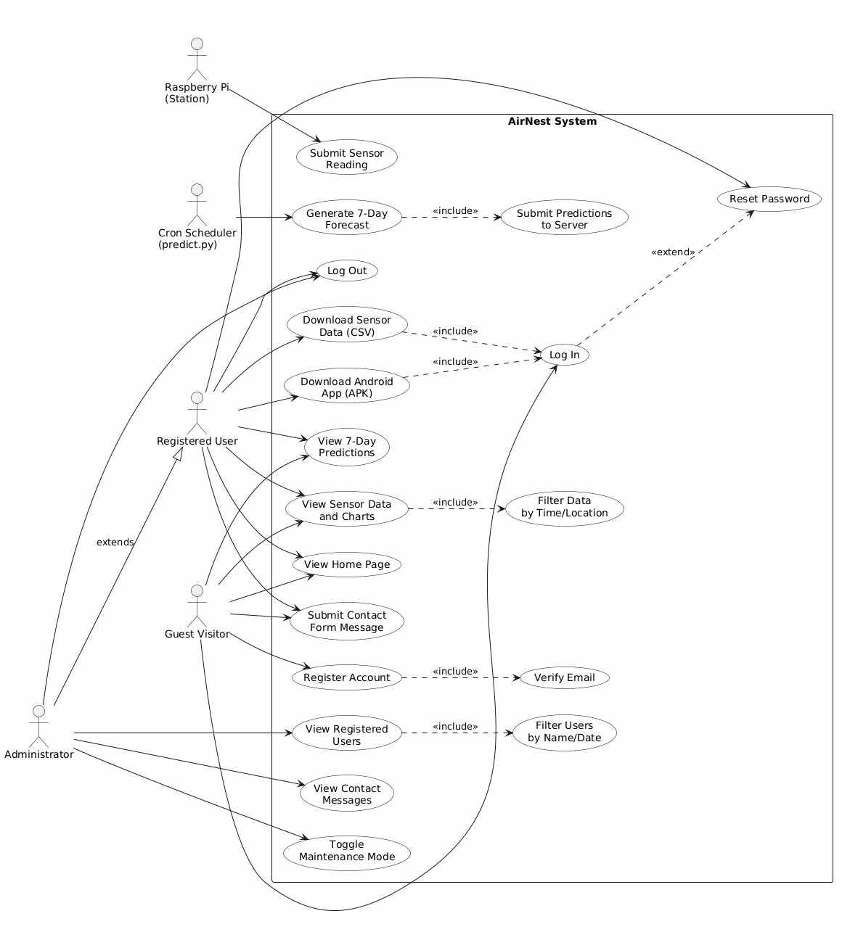

SOFTWARE ARCHITECTURE

Slide 8

PREDICTIONS
There are two models used:
Prophet (used for predicting temperature and humidity up to 7 days ahead)
Random Forest Classifier( used to classify if a future day will have dangerous air quality levels)

Slide 9
TESTING
To make sure the system is functioning properly, testing was conducted in two parts:
Data gathered and computed by the station to ensure its accuracy.
The generation of predictions and sending data.
Testing the website and mobile application so there are no errors and data is available to see when used by the user.

Slide 10
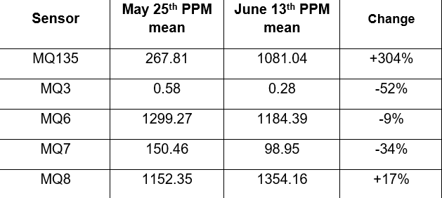
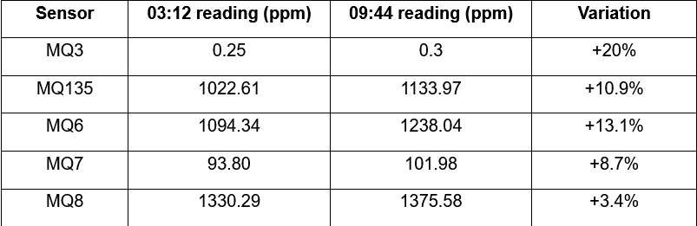
RESULTS
Value comparison between two different days (25th May before and 13th June after sensor calibration)
Comparison between values at the beggining and end of a session (June 13th)

Slide 11
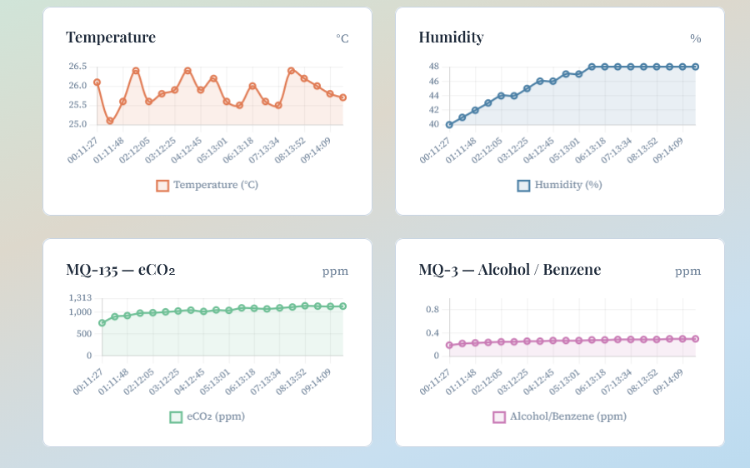
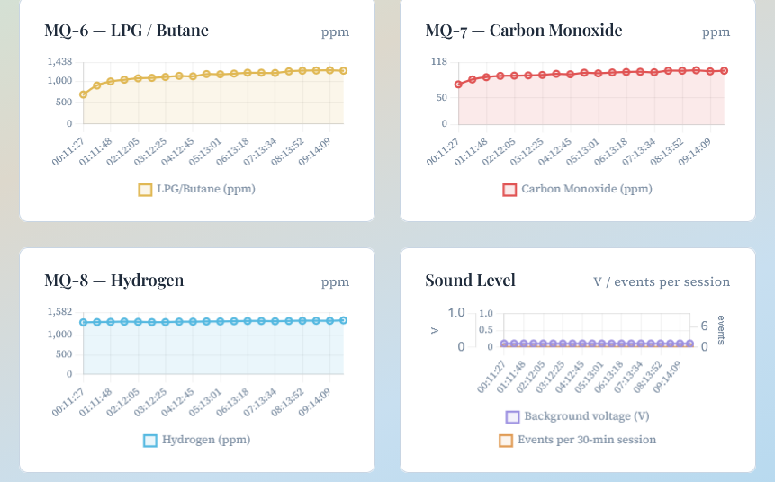
RESULTS
Chart data present on the pictures above is from June 13th

Slide 12
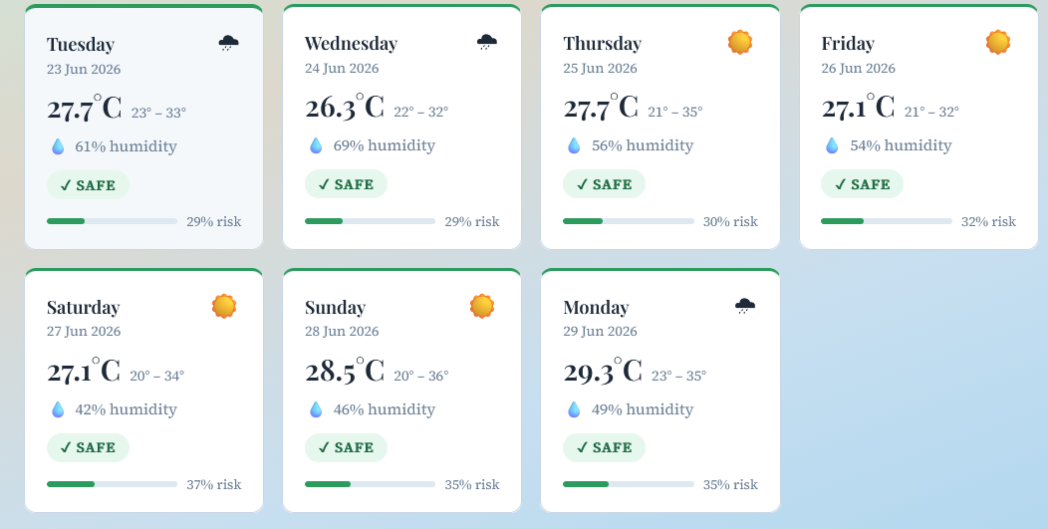
RESULTS
The predictions in the picture were generated on 23.06.2026

Slide 13
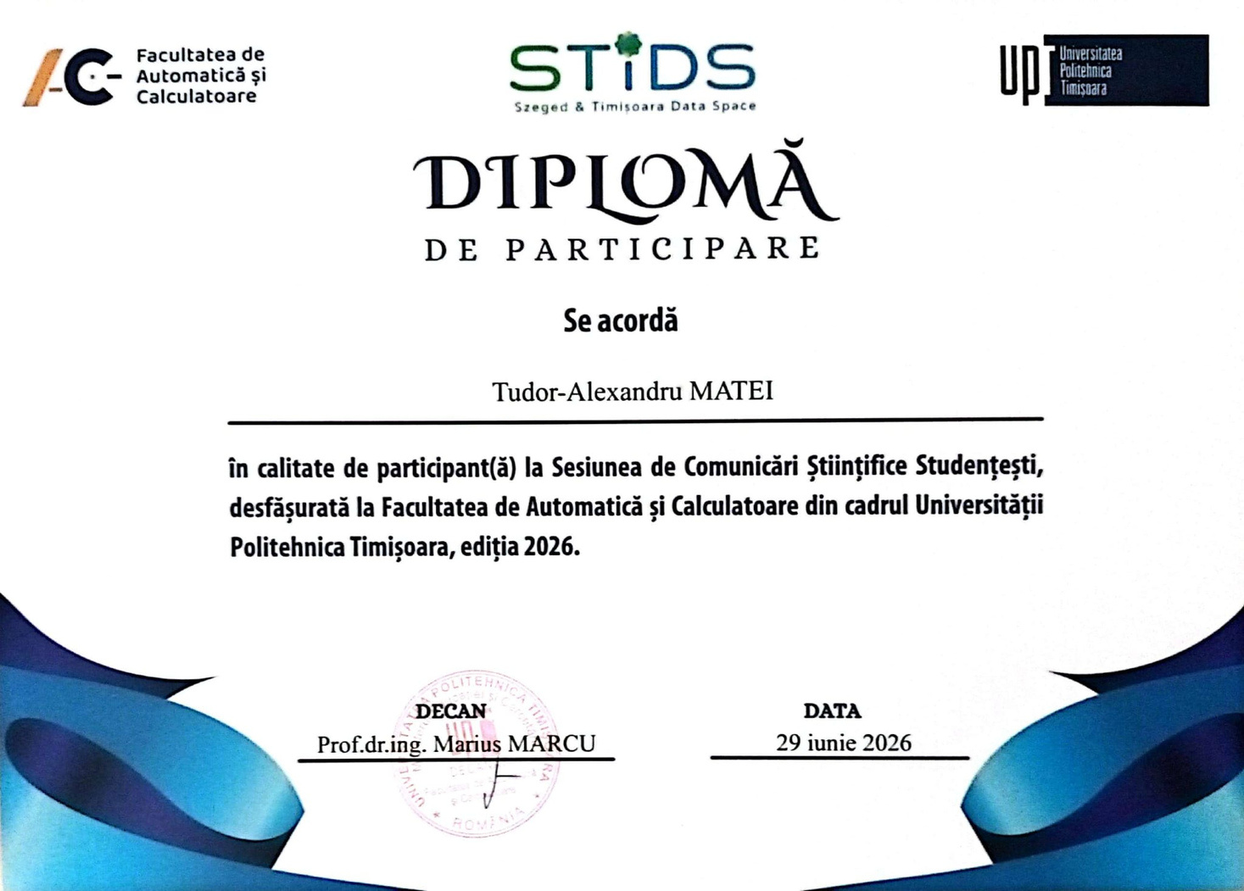

Slide 14
CONCLUSION
This project presents an IoT-based smart indoor air quality monitoring product which integrates multiple sensors with a Raspberry Pi 4, cloud storage, web and mobile applications, and 2 machine learning prediction models. By combining all of these, the system offers a solution for improving indoor environmental awareness.

Slide 15
FUTURE WORK
adding new sensors
upgrading already existing sensors
cooling option for the Raspberry Pi
designing a protective case for the product
further training of AI models for more accurate predicitons

Slide 16
THANK YOU!

