Slide 1




























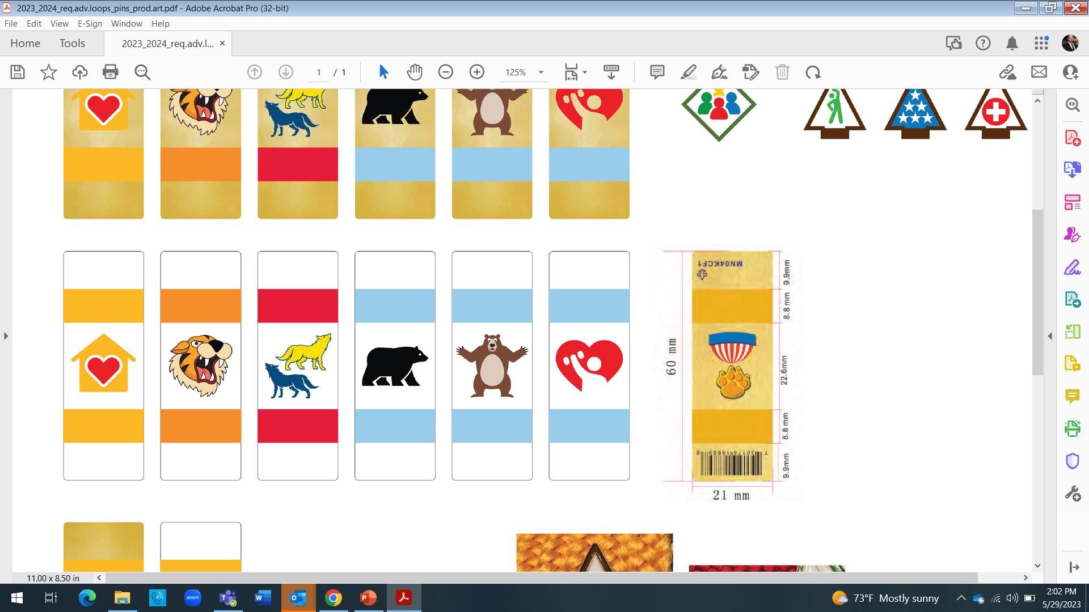
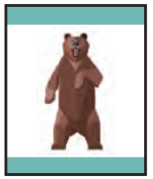







2024-2025 Cub Scout Badges of Rank
The Bobcat Adventure is designed to be the first required Adventure.
Each badge of rank is earned by completing six required and two elective Adventures.
The six required Adventures are focused on the aims and focus areas of the BSA.
Requirements
LION
Kindergarten
TIGER
1st Grade
WOLF
2ND Grade
BEAR
3RD Grade
WEBELOS
4TH Grade
®
ARROW OF LIGHT
®
®
®
®
®
5TH Grade
BOBCAT
Character/Leadership
BOBCAT
Character/Leadership
BOBCAT
Character/Leadership
BOBCAT
Character/Leadership
BOBCAT
Character/Leadership
BOBCAT
Character/Leadership
MOUNTAIN LION
Outdoors
TIGERS IN THE WILD
Outdoors
PAWS ON THE PATH
Outdoors
BEAR HABITAT
Outdoors
WEBELOS WALKABOUT
Outdoors
OUTDOOR ADVENTURER
Outdoors
FUN ON THE RUN
Personal Fitness
TIGER BITES
Personal Fitness
RUNNING WITH THE PACK Personal Fitness
BEAR STRONG Personal Fitness
STRONGER, FASTER, HIGHER
Personal Fitness
PERSONAL FITNESS
Personal Fitness
KING OF THE JUNGLE
Citizenship
TEAM TIGER
Citizenship
COUNCIL FIRE
Citizenship
PAWS FOR ACTION
Citizenship
MY COMMUNITY Citizenship
CITIZENSHIP
Citizenship
LION ROAR
Personal Safety
TIGER ROAR
Personal Safety
SAFETY IN NUMBERS
Personal Safety
STANDING TALL
Personal Safety
MY SAFETY
Safety/First Aid
FIRST AID
Safety/First Aid
LION’S PRIDE
Family/Reverence
TIGER CIRCLES
Family/Reverence
FOOTSTEPS
Family/Reverence
FELLOWSHIP
Family/Reverence
MY FAMILY
Family/Reverence
DUTY TO GOD
Family/Reverence
2 Elective Adventures
2 Elective Adventures
2 Elective Adventures
2 Elective Adventures
2 Elective Adventures
2 Elective Adventures
11/9/23

