Slide 1


MSDS 6306 Case Study 1
US Craft Beer and Brewery Analysis
Presented By: Steven Cox
Notes:
Hello and welcome to Team 4 Presentation on US Craft Beer and Brewery Analysis. My name is Steven Cox and currently a student in the Data Science program at SMU.

Slide 2
Topics Covered in this Case Study
How many Breweries are there in the US?
How does each State rank when comparing Alcohol Content and Bitterness?
Wrangling the data – How we handled missing values and unknows
Is there a relationship between ABV and Bitterness?
Analysis of Alcohol content by Volume (ABV)
Modeling analysis of ABV and IBU focusing on Ales and IPAs
Lastly, additional modeling that we found to be useful and exciting.
Notes:
In this presentation, we will be addressing questions in regards to the Beers and Breweries data set. The questions asked of us are …

Slide 3



How many breweries are in the US and each State?
On initial investigation, it appeared that the data represented approximately 558 breweries in the US.
However, when we went to break down the number of breweries per State, we discovered that there were 7 breweries that had duplicate IDs.
So…with the duplicates merged, we can confidently break down all 551 breweries down by State.
Notes:
*
When addressing the question of how many breweries there are in each state, the data initially indicated that there are 558 breweries spread across the country.
*
However, when we went to break down the number of breweries per State, we discovered that there were 7 breweries that had duplicate IDs
*
So…with the duplicates merged, we can confidently break down the 551 breweries by State.

Slide 4
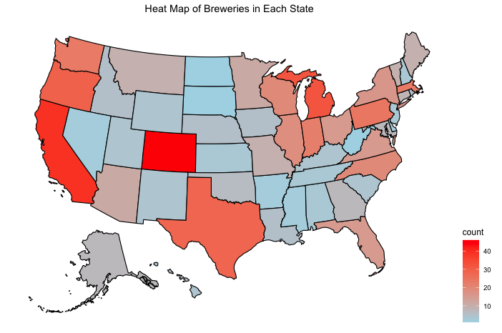
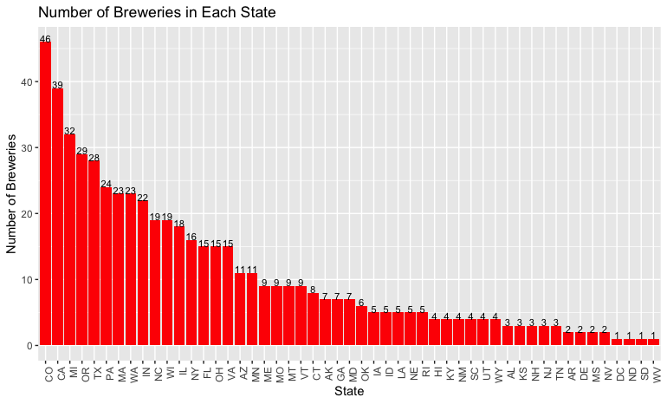
Number of Breweries In Each State
Top 5 States
Colorado (46)
California (39)
Michigan (32)
Oregon (29)
Texas (28)
Bottom 5 States
North and South Dakota (1 ea.)
West Virginia (1)
Mississippi (2)
Nevada (2)
Arkansas (2)
Notes:
*Here we have a heatmap and a bar chart of the number of breweries per State.
*The top 5 States are
*The bottom 5 States are.
*Here are all the Budweiser Breweries laid out over the heatmap.
*Further analysis may prove beneficial if Budweiser is looking to add additional breweries into the north west.
In the United States, A-B owns 12 breweries: St Louis; Newark, New Jersey; Los Angeles; Houston; Columbus, Ohio; Jacksonville, Florida; Merrimack, New Hampshire; Williamsburg, Virginia; Fairfield, California; Baldwinsville, New York; Fort Collins, Colorado; and Cartersville, Georgia.

Slide 5
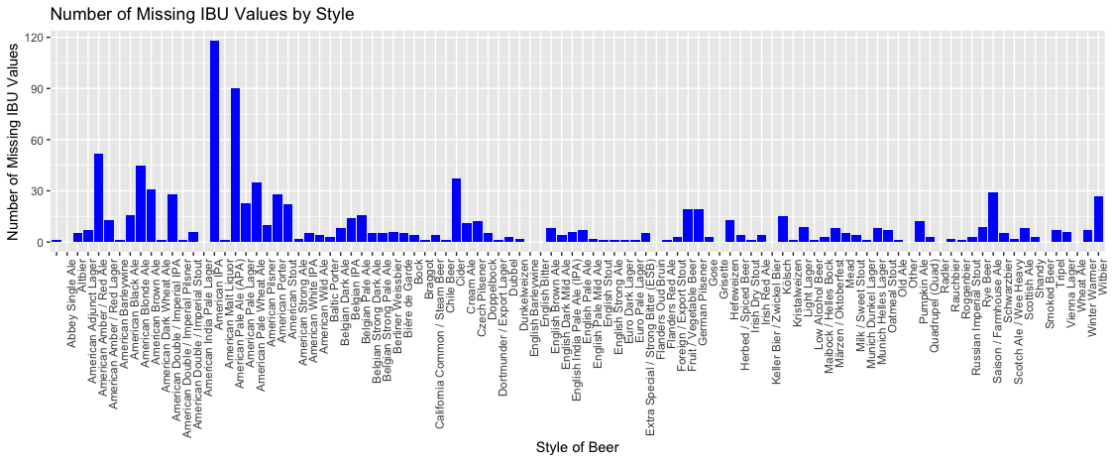
Wrangling the Missing Data
Out of the 2410 beers from our data:
Before: 62 have missing ABV values ~ 3%
With only a few missing ABV values, it was more efficient to simply search for the data online and replace those that were available. In doing so, we were able to find 47 values and an additional 2 that were misrepresented as beers.
After: 13 missing ABV values ~ 0.5%
Out of the 2410 beers from our data:
Before: 1005 have missing IBU values ~ 42%
This is much more significant and requires further investigation.
IBU values appear to be missing at random. The amount differs by style of beer, but we have no reason to believe it differs based on the actual value of IBU. American IPA’s have the highest number of missing IBU values but, as we will see later, they have a unique range of IBU values, so the imputation should be accurate.
After performing imputation with the mean value IBU by style, we reduced our missing IBUs to 2%
Notes:
Out of the 2410 beers from our data: we found that 62 of them had missing ABV values, which is approx. 3% of the observations.
* With only a few missing ABV values, it was more efficient to simply search for the data online and replace those that were available. In doing so, we were able to find 47 values and an additional 2 that were misrepresented as beers.
In terms of IBU values, we found that 1005 had missing values equating to 42% of the observations.
It is understandable that the IBU values had so many missing values. As IBUs are often hard to measure and not required by law.
*However, This is much more significant and requires further investigation
IBU values appear to be missing at random. The amount differs by style of beer, but we have no reason to believe it differs based on the actual value of IBU.
So in handling this, we imputed the mean IBU by style to those with missing IBUs.
52 of the beers were unique, and therefore we could not impute the average IBU. Tthose only accounted for 2% of the observations, and only 1 of which was an Ale or IPA which is where our main focus lied.

Slide 6
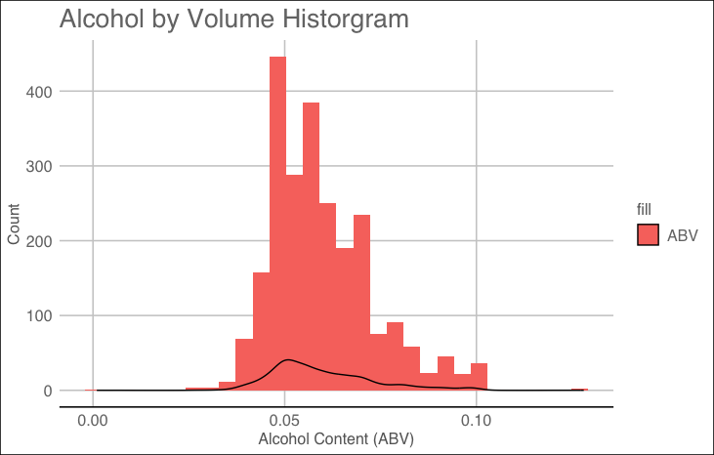
Alcohol by Volume (ABV) Statistics
Avg ~ 6.0%
Median ~ 5.6%
Std. Dev ~ 1.0%
Min ~ 0.1%
Max ~ 12.8%
For comparison, Bud Light has an ABV of 4.2% while Budweiser has around a 5.0%
Notes:
One of the questions posed to our team was specifically in regards to Alcohol content by volume.
What we found was that our of the 2400+ beers,
*the Average (or Mean) is right at 6% and right skewed
*with a median of 5.6% and
*The standard deviation is right at 1%.
*The non alcoholic beers showed to be the minimum at .1% and the highest ABV value reaching 12.8%.
*For comparison, Bud Light has an ABV value of 4.2% which is 2 std dev away from the average, and Budweiser at 1 standard dev away at 5%

Slide 7
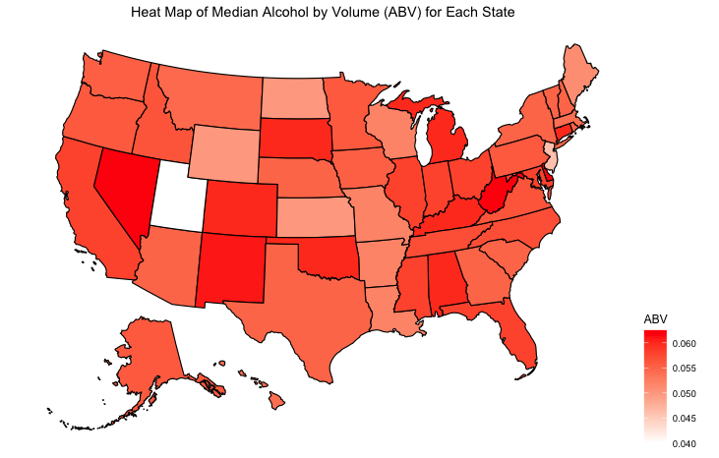
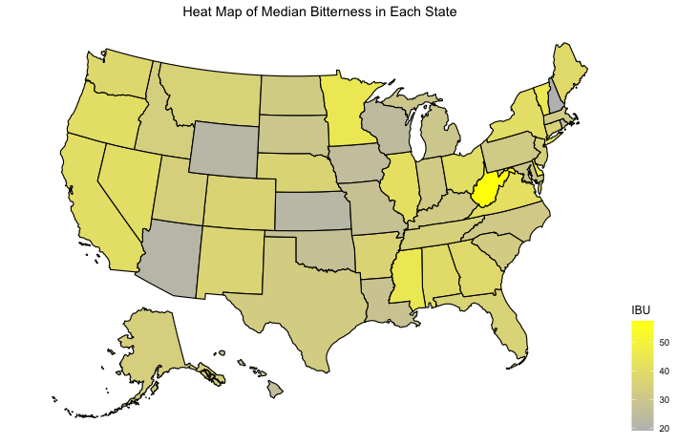
Median ABV and IBU Value by State
There is not an excessive variation in median ABV across the states.
The notable difference Utah.
This abnormality we believe is caused by a recently overturned law which limited beers to and ABV of 3.2%.
Though the heat maps provide a great visualization of ABV and IBU medians, we must recognize that some states like West Virginia and Delaware only had 2 observations.
The most alcoholic beer in the dataset is from Colorado. It is a Belgian Quadrupel with a 12.8% ABV
The most bitter beer is called “Bitter Bitch Imperial IPA”, which is from Oregon and has 138 IBU.
Notes:
Starting with the Median ABV by State, we can see that the relative ABV values are pretty close
*
with only one notable exception… Utah. *
* Here we have the Bitterness heatmap, again we can see that there really isn’t any extreme instances.
*Though the heat maps provide a great visualization of ABV and IBU medians, we must recognize that some states like West Virginia and Delaware only had 2 observations.
This begs the question of which state had the highest ABV…
*.That would be Colorado with a Belgian at 12.8%.
*And Oregon claims the most bitter beer at 138 IBUs.

Slide 8
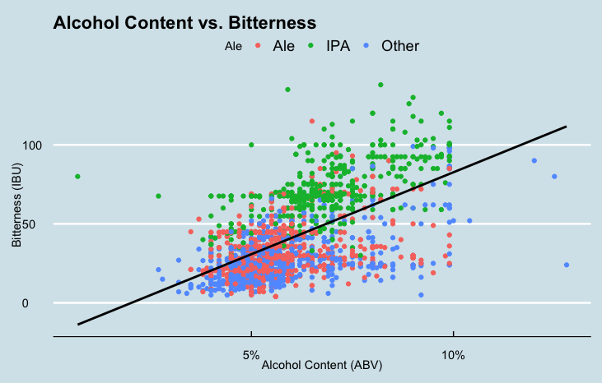
Relationship Between ABV and IBU
The positive slope depicts that there is a direct correlation between the bitterness of the beer vs. the alcohol content by volume.
It is also very apparent that IPAs are considerably more bitter than the other types of Ales when comparing with the alcohol content.
Notes:
Moving on, we were asked to investigate the relationship between Alcohol Content and Bitterness.
*When the two are plotted against each other, we can see a positive correlation between ABV and IBU, meaning that the higher the ABV, the more bitter the beer.
*It is also very apparent that IPAs are considerably more bitter than the other types of Ales when comparing with the alcohol content.

Slide 9
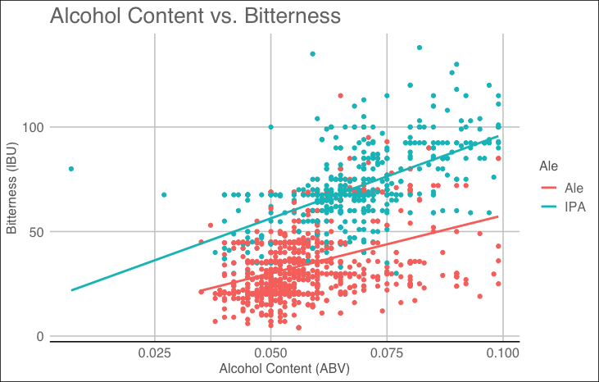
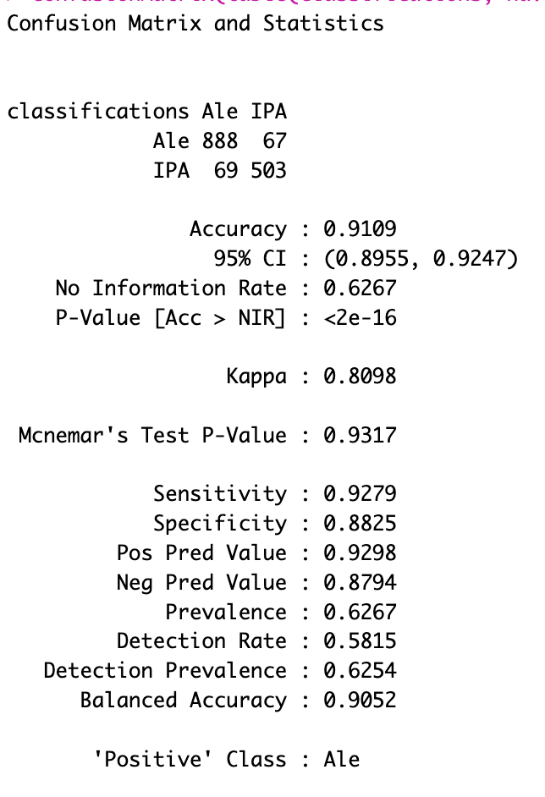
KNN Classification with Only Ales
Notes:
Addressing this relationship, we created a KNN model as to be able to predict what style of beer we would have given both the ABV and IBU.
*The KNN model using only Ales (IPAs and other Ales) has more than a
*91% accuracy rate.
Where 888 Ales were identified correctly giving us a sensitivity of 93% and
*503 IPAs were also correctly identified, leading to a specificity of 88%.

Slide 10
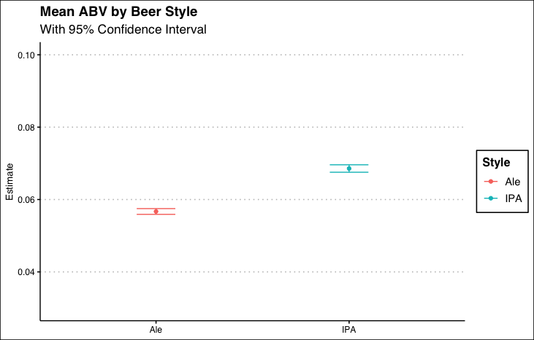
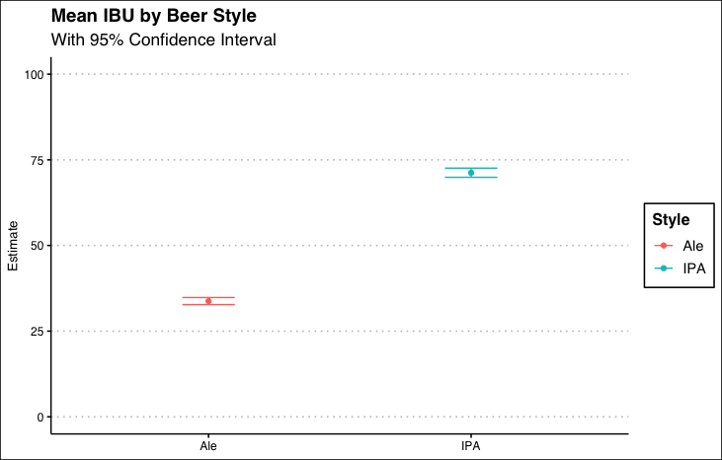
Comparing the ABV and Bitterness Between the Between Ales and IPAs
Notes:
Using a slightly different visualization, we can see that the mean ABV of IPA's is significantly higher than the mean ABV of Ales.
The error bars indicate that we can be 95% confidence interval and clearly their ranges are not close to overlapping.

Slide 11
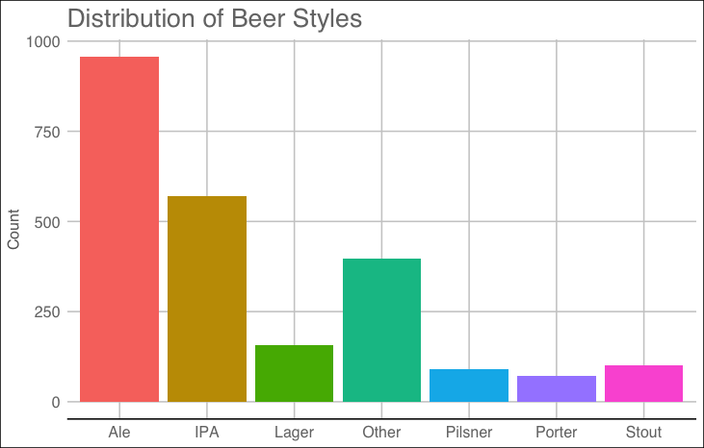
Expanding Beer Classifications
Since the analysis of Ales vs IPAs, was so effective, we decided to investigate the difference between the other styles of beer.
This may be useful for Budweiser to determine what specific profiles of ABV and IBU are associated with each style of beer.
Notes:
Starting with such a solid model, we ventured off and decided to investigate this even further by breaking up the beers into seven categories as shown. We have a great number of observations, so modeling further modeling proved to be worthwhile.
We believe this modeling may help in classifying new beers, or possibly even the reclassification of current beers.

Slide 12
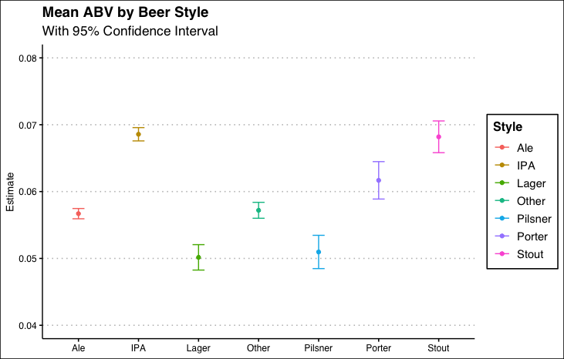
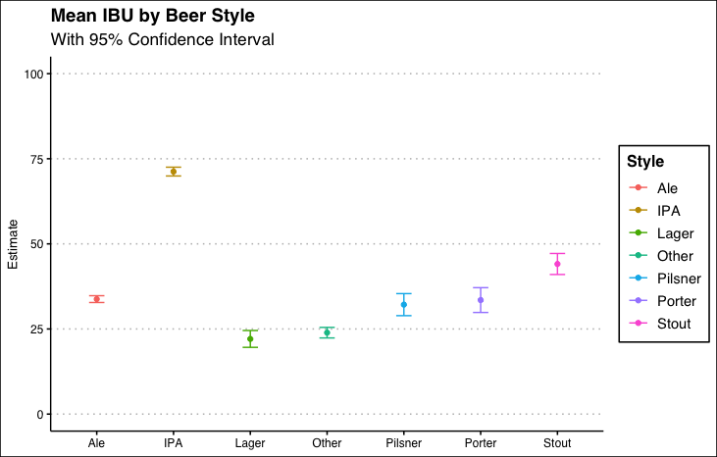
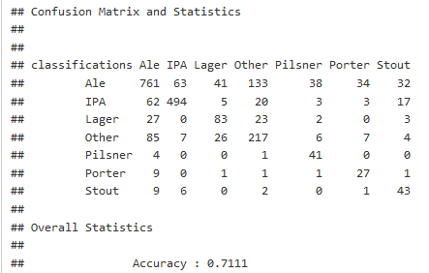
Comparing the ABV and Bitterness Between the Different Styles of Beer
After expanding the ABV’s over the different beer styles, we can better visualize the similarities and differences in relation to ABV.
Expanding the beer styles, we can see that other styles of beer are more closely aligned with Ales than IPAs. With Ales, Pilsners, and Porters statistically the same.
This KNN model does very well, allowing us to classify the beers with a 71% accuracy.
Notes:
As we observed earlier with Ales and IPAs,
*now we can take a look after breaking it into the seven styles.
Statistically, Ales align with Others, while Lagers and Pilsners are relatively identical when only utilizing ABV values.
*When observing the IBU values, we can see the bitterness is more in line with Ales rather than IPAs.
* However when we use both ABV and IBU attributes to model this all together, we find that the KNN model does very well with a 71% overall accuracy.
and correctly categorizing Ales 80% and 87% of the time for IPAs. This is a slight decrease from our previous model, however it is understandable since we’re now categorizing 7 different styles instead of 2.

Slide 13
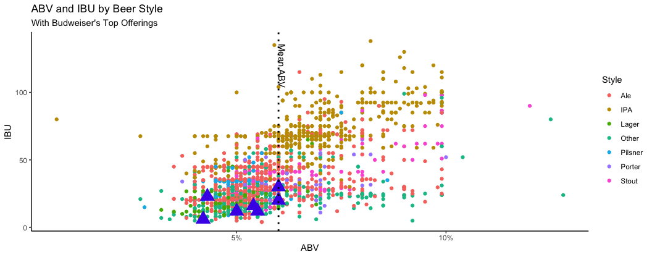
Additional Areas for Exploration
Budweiser
Visualizing the relationship between the ABV and IBU for the different styles of beer, we can see the industry norms and use this to help classify newly created beers.
Interesting to note that Budweiser's top offerings are all in the lower range of ABV and IBU for the market
Notes:
Bringing this all full circle and graphing all the styles together as we did with Ales and IPAs, we can better visualize how all the styles relate. As expected, the many styles are similar with that of the Ales, while the IPAs are very much predominate in the higher areas of ABV and IPUs.
We found it Interesting to note that Budweiser’s 6 top offerings are all in the lower range of ABV and IBUs, even when compared to similar style beers.
Further investigation and analysis on how these styles are brewed in each State may prove to be very enlightening.

Slide 14


Team 4
Thank You
Nicholas Sager
nsager@mail.smu.edu
Steven Cox
sacox@mail.smu.edu
Notes:
I want to thank you for the opportunity in presenting our analysis and we hope to have shed some insight into your questions. For any additional questions about this analysis or proposals for more research, please feel free to contact Nick or myself.

