Slide 1





Building
a
Scratch 3
Game Development Toolkit
Laurence Molloy
@MolloyLaurence
laurence.molloy@gmail.com
23-25 August 2019

Slide 2
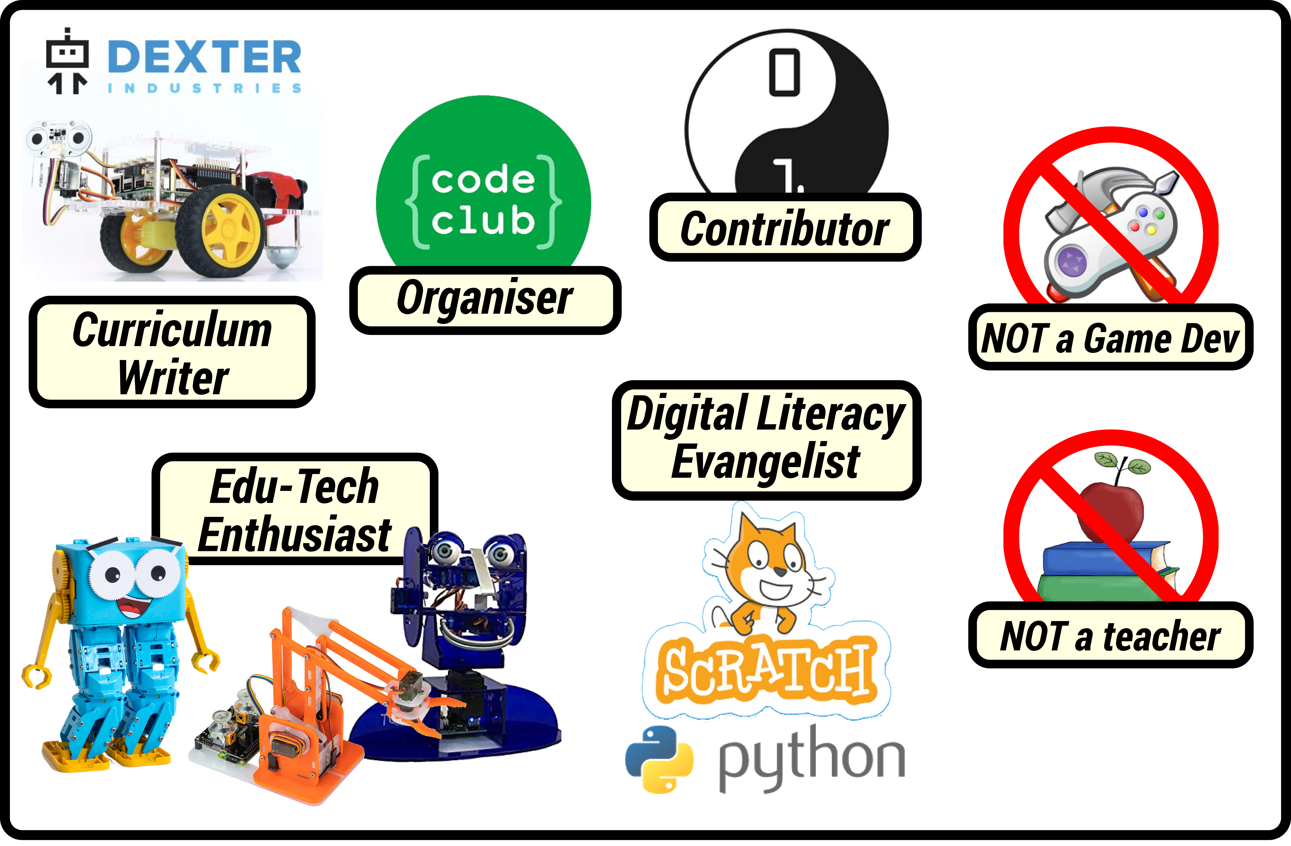
Who (...am I?)
@MolloyLaurence
laurence.molloy@gmail.com
Laurence Molloy

Slide 3
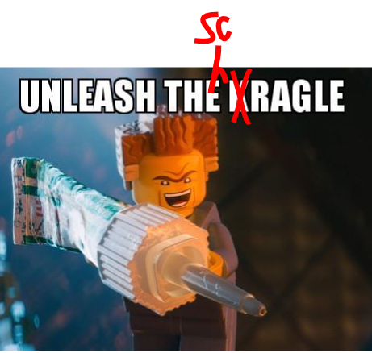

What (...is ScraGLE?)
Scratch
Game
Library for
Educators
@MolloyLaurence
laurence.molloy@gmail.com
Laurence Molloy

Slide 4
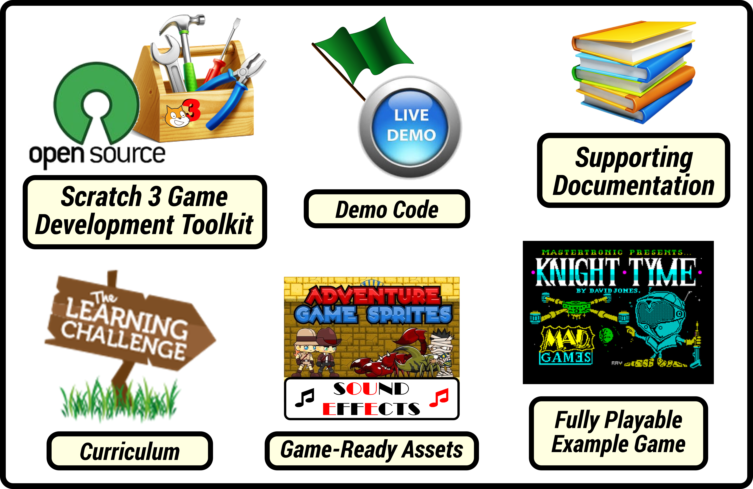
What (...is ScraGLE?)
@MolloyLaurence
laurence.molloy@gmail.com
Laurence Molloy

Slide 5
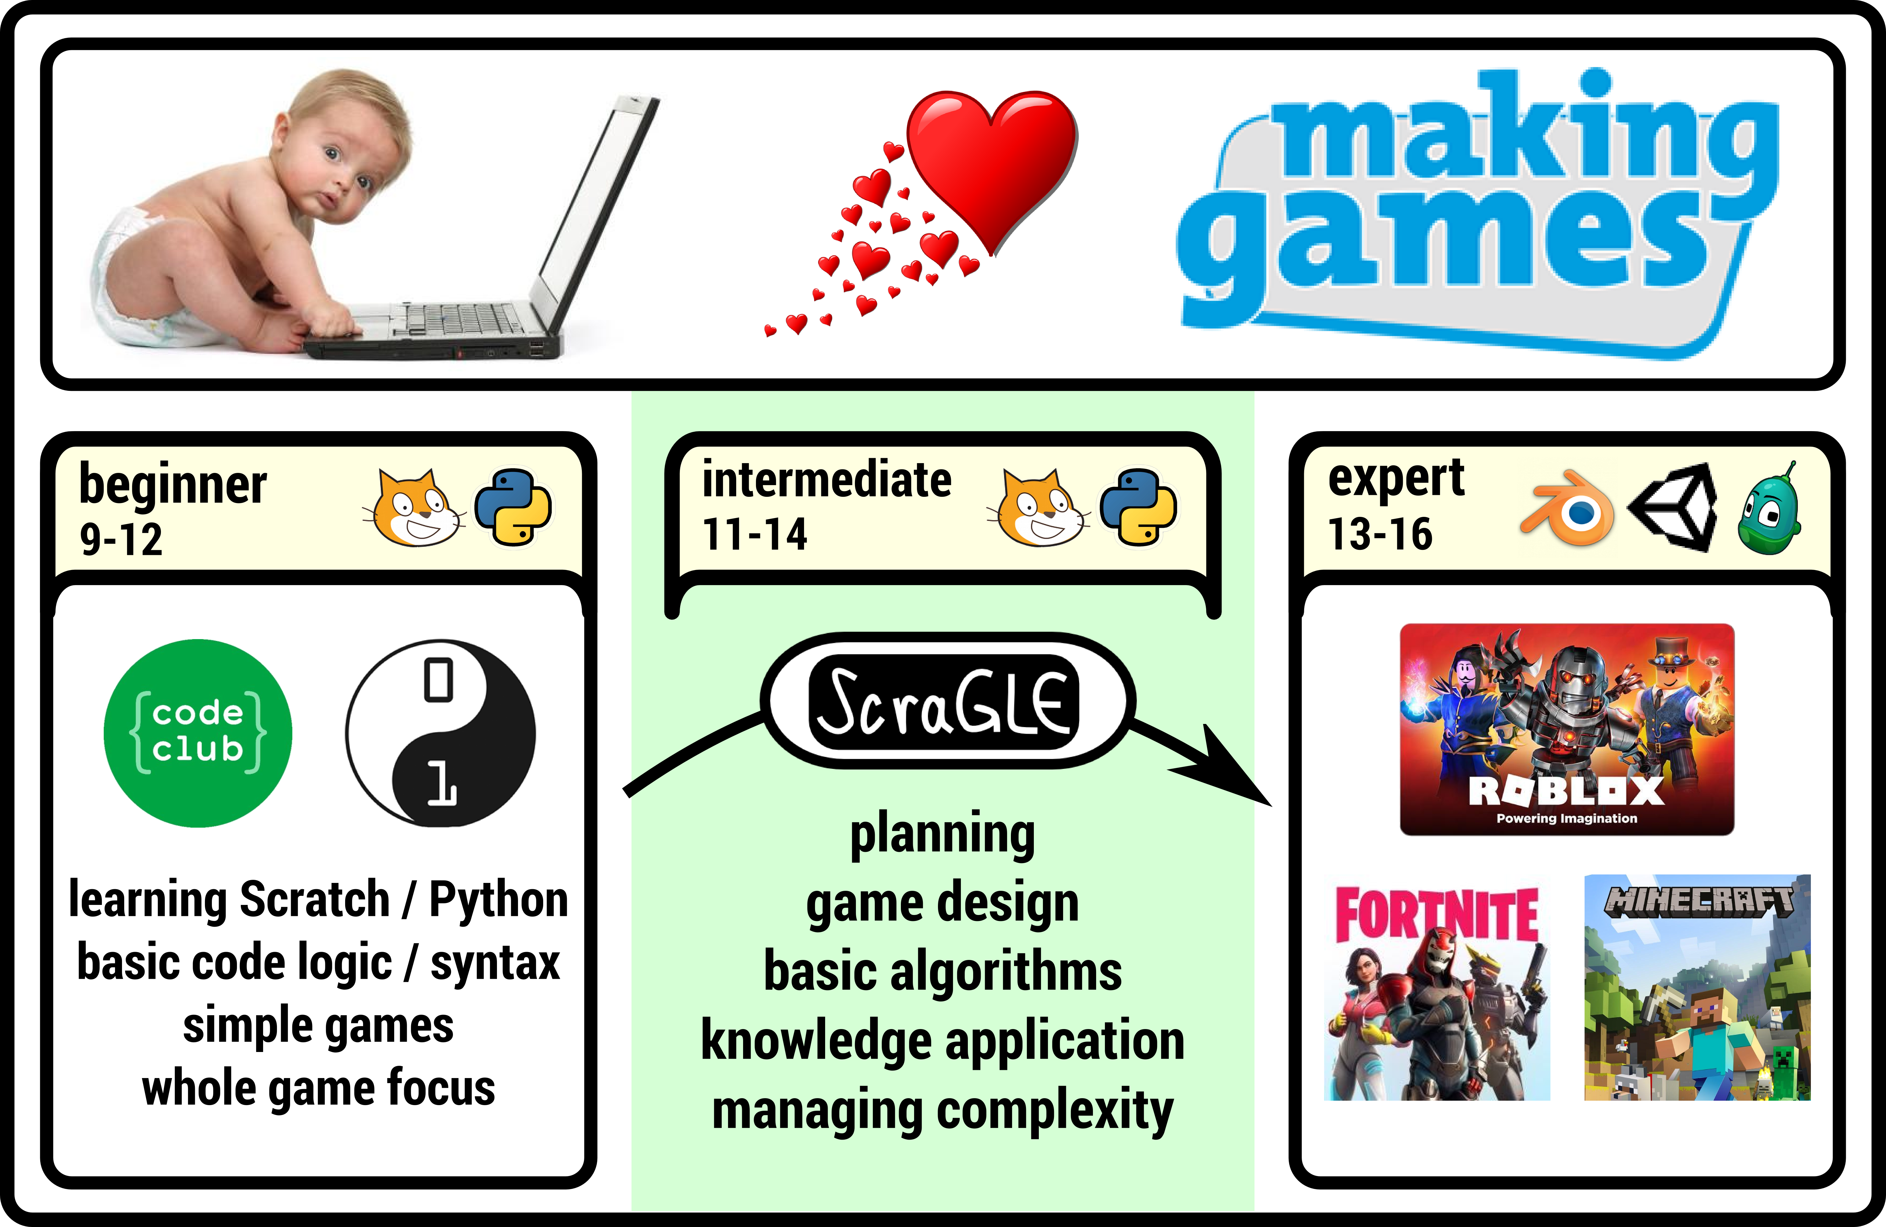
Why (...is ScraGLE needed?)
@MolloyLaurence
laurence.molloy@gmail.com
Laurence Molloy

Slide 6
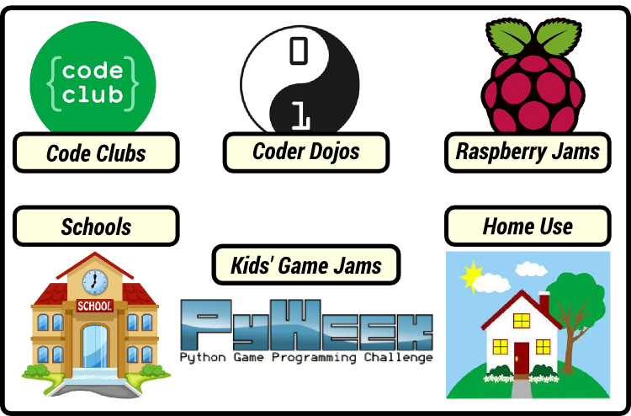
Where (...will ScraGLE be used?)
@MolloyLaurence
laurence.molloy@gmail.com
Laurence Molloy

Slide 7
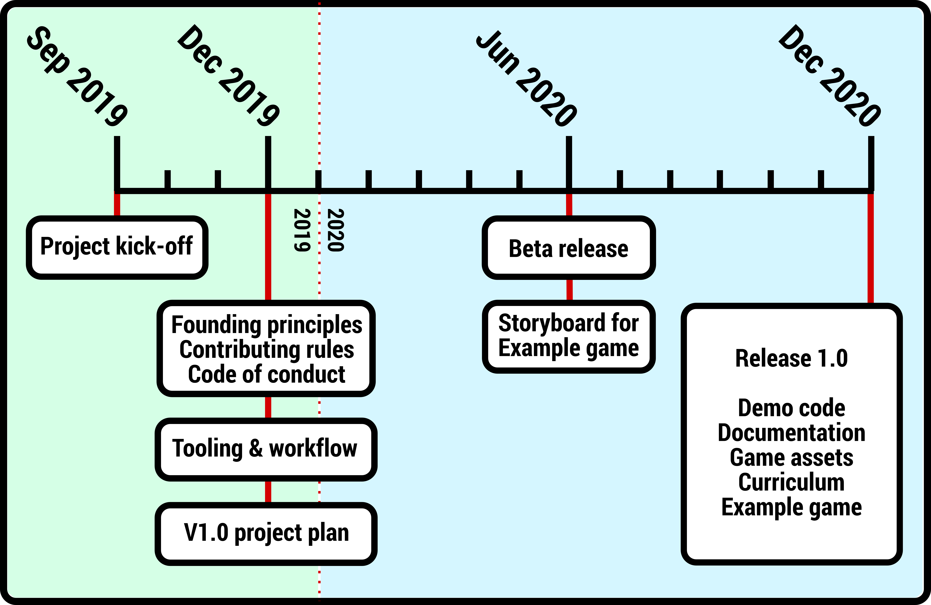
When (...will ScraGLE be released?)
* licks finger, sticks it in the air *
@MolloyLaurence
laurence.molloy@gmail.com
Laurence Molloy

Slide 8

How (...can I get involved?)
@MolloyLaurence
laurence.molloy@gmail.com
Laurence Molloy

