Slide 1
Team D Tetris
Team Leader: Jacob Nelson
Team Members: Quay Robinson, Seth Beesley, Brooks Arthur

Slide 2
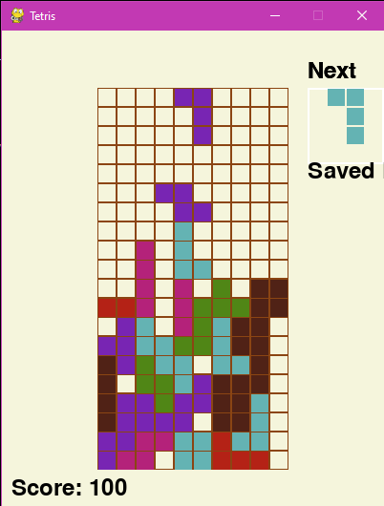
Tetris
This semester we were tasked to refine a terrible Tetris game and turn it into something great.
The game has all of the features common with modern Tetris games including a few extras.

Slide 3
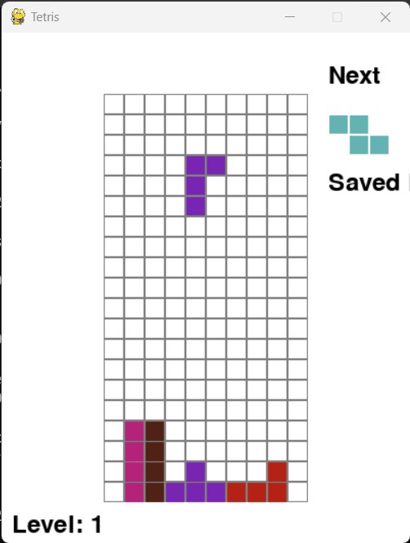

Brooks: Piece Saving
The ability to save pieces for later use adds a tactical layer to the game, offering players more control over their gameplay and fostering strategic thinking.

Slide 4
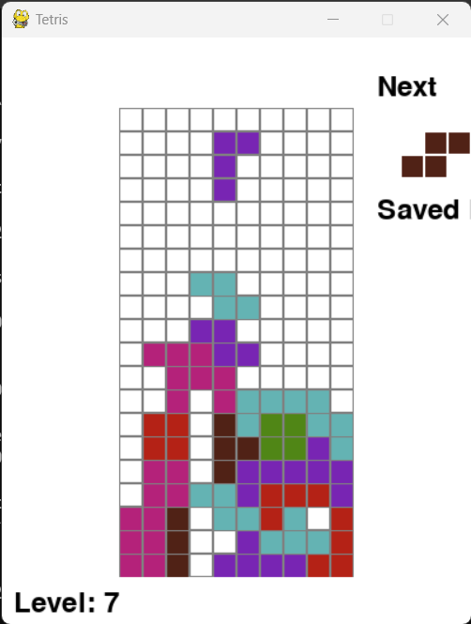
Brooks: Speed Increase
Speed increases add challenge as the game progresses, keeping it exciting and ensuring long-term engagement by continuously testing players' skills.

Slide 5
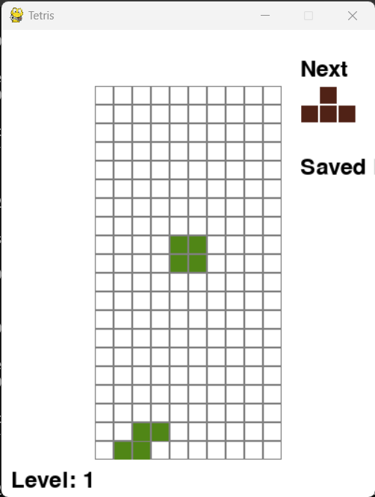
Brooks: Piece Preview
Piece preview provides a strategic element, allowing players to plan moves in advance. This enhances the game's cognitive challenge, appealing to strategy-minded players.

Slide 6
Seth: Color Palates
Color switching modes allow players to customize their visual experience, making the game more enjoyable and accessible for everyone, including those with visual preferences or impairments.

Slide 7
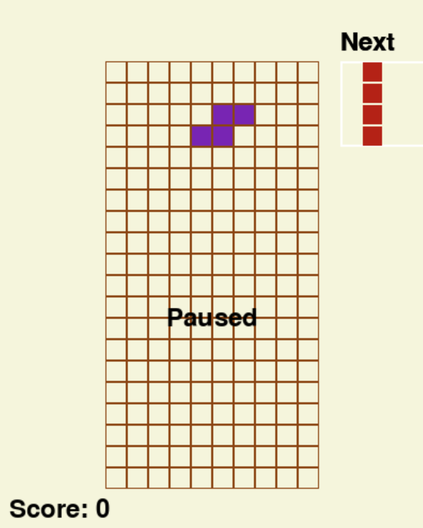
Seth: Pausing
The pause feature offers players the flexibility to take breaks without losing progress, making our game more user-friendly, especially for players with busy lifestyles.

Slide 8
Seth: Score Counter
The score counter keeps track of players' progress and achievements, enhancing engagement and offering a metric for competition and self-improvement.

Slide 9
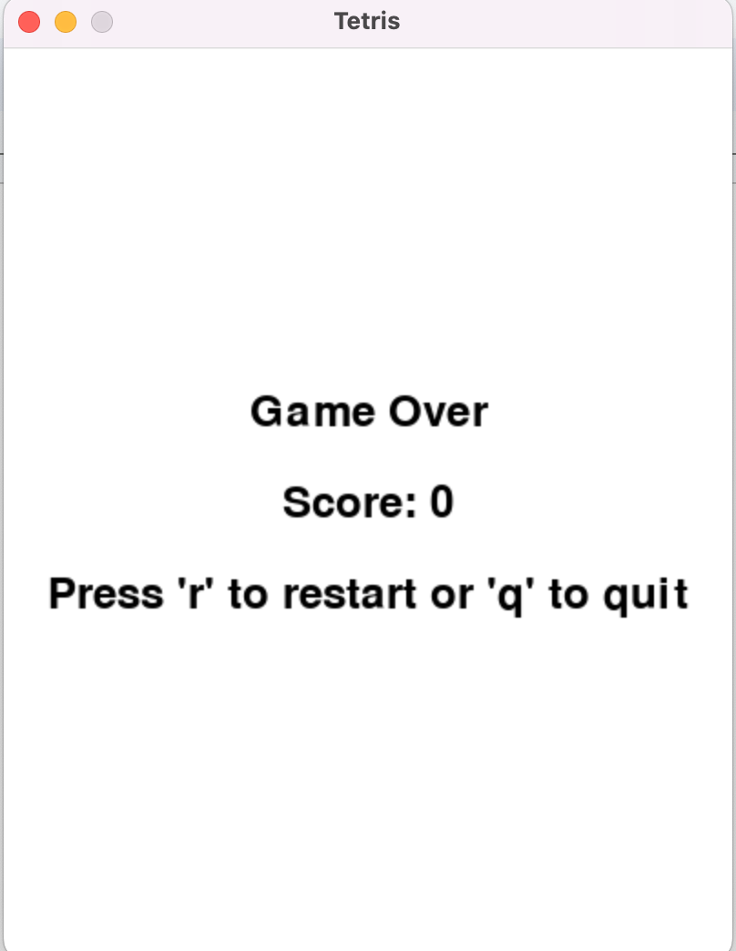
Quay: Game Over Screen
The game over screen provides essential feedback and a sense of closure to the gaming experience, encouraging players to reflect on their performance and motivating them to play again.

Slide 10
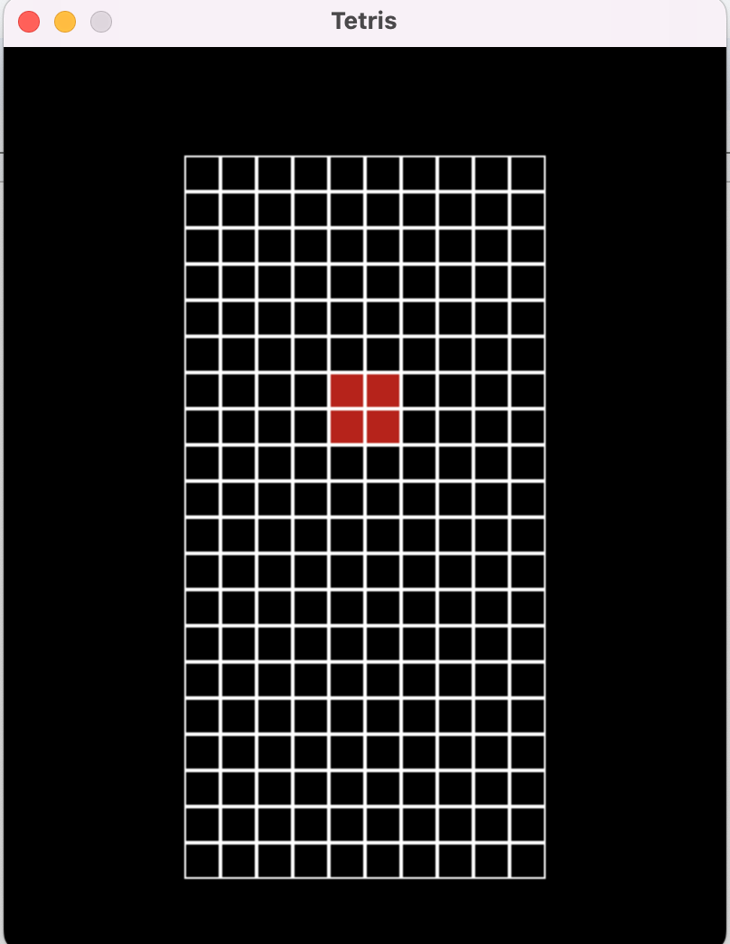
Quay: Dark Mode
Dark mode caters to playing in low-light environments, reducing eye strain, and making our game more comfortable to play at any time, thereby widening our user base and playing time.

Slide 11
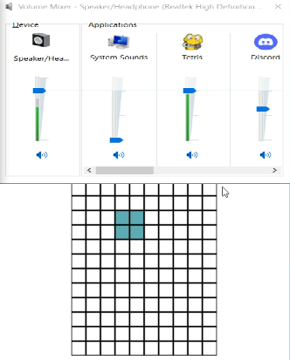
Quay: Sound Effects
Engaging sound effects enhance the game's immersive experience, making gameplay more enjoyable and stimulating. This feature adds an emotional and sensory dimension to player interaction.

Slide 12
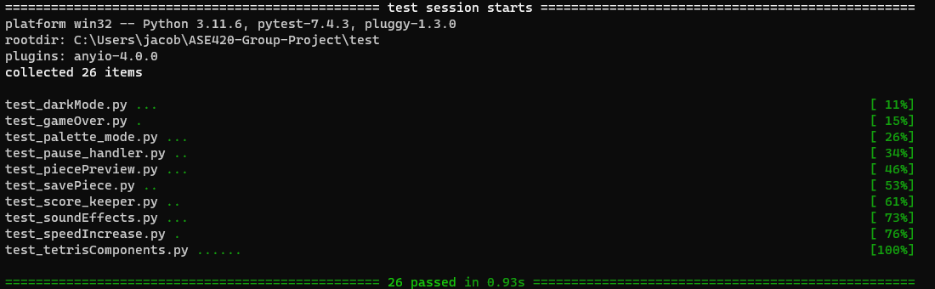
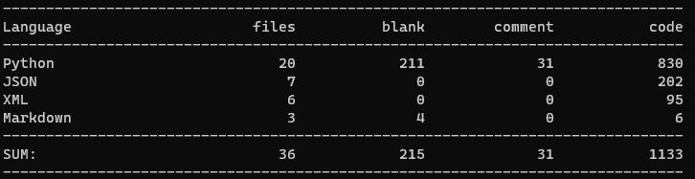
Code
Starting lines of code: 177
Ending lines of code: 1133
Tests: 26
Acceptance Tests: 9
Integration Test: 1
Regression Test: 1
Unit Tests: 15
12

Slide 13
What We Learned
How to effectively create tests and the importance of TDD.
Working effectively in a team.
Using UML to guide our code to prevent coding like crazy.
The importance of code smells, refactoring, and design patterns.

