Slide 1

JADN Sandbox User Guide

Slide 2
Table of Contents
JADN Sandbox Capabilities
Schema Creation
How to get started…
Schema Visualization
Schema Translation
Data Creation
Data Validation
Example Data Generation
Schema Transformation
Other Features
Docker Desktop
How to Get the JADN Sandbox Image
How to Run the JADN Sandbox Image
How to Update the JADN Sandbox Image
How to Stop the JADN Sandbox Image
How to Learn More about Docker

Slide 3

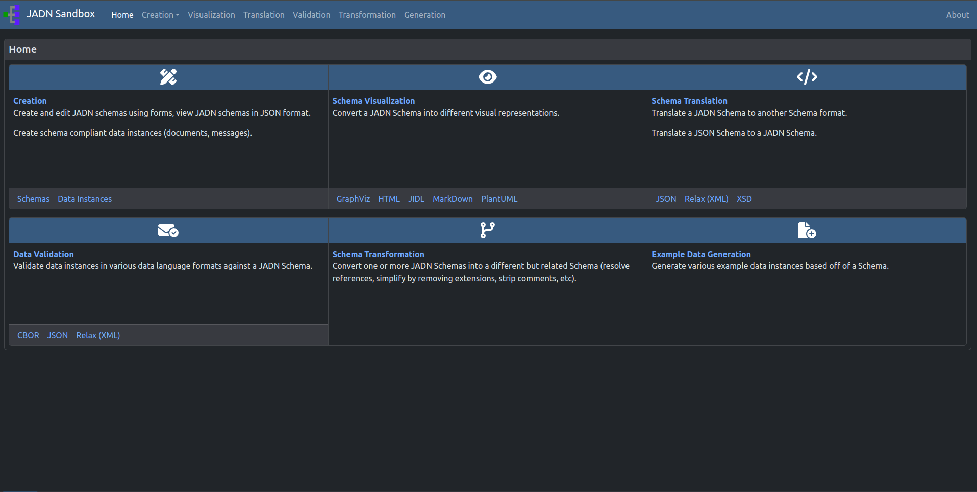
JADN Sandbox
Capabilities

Slide 4
JADN Sandbox Table of Contents
Schema Creation
Feature: Editor Style
To Start
Add Data
Edit Data
Feature: Types Outline
More Functions and Features
Schema Transformation
Result: A Resolved Schema
Result: Strip Comments
Other Features
Theme Switcher
Add Custom Files
Remove Custom Files
Download Files
How to get started…
Schema Visualization
Results: Selecting One Language
Results: Selecting Multiple Languages
Schema Translation
Data Creation
View JSON/Creator
Data Validation
Invalid Results
Valid Results
Example Data Generation
Results

Slide 5
Schema Creation
Create valid JADN Schemas

Slide 6
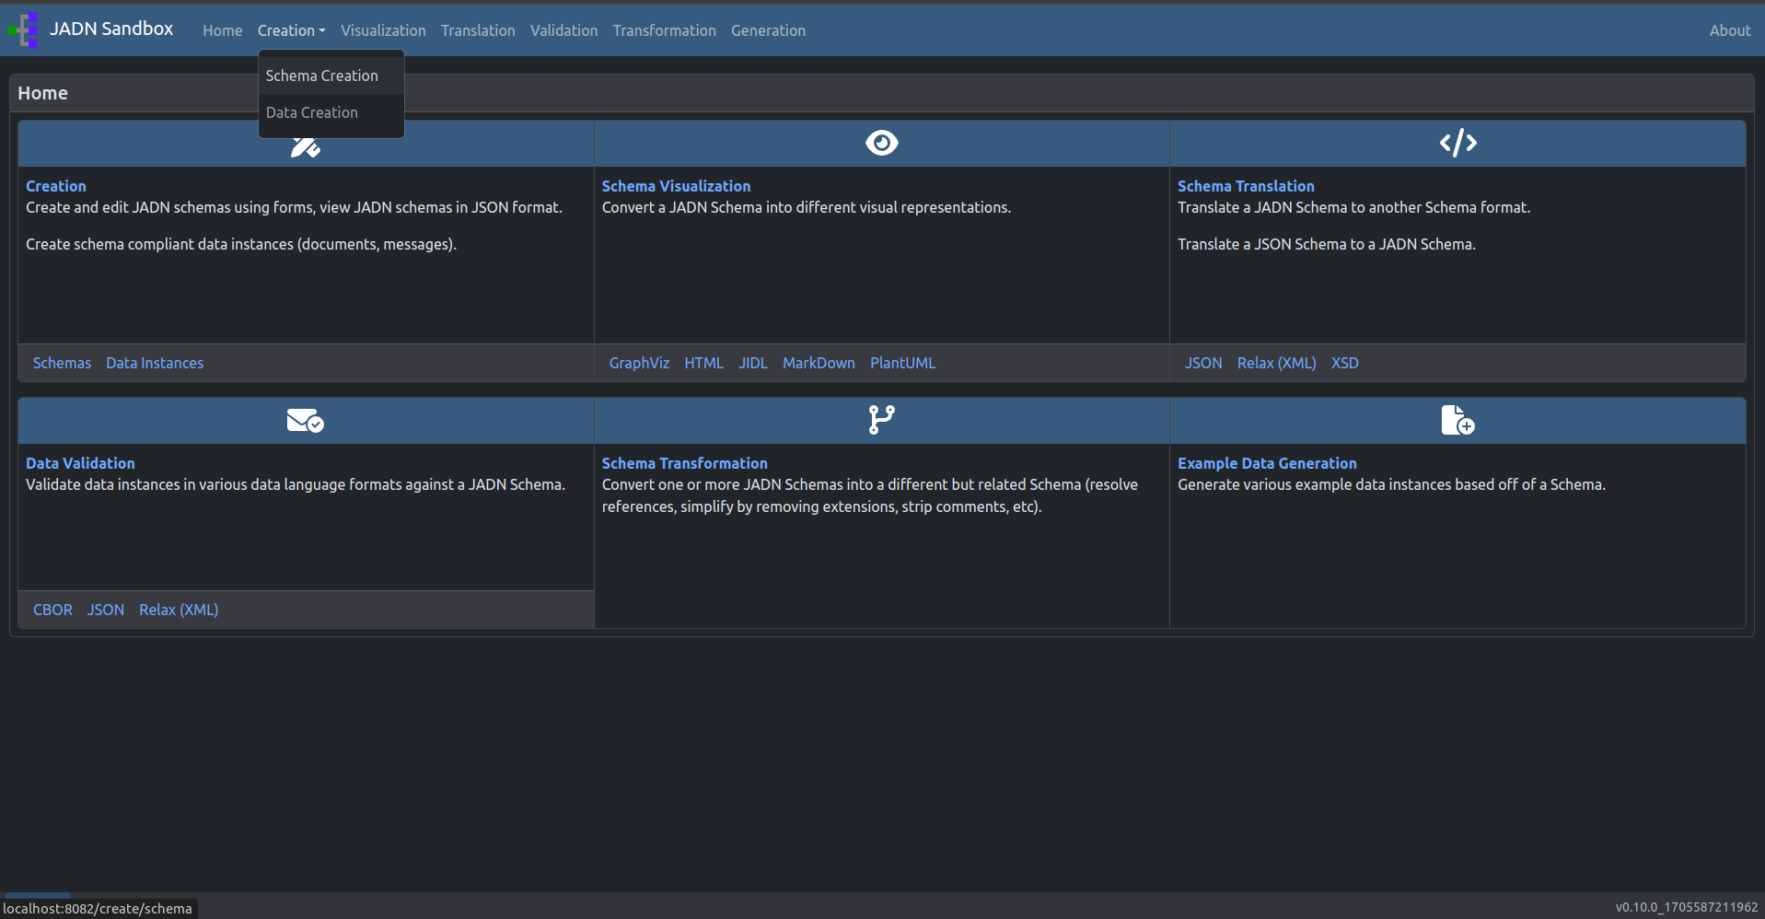
Go to: Creation
When the drop down menu appears, select Schema Creation

Slide 7
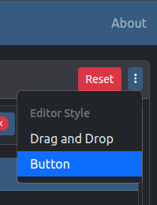
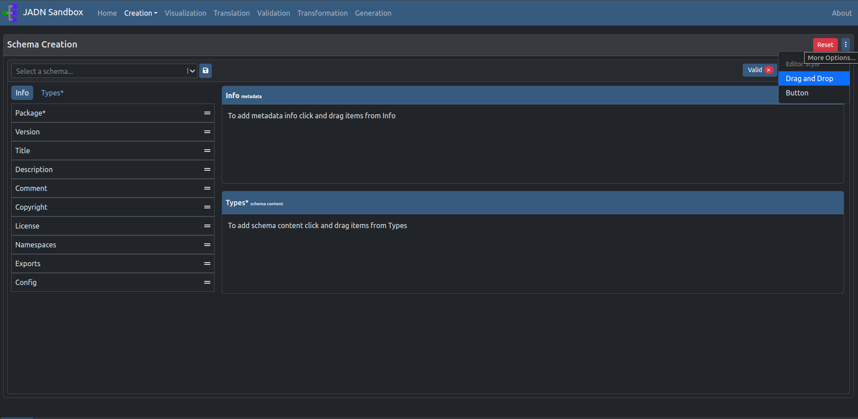
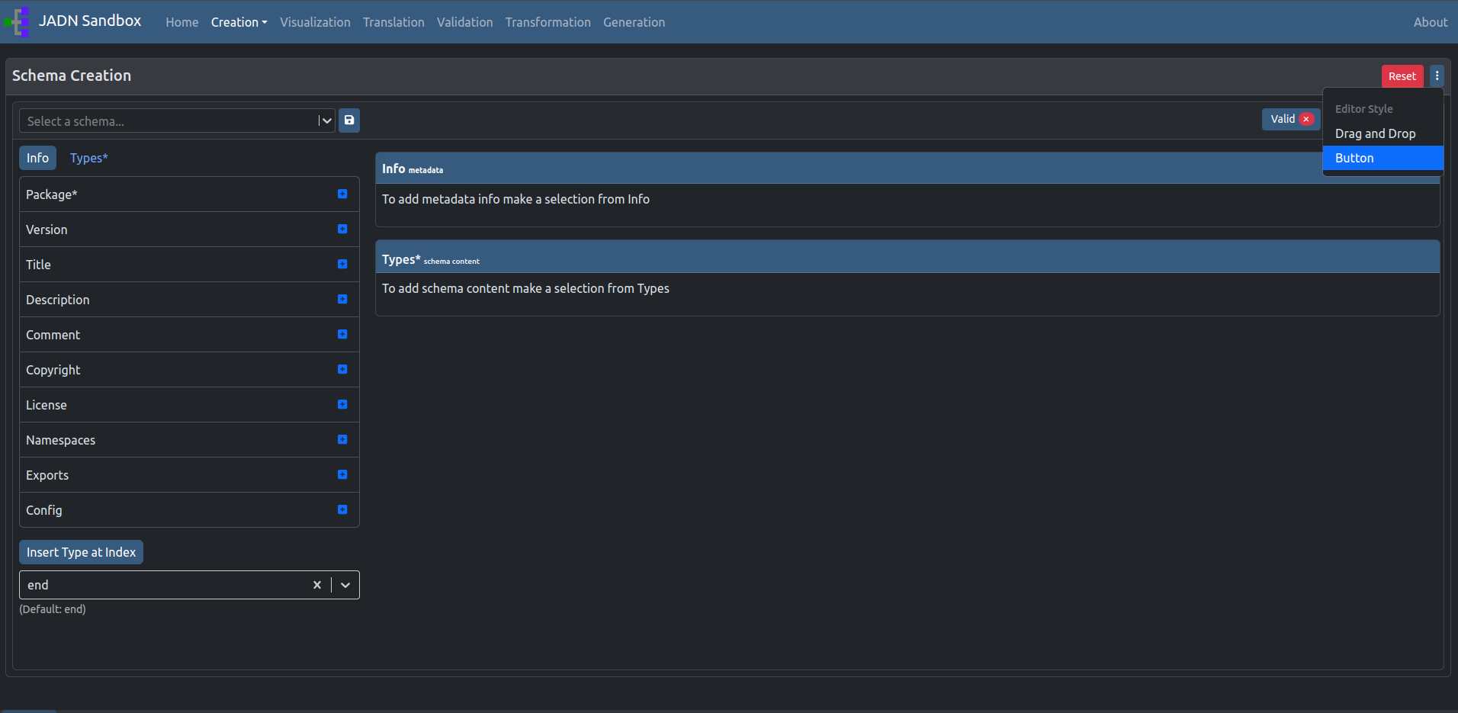
Feature: Editor Style
Choose your schema creation editor style:
Drag and Drop (default)
Button
Drag and drop style (default)
Button style

Slide 8
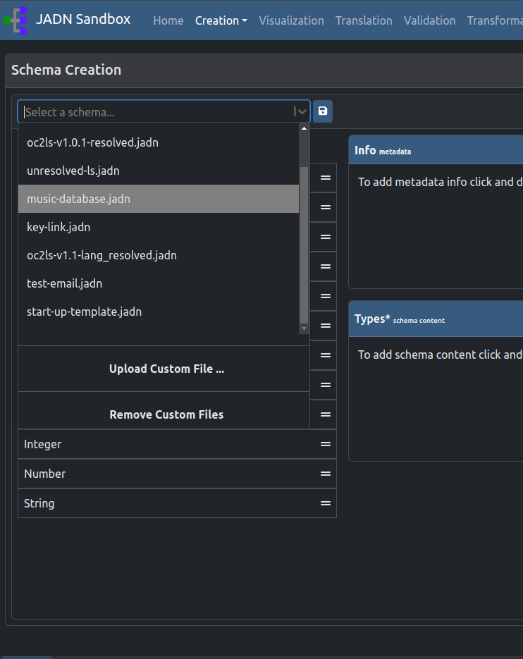
To start…
1
Select an example schema
or
Upload a syntactically valid JADN Schema
or
From scratch (blank schema)
1
2
2
3

Slide 9
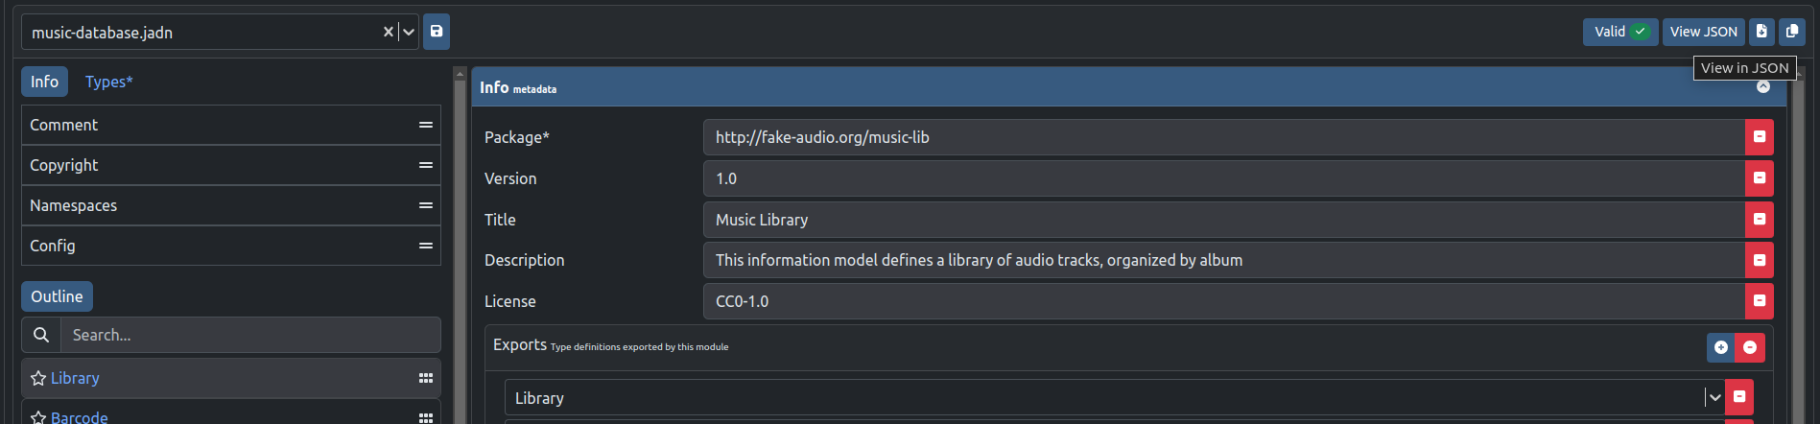
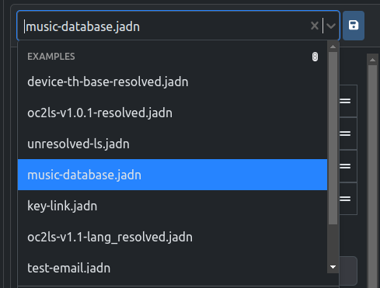
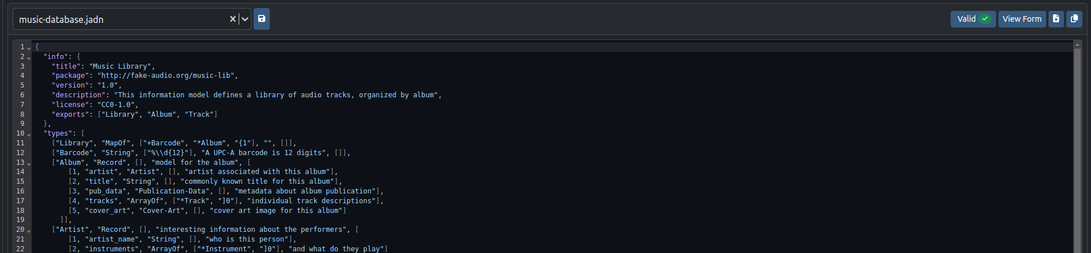

Option 1 to Start: Select a Schema
1
Selecting a preloaded Schema from the drop down menu will automatically generate the Schema in the Schema Creator.

Slide 10
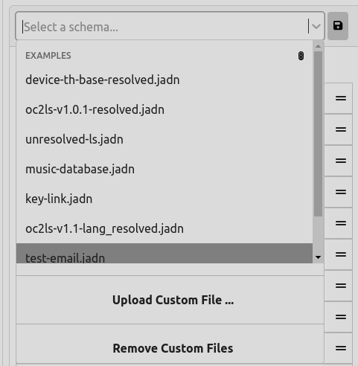
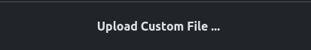
Option 2 to Start: Upload a Schema
2
Click ‘Upload Customer File…’ to upload a file using the computer’s file loader
This will upload any JADN file and then attempt to validate it.

Slide 11
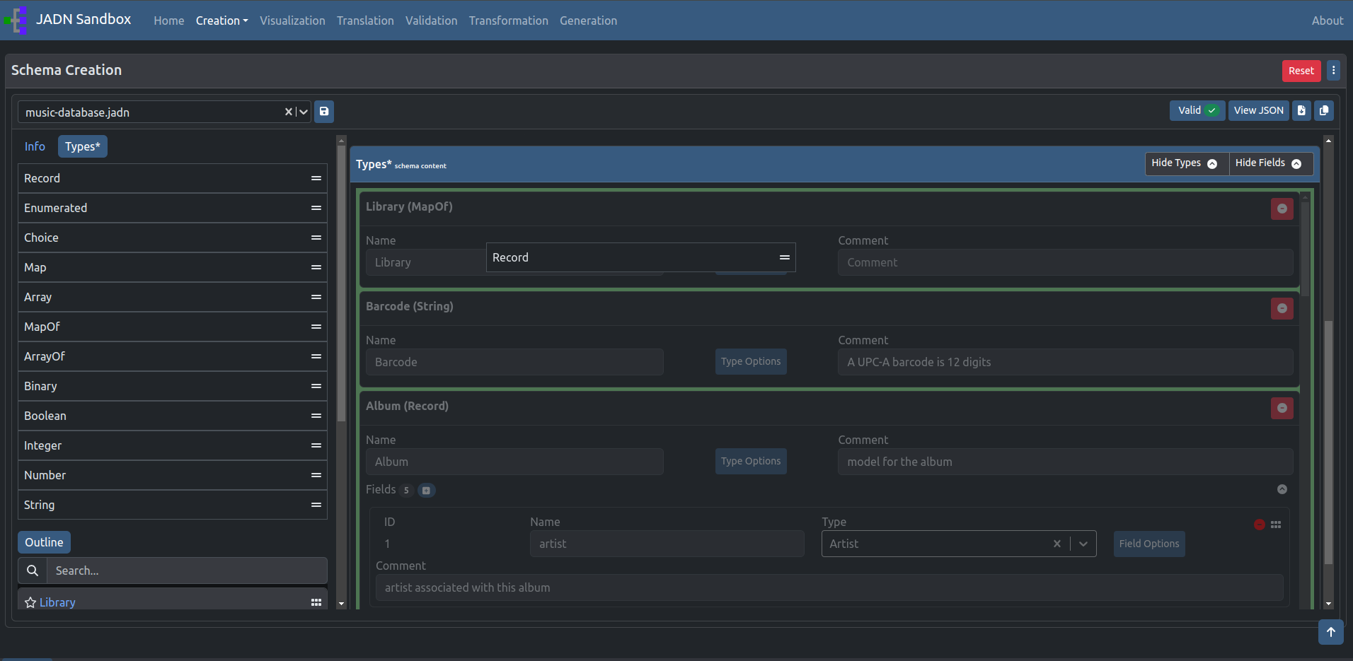
Add Data:
Drag and Drop Style
Using the default drag and drop style creator, drag items from left to right.
Drop the card when backgrounds are highlighted green.
When dragging, the background will change colors (in this case, to dark gray) to indicate where you can drop the card. It will then change to a green background when you are able to drop the card.

Slide 12
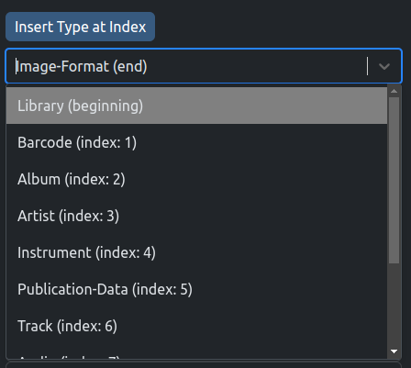
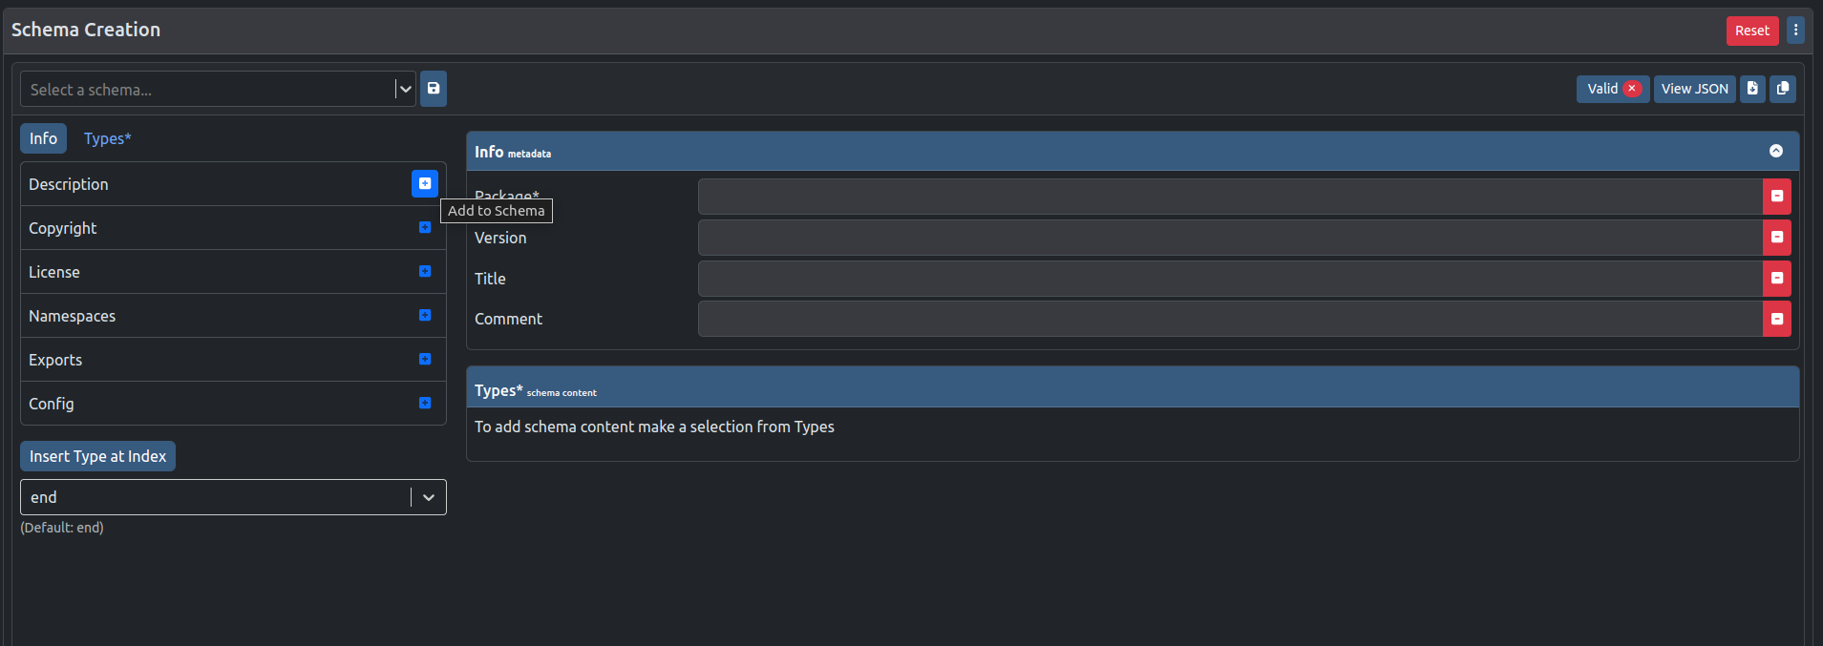
Add Data:
Button Style
The ‘Insert Type at Index’ allows you to select where you would like to add your Type. Types are added to the end of the Schema by default.
Click to add Info or Type to the schema.

Slide 13
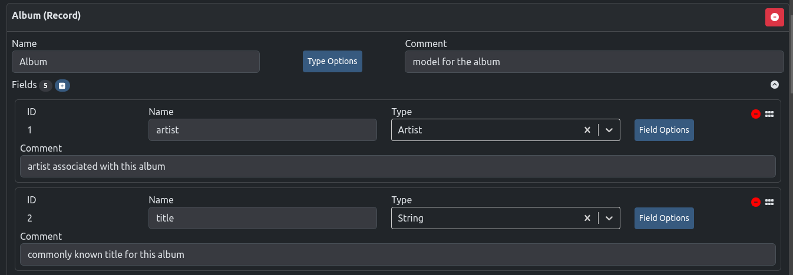



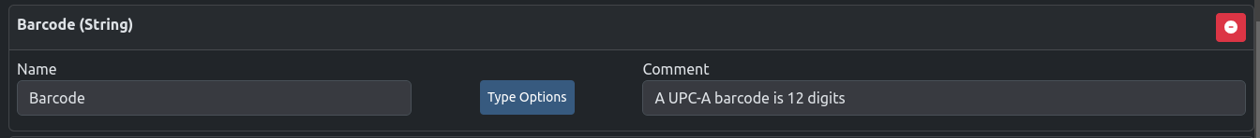
Edit Data:
Add, change, or remove Types
The cards dropped on the right can be edited by clicking within input fields
or removed .
Fields, if applicable, can be:
Added,
removed,
hidden, and
easily rearranged.

Slide 14
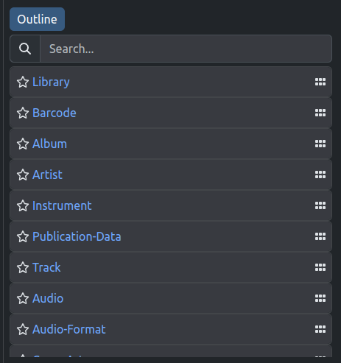
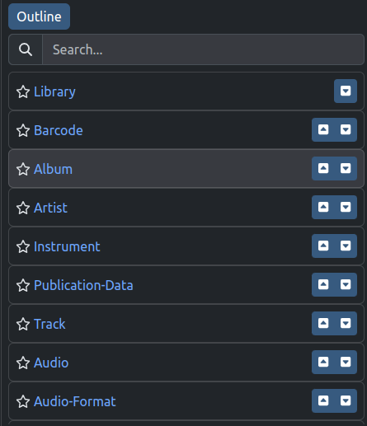

Feature: Schema Types Outline
You can easily search or rearrange the Types within the Outline.
The cards within the outline can also be starred for future reference.
Clicking on the Type Name will take you to the card in the Types section of the schema on the right.

Slide 15
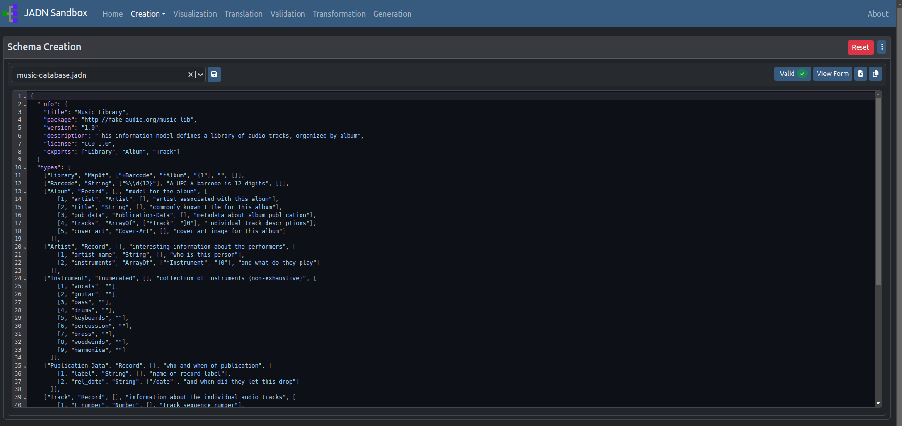









Functions
As you build your schema, you can view the JSON code by clicking on ‘View JSON’ .
This code can be:
Downloaded to your local storage
Copied to the clipboard
Saved onto the file uploader for easy selection
Other features include:
Checked for validation
Reset to start over
Scroll to top (appears when you scroll down on window)
Click ‘View Form’ to return to the Schema Creator.

Slide 16
The following slide shows you how to begin interacting with the page.
This applies to the following pages:
Schema Visualization
Schema Translation
Data Creation
Data Validation
Example Data Generation

Slide 17
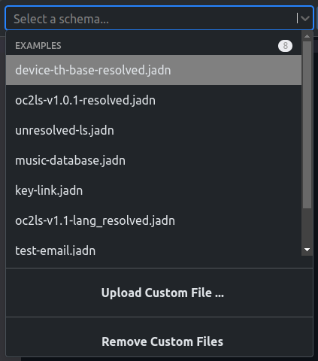

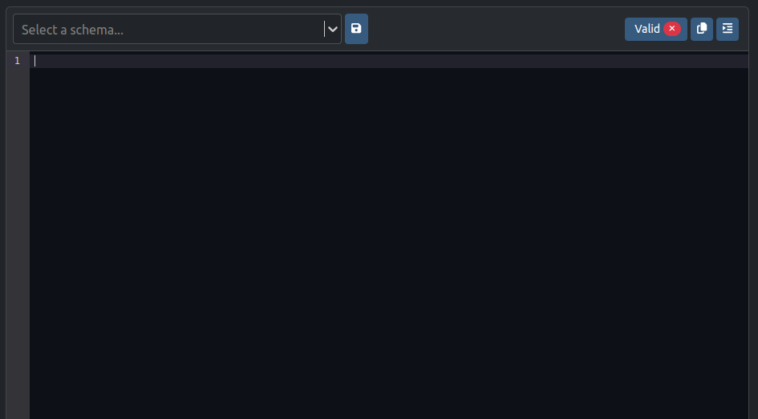

Start with the File Loader :
1
Select a valid example schema
or
Upload a valid JADN Schema
or
Type/ Paste in a valid JADN Schema in the code editor
You can also:
format the Schema
copy to clipboard
Save the Schema to the file loader
1
2
2
3
3

Slide 18
Schema Visualization
View JADN schema in another language format:
JIDL¹, HTML, Markdown, PlantUML, GraphViz
JADN Interface Definition Language (IDL) is a textual representation of JADN type definitions

Slide 19
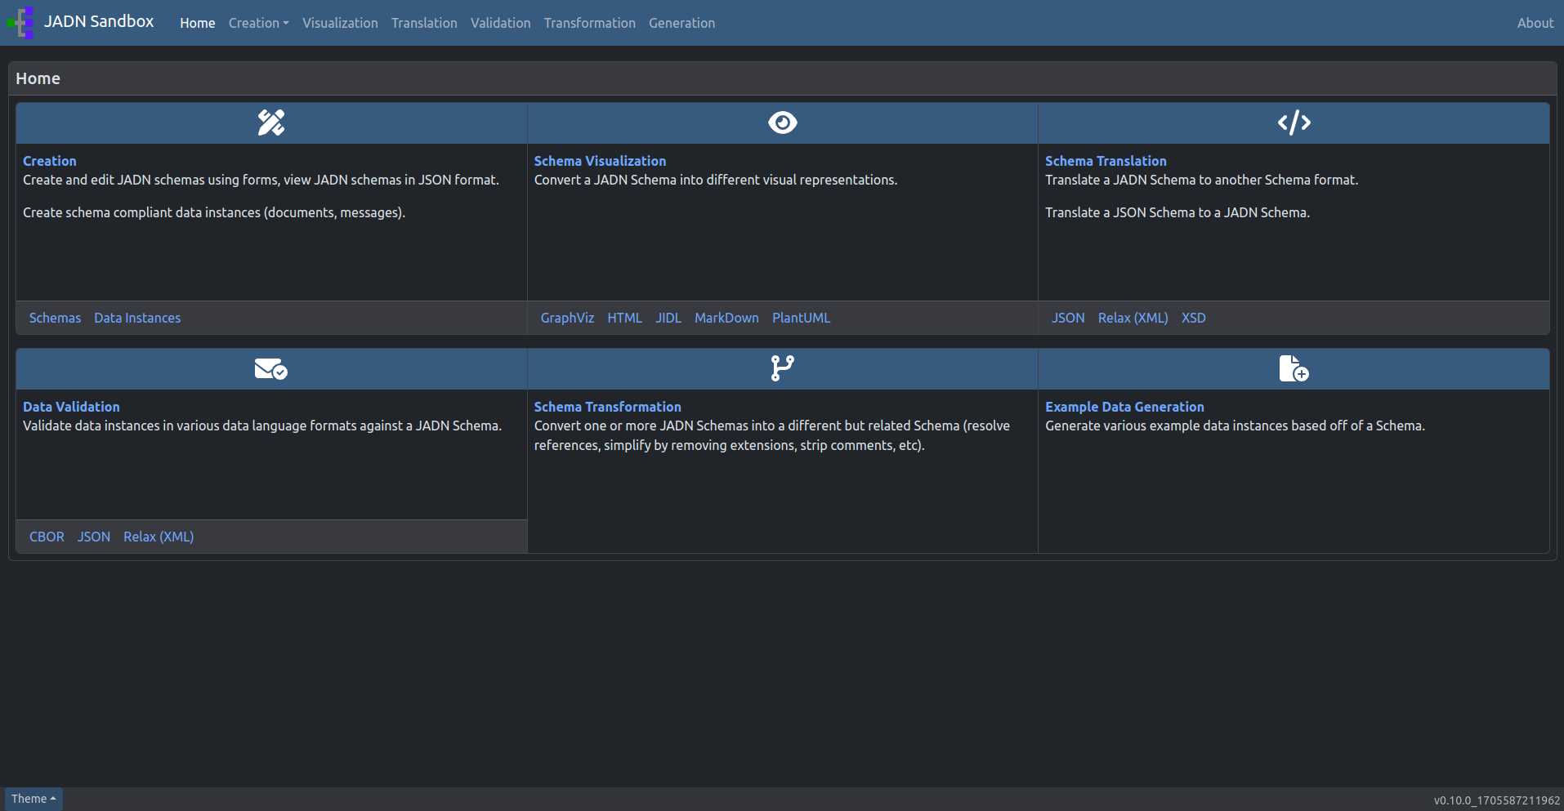
Go to: Visualization

Slide 20
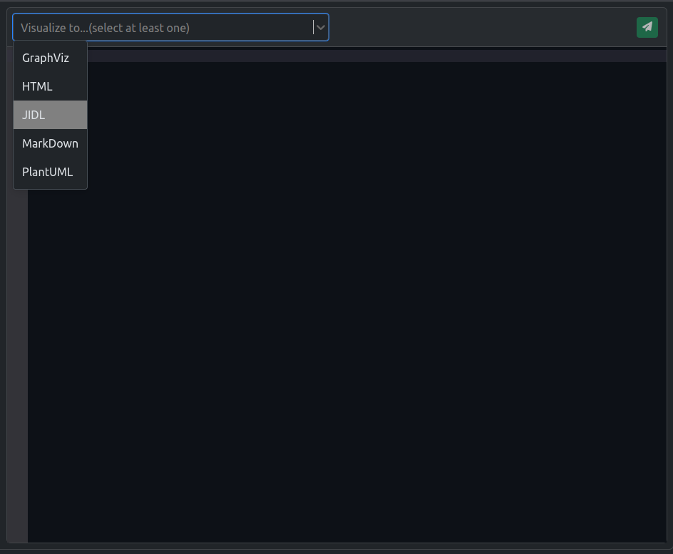
To Start : click here
Note: Only a JADN Schema can be uploaded.
After selecting a valid schema, select the desired languages you would like to convert the schema to.
Options on this page are for visual representation of JADN data. For Schema Translations (like to JSON or XML) click here

Slide 21

Visualize
Once you have selected the languages, the green paper airplane button should light up allowing you to proceed to visualize the schema to the selected messages.
Click the Visualize button to proceed.

Slide 22
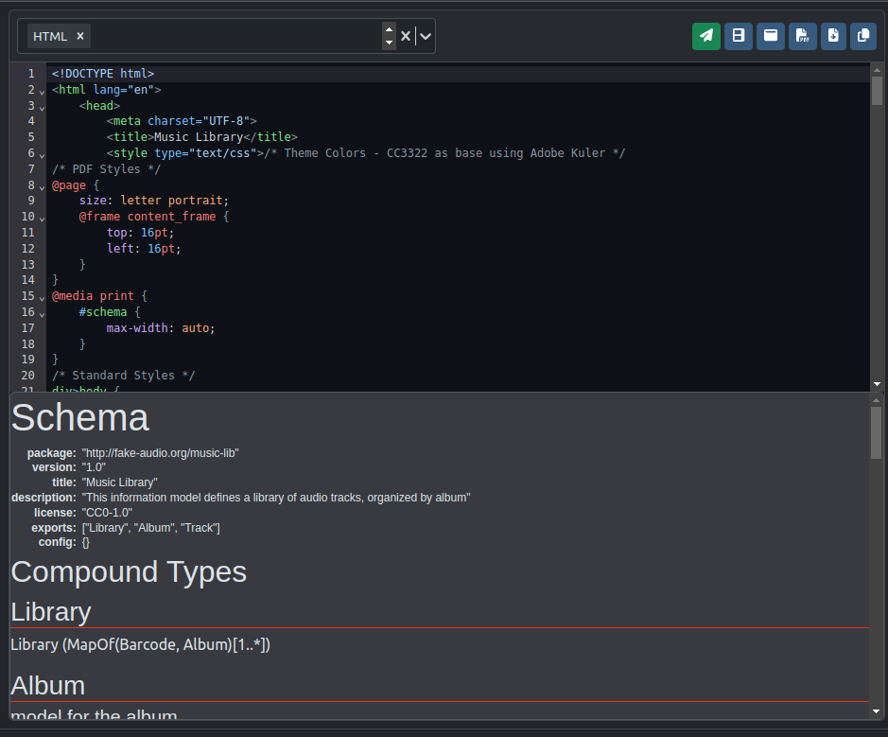






Results: Selecting one language
The result will show you the code in the selected language.
The following features allow you to interact with the visualization as you need.
Split view (currently shown) : To view the code and visualization simultaneously
Pop out : See the visualization in a new tab window
Download visualization as PDF
Download visualization as an image
Download code
Copy code to Clipboard

Slide 23
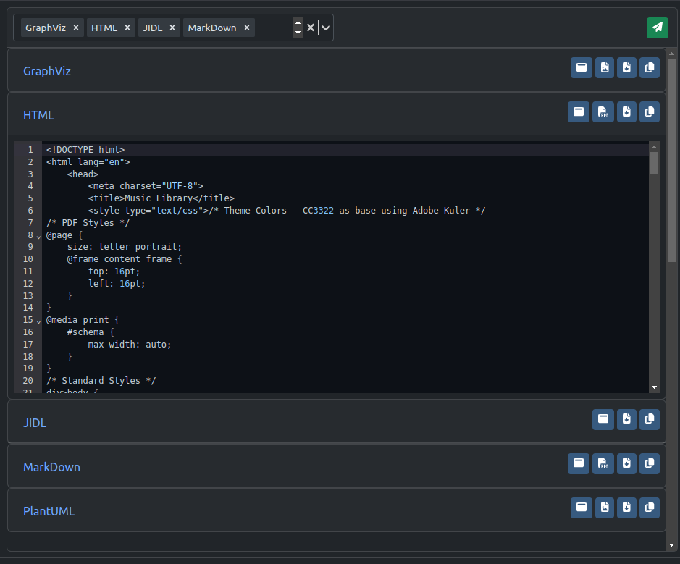
Results: Selecting multiple languages
You also have the ability to visualize multiple languages at once.
You can view the code for one or multiple languages at once by clicking on the header of each section.
Each language has its own applicable features as seen in each section.

Slide 24
Schema Translation
Convert JADN Schema to JSON , Relax XML, or XSD.
Convert JSON Schema to JADN.

Slide 25
Go to: Translation

Slide 26
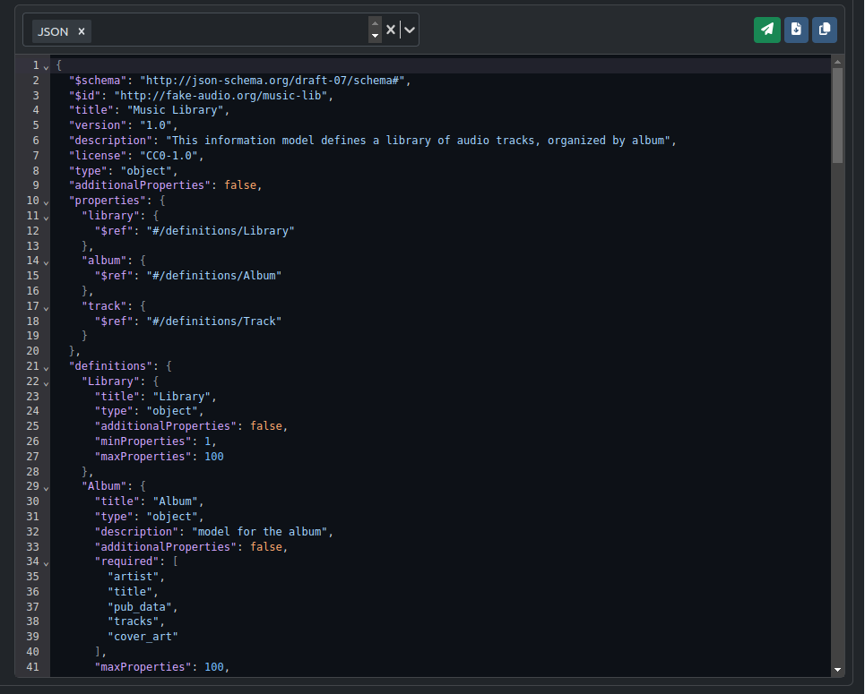
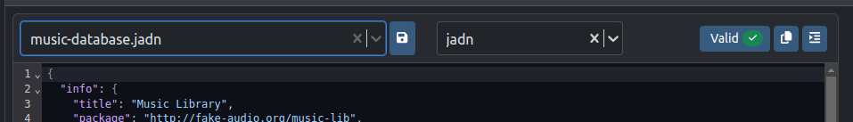
To Start : click here
Note: A JSON or JADN Schema can be uploaded.
Similar to Schema Visualization, Schema Translation allows you to translate your schema into your desired language.
When selecting a schema, make sure to select the type of schema you want to translate from: JADN or JSON.
Result: Translated Schema to one language

Slide 27
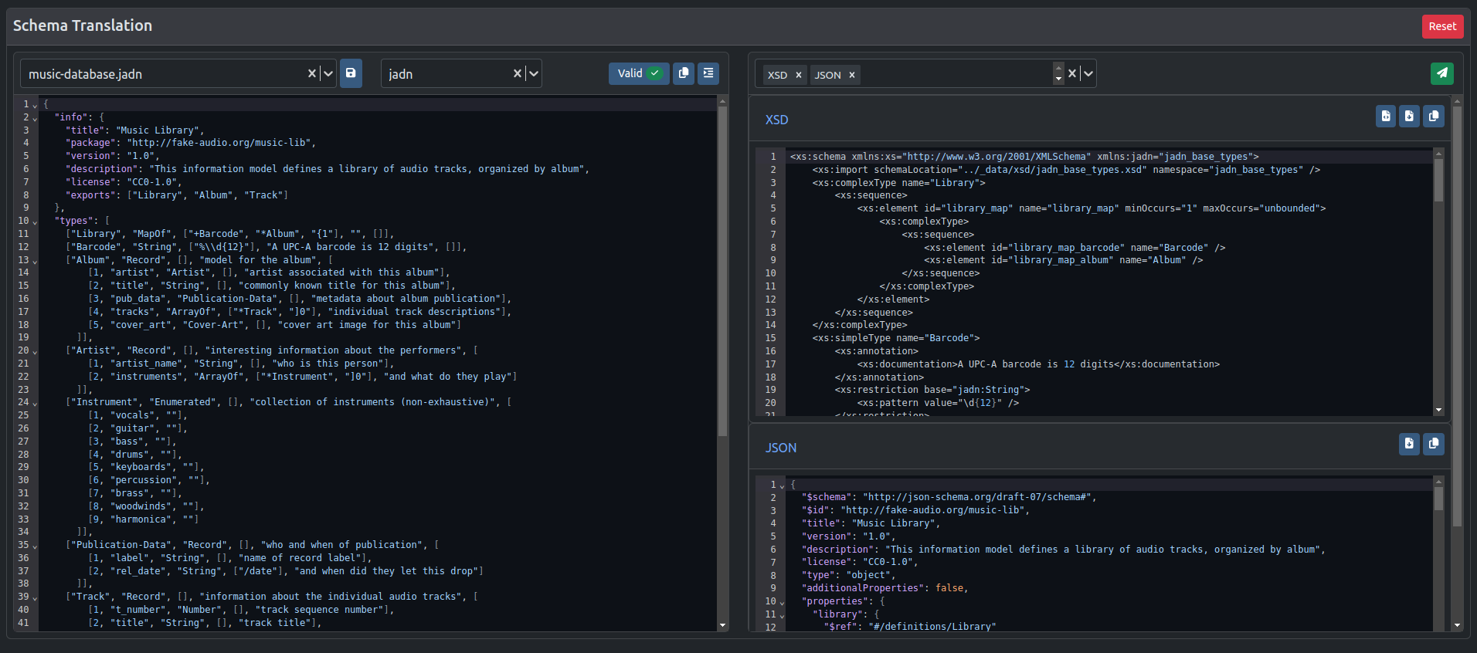
Result: Translated Schema to multiple languages
You can translate from JADN to JSON and XML (XSD or Relax) or from JSON to JADN.

Slide 28
Data Creation
Create valid data instances from a JADN Schema

Slide 29
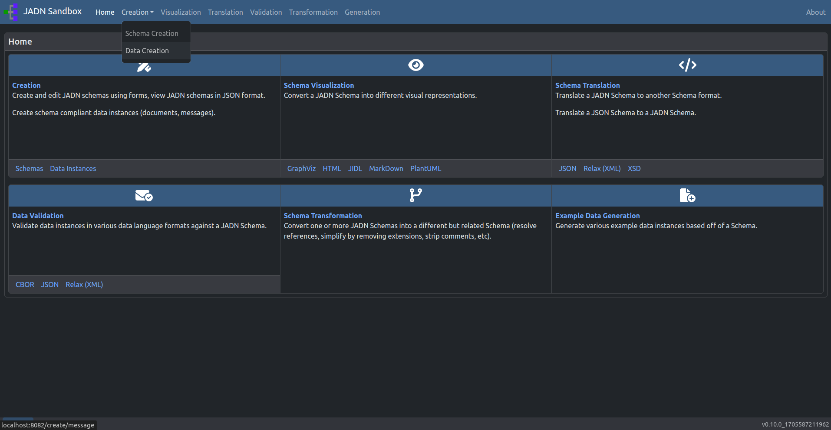
Go to: Creation
When the drop down menu appears, select Data Creation

Slide 30
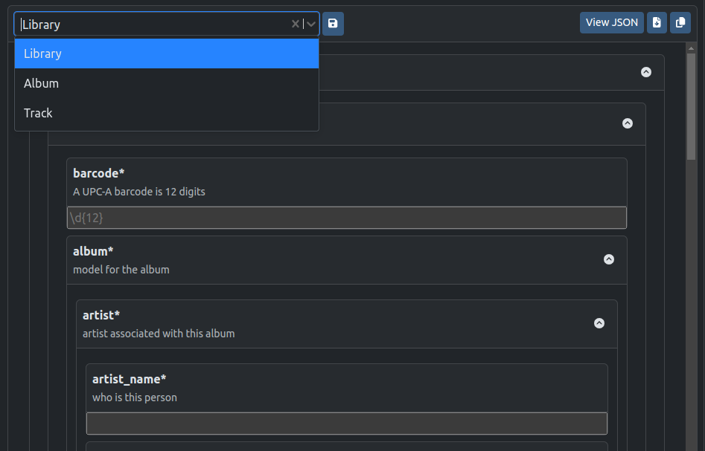
To Start : click here
Note: Only a JADN Schema can be uploaded.
After selecting a schema, you should be able to select a data type.
Note: This drop down menu is based on the Schema exports.
Once you have selected a data type, a form will appear to help guide you in building data that is valid against the selected schema.

Slide 31
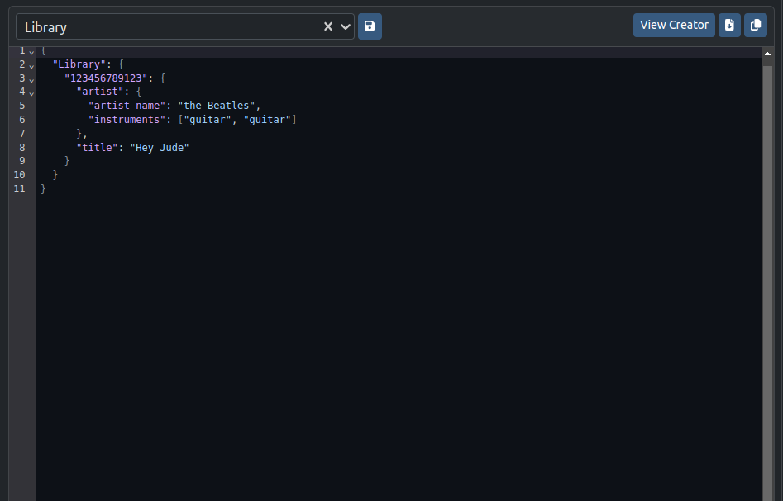


View JSON / Creator
After filling out the form, you can click ‘View JSON’ to see the data you have created in JSON.
Click ‘View Creator’ to go back to the form.
The JSON can also be:
Downloaded to your local storage
Copied to the clipboard

Slide 32
Data Validation
Validate data instances in JSON, XML, or CBOR against a JADN Schema

Slide 33
Go to: Validation

Slide 34
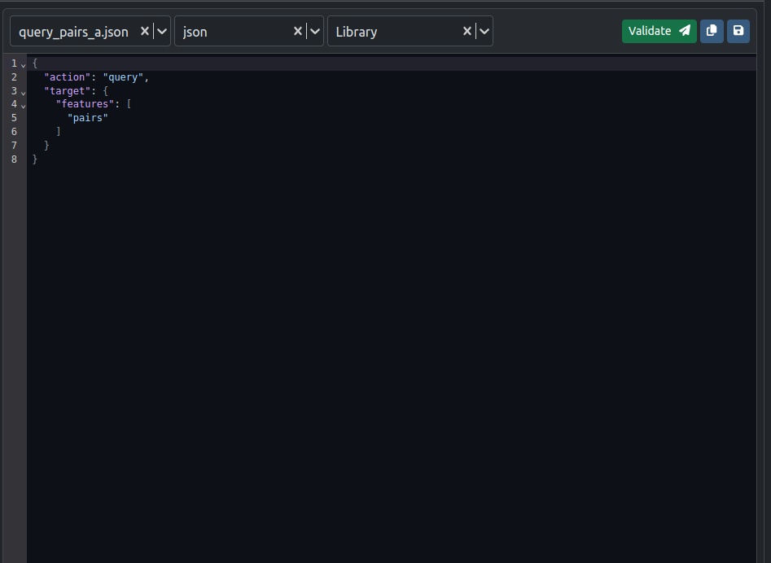
To Start : click here
Note: Only a JADN Schema can be uploaded.
1
2
3
Select data to validate.
Make sure the correct data format is selected.
Make sure the correct data type being validated is selected.
In this example, the data is a json file being validated against the Library type from the music-database.jadn
1
2
3

Slide 35
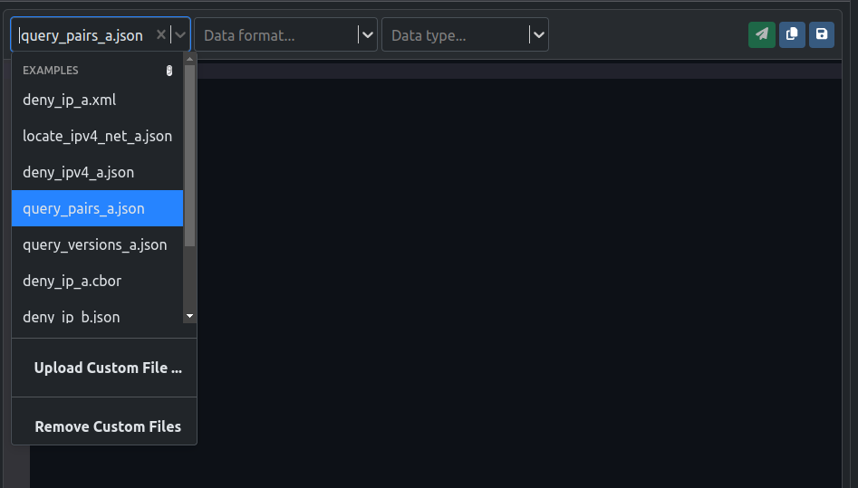
Select data to validate
1
Starting by uploading data:
Select example data
or
Upload a custom file
or
type/paste directly into code editor.
1
2
3
3
2

Slide 36
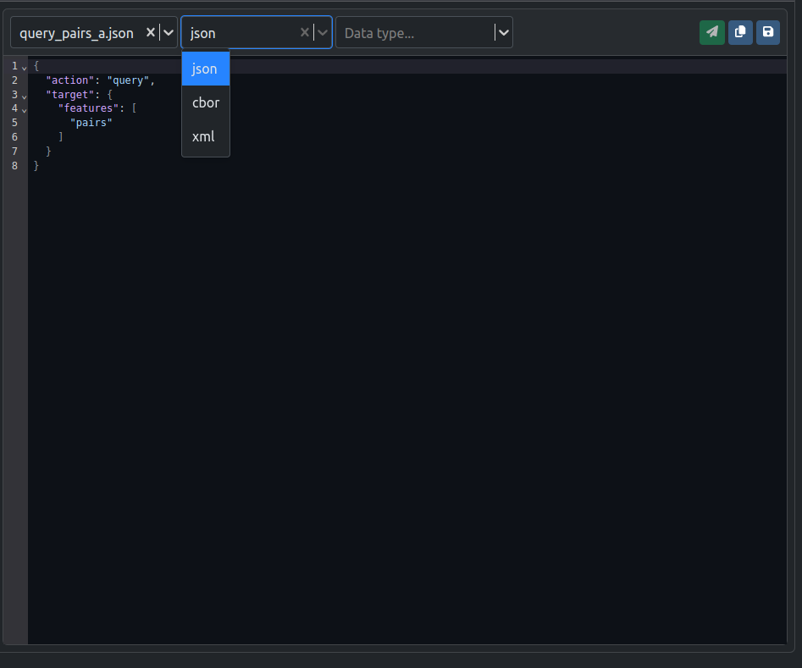
Make sure to select the correct data format
The JADN Sandbox can currently validate JSON, CBOR, and XML data against a JADN Schema.
If using a data file, the data format drop down may be pre-selected.

Slide 37
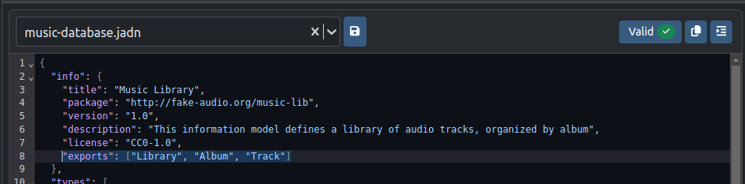
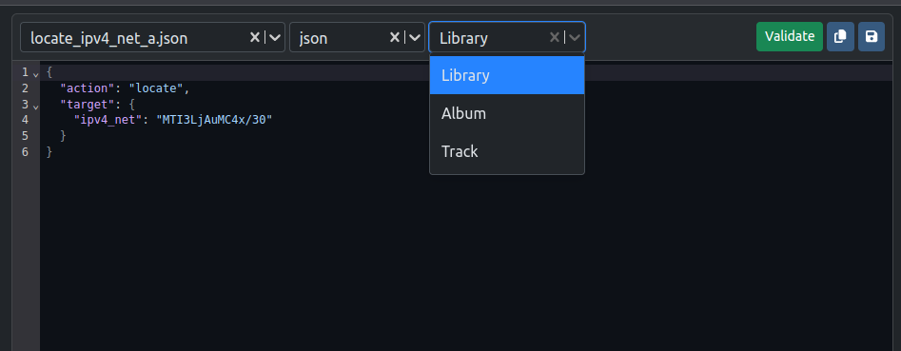
Make sure the correct data type is selected
The Data types available to validate against are based off of the exports from the JADN Schema file.
In this example, notice that the uploaded schema music-database.jadn has exports that correspond to the valid datatypes:
Library, Album, Track

Slide 38
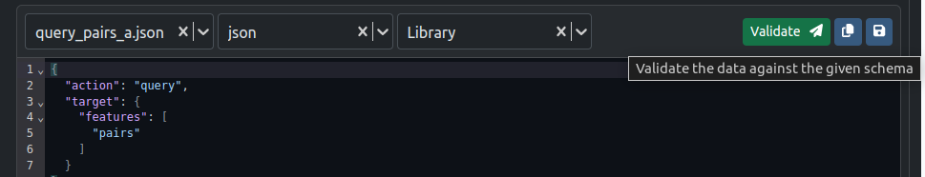
Validate
Once you have selected:
A Schema,
Data,
Data format, and
Data type
Click the bright, green “Validate” button.

Slide 39
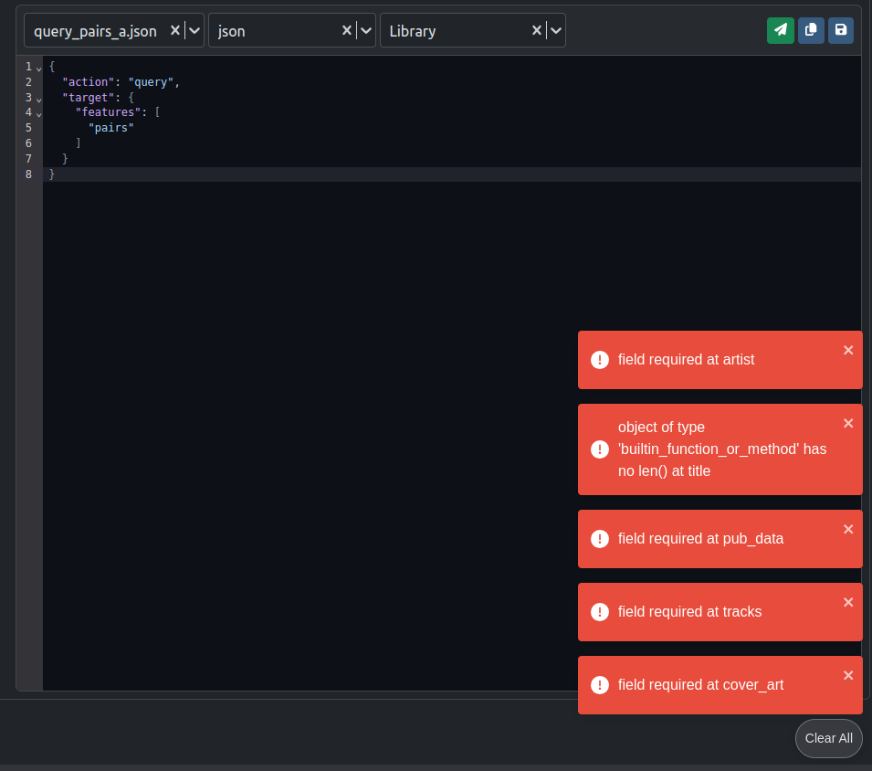
Invalid Results
An invalid data file will return errors to help fix the data.

Slide 40
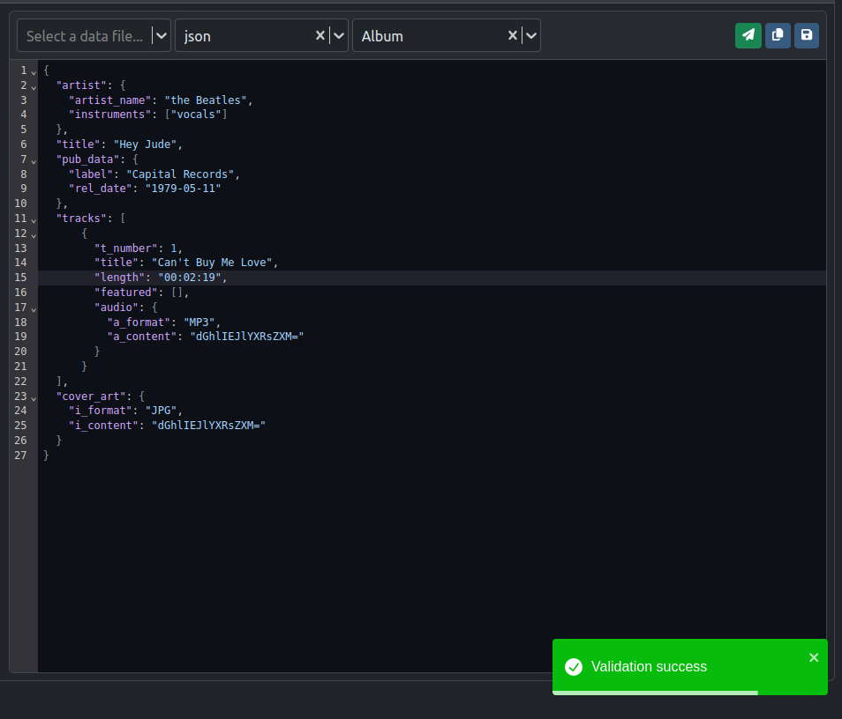
Valid Results
A valid data file will return a green success notification.

Slide 41
Schema Transformation
Strip comments from Schemas or Resolve a schema with references

Slide 42
Go to: Transformation

Slide 43
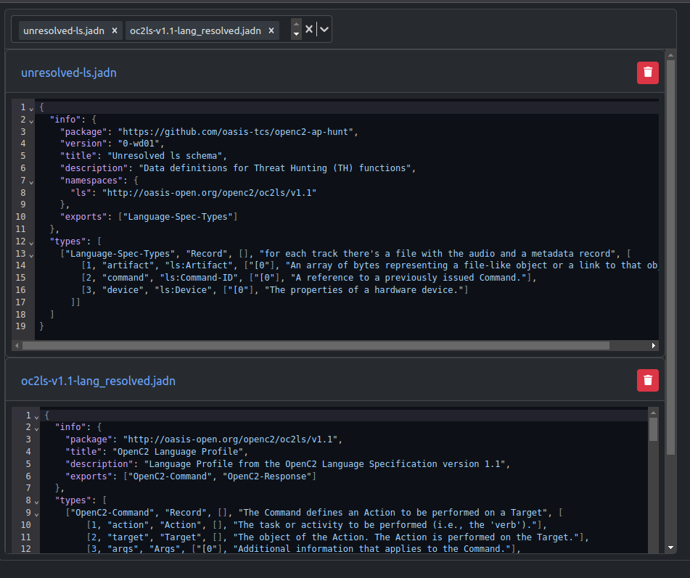
To Start :
Select at least one schema to upload.
Notice that there is no code editor. Therefore, schemas must be uploaded.
Here you can see 2 schemas selected to start:
unresolved-ls.jadn
ocls-v1.1-lang_resolved.jadn

Slide 44
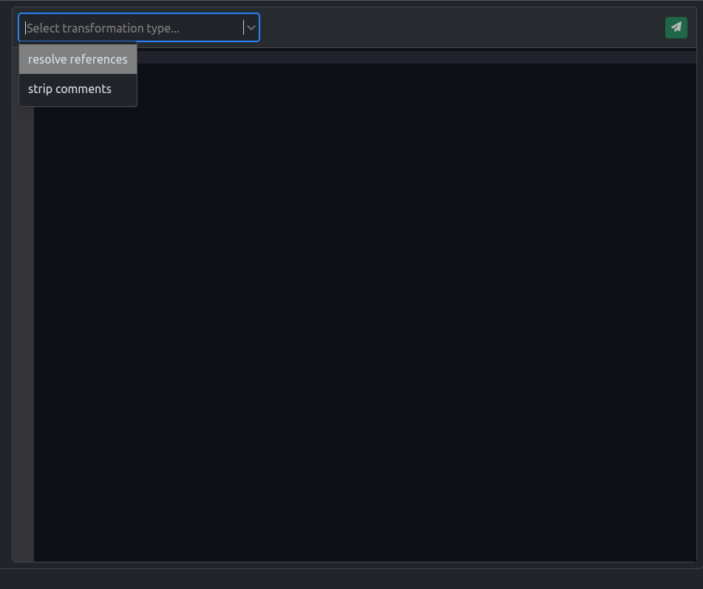
After selecting the desired schemas, you can select your desired transformation:
Resolve references
Create a single JADN schema from an unresolved schema and its imports
Strip comments
Remove comments from a JADN schema to reduce size
or visual clutter

Slide 45
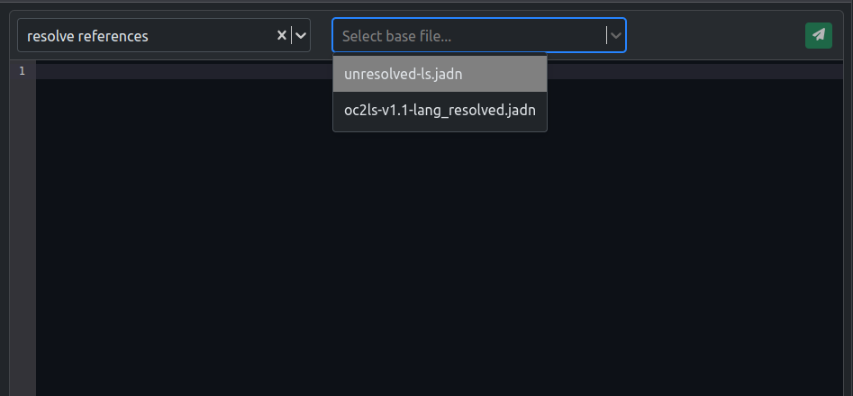
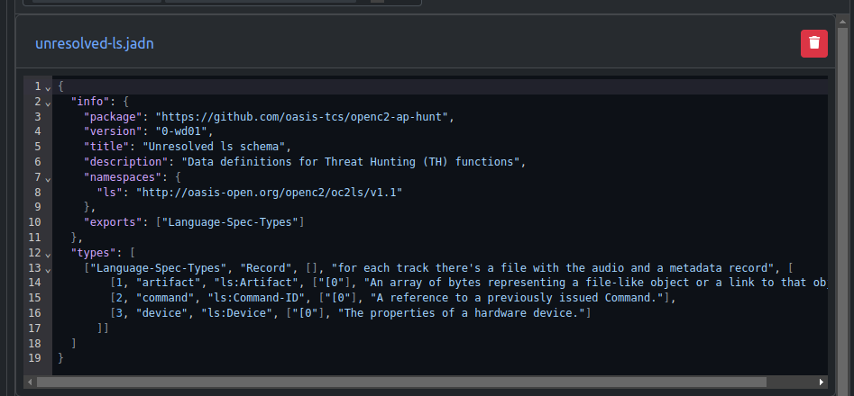
Resolve References ¹
For resolving references, you will need to select a base file. This file is the file you would like to be resolved.
The other uploaded files will be used to help resolve the chosen base file.
In this example, the base file is : unresolved-ls.jadn
A resolved Schema is a schema without references.

Slide 46
What is an unresolved Schema?
A Schema is unresolved if it has namespaces (references to types defined in other schemas).

Slide 47

Click Transform to resolve the base file.

Slide 48
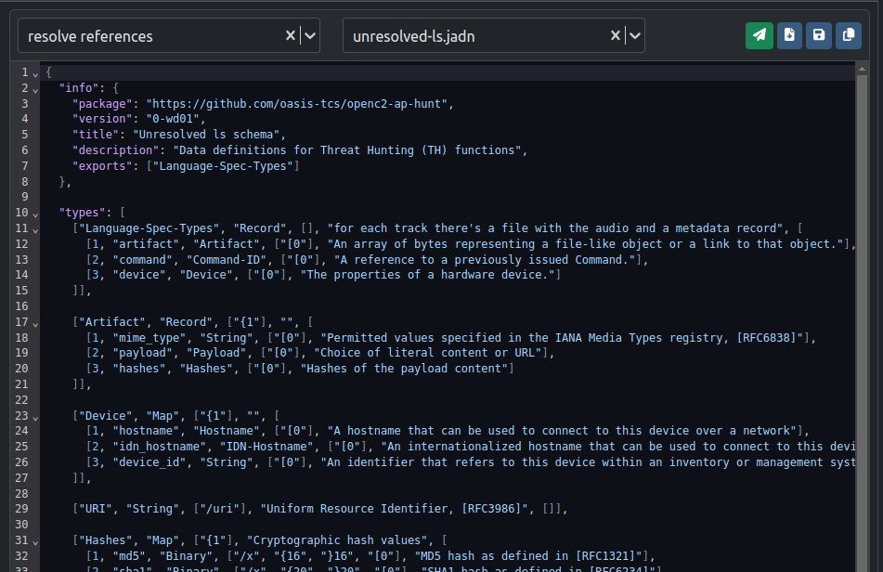
Result: A resolved Schema
Notice there is no namespace and that the types from the unresolved schema can be referenced within the resolved schema.
Ls: Artifact —> Artifact
Ls: Command-ID —> Command-ID
Ls: Device —>Device

Slide 49
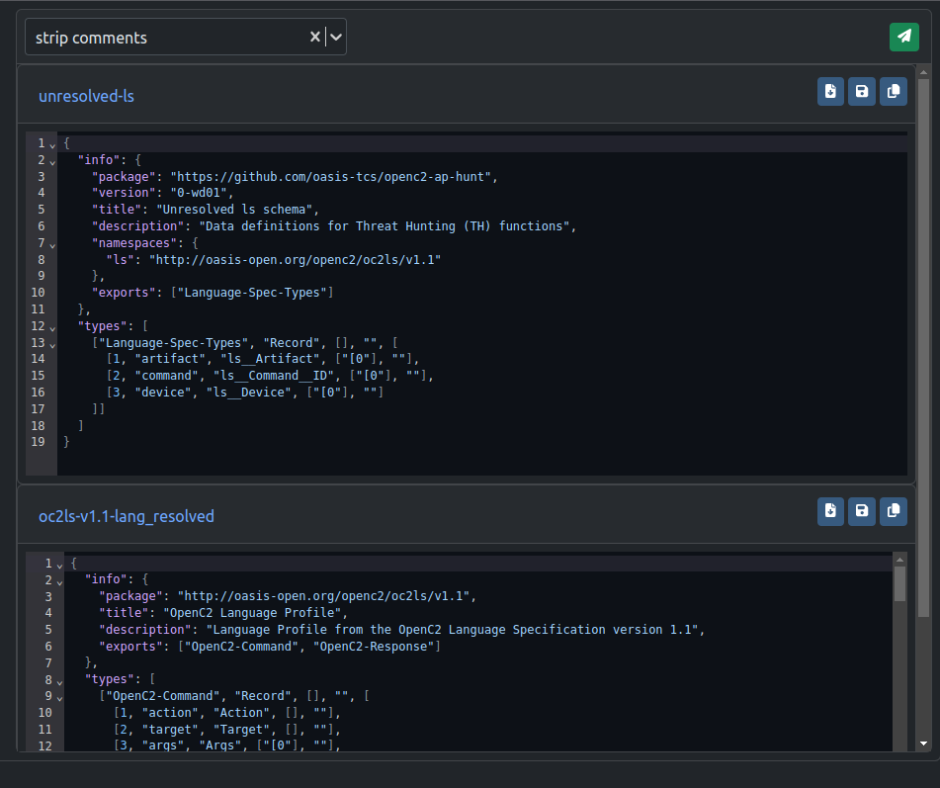
Result: Strip Comments
When stripping comments, results will return all schemas without comments.

Slide 50
Example Data Generation
Automatically create valid data instances given the JADN Schema

Slide 51
Go to: Generation

Slide 52
To Start : click here
Note: Only a JADN Schema can be uploaded.
Enter the desired number of examples you would like generated. This number should be between 1 - 10.
(In this example, we have selected 3.)
After you input a number, click the green “Generate” button.
Note: The button will only be clickable if you have a valid JADN schema and the number of examples desired.
Warning: Example Generation may fail due to large Schema data. As a result, the application may lock itself. In this case, please restart docker container.

Slide 53
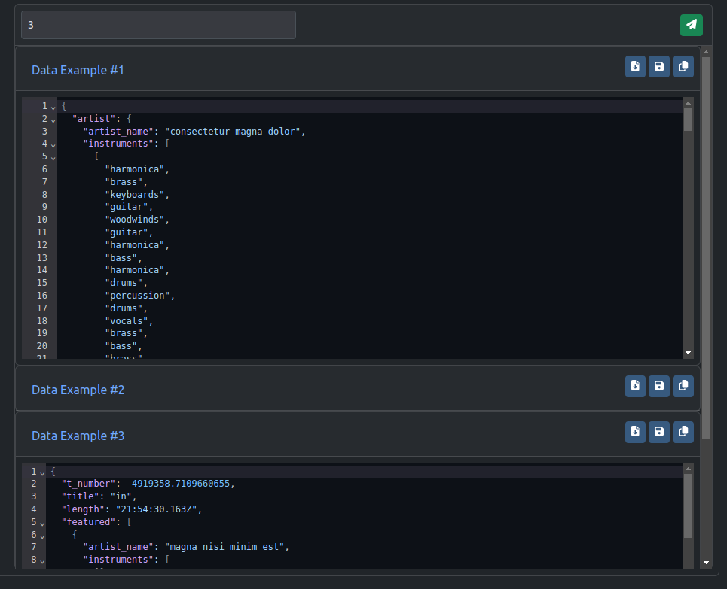
Results
If successfully generated, you will be able to view and hide the example data generated.
For each example, you can:
Download to local storage
Save the file to data uploader (The file can then be found for easy access in the Data Validation page)
Copy to clipboard

Slide 54
Other Features

Slide 55
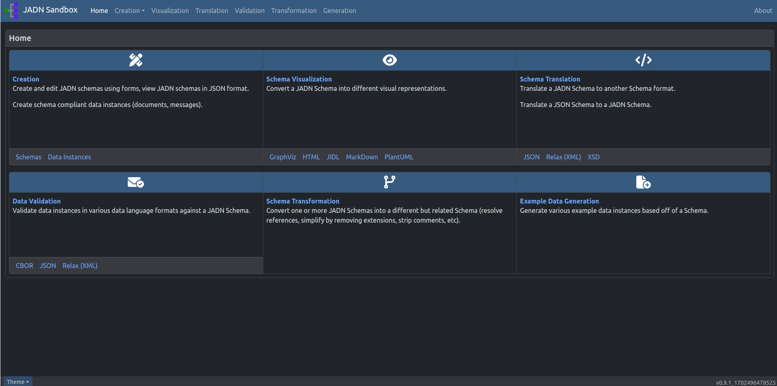
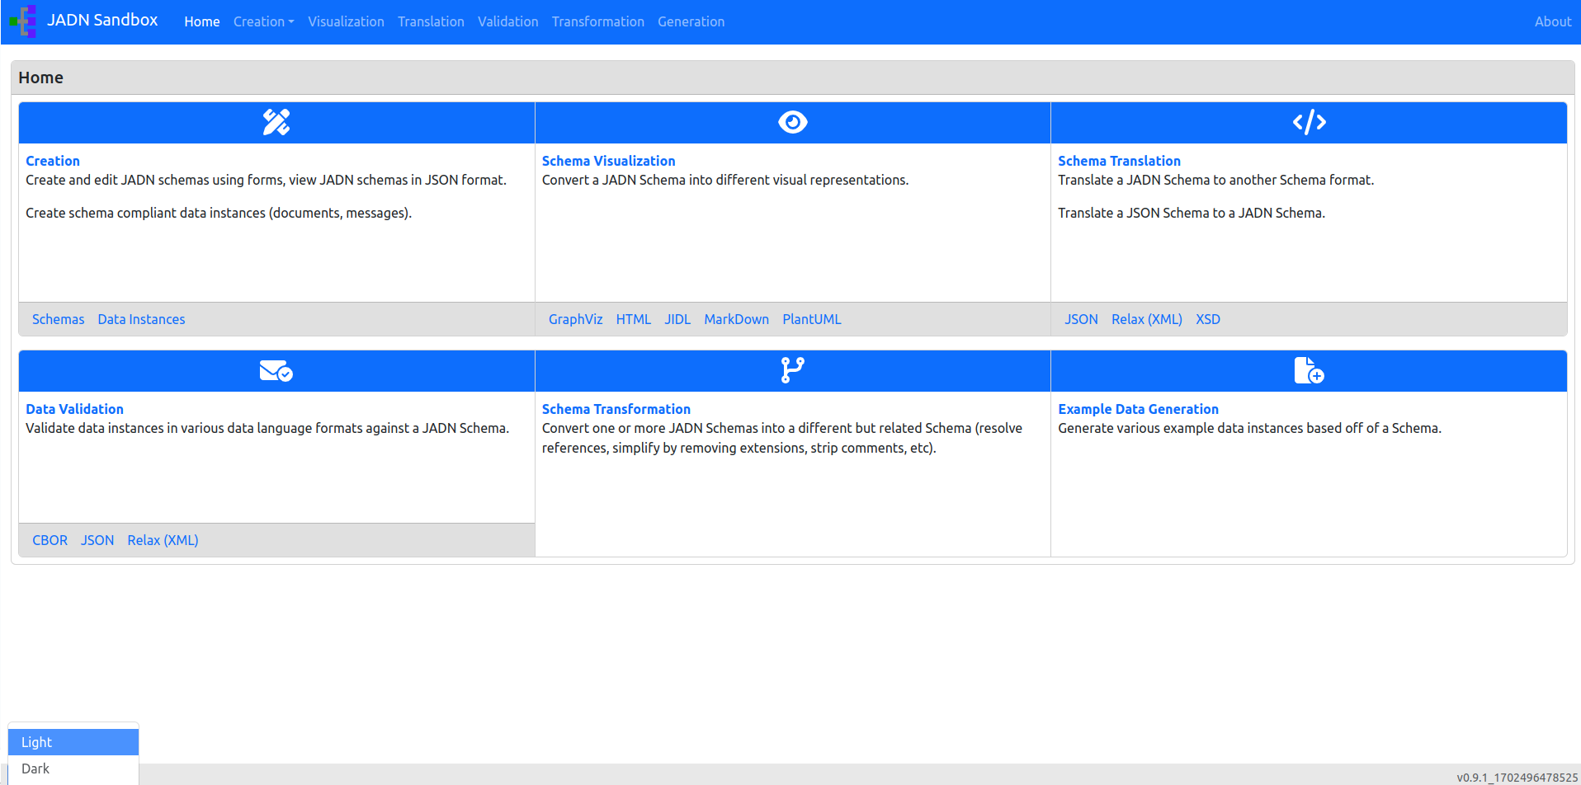
Theme Switcher: Choose between light and dark mode.
Note: Dark is the default theme.

Slide 56

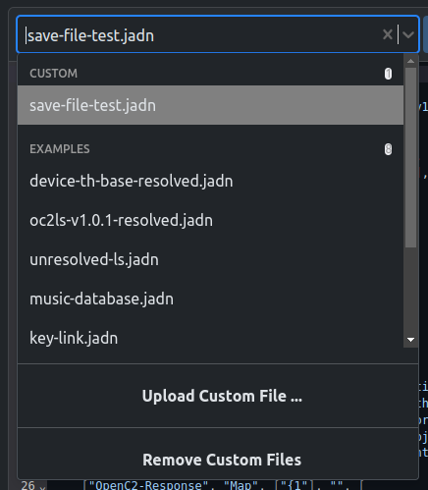
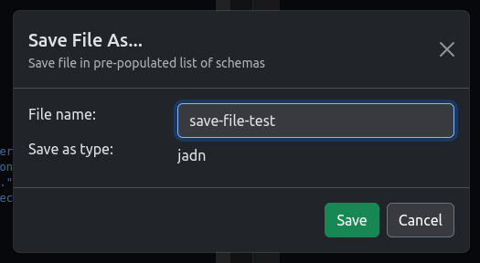
Add custom files (Save as…)
The file saver will allow you to name and save data into a file to be found in the file loader for future use.

Slide 57

Delete custom files
Custom files can be removed from the file loader if no longer needed.

Slide 58


Download files to local storage (Download As..)
Files can be named and saved to your Downloads Folder.

Slide 59

Docker Desktop Start Up Guide
JADN Sandbox

Slide 60
Docker Table of Contents
How to Get the JADN Sandbox Image
How to Run the JADN Sandbox Image
From Images¹
From Containers²
From Search Bar
How to Update the JADN Sandbox Image
From Images
From Search Bar
How to Stop the JADN Sandbox Image
How to Learn More about Docker
A Docker image is like a set of instructions. It is the template loaded onto the container to run it.
A Docker container is a self-contained, runnable software application or service created from a docker image.

Slide 61
How to Get
the JADN Sandbox Image

Slide 62

Click in the search bar, search: jadn

Slide 63

Then, click Pull: screambunn/jadn_sandbox

Slide 64
How to Run
the JADN Sandbox Image
From Images
From Containers
From Search Bar

Slide 65
From Images

Slide 66

Under Images, find the desired image and click the play button to run the image.

Slide 67

After clicking the play button, this window will appear.
You will need to enter information on the container to be able to run the image.
Click the carrot icon (v) to expand the Optional settings.

Slide 68

After clicking the carrot icon, you will see the settings as shown.
The Container Name is optional, but has been provided as an example (UserGeneratedContainerName1).
Note: no spaces allowed in the container name.
REQUIRED INFORMATION: Host Port - Enter: 8082
Click Run.

Slide 69


After clicking on Run, a container will appear.
Click on the link provided to open the image in a browser window.
You can also enter the link itself in the browser:
http://localhost:8082/

Slide 70

To stop the container, click the stop button.

Slide 71
From the Search Bar

Slide 72
In the search bar, search: jadn
Then, click Run: screambunn/jadn_sandbox

Slide 73
After clicking the play button, this window will appear.
You will need to enter information on the container to be able to run the image.
Click the carrot icon (v) to expand the Optional settings.

Slide 74

After clicking the carrot icon, you will see the settings as shown.
The Container Name is optional.
Note: no spaces allowed in the container name.
REQUIRED INFORMATION: Host Port - Enter: 8082
Click Run.

Slide 75
After clicking on Run, a container will appear.
Click on the link provided to open the image in a browser window.
You can also enter the link itself in the browser:
http://localhost:8082/

Slide 76
From Containers

Slide 77

First, make sure to stop any running containers.

Slide 78

Click play on the desired container and then click on link to see terminal of running container.

Slide 79

Click on the link provided to open the image in a browser window.
You can also enter the link itself in the browser:
http://localhost:8082/

Slide 80
How to Update
the JADN Sandbox Image
From Images
From Search Bar

Slide 81
From Images

Slide 82

OPTIONAL: Delete all containers related to the image (screambunn/jadn_sandbox:latest) by clicking the delete button (trash can icon) under Action.
Note: Containers use the image that it was created with. Even though the image is named the same, its versioning is different. Therefore older containers will be out of date.

Slide 83


Pulling image..
Under Images, Go to Actions and click the 3 dotted icon.
A menu drop down will appear. Click Pull.
Then go through the steps to run the image.

Slide 84
From the Search Bar

Slide 85
In the search bar, search: jadn
Then, click Pull: screambunn/jadn_sandbox

Slide 86
How to Stop
the JADN Sandbox Image

Slide 87

Click the stop button under Action in Containers.

Slide 88

Alternatively, Click the stop button within the running container

Slide 89
How to Learn More about Docker

Slide 90

Go to the Learning center to learn more about Docker.

