Slide 1
Tunis
C12
Londres
Restaurant
Tampon
C11
Accès aux parkings Est
(50)
C4
Monaco
Tribunes VIP
Tribune Prestige
Bamako
(50)
Salle de presse
Moscow
Sous-sol athlètes
C3
(10)
Dubllin
Harare
(200)
Asia
(800)
(200)
Pekin
(100)
Mexico
(200)
Berlin
C5
Tokyo
C9
Oslo
Arene
Rabat
Dakar
C1
C2
(800)
Nairobi
C8
Oceania
Madrid
Tribune Ouest
Quito
(10)
Lisbonne
Europa
Oceania
Tribune Est
Salle de contrôle
Africa
Suva
Caracas
Alger
(200)
Kampala
Riga
(200)
(200)
Entretien
Jerusalem
Kaboul
Village olympique
Kingston
Katmandou
Admin-
istration
Lima
Restaurant athlèthes
(10)
Zone stade
(80)
(300)
(2000)
C6
C7
Washington
(800)
Athenes
Paris
C10
Dubllin
2 bissas Astra
caméra externe
Acces aux parkings Ouest
10 bissas Astra
(100)
nb de personnes maximum
Stade Nilton-Santos Rio de Janeiro

Slide 2
Parkings employés
Xe
Cd
Cs
Fe
Mn
DM
Ar
PT
(5)
*
zone IL
(60)
U1
*
1 bissas Xtra
(500)
De
U2
*
2 bissas Astra
PO
Na
(10)
caméra externe
(60)
Li
Cs
Accueil
(4)
Salle De controle
X
*
Parking visiteurs
Rn
(20)
Rb
Kr
(2)
Ne
ADministration
Morrocoy

Slide 3

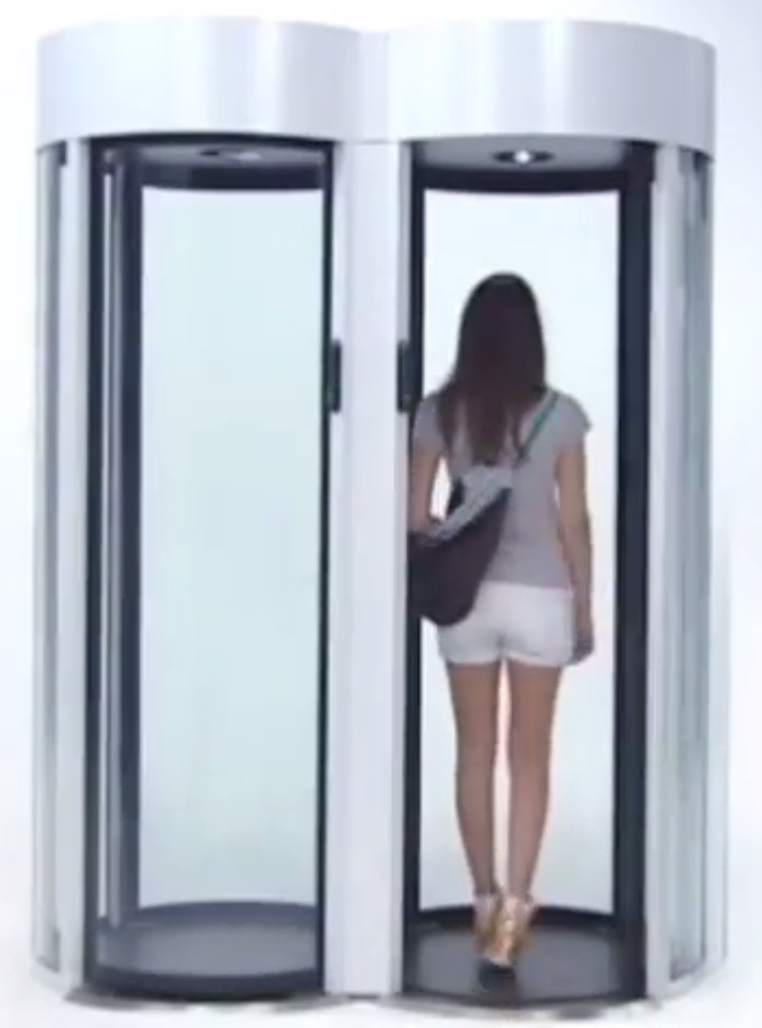
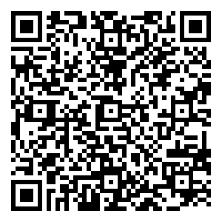
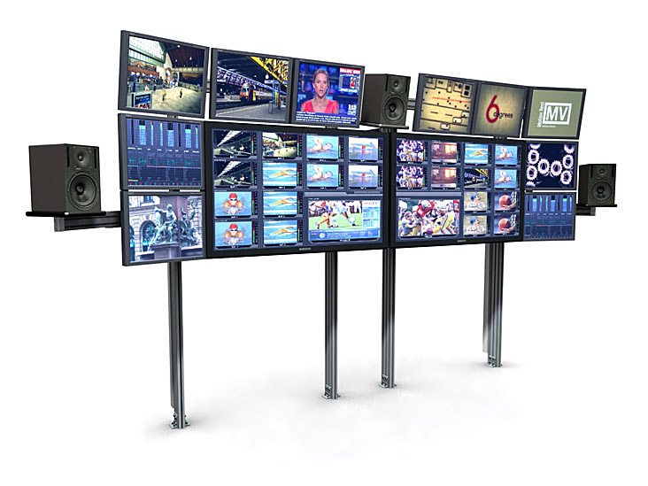
RIO 2016
VIRGINIE-MARIS-P283728746----------------
TRIPLEJUMP-B12---------------------------------------
2016-08-16 ---11:00-18:00-----------------------
NILTON-SANTOS-OUEST-F23------
879277246472
http://www.archiexpo.com/prod/alluser-industrie/sliding-doors-commercial-buildings-security-automatic-52110-624140.html#product-item_142100
<sales transaction="8JH8HHDNKHJA7887787" items="145" date="20141226">
<sale>
<firstName>Virginie</firstName>
<lastName>Maris</lastName>
<nationalId>P283728746</nationalId>
<tickets type='internet' vendor='ticket4all.com' vendorid='4528'>
<ticket id='879277246472''>
<product>Hockey B12</product>
<period start='20150116T1100-0430' end='20150116T1800-0430/>
<qrcode>UDH2846DHSQJ3JF ... GS73Z84DFHDFGSHSDG3657D</qrcode>
<price amount="28" money="EUR"/>
<seat>T23</seat>
...
...
2015
http://www.tbcconsoles.com/gallery.aspx?galleryid=3#.VLAvlytjV8E

