Slide 1

ModelScribes Languages
eScribis
ModelScribes is a set of coordinated textual modeling languages based on UML and extended/restricted for educational purposes.
re
gl
ossary
re
glossary model
Jungle TropicalWetDrill
| Imaginary location where `tarzan`
| lives and eats `Bananas`.
Banana
| Fruit from the `Jungle`.
cl
asses
re
class model Jungle
import glossary model
import constraint model
class Banana
attributes
size:Integer
association HasCrushed
roles
elephant : Elephant[0..1]
bananas : Bananas[*]
constraint BananaSize
| The size of a banana ...
scope
Banana.size
ocl self : Banana
small : self.size > 0
us
ecases
usecase model
import glossary model
actor Animal
actor Monkey extends Animal
actor Elephant extends Animal
usecase EatBananas
| They start to remove the `skin`.
usecase CrushCoconut
priority: low
interactions
a Monkey can EatBananas
an Elephant can CrushCoconut
re
pe
re
rmissions
ta
permission model
import usecase model
import class model
Monkey, Elephant can delete Banana
usecase EatBananas can RU Banana.size
re
sks
ob
ject
task model
import glossary model
import usecase model
task tree
...
state model J4
import glossary model
import class model
– `tarzan` IsFriendOf pipo
create tz : Person
set tz.name := "tarzan"
create p : Elephant
insert(tz,p) into IsFriendOf
re
au
i
re
aui model
import glossary model
import task model
space
...
re
lation
relation model
import glossary model
import class model
– `tarzan` IsFriendOf pipo
relation Banana
re
sc
enarios
scenario model s26
import glossary model
import class model
import usecase model
import permission model
import state model J4
– 1. One day pipo the `Elephant` ...
actor instances
pipo : Elephant
context
create coco3 : Coconut
end
usecasei pipo CrushCoconut
– 2. pipo see the `Coconut` ...
– 3. pipo crush half of it.
! coco3.size := coco3.size / 2
end
 | language | main concepts | based on | diagrams
gl | GLossaries | term, definition, reference, synonym ... | rst | -
cl | CLasses | class, association, inheritance, attribute, ... | uml use rst | class diag.
us | USecases | actor, usecase, interaction, ... | uml rst | use case diag.
pe | PErmissions | permission, subject, action, resource, ... | rst | -
ob | OBjects | object, link, att. value | uml use soil rst | object diag.
sc | SCenarios | step, actor instance, usecase instance, ... | use soil rst | -
qu | QUalities | rule, package, parameter, derivation, ... | rst | -
ta | Tasks | task, concept reference |  | task diagram
au | AUI (Abstract User interfaces) | space, concept reference
re | Relations | relation, column, constraint | relational model
tt | Time tracking
pr | Project
gl
qu
pr
us
cl
ti
ta
pe
ob
au
re
sc

Slide 2
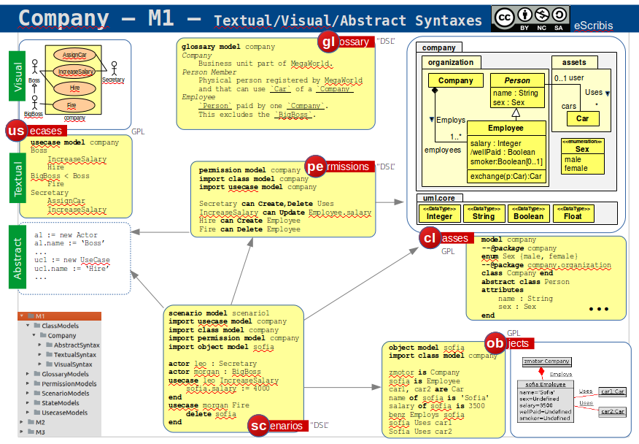
dans CyberMetamodels
pas trouvé, mais peut etre dans m2r ou m2gi, ou sur github

