Slide 1
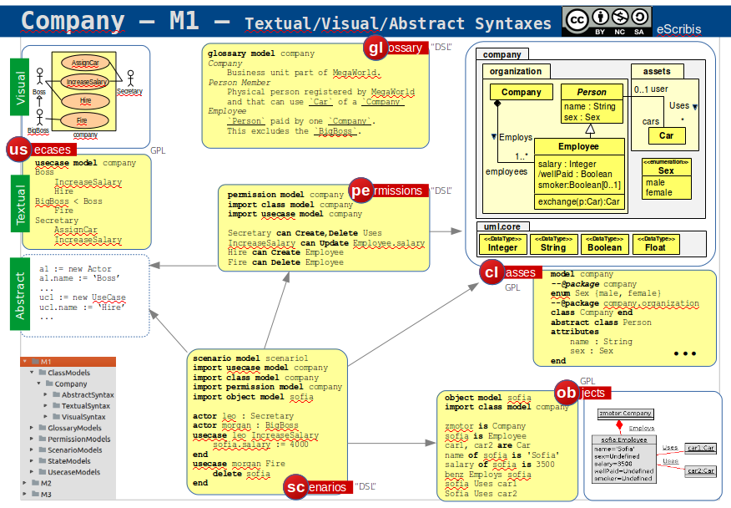
dans CyberMetamodels
pas trouvé, mais peut etre dans m2r ou m2gi, ou sur github

Slide 2

ModelScribes Languages
eScribis
re
gl
ossary
ModelScribes is a set of coordinated textual modeling languages based on UML and extended/restricted for educational purposes. In part based
on USE OCL.
glossary model
Jungle TropicalWetDrill
Imaginary location where `tarzan`
lives and eats `Bananas`.
Banana
Fruit from the `Jungle`.
re
re
quirements
requirement model
import glossary model
1. No more than 5 `Bananas`s per day.
2. `Monkey`s hate `Lion`s.
re
cl
asses
re
re
co
nstraints
us
ecases
class model Jungle
import glossary model
import constraint model
class Banana
attributes
size:Integer
end
usecase model
import glossary model
actor Animal
actor Monkey < Animal
actor Elephant < Animal
usecase EatBananas
They start to remove the `skin`.
usecase CrushCoconut
priority low
interactions
Monkey EatBananas
Elephant CrushCoconut
constraint model
import glossary model
import class model
– The size of `Banana` ...
constraint self : Banana
inv small : self.size > 0
re
st
ate
state model 4
import glossary model
import class model
– `tarzan` IsFriendOf pipo
! create tz : Person
! tz.name := "tarzan"
! create p : Elephant
! insert(tz,p) into IsFriendOf
re
pe
rmissions
permission model
import usecase model
import class model
– Usecase/Actor can CRUD Class/Att./Assoc.
– Use C or Create, D or Delete, etc.
Monkey,Elephant can Delete Banana
EatBananas can RU Banana.size
everyone can R Banana.*
no one can Create Banana
re
sc
enarios
re
scenario model 26
import glossary model
import class model
import usecase model
import permission model
import state model 4
– 1. One day pipo the `Elephant` ...
actori pipo : Elephant
context
create coco3 : Coconut
end
usecasei pipo CrushCoconut
– 2. pipo see the `Coconut` ...
– 3. pipo crush half of it.
! coco3.size := coco3.size / 2
end
is
issue model
Q1 Are coconuts fresh ?
`CR2.2` says that …
H1 Coconuts are fresh and juicy.
sues
 | language | main concepts | based on | diagrams
gl | GLossaries | term, definition, reference, synonym ... | rst | -
re | REquirements | requirements, dependency, priority ... | rst | -
cl | CLasses | class, association, inheritance, attribute, ... | uml use rst | class diag.
co | COnstraints | constraints, invariant ... | uml ocl use rst | -
us | USe cases | actor, usecase, interaction, ... | uml rst | use case diag.
pe | PErmissions | permission, subject, action, resource, ... | rst | -
st | STates | object, link, att. value | uml use soil rst | object diag.
sc | SCenarios | step, actor instance, usecase instance, ... | use soil rst | -
is | ISsues | questions, hypothesis, ... | rst | -
qu | QUalities | rule, package, parameter, derivation, ... | rst | -
gl
re
us
cl
co
join
the
dots...
pe
st
sc
is

