Slide 1
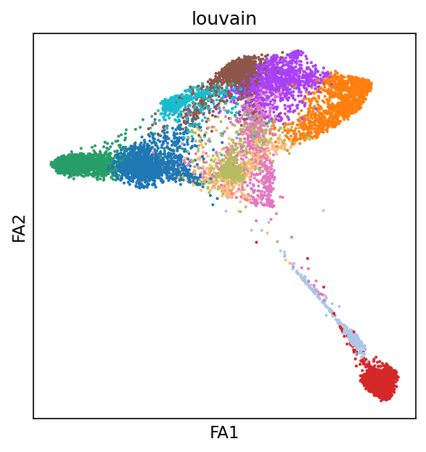
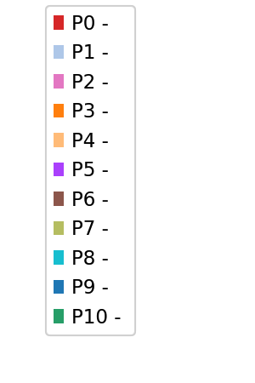
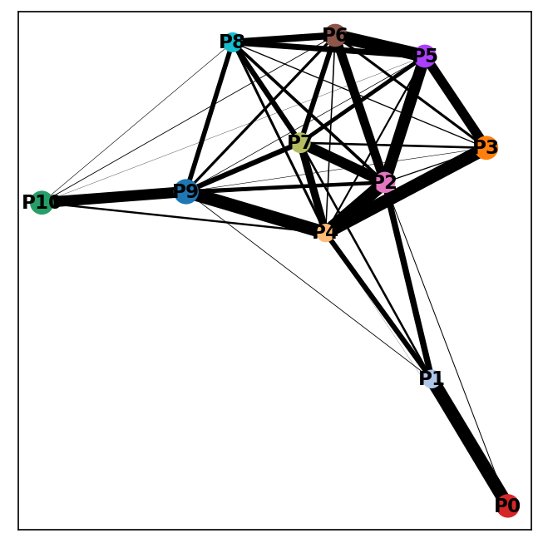
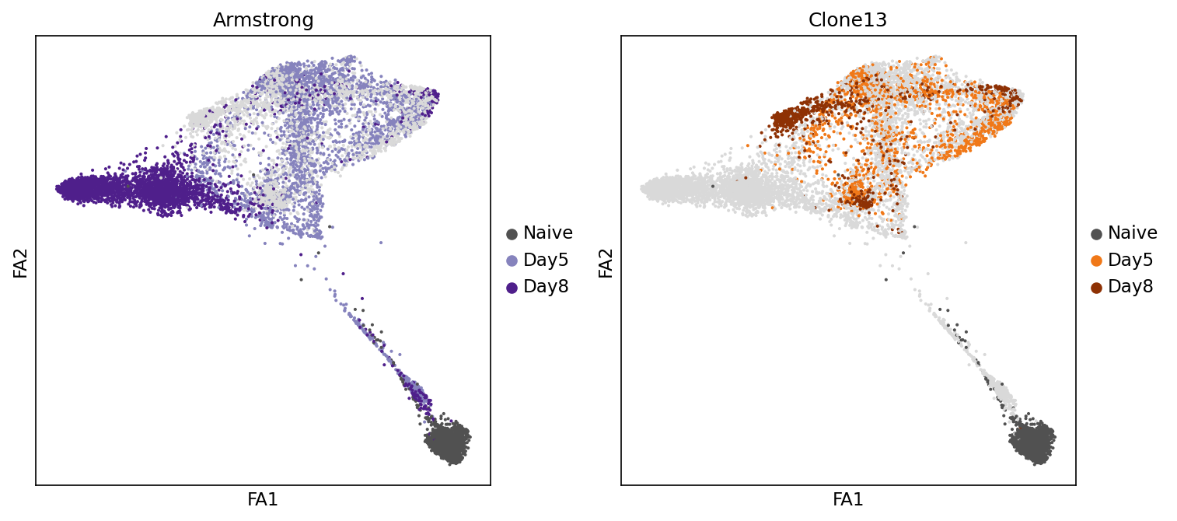
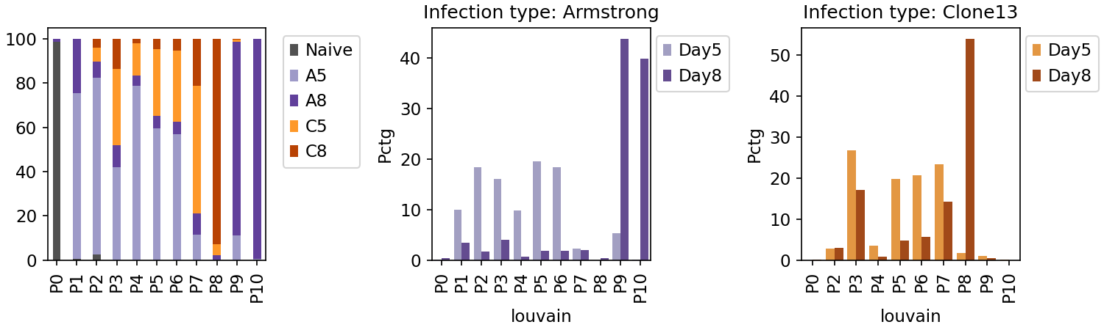
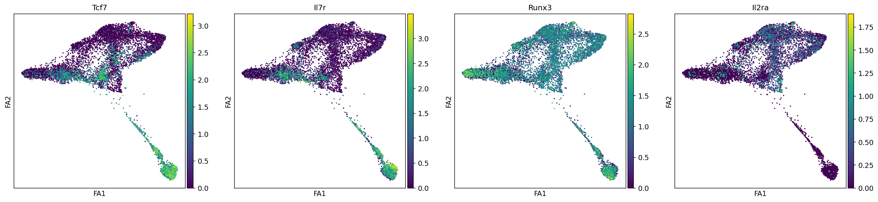
Differential volcano plots:
Clusters v.s. Cluters along trajectory
P2 arm v.s. Cl13
Violin plot: selected genes
Use a heatmap instead of bar chart for representing distribution of:
- Day5/Day8
– Arm / Cl13
- P14 / Tetramer

Slide 4
RNA velocity analysis
- Re-interrogate the developmental relations between cells with RNA-velocity

