Slide 1
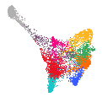
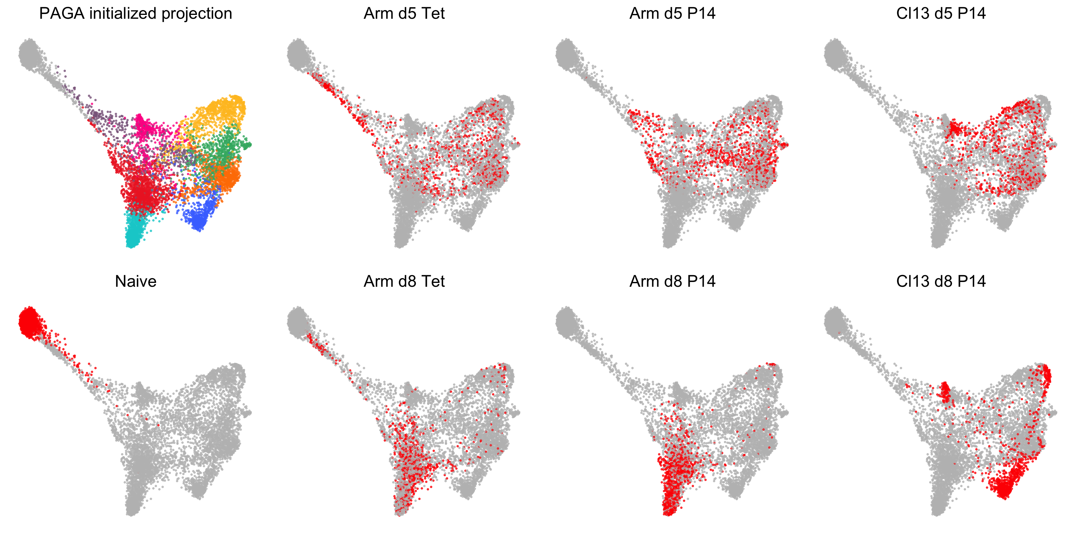
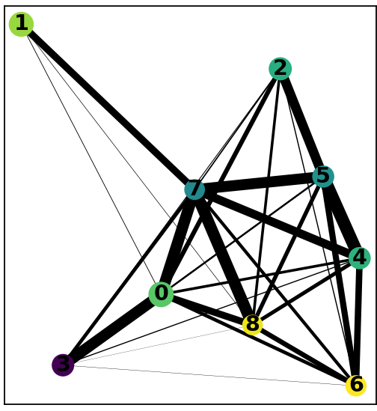
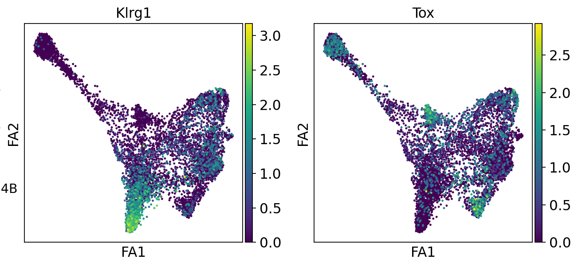
A
B
C
0
Louvain clusters
P0: Naïve
P1: Comm. Progenitor
P2: T_{STEM}
P3: Precursors of T_{CM} / T_{RM}
P4: T_{CIRC} / TE
P5: EE
P6: T_{EXH} / T_{RM}
P7: Early activated / DP
P8: T_{EXH}
PAGA correlations
0
Combine on one plot – use 3 different colors to mark naïve, day 5 and day 8 cells. “Gray-out” cells from LCMV_{Arm} vs LCMV_{cl13}.
2
8
8
7
1
7
3
5
3
5
Bar charts
% of cells in cluster
Different color bars for day 5 and day 8
Bar charts
% of cells in cluster
6
2
LCMV_{Arm}
LCMV_{C13}
4
4
6
P0
P1
P2
P3
P4
P5
P6
P7
P8
P0
P1
P2
P3
P4
P5
P6
P7
P8
D
GSEA of CD8 T cell types
E
Like this
d-5 KLRG1^{hi}
T_{CIRC}
Naive
T_{CM}
P0
P1
P2
P3
P4
P5
P6
P7
P8
T_{EFF} signatures
T_{MEM} signatures
T_{EX} signatures
LCMV_{Arm}
F
Tcf7
Il7r
Runx3
Il2r
P0
P1
P2
P3
P4
P5
P6
P7
P8
T_{EFF} signatures
T_{MEM} signatures
T_{EX} signatures
LCMV_{C13}
G
Violin Plots
H
T_{EFF} signatures
T_{EFF} signatures
GSEA - Best et al Signatures
T_{EFF} signatures
T_{EFF} signatures
P0
P1
P2
P3
P4
P5
P6
P7
P8
P0
P1
P2
P3
P4
P5
P6
P7
P8
Fig. 1

