Slide 1

Distributed Application Runtime
Ryan Nowak - @aVerySpicyBoi
Sample code & slides: https://github.com/rynowak/presentations

Slide 2
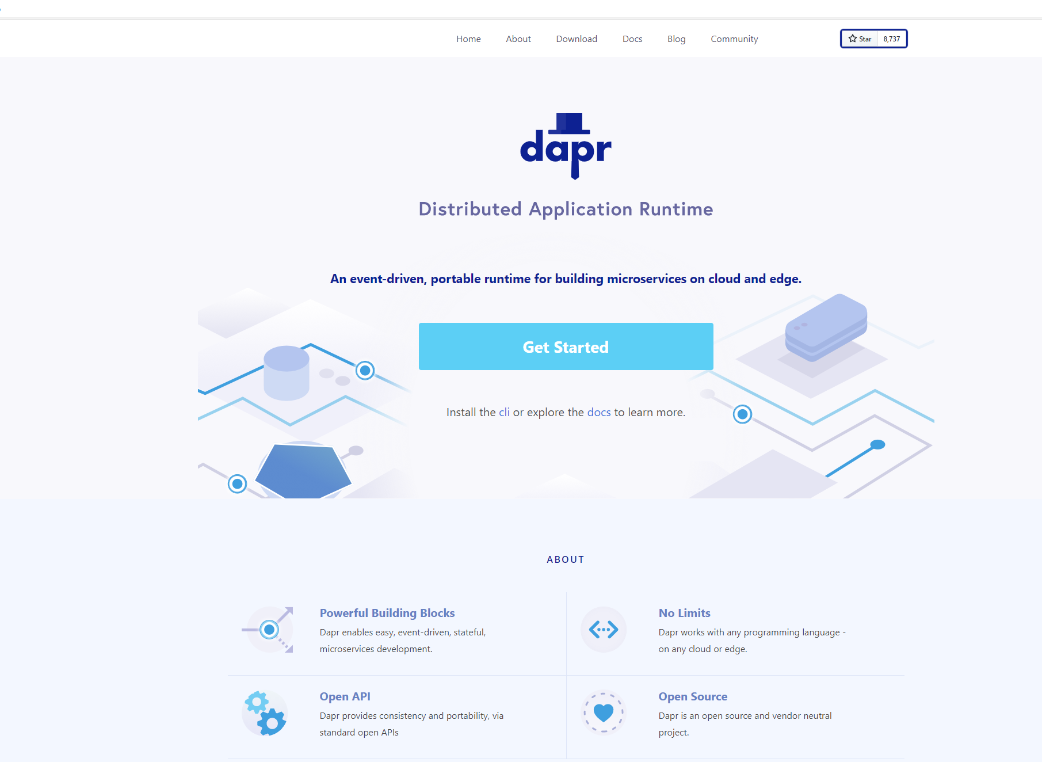
Distributed Application Runtime
Portable, event-driven, runtime for building distributed applications across cloud and edge
https://dapr.io

Slide 3
What’s hard about microservices?
Need to support lots of different integration points
(cache, message queues, 3rd party APIs, secret stores)
This results in coupling in your code.
Coupled to specific service and SDK
Lots of different targets to support tracing, configuration, and secret management

Slide 4
Microservice building blocks
HTTP API
gRPC API
Service-to-service invocation
State management
Publish and subscribe
Resource bindings and triggers
Actors
Observability
Secrets
Extensible

Slide 5

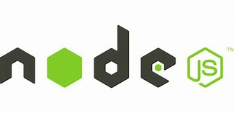


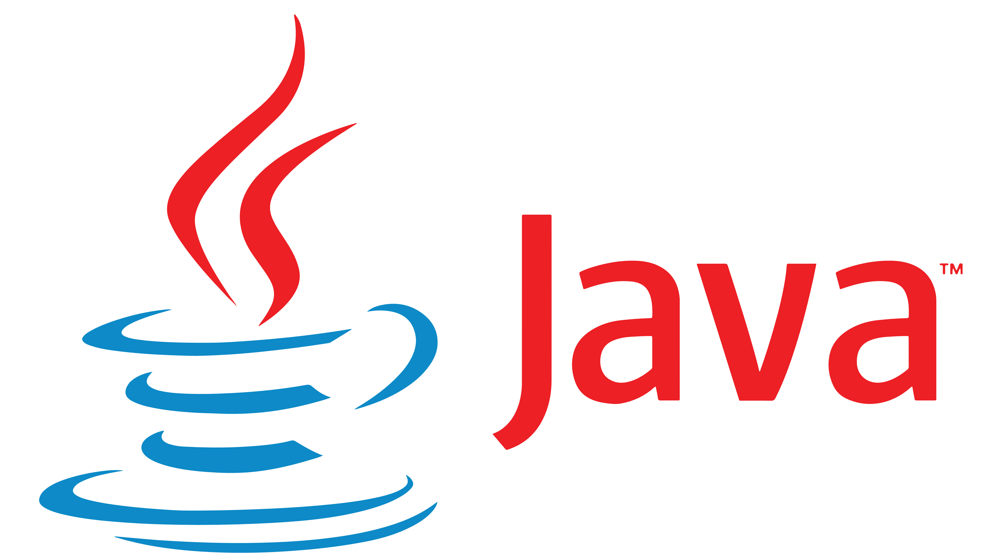
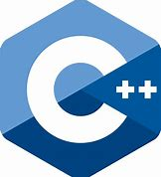

Microservice building blocks
Standard APIs accessed over http/gRPC protocols from user service code
http://localhost:3500/v1.0/invoke/cart/method/neworder
http://localhost:3500/v1.0/state/inventory/item67
Runs as local “side car library” dynamically loaded at runtime for each service
Application code
Microservices written in
Any code or framework…
HTTP API
gRPC API
Service-to-service invocation
State management
Publish and subscribe
Resource bindings and triggers
Actors
Observability
Secrets
Extensible

Slide 6
71 Dapr Components
27 I/O Bindings
18 State stores
11 Pub/Sub
13 General
7 Azure
5 AWS
Aerospike
Cassandra
Cloudstate
Couchbase
etcd
Hashicorp Consul
Hazelcast
Memcached
MongoDB
PostgreSQL
RethinkDB
Redis
Zookeeper
Azure CosmosDB
Azure SQL Server
Azure Table Storage
Azure Blob Storage
Google Cloud Firestore
Redis Streams
Apache Kafka
AWS SNS/SQS
Azure Events Hub
Azure Service Bus
GCP Pub/Sub
Hazelcast
MQTT
NATS streaming
Pulsar
RabbitMQ
APNs
Cron (Scheduler)
HTTP
InfluxDB
Kafka
Kubernetes Events
MQTT
PostgreSql
RabbitMQ
Redis
Twilio
Twitter
SendGrid
Azure Blob Storage
Azure EventHubs
Azure CosmosDB
Azure Service Bus Queues
Azure SignalR
Azure Storage Queues
Azure Event Grid
AWS DynamoDB
AWS S3
AWS SNS
AWS SQS
AWS Kinesis
1 AliCloud
Blob Storage
2 GCP
GCP Cloud Pub/Sub
GCP Storage Bucket
8 Secret stores
Azure Key Vault secret store
Azure Key Vault with Kubernetes MI
AWS Secrets Manager
GCP Secret Manager
HashiCorp Vault
Kubernetes Secrets
Local environment variables (for Development)
Local file (for Development)
4 HTTP Middleware
2 Name Resolution
OAuth2
Open Policy Agent (OPA)
Rate limit
Bearer
Kubernetes
Multicast DNS

Slide 7











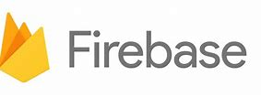


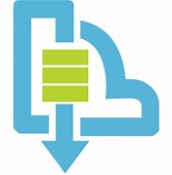
Observability
Sidecars and
components
Capturing, querying
traces, logs and metrics
Prometheus
AppInsightts
Jaeger
Bindings
…others
Scanning for events
Input/output
EventHub
Kafka
AWS SQS
GCP pub/sub
Application
Secure communication with mTLS
Service
code A
Service
code B
Dapr API
Dapr API
Tracing, logs
and metrics
Tracing, logs
and metrics
Sidecar
Sidecar
Load and
save state
State stores
…others
AWS DynamoDB
CosmosDB
Publish & subscribe
Messaging
…others
Service Bus

Slide 8
Dapr building blocks
Service invocation
Post
http://localhost:3500/v1.0/invoke/nodeapp/method/neworder
{
“orderid":“123",
“data":“item1"
}
pythonapp
1
2
multicast DNS component
6
Post
http://10.0.0.2:8000/neworder
{
“orderid":“123",
“data":“item1"
}
3
5
nodeapp
3
4

Slide 9
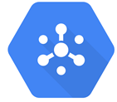
Dapr building blocks
Publish and subscribe
Publish
Subscribe
“cart”
“shipping”
Post
http://10.0.0.5:8005/order
Post
http://localhost:3500/v1.0/publish/
"data":{
"user":"johndoe",
"item":"ZeroDay"
}
"topic":"order",
"data":{
"user":"johndoe",
"item":"ZeroDay"
},
Post
http://10.0.0.4:8004/order
“email”

Slide 10
How Dapr is run
Kubernetes
Standalone (self-hosted)
apiVersion: apps/v1
kind: Deployment
metadata:
name: my-app
labels:
app: my-app
spec:
selector:
matchLabels:
app: my-app
template:
metadata:
labels:
app: my-app
annotations:
dapr.io/enabled: "true"
dapr.io/app-id: "my-appr"
dapr.io/app-protocol: ”http"
dapr.io/app-port: ”8080”
…
dapr run --app-id my-app \
--app-protocol grpc \
--app-port 50105 \
--components-path ./config \
go run main.go
dapr run --app-id my-app \
--app-protocol http \
--app-port 3000 \
--components-path ./config \
dotnet run
dapr run --app-id my-app \
--app-protocol http \
--app-port 5678 \
--components-path ./config \
./my-exe
Notes:
So, how do you get that magical sidecar that does all these things?
Well, on k8s, that’s as simple as decorating your deployment with a few annotations (2 required, enabled, app-id, but there is more)
Dapr will inject a sidecar into your Pod, and your app has the same API you had on your laptop during the development
In a standalone mode (or self-hosted as it is sometimes called) you use the “dapr run” command with a few flags
Whether this is Java, C#, Go, Python or compiled executable

Slide 11
DEMO: Dapr state management and bindings
DEMO
Dapr for the .NET developer

