Slide 1
Top header
Left header
Grid

Slide 2
Cell top header
Cell left header
Cell grid

Slide 3
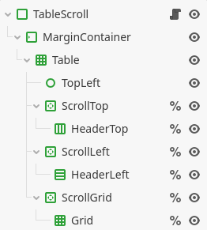
PanelContainer
MarginContainer
GridContainer
Control
ScrollContainer
HBoxContainer
ScrollContainer
VBoxContainer
ScrollContainer
GridContainer

Slide 7
#696eff
#f8acff

