Slide 1

Orange Ninja – Post Mortem Presenation

Slide 2
Project Overview
And Roles
Team Break down Based on System Responsibilites
Aiden – Sprites/Interactions
Ro – Level Design
Jaskaran – Menu/UI
Safal – Player Controller/
Syed – Enemies/Background
Gurneet – Audio System

Slide 3
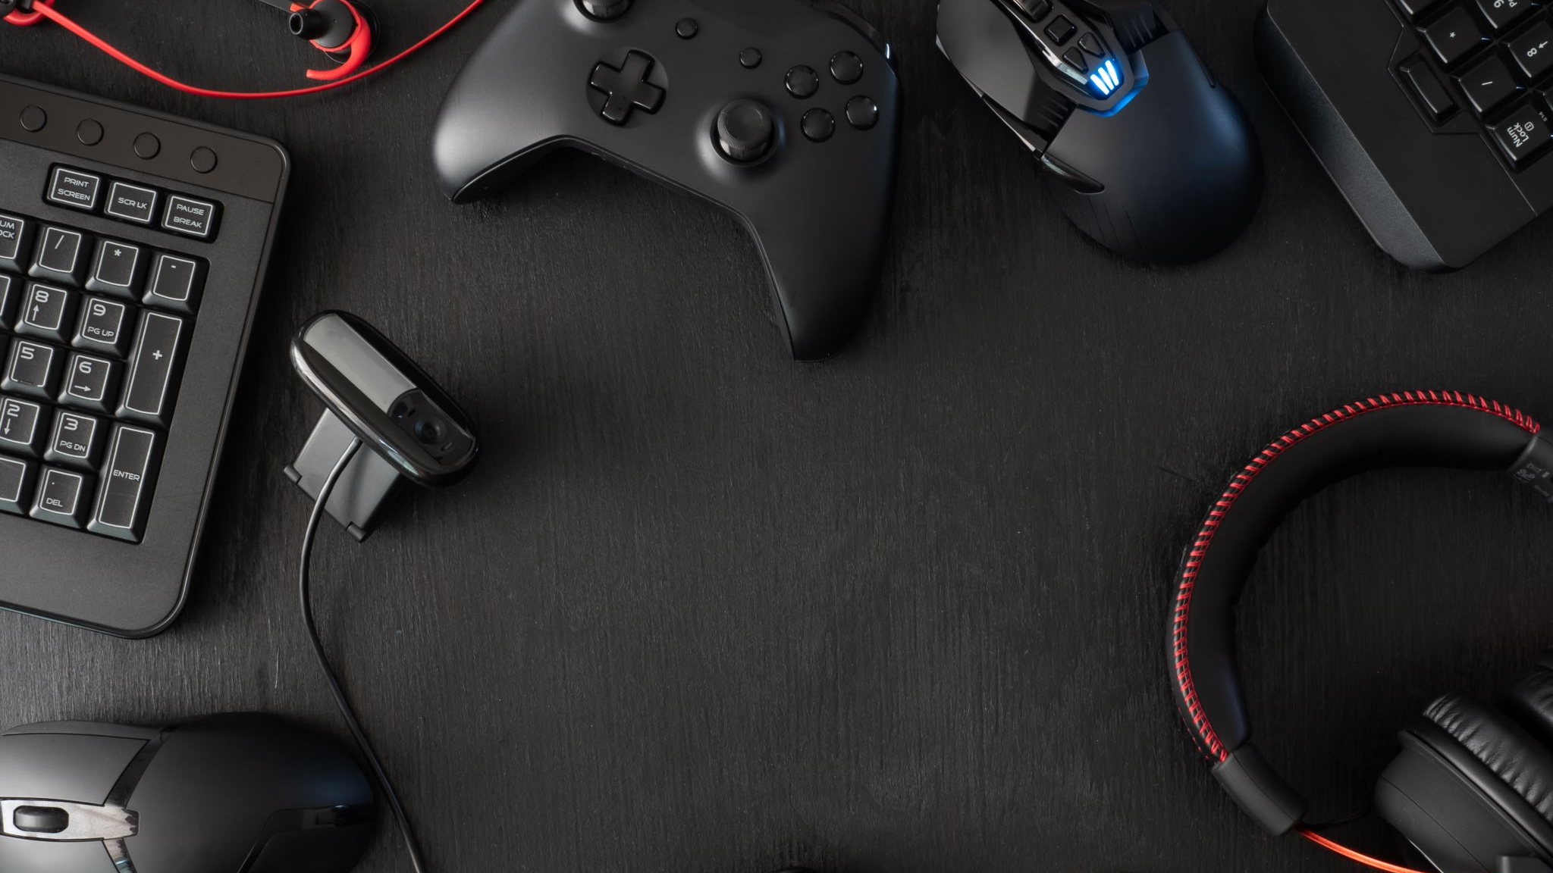
GRASP Principles
1. Low Coupling
Systems interacted through simple triggers and references
Prevented unnecessary dependencies
2. High Cohesion
Each subsystem handled one job only (e.g., audio only handled audio)
3. Controller
Game logic acted as the controller, routing events to audio, UI, or rendering
4. Indirection
Settings → Asset Library → Save Data kept systems decoupled

Slide 4
What Went Well
Player controller finished early
Team learned Unity very quickly
Good division of responsibilities
Architecture made sense and reduced confusion
following the Coding Standards

Slide 5
What Went Wrong
Merge conflicts broke inspector references
Some major features were not completed (levels, boss system)
Time management issues
Limited communication or planning
Integration started too late
Some features could not be tested because dependencies were missing

Slide 6
What we would change Next Time
Weekly team meetings / check-ins
Do early testing with mock objects
Set merge rules to protect the project
Integrate systems earlier instead of last minute
Better Breakdown Approach

Slide 7
Pair Programming
Level Designing
Enemy controls
Boundary logic
Background/Visuals

Slide 8
ABET Outcome Connection
Analyzing & designing a complex game architecture
Implementing & evaluating a full working solution
Communicating professionally through presentations & documentation
Collaborating effectively as a development team

Slide 9
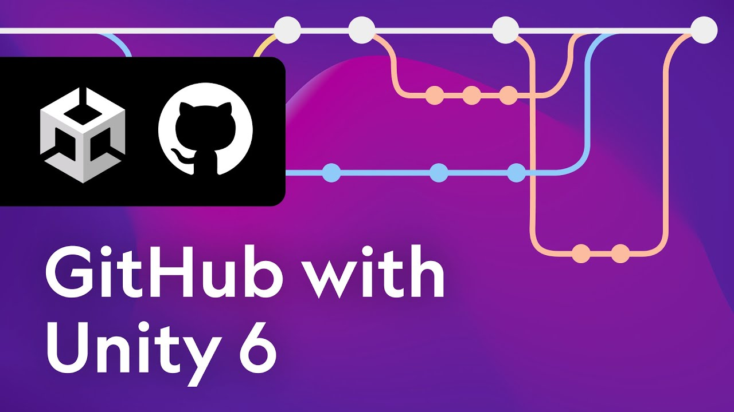
Course Enhancement
Tips for avoiding inspector conflicts and merge issues.
Provide clearer examples of documentation quality (UML diagrams, GRASP explanations, PERT, Gantt, use cases.)

