Slide 1
HealthNet: R1 Release
Team 5- Tigers

Slide 2
The Team
Robert Mason – Team Coordinator
Zahir Javaid – Requirements Coordinator
Austin Zielinski – Test Management and Quality Control
Egor Kozitski – Development Coordinator

Slide 3
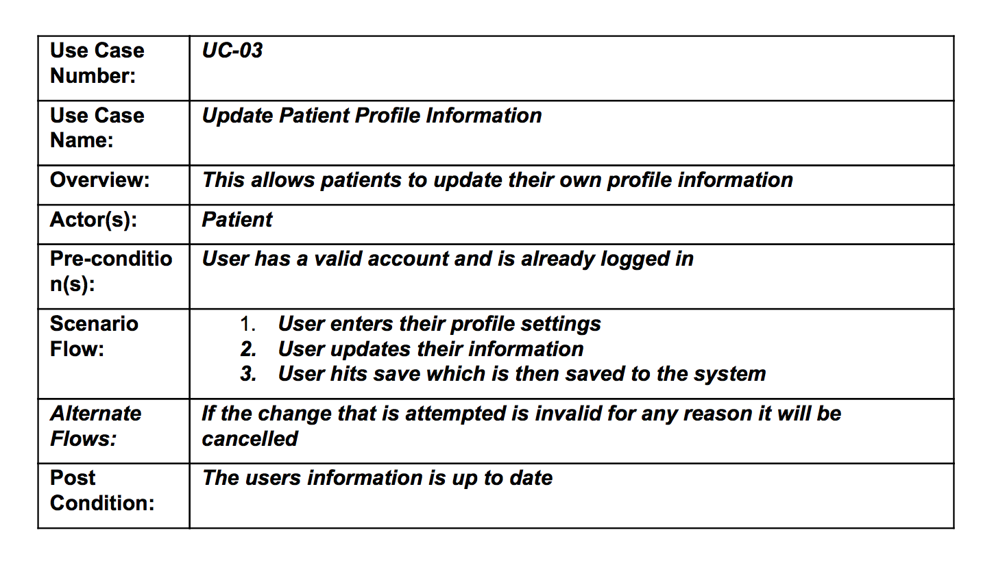
The Requirements

Slide 4
Breaking the Problem Down
Individual steps for success
Separating out issues
Sorting out short vs. long term projects
Adding early to save time later
Direction of focus
Efficiency
Linear Design

Slide 5
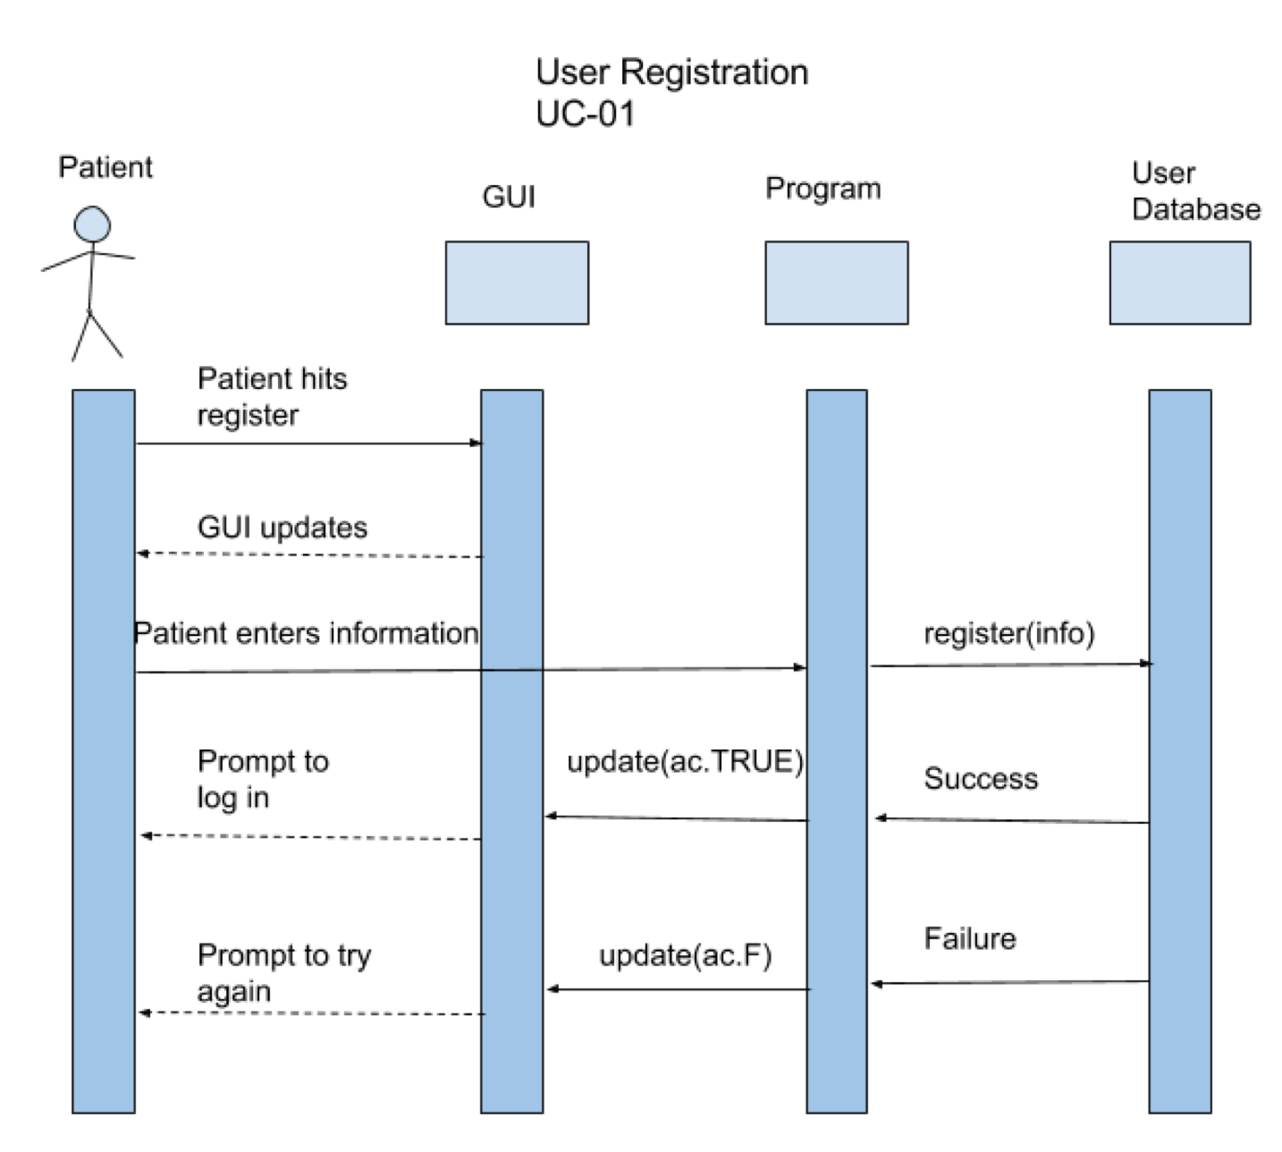
Modeling

Slide 6
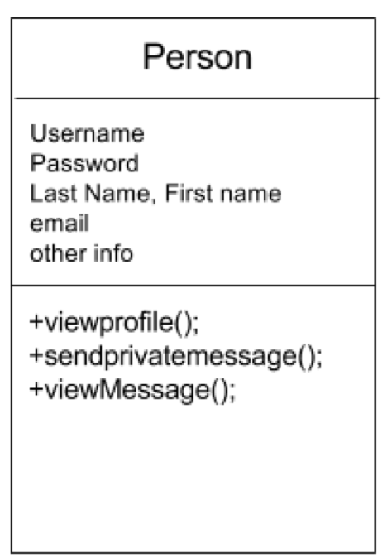
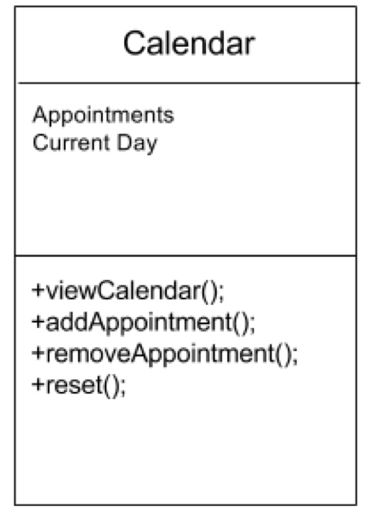
Design

Slide 7
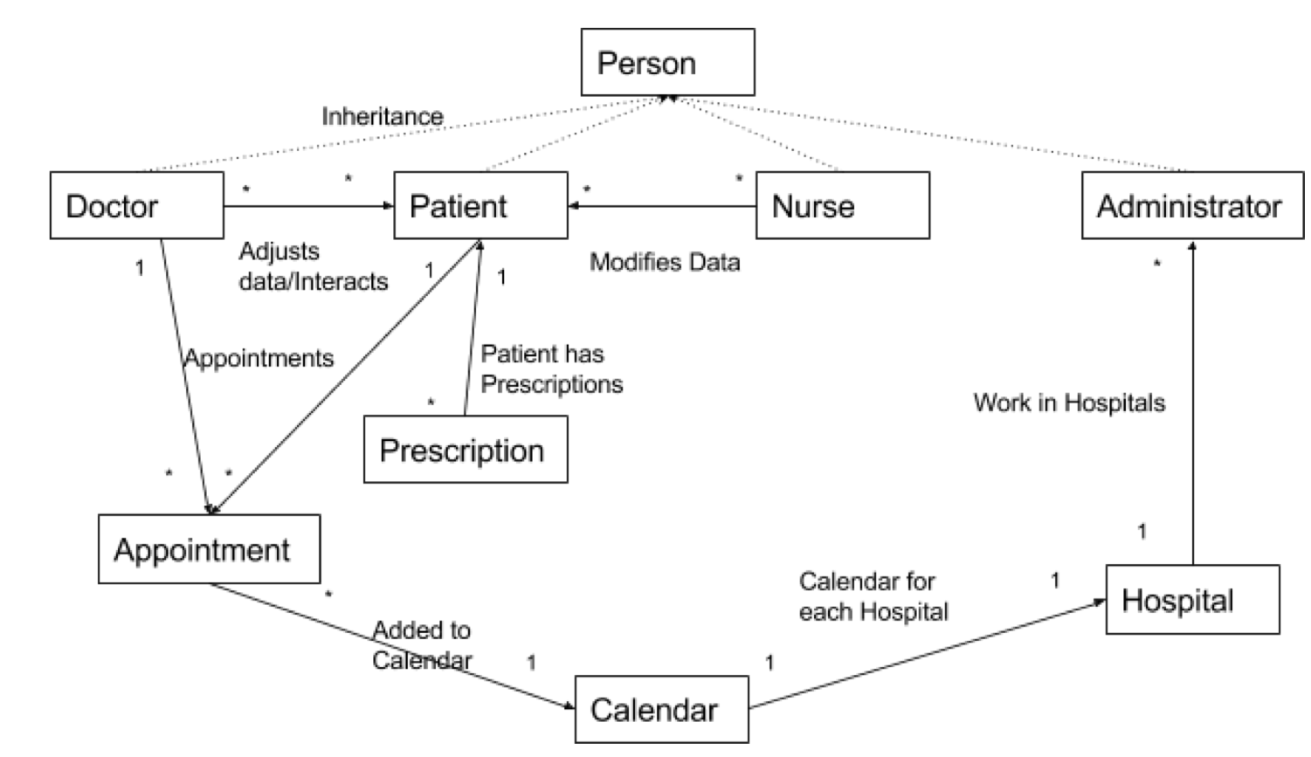
Put Together

Slide 8
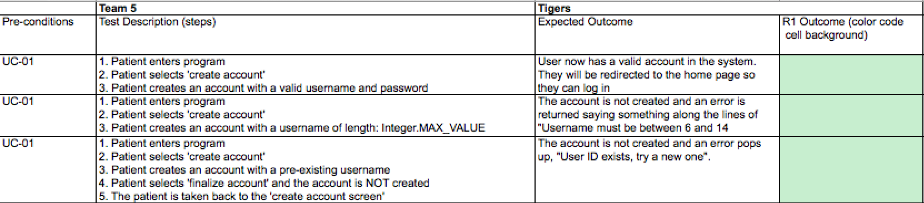
Testing

