Slide 1
Setting up the Mixed Reality Development Enviroment
Mickey MacDonald – Technical Evangelist
@Scruffyfurn

Slide 2
Enabling Developer Mode
Let's start by enabling Developer Mode on your device.
Go to Settings
Select Update and Security
Select For developers
Enable Developer Mode
*Read the disclaimer for the setting you chose, then click Yes to accept the change.

Slide 3
Creating a Unity Windows Mixed Reality Project
Software needed:
Visual Studio 2017 (Community works) with Windows Falls Creator Update SDK
Unity 2017.2.1 p2 with Windows Store .NET Scripting Backend
You may also want to check your video card manufacturer's website for the most up-to-date graphics drivers.

Slide 4
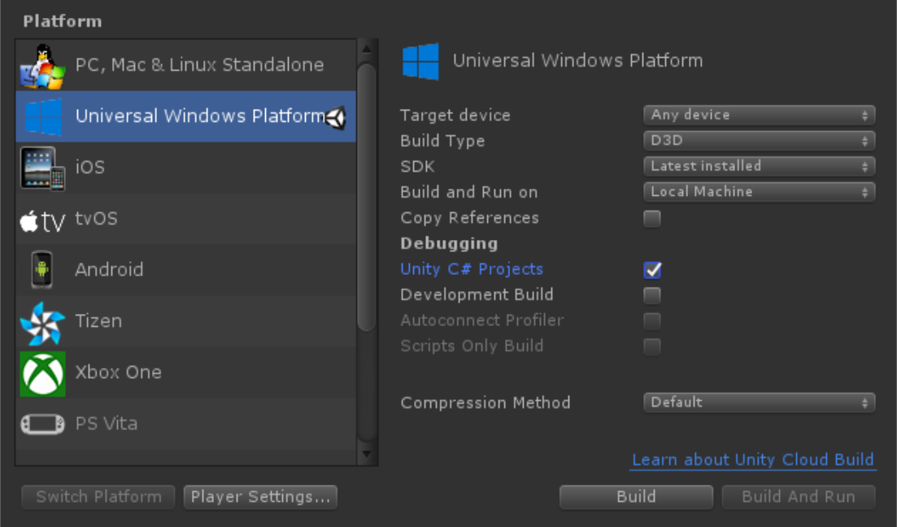
Targeting Windows Mixed Reality
To target Windows Mixed Reality, you first need to set your Unity project to export as a Universal Windows Platform app.
Select File > Build Settings...
Select Universal Windows Platform in the Platform list and click Switch Platform
Set Target device to Any Device
Set Build Type to D3D
Set UWP SDK to Latest installed
Notes:
When you first create a new Unity project, there are a small set of Unity settings you'll need to change for Windows Mixed Reality support.

Slide 5
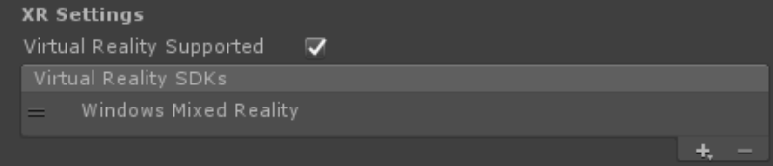
Targeting Windows Mixed Reality
We then need to let Unity know that the app we are trying to export should create an immersive view instead of a 2D view.
From the Build Settings... window, open Player Settings...
Select the Settings for Universal Windows Platform tab
In the XR Settings group, confirm that "Windows Mixed Reality" is listed as a supported device. (this may appear as "Windows Holographic" in older versions of Unity)
Notes:
We then need to let Unity know that the app we are trying to export should create an immersive view instead of a 2D view.
We do that by enabling "Virtual Reality Supported" via the following steps:

Slide 6
Importing Lab Assets
To import the needed assets, follow these steps:
Select Assets > Import Package > Custom Package
Navigate to the Assets folder in the Lab1 directory
Select Lab1_Assets.unitypackage
In the dialog pop-up, make sure all components are check marked, and then click Import
Notes:
To give our virtual world a little more flare, we are going to add a Skybox and Terrain object to the Unity scene.

Slide 7
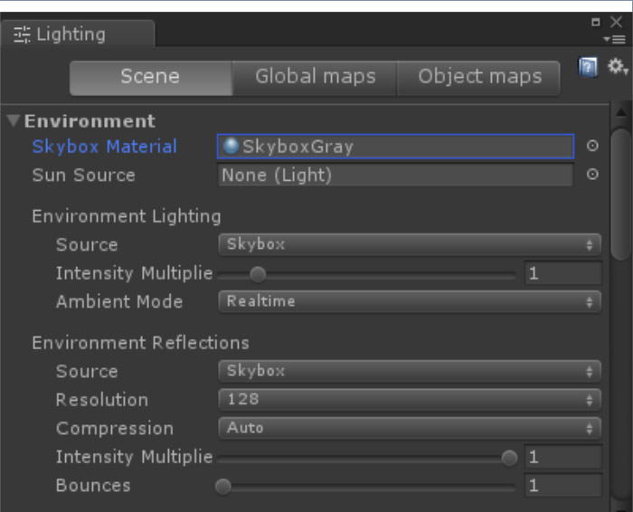
Adding the Skybox
To add the Skybox to our project, follow these steps:
Select Window > Lighting < Settings
In the Environment section, select the Skybox Material, using the small circle to the right of the selection box
In the Select Material dialog the opens, scroll to the top and select the Mars Skybox material
Notes:
Now with the assets imported we can use them in our scene. Lets start with the Skybox.

Slide 8
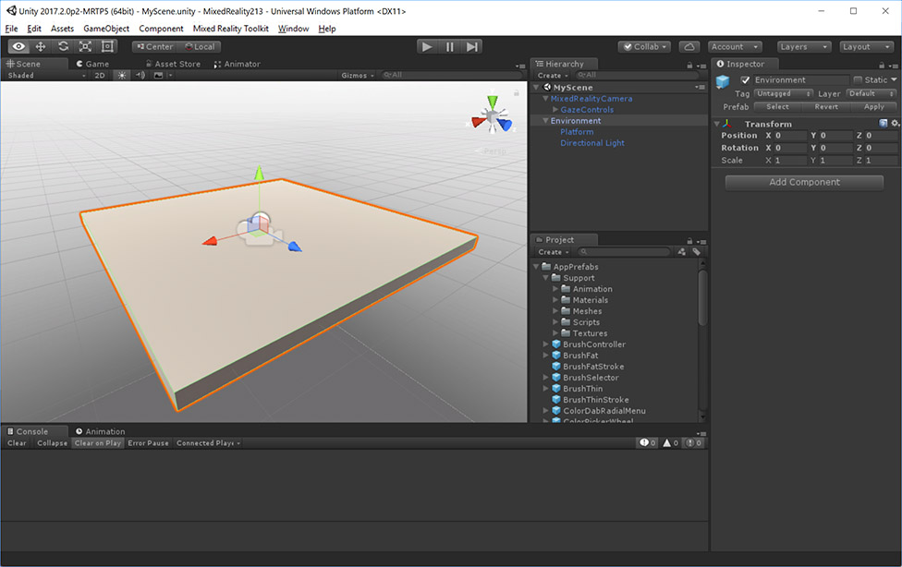
Adding the terrain
To add some simple terrain, we will use the terrain prefab we just imported
In the Project view, under the Assets folder, is a folder labeled Terrain. Expand this folder.
Drag and drop the Terrain_x0_y0 prefab into the Scene Hierarchy view
Select the Main Camera object in the Scene Hierarchy
Change the Position Y value to 10 (this will raise our camera view up off the ground)
Notes:
Next, lets go ahead and add some simple terrain to the scene. To do this we will use a terrain prefab that we just imported.

Slide 9
Running the Lab
With the Headset connected, open the Windows Mixed Reality Portal application.
From inside the Unity editor, select the run button at the top of the Scene view
Put on your headset and view the world in complete 360 degrees
Notes:
Provided you have followed all the steps above, or have opened the completed version of the project, you should now be able to test out the virtual world we are creating.

Slide 10
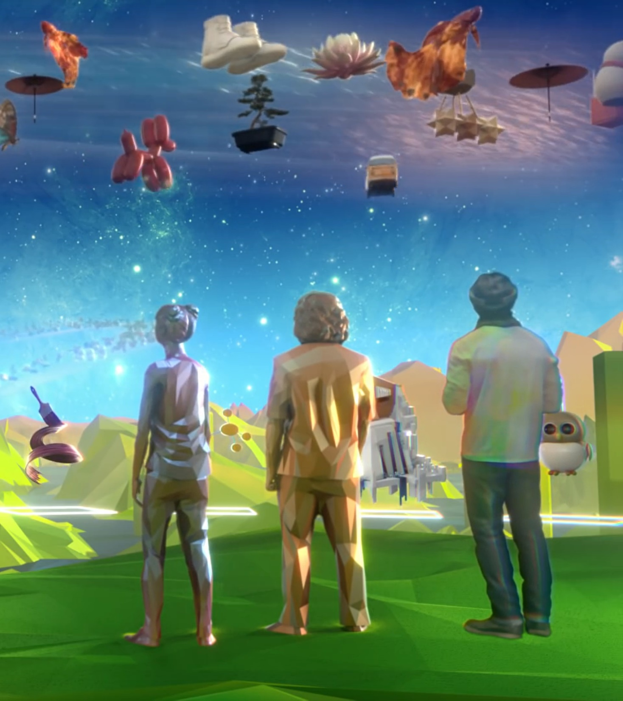
Thank you
Mickey MacDonald – Technical Evangelist, Microsoft Canada
@Scruffyfurn

