Slide 1
Motion Controls & Object interaction
Mickey MacDonald – Technical Evangelist
@Scruffyfurn

Slide 2

https://github.com/Microsoft/MixedRealityToolkit-Unity
The Mixed Reality Toolkit is a collection of scripts and components intended to accelerate development of applications targeting Microsoft HoloLens and Windows Mixed Reality headsets.
Notes:
What is MixedRealityToolkit-Unity?
The Mixed Reality Toolkit is a collection of scripts and components intended to accelerate development of applications targeting Microsoft HoloLens and Windows Mixed Reality headsets. The project is aimed at reducing barriers to entry to create mixed reality applications and contribute back to the community as we all grow.
MixedRealityToolkit-Unity uses code from the base MixedRealityToolkit and makes it easier to consume in Unity.

Slide 3
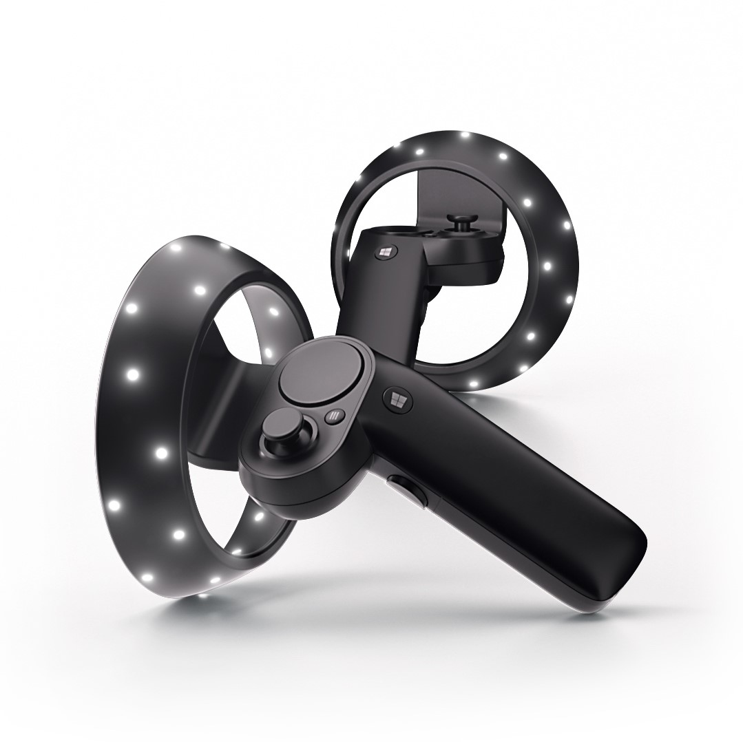
Motion Controllers
Motion controllers are hardware accessories that allow users to take action in mixed reality.
Notes:
Motion controllers are hardware accessories that allow users to take action in mixed reality. An advantage of motion controllers over gestures is that the controllers have a precise position in space, allowing for fine grained interaction with digital objects. For Windows Mixed Reality immersive headsets, motion controllers are the primary way that users will take action in their world.

Slide 4
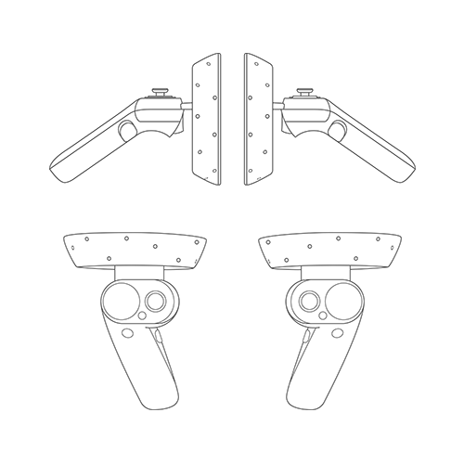
Motion Controllers
Features:
Optical tracking
Trigger
Grab button
Thumbstick
Touchpad
Notes:
Windows Mixed Reality motion controllers offer precise and responsive tracking of movement in your field of view using the sensors in the immersive headset, meaning there is no need to install hardware on the walls in your space. These motion controllers will offer the same ease of setup and portability as Windows Mixed Reality immersive headsets. Our device partners plan to market and sell these controllers on retail shelves this holiday.

Slide 5
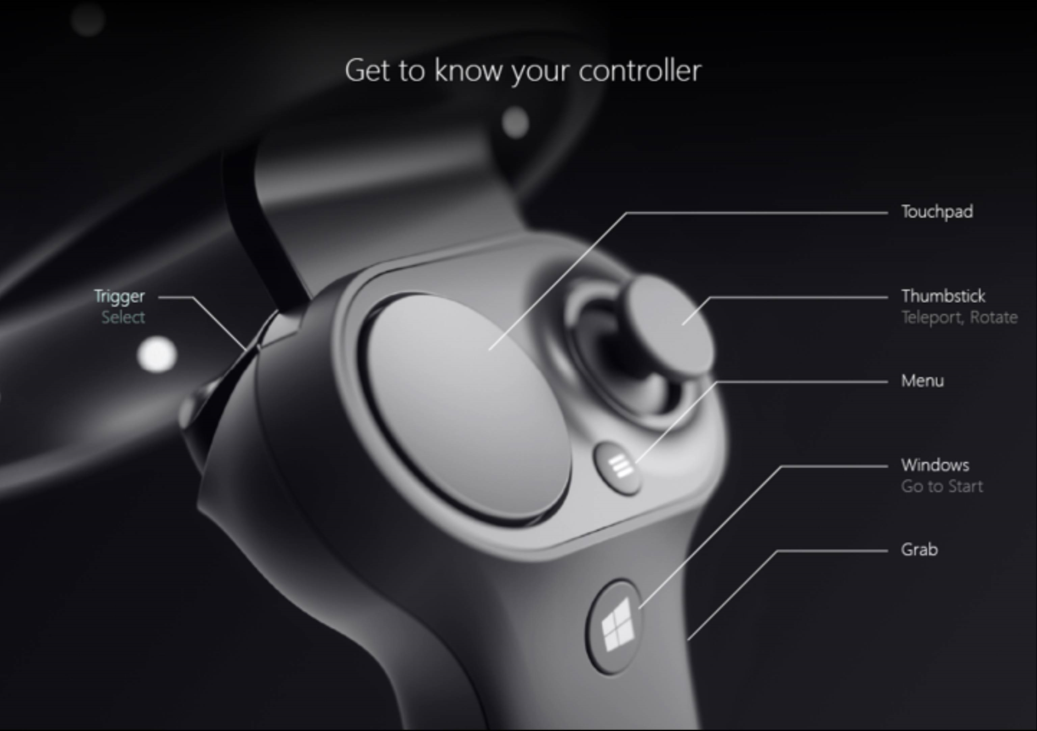
Motion Controllers
The core interactions across hands and motion controllers are
Select
Menu
Grasp
Touchpad
Thumbstick
and Home.
Notes:
Select is the primary interaction to activate a hologram, consisting of a press followed by a release. For motion controllers, you perform a Select press using the controller's trigger. Other ways to perform a Select are by speaking the voice command "Select". The same select interaction can be used within any app. Think of Select as the equivalent of a mouse click, a universal action that you learn once and then apply across all your apps.
Menu is the secondary interaction for acting on an object, used to pull up a context menu or take some other secondary action. With motion controllers, you can take a menu action using the controller's menu button. (i.e. the button with the hamburger "menu" icon on it)
Grasp is how users can directly take action on objects at their hand to manipulate them. With motion controllers, you can do a grasp action by squeezing your fist tightly. A motion controller may detect a Grasp with a grab button, palm trigger or other sensor.
Touchpad allows the user to adjust an action in two dimensions along the surface of a motion controller's touchpad, committing the action by clicking down on the touchpad. Touchpads provide a pressed state, touched state and normalized XY coordinates. X and Y range from -1 to 1 across the range of the circular touchpad, with a center at (0, 0). For X, -1 is on the left and 1 is on the right. For Y, -1 is on the bottom and 1 is on the top.
Thumbstick allows the user to adjust an action in two dimensions by moving a motion controller's thumbstick within its circular range, committing the action by clicking down on the thumbstick. Thumbsticks also provide a pressed state and normalized XY coordinates. X and Y range from -1 to 1 across the range of the circular touchpad, with a center at (0, 0). For X, -1 is on the left and 1 is on the right. For Y, -1 is on the bottom and 1 is on the top.
Home is a special system action that is used to go back to the Start Menu. It is similar to pressing the Windows key on a keyboard or the Xbox button on an Xbox controller. You can go home by pressing the Windows button on a motion controller. Note, you can also always return to Start by saying "Hey Cortana, Go Home". Apps cannot react specifically to home actions, as these are handled by the system.

Slide 6
Gazing and pointing
Windows Mixed Reality supports two key models for interaction, gaze and commit and point and commit:
With gaze and commit, users target an object with their gaze and then select objects with hand air-taps, a gamepad, a clicker or their voice.
With point and commit, a user can aim a pointing-capable motion controller at the target object and then select objects with the controller's trigger.
Apps that support pointing with motion controllers should also enable gaze-driven interactions where possible, to give users choice in what input devices they use.
Notes:
*Advanced Topic*
Managing recoil when pointing
When using motion controllers to point and commit, your users will use the controller to target and then take action by pulling its trigger. Users who pull the trigger vigorously may end up aiming the controller higher at the end of their trigger pull than they'd intended.
To manage any such recoil that may occur when users pull the trigger, your app can snap its targeting ray when the trigger's analog axis value rises above 0.0. You can then take action using that targeting ray a few frames later once the trigger value reaches 1.0, as long as the final press occurs within a short time window. When using the higher-level composite Tap gesture, Windows will manage this targeting ray capture and timeout for you.

Slide 7
Grip pose vs. pointing pose
Windows Mixed Reality supports motion controllers in a variety of form factors.
To better represent these controllers, there are two kinds of poses you can implement :
Grip pose
Pointer pose.
Notes:
Windows Mixed Reality supports motion controllers in a variety of form factors, with each controller's design differing in its relationship between the user's hand position and the natural "forward" direction that apps should use for pointing when rendering the controller.
To better represent these controllers, there are two kinds of poses you can investigate for each interaction source, the grip pose and the pointer pose.

Slide 8
Grip pose
The grip pose is defined specifically as follows:
The grip position: The palm centroid when holding the controller naturally, adjusted left or right to center the position within the grip. On the Windows Mixed Reality motion controller, this position generally aligns with the Grasp button.
The grip orientation's Right axis: When you completely open your hand to form a flat 5-finger pose, the ray that is normal to your palm (forward from left palm, backward from right palm)
The grip orientation's Forward axis: When you close your hand partially (as if holding the controller), the ray that points "forward" through the tube formed by your non-thumb fingers.
The grip orientation's Up axis: The Up axis implied by the Right and Forward definitions.
The grip pose represents the location of the palm holding a motion controller.
Notes:
On immersive headsets, the grip pose is best used to render the user's hand or an object held in the user's hand, such as a sword or gun. The grip pose is also used when visualizing a motion controller, as the renderable model provided by Windows for a motion controller uses the grip pose as its origin and center of rotation.

Slide 9
Pointer pose
The pointer pose represents the tip of the controller pointing forward.
The system-provided pointer pose is best used to raycast when you are rendering the controller model itself
If you are rendering some other virtual object in place of the controller, such as a virtual gun, you should point with a ray that travels along the barrel of the app-defined gun model.
Notes:
The system-provided pointer pose is best used to raycast when you are rendering the controller model itself. If you are rendering some other virtual object in place of the controller, such as a virtual gun, you should point with a ray that is most natural for that virtual object, such as a ray that travels along the barrel of the app-defined gun model. Because users can see the virtual object and not the physical controller, pointing with the virtual object will likely be more natural for those using your app.

Slide 10
Gazing and pointing
Windows Mixed Reality supports two key models for interaction, gaze and commit and point and commit:
With gaze and commit, users target an object with their gaze and then select objects with hand air-taps, a gamepad, a clicker or their voice.
With point and commit, a user can aim a pointing-capable motion controller at the target object and then select objects with the controller's trigger.
Apps that support pointing with motion controllers should also enable gaze-driven interactions where possible, to give users choice in what input devices they use.

Slide 11
Rendering Motion Controllers
Windows makes available to apps a renderable model of each motion controller currently active in the system.
Default - Using default controller without modification
Hybrid - Using default controller, but customizing some of its elements or overlaying UI components
Replacement - Using your own customized 3D model for the controller
Notes:
Windows Mixed Reality provides an animated controller model for controller visualization. There are several approaches you can take for controller visualization in your app:
By having your app dynamically load and articulate these system-provided controller models at runtime, you can ensure your app is forward-compatible to any future controller designs.

Slide 12
Importing the Mixed Reality ToolKit
Select Assets > Import Package > Custom Package
Navigate to the Assets folder in the Lab2 directory
Select HoloToolkit-Unity-2017.2.1.1.unitypackage
In the dialog pop-up, make sure all components are check marked, and then click Import
The Mixed Reality ToolKit provides many scripts, assets, and prefabs to really speed up development.

Slide 13
Rendering Motion Controllers
First let start off by replacing the default camera with the Mixed Reality ToolKits default prefab.
In the Hierarchy panel, select the Main Camera object and hit the delete button.
In the Project view panel, type MixedRealityCamera in the search box (It can also be found under Assets/HoloToolkit/Input/Prefabs/MixedRealityCamera).
Drag the MixedRealityCamera prefab into the Hierarchy panel

Slide 14
Rendering Motion Controllers
Next we can add the MotionControllers prefab
In the Project view panel, type MotionControllers in the search box (You can also find it under Assets/HoloToolkit/Input/Prefabs/).
Drag the MotionControllers prefab into the Hierarchy panel.
Save the scene and click the play button.

Slide 15
Create and place 3D objects via Motion Controllers
Lets use the Select and Grasp button input events to instantiate some 3D objects in our world
In the Project view panel, type ObjectSpawner in the search box (You can also find it under Assets/AppPrefabs/)
Drag the ObjectSpawner prefab into the Hierarchy panel.
Save the scene and click the play button.

Slide 16
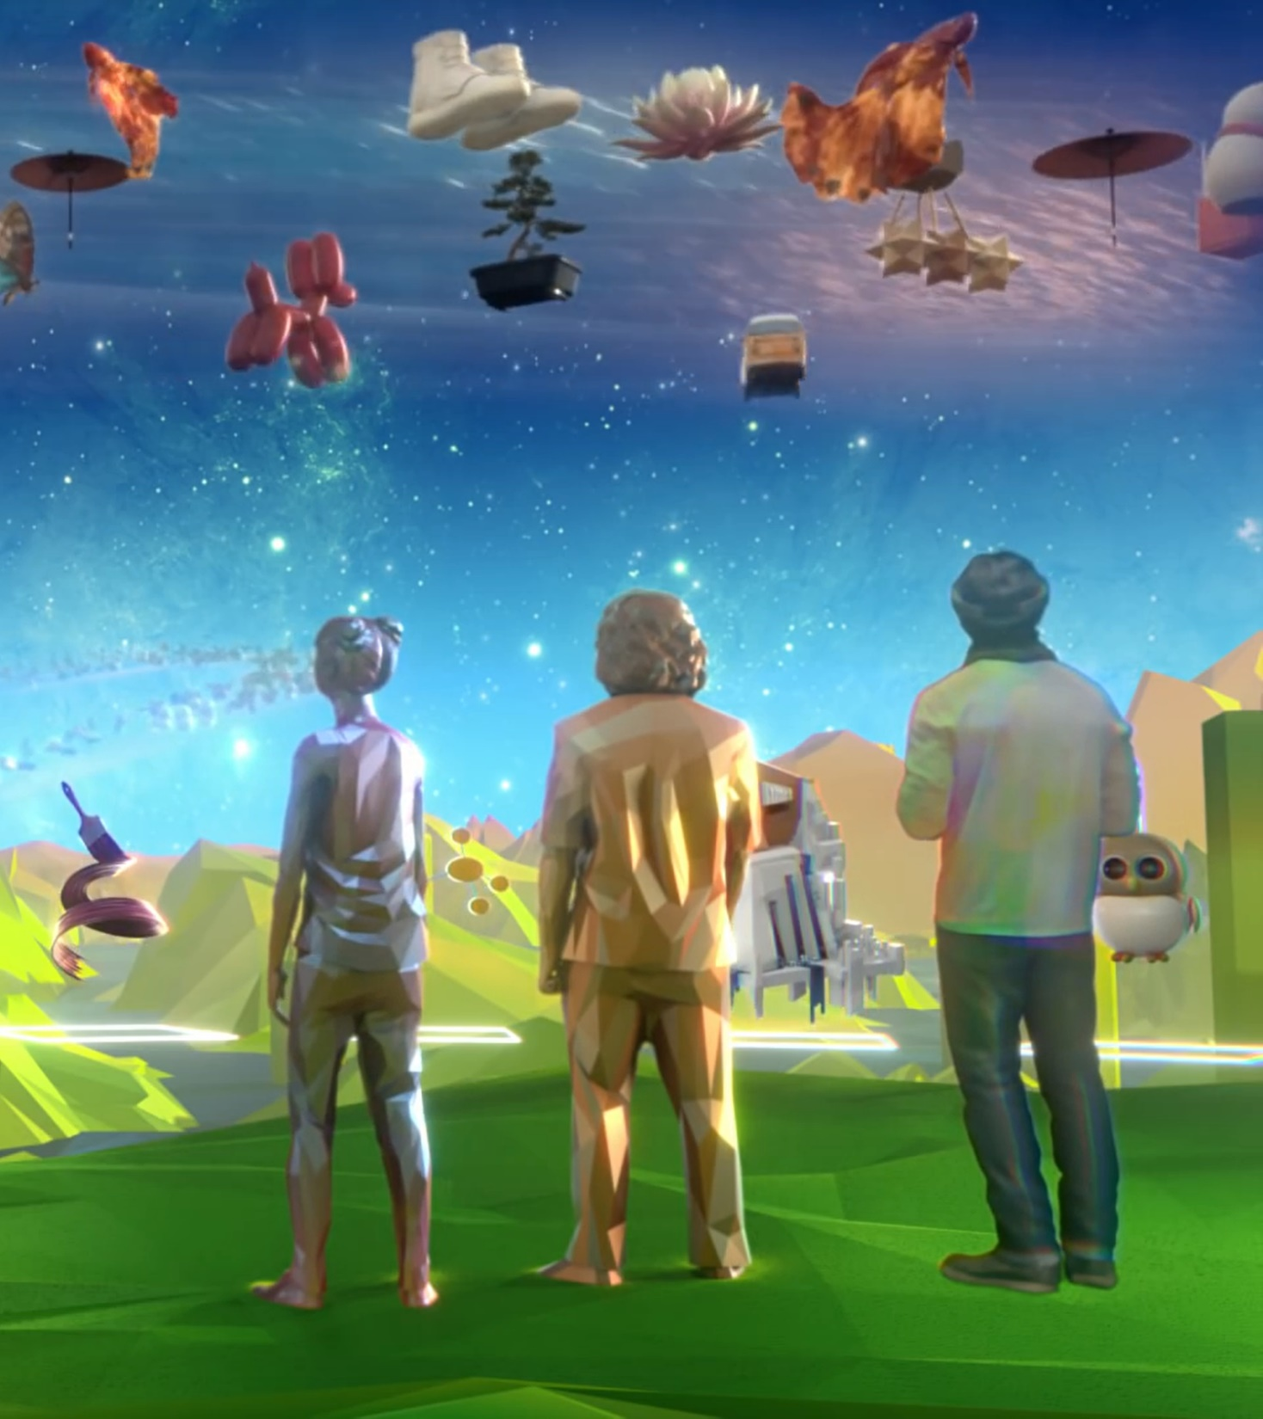
Thank you
Mickey MacDonald – Technical Evangelist, Microsoft Canada
@Scruffyfurn

