Slide 1
Teleportation and locomotion
Mickey MacDonald – Technical Evangelist
@Scruffyfurn

Slide 2
Sitting, Standing and Room-scale
Mixed reality apps can design for a broad range of user experiences, from 360-degree video viewers, to full world-scale apps and games
Notes:
https://developer.microsoft.com/en-us/windows/mixed-reality/coordinate_systems

Slide 3
Mixed reality experience scales
Experience scale | Requirements | Example experience
Orientation-only | Headset orientation (gravity-aligned) | 360° video viewer
Seated-scale | Above, plus headset position relative to zero position | Elite: Dangerous
Standing-scale | Above, plus stage floor origin | Obduction
Room-scale | Above, plus stage bounds polygon | Fantastic Contraption
Notes:
By default the standard Unity game objects (such as the camera) will light up immediately for a seated-scale experience, with the camera's position updated automatically as the user moves their head through the world.
If you're looking to build an orientation-only or seated-scale experience, you'll need to set Unity's tracking space type to Stationary.
If you're looking to build a standing-scale or room-scale experience, you'll need to ensure Unity's tracking space type is successfully set to RoomScale.
If you're looking to build a world-scale experience on HoloLens, letting users roam beyond 5 meters, you'll need to use the WorldAnchor component.

Slide 4
Locomotion in Mixed Reality
One of the biggest challenges facing MR developers is how to handle player locomotion in a virtual world
Notes:
Locomotion is one of the most glaring problems plaguing developers who work on VR games. In traditional video games, movement mechanics are pretty much locked down: You either have a keyboard and mouse or a gamepad. In the case of the former, you’ll use the arrow keys or the WASD keys to move forward and aft and strafe from side to side. In modern games, you make use of the mouse for aiming, targeting, or navigating menu items. Gamepads come with consoles, so developers always have a standard control scheme to work with that doesn’t change much from game to game.
You won’t find many VR-supported games that use keyboard and mouse configurations, but there are many VR games that take advantage of traditional gamepads. There’s nothing stopping developers from supporting the classic two-thumbstick artificial locomotion method

Slide 5
First-Person Locomotion Methods
There are many different methods for handling locomotion, here are some of the more popular choices.
Teleportation – Used for seated, standing and room-scale experiences. Intuitive, understandable, simple, No VR sickness
Comfort Mode / Cloud step – Used for seated experiences. Reduces simulator sickness and improve player comfort
Blink / Warp Speed – Used for seated, standing and room-scale experiences. Reduce simulator sickness Allows for the scaling of play space sizes
Arm Swinger – Used for standing and room-scale experiences. Works in most types of games and experiences More immersive than teleportation
Notes:
Teleportation - Look or point in the direction you want to go and click a button to warp. Can be Immersion breaking, Exhausting, confusing in move from point A-B puzzle games.
Cloudstep - Using the analog stick from a gamepad, players will move in that direction in discreet steps, similar to miniature teleportation's. This method removes all vection, hence eliminating simulator sickness with first person locomotion.
Blink - Builds upon Teleportation to create 3 more types of movement techniques called Cinematic Blink, Precision Blink and Volume Blink
Arm Swinger - Players move by swinging their arms as if they are running but do not move their legs. Has the drawback of weapons or actions cannot be used or preformed with hands while moving.

Slide 6
Not Everyone Likes Teleporting
Notes:
Teleportation is undeniably one of the most comfortable VR locomotion solutions around, but it’s not for everyone, and it’s certainly not suitable for every type of game. Being able to move great distances in the blink of an eye feels like a cheat to some people. Admittedly, it’s not the best solution for competitive gameplay.
Offer multiple locomotion solutions if possible

Slide 7
Adding Teleportation
Lets add support for teleportation using the controllers thumbstick
We are going use MixedRealityCameraParent prefab instead of MixedRealityCamera.
We will also use InputManager and DefaultCusor prefabs from the Mixed Reality Toolkit.
Remove existing MotionControllers and Terrain prefabs. Select both in the Hierarchy panel and hit delete.
From the Project panel, search for the MixedRealityCameraParent prefab and drag it into the Hierarchy panel (You can find it in Assets/HoloToolkit/Input/Prefabs/MixedRealityCameraParent)
Do step 2 for the InputManager and DefaultCursor prefabs (They can be found in Assets/HoloToolkit/Input/Prefabs/InputManager and Assets/HoloToolkit/Input/Prefabs/Cursor/DefaultCursor)
In the Hierarchy panel, click the Input Manager prefab
In the Inspector panel, scroll down to the Simple Single Pointer Selector section
From the Hierarchy panel, drag the DefaultCursor prefab into Cursor field
Save the scene and click the play button.

Slide 8
Using custom 3D models for Motion Controllers
Lets replace the right-hand motion controller model with our own custom 3D model.
Click MotionControllers in the Hierarchy panel.
Click the circle on the right side of the Alternate Right Controller field.
Type in 'BrushController' and select the prefab from the result (You can find it under Assets/AppPrefabs/BrushController)
Check Always Use Alternate Right Model
Save the scene and click the play button.

Slide 9
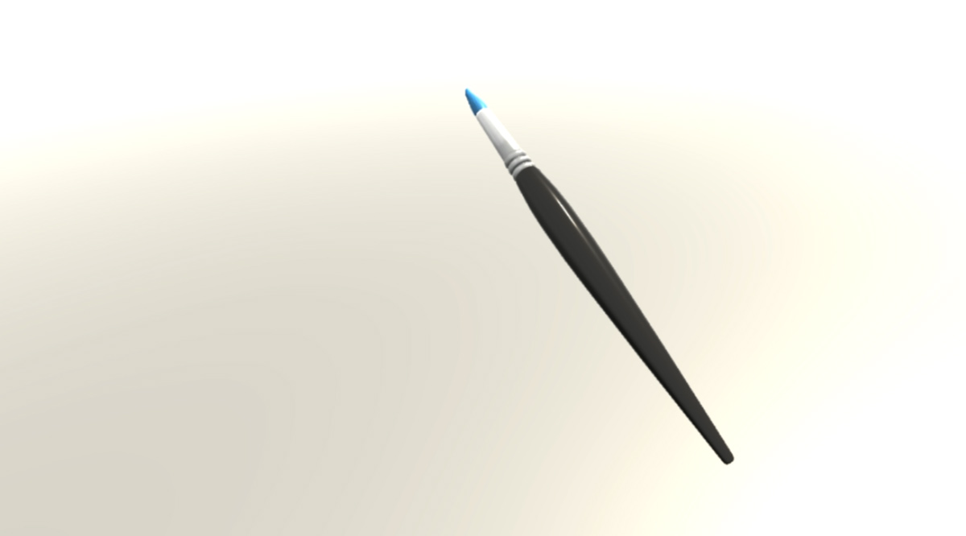
Painting with the brush
Using the BrushContoller we can subscribe to interaction events.
When an InteractionSourcePressed event is triggered, the brush's Draw property is set to true; when InteractionSourceReleased event is triggered, the brush's Draw property is set to false.
While Draw is set to true, the brush will generate points in an instantiated Unity LineRenderer.
Notes:
The BrushController subscribes to the InteractionManager's InteractionSourcePressed and InteractionSourceReleased events. When InteractionSourcePressed event is triggered, the brush's Draw property is set to true; when InteractionSourceReleased event is triggered, the brush's Draw property is set to false. While Draw is set to true, the brush will generate points in an instantiated Unity LineRenderer.

Slide 10
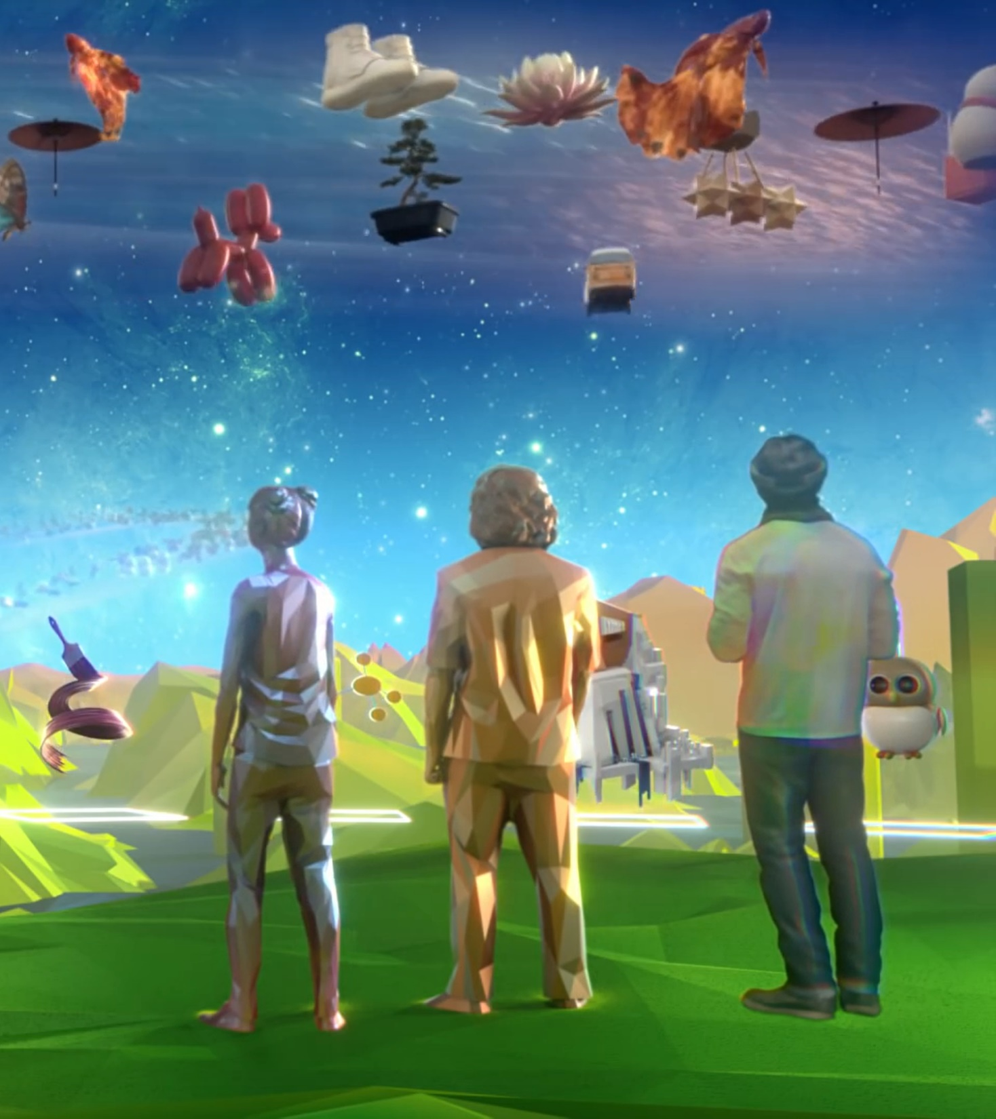
Thank you
Mickey MacDonald – Technical Evangelist, Microsoft Canada
@Scruffyfurn

