Slide 1
Deploying & Building a 3D launcher
Mickey MacDonald – Technical Evangelist
@Scruffyfurn

Slide 2
Exporting and building a Unity Visual Studio solution
How to export from Unity:
When you are ready to export your project from Unity, open the File menu and select Build Settings...
Click Add Open Scenes to add your scene to the build
Optional: Unity C# Projects: Checked. NOTE: Checking this box allows you to 1.) debug your app in the Visual Studio remote debugger, and 2.) edit scripts in the Unity C# project while using IntelliSense for WinRT APIs.
Select Build
In the Windows Explorer dialog that appears, create a new folder to hold Unity's build output. Generally, we name the folder "App".
Select the newly created folder and click Select Folder.
Once Unity has finished building, a Windows Explorer window will open to the project root directory. Navigate into the newly created folder.
Open the generated Visual Studio solution file located inside this folder.
Notes:
If you don't intend on using the system keyboard in your application, our recommendation is to use D3D as your application will use slightly less memory and have a slightly faster launch time. If you are using the TouchScreenKeyboard API in your project to use the system keyboard, you need to export as XAML.

Slide 3
Deploying an app to your Local PC (immersive headset)
Follow these instructions when using a Windows Mixed Reality immersive headset that connects to your PC or the Mixed Reality simulator. In these cases, simply deploy and run your app on the local PC.
Select an x86 or x64 build configuration for your app
Select Local Machine in the deployment target drop-down menu
Select Debug > Start debugging to deploy your app and start debugging

Slide 4
Making a model ready for use as 3D app launcher
From your favorite apps/tools, export a 3D model as glTF 2.0 with the .glb extension
NOTE: The model must have less than 10k triangles. If you get a red cross instead of the 3D Launcher, this could be the root cause
Download the WindowsMRAssetConverter.exe from the glTF-Toolkit on gitHub Simply use the WindowsMRAssetConverter.exe tool with your model (.glb file) as parameter:
WindowsMRAssetConverter.exe C:\Temp\MyModel.glb
Notes:
References
3D Model testing for using in Windows Mixed Reality Home - https://medium.com/@sbovo/3d-model-testing-for-using-in-windows-mixed-reality-home-768d38867aed
Implementing 3D app launchers - https://developer.microsoft.com/en-us/windows/mixed-reality/implementing_3d_app_launchers
3D app launcher design guidance - https://developer.microsoft.com/en-us/windows/mixed-reality/3d_app_launcher_design_guidance
Windows Mixed Reality | Creating 3D App Launchers for Windows Mixed Reality - https://www.youtube.com/watch?v=TxIslHsEXno
#ifdef 3D_LAUNCHERS | glTF TOOLKIT - https://www.youtube.com/watch?v=DYcrBo9S83k
glTF - https://github.com/KhronosGroup/glTF/blob/master/README.md#converters-and-exporters

Slide 5
Adding the converted model to the project
First lets import the modified model into our project:
Build your Windows Mixed Reality project from Unity generating the Visual Studio C# Solution (Unity C# Projects: Checked.)
Select Build
In the Windows Explorer dialog that appears, Select the previous created folder (Lab 4a) and click Select Folder
Open the built Windows Mixed Reality C# solution in Visual Studio.
Right click on the UWP project in the SOLUTION EXPLORER window and choose ADD / EXISTING ITEM
Navigate to where you saved the modified model, and select it
Click on the model file in the Solution Explorer
In the Properties dialog, make sure that the BUILD ACTION for the added .glb file is set to CONTENT

Slide 6
Adding the converted model to the project
Next, we need to add it to the App manifest so the program knows to use the model as the launcher:
Open the Package.appxmanifest with a text editor (or right click on it in Visual Studio and then VIEW CODE)
Add the uap5 schema in the Package item at the begining of the file:
xmlns:uap5=http://schemas.microsoft.com/appx/manifest/uap/windows10/5
Add uap5 in the IgnorableNamespaces list:
IgnorableNamespaces="uap uap2 uap5 mp“
Modify the DefaultTile element to integrate a uap5:MixedRealityModel element like: <uap5:MixedRealityModel Path="MyModel_converted.glb"/>

Slide 7
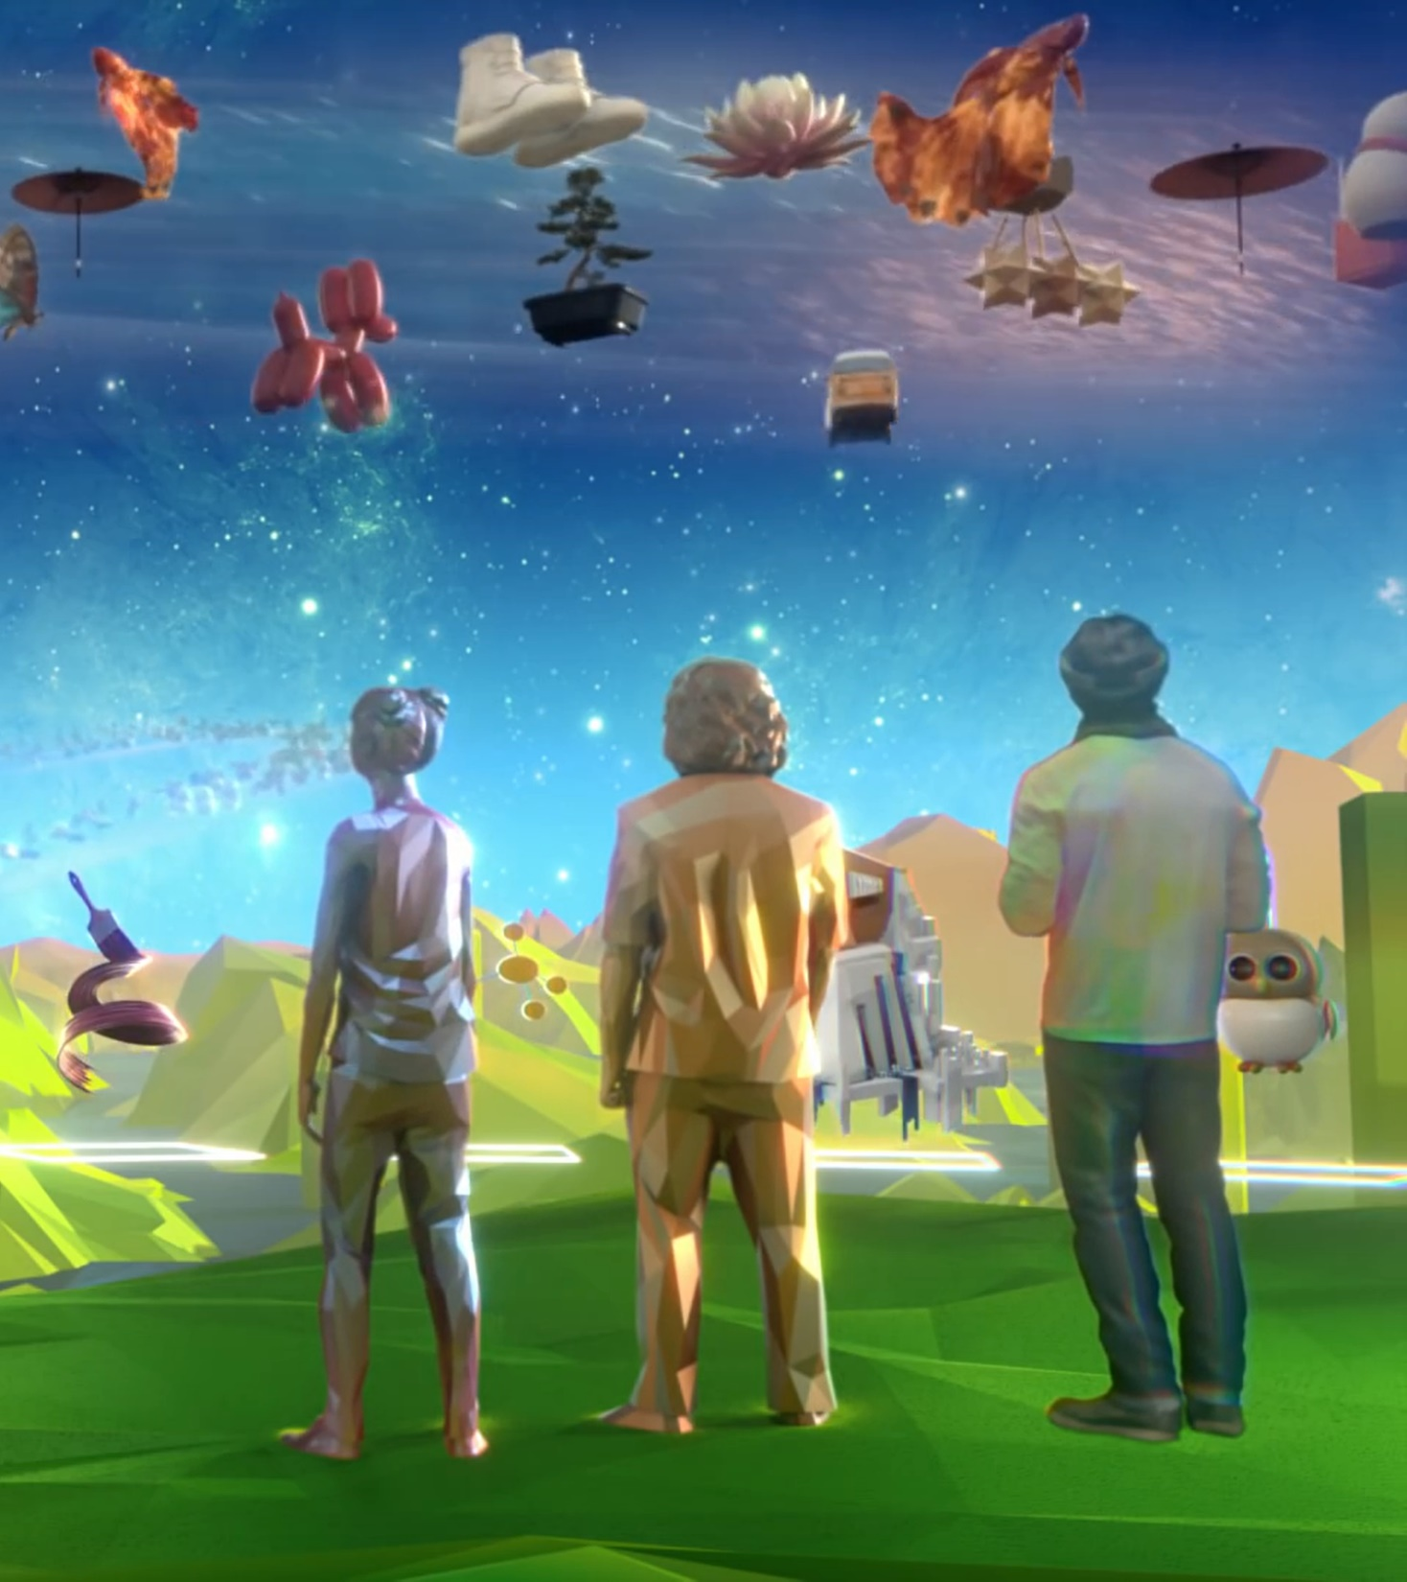
Thank you
Mickey MacDonald – Technical Evangelist, Microsoft Canada
@Scruffyfurn

