Slide 1
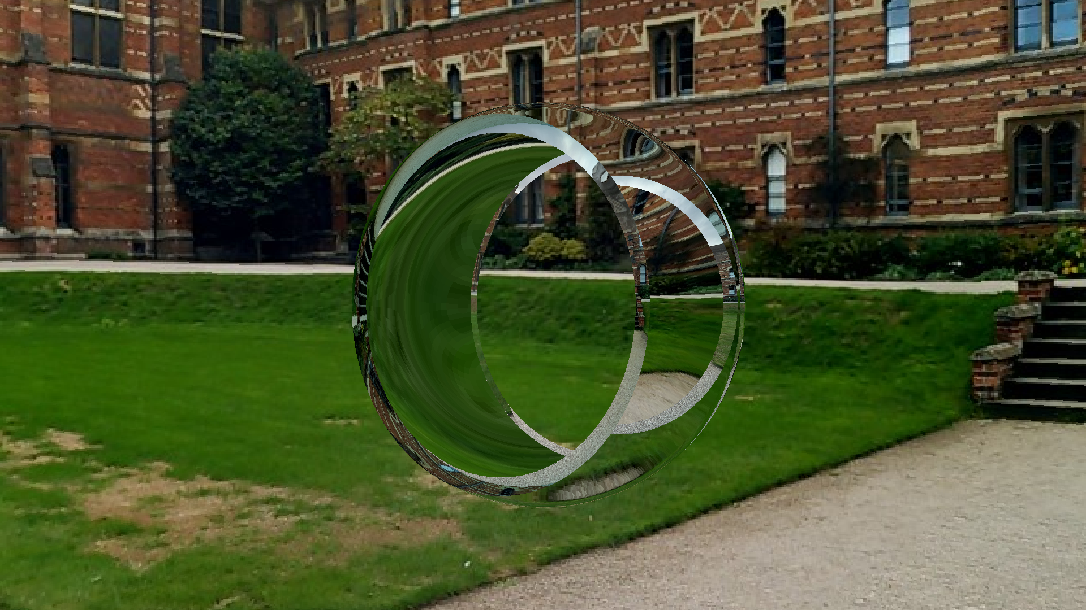
Ray Tracing
Joe Fowler

Slide 2
What is the goal?
Rendering – The process of converting a mathematical description of a collection of simple geometric shapes (commonly referred to as a scene) into an image.
Rasterisation – Officially, this has a slightly more general meaning, but we will use it to mean methods of rendering other than ray tracing.
Ray – A ray is an interval of a line in 3D space, most commonly the interval

