Slide 1
3D Oil and Gas Data in
ArcGIS Pro
7/11/17
ESRI UC 2017

Slide 2
Agenda
University Lands
Our Challenge
3D Data
ArcGIS Pro
Questions

Slide 3
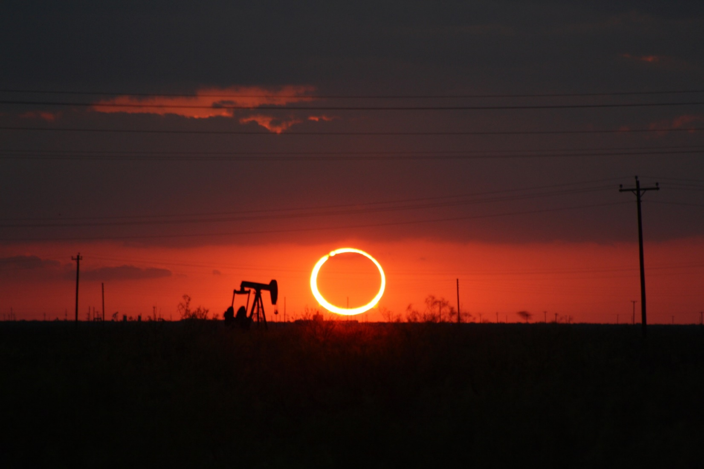
University Lands

Slide 4
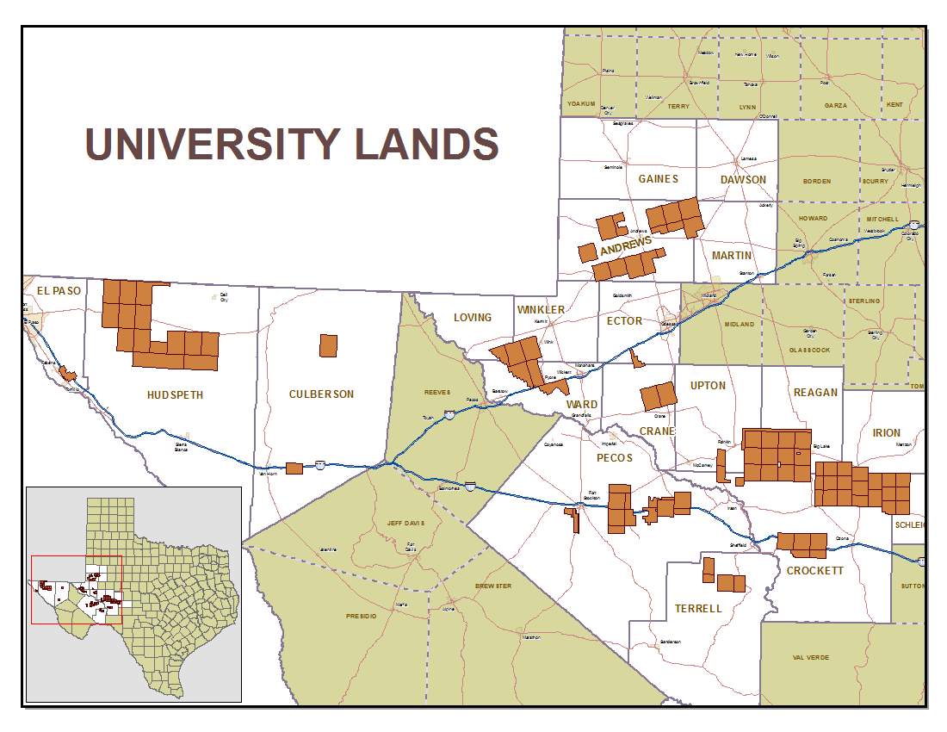
University Lands
Land set aside beginning in 1838
Appropriated Lands for University System in 1876
2.1 million acres primarily in West Texas
Revenue Supports UT & A&M Systems
Permanent University Fund (PUF) Value = $17.4 Billion
$9.4 Billion Deposited by UL
Notes:
University Lands manages the surface and mineral interest of land for the benefit of the Permanent University Fund also known as the PUF. This land was set aside in the beginning of 1838 and appropriated for a University System in 1876. The 2.1 million acres of land is primarily in West Texas and the revenue supports UT and A&M Systems. The University of Texas System owns 67% and Texas A&M System owns 33%. The PUF is currently valued at $17.4 billion with University Lands depositing $9.4 billion, $4.9 has been deposited just since 2009. The oil and gas operations is our biggest asset and with the land(some percentage) leased, there needed to be some changes to how this land was visualized.

Slide 5
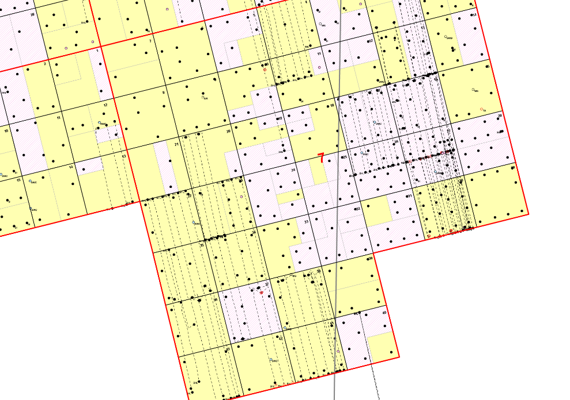
Our Challenge
Horizontal drilling introduced a new issues
Laterals overlap in different horizons
Need to quickly identify production sources
Land and Regulatory need to see info in 3D
ArcReader
Can’t view 3D
Notes:
Our Land and Regulatory departments were using ArcReader as their main mapping source. This is a very good product and it served its purpose well but with the ramping up of horizontal drilling it was getting difficult to visualize in 2D which leases a lateral was passing through. Specially where laterals passed through depth severed leased. If laterals are at different horizons and same direction, on 2D maps the overlap appeared to be a single lateral. It was clear to that only showing this data in 2D was no longer sufficient. They also did not have any visual markers to see where the lateral was pulling production from and would have to use the measure tool to measure out the first and last take points. A 3D solution seemed to be the best fit to help with needs of these departments.

Slide 6
Our Challenge - 3D Oil & Gas Data
No GIS data was in 3D
This meant that we needed to create or acquire the 3D datasets
Leases
Laterals
Perforations (first and last take points)
This data needed to be integrated with the current enterprise GIS system
Notes:
To tackle the problem of having only a 2D mapping platform, we needed to start with creating or acquiring 3D data. The datasets we needed to show in 3D were; leases, laterals and perforations at least the first and last take points. After having the new datasets we needed a way to display them and ArcReader just was not going to work.

Slide 7
3D Oil & Gas Data - Leases
Problem
Leases are stored as 2D Polygons
Leases are depth severed
Solution
Leases could be extruded based on the top and bottom depths
Multipatch feature class of leases

Slide 8
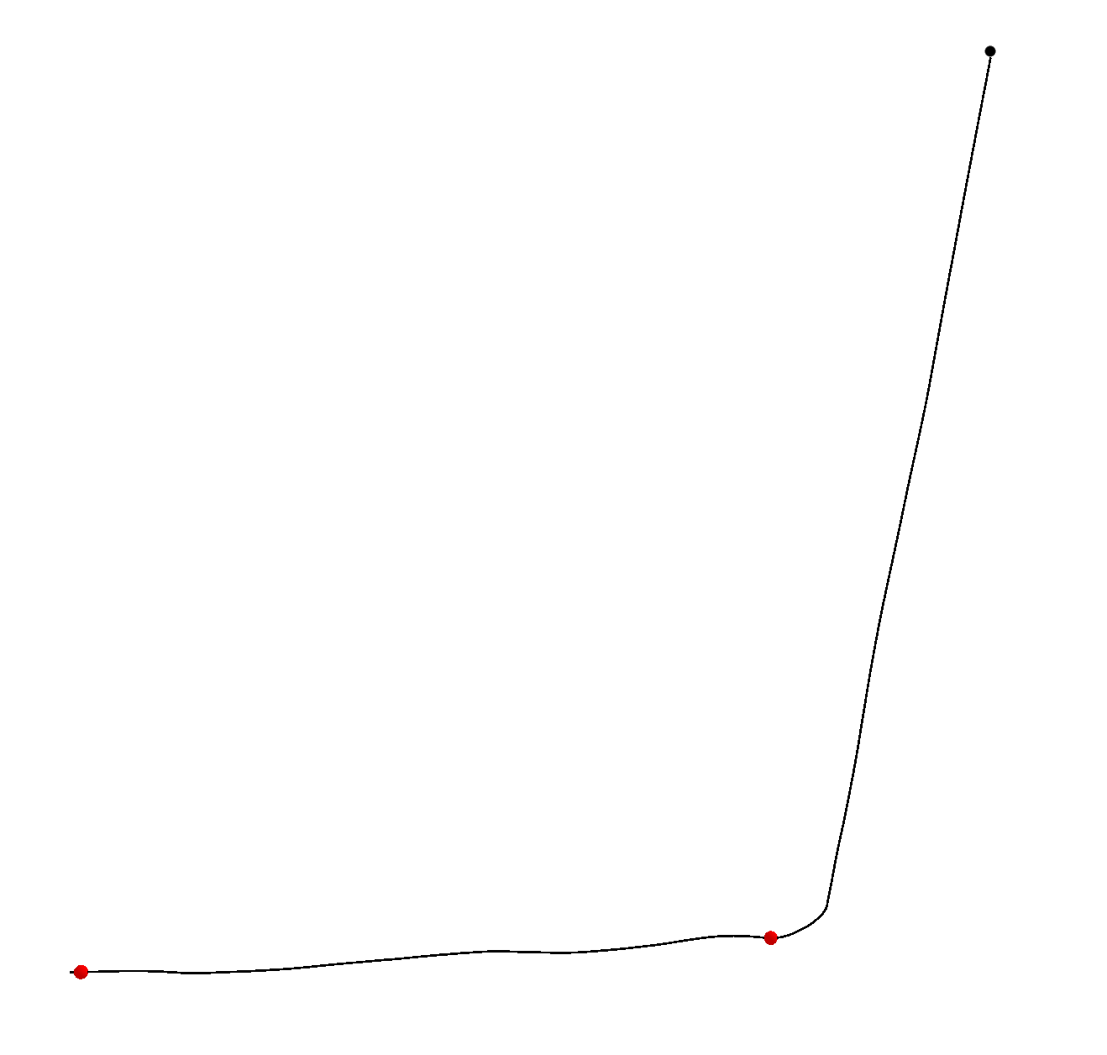
3D Oil & Gas Data - Laterals
Problem
Lateral information currently stored in 2D feature class
There are close to 2000 laterals on University Lands
Directional surveys are stored in Excel and PDF format
Solution
Downloaded Lateral information from third party (1200 laterals)
Converted to GIS using ArcPy site package
Data Conversion
corrected with UL well spots
Added z and m value
m value stored the measure distance
This allowed for the creation of perfs
Tool in ArcMap but would require manual entry of each point (no batch)
Used python script to create point along line based on measure value

Slide 9
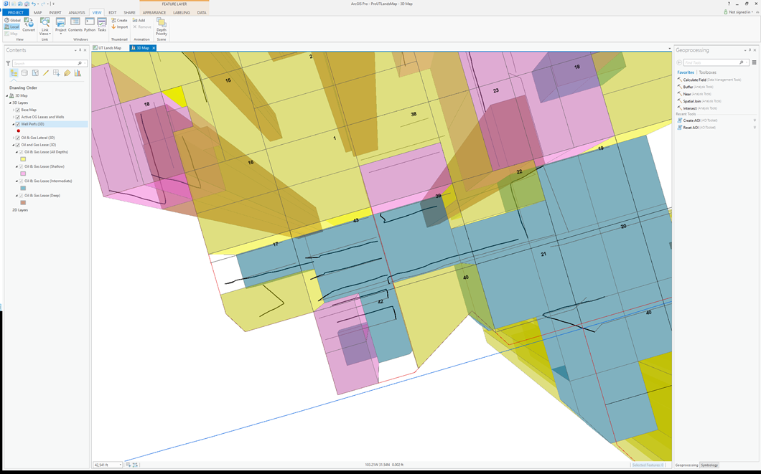
ArcGIS Pro - 3D Integration
Chose ArcGIS Pro
Easy to switch between 2D and 3D maps
Easy to integrate with current GIS architecture
Allowed for the building of tools

Slide 10
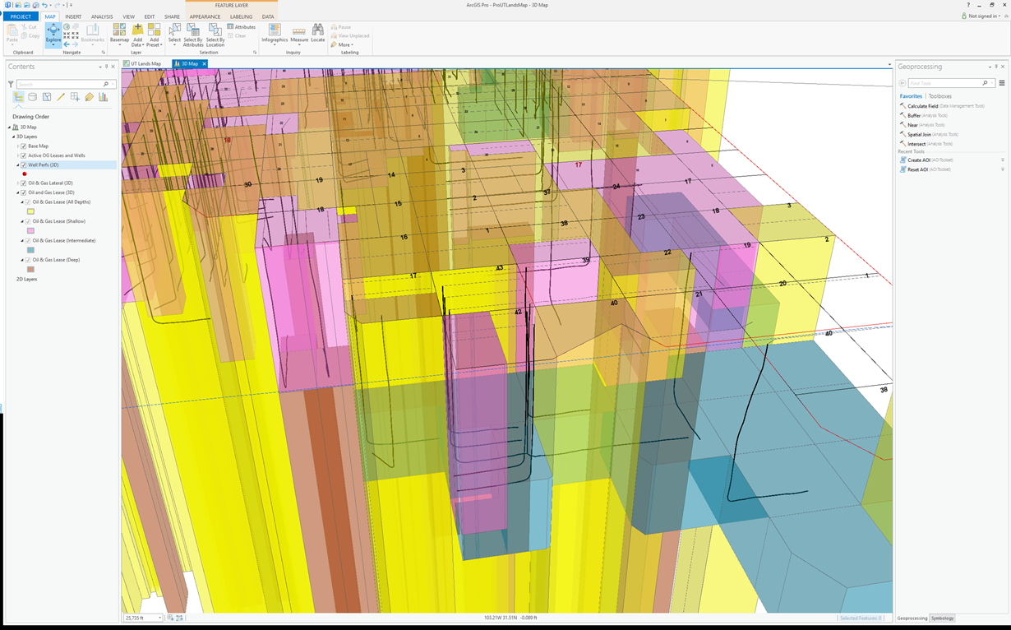
ArcGIS Pro - 3D Integration
Visual Nightmare
Not useful in this form

Slide 11
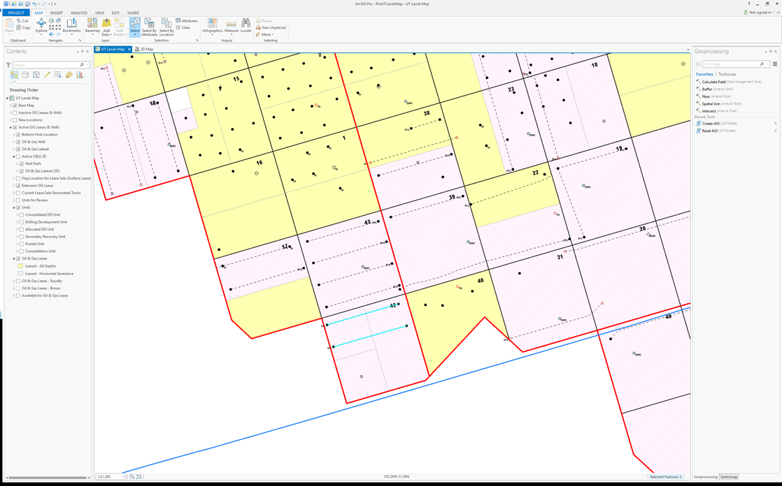
ArcGIS Pro - AOI
Area Of Interest (AOI) Tool
Created so that a specific area could be explored
Developed using python – What its doing

Slide 12
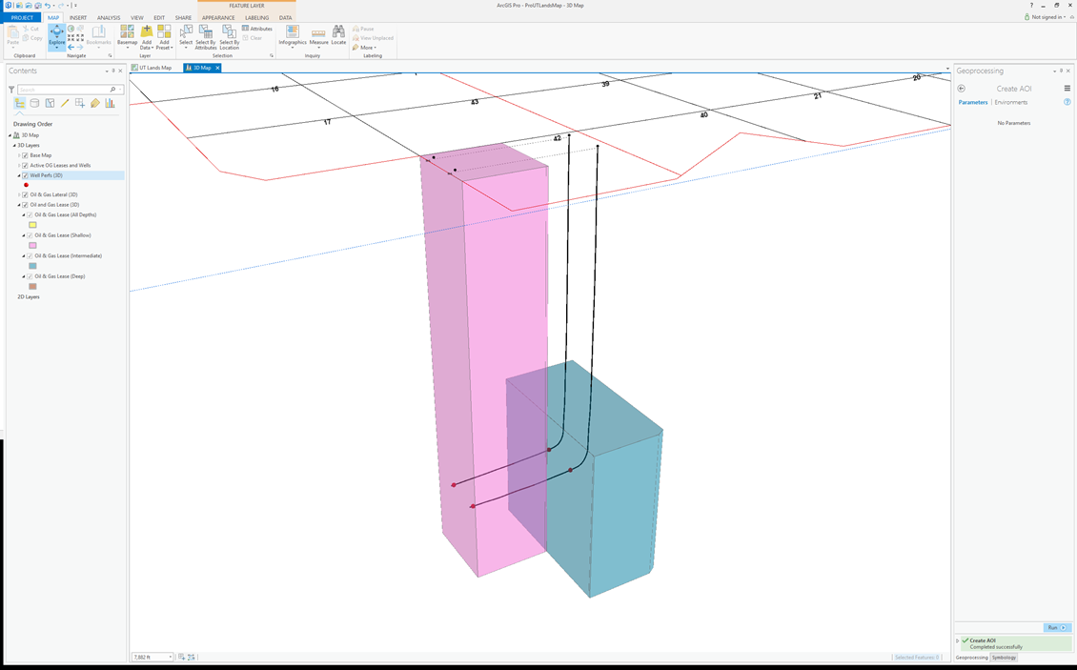
ArcGIS Pro – AOI
Result after running the AOI tool
Only Leases that intersect laterals are shown

Slide 13
Take A Ways
Most challenging part was data creation
Python and ArcPy saved hundreds of man hours
Map optimization and display
Map Optimization for speed of drawing
Platform for future development
Add additional datasets - geologic etc.
3D data storage

Slide 14
Questions?
Scripts can be downloaded from:
https://github.com/ULGIS/ESRIUC2017

