Slide 1

Capture The Flag
NAME: Reece Zunino
Team Name: 404 not foUnd

Slide 2
Introduction
The CTF Problem
Steps to Solve
The Solution
Workplace Relevance
Notes:
Tell your audience what you intend to cover in your project. This is the purpose of your communication.
In Section 1, provide some background of the category of your CTF challenge.
Introduce the audience to the problem and tell us how you plan to approach it and get the solution.
In Section 2, cover the steps you used to solve the problem. This may cover multiple solves.
In Section 3, talk about how you found the solution and discuss the pitfalls and recommendations when facing these types of problems.
In Section 4, talk about the relevance of Capture the Flag problems to the workplace and your job role.

Slide 3
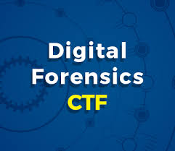
CTF Category Description
Category 1 registry analysis.
The question for Category 1 is:
There is a malicious startup Application set to run when a user logs in. Please find the Registry key and the Name of that application.
Hint Team1-##### is the format for the flag.

Slide 4
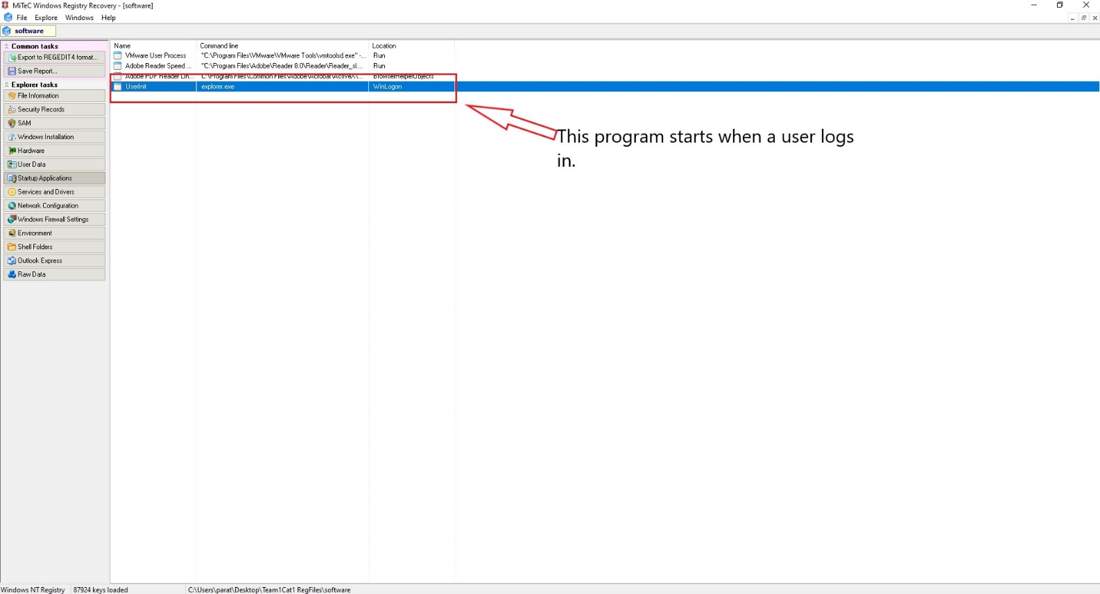
Introduction to the Problem
Use WRR to find what program is part of the startup applications
The CTF challenge was to find a malicious startup application.

Slide 5
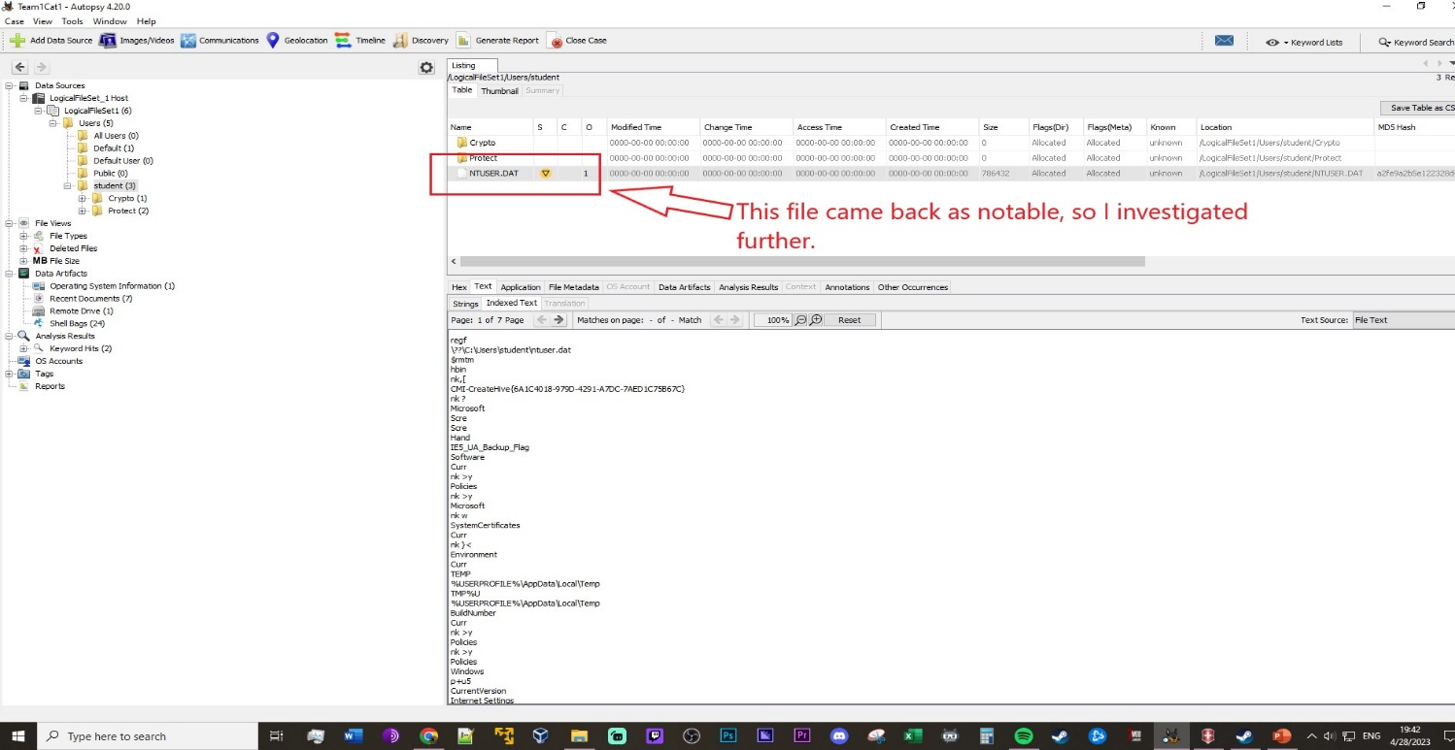
Working Toward a Solution
In the Autopsy program, add all the files to the case file after creating the case.
Identify suspicious files using Autopsy
Search for notable analysis remarks from Autopsy
Search through the data text for key terms and CTF

Slide 6
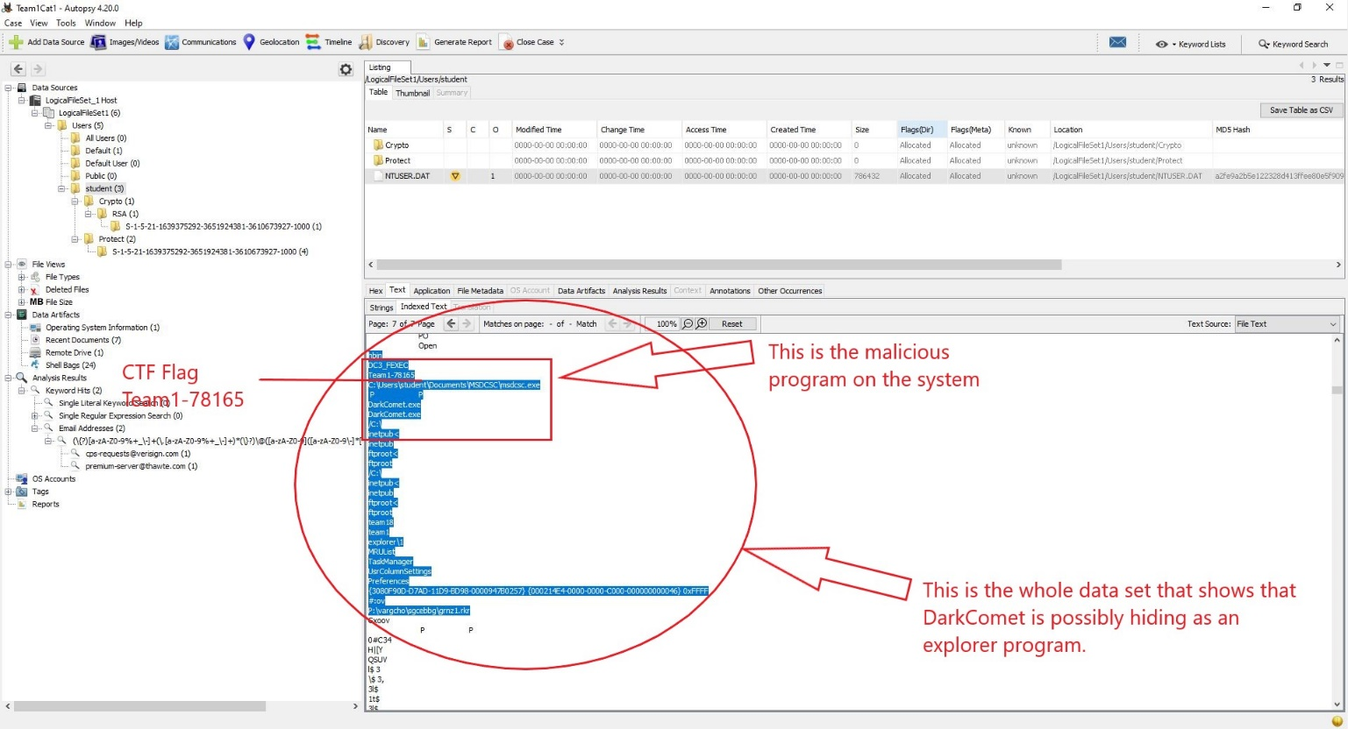
Arriving at the Solution
Navigate to the student user folder then to the NTUSER.DAT file.
In the text tab of the viewer window in Autopsy go to page 7 and scroll towards the bottom.
This provided me with the flag and the malicious program information and allowed me to solve the Registry Analysis problem for Team 1.
The screenshot below includes the date/time from the host system.

Slide 7

Strategies, Pitfalls, Lessons Learned
Strategies:
Utilize the tools available to tackle the problem
Researched keywords that stood out in file data
Pitfalls:
Not familiar with forensic tools such as Autopsy
Lessons learned:
Practice more with current digital forensics tools
Become more familiar with strategies when it comes to finding data artifacts

Slide 8

The Relationship to the Workplace
Analyzing registry files is a baseline task for digital forensics
Identifying malicious programs during an investigation can help either side of a case get to the truth about the crime
Registry analysis allows an investigator to get a snapshot of the person’s digital footprint if they did not successfully delete any information.

Slide 9


Summary
Learned how to identify programs and the location of certain files in a computer registry.
Identify the correct tools for different tasks when finding specific data.
More experience in using Autopsy to identify notable artifacts in registry files.

Slide 10
References
Agha, D., Huntress Labs, Moe, O., @oddvarmoe, & @Purp1eW0lf. (2020, January 23). Boot or Logon Autostart execution: Registry run keys / Startup folder, sub-technique T1547.001 - Enterprise | MITRE ATT&CK®. MITRE ATT&CK®. https://attack.mitre.org/techniques/T1547/001/
BASISTECH LLC. (2020, October 19). Autopsy. https://www.autopsy.com/
LLC, J. S. (n.d.). Automated malware analysis report for Dc3.exe - Generated by Joe sandbox. Automated Malware Analysis - Joe Sandbox Cloud Basic. https://www.joesandbox.com/analysis/192612/0/html
MajorGeeks. (2022, September 19). MiTeC Windows registry recovery. MajorGeeks.Com - MajorGeeks. https://www.majorgeeks.com/files/details/mitec_windows_registry_recovery.html
Malwarebytes. (2023). DarkComet: Backdoor.DarkComet. https://www.malwarebytes.com/blog/detections/backdoor-darkcomet
Sonya. (2022, November 28). What is Userinit.exe and what can it do on your computer? MiniTool.

