Slide 1
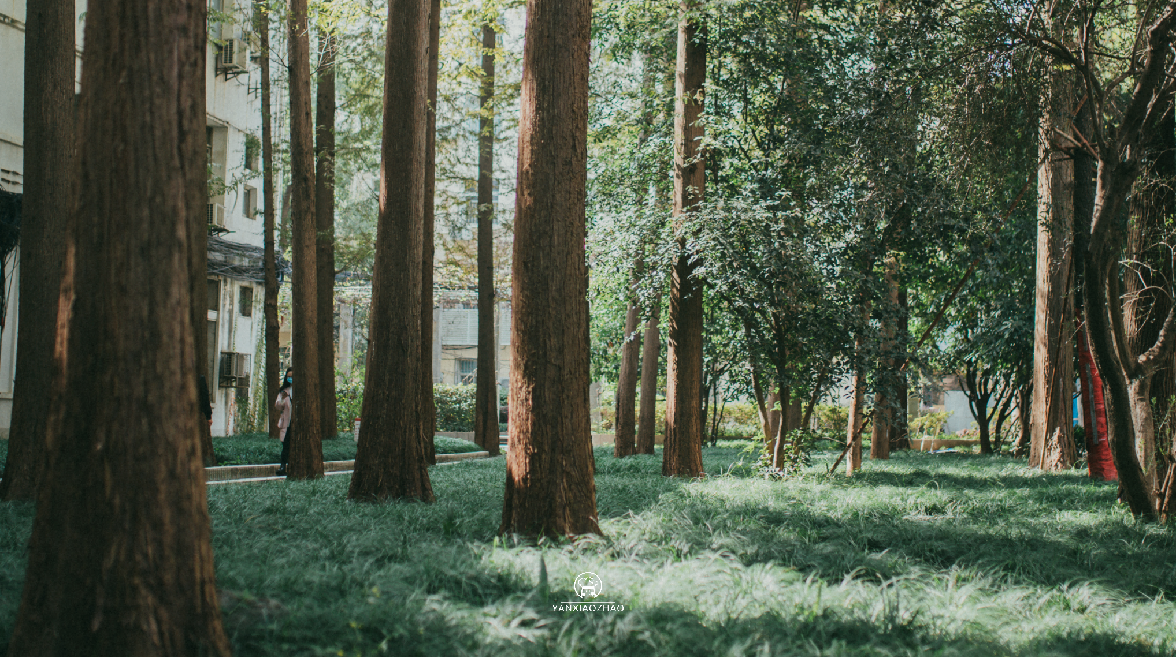
Huazhong university of
华中大PPT模板
science and technology
汇报人：研小招 导师：xxx
汇报时间：x年x月x日

Slide 2


目 录
CONTENTS
01
请输入标题
Please enter a title
02
请输入标题
Please enter a title
03
请输入标题
Please enter a title
04
请输入标题
Please enter a title

Slide 3
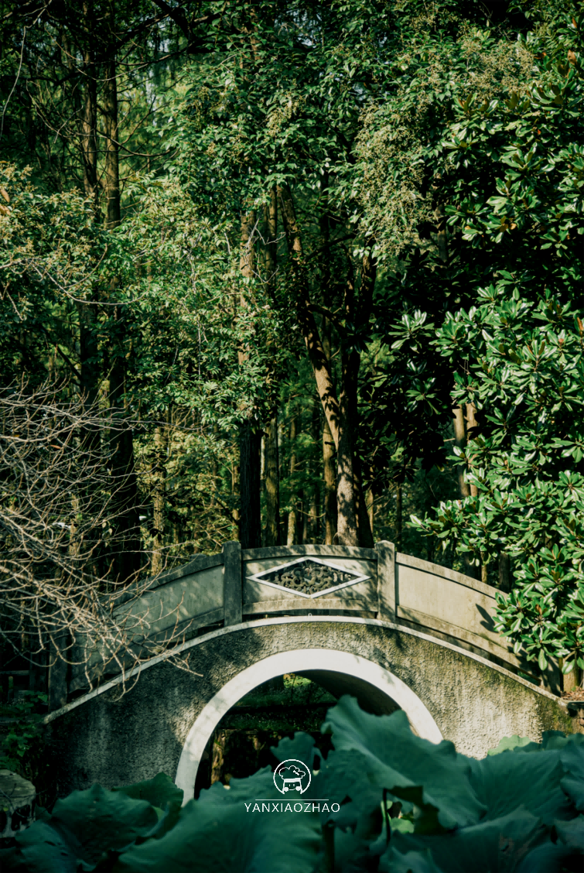
P A R T
01
输入您需要的主题

Slide 4
请输入你需要的主题
输入标题
输入标题
输入标题
It is known as "Forest University". The school has a complete teaching and research support system and complete public service facilities.
The campus covers an area of more than 7000 mu, with verdant trees, green grass, elegant environment, beautiful scenery and 72% green coverage.
It is known as "Forest University". The school has a complete teaching and research support system and complete public service facilities.
The campus covers an area of more than 7000 mu, with verdant trees, green grass, elegant environment, beautiful scenery and 72% green coverage.
It is known as "Forest University". The school has a complete teaching and research support system and complete public service facilities.
The campus covers an area of more than 7000 mu, with verdant trees, green grass, elegant environment, beautiful scenery and 72% green coverage.

Slide 5
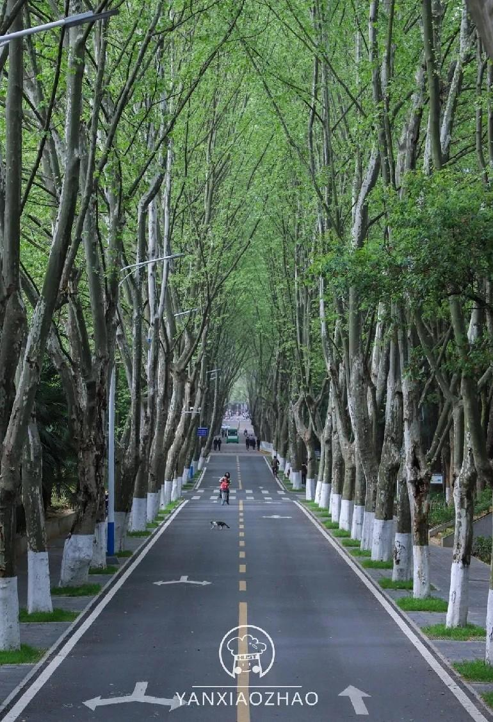
P A R T
02
输入您需要的主题

Slide 6




请输入你需要的主题
请输入您需要的内容，字体和颜色均可根据您的需要更改。
请输入您需要的内容，字体和颜色均可根据您的需要更改。
请输入您需要的内容，字体和颜色均可根据您的需要更改。
请输入您需要的内容，字体和颜色均可根据您的需要更改。
内容一
内容二
内容三
内容四

Slide 7
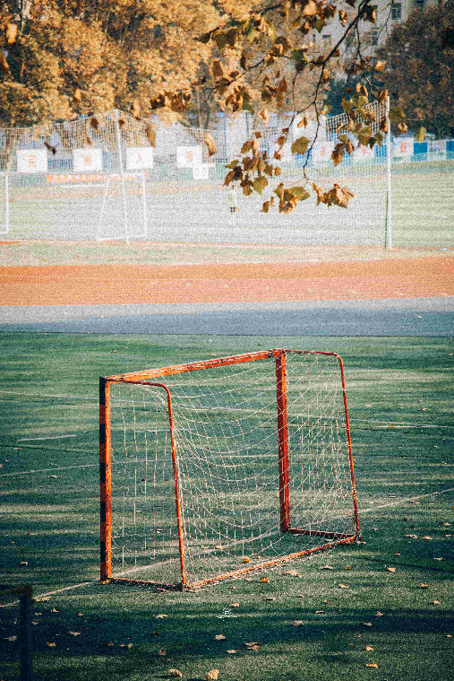
请输入你需要的主题
输入标题
The campus covers an area of more than 7000 mu, with verdant trees, green grass, elegant environment, beautiful scenery and 72% green coverage. It is known as "Forest University". The school has a complete teaching and research support system and complete public service facilities.
The campus covers an area of more than 7000 mu, with verdant trees, green grass, elegant environment, beautiful scenery and 72% green coverage. It is known as "Forest University". The school has a complete teaching and research support system and complete public service facilities.

Slide 8

P A R T
03
输入您需要的主题

Slide 9
请输入你需要的主题
The campus covers an area of more than 7000 mu, with verdant trees, green grass, elegant environment, beautiful scenery and 72% green coverage.
The campus covers an area of more than 7000 mu, with verdant trees, green grass, elegant environment, beautiful scenery and 72% green coverage.
The campus covers an area of more than 7000 mu, with verdant trees, green grass, elegant environment, beautiful scenery and 72% green coverage.
The campus covers an area of more than 7000 mu, with verdant trees, green grass, elegant environment, beautiful scenery and 72% green coverage.

Slide 10
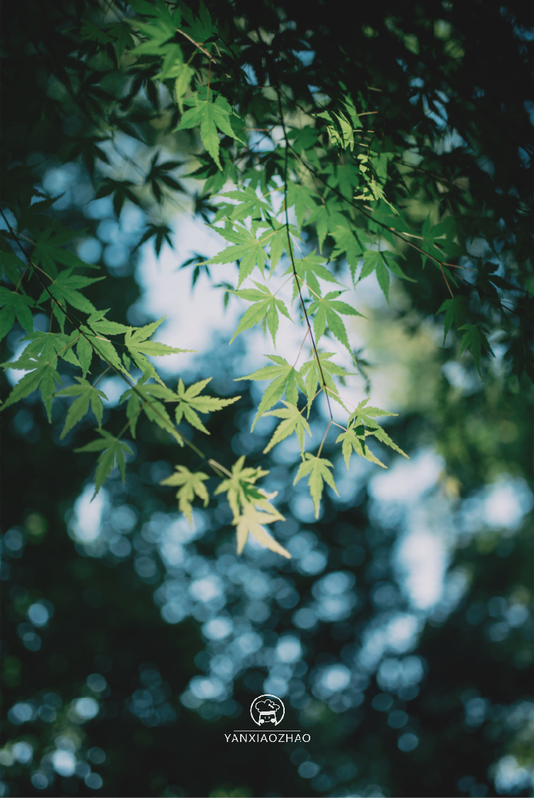
P A R T
04
输入您需要的主题

Slide 11
请输入你需要的主题
研究过程
研究过程
研究过程
研究过程
It is known as "Forest
University"
It is known as "Forest
University"
It is known as "Forest
University"
It is known as "Forest
University"

Slide 12
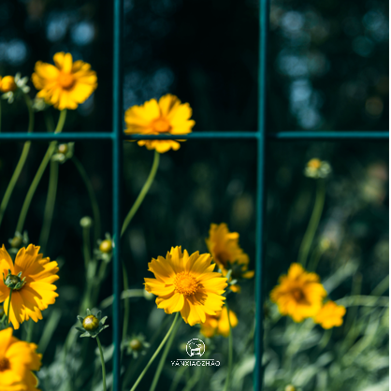
请输入你需要的主题
The campus covers an area of more than 7000 mu, with verdant trees, green grass, elegant environment, beautiful scenery and 72% green coverage. It is known as "Forest University". The school has a complete teaching and research support system and complete public service facilities.
The campus covers an area of more than 7000 mu, with verdant trees, green grass, elegant environment, beautiful scenery and 72% green coverage. It is known as "Forest University". The school has a complete teaching and research support system and complete public service facilities.
The campus covers an area of more than 7000 mu, with verdant trees, green grass, elegant environment, beautiful scenery and 72% green coverage. It is known as "Forest University". The school has a complete teaching and research support system and complete public service facilities.
The campus covers an area of more than 7000 mu, with verdant trees, green grass, elegant environment, beautiful scenery and 72% green coverage.

Slide 13


THANK YOU
华中科技大学20XX级XX学院
汇报人：研小招
导师：XXX

