Slide 1
Expected Outcome of the Capstone project
The 12-minute presentation serves as a platform for students to showcase their capstone project, demonstrating their understanding, problem-solving abilities, and communication skills. The presentation should concisely cover the project’s key aspects, including the problem addressed, theoretical analysis, methodology, results, and conclusions.
Suggested Presentation Structure (12 minutes Presentation + 8 minutes Q&A)
Introduction & Problem Statement (3 minutes)
Briefly explain the project’s purpose and relevance.
Theoretical Foundation (3 minutes)
Discuss key theoretical concepts and methods used.
Practical Application (3 minutes)
Showcase your implementation, challenges faced, and the results.
Future Work & Conclusion (3 minutes)
Share potential future applications, possible improvements, and a final summary.
Q&A – Discussion (8 minutes)

Slide 2
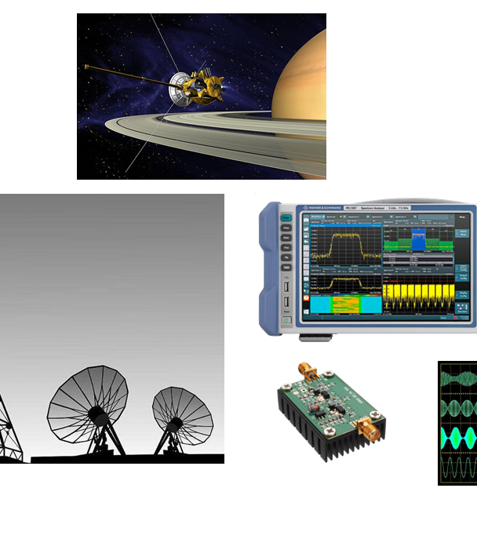
My project
Modulschlussprüfungen
Digital Communication (dcom)
Pozar Janes

Slide 3
Outline Subtitle
I – Understanding the problem – ISI in Digital Communication
What is ISI
Why ISI is a Problem
III – Performance Analysis
Bit Error Rate (BER) Analysis
II – DFE Theory & Simulation
DFE Concept
ISI-Channel Simulation & Visualization
DFE Implementation & Visualization
IV – Application and Conclusion
Conclusion
Practical Use Cases of DFE
Questions

Slide 4
Introduction & Objectiv
Introduction
What is Inter-Symbol Interference (ISI)
Project Objectiv
Notes:
Digital Communication offers problems to transport information trough a channel e.g. Air or twisted copper pair
ISI is the smearing of the symbols, influece of others symbols
Aim is to «cancel» these interference an improve throuth that the decision for a symboe (choice)

Slide 5
Unterstanding the Inter-Symbol Interference
Definition
Causes
Impact
Notes:
When the tail of one symbol is interferes with the detecion of subsequent symbols
transmitted signals are damped. Influece of mulitpath, from walls,same symbol comes at different times
Increased Bit Error rate, worse signal quality

Slide 6
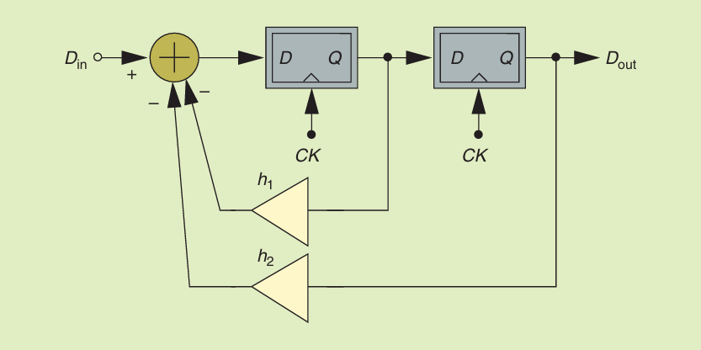
Decision Feedback Equalizer (DFE)
What is DFE ?
How it works
Components
Advantage
Notes:
Is a equalization technique
Uses past decisions to cancel out the isi from future symbols
Uses a feedback filter to substract from the current symbol the last symbol with a weight. Works with numerous h.
Can combat ISI with the subtraction of the ISI itself from the decisions of the last symbols

Slide 7
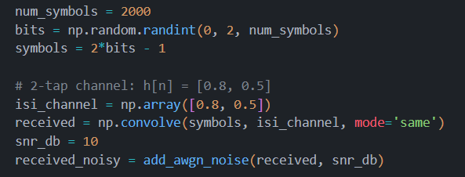
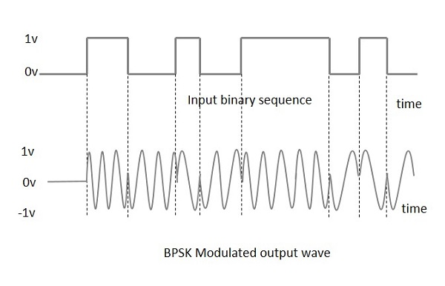
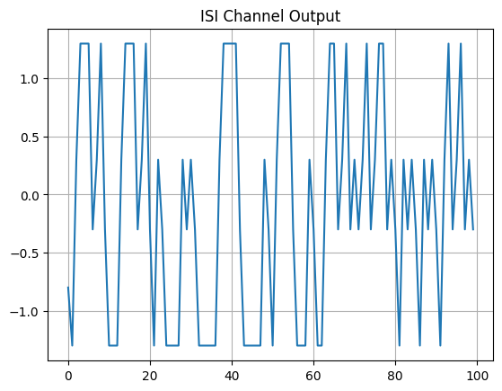
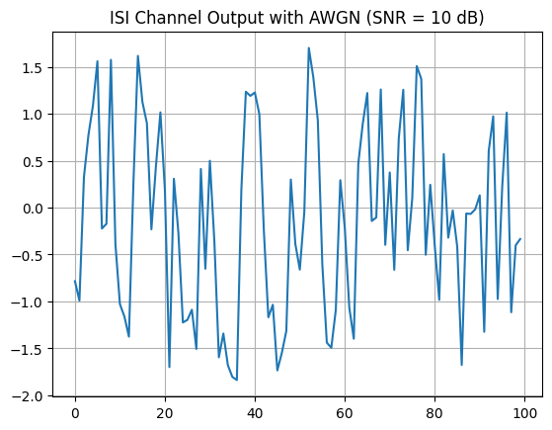
ISI-Channel Simulation
Channel model is y[n] = 0.8*x[n] + 0.5*x[n-1]
Attenuation of 0.8 of the current symbol
Influence of 0.5 from the last symbol
Signal Generation is BPSK
Signal is convoluted with the channel
Added AWGN with a SNR of 10 dB

Slide 8
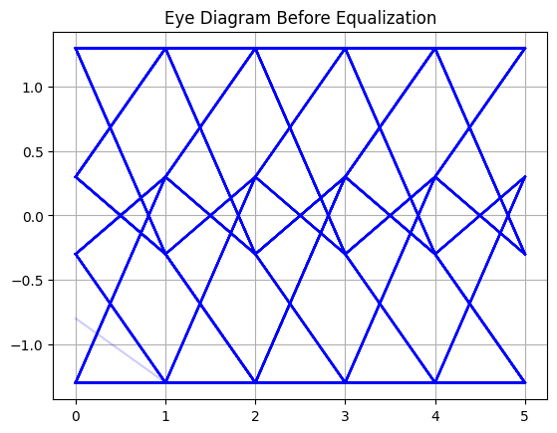
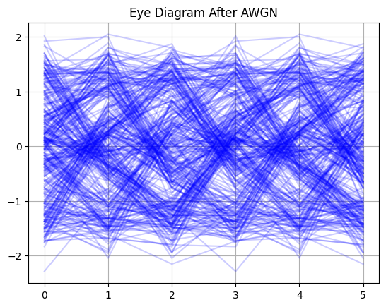
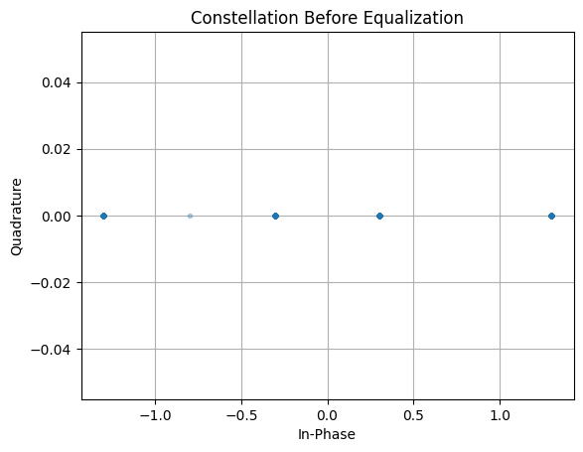
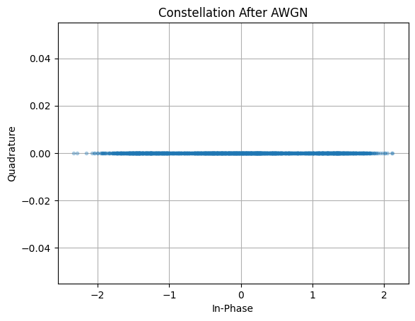
Visualize ISI Effects before Equalization

Slide 9
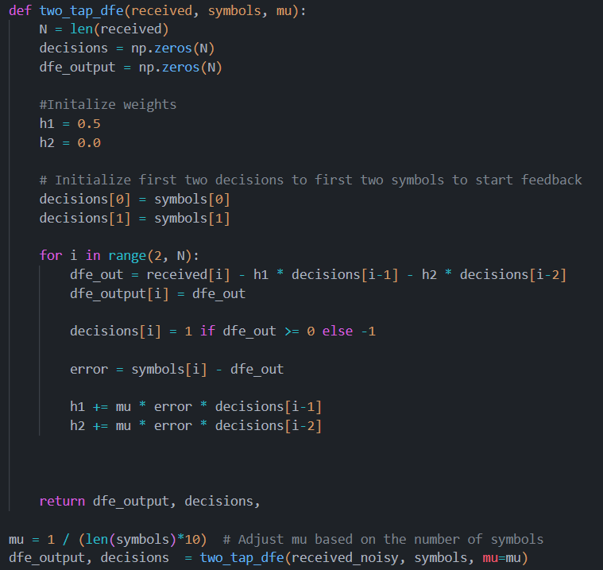
Decision Feedback Equalizer Implementation
Notes:
Start Values for filter coefficents, then LMS to adjust coefficents, Minimizes the error between desired output the equalized output, h1 and h2 are learned by the true smybols.
Uses past decision n-1 and n-2 with the error from the true symbols for decision

Slide 10
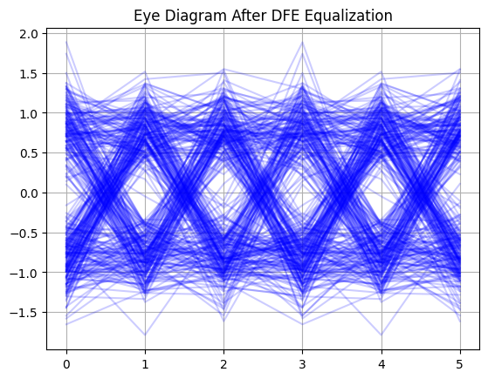
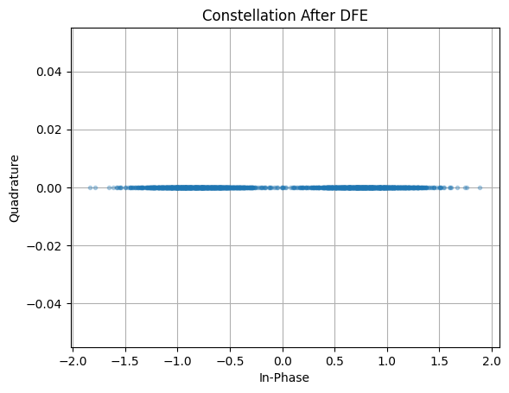
Visualize ISI Effects after Equalization

Slide 11
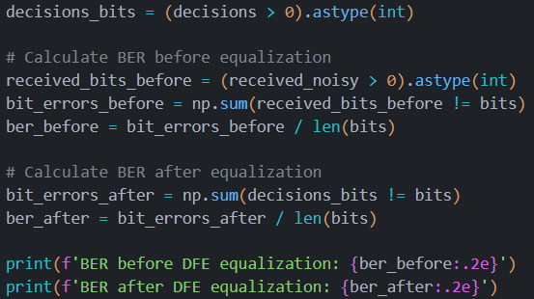

Bit Error Rate (BER)
What is BER ?
From 8.1% BER to 0.45% BER
Improvement around 95%
Notes:
Number of bit errors / Total number of bits Transmitted

Slide 12
Conclusion
DEF can reduce the BER induced by ISI
Eye is more open in the Eye Diagramm, better decision making
Challenge was to find the right starting values for h1 and h2,
Future Work could be implement adaptive algorithms and a feedforward filter
For pratical cases DFE can be uses for copper wires to overcome the channels ISIs
Highspeed data transmit, «smearing» can occur
Notes:
Number of bit errors / Total number of bits Transmitted

Slide 13
Questions

