Slide 1

Second Hand Car Price Prediction Model Using MACHINE LEARNING

Slide 2
Introduction
Scope
CONTENTS
Tools Used
Modules

Slide 3
Introduction

Slide 4
About the Project
The Project is about the Prediction of price of a used Car on the basis of different factors such as the number of years for it is used , Type of Fuel , Kms driven and other important factors .
The Model works on Supervised Machine Learning which is the types of machine learning in which machines are trained using well "labelled" training data, and on basis of that data, machines predict the output. The labelled data means some input data is already tagged with the correct output.

Slide 5
Features of the Model Used
Fuel Type
ShowRoom Price(in Lakhs)
Whether te Fuel type of the Car is Petrol , CNG or Diesel
The Model takes into account the showroom price of the Car
Transmission
It also takes into account whether the car is Automatic or Manual
Years
The number of years for which the Car has been used
Kms Driven
The number of kms that the car has driven is uesed .

Slide 6
Scope of the Project
For 2nd Hand Car Dealers : This model is best suited for Car Dealers who want to know the price of a Car before purchasing or selling it beforehand and then estimating the profit they might earn.
In a website submodule for a Car Company :A car company website can add this model to let the customers get information about the price of the car before purchasing according to the market.

Slide 7
Tools Used in this Project
Languages
Libraries
Python Html CSS
Flask ,Pandas , Seaborn , Sklearn Pickle
Car Price
Pred
Dataset
Apps Used
Kaggle Dataset
car data.csv
Anaconda , Jupyter Notebook , Spyder Notebook , Notepad

Slide 8
Working of the Model

Slide 9
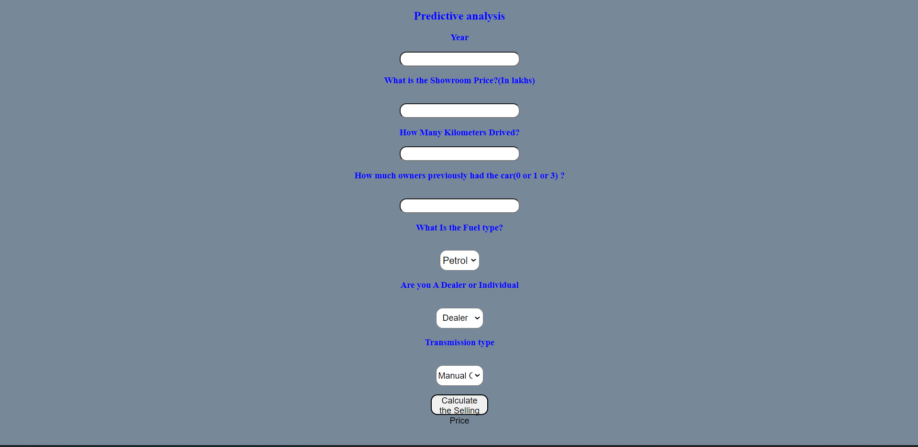
Initial State of the Model

Slide 10
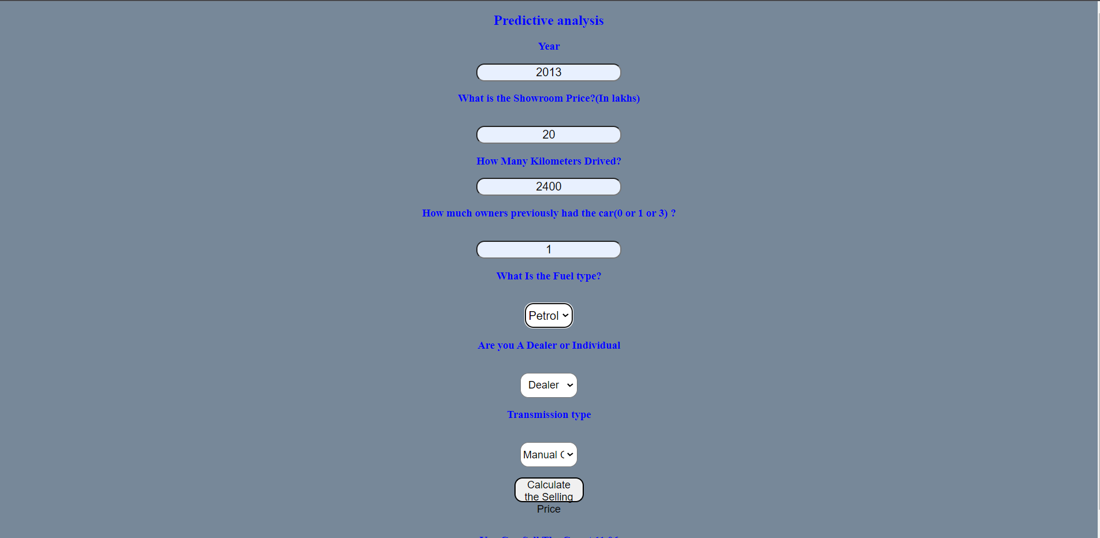
Using the Model

Slide 11
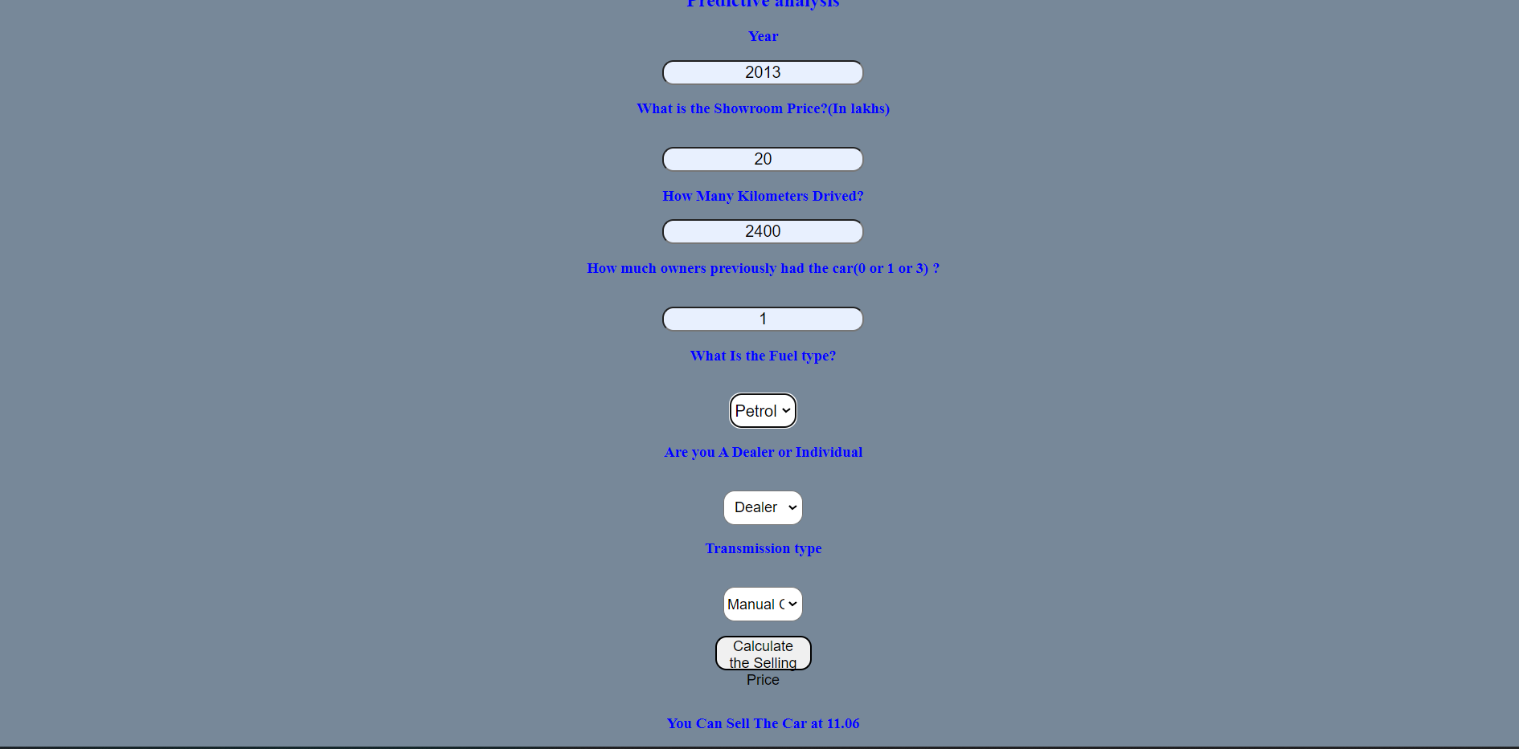
Output from the Model

Slide 12
THANK YOU FOR WATCHING

