Slide 1


Blinkit Grocery Analysis
Presented By Shuvam

Slide 2

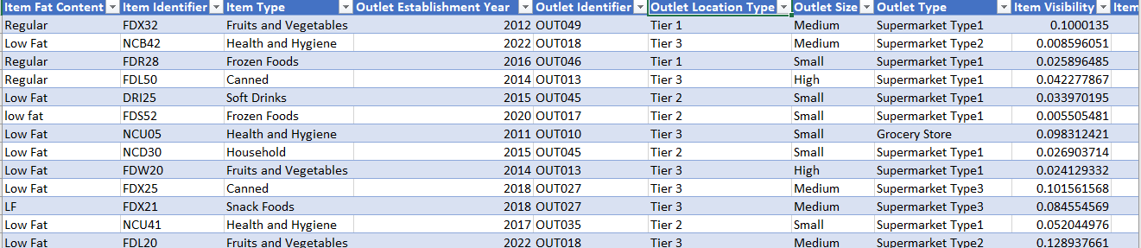
Data Overview
1. Item Fat Content - Describes the volume of Goods
2. Item Identifier - Product code of items
3. Item Type - Types of goods
4. Outlet establishment year - Year of starting particular outlet
5. Outlet Identifier - Code ID of Outlets
6. Outlet Location - Tier wise city
7. Outlet Type - What is the known role of outlet
8. Outlet Size - Small/Mid/Large
9. Item Visibility - Percentage of Items
10. Item Weights - Overall Kgs
11. Sales - Items selling price
12. Ratings - Customer Satisfaction

Slide 3
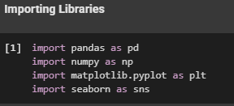

Data Analysis
Tool Used : Python , Pandas, Numpy, Matplotlib and Seaborn
Importing Libraries
Load the Dataset

Slide 4
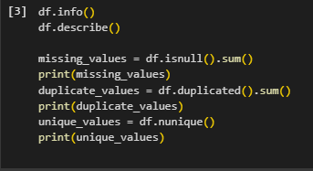
Data Analysis
Tool Used : Python , Pandas, Numpy, Matplotlib and Seaborn
Checking Data Insights

Slide 5
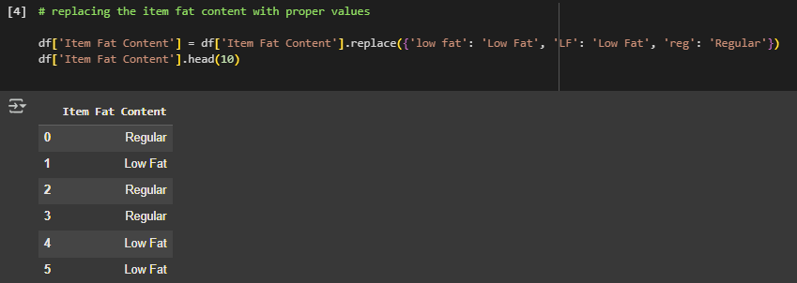
Data Analysis
Tool Used : Python , Pandas, Numpy, Matplotlib and Seaborn
Data Cleaning : Replace Data
Item Fat Content are now classified into Low Fat and Regular Content

Slide 6

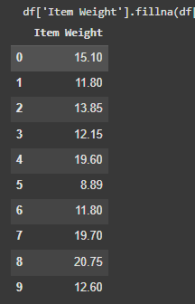
Data Analysis
Tool Used : Python , Pandas, Numpy, Matplotlib and Seaborn
Data Cleaning : Missing Values Handle
Output ::

Slide 7
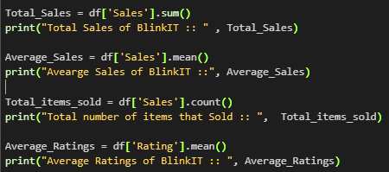
Data Analysis
Tool Used : Python , Pandas, Numpy, Matplotlib and Seaborn
KPIS Requirement
1. Total Sales
2. Average Sales
3. Number of items
4. Average Ratings
Total Sales of BlinkIT :: 1201681.4928
Avearge Sales of BlinkIT :: 140.99278338613163
Total number of items that Sold :: 8523
Average Ratings of BlinkIT :: 3.965857092573038
Output ::

Slide 8
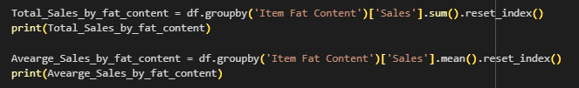
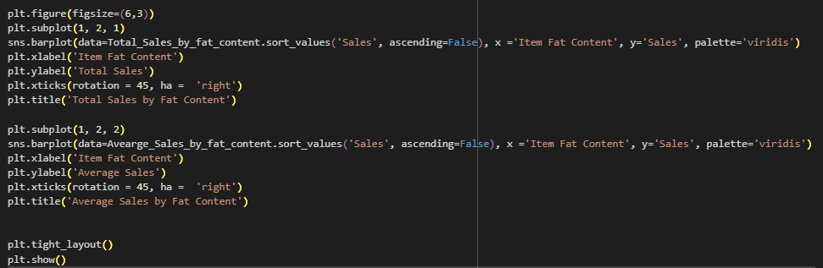
Data Analysis
Tool Used : Python , Pandas, Numpy, Matplotlib and Seaborn
EDA

Slide 9
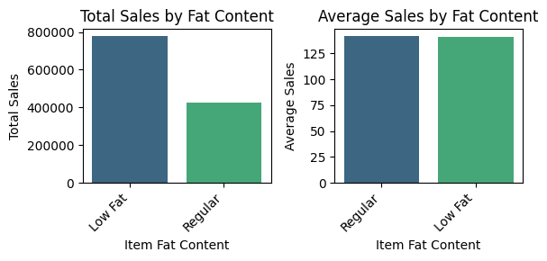
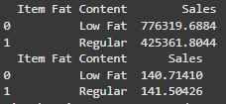
Data Analysis
Tool Used : Python , Pandas, Numpy, Matplotlib and Seaborn
Output : Visuals
Output

Slide 10
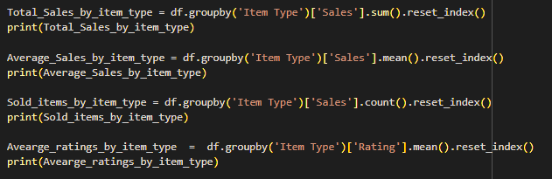
Data Analysis
Tool Used : Python , Pandas, Numpy, Matplotlib and Seaborn
Sales Analysis by Item Type : Groupby

Slide 11
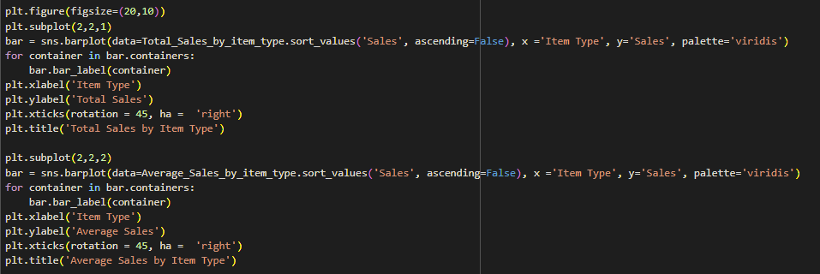
Data Analysis
Tool Used : Python , Pandas, Numpy, Matplotlib and Seaborn
Visualization

Slide 12
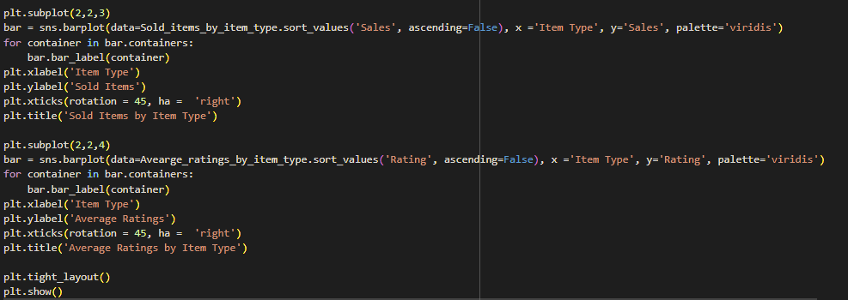
Data Analysis
Tool Used : Python , Pandas, Numpy, Matplotlib and Seaborn
Visualization

Slide 13
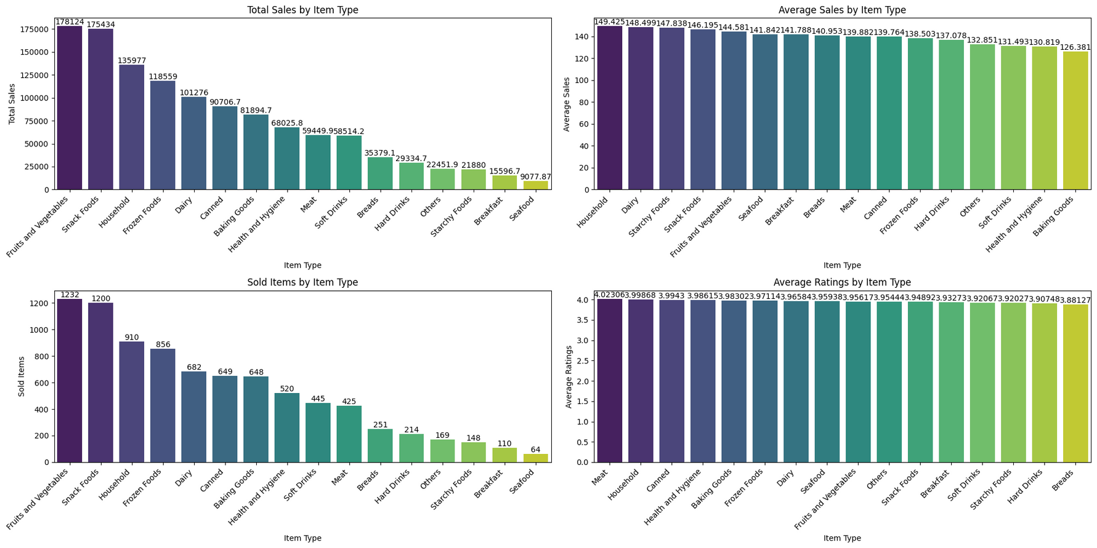
Data Analysis
Tool Used : Python , Pandas, Numpy, Matplotlib and Seaborn
Output : Visuals

Slide 14
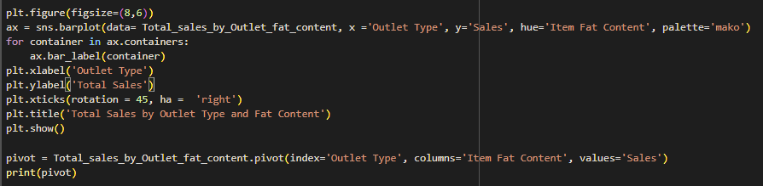
Data Analysis
Tool Used : Python , Pandas, Numpy, Matplotlib and Seaborn
Sales across different Outlet segement by fat content
Visualization

Slide 15
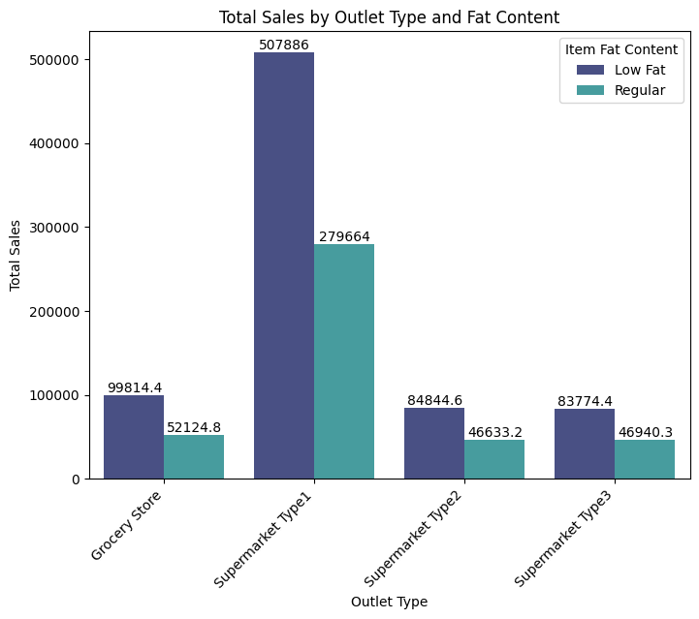
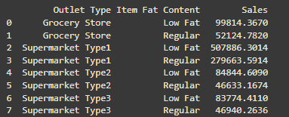
Data Analysis
Tool Used : Python , Pandas, Numpy, Matplotlib and Seaborn
Output : Visuals

Slide 16
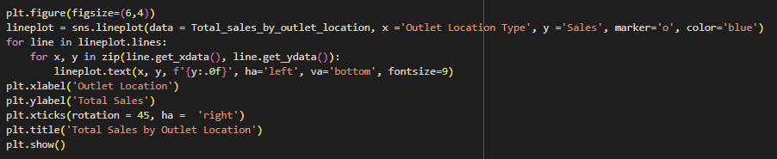
Data Analysis
Tool Used : Python , Pandas, Numpy, Matplotlib and Seaborn
Sales by Outlet Location : Groupby
Visualization

Slide 17
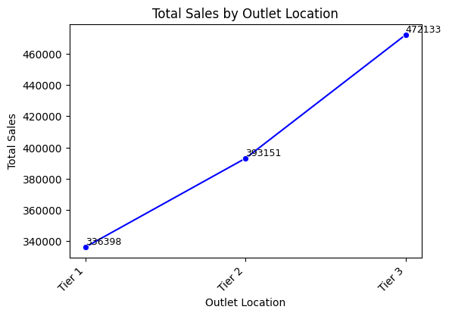

Data Analysis
Tool Used : Python , Pandas, Numpy, Matplotlib and Seaborn
Output : Visuals

Slide 18
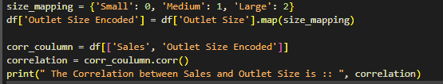
Data Analysis
Tool Used : Python , Pandas, Numpy, Matplotlib and Seaborn
Sales by Outlet Size: Groupby
Visualization
Correlation

Slide 19
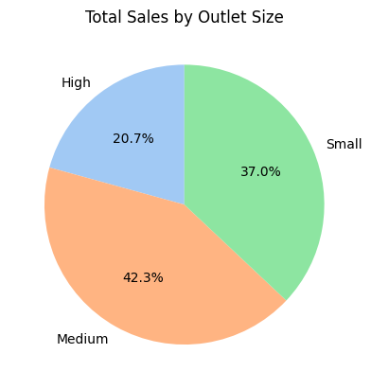


Data Analysis
Tool Used : Python , Pandas, Numpy, Matplotlib and Seaborn
Output : Visuals

Slide 20
Data Analysis
Tool Used : Python , Pandas, Numpy, Matplotlib and Seaborn
Findings and Analysis
Sales is higher in Low fat materials
Total Sales is highest in Fruits and Vegetables
Overall customer satisfaction is 3.9
Average satisfaction is best for Meat
Sales in SuperMarket Type1 for both Low fat and Regular is best
Blinkit Sales is mostly happen in Tier3 Cities
Sales is mainly captured market by Medium Outlet

Slide 21
Thank You

