Slide 1

Employee Performance Analysis
DAT7 Capstone Project
Sneha Bhaskar
Notes:
What is your workflow management style?
What is the most interesting part of your job?
What motivates you to give your best at work?
What obstacles are currently in your way in achieving success at the office?

Slide 2
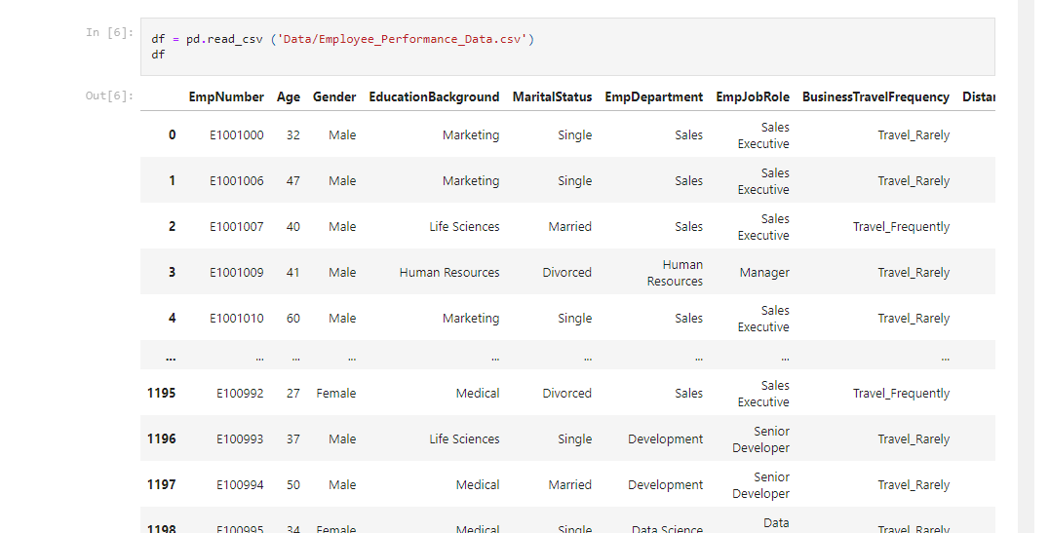
Background Knowledge About The Dataset
Notes:
The Employee Performance Dataset, sourced from a prominent analytics blog, contains 1200 entries across 28 features. Of these, 19 are quantitative (11 numerical and 8 ordinal) and 8 are qualitative, with the 'Employee Number' being alphanumerical but not influential for performance assessment. To analyze this dataset, the OSEMN framework was utilized. For deeper insights into performance trends, both logistic and linear regression models were applied, with the former predicting categorical outcomes like performance ratings and the latter estimating continuous scores based on multiple variables.

Slide 3
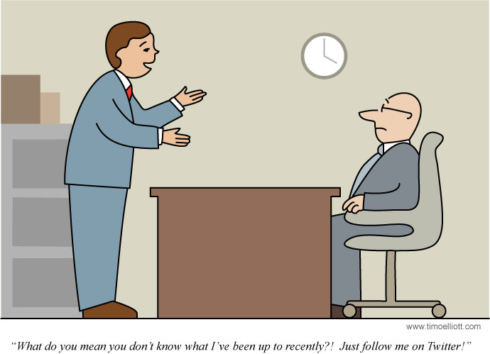
Business & Goal of this project
Analyze the Employee dataset
Identify key factors affecting performance ratings
Accurately predict performance outcomes
Inform HR decision-making
Boost employee performance
Support organizational growth.
Notes:
The project aims to analyze the Employee dataset to identify key factors affecting performance ratings. By understanding these determinants, the company hopes to accurately predict performance ratings and make informed HR decisions, ultimately boosting employee performance and supporting organizational growth.

Slide 4
Key Findings
Department-wise Performance Rating
Top 3 Determinants Impacting Employee Performance
Key Takeaways for HR and Organizations

Slide 5
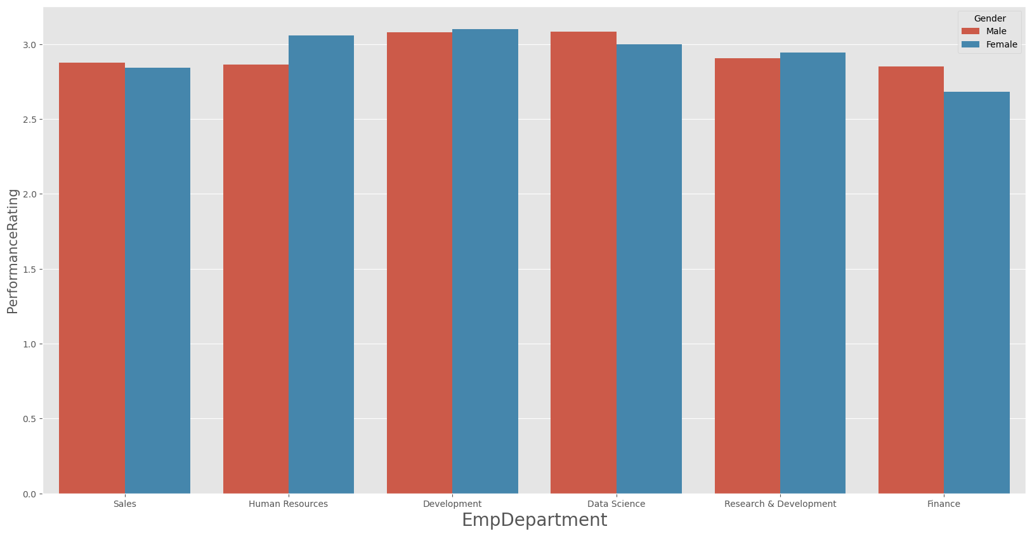
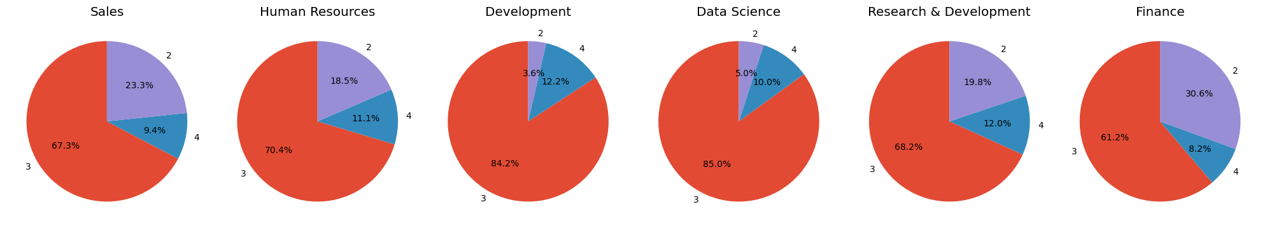
Department-wise Performance Rating
Low
Good
Excellent - All the departments have almost 60-80% excellent employee performance rate
Outstanding
Notes:
In reviewing departmental performance ratings, most departments have a significant 60-80% of employees rated as "excellent." In Sales, men slightly outperform women, while most attain a rating of 3. In Human Resources, male employees lag a bit, but women shine with top performances. In Development, age doesn't differentiate performance, and both genders perform admirably. Data Science stands out with the highest average of level 3 performers, with men slightly ahead. In Research & Development, women are excelling, while age isn't a major differentiator. Finally, in Finance, as employees age, there's a noticeable dip in performance, with men leading in ratings. Experienced female finance professionals face some challenges, as their ratings tend to be a tad lower.

Slide 6
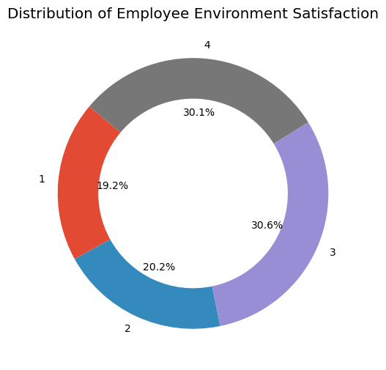
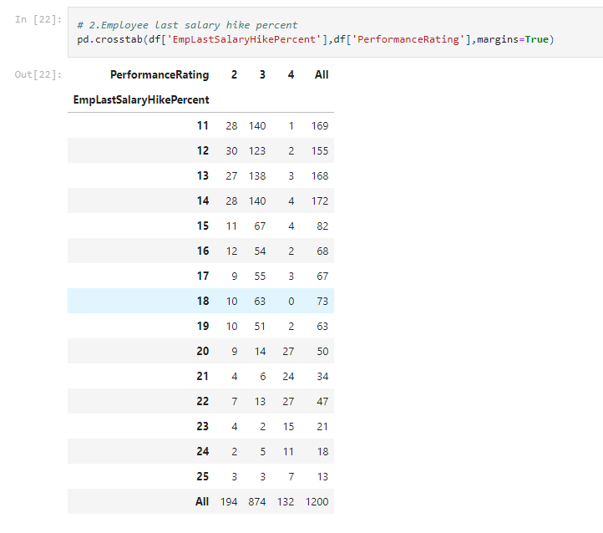
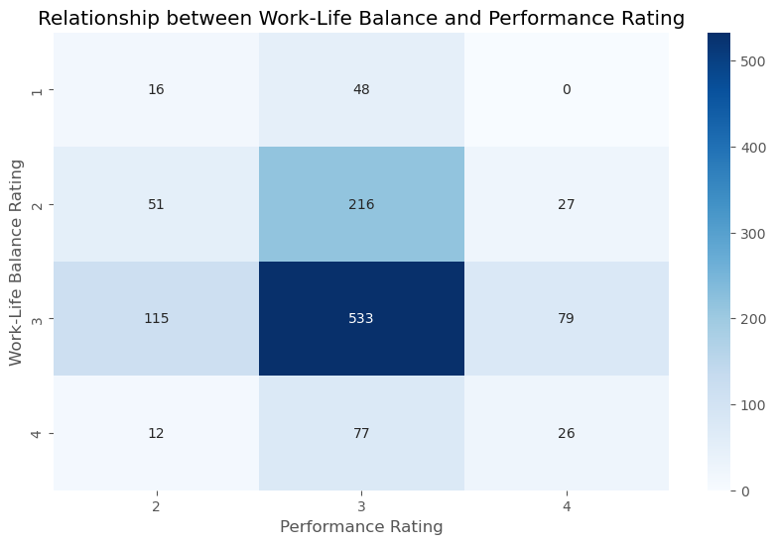
Top 3 Determinants Impacting Employee Performance
Notes:
1. Employee Environment Satisfaction
When it comes to Employee Environment Satisfaction, the majority fall within the High (30.6%) and Very High (30.1%) satisfaction levels, indicating a predominantly positive workplace environment. Employees at these levels enjoy conducive work conditions, with the "Very High" category often benefiting from additional perks and a positive culture. On the other hand, those ranking their satisfaction as Low (19%) are generally discontent, affecting morale and productivity, while the Medium category (20.2%) suggests room for improvement. Overall, maintaining and enhancing environmental satisfaction is crucial for morale, productivity, and employee loyalty.
2. Employee Last Salary Hike Percentage
Employees who received a salary hike between 11-19% primarily fall within 'Good' and 'Excellent' performance ratings, suggesting consistent, albeit not groundbreaking, contributions to the company. They've met or slightly exceeded expectations, hence the considerable hike. Conversely, those who secured a raise between 20-22% predominantly hold an 'Outstanding' rating. This significant increase reflects their exceptional performance and vital impact on the organization. The company, by awarding these substantial hikes, recognizes and aims to retain these top-performing talents.
3. Employee Work-life balance
The heatmap reveals that employees rating their work-life balance as 'Better' often achieve excellent performance. This emphasizes the crucial role of work-life balance in enhancing performance. Such a balance likely results in reduced stress and increased job satisfaction, boosting motivation and productivity. If the 'Better' rating stands out compared to 'Good' or 'Best', it suggests unique conditions or perceptions tied to the 'Better' group, warranting further exploration.

Slide 7

Key Takeaways for HR and Organizations
Focus on Employee Environment Satisfaction
Review Compensation Regularly
Promote Work-Life Balance
Continuous Learning & Development
Feedback Mechanism
Data-Driven Decision Making
Promote Collaboration
Recognition and Reward System
Career Path Clarity
Notes:
To enhance employee satisfaction and performance, it's essential to prioritize workspace improvements, such as ergonomic designs and noise control. Strengthening organizational culture through inclusivity and transparency, and regularly assessing salaries against market benchmarks are critical. Promote work-life balance with flexitime and remote options, while supporting mental health through workshops and counseling. Prioritize continuous learning with targeted training and skill enhancement. Implement regular feedback check-ins, use data-driven approaches for decision-making, and foster collaboration across departments. Celebrate achievements with a reward system, offer clear career progression, and always recognize outstanding performance to motivate others.
By implementing these strategies and continuously evaluating their impact, companies can effectively enhance employee performance ratings over time.

Slide 8
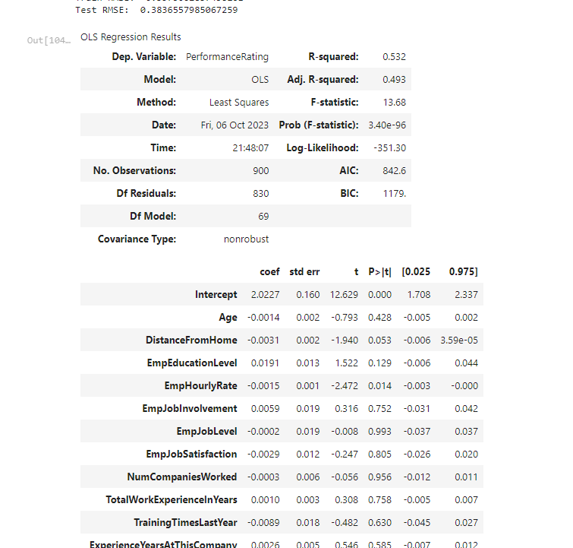
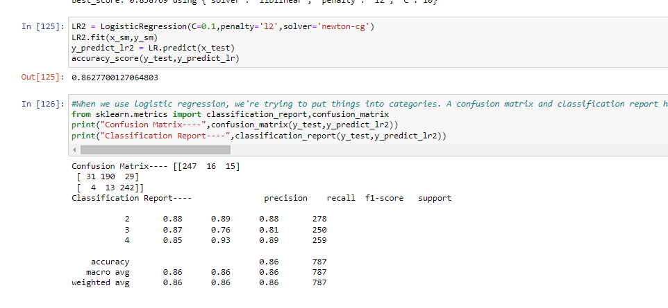
Regression Analysis Insights
Notes:
Linear regression resulted in an R-square value of 0.53, while logistic regression yielded a more promising 0.86. Given the nature of the dataset and the categorization of employee performance ratings, logistic regression proves to be a more suitable model.
Importance of Logistic Regression for This Dataset: Linear regression, which is predominantly used for continuous dependent variables, did not reveal a strong correlation between the variables in this dataset. However, the higher logistic regression score of 0.86 indicates its efficacy in predicting categorical outcomes like employee performance ratings.
In summary, for datasets where the dependent variable is categorical, like our performance ratings, logistic regression offers a more relevant and effective analytical approach compared to linear regression.
When we use logistic regression, we're trying to put things into categories. A confusion matrix and classification report help us see how well we did that. Think of it like a report card for our model. The confusion matrix tells us where our model got things right and where it goofed up. The classification report gives us grades on specifics like how often it was right and how often it missed the mark. Using both helps us figure out if our model's doing a good job or if it needs more training. Cool, right?
What other models you could have used?
Logistic Regression: While it's traditionally used for binary classification, it can be extended for multiclass using techniques like "One-vs-Rest" or "Multinomial".
Decision Trees: They naturally handle multiclass classification.
Random Forest: An ensemble of decision trees, it's great for handling multiple categories.
Gradient Boosting Machines (e.g., XGBoost, LightGBM): Advanced boosting algorithms that handle multiclass scenarios very well.
Support Vector Machines (SVM): With the right kernel and using "One-vs-One" or "One-vs-Rest" strategies.
K-Nearest Neighbors (KNN): Assigns a category based on the majority class among its 'k' nearest data points.
Neural Networks: Deep learning models, especially feed-forward neural networks, can be used for multiclass classification by having the final layer output as many neurons as there are classes, usually combined with a softmax activation.
Naive Bayes: Algorithms like Multinomial Naive Bayes or Gaussian Naive Bayes can be used for multiclass problems.
Linear Discriminant Analysis (LDA): Used to find a linear combination of features that separates multiple classes.
Remember, the best model often depends on the nature of your data and the problem specifics. It's generally a good idea to try out a few different models and see which one works best for your particular dataset and use case.

Slide 9

Thank You
Email: Sneha.bhaskar1995@gmail.com
GitHub: @Sdec30
LinkedIn: https://www.linkedin.com/in/sneha-bhaskar-8aa158186/

Slide 10


