Slide 1


KING COUNTY HOUSE SALES ANALYSIS REPORT
Sneha Bhaskar
Notes:
The dataset is from 2014-2015

Slide 2
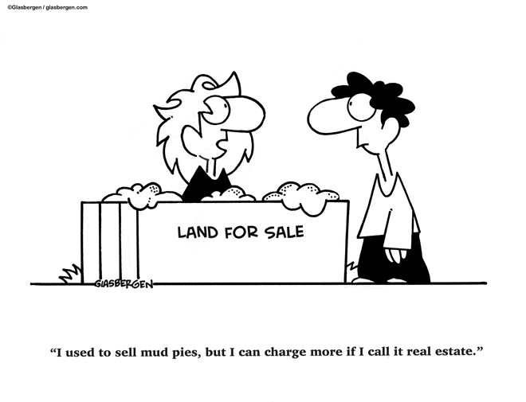
TABLE OF CONTENT
BUSINESS PROBLEM
KEY FINDINGS
RECOMMENDATION

Slide 3

BUSINESS PROBLEM
The Pro Home Builder Company aims to construct residences in King County Washington and wants to identify which housing features to focus on for maximum profitability. By understanding which amenities significantly influence home prices, the company can make data-driven choices on the types of houses to build in order to optimize profits

Slide 4
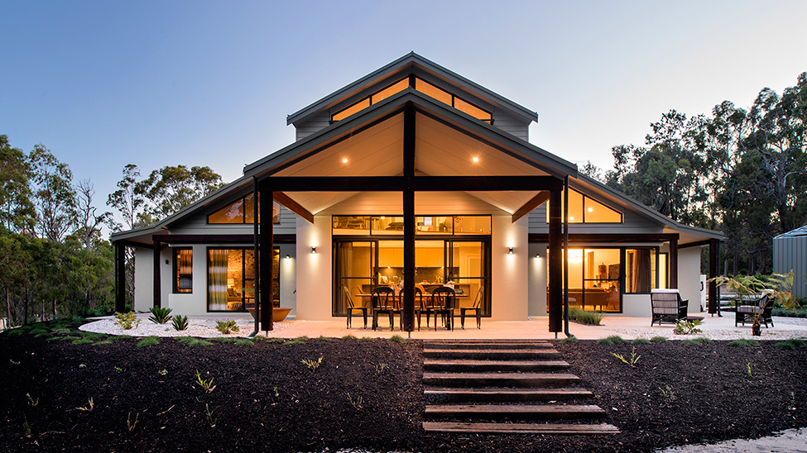
KEY FINDINGS

Slide 5
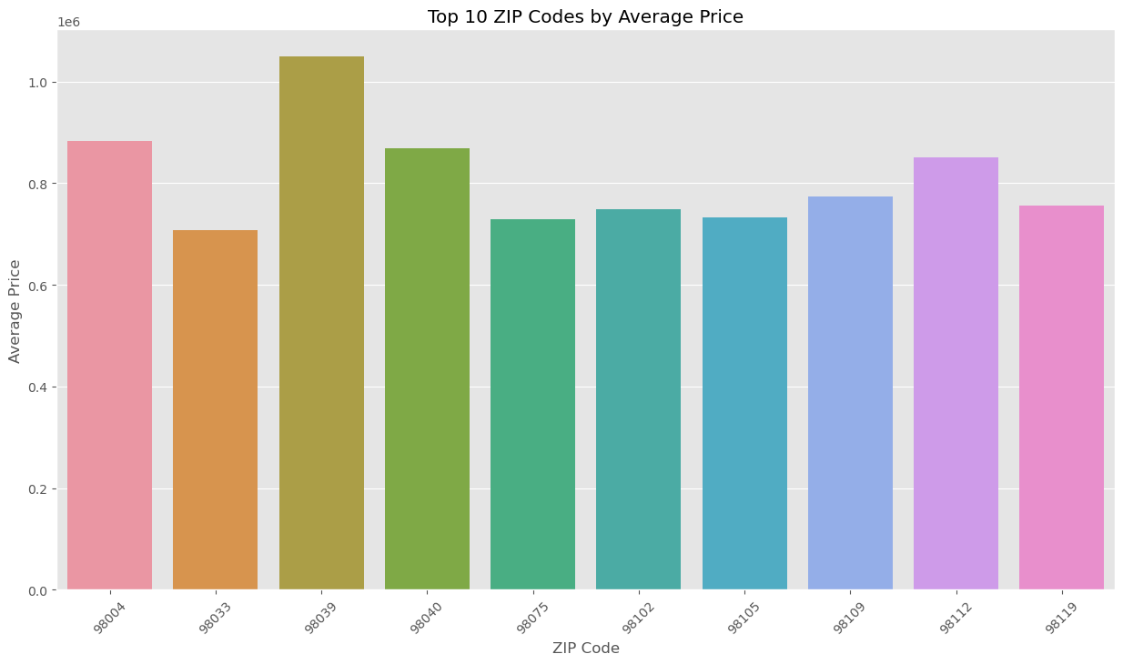
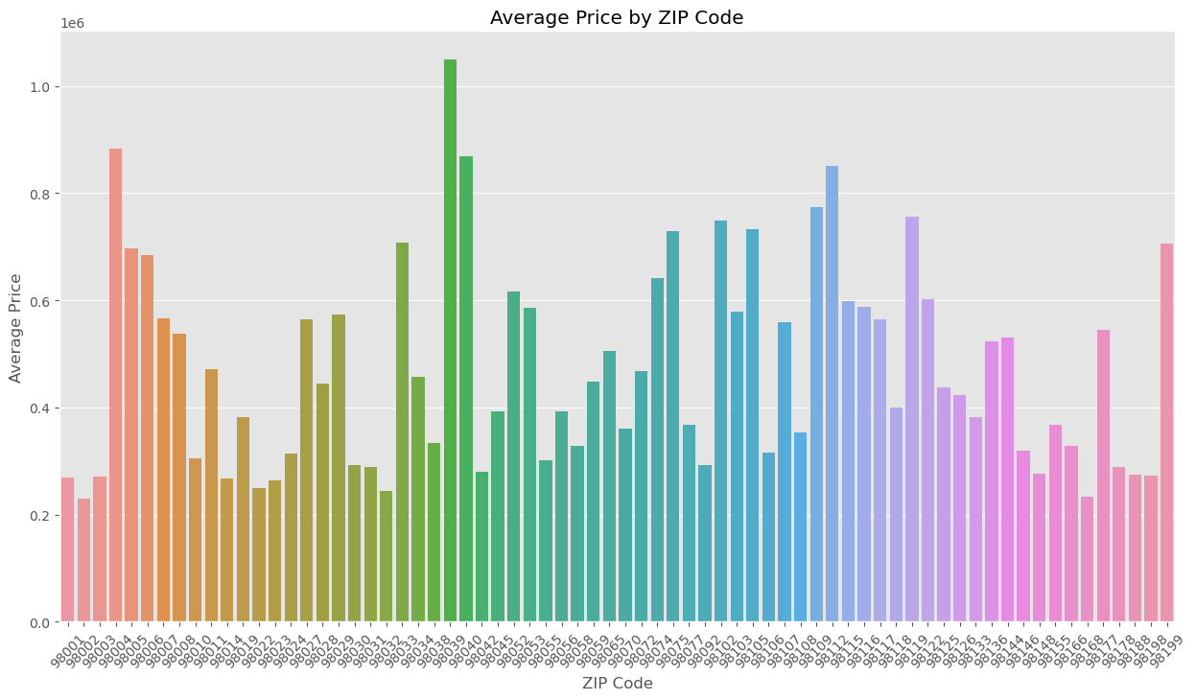
ZIP Codes Vs Price
Notes:
Zip Code:
Property Value: Zip codes are often indicators of property value. More affluent areas usually have higher selling prices, which can result in greater profit margins for builders.
Demographics: Knowing the demographics of a zip code can help builders design homes that appeal to the people most likely to live there, whether they are families, young professionals, retirees, etc.
Regulations and Zoning: Different zip codes may have different building regulations and zoning laws, which can affect the cost and scope of a building project.
Market Demand: Certain zip codes may be more desirable due to factors like school districts, proximity to amenities, or lower crime rates, affecting how quickly homes sell.
Comparative Analysis: Builders can compare construction costs, potential sale prices, and profitability more accurately between different zip codes.
Local Partnerships: Builders may establish connections with local suppliers and subcontractors who are familiar with the requirements and nuances of working in a particular zip code.

Slide 6

TOP SUBURBS IN KING COUNTY
West Bellevue
Kirkland
Medina
Mercer Island
Sammamish
Seattle
Overlake
Education Hill

Slide 7
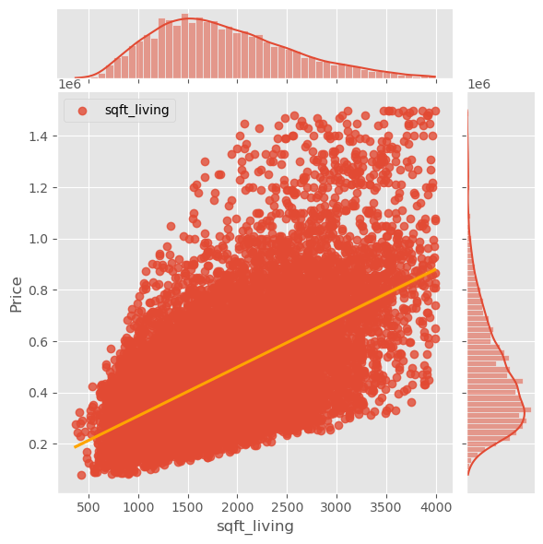
Square Foot Living Vs Price
This visualization shows there seems to be a relatively strong linear relationship between square feet of living space and the price of a house.
1500 - 2500 sqft_living is the most observed footage of the house in this dataset
Notes:
When we talk about a "positive correlation" between square footage and price in real estate, we mean that as one variable goes up, the other tends to go up as well. In simpler terms, bigger homes generally cost more, and smaller homes usually cost less.
There are many factors that contribute to the price of a home, such as location, age, condition, and features, but square footage is one of the most straightforward and easily understandable factors. People intuitively get that more space generally equals a higher price.

Slide 8
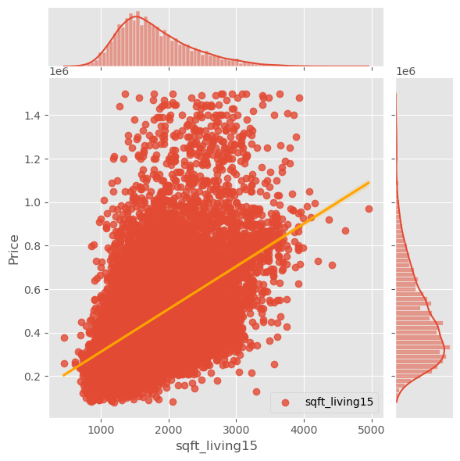
The square footage of interior housing living space for the nearest 15 neighbors Vs Price
Notes:
The square footage of interior housing living space for the nearest 15 neighbors was positively correlated with house price" suggests that as the size of the living space inside houses increases, the price of those houses also tends to increase, at least for a specific group of 15 neighboring houses.
In simpler terms, bigger houses (in terms of living space) among these 15 neighbors are generally more expensive. This is a positive correlation, meaning both variables move in the same direction. When one increases, the other tends to also increase.
For , such a correlation could offer insights into market trends and what factors drive home values in that particular neighborhood.
Understanding that larger homes tend to command higher prices in a specific area can help a builder make informed decisions on project investments and pricing strategies. This knowledge can optimize resource allocation and potentially increase profitability by catering to market demand for larger living spaces. However, this insight should be balanced with other market factors for a comprehensive approach such as grading.

Slide 9
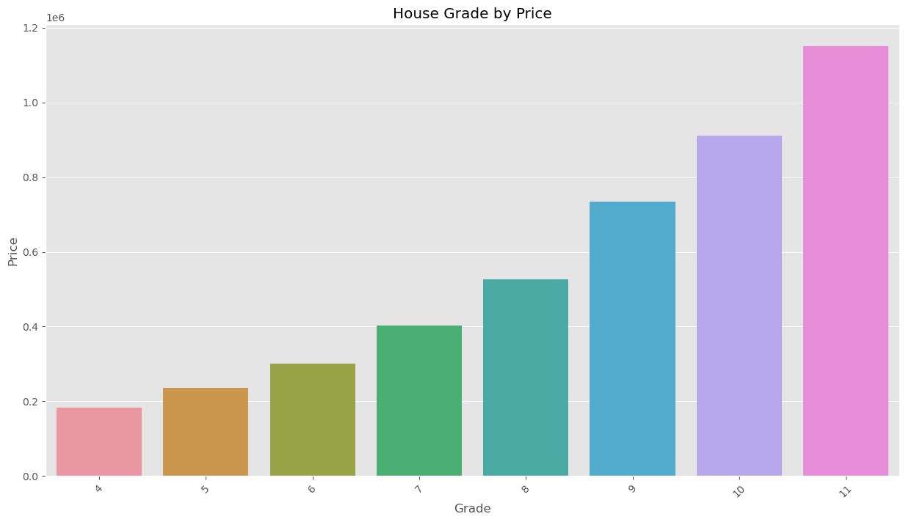
House Grade by Price
The visualization above shows that when the building grade improves, the house price rises as well. We can see in the bar plot that the mean house price for a home with a grade of 11 is far above other grades. While the building grade of 4 falls short of minimum building standards based on the King County grading system.
Notes:
Building grade:
Represents the construction quality of improvements. Grades run from grade 1 to 13. Generally defined as:
1-3 Falls short of minimum building standards. Normally cabin or inferior structure.
4 Generally older, low quality construction. Does not meet code.
5 Low construction costs and workmanship. Small, simple design.
6 Lowest grade currently meeting building code. Low quality materials and simple designs.
7 Average grade of construction and design. Commonly seen in plats and older sub-divisions.
8 Just above average in construction and design. Usually better materials in both the exterior and interior finish work.
9 Better architectural design with extra interior and exterior design and quality.
10 Homes of this quality generally have high quality features. Finish work is better and more design quality is seen in the floor plans. Generally have a larger square footage.
11 Custom design and higher quality finish work with added amenities of solid woods, bathroom fixtures and more luxurious options.
12 Custom design and excellent builders. All materials are of the highest quality and all conveniences are present.
13 Generally custom designed and built. Mansion level. Large amount of highest quality cabinet work, wood trim, marble, entry ways etc.

Slide 10
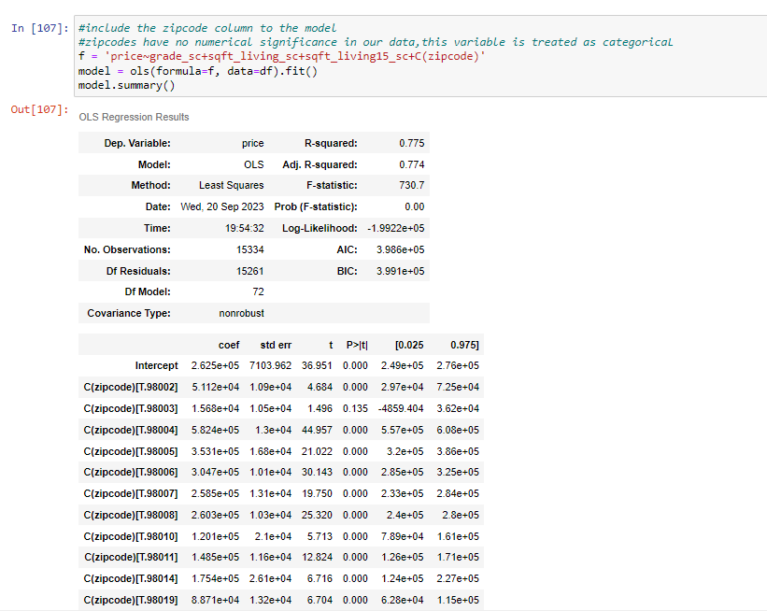
Regression analysis
The results of the analysis were as follows:
The model above with an R-squared value of 0.775, telling us that the model fits the data with an accuracy of 78%, We can confidently say that zip code is one of the strongest influencers on the value of homes in King County.
Other features that were positively correlated with price included:
Square footage of living space, which was positively correlated with house prices.
Building grade, which was positively correlated with house prices
The square footage of interior housing living space for the nearest 15 neighbors which was also positively correlated with house price.
Notes:
Upon conducting multiple regression analyses, the fifth model demonstrated a robust R-squared value of 0.775 USING ONLY SELECTED VARIABLES LIKE PRICE, GRADE, SQFT LIVING, AND SQFT LIVING OF NEAREST 15 NEIGHBORS, signifying that approximately 78% of the variability in home prices within King County can be explained by the predictors in the model. Notably, the postal code emerged as one of the most significant determinants influencing property valuation. Additional variables that were positively correlated with property prices include:
Living Space Square Footage
Building Grade, as per the King County Grading System
Average Interior Square Footage of the Nearest 15 Residences

Slide 11

Strategic Recommendations for a Pro Home Builder Company
Strategic Location Selection
Optimize Living Space
Quality of Construction
Neighborhood Composition
Notes:
Strategic Recommendations for a Pro Home Builder Company:
To optimize the profitability and marketability of residential properties in King County, the following strategies are recommended:
Strategic Location Selection: Prioritize property acquisition in high-value zip codes to benefit from the area's intrinsically higher property valuations.
Optimize Living Space: Expand the square footage of the living area to align with the positive correlation observed between living space and property value.
Quality of Construction: Employ premium-quality building materials and construction techniques to secure the highest possible building grade according to the King County Grading System. This will not only enhance the property's intrinsic value but also its appeal to potential buyers.
Neighborhood Composition: Opt for land parcels where the surrounding 15 residences have a higher average interior square footage. This is indicative of a neighborhood's overall property value and can positively influence the value of the new development.
By implementing these targeted strategies, housing development firms can substantially increase the likelihood of marketing higher-priced homes in King County

Slide 12

FUTURE WORK
Notes:
In the future, the next steps would be reducing noise in the data to improve the accuracy of our model. Additionally, I would like to investigate certain features like proximity to good schools, and other facilities like hospitals, gyms, restaurants, and playgrounds that could eventually boost the pricing of that suburbs.

