Slide 1


KINGS COUNTY HOUSE SALES ANALYSIS REPORT
Sneha Bhaskar

Slide 2
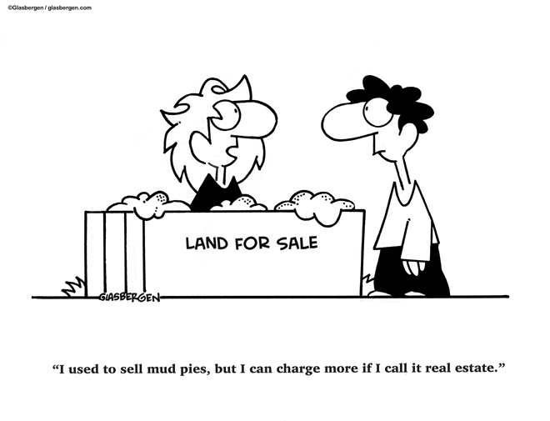
TABLE OF CONTENT
BUSINESS PROBLEM
KEY FINDINGS
RECOMMENDATION

Slide 3

BUSINESS PROBLEM
The Pro Home Builder Company aims to construct residences in King County Washington and wants to identify which housing features to focus on for maximum profitability. By understanding which amenities significantly influence home prices, the company can make data-driven choices on the types of houses to build in order to optimize profits

Slide 4
KEY FINDINGS

