Slide 1



Slide 2
Agenda
What is Prometheus
What is Grafana
Why Grafana
Grafana Competitors
Grafana Vs Kibana
Installing Grafana
Use Case
Q & A

Slide 3


Prometheus

Slide 4
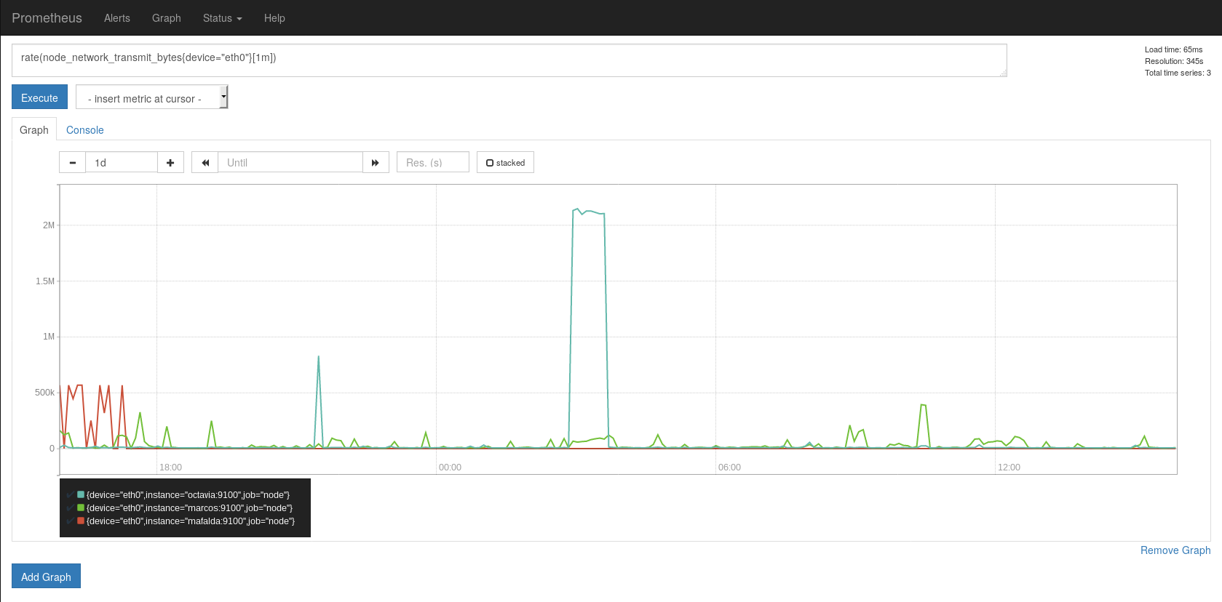
Prometheus is an open-source systems monitoring and alerting toolkit originally built at SoundCloud. Prometheus works well for recording any purely numeric time series. It fits both machine-centric monitoring as well as monitoring of highly dynamic service-oriented architectures. Software was developed because of need to monitor multiple micro services that might be running on system.
One of the strongest point would be Prometheus supports multiple Exporter.

Slide 5
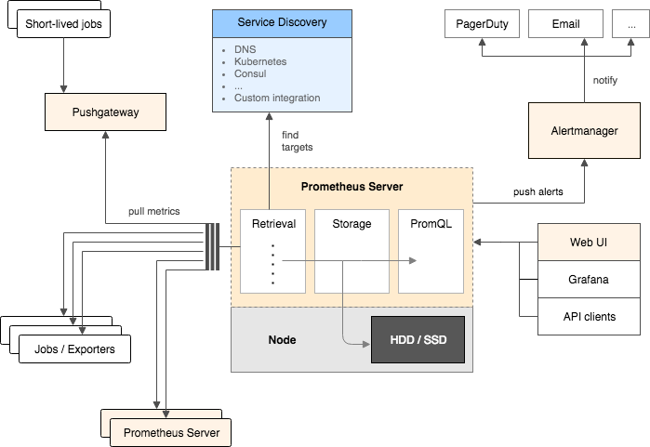
Prometheus Architecture:

Slide 6
GRAFANA

Slide 7
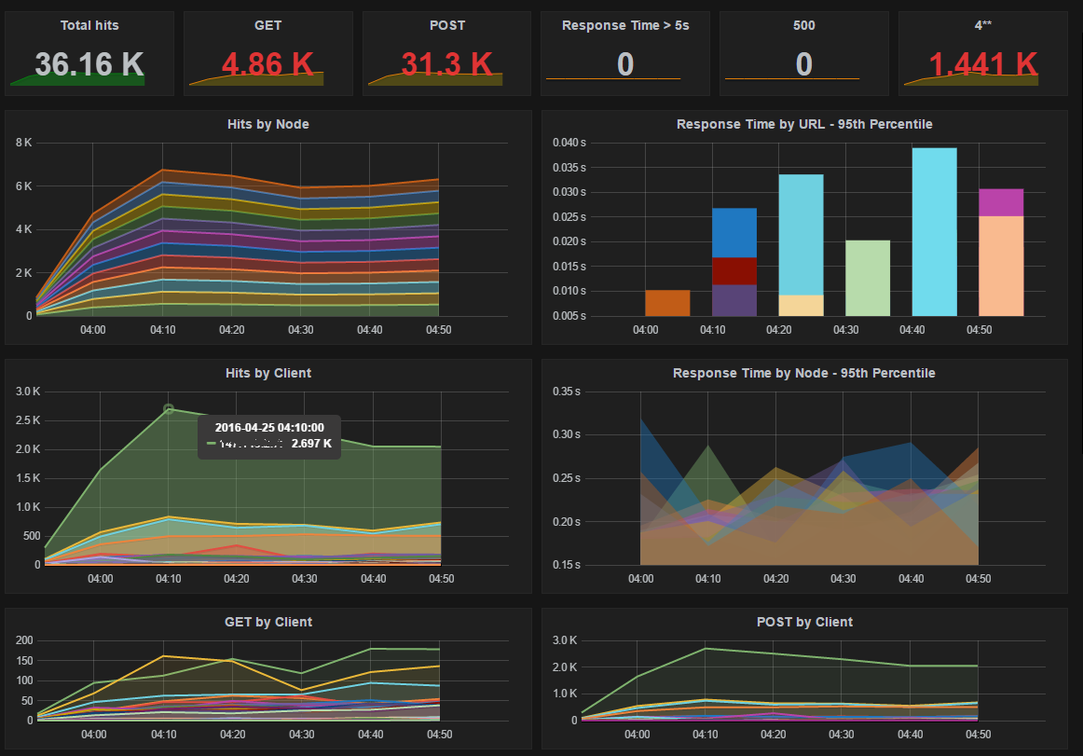
What is Grafana?
Grafana is an open source metric analytics & visualization suite. It is most commonly used for visualizing time series data for infrastructure and application analytics.
Grafana supports many different storage backend for your time series data (Data Source). Each Data Source has a specific Query Editor that is customized for the features and capabilities that the particular Data Source exposes.
Source: https://www.codeproject.com/Articles/1094405/Powerful-IIS-Apache-Monitoring-dashboard-using

Slide 8
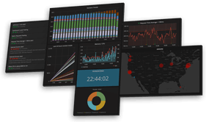

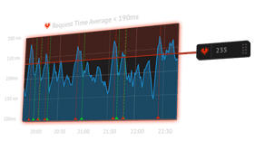
Why Grafana
Visualize
Unify
Grafana has plenty of visualization options from heatmap to histogram, Graph to geomap, to help users understand data beautifully without much effort.
Grafana supports dozens of Data Source, natively. Users can mix different Data Source in a single Dashboard
Alert
Visually define alert rules for important metrics. Grafana will continuously evaluate them and can send notifications.

Slide 9

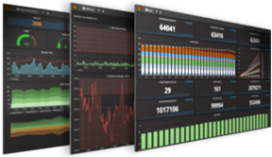

Open
Collaborate
Grafana is completely open source and can be installed easily on any platform
Grafana empowers users, and helps foster a data driven culture.
Extend
Plenty of Dashboards and Plugins are available in Grafana official library and new ones get added up every week by community

Slide 10



Grafana Competitors
Competitors | Difference seen
 | Advantage that Grafana has over Datadog is, the ability to export and import dashboards via JSON files
 | Both Kibana and Grafana are powerful visualization tools. Find the major difference in slide 6
 | Grafana is only a visualization solution. Prometheus can do the data collection part along with the storage
Datadog
Kibana
Prometheus

Slide 11
Major difference found in close competitor
Kibana | Grafana
Can create a comprehensive log analytics dashboard | Grafana focuses on presenting time-series charts based on specific metrics such as CPU and I/O utilization
There are no built-in role-based access (RBA) controls. If you need to set up permission levels for multiple users, you will have to purchase Shield to add the additional configuration overhead. | Grafana’s built-in RBA allows you to maintain user and team access to dashboards. In addition, Grafana’s rich API can be used for tasks such as saving a specific dashboard, creating users, and updating data sources.
Kibana’s native integration within the ELK Stack makes the setup fairly simple and user-friendly. | Grafana supports many different storage backend. For each data source, Grafana has a specific query editor that is customized for the features and capabilities that are included in that data source

Slide 12
Installing Grafana
Installing on Windows : http://docs.grafana.org/installation/windows/
Installing on Debian / Ubuntu : http://docs.grafana.org/installation/debian/
Installing on CentOS/ RedHat : http://docs.grafana.org/installation/rpm/

Slide 13
Use Case Flow
Use Case: In Grafana using Prometheus as Data source, monitor CentOS metrics
Install Prometheus
Install Node Exporter for Prometheus
Run Node Exporter as a Service to get Metrics(CPU load, Memory usage etc.)
Start Prometheus Server
Start Grafana and add Prometheus as Data source

Slide 14
Use Case set up
Node Exporter
Prometheus
Grafana

Slide 15
Step1: Installing Prometheus
Step1: Login as Root user and create a new directory to have all downloads in one place
Step2: Use curl to download the latest build of the Prometheus server and time-series database from GitHub
Step3: It is better to have all components in one directory, so create one using mkdir
Step4: Enter the directory you just created
Step5: Use tar to extract prometheus-0.16.0.linux-amd64.tar.gz
Step6: This completes the installation of Prometheus server. Verify the installation by typing in the following command:
$ mkdir ~/Downloads
$ cd ~/Downloads
$ curl -LO "https://github.com/prometheus/prometheus/releases/download/0.16.0/prometheus-0.16.0.linux-amd64.tar.gz"
$ mkdir ~/Prometheus
$ cd ~/Prometheus
$ tar -xvzf ~/Downloads/prometheus-0.16.0.linux-amd64.tar.gz
$ ~/Prometheus/prometheus-0.16.0.linux-amd64/prometheus -version

Slide 16
Step 2: Installing Node Exporter
Prometheus was developed for the purpose of monitoring web services. In order to monitor the metrics of your CentOS server, Install a tool called Node Exporter. Node Exporter, exports lots of metrics (such as disk I/O statistics, CPU load, memory usage, network statistics, and more) in a format Prometheus understands.
Step1: Enter the Downloads directory and use curl to download the latest build of Node Exporter which is available on GitHub
Step2: Create a new directory called node_exporter inside the Prometheus directory, and get inside it
Step3: You can now use the tar command to extract node_exporter-0.11.0.linux-amd64.tar.gz
$ cd ~/Downloads && curl -LO "https://github.com/prometheus/node_exporter/releases/download/0.11.0/node_exporter-0.11.0.linux-amd64.tar.gz"
$ mkdir ~/Prometheus/node_exporter
$ cd ~/Prometheus/node_exporter
$ tar -xvzf ~/Downloads/node_exporter-0.11.0.linux-amd64.tar.gz

Slide 17
Step3: Running Node Exporter as a Service
To make it easy to start and stop Node Exporter, let us now convert it into a service
This file should contain the path of the node_exporter executable. Add the following code and save
Reload systemd so that it reads the configuration file you just created
$ sudo vi /etc/systemd/system/node_exporter.service
[Unit]
Description=Node Exporter
[Service]
User=prometheus
ExecStart=/home/prometheus/Prometheus/node_exporter/node_exporter
[Install]
WantedBy=default.target
$ sudo systemctl daemon-reload

Slide 18
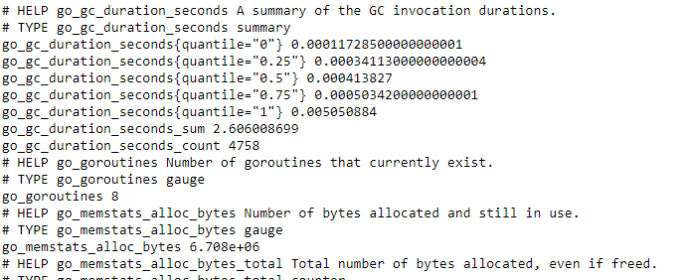
At this point, Node Exporter is available as a service which can be managed using the systemctl command. Enable it so that it starts automatically at boot time
Command to start the service manually
Once it starts, use a browser to view Node Exporter's web interface, which is available at http://your_server_ip:9100/metrics.
You should see a page with a lot of text:
$ sudo systemctl enable node_exporter.service
$ systemctl start node_exporter.service

Slide 19
Step4: Starting Prometheus Server
Enter the directory where you installed the Prometheus server
Before you start Prometheus, you must first create a configuration file for it called prometheus.yml
Copy the following code into the file.
This creates a scrape_configs section and defines a job called node. It includes the URL of your Node Exporter's web interface in its array of targets.
The scrape_interval is set to 15 seconds so that Prometheus scrapes the metrics once every fifteen seconds.
$ cd ~/Prometheus/prometheus-0.16.0.linux-amd64
$ vi ~/Prometheus/prometheus-0.16.0.linux-amd64/prometheus.yml
scrape_configs:
- job_name: "node"
scrape_interval: "15s"
target_groups:
- targets: ['localhost:9100']

Slide 20
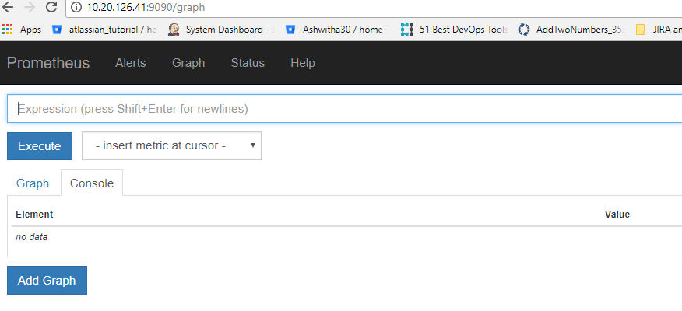
Start the Prometheus server as a background process
Redirected the output of the Prometheus server to a file called prometheus.log. You can view the last few lines of the file using the tail command:
Visit Prometheus's homepage available at http://your_server_ip:9090
$ nohup ./prometheus > prometheus.log 2>&1 &
$ tail ~/Prometheus/prometheus-0.16.0.linux-amd64/prometheus.log

Slide 21
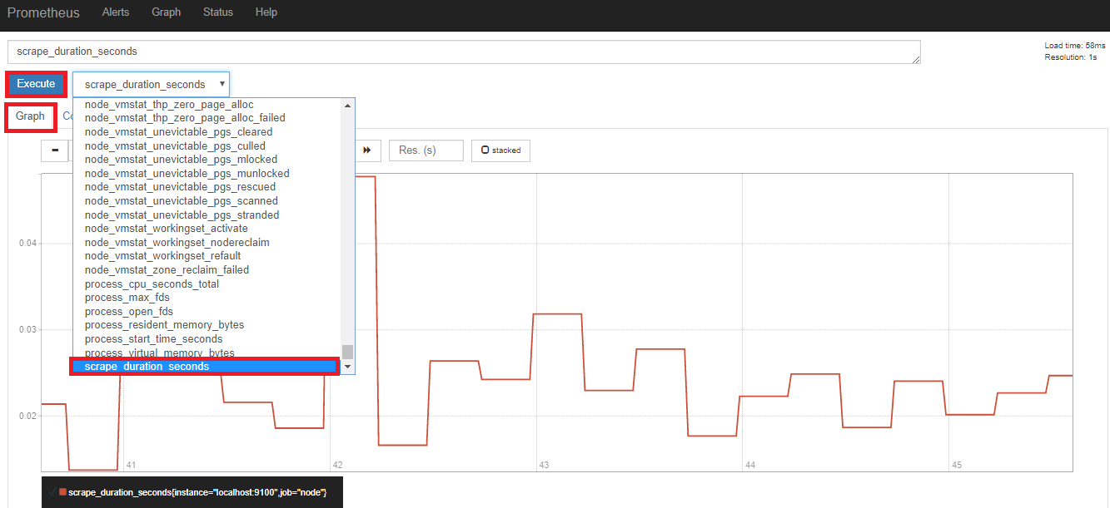
To make sure that Prometheus is scraping data from Node Exporter, click on the Graph tab at the top of the page. Type in the name of a metric in the text field that says Expression. Then, press Execute button

Slide 22
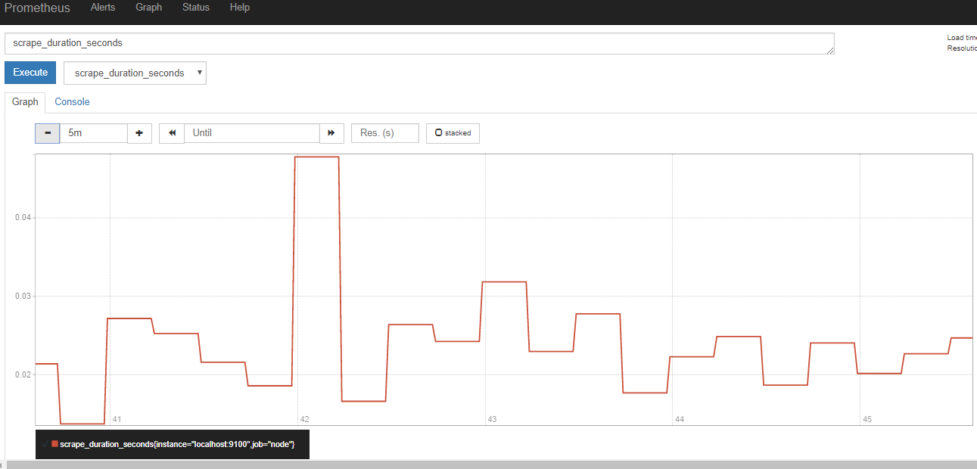
The following Graph will be displayed in Prometheus for executed query

Slide 23
Step5: Start Grafana and add Prometheus as Data source
Creating a Data source
Follow below procedure to create a Prometheus data source
Click on the Grafana logo to open the sidebar menu.
Click on "Data Sources" in the sidebar.
Click on "Add New".
Select "Prometheus" as the type.
Set the appropriate Prometheus server URL (for example, http://localhost:9090/)
Adjust other data source settings as desired (for example, turning the proxy access off).
Click "Add" to save the new data source.

Slide 24
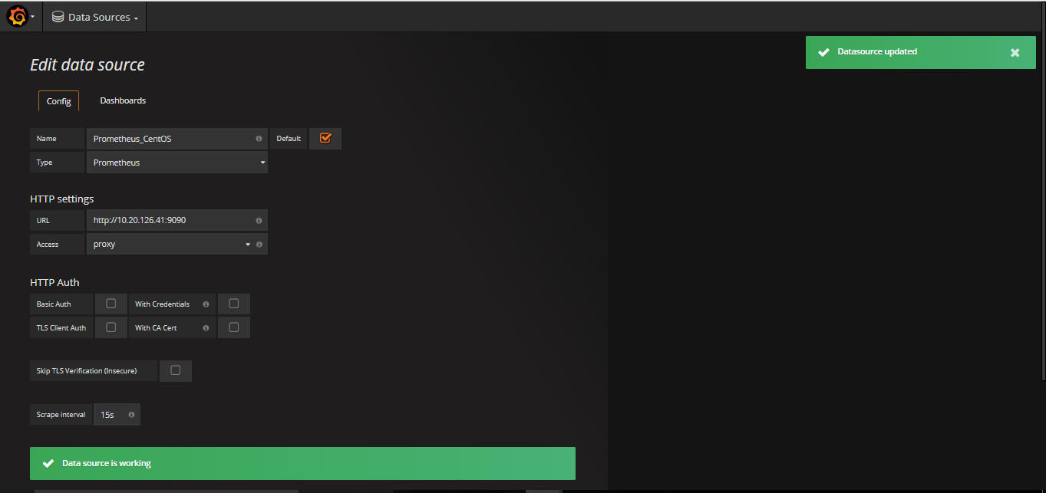
Example Data source configuration

Slide 25
Creating Dashboard
Follow the steps for adding a new Grafana dashboard
Click on the Grafana logo -> Dashboards -> New
Select the type of Panel (Graph, Heatmap, Table etc.)
Click the graph title(Panel Title), then click "Edit".
Under the "Metrics" tab, select your Prometheus data source (bottom right).
Enter any Prometheus expression into the "Query" field, while using the "Metric" field to lookup metrics via autocompletion.
Tune other graph settings until you have a working graph.

Slide 26
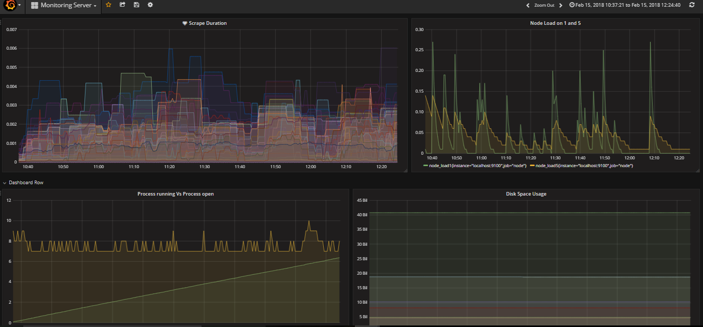
Grafana Dashboard
Example of different Metrics from Prometheus Data Source

Slide 27
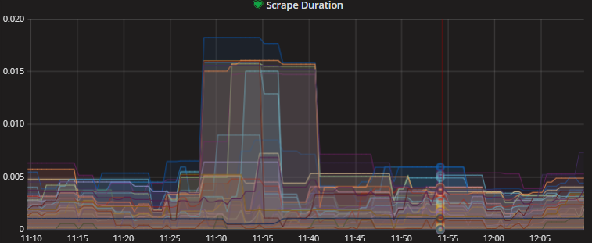
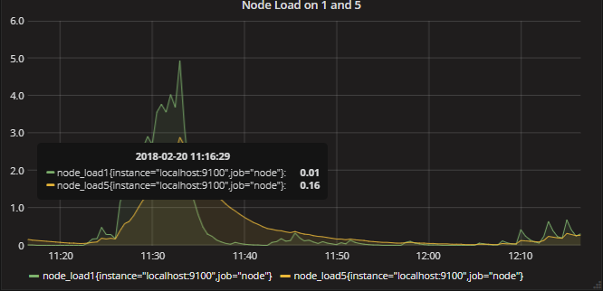
Query for each Graph
Title:
Scrape Duration
Metric Query:
node_exporter_scrape_duration_seconds
Title:
Comparison of Node Load on 1 and Load on 5
Metric Query:
A: node_load1
B: node_load5

Slide 28
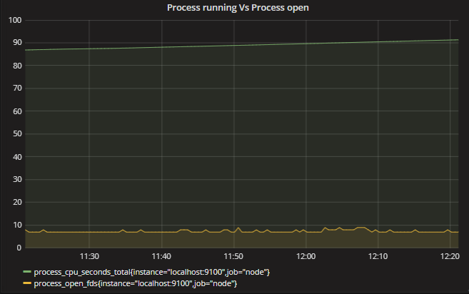
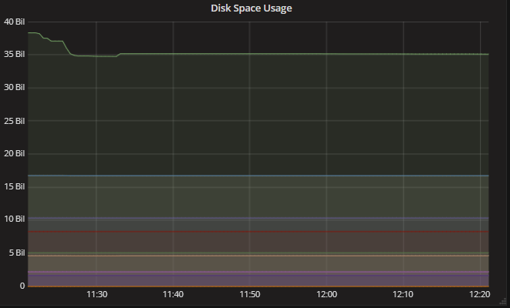
Query for each Graph
Title:
Process running Vs Process open
Metric Query:
A: process_cpu_seconds_total
B: process_open_fds
Title:
Disk Space Usage
Metric Query:
node_filesystem_free

Slide 29
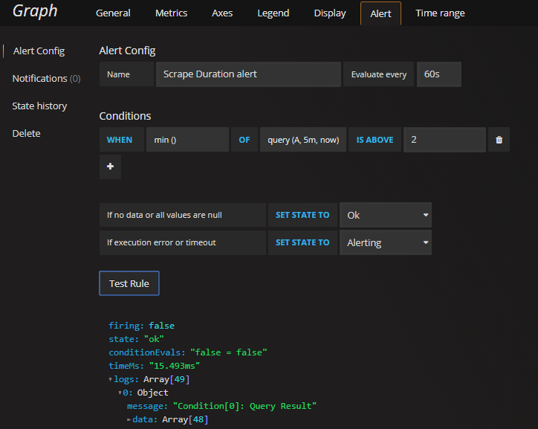
Setting Alerts
Alerting in Grafana allows you to attach rules to your dashboard panels. When you save the dashboard Grafana will extract the alert rules into a separate alert rule storage and schedule them for evaluation.
In the alert tab of the graph panel you can configure how often the alert rule should be evaluated and the conditions that need to be met for the alert to change state and trigger its notifications.
Rule Configuration :

Slide 30
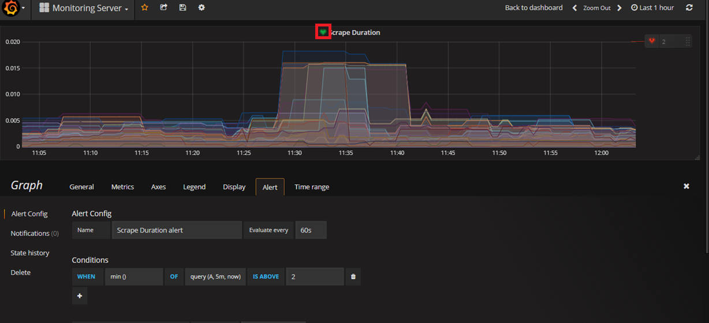
Monitoring Heath:

Slide 31
The above Use case can be viewed in Red Hat Enterprise Linux 7 machine, 10.20.126.41
Prometheus : http://10.20.126.41:9090/
Node Exporter : http://10.20.126.41:9100/metrics
Grafana : http://10.20.126.41:3000/
User name: admin
Password : admin
References
http://docs.grafana.org/features/datasources/prometheus/
http://docs.grafana.org/installation/rpm/
http://docs.grafana.org/v3.1/datasources/prometheus/
https://www.digitalocean.com/community/tutorials/how-to-use-prometheus-to-monitor-your-centos-7-server
https://logz.io/blog/grafana-vs-kibana/

Slide 32
Responsibility | Owner
POC by | Ashwitha H N <AH00353362@TechMahindra.com>
Reviewed by | Ragesh Neelakanta Pillai <RP00544708@TechMahindra.com>
Approved by

Slide 33
Thank you
Visit us at www.techmahindra.com

