Slide 1
Bitbucket-Jenkins-MongoDB Integration for Deployment

Slide 2
Table of contents
What is mongoDB
Architectural feature of mongoDB
Bitbucket-Jenkins-MongoDB Integration and Deployment
Installation steps
Integrate with Bitbucket
What is Webhooks?
Jenkins and MongoDB integration
Configuring Jenkins Jobs for Document Upload
JSON Document to be uploaded to MongoDB
Restoring database from Bitbucket to Mongodb
Taking backup of mongodb and storing it in Bitbucket
Taking mongoDB backup to filesystem

Slide 3
MongoDB is a cross platform and open source document oriented NoSQL database.
What is MongoDB?
Key Features:-
MongoDB stores data in flexible, JSON-like documents, meaning fields can vary from document to document and data structure can be changed over time.
The document model maps to the objects in your application code, making data easy to work with.
Ad hoc queries, indexing, and real time aggregation provide powerful ways to access and analyze your data.
MongoDB is a distributed database at its core, so high availability, horizontal scaling, and geographic distribution are built in and easy to use.
MongoDB is free and open-source, published under the GNU Affero General Public License.

Slide 4
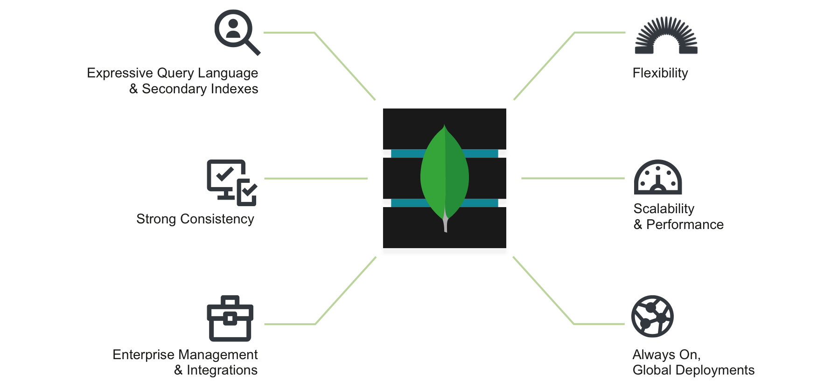
Architectural feature of MongoDB

Slide 5
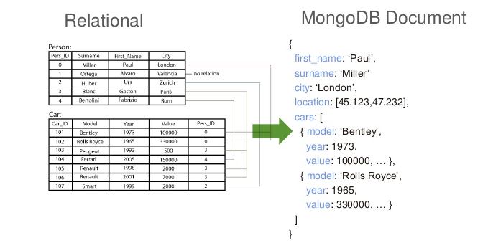
Data Models : Relational to Document

Slide 6
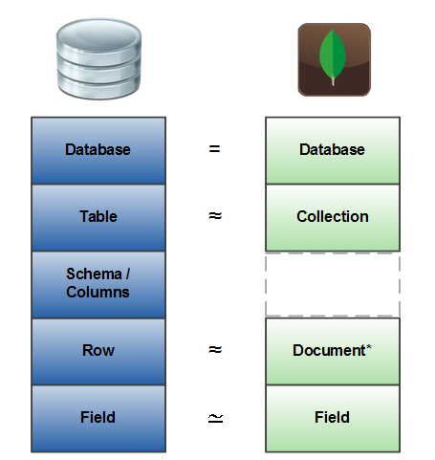
Rdbms and MongoDB Terminology comparison

Slide 7
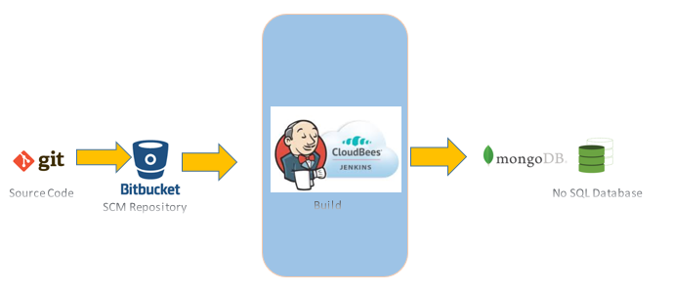
Bitbucket-Jenkins-MongoDB Integration and Deployment

Slide 8
Installation Steps
Install and configure MongoDB
Integrate Jenkins with Bitbucket
Web hooks configuration in Jenkins
Jenkins and MongoDB Integration
Upload JSON files to MongoDB

Slide 9
Install MongoDB Community Edition on Red Hat Enterprise or CentOS Linux
Create a file /etc/yum.repos.d/mongodb-org-3.6.repo, so that you can install MongoDB directly, using yum
#touch /etc/yum.repos.d/mongodb-org-3.6.repo
#vi /etc/yum.repos.d/mongodb-org-3.6.repo
==================================================
[mongodb-org-3.6]
name=MongoDB Repository
baseurl=https://repo.mongodb.org/yum/redhat/$releasever/mongodb-org/3.6/x86_64/
gpgcheck=1
enabled=1
gpgkey=https://www.mongodb.org/static/pgp/server-3.6.asc
====================================================

Slide 10
Continued…..
To install the latest stable version of MongoDB, issue the following command:
Start a mongo shell on the same host machine as the mongod. Use the --host command line option to specify the localhost address and port that the mongod listens on:
#yum install -y mongodb-org
#service mongod start
#chkconfig mongod on
#mongo --host 127.0.0.1:27017

Slide 11


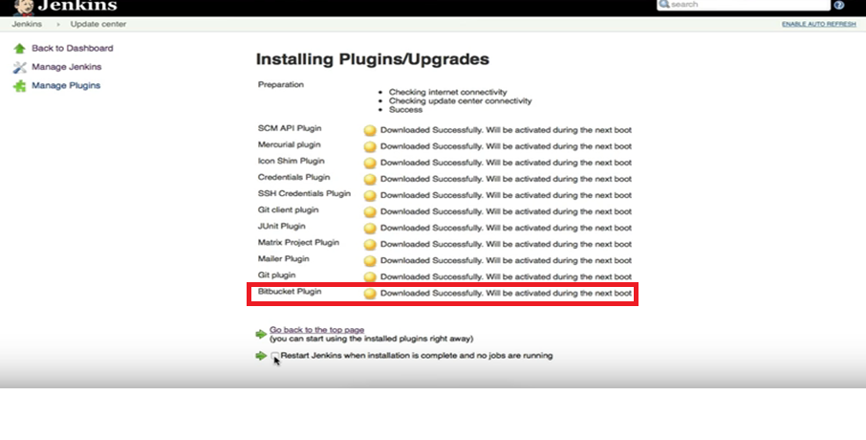
Install Bitbucket Plugin
Integrate with Bitbucket : build after each commit

Slide 12
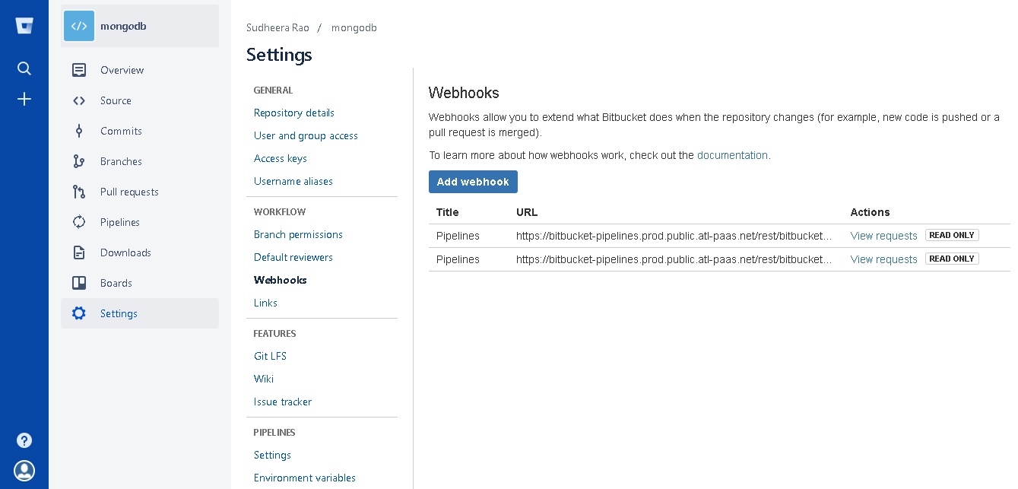
What is Webhooks?
Webhooks to integrate applications with Bitbucket Server.
Every time a user pushes commits into repository, It will notify to Jenkins to start a build.
Every time a user pushes commits or creates a pull request, you may want to display a notification in your application.

Slide 13
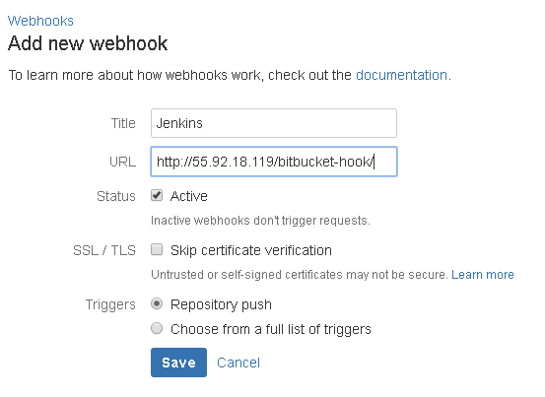
Creating Webhooks

Slide 14
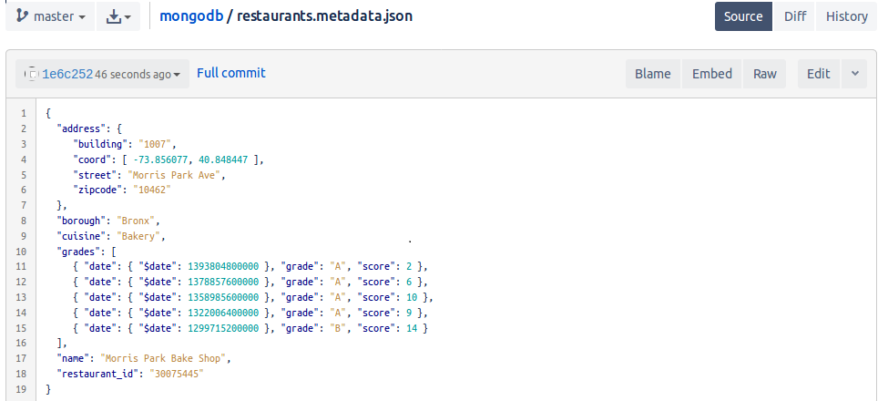
JSON Document to be uploaded to MongoDB

Slide 15

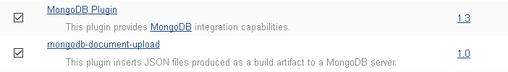
Install below 2 mongoDB plugins for Jenkins
1) MongoDB Plugin
2) mongdb-document-upload
Jenkins and MongoDB integration

Slide 16
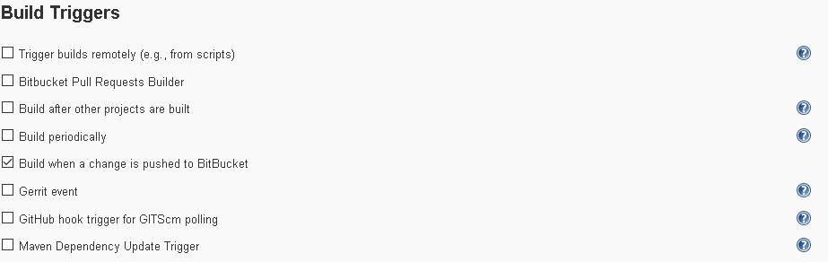
Configuring Jenkins Jobs for Document Upload

Slide 17
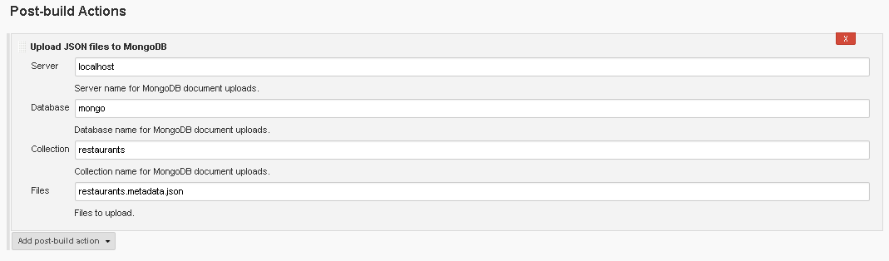
Continued…….

Slide 18
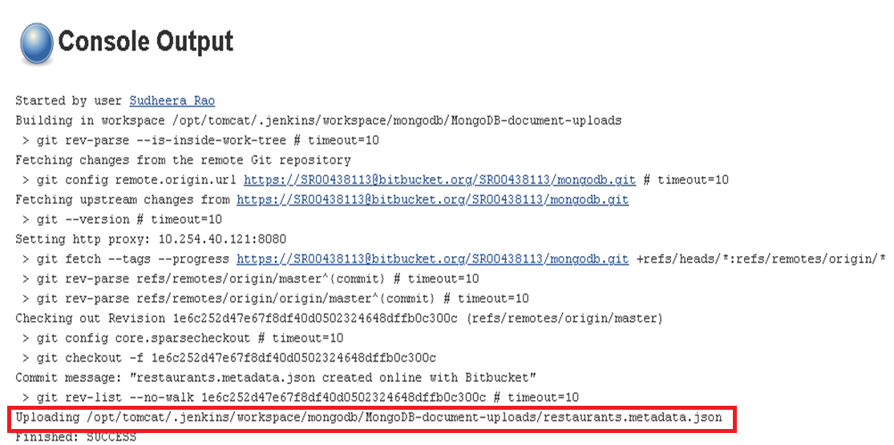

Slide 19
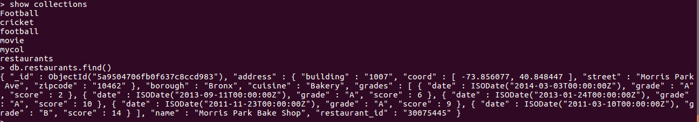
MongoDB console Output

Slide 20
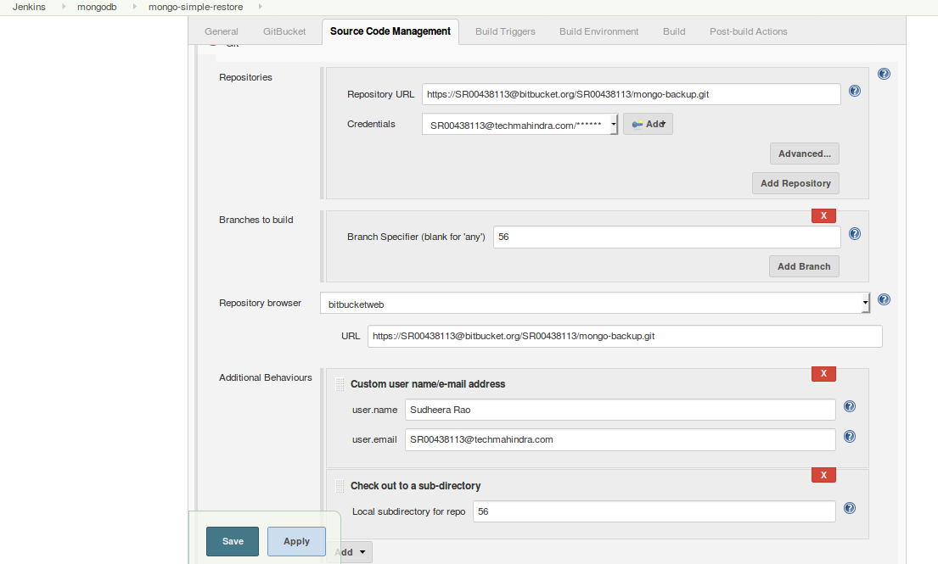
Restoring database from Bitbucket to Mongodb

Slide 21
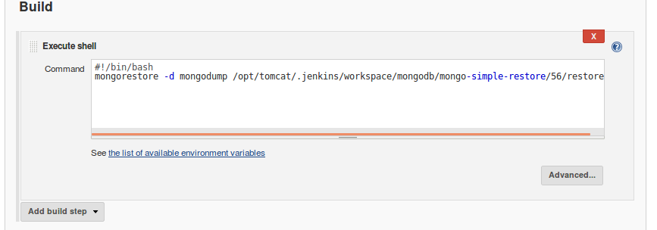
Continued…….
Copy the code below:
#!/bin/bash
mongorestore -d mongodump /opt/tomcat/.jenkins/workspace/mongodb/mongo-simple-restore/56/restore/

Slide 22
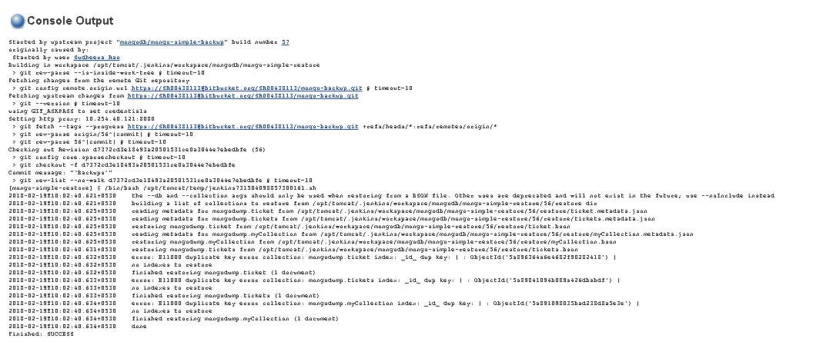

Slide 23
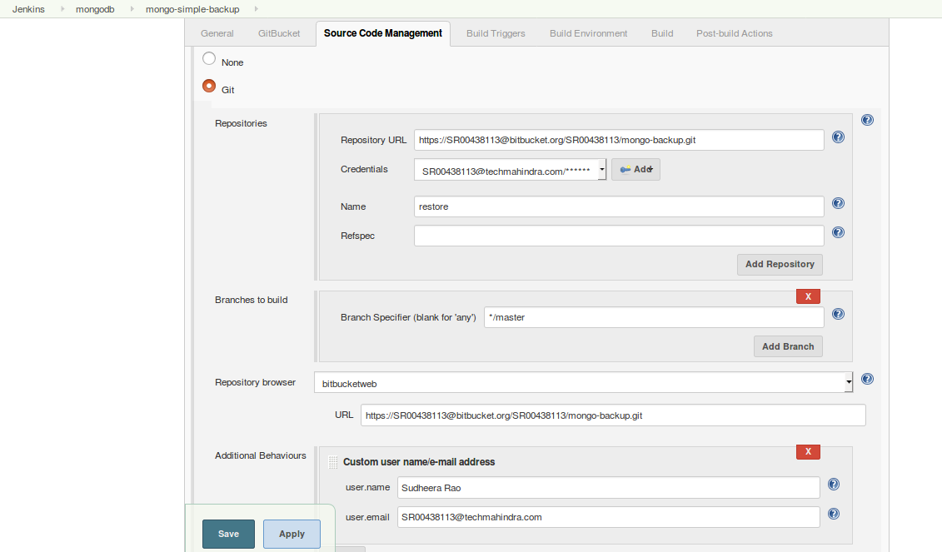
Taking backup of mongodb and storing it in bitbucket

Slide 24
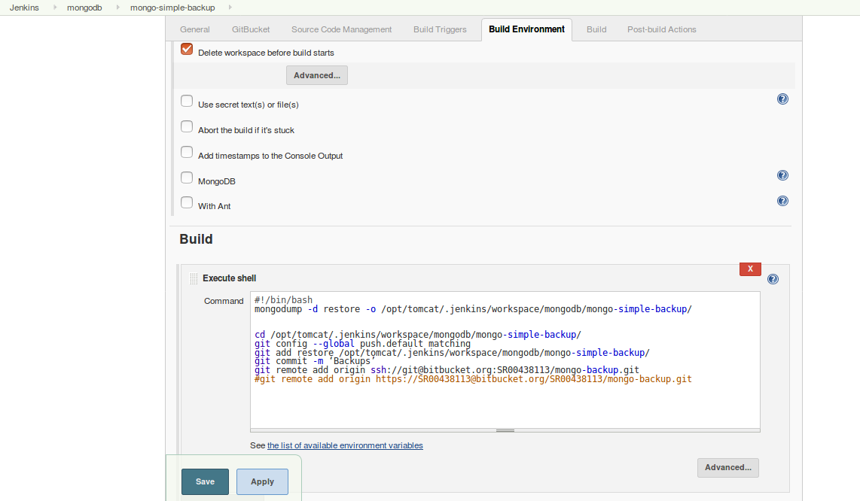
Continued…….

Slide 25
#!/bin/bash mongodump -d restore -o /opt/tomcat/.jenkins/workspace/mongodb/mongo-simple-backup/ cd /opt/tomcat/.jenkins/workspace/mongodb/mongo-simple-backup/ git config --global push.default matching git add restore /opt/tomcat/.jenkins/workspace/mongodb/mongo-simple-backup/ git commit -m ‘Backups’ git remote add origin ssh://git@bitbucket.org:SR00438113/mongo-backup.git
Continued…….

Slide 26
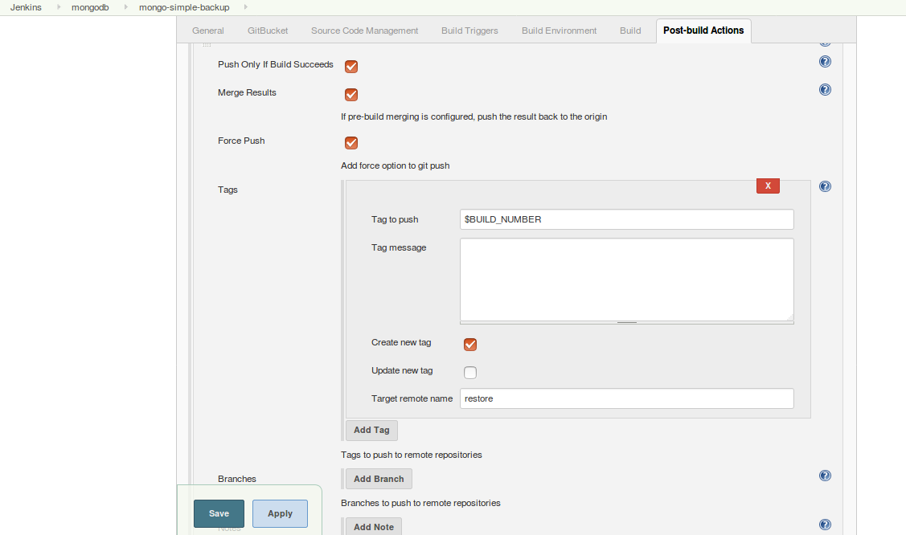
Continued…….

Slide 27
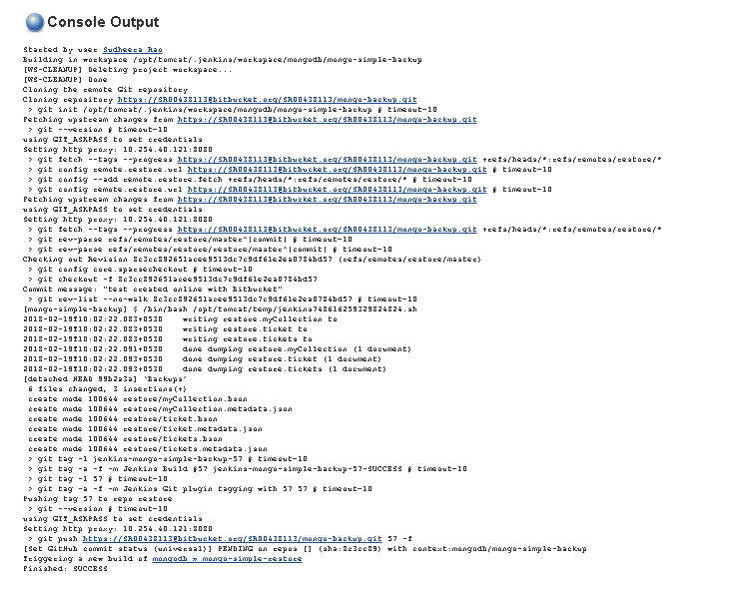

Slide 28
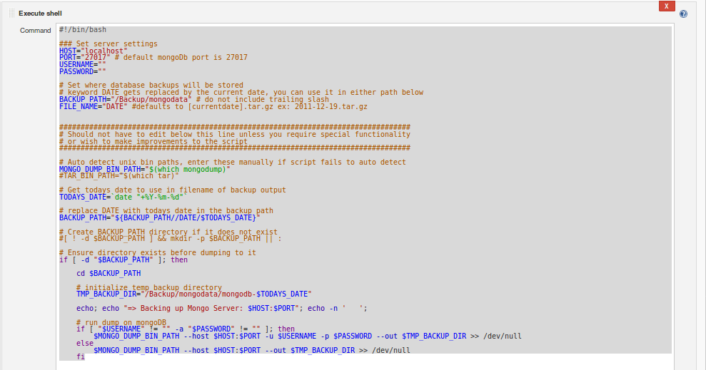
Taking mongoDB backup to filesystem.

Slide 29
Continued…….
#!/bin/bash
### Set server settings
HOST="localhost"
PORT="27017" # default mongoDb port is 27017
USERNAME=""
PASSWORD=""
# Set where database backups will be stored
# keyword DATE gets replaced by the current date, you can use it in either path below
BACKUP_PATH="/Backup/mongodata" # do not include trailing slash
FILE_NAME="DATE" #defaults to [currentdate].tar.gz ex: 2011-12-19.tar.gz
##################################################################################
# Should not have to edit below this line unless you require special functionality
# or wish to make improvements to the script
##################################################################################

Slide 30
Continued…….
# Auto detect unix bin paths, enter these manually if script fails to auto detect
MONGO_DUMP_BIN_PATH="$(which mongodump)"
#TAR_BIN_PATH="$(which tar)"
# Get todays date to use in filename of backup output
TODAYS_DATE=`date "+%Y-%m-%d"`
# replace DATE with todays date in the backup path
BACKUP_PATH="${BACKUP_PATH//DATE/$TODAYS_DATE}"
# Create BACKUP_PATH directory if it does not exist
#[ ! -d $BACKUP_PATH ] && mkdir -p $BACKUP_PATH || :
# Ensure directory exists before dumping to it
if [ -d "$BACKUP_PATH" ]; then
cd $BACKUP_PATH

Slide 31
Continued…….
# initialize temp backup directory
TMP_BACKUP_DIR="/Backup/mongodata/mongodb-$TODAYS_DATE"
echo; echo "=> Backing up Mongo Server: $HOST:$PORT"; echo -n ' ';
# run dump on mongoDB
if [ "$USERNAME" != "" -a "$PASSWORD" != "" ]; then
$MONGO_DUMP_BIN_PATH --host $HOST:$PORT -u $USERNAME -p $PASSWORD --out $TMP_BACKUP_DIR >> /dev/null
else
$MONGO_DUMP_BIN_PATH --host $HOST:$PORT --out $TMP_BACKUP_DIR >> /dev/null
fi

Slide 32
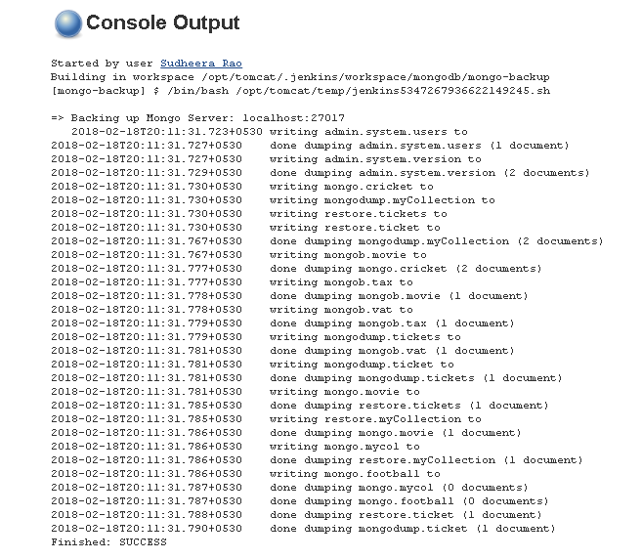

Slide 33
The above Use case can be viewed in Red Hat Enterprise Linux 7 machine, 10.20.126.41
Bitbucket : https://bitbucket.org/
Jenkins : http://10.20.126.41:8080
User name: admin
Password : admin
References
https://www.mongodb.com/
https://support.smartbear.com/viewarticle/91286/
https://jenkins.io/

Slide 34
Responsibility | Owner
POC by | Sudheera Rao <SR00438113@TechMahindra.com>
Reviewed by | Ragesh Neelakanta Pillai <RP00544708@TechMahindra.com>
Approved by

Slide 35
Thank you
Visit us at www.techmahindra.com

