Slide 1
PHYCHO – PHYSICAL TRAINING
FOR WOMEN SAFETY
Scheme Name: AMRIT MAHOTSAV SHRI SHAKTI CHALLENGE 2021
M Sathiyadevi, M.E.,
Dlaxmi Research & Development Centre,
Tiruchirappalli
mdlsathiyadevi@gmail.com, +91-8438321560
Dr B Lakshmi, Ph. D.,
Dlaxmi Research & Development Centre,
Tiruchirappalli
lakshminmc@gmail.com, +91-8072431331
T Angeline Sugantha, M.E.,
Dlaxmi Research & Development Centre,
Tiruchirappalli
Angeline.sugi84@gmail.com, +91-9443837852

Slide 2
APPROACH TOWARDS PROBLEM SOLVING
Women are facing a number of safety threats in day to day life. Not only in work places outside their home, even in their homes either by known or unknown persons. The girl needs protection. Protection teams need quiet time to reach the girl to rescue. In mean time the girl should not being a dumbstruck she tries to protect herself. For that she needs some physical and mental training.
The main goal of our idea is to make a girl to protect herself. For this we find 3 solutions that is,
Preventive Digital Diary App
Evoking Device
Self Protection Game App

Slide 3
Preventive Digital Diary App
This app works as a diary. It is useful in maintaining their day to day events.
Whenever and wherever, a girl feels insecure, they can log it and can prioritize them. Based on the database, an algorithm will raise an alarm whenever there is a possibility of threat to the women.

Slide 4
Preventive Digital Diary App
Start
Enter day to day events
Insecure event?
No
Yes
Yes
Add another event?
Put event in alarm list
No
Stop

Slide 5
Evoking Device– Evoking Smart Watch
This smart watch contains pulse reading sensor, needle or electric shock wire and communication sensors.
While the girl in situation if the girl is being a dumbstruck the measuring parameters in the smartwatch read the abnormality of pulse changes from her hand and pricks the girl using needle or shock wire to evoke her to prevent herself. And also the app will send the message and current location of her to her caretaker, and nearest police station through the social network like facebook,twitter…
A smart watch and an android application can help the person reach to safety.

Slide 6




Evoking Device– Evoking Smart Watch
Wrist Watch contains pulse and heart rate reading sensors, Bluetooth/Wi-Fi Communicators and a needle / a shock wire

Slide 7
Self Protection Game App
This application is a self protection game which will train the mind of girl. Since the children are mostly playing games in mobile a simple gaming application can train the girl to save themselves by using their belongings(hairpins, safety pin, dupatta, her hand ,nail…) and available things surrounding her(soil, wood pieces…) from the hands of culprits. The starting levels will be like an unknown person chasing her, and the girl collecting some essential things while running to save herself from the enemy. In each stage, the hurdles the girl faces can be changed and the things the girl collects to face the hurdles can be decided on the run. This game likes “Temple Run” game. When girls play such games the mind gets trained to danger and helps them to tackle such situations without being dumbstruck.
“By actually doing something new over and over again, your brain wires new pathways that help you do this new thing better and faster by improving specific cognitive functions. Ref:8 Ways to Train Your Brain to Learn Faster and Remember More – Lifehack”.

Slide 8


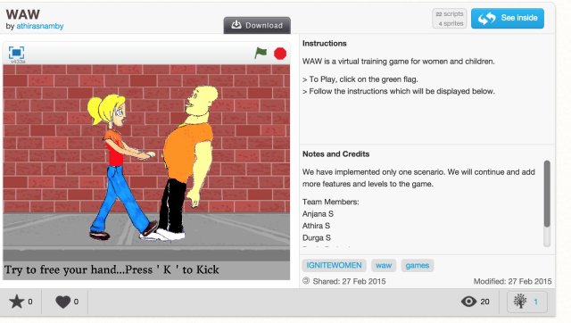
Trainable – Trainable safety app

Slide 9

Workflow
Preventive Diary App
Event Form
DB
--
------
Reading Pulse
Event Detected?
No
Pulse abnormal?
Evoking Smart Watch
Yes
No
Trigger Alarm
Idle
Yes
Prick the girl to run or fight & share the current location to relatives and near by police station
Choose level
Self Protection Game
Start to play game

Slide 10
Solution Technical Feasibility
For this project we are going to use .NET framework.
Xamarin- mobile app
Unity –Game developing
MS Sql Server –Database
Nano Framework- Smart Watch

Slide 11
Product Roadmap
Duration of our project.
Smart watch-Reading values from sensors and integrating with mobile app-1 month
Digital diary-Store and retrieve data from database and alert through alarm-a week
Psychological strengthening game-3 months
Testing – 1 month

Slide 12
Addressable Market
The product developed will be useful for the entire women in the society irrespective of working / non-working, highly aged/low aged and all other categories.
The end product will be a portable battery operated devices which will always be with women to safeguard them.

Slide 13
Deliverable Outcomes
1. A SMART WATCH
2. An ANDROID APP FOR DIGITAL DIARY
3. An ANDROID APP FOR GAMES PROVIDING
PSYCOLOGICAL TRAINING

Slide 14
Thank You All…

