Slide 1

Name : Shubhangi Divate Batch – Pune Exl Batch Code- 7236 Enrollment No- EBEON032258322

Slide 2
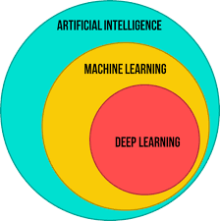
AI vs ML vs DL vs DS

Slide 3
AI – Artificial Intelligence
Final Goal is to create an AI application.
AI application is able to do it’s own task without any human intervention
For ex. Netflix, YouTube recommendation, Self Driving Cars, etc.
ML – Machine Learning
ML is subset of AI. It provides statistics tools to analyse the data, visualize
the data and apart from that to do predictions and forecasting.
DL – Deep Learning
DL is again subset of ML.
In 1950-60’s scientists thoughts that can we make machine learn like
how we human learn. Deep Learning is type of Machine Learning, which
is about computers learning to think using structures modeled on the
human brain.

Slide 4
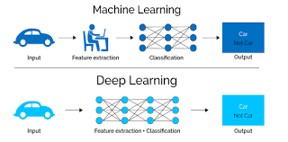

Slide 5
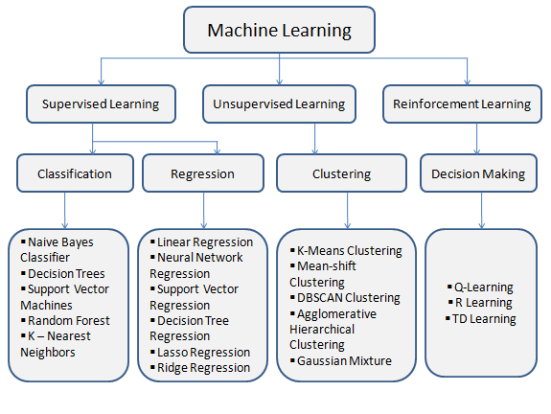
Introduction To Machine Learning Algorithms For Data Science

Slide 6
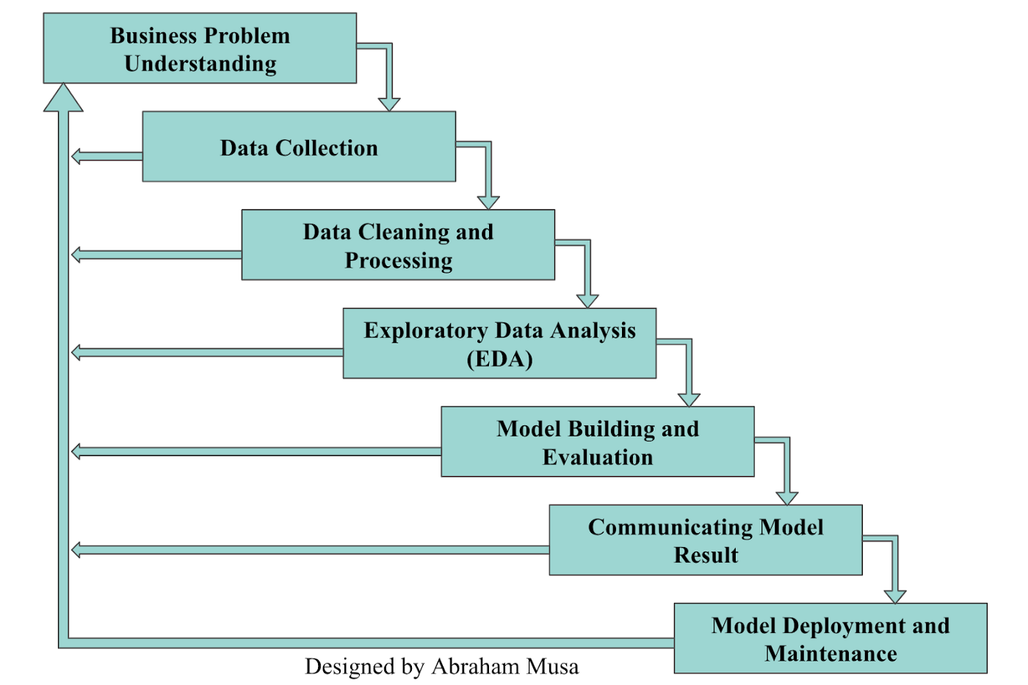
Life Cycle Of Data Science Project

Slide 7
Project Name – Cars: Purchase Decision Dataset
This dataset contains details of 1000 customers who intend to buy a car,
considering their annual salaries. We are taking the dataset from Kaggle.com
named as car_data.csv
- Columns:
- User ID
- Gender
- Age
- Annual Salary
- Purchase Decision (No = 0; Yes = 1)
In this data set we are predicting whether the person make decision to buy a car or not

Slide 8
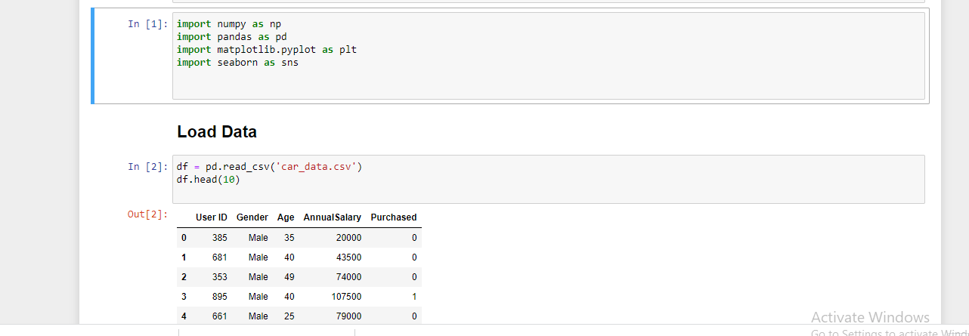
Importing libraries and Loading Data

