Slide 1
FedCSIS 2023 Challenge: Cybersecurity Threat Detection in the Behavior of IoT Devices

Slide 2
Problem Description
The FedCSIS 2023 Challenge is designed to advance the field of cybersecurity by leveraging machine learning to identify and classify attack events within system activity logs. The challenge involves processing a large dataset of system events, each of which may or may not be part of a cyberattack. The goal is to preprocess this data, extract meaningful features, and develop a robust model to detect these attack events accurately.

Slide 3
Data Features
The dataset consists of multiple CSV files, each representing logs of system activities. The columns in the dataset include various attributes related to system calls, processes, user actions, andmore. The key features in the data are as follows
SYSCALL_timestamp: The timestamp of the system call event.
SYSCALL_syscall: The type of system call.
SYSCALL_success: Indicates if the system call was successful.
SYSCALL_exit: Exit code of the system call.
PROCESS_comm: Command name associated with the process.
PROCESS_exe: Executable path of the process.
PROCESS_PATH: Path related to the process.
CUSTOM_openFiles: Custom attribute for open files.
CUSTOM_libs: Custom attribute for libraries used.
PROCESS_uid: User ID associated with the process.

Slide 4
PROCESS_gid: Group ID associated with the process.
SYSCALL_exit_hint: Hint for the system call exit status.
SYSCALL_pid: Process ID for the system call.
USER_AUTH: User authentication information.
CRED_COUNT: Credential count.
SYSTEM_COUNT: System count.
SERVICE_COUNT: Service count.
CUSTOM_openSockets: Custom attribute for open sockets.
USER_ACTION_op: User action operation.
USER_ACTION_src: Source of the user action.
USER_ACTION_res: Result of the user action.
USER_ACTION_addr: Address related to the user action.
PROCESS_name: Name of the process.
attack: Label indicating if the event is part of an attack (1 for attack, 0 for normal).

Slide 5
Preprocessing Steps Explanation:
Extracting Data: This step involves unpacking the raw dataset from a ZIP file into a specified directory for further processing.
Initial Data Exploration: Here, we analyze the dataset's structure and content by determining the number of files and displaying the first few rows of the first file.
Removing Single-Valued Columns: Columns with only one unique value across all rows are removed as they do not contribute meaningful information for distinguishing between normal and attack events.
Labeling Attack Files: Each file is labeled to indicate whether it contains an attack event based on a predefined list of attack file names.
Label Encoding: Categorical columns are transformed into numerical values using label encoding to prepare them for machine learning algorithms.
Handling Missing Values: Missing values in categorical columns are filled with the string 'missing', while those in numerical columns are filled with the median value. Remaining missing values are filled with -1.
Merging Data Files: All processed and encoded files are merged into a single CSV file for easier analysis and modeling.
Normalizing Data: Data normalization is performed to ensure all features contribute equally to analysis by scaling them between 0 and 1.
Handling Columns with Missing Values Post-Normalization: Columns still containing missing values after normalization are removed from the dataset.

Slide 6
Our Models
XGBoost
Decision Tree
Random Forest
Logistic Regression

Slide 7
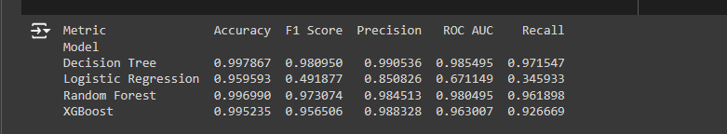
Visualization

Slide 8
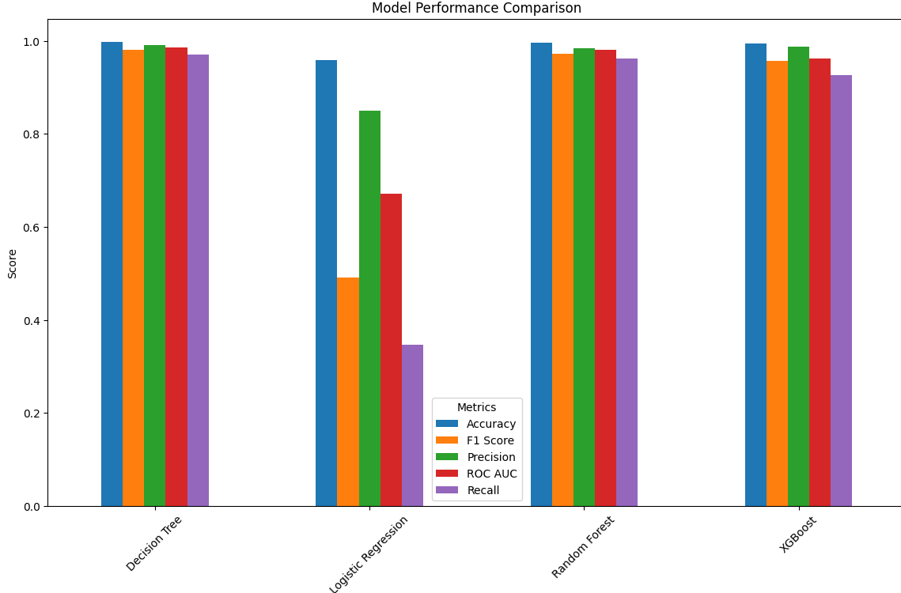
Visualization

Slide 9
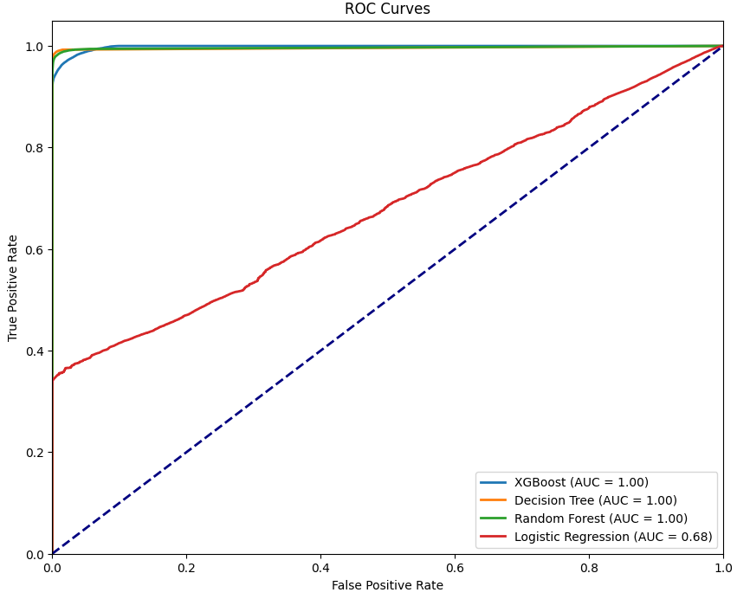
Visualization

Slide 10
Preparers:
Abdulkadir Dağlar 2000610233
Suat Deniz 2006102002
Berkay Caplık 2206102900

