Slide 1
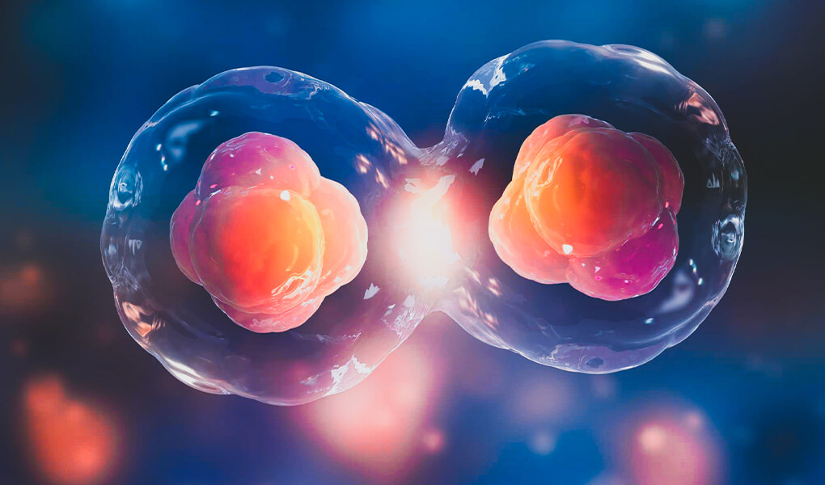
Embryo Viability Classification with Deep Learning
World Championship 2023 – Computer Vision Track
EEE406 – Fundamentals of Biomedical Signal Processing
Group Members: Suat Deniz, Abdulkadir Dağlar, Berkay Caplık

Slide 2
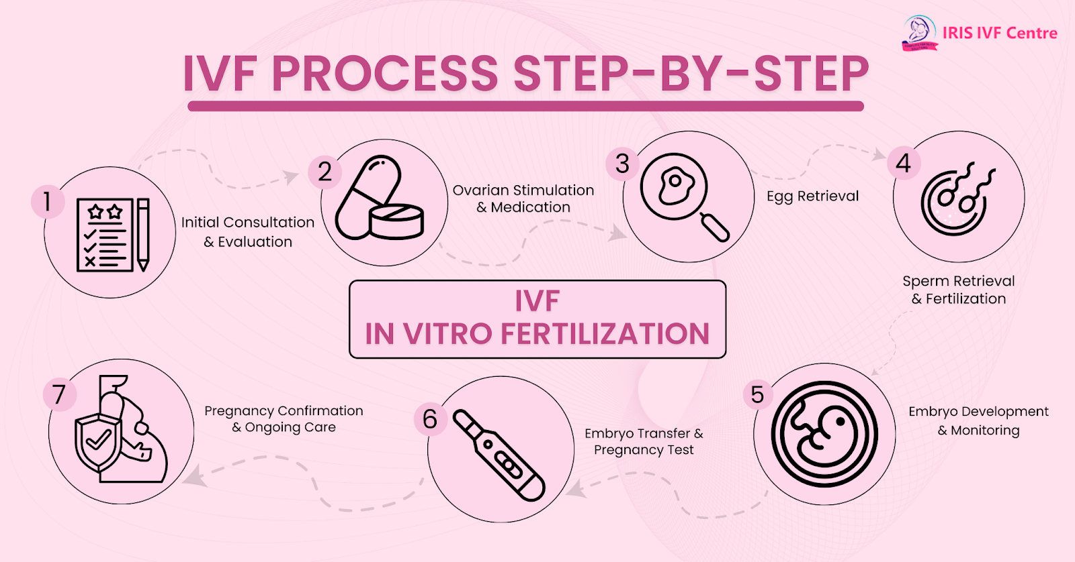
Problem Definition and Motivation
Embryo selection is a critical step in IVF procedures.
Manual assessment is subjective, time-consuming, and inconsistent.
Our goal is to automate embryo classification using deep learning.

Slide 3
Model Architecture and Approach
We used MobileNetV3Large, EfficientNetB0, and DenseNet121 via transfer learning.
01
Input images were resized, normalized, and augmented.
02
A global average pooling and sigmoid layer enabled binary classification.
03

Slide 4
How Our Pipeline Works
📁 Data Collection:
We use ~1,000 labeled embryo images from a Kaggle competition dataset.
🧪 Preprocessing:
Images are resized to 224×224, normalized, and augmented using rotation, flipping, zoom, and brightness shifts.
🧠 Model Selection:
We utilize transfer learning with MobileNetV3Large, EfficientNetB0, and DenseNet121.
⚙️ Training:
Each model is trained using early stopping, class weighting, and learning rate scheduling.
📈 Validation:
Performance is evaluated on a stratified 20% validation set using accuracy, precision, recall, and F1-score.
🔍 Testing & Inference:
The trained models predict embryo viability on test images.
📝 Submission:
Predictions are formatted and saved as .csv files for submission.

Slide 5
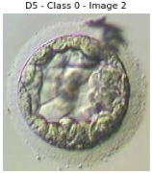
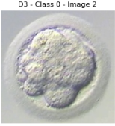
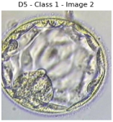
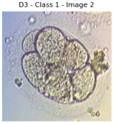
Dataset and Evaluation Setup
Dataset includes ~1,000 high-resolution embryo images from Day 3 and Day 5.
Images are labeled as “Good” or “Not Good” based on morphological features.
We used an 80/20 stratified train-validation split.
Our evaluation metrics as follow as Accuracy, Precision, Recall, and F1-score.

Slide 6
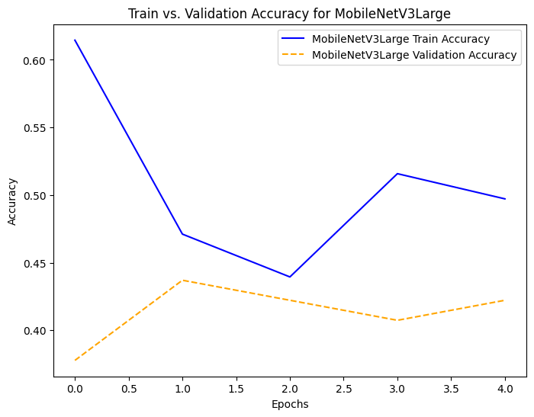
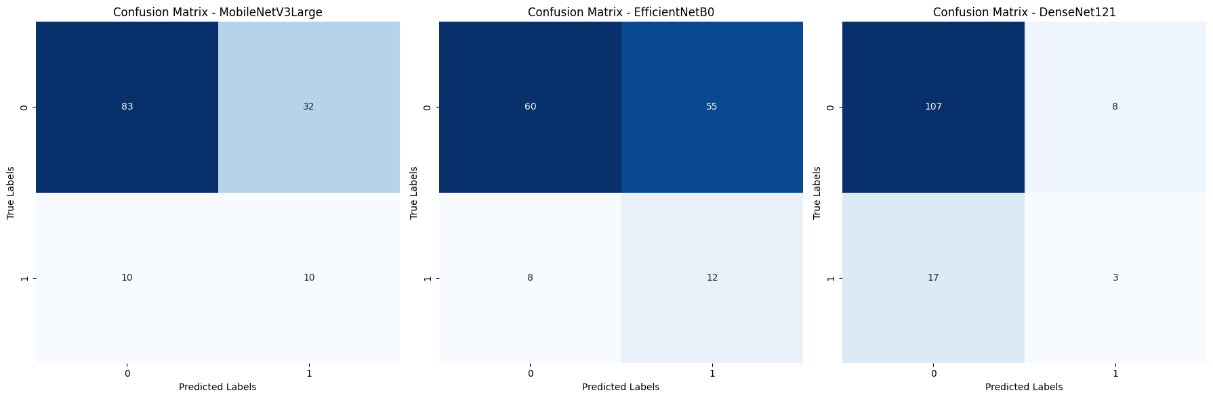
MobileNetV3Large - Training Performance
Achieved ~52% training accuracy and ~68% validation accuracy.
Validation loss was 0.77, indicating stable but limited learning.
Low overfitting risk due to consistent gap between training and validation accuracy.
Performs moderately well for a lightweight architecture but may lack capacity for deeper features.

Slide 7
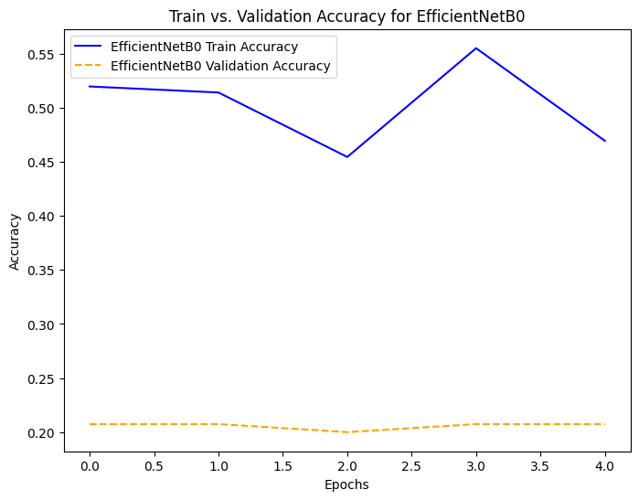
EfficientNetB0 – Training Performance
Reached ~61% training accuracy, but only ~53% validation accuracy.
Validation loss was 0.82, the highest among all three models.
Medium overfitting risk: strong learning in training, but poor generalization.
Model likely requires fine-tuning or better regularization to handle this dataset effectively.

Slide 8
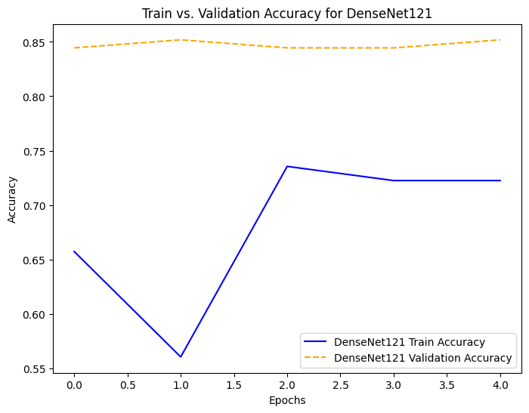
DenseNet121 – Training Performance
Achieved the highest training (~73%) and validation accuracy (~81%).
Validation loss was the lowest at 0.42, indicating excellent generalization.
Low overfitting risk despite higher model complexity.
Dense connectivity helped capture subtle morphological features in embryo images.

Slide 9
Model Performance Summary
Model | Train Accuracy | Val Accuracy | Val Loss | Overfitting Risk
MobileNetV3Large | ~52% | ~68% | 0.77 | Low
EfficientNetB0 | ~61% | ~53% | 0.82 | Medium
DenseNet121 | ~73% | ~81% | 0.42 | Low

Slide 10
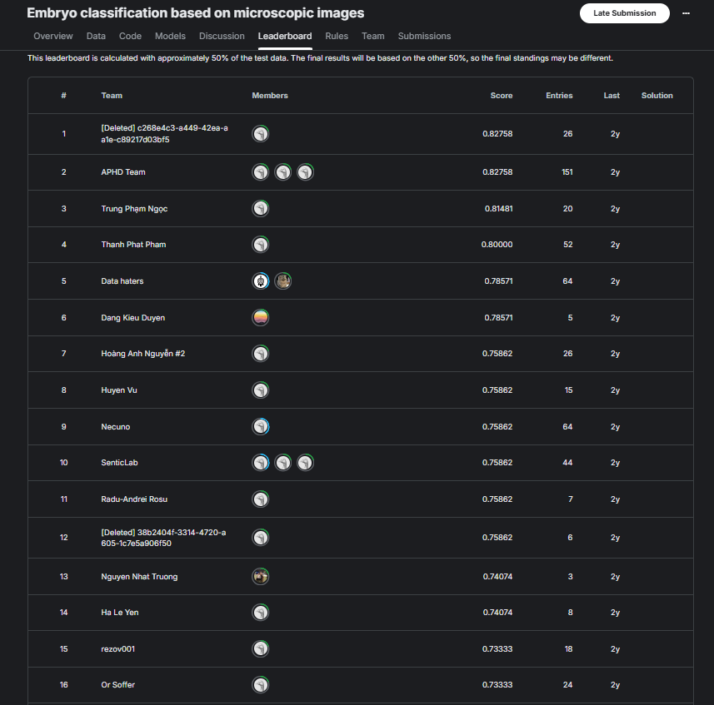
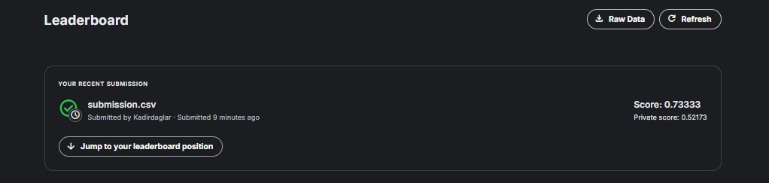
Kaggle Competition Results and Leaderboard Position
Our final submission achieved a public leaderboard score of 0.73333.
This score would place us at rank 15 out of all participating teams.
Due to late submission, our team name does not appear in the official leaderboard.
We have contacted Kaggle via email to request manual leaderboard inclusion.
Our result still demonstrates competitive performance among top-ranking teams.
We ranked 15th overall based on our public score.

Slide 11
Conclusion and Outlook
DenseNet121 achieved the best performance with 81% validation accuracy and low overfitting risk.
Our final public leaderboard score was 0.73333, corresponding to 15th place globally.
The results validate the use of transfer learning in biomedical image classification.
Despite late submission, our solution proved competitive and reliable.

Slide 12
Future Work Section
We can apply model ensembling for improved robustness.
We can use explainability methods (e.g., Grad-CAM) to visualize decisions.
We can collect or generate a larger and more diverse dataset.
We can consider fine-tuning base layers for even better adaptation.

Slide 13


