Slide 1
BITS Pilani presentation
Prof. T S L Radhika
Dept. of Mathematics, Hyderabad Campus

Slide 2
<SS ZC416, MFDS>
Lecture No. 1

Slide 3
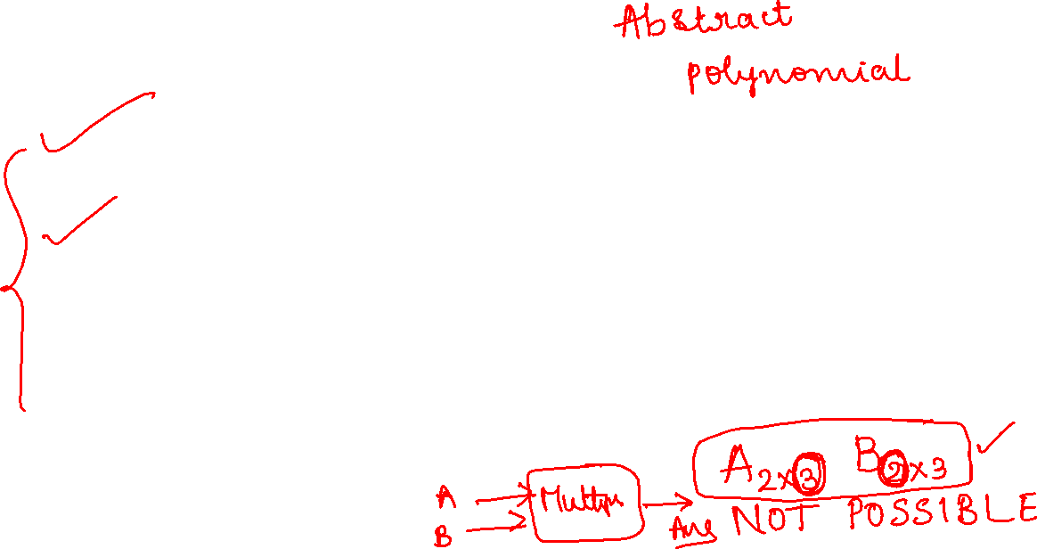
Basic TOOLS to master
Linear Algebra is used in machine learning to understand how algorithms work.
Calculus is utilized in machine learning to formulate the functions used to train algorithms to reach their objective, known by loss/cost/objective functions.
Statistics and probability are used in machine learning and data science to analyze and understand data and discover and infer valuable insights and hidden patterns.

Slide 4
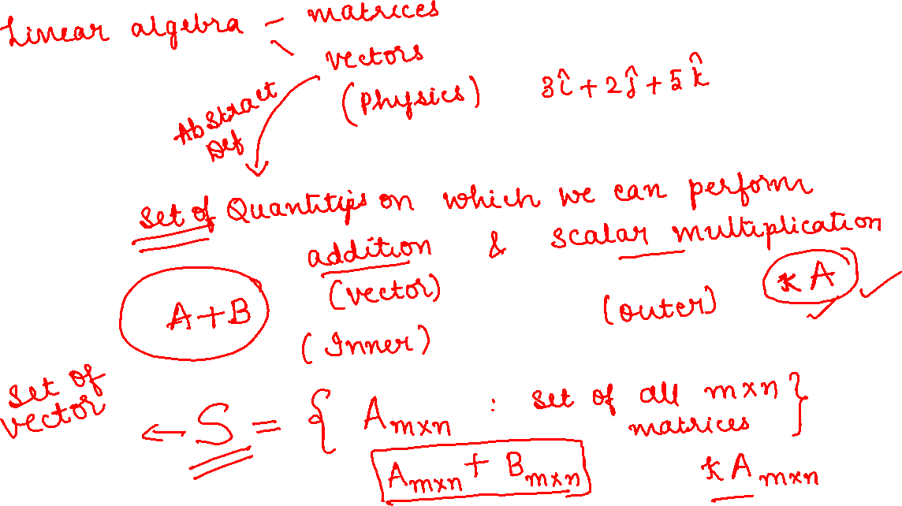

Slide 5
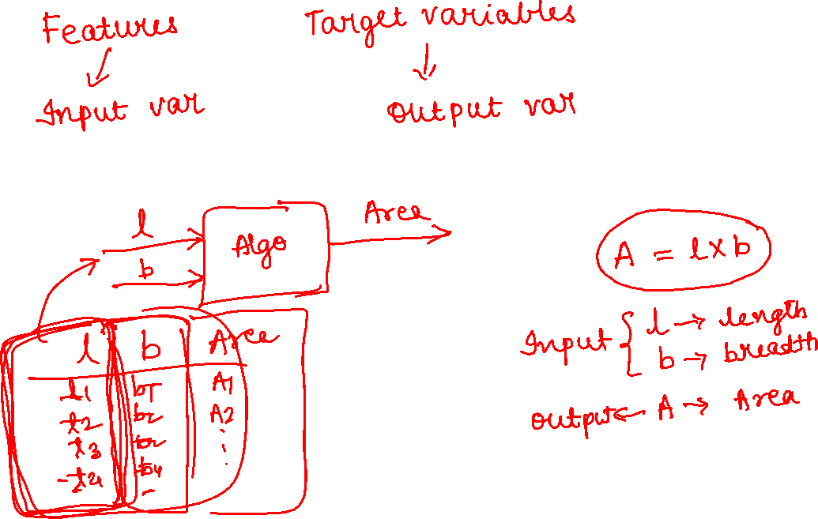

Slide 6
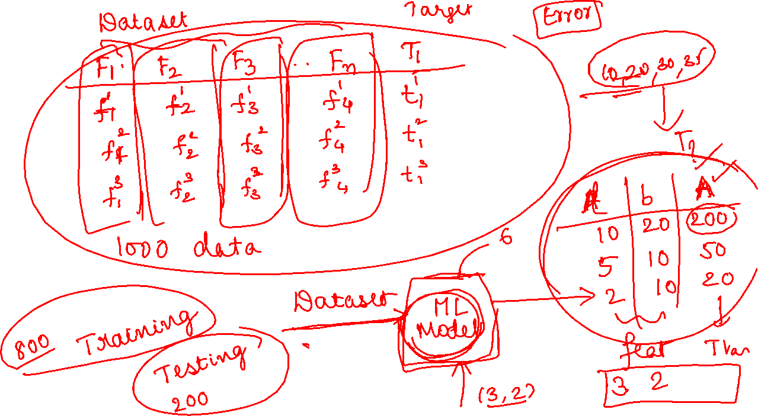

Slide 7
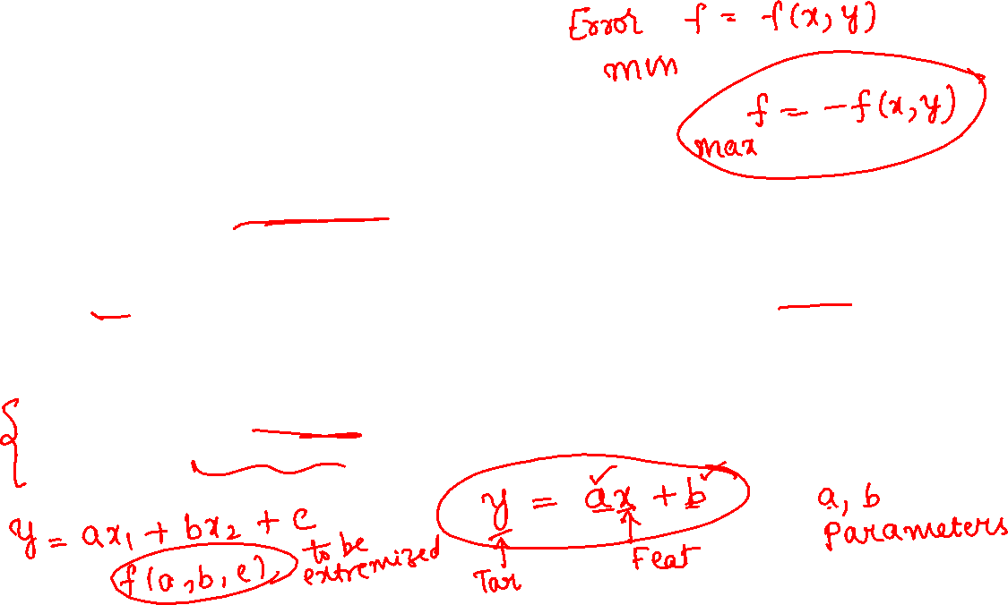
Linear Algebra:
Vectors and Matrices:
Fundamental for representing and manipulating data.
Linear algebra is used in various machine learning algorithms, such as in the formulation of linear regression and matrix factorization methods.
Eigenvalues and Eigenvectors:
Important in dimensionality reduction techniques like Principal Component Analysis (PCA).
Differential Calculus:
Used in optimization algorithms to find the minimum or maximum of a function. Gradient descent, a widely used optimization algorithm, relies on calculus.

Slide 8
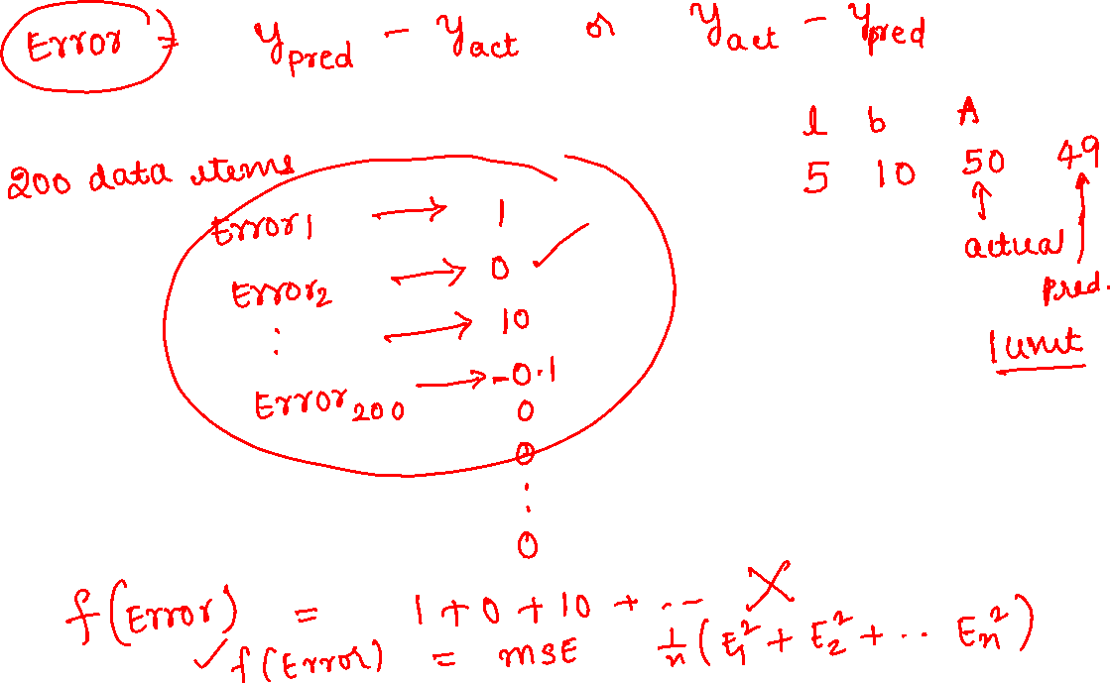

Slide 9
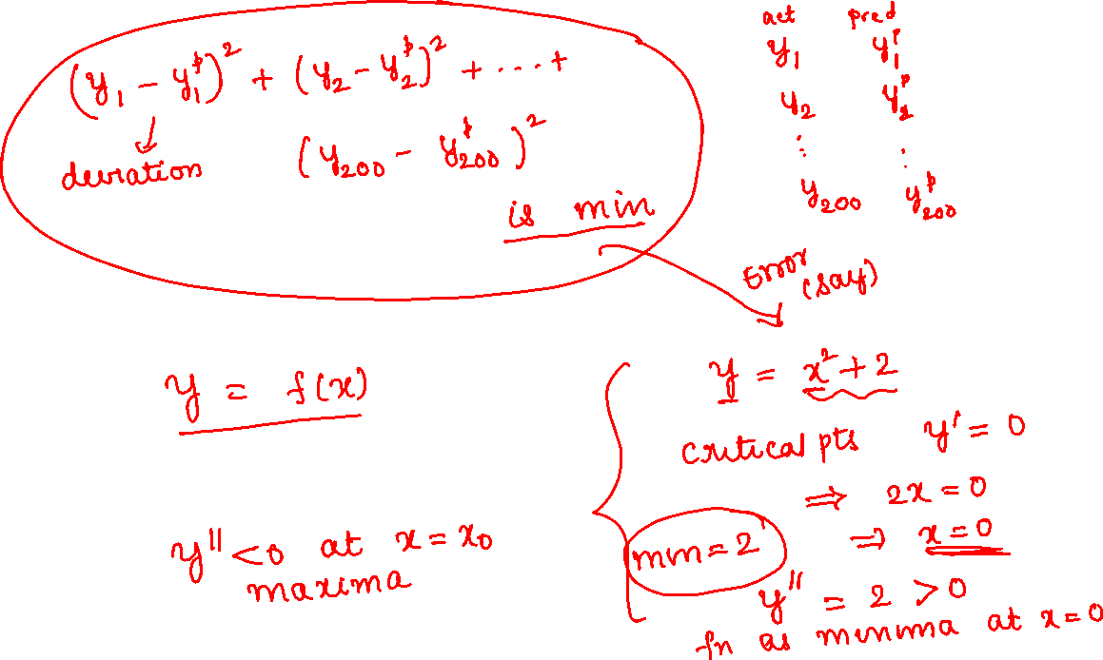

Slide 10
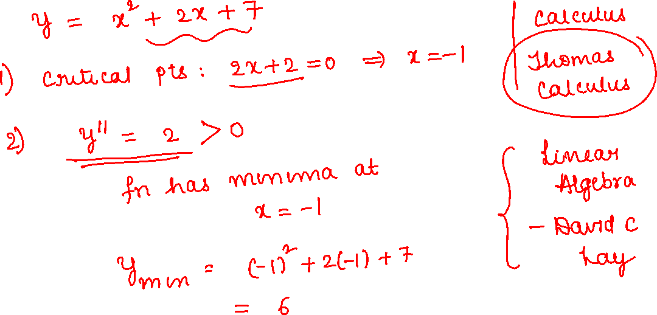

Slide 11
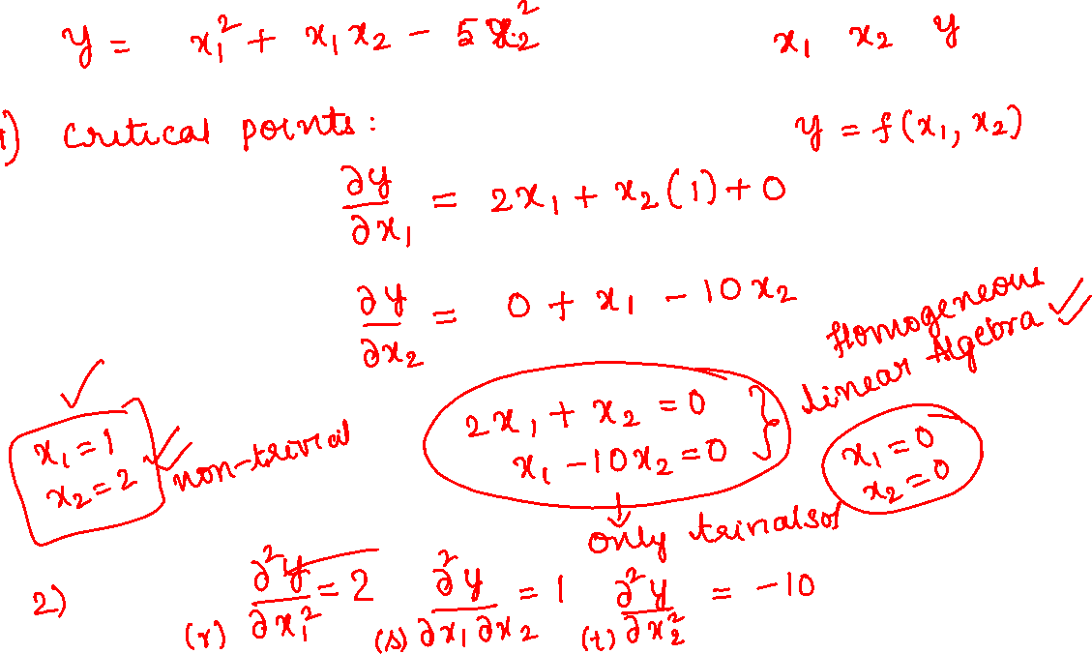

Slide 12
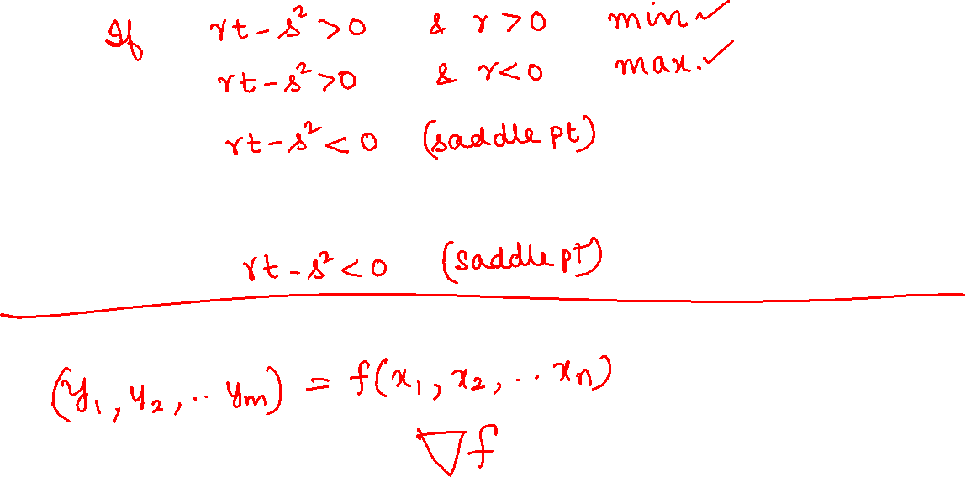

Slide 13
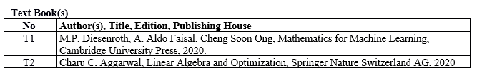

Slide 14
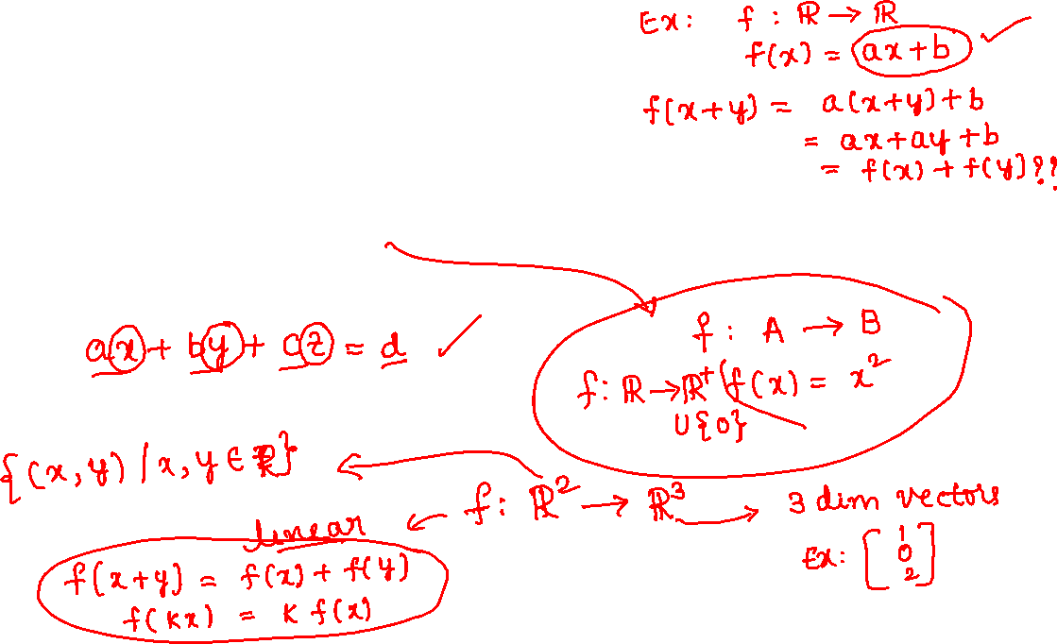
Chapter -2 Linear Algebra
Linear Algebra is a branch of mathematics that deals with linear equations and linear functions which are represented through matrices and vectors.

Slide 15
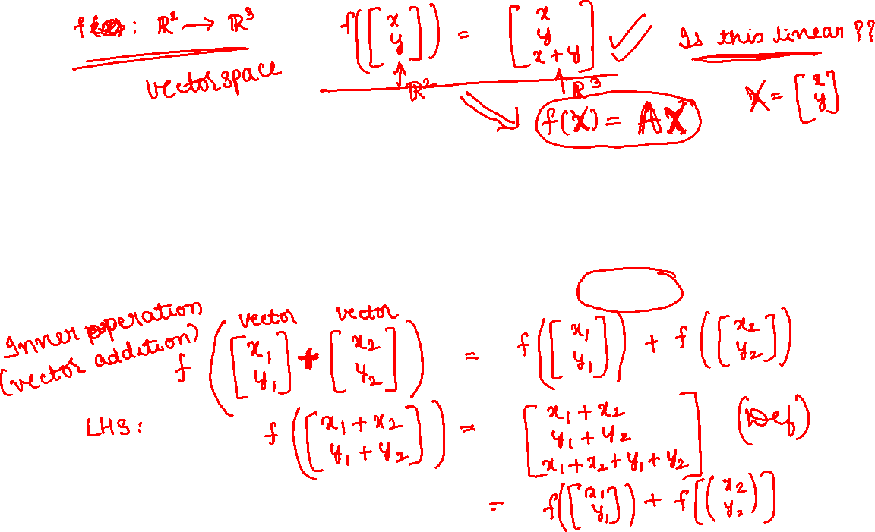
Vectors are not only the familiar geometric vectors from high school (points in 2D/3D space) but any special objects that can be added together and multiplied by scalar values to produce another object of the same kind.
For example, polynomials can also be treated as vectors.

Slide 16
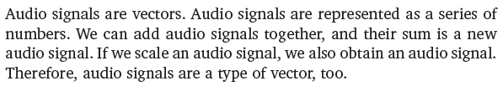
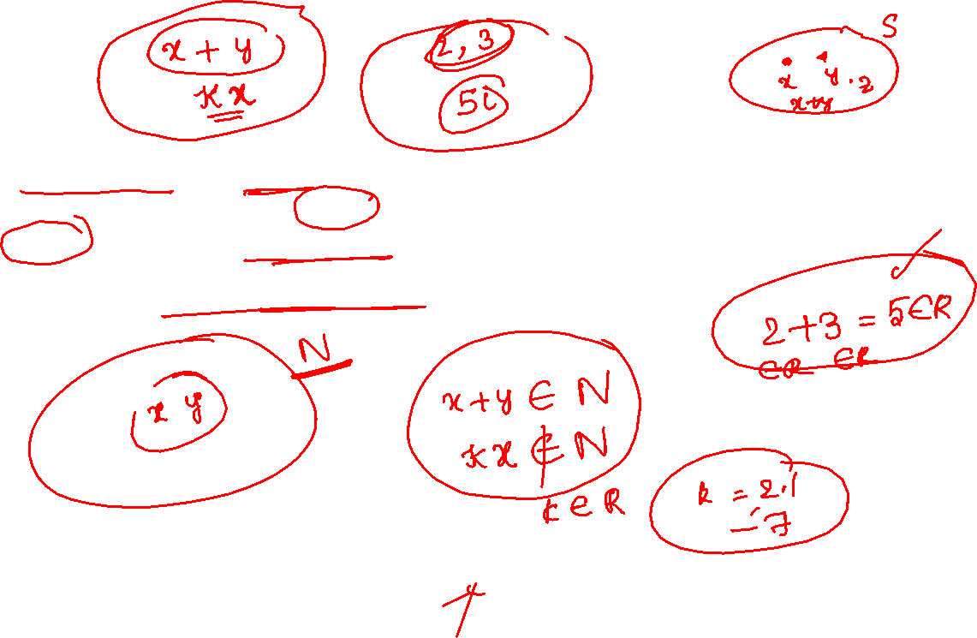

Slide 17
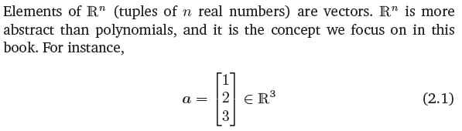
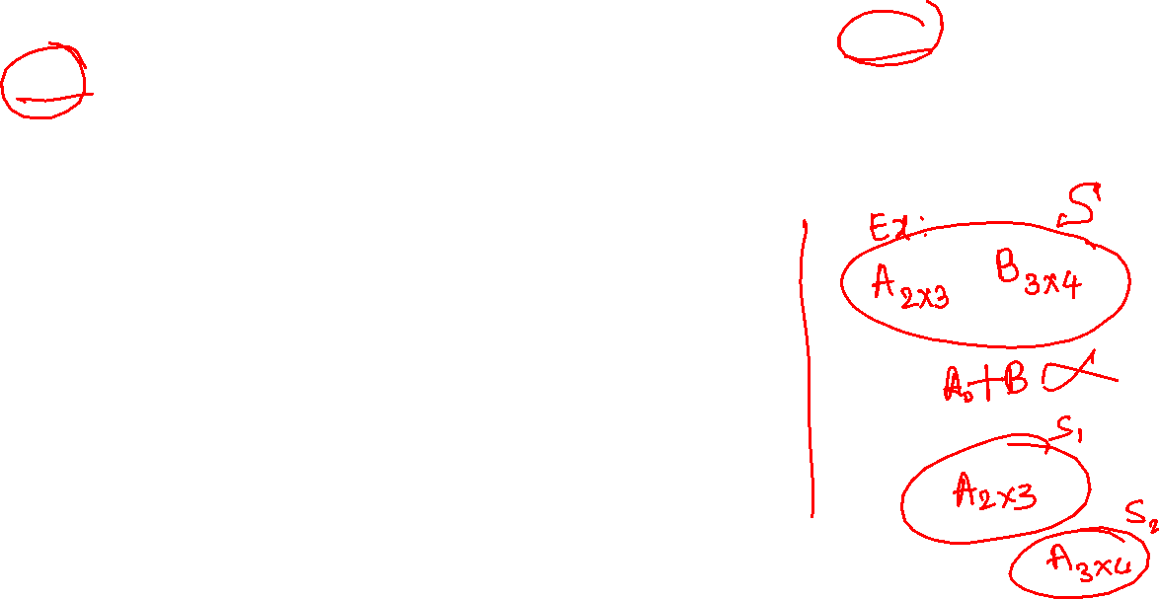

Slide 18
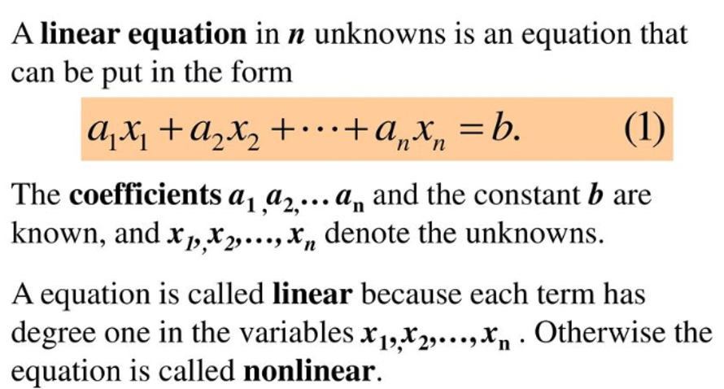
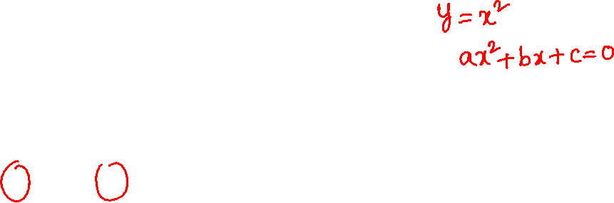
2.1 Systems of Linear Equations

Slide 19
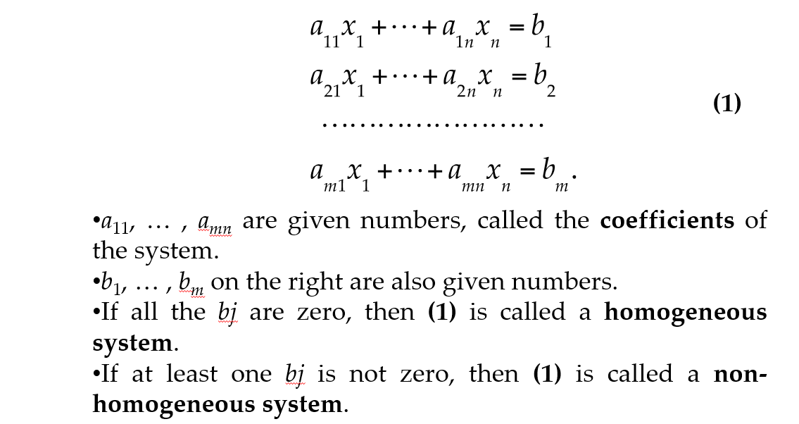
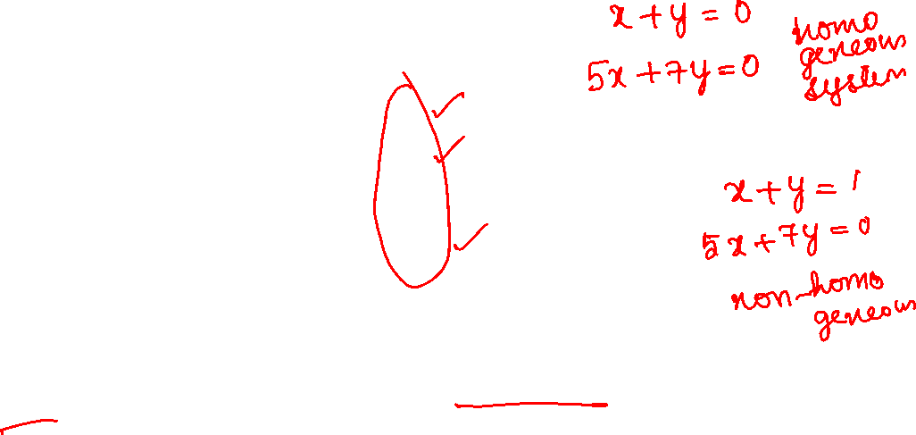
Linear System

Slide 20
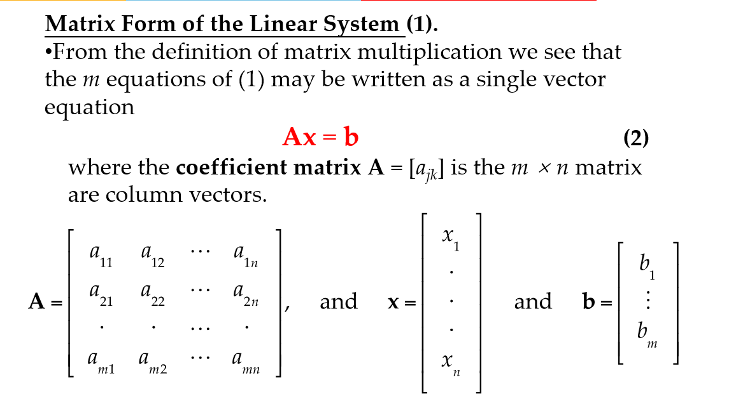
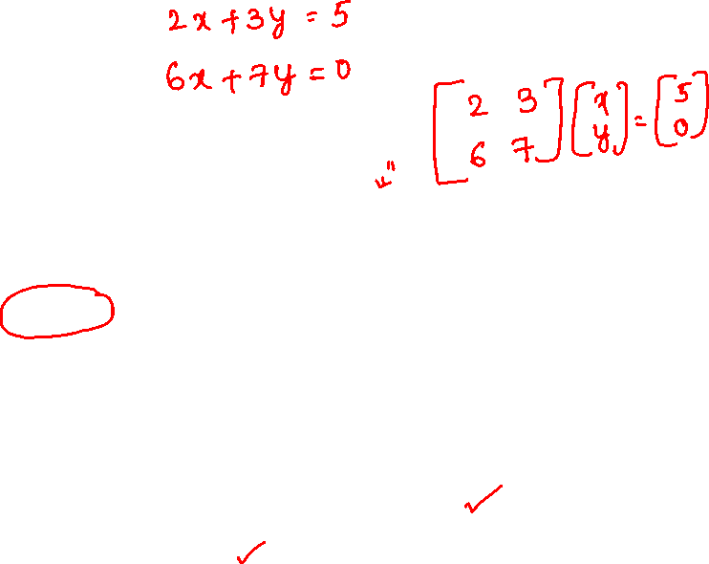
Coefficient Matrix

Slide 21
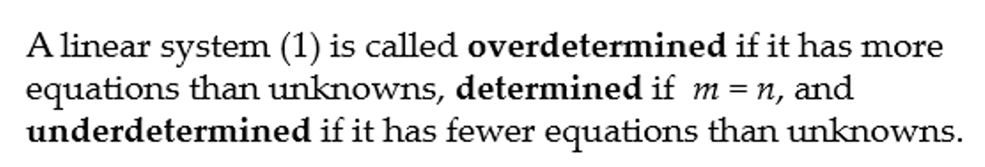
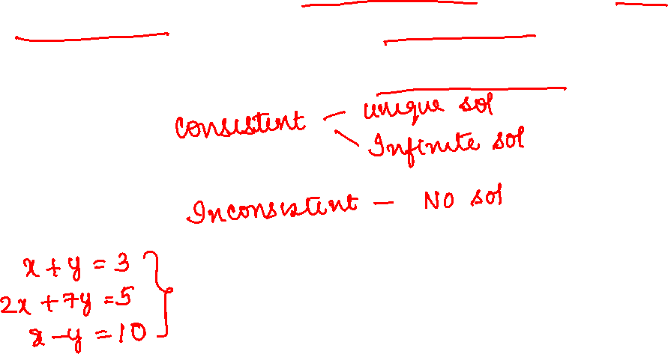

Slide 22
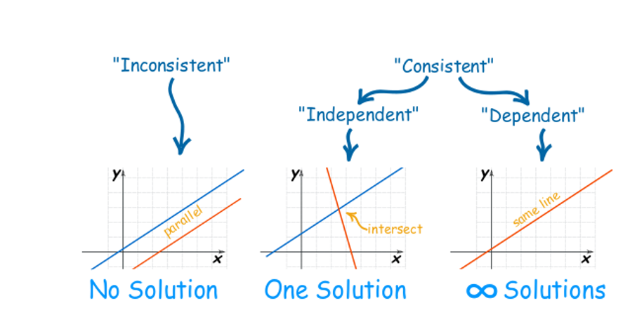
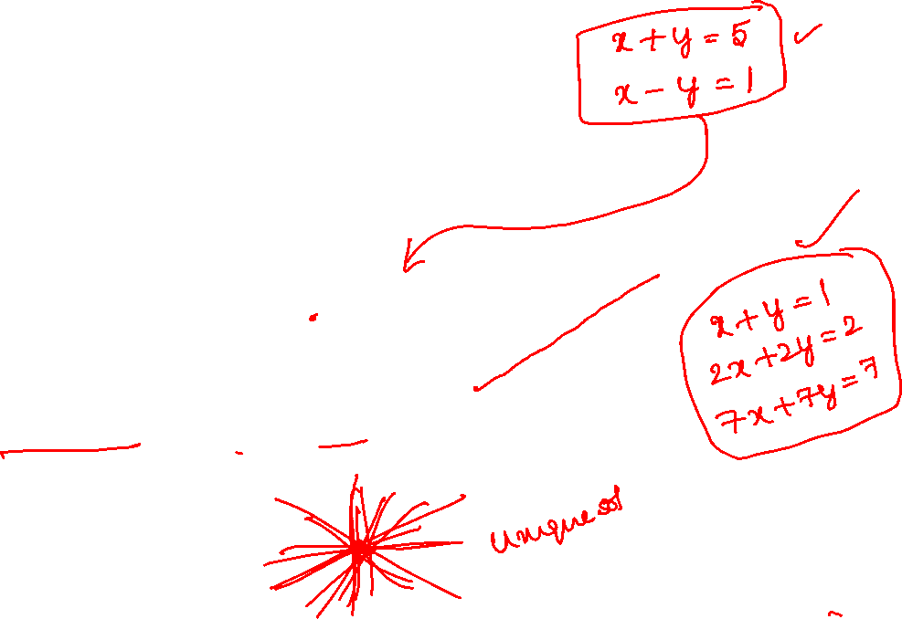

Slide 23
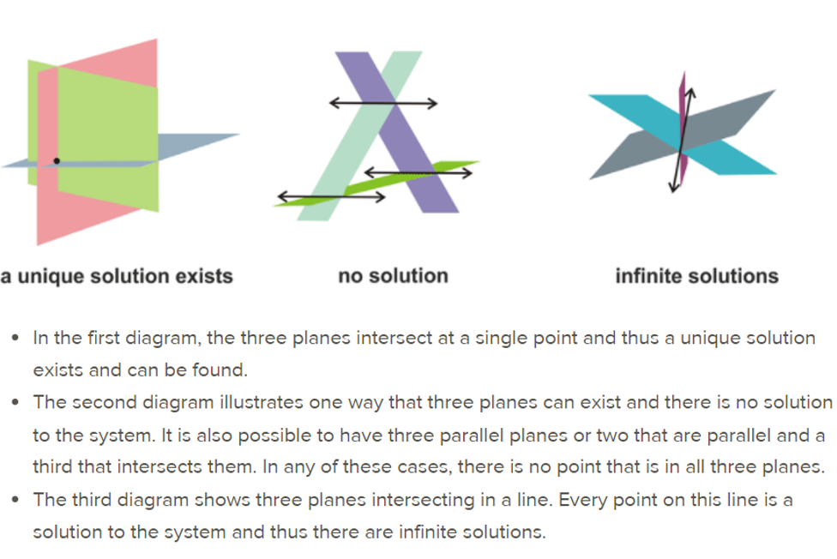
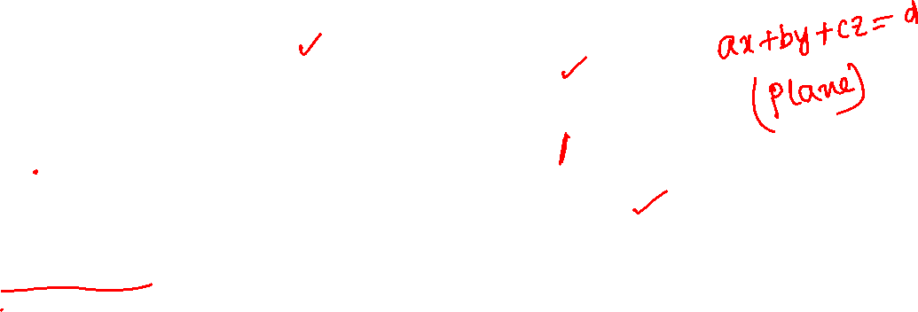

Slide 24
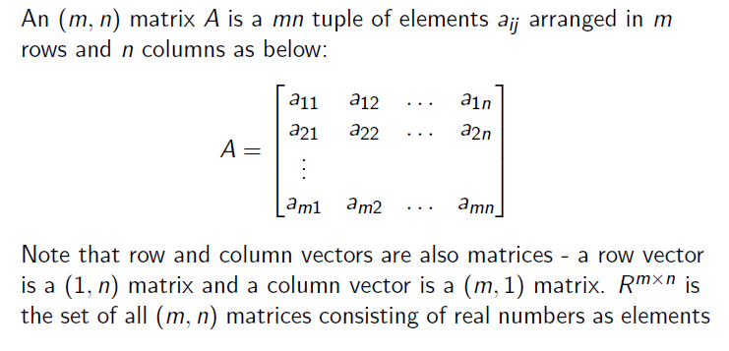
2.2 Matrices

Slide 25
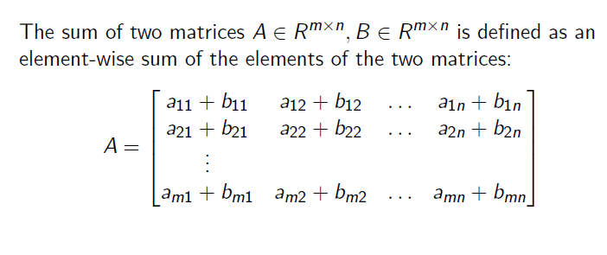
2.2.1 Matrix Addition

Slide 26
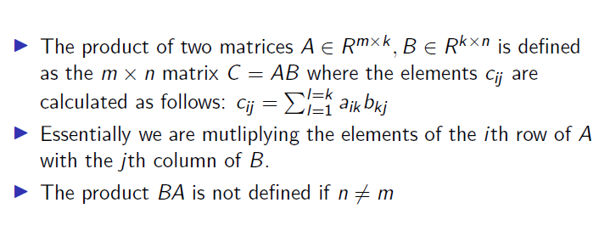

Matrix Multiplication

Slide 27
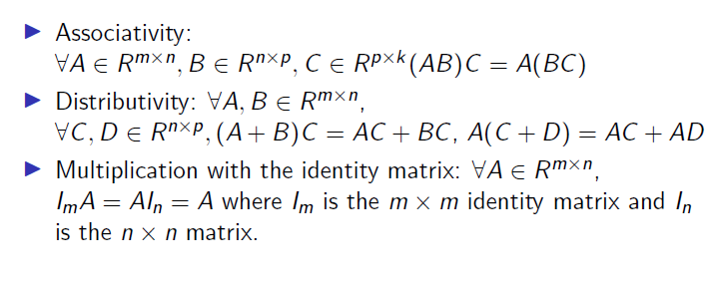
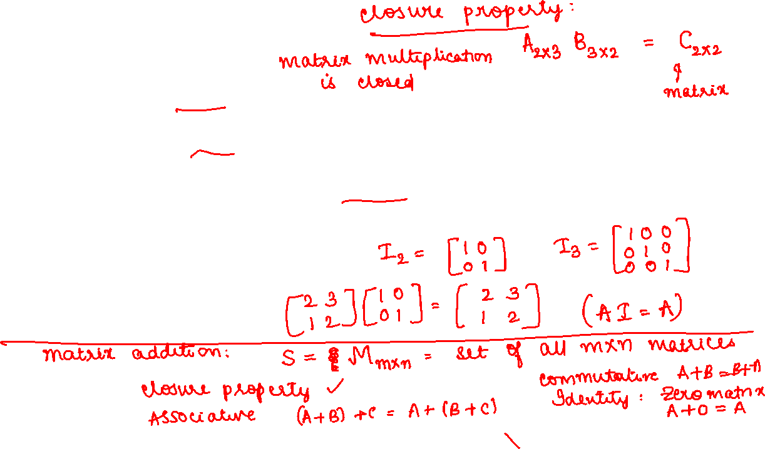
Properties

Slide 28


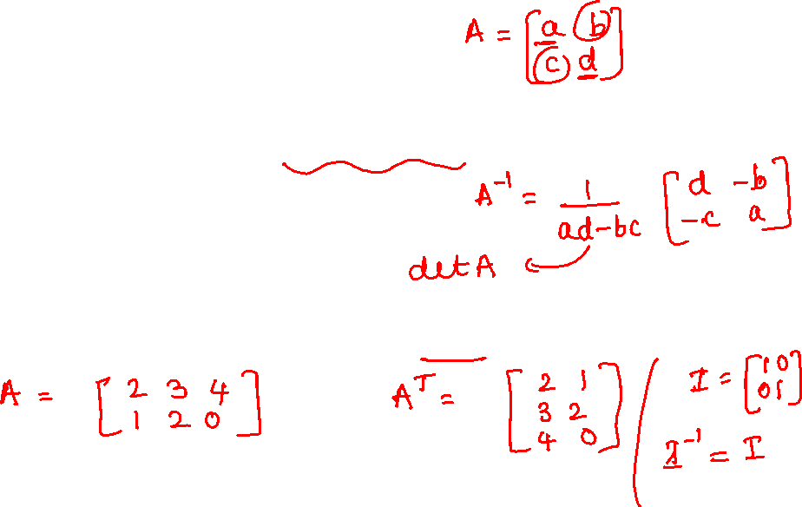
2.2.2 Inverse and Transpose

Slide 29
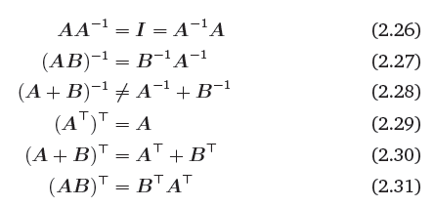
Important Properties

Slide 30
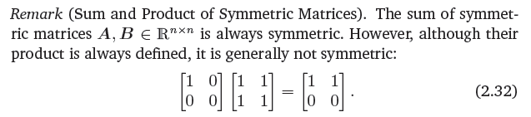
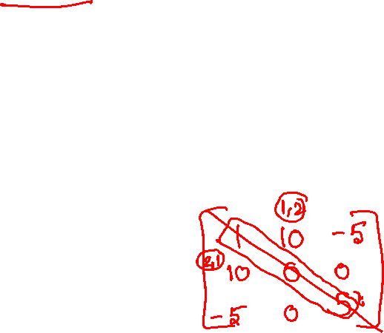

Slide 31
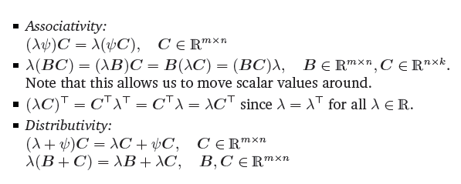
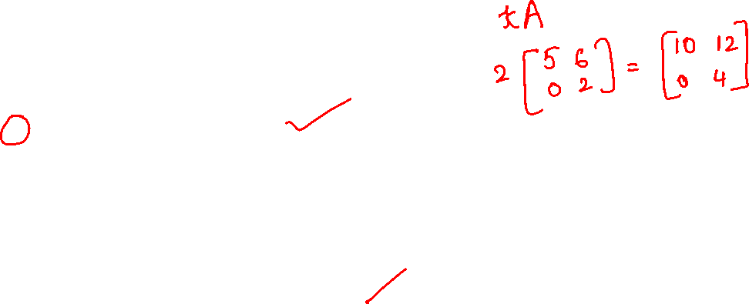
2.2.3 Multiplication by a scalar

Slide 32
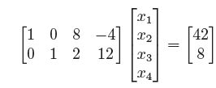
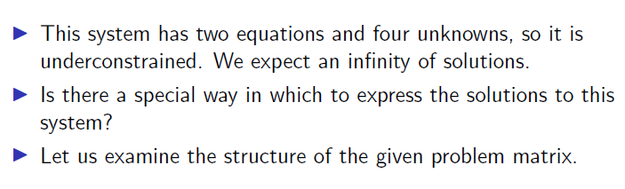
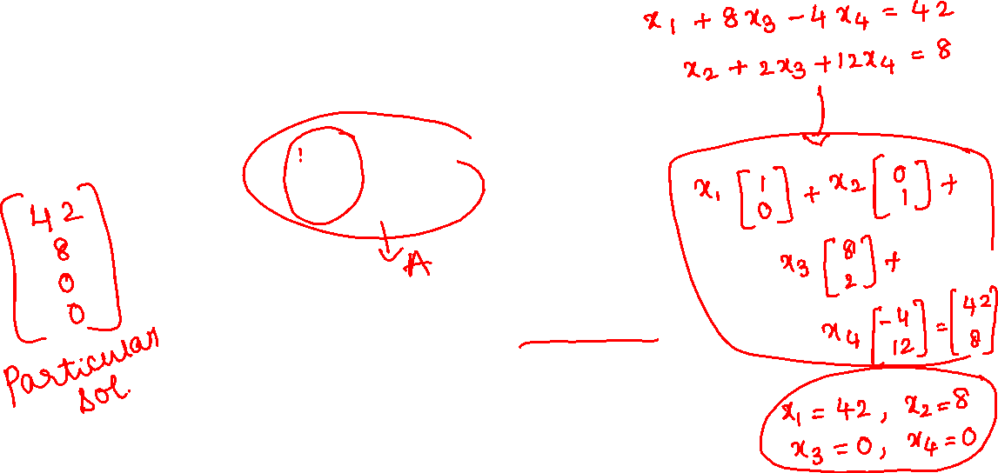
2.3 Solving Systems of Linear Equations
2.3.1 Particular and General Solution

Slide 33
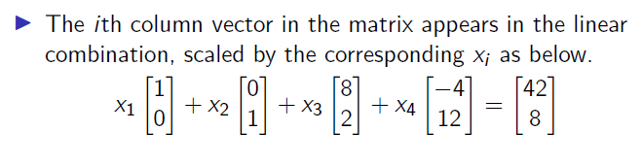


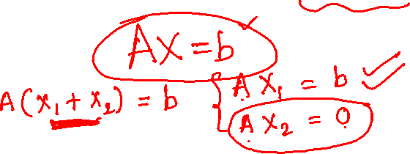
This solution is called the particular solution

Slide 34
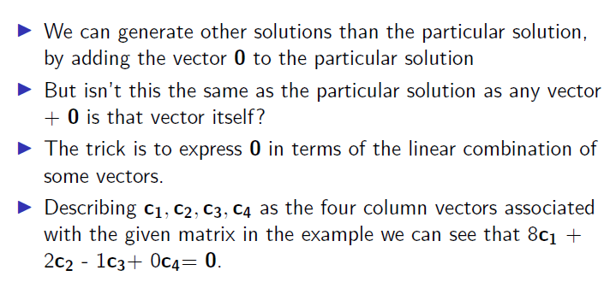
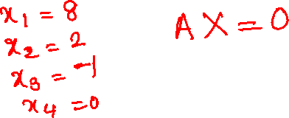

Slide 35
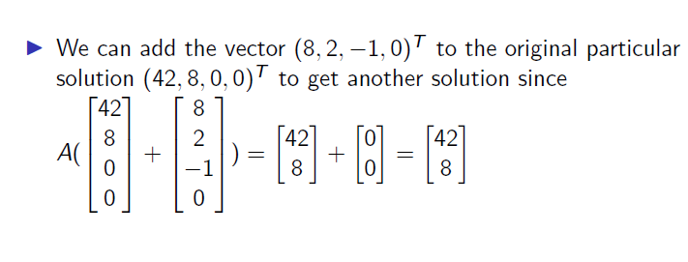
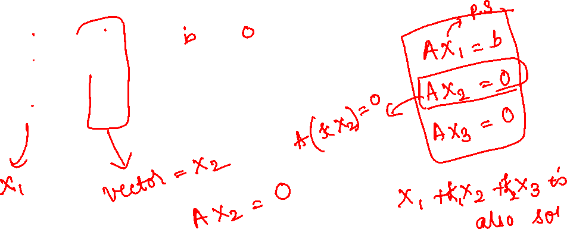

Slide 36
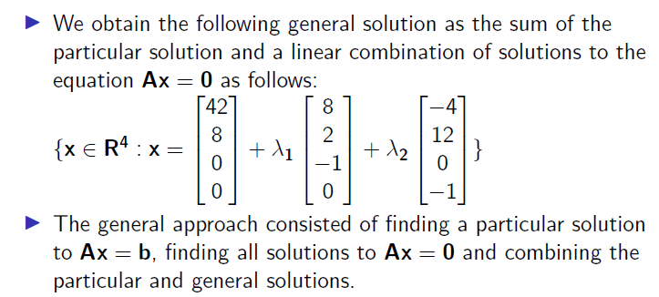


Slide 37

2.3.2 Elementary transformations

Slide 38



Slide 39
Echelon form (Stair case pattern):
(i) Zero rows if any occur as last rows.
(ii) The number of zeros before the first non-zero entry (pivot element) in any non-zero row increases with row number.
Further, if the first non-zero element in any non-zero row is unity and all entries below and above the first non-zero entry of each row are zero, the matrix is said to be in RRE form.

Slide 40




Slide 41



Slide 42


Slide 43

Important:
If the Echelon/ RRE form has a row as [0 0 0 …0 I c], where c is non-zero, then the system is inconsistent otherwise consistent.
If every column has a pivot element, then the system has unique solution.
If certain columns do not have pivot elements, the system has infinitely many solutions.

Slide 44


Slide 45
2.3.3 The Minus-1 Trick

Slide 46


Calculating the Inverse

Slide 47



Slide 48


2.3.4 Algorithms for Solving a System of Linear Equations

Slide 49
Solutions to homogeneous systems:
A homogenous system AX=O is always consistent.
Trivial solution is always a solution to it.
In the echelon/ RRE form of A, if
Every column has a pivot element, the system has only trivial solution other wise it has non-trivial solutions as well.

