Slide 1
BITS Pilani presentation
Prof. T S L Radhika
Dept. of Mathematics, Hyderabad Campus

Slide 2
<SS ZC416, MFDS>
Lecture No. 2

Slide 3


Slide 4


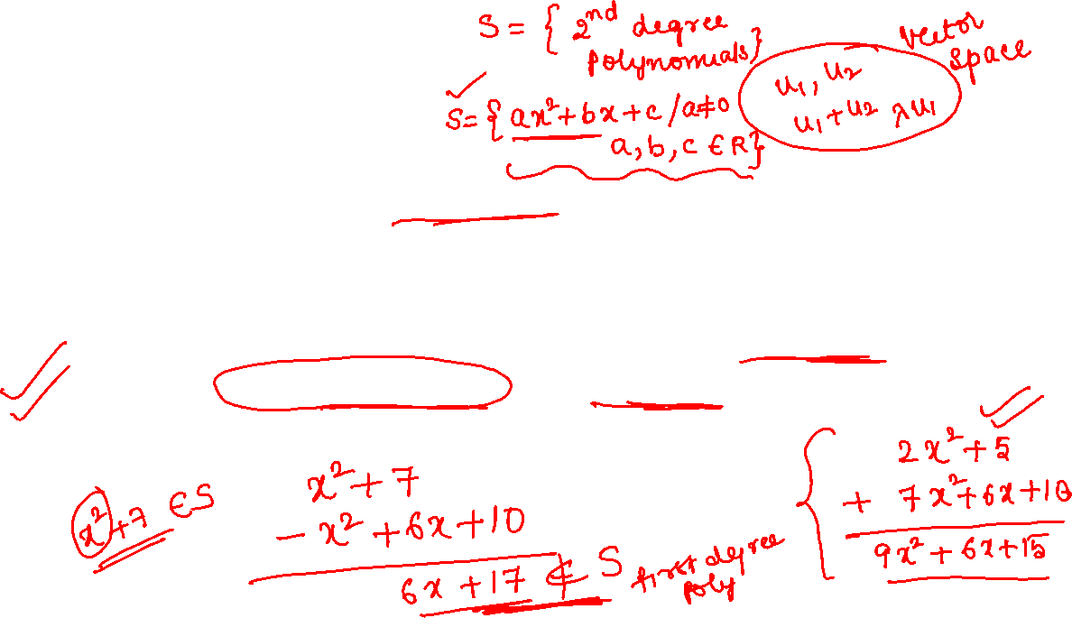
2.4 Vector Spaces

Slide 5
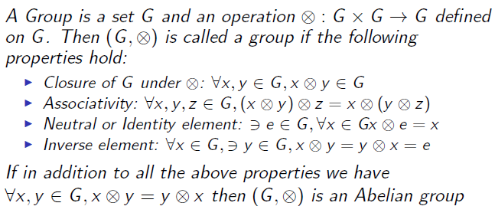
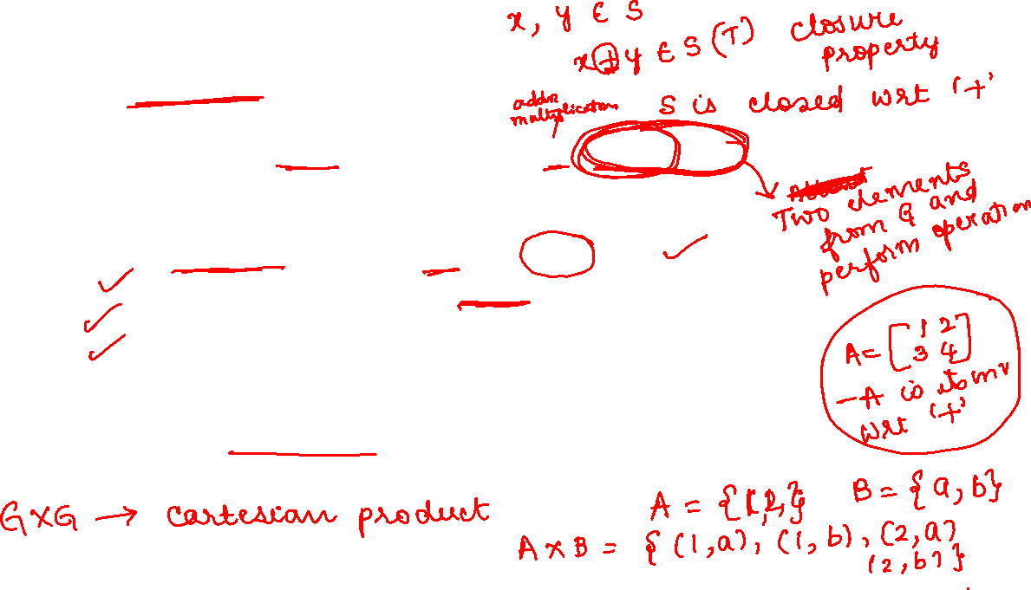
2.4.1 Groups

Slide 6
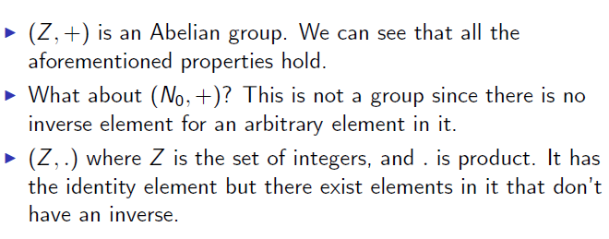
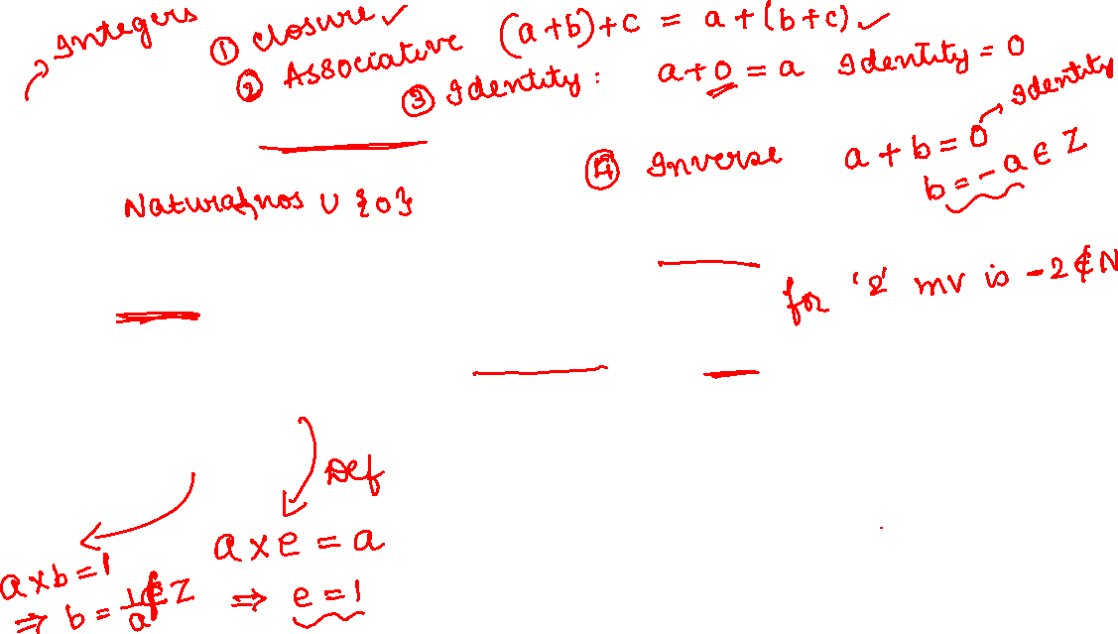

Slide 7



Slide 8

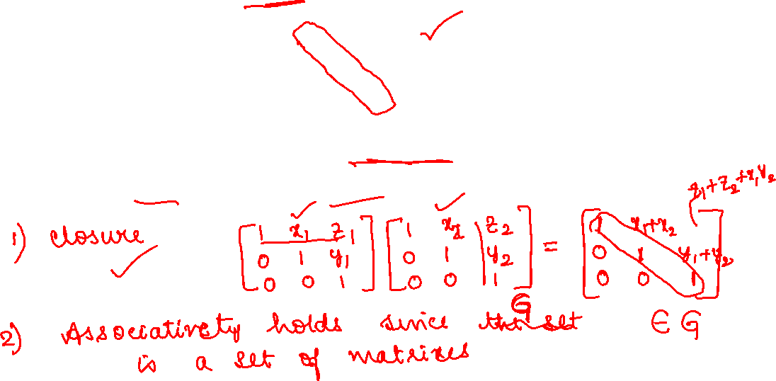

Slide 9
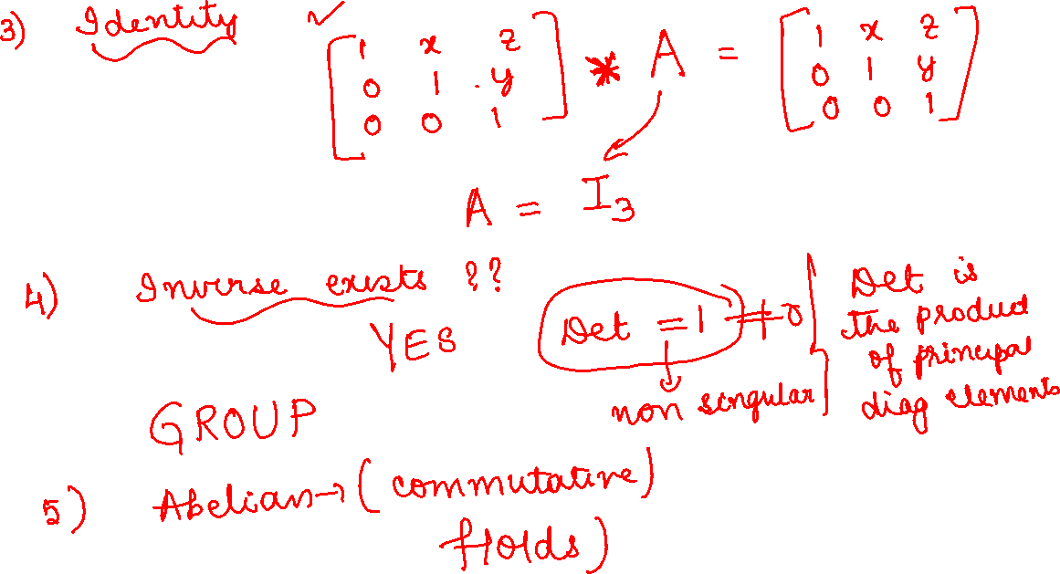

Slide 10

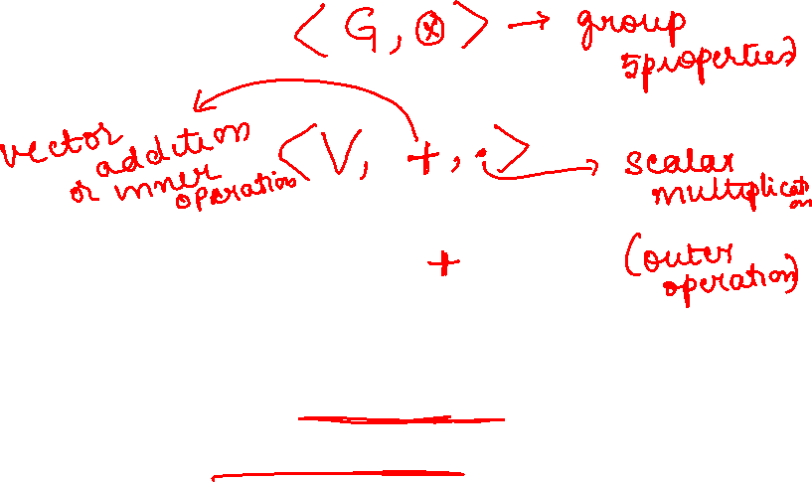
2.4.2 Vector Spaces

Slide 11
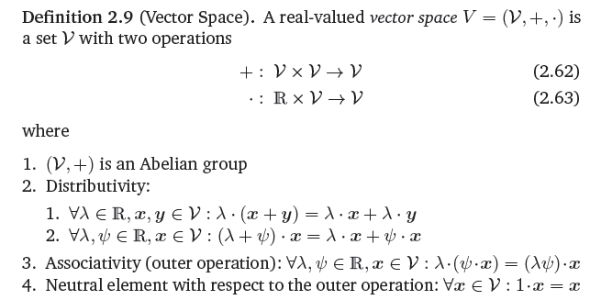


Slide 12
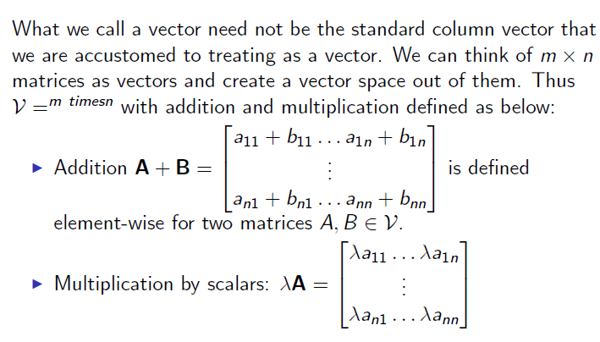
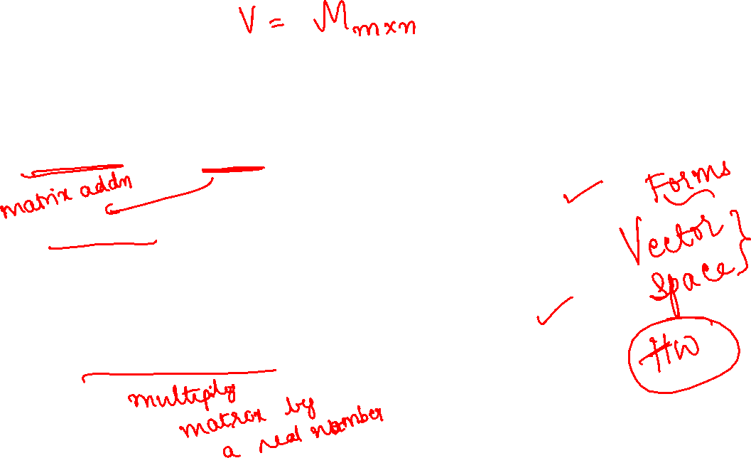

Slide 13
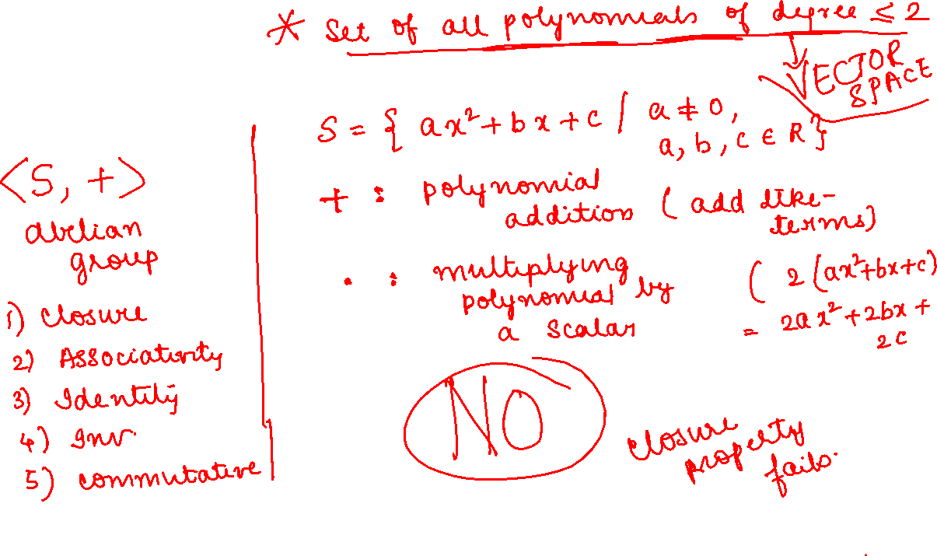
Set of all polynomials of degree 2.

Slide 14
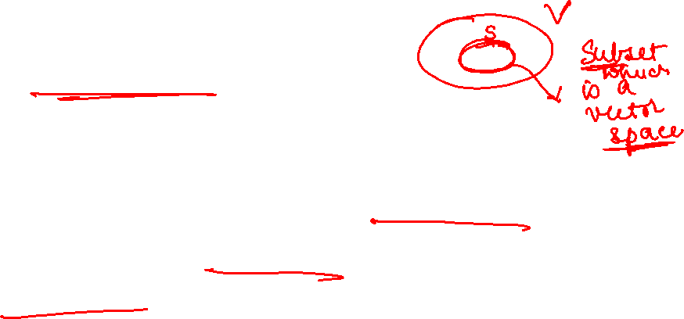
2.4.3 Vector Subspaces
  Let V be a vector space and U ≠ Φ be a subset of V
    U is a subspace of V if it is a vector space under the operations of addition and scalar multiplication of V.

Slide 15

U is a subspace of V if
(i) it is non-empty subset of V
(ii) It is closed w.r.t the inner operation
(iii) It is closed w.r.t the outer operation.
It then inherits all other vector properties of V.

Slide 16
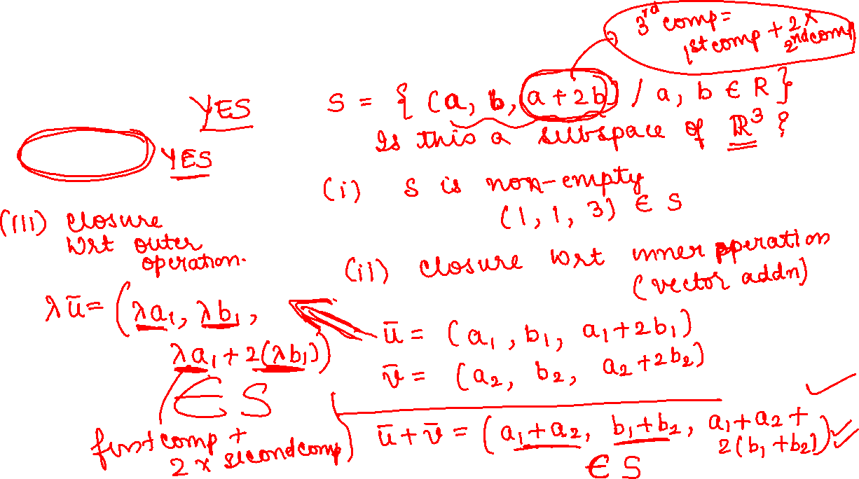
Determine whether the sets are subspaces of R² or R³
(i) (a,b,a+2b)
(ii) (a,0)

Slide 17
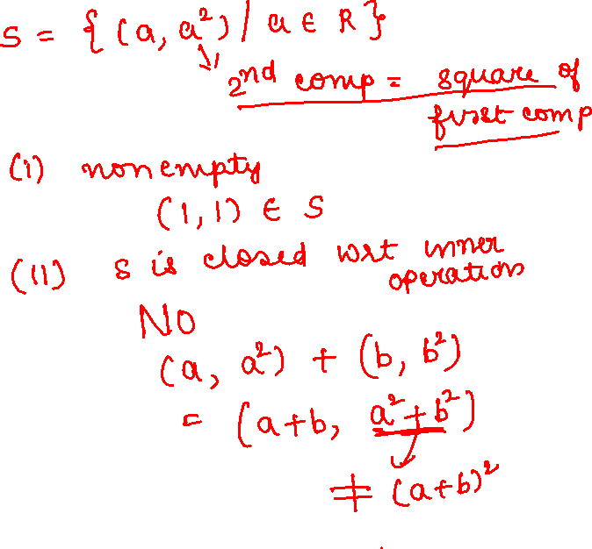
(iii) (a,a²)
(iv) (a, b, c) where ab=5

Slide 18

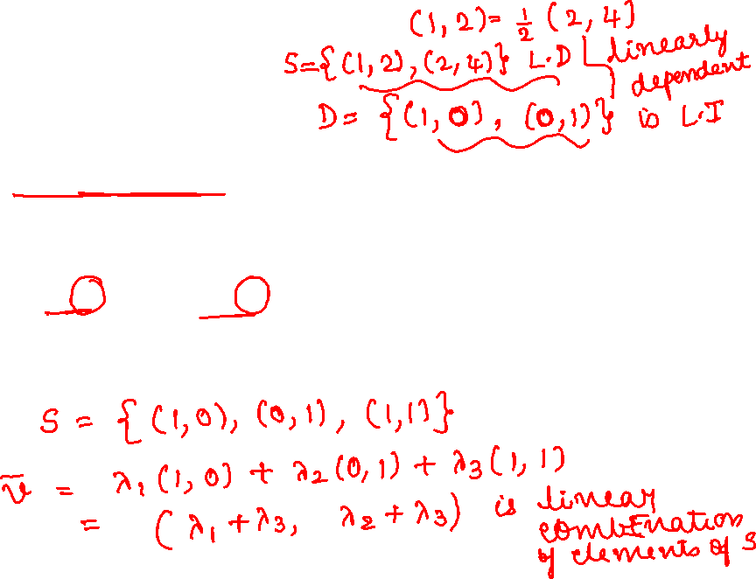
2.5 Linear Independence

Slide 19

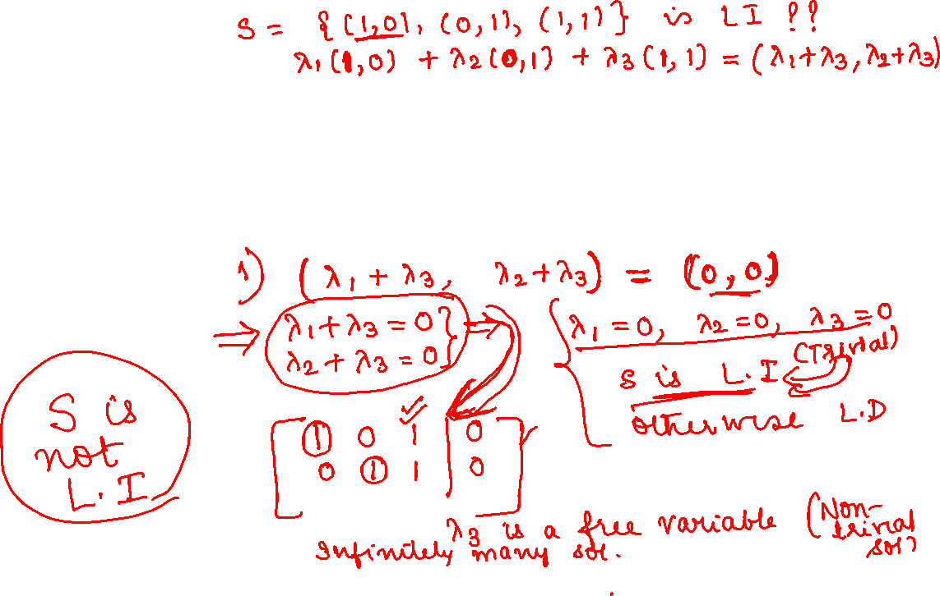

Slide 20
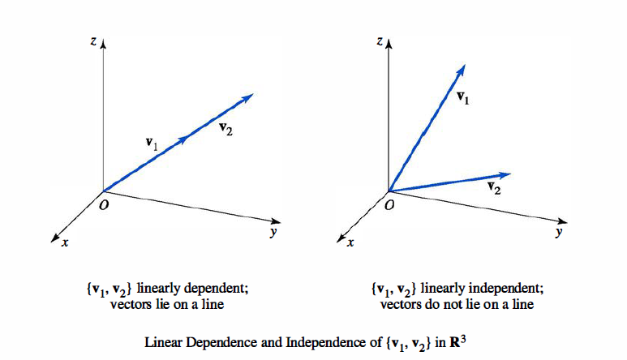


Slide 21
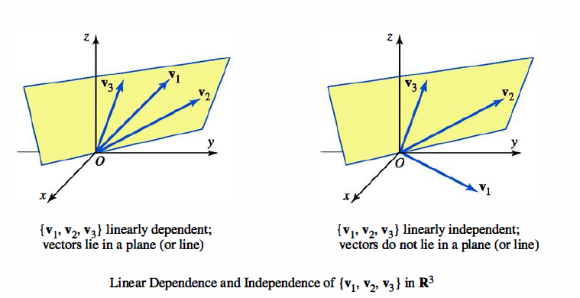


Slide 22
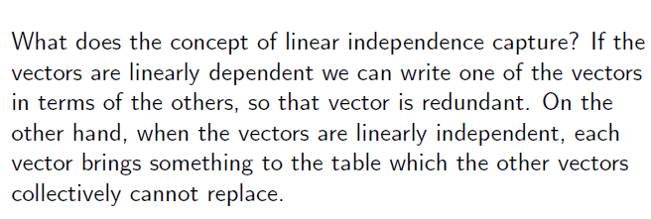
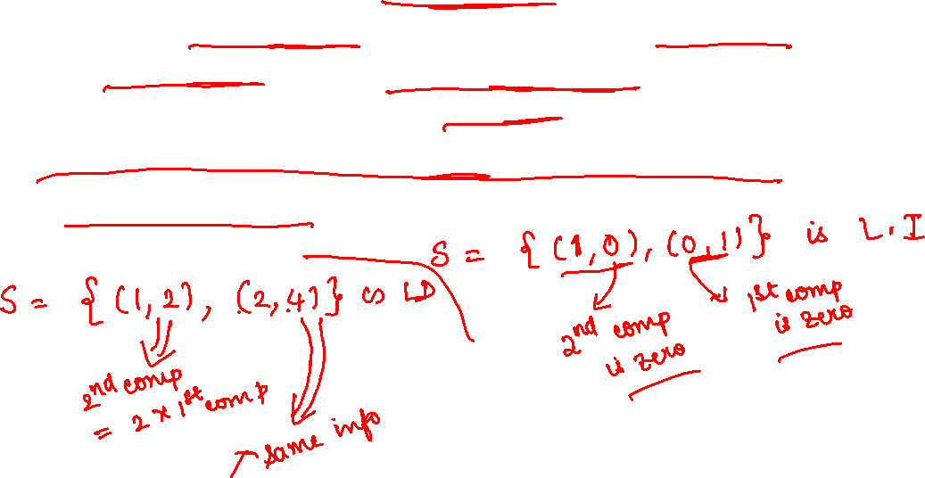

Slide 23
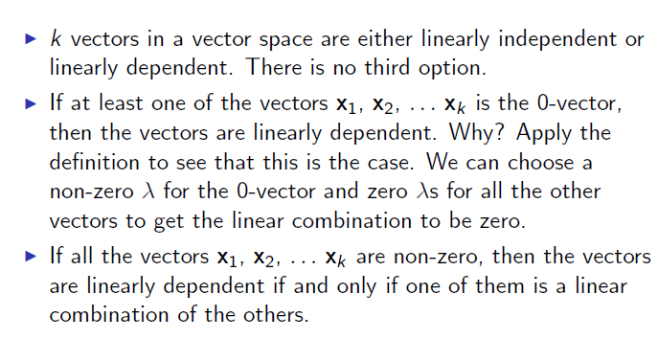


Slide 24
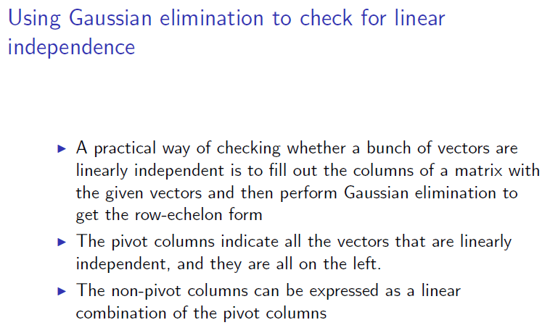
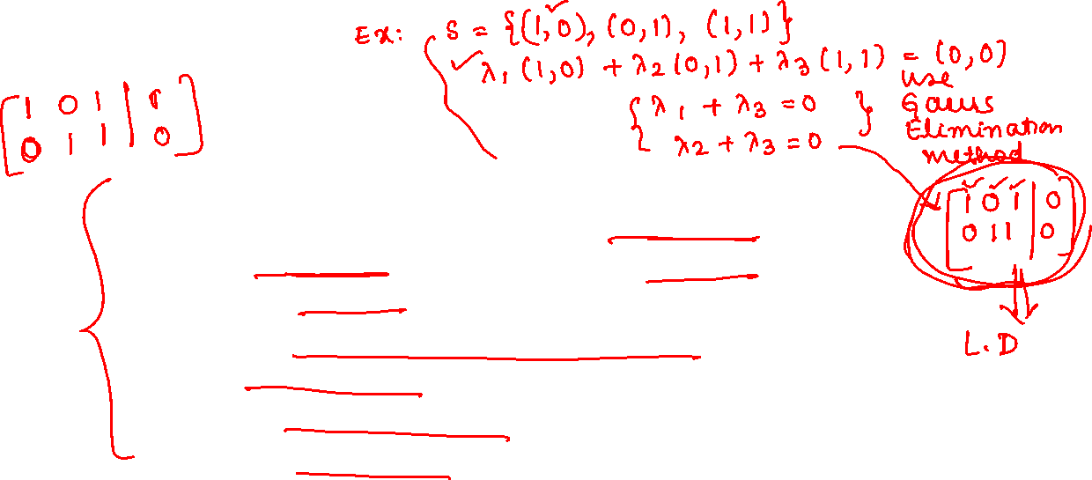

Slide 25


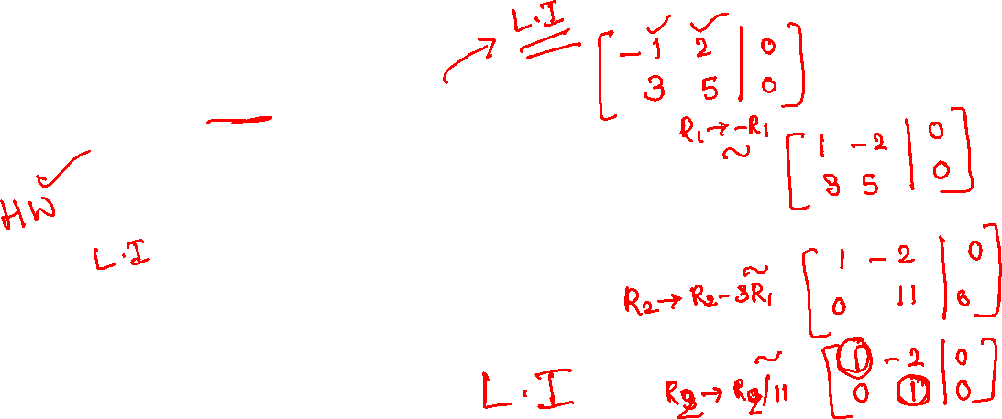

Slide 26

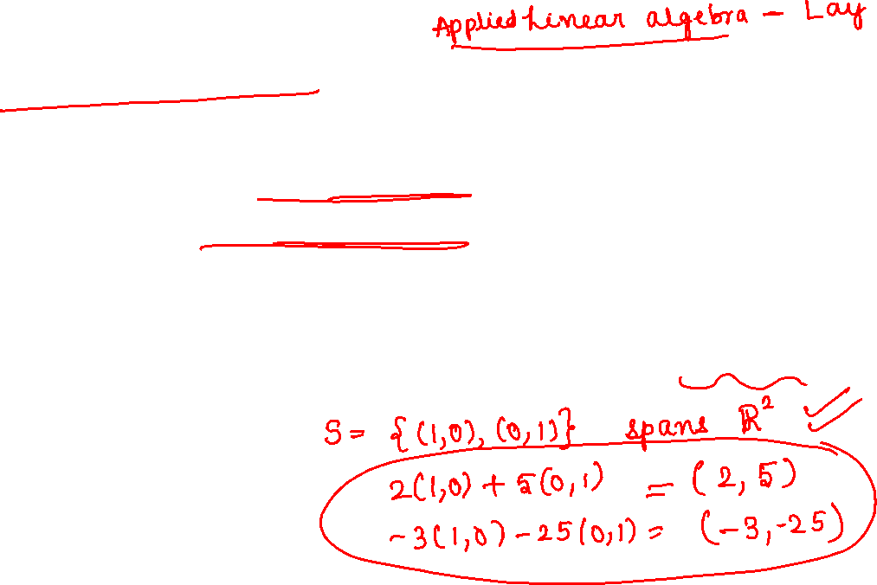
2.6 Basis and Rank

Slide 27
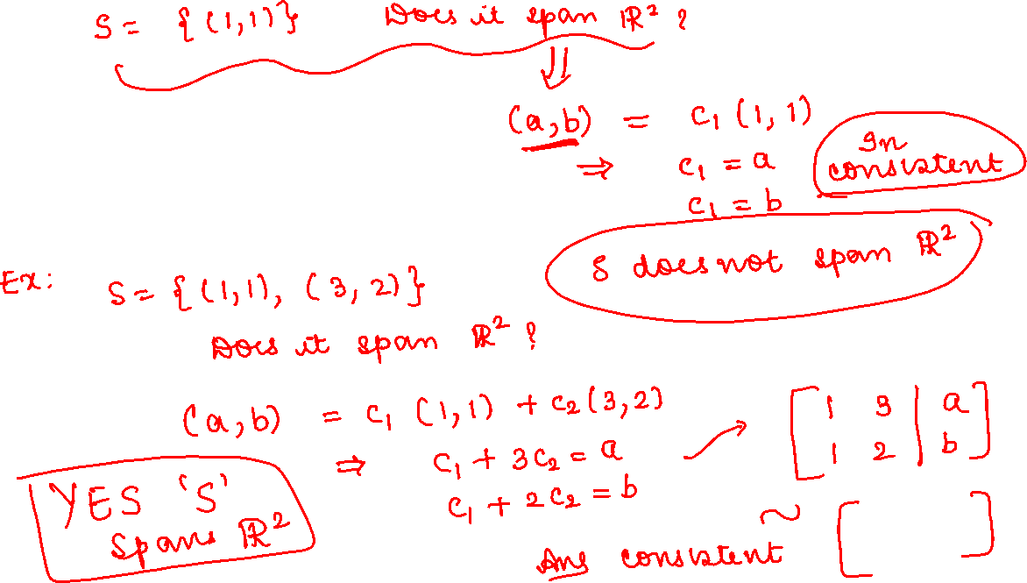

Slide 28

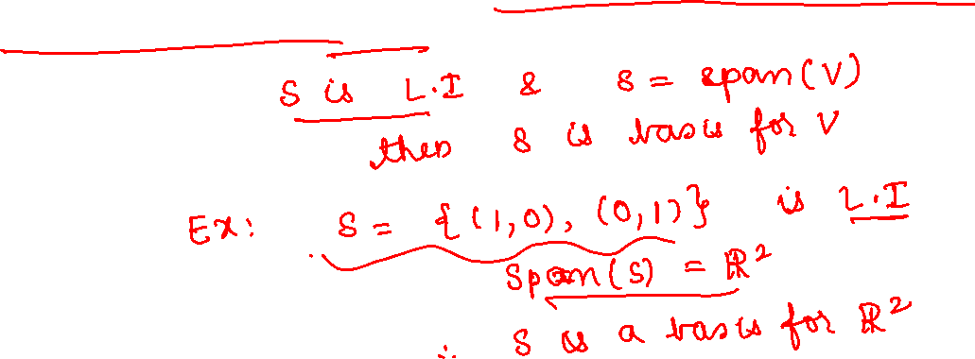

Slide 29
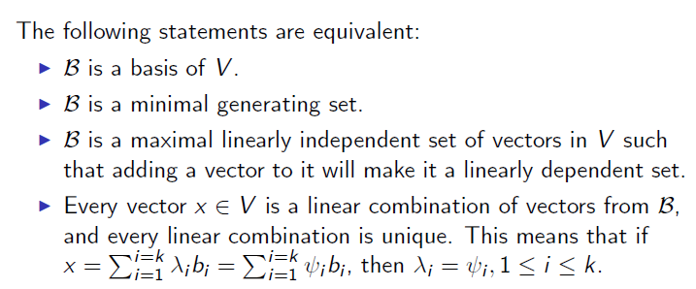


Slide 30
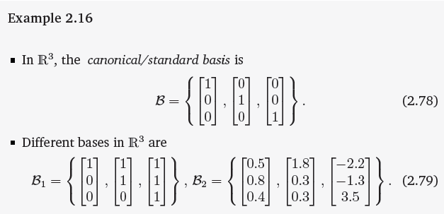
Basis is not unique

Slide 31
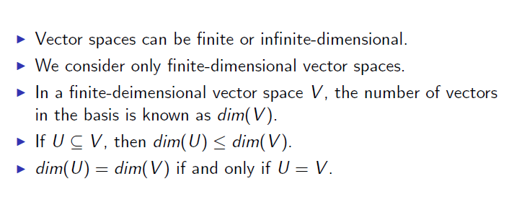
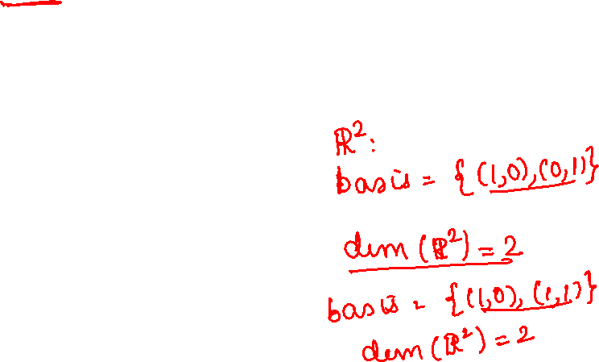

Slide 32
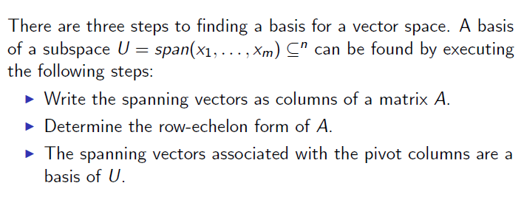
Method to find a basis for a given vector space

Slide 33

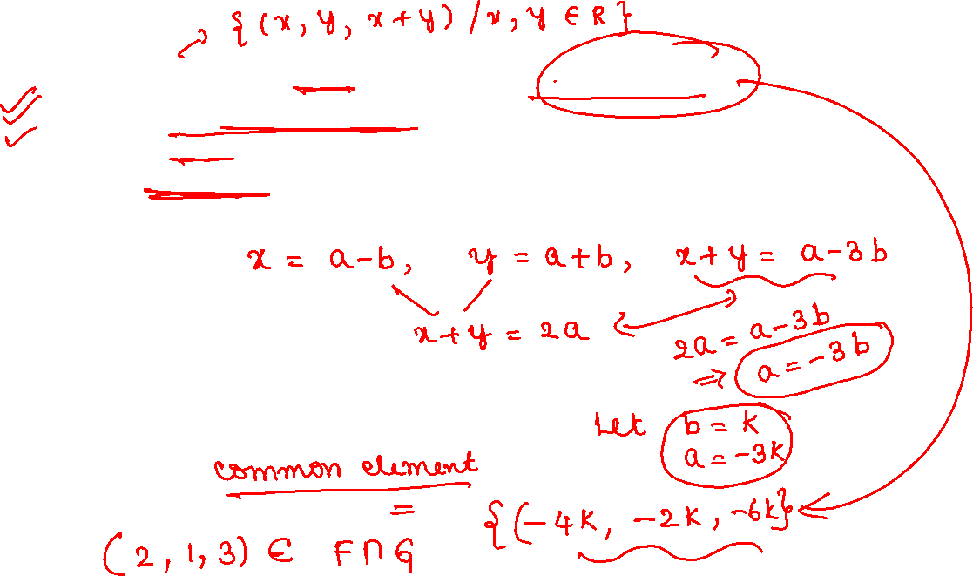

Slide 34
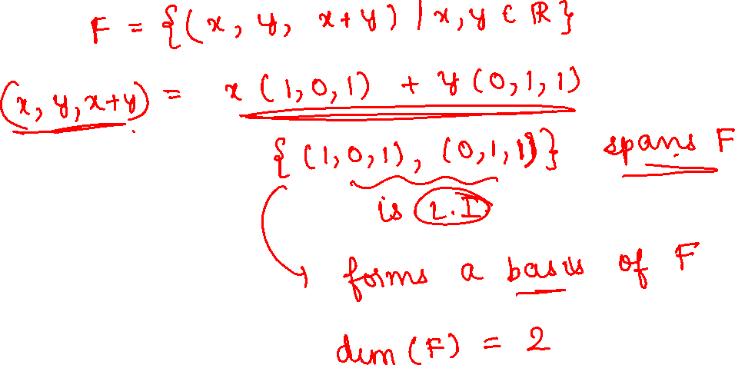

Slide 35

2.6.2 Rank

Slide 36
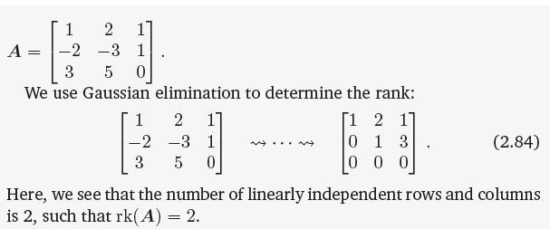
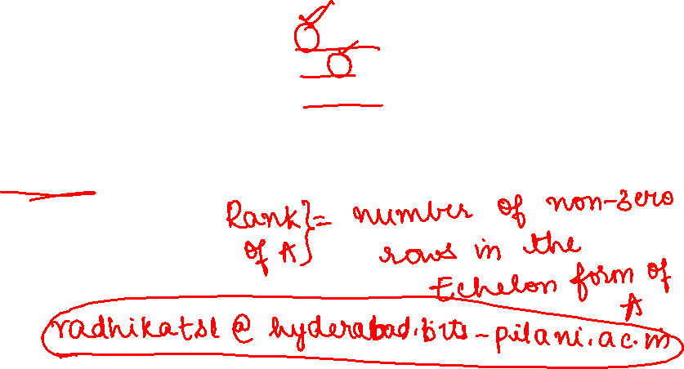

Slide 37
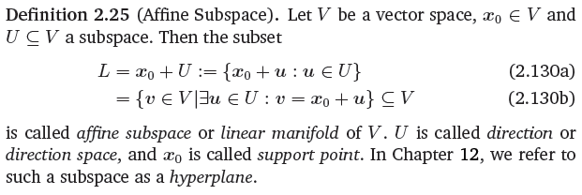
2.8 Affine Spaces

