Slide 1
BITS Pilani presentation
Prof. T S L Radhika
Dept. of Mathematics, Hyderabad Campus

Slide 2
<SS ZC416, MFDS>
Lecture No. 3

Slide 3

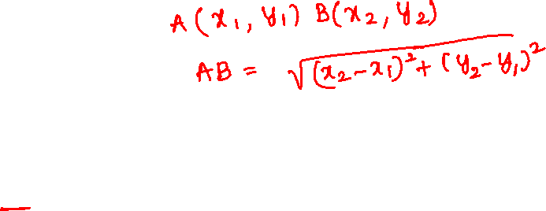

Slide 4

Chapter 3: Analytic Geometry

Slide 5
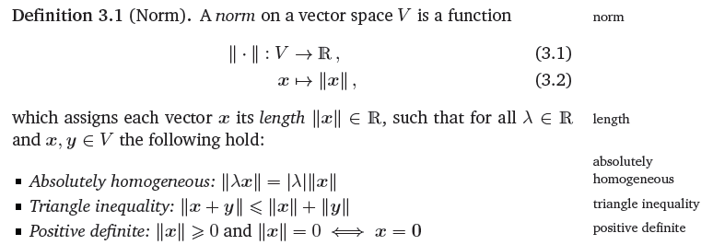
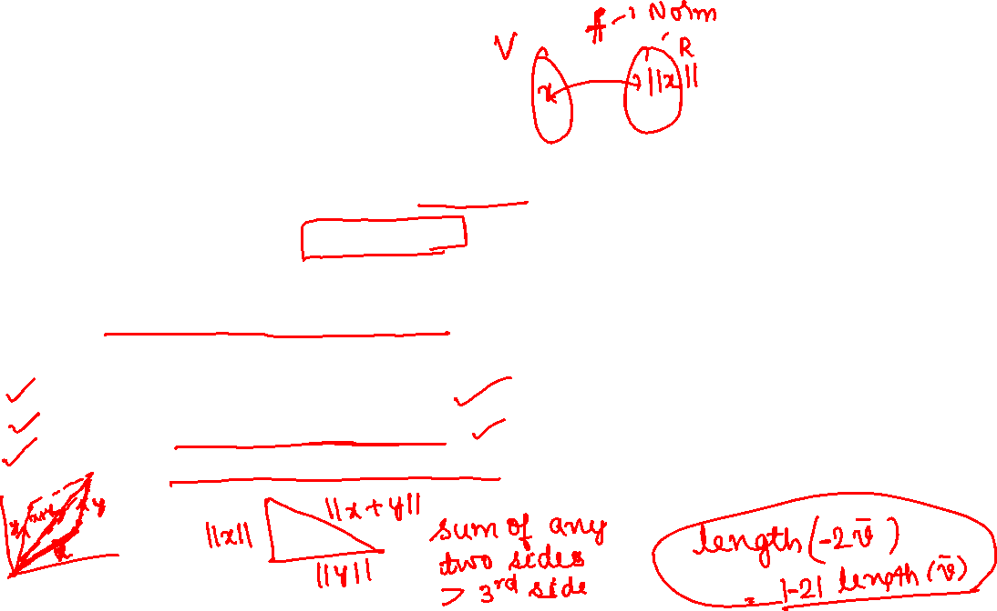
3.1 Norm

Slide 6

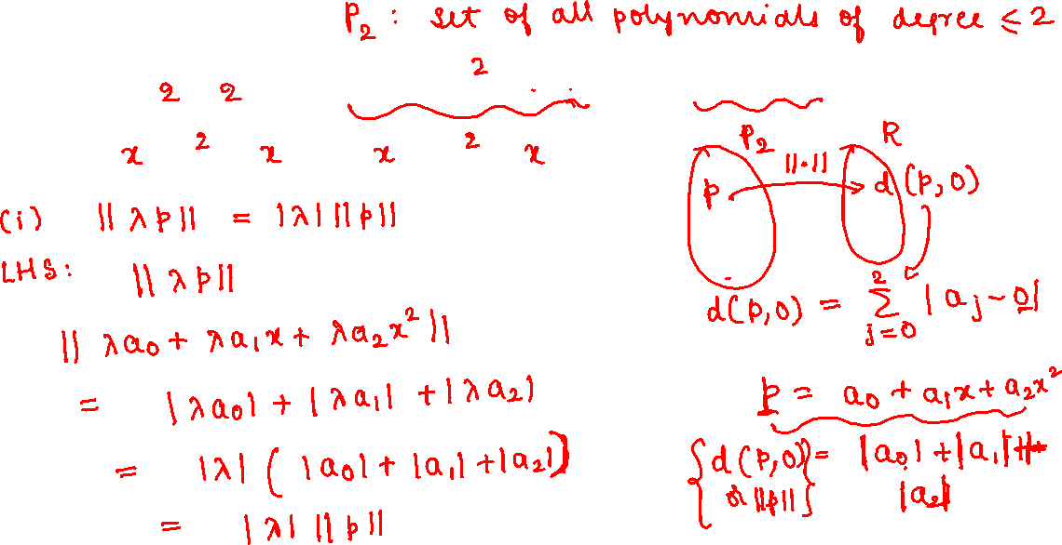
(True or False)

Slide 7
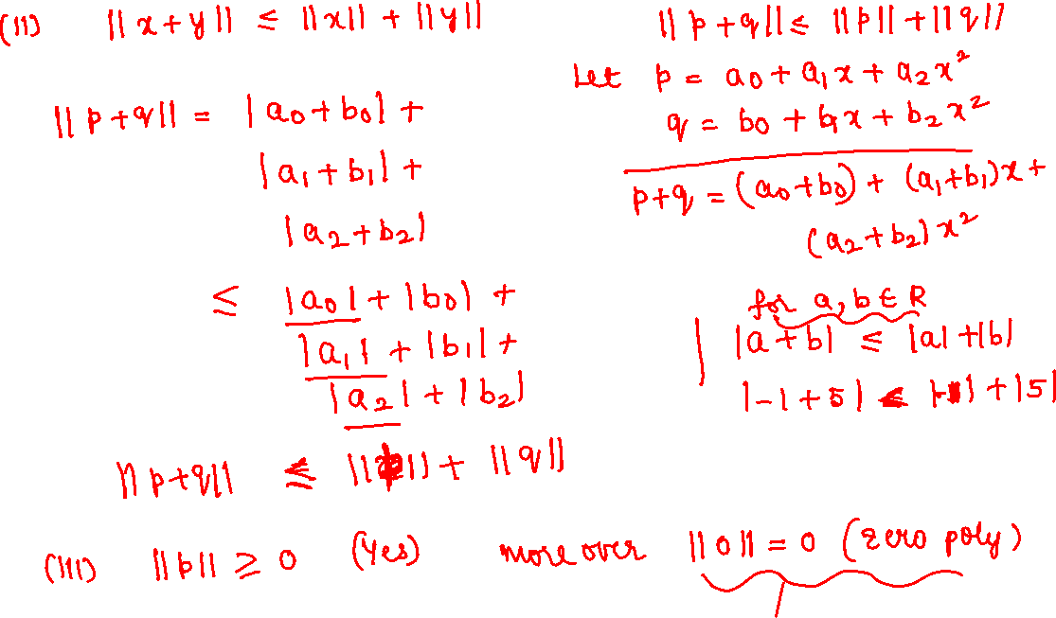

Slide 8
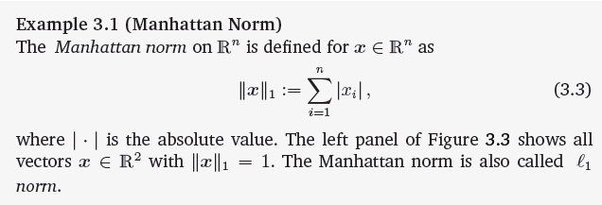
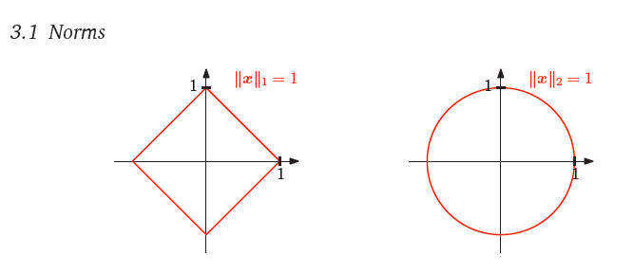
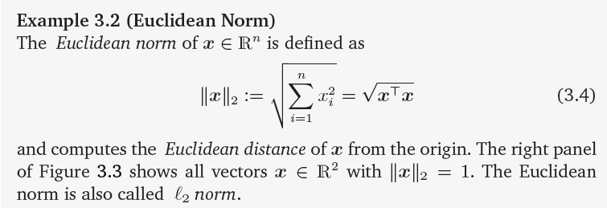
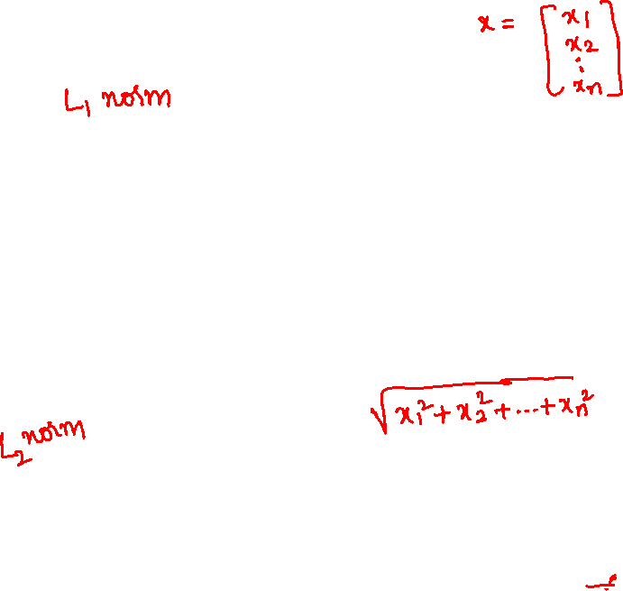

Slide 9

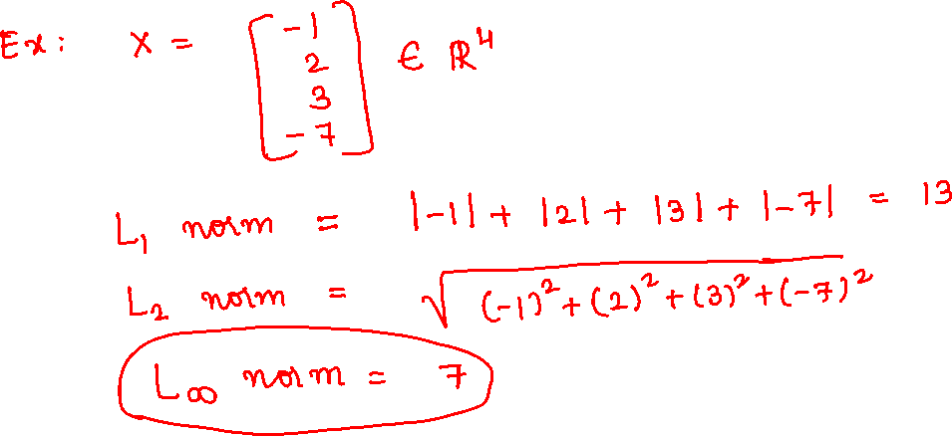

Slide 10

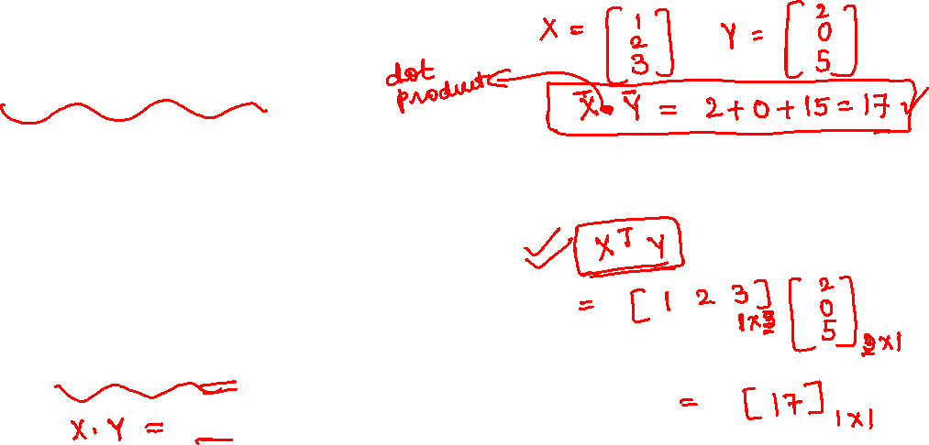
3.2 Inner Product
Inner products allow for the introduction of intuitive geometrical concepts, such as the length of a vector and the angle or distance between two vectors.

Slide 11


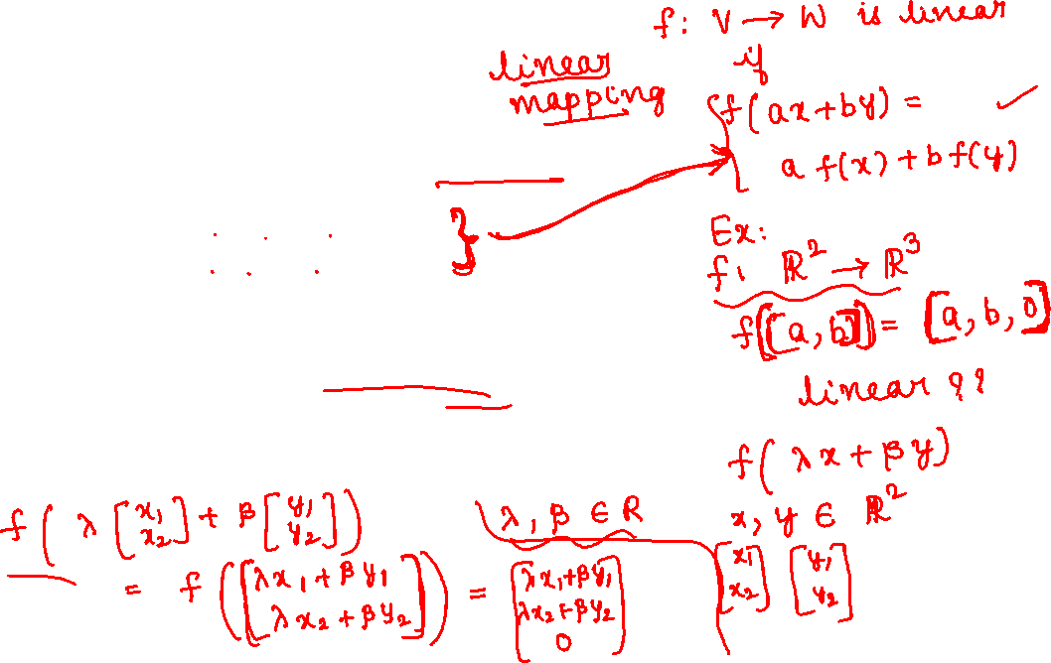
Linear Map:

Slide 12
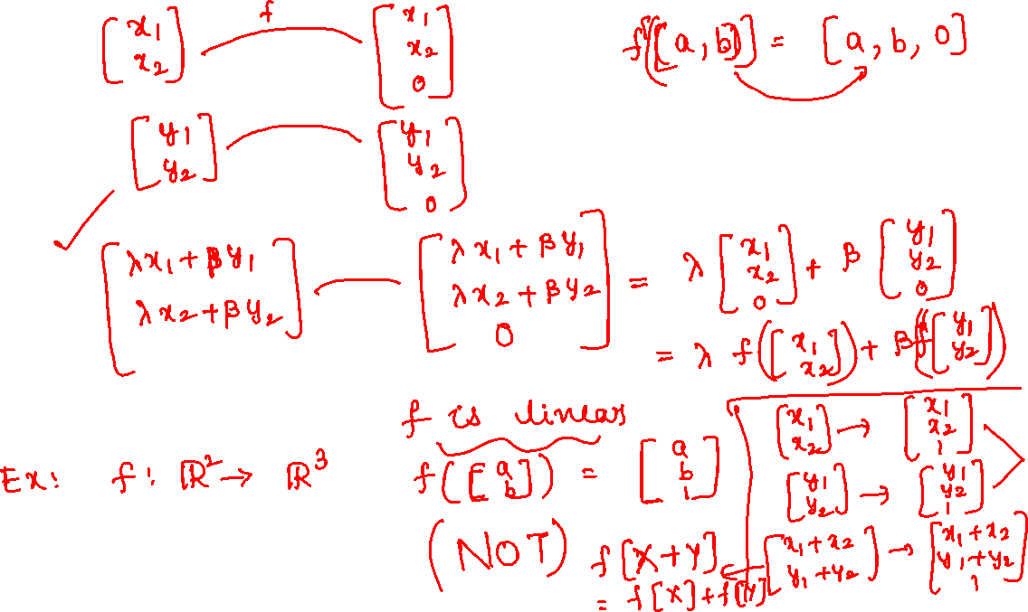

Slide 13

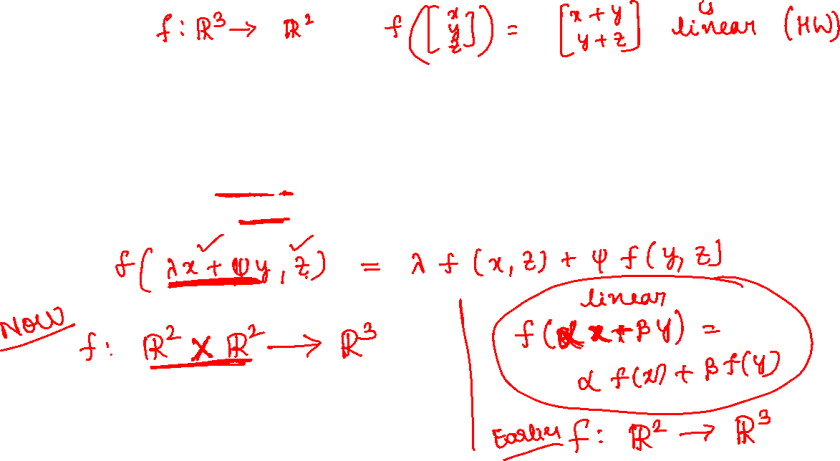

Slide 14
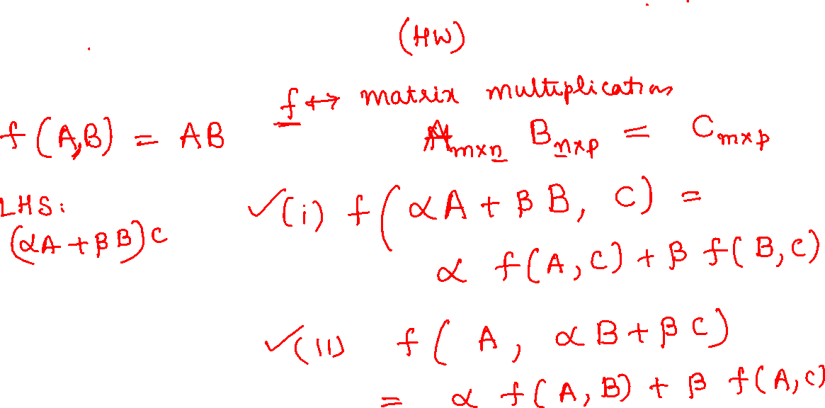
Matrix multiplication is a bilinear map M(m, n) × M(n, p) → M(m, p).

Slide 15



Slide 16



Slide 17

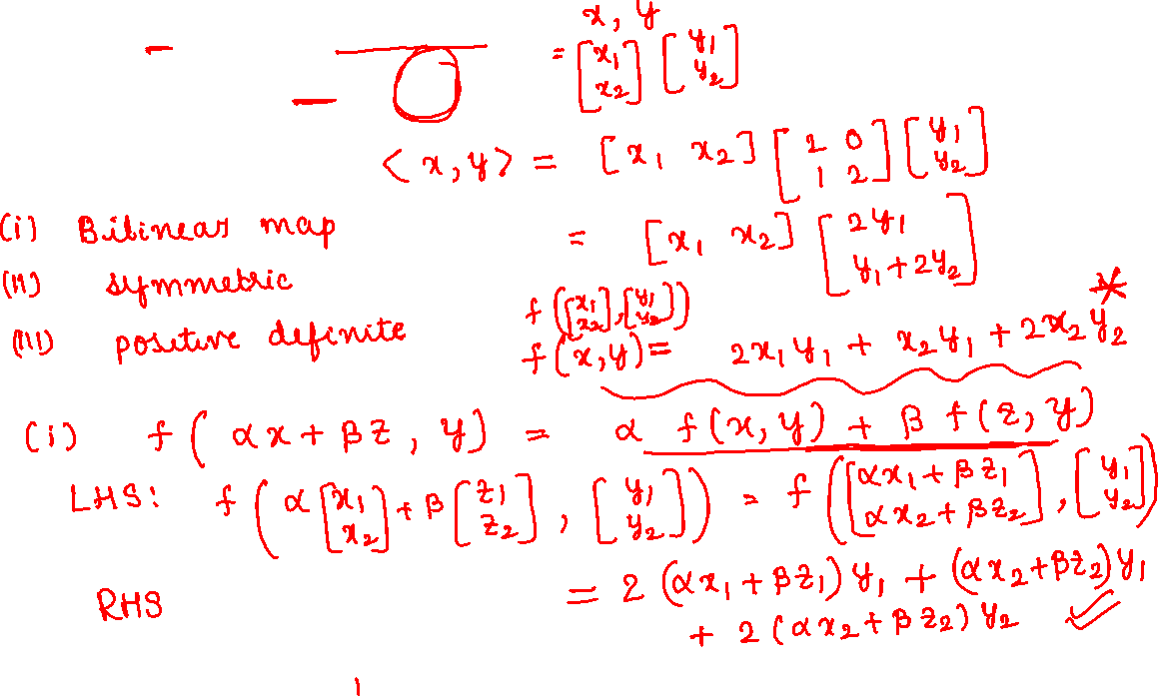

Slide 18
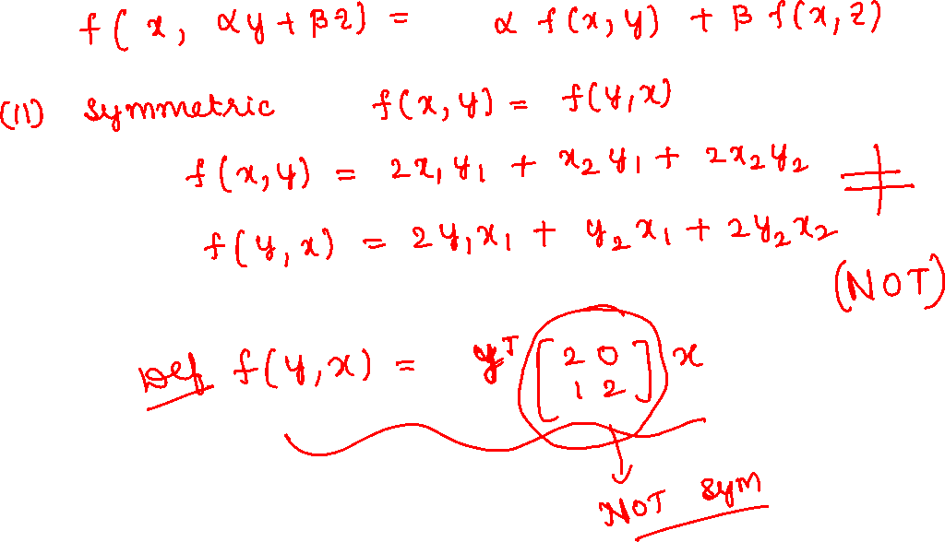

Slide 19
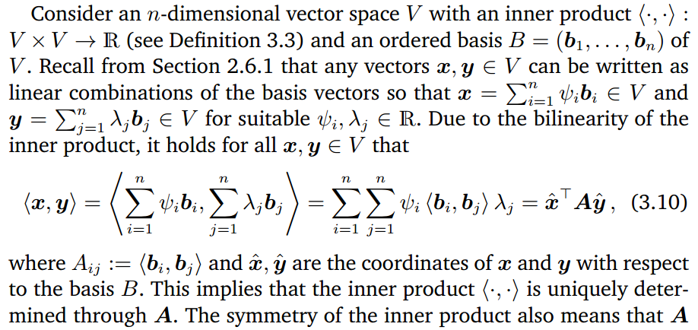

3.2.3 Symmetric Positive Definite Matrix

Slide 20
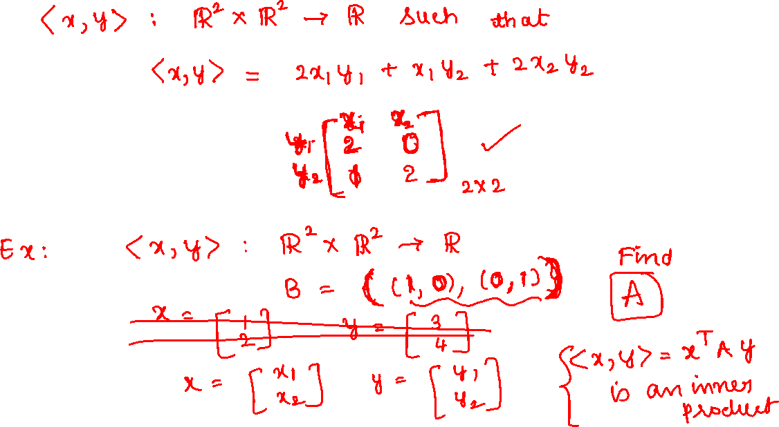

Slide 21
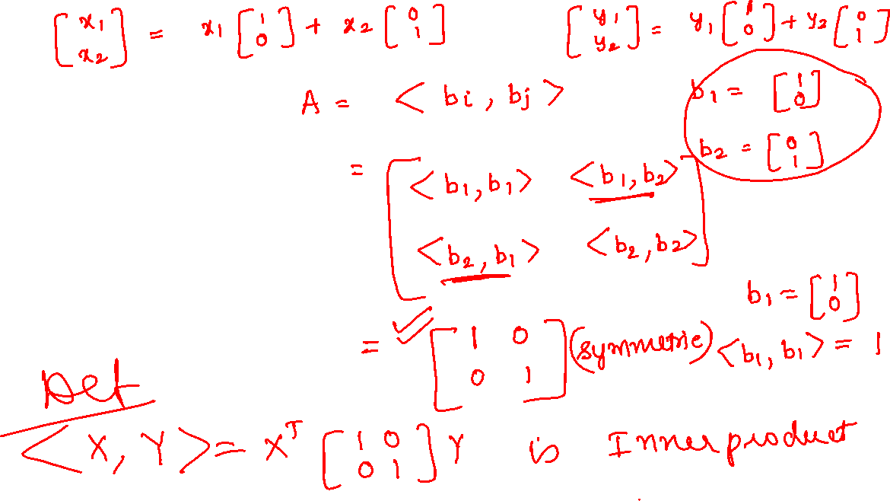

Slide 22


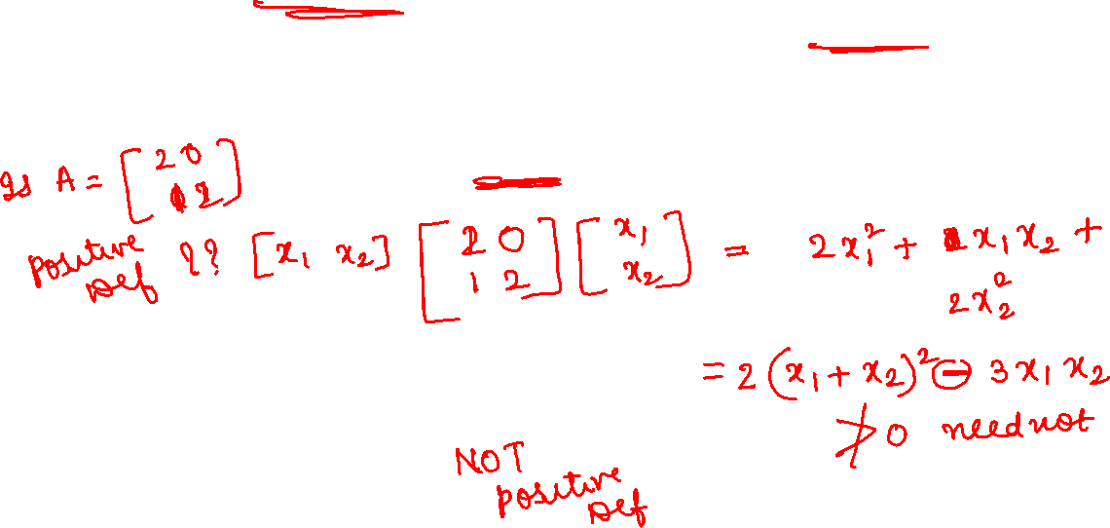

Slide 23
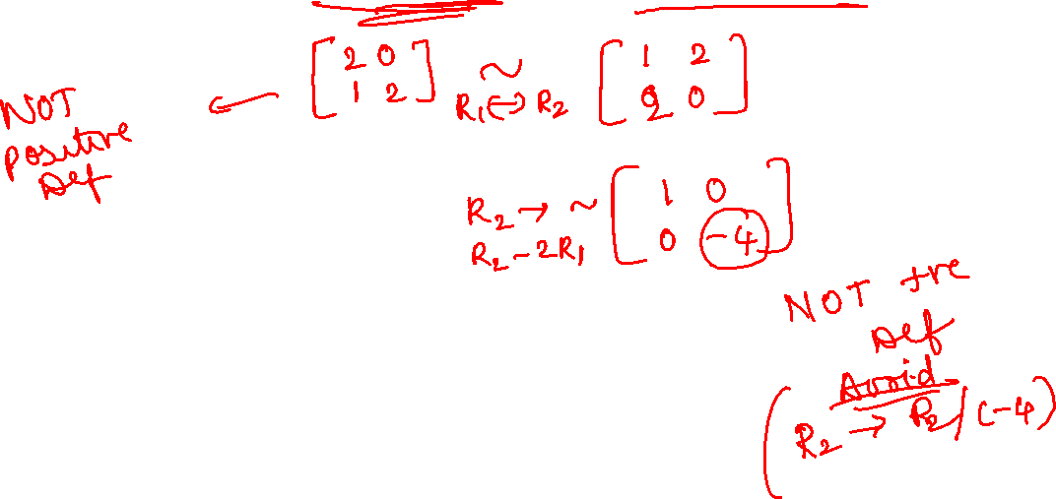

Slide 24




Slide 25


Slide 26



Slide 27
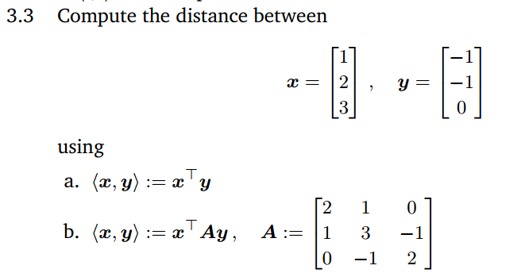
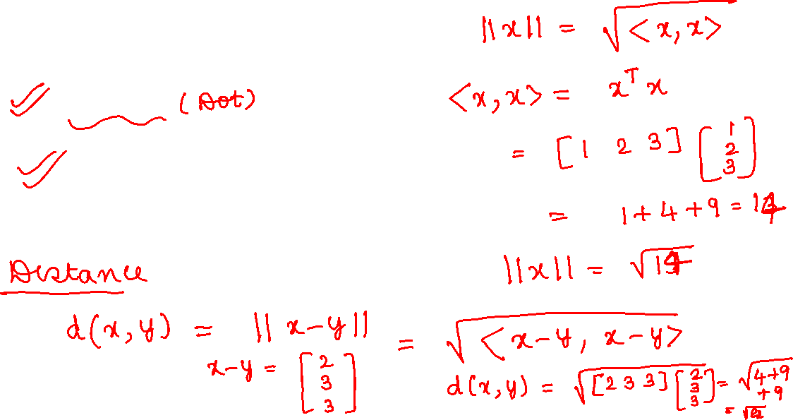

Slide 28
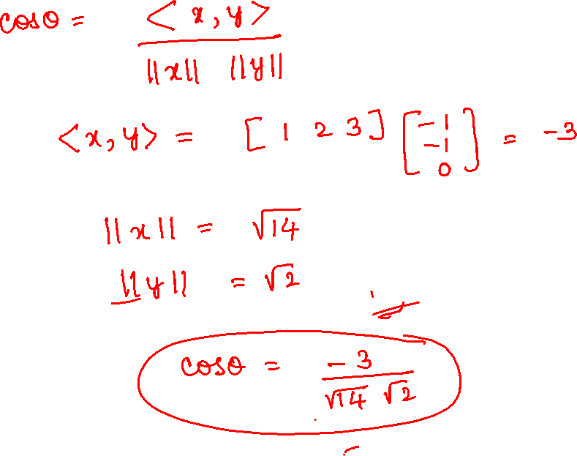

Slide 29


Slide 30


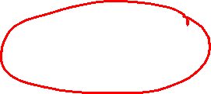

Slide 31
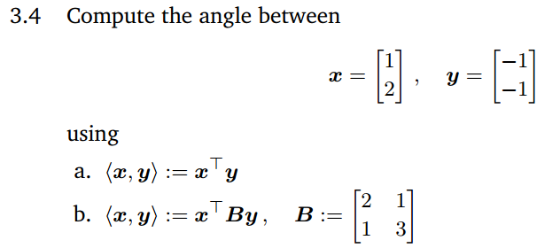

Slide 32


Slide 33


Slide 34


