Slide 1
BITS Pilani presentation
Prof. T S L Radhika
Dept. of Mathematics, Hyderabad Campus

Slide 2
<SS ZC416, MFDS>
Lecture No. 4

Slide 3
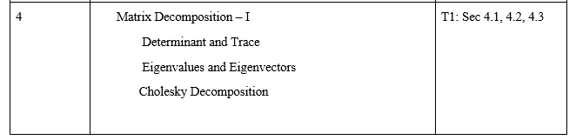

Slide 4
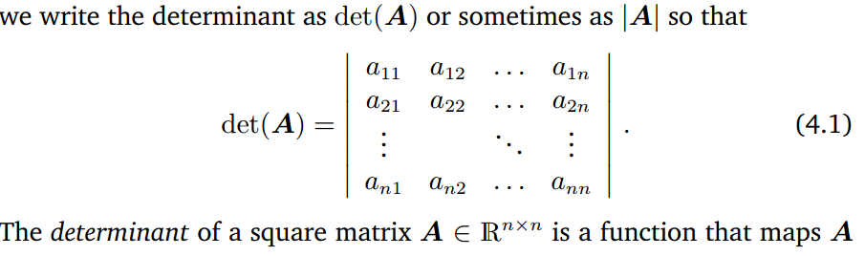

Slide 5
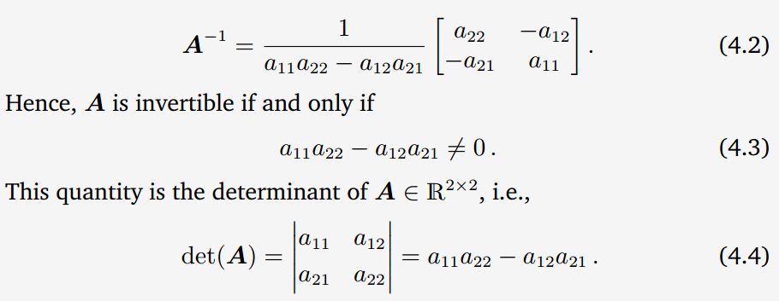

Slide 6
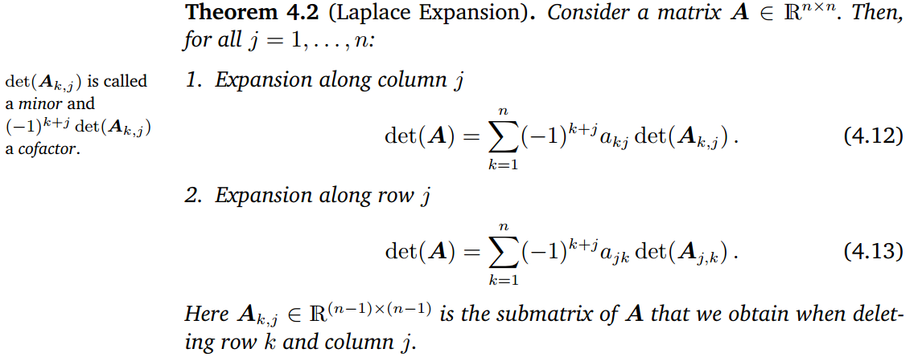
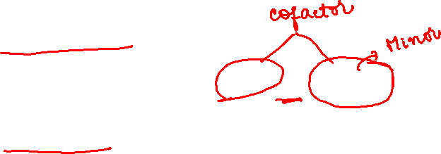

Slide 7
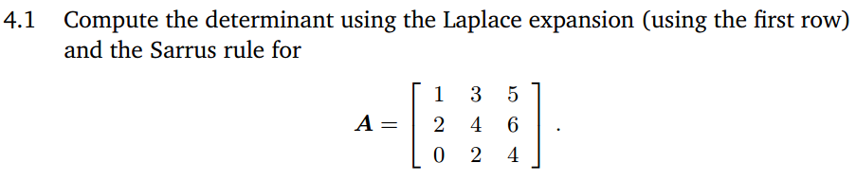
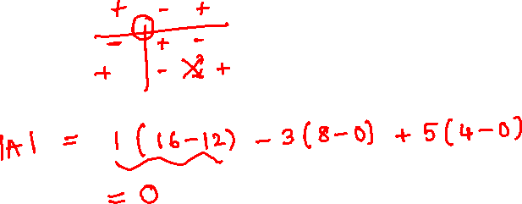

Slide 8
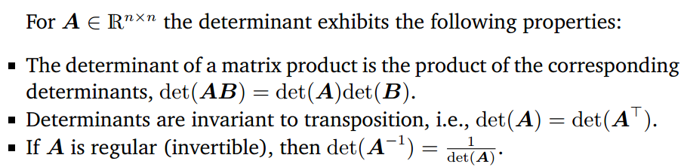


Slide 9
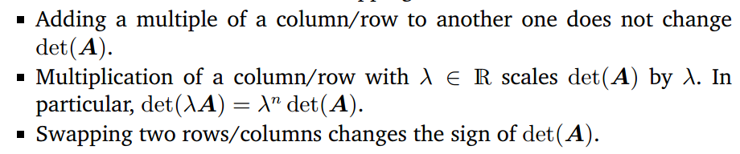
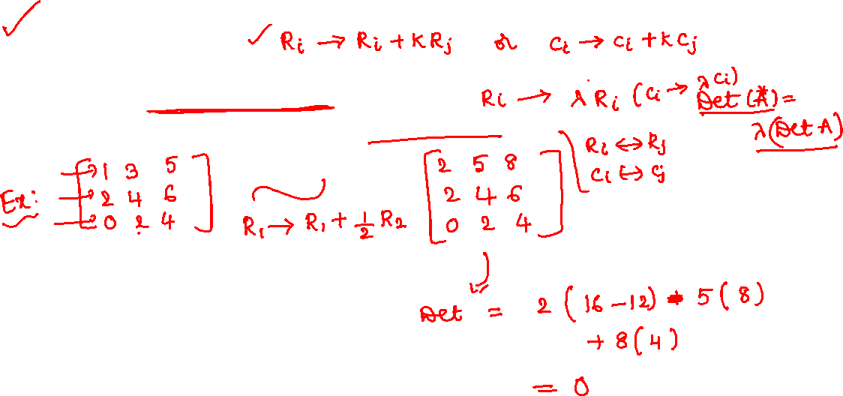

Slide 10

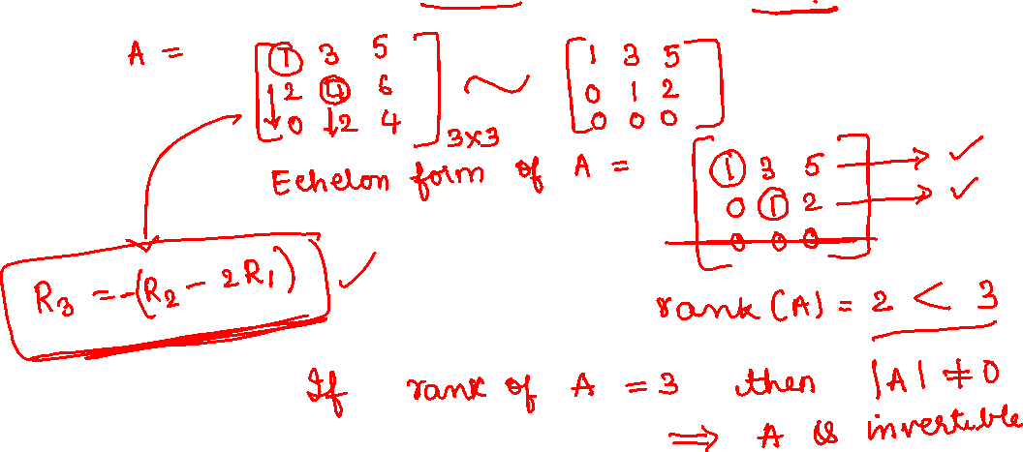

Slide 11

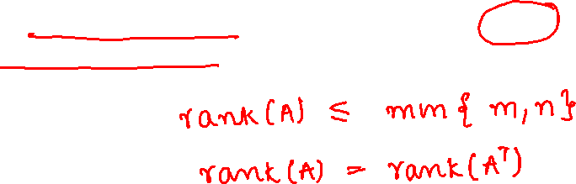
2.6.2 Rank

Slide 12
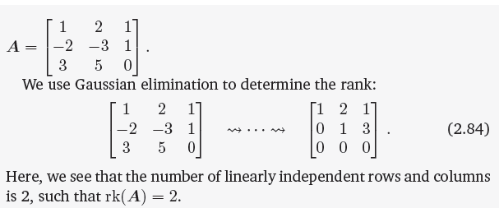


Slide 13
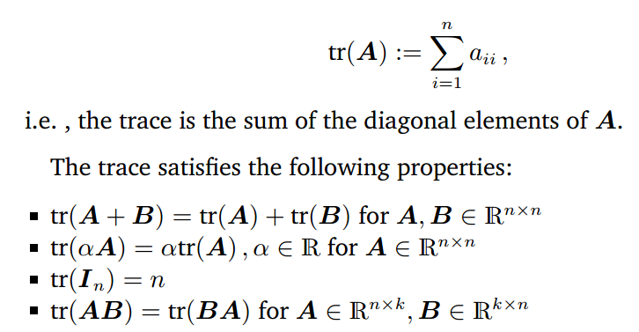
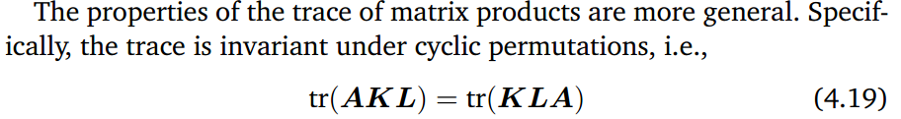
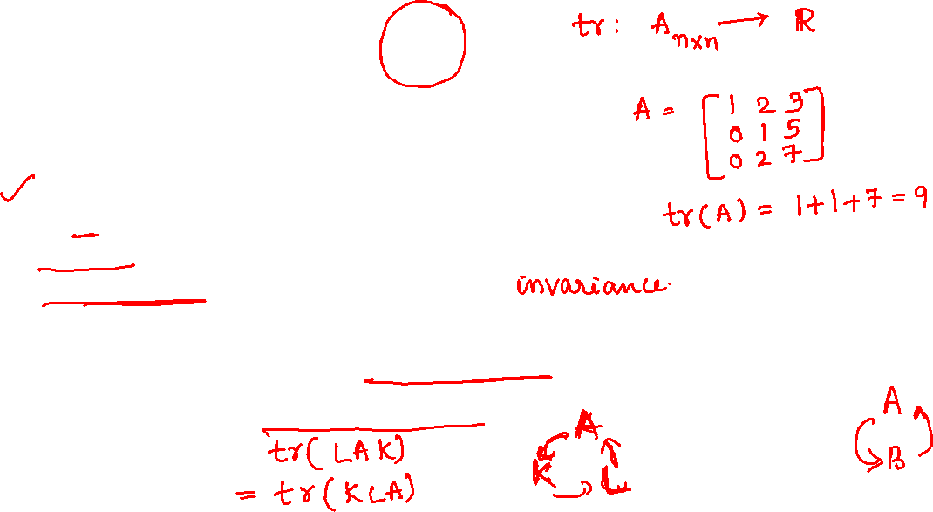

Slide 14

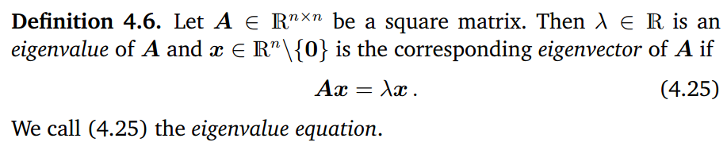


Slide 15
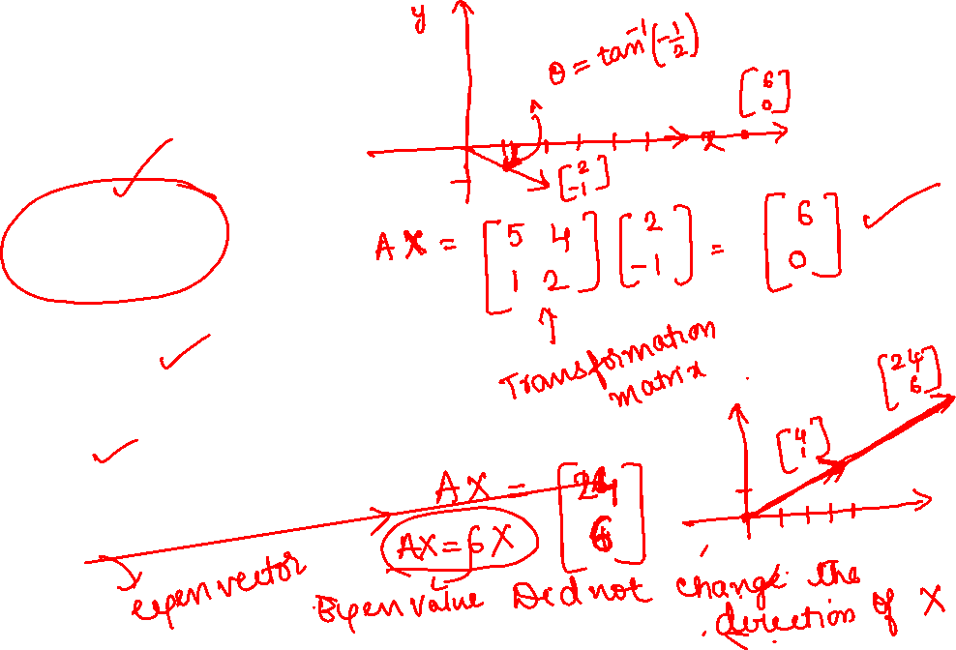
Eigen vectors
A =
X=
Find AX.
Now take X= and find AX

Slide 16
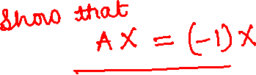
Problem
If
verify that -1 is an eigenvalue of A
and X= is the associated Eigen vector.

Slide 17
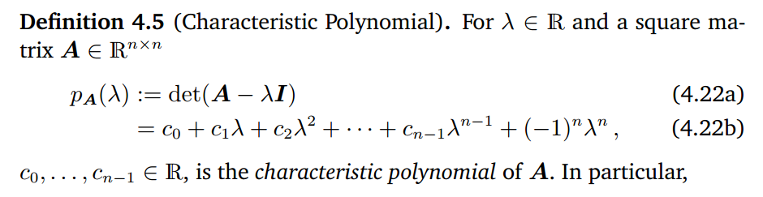
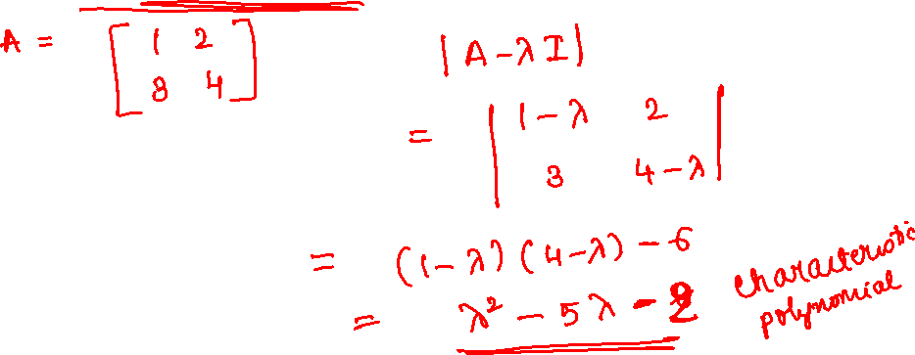

Slide 18
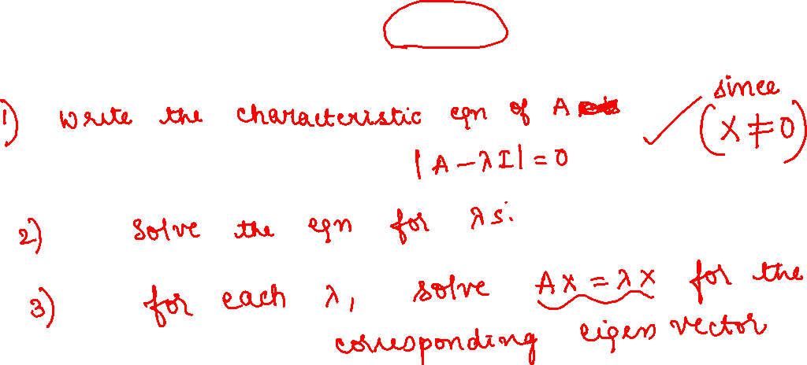

Slide 19
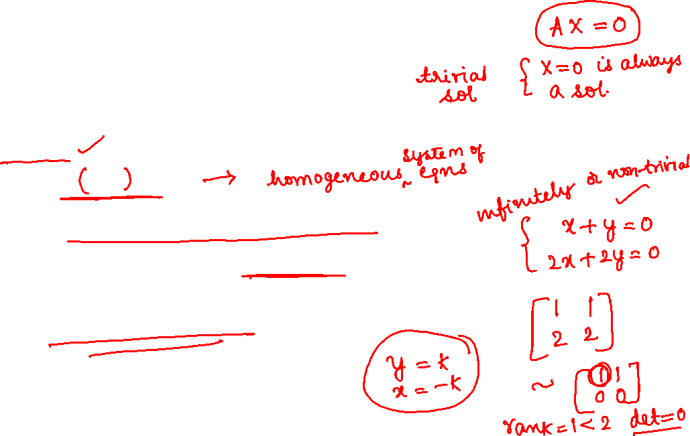
Method of finding Eigen Pairs
let X be an eigenvector of A corresponding to the eigenvalue λ, then we have AX= λX
This homogeneous system has a nontrivial solution if …………….(1)
(1) is called the characteristic equation of A.

Slide 20
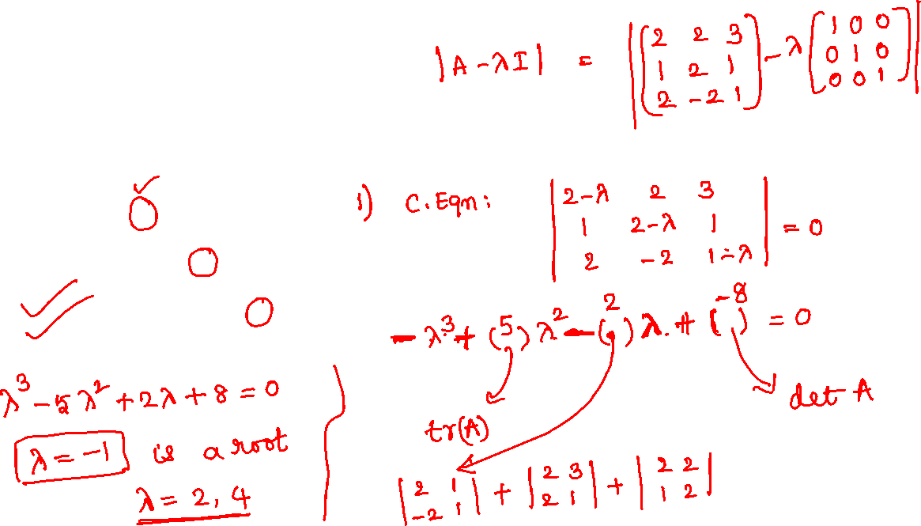
Problem
Find the eigen values and the associated eigen vectors of

Slide 21
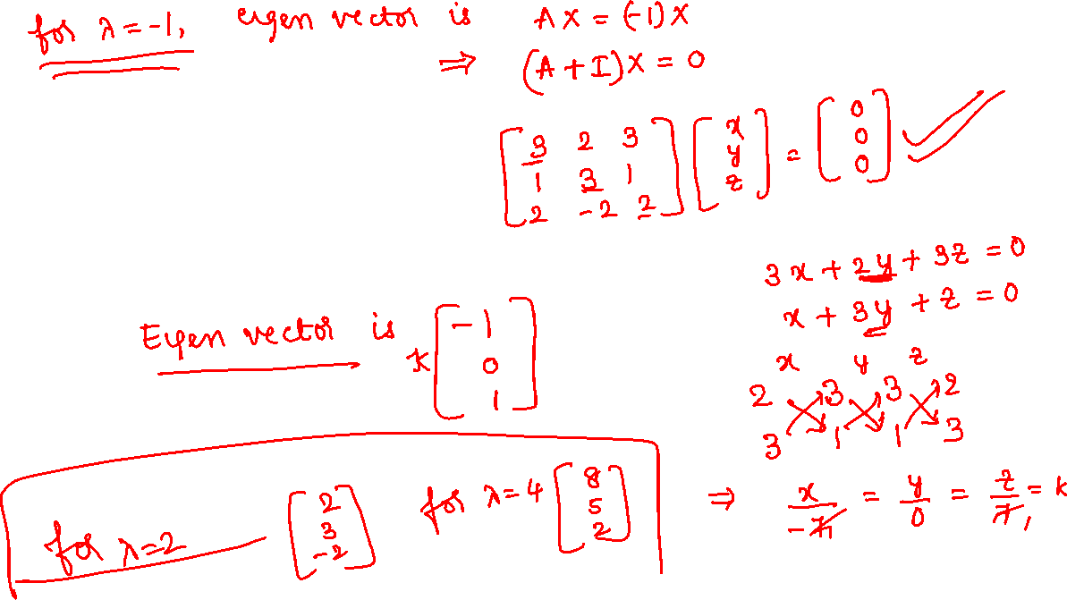

Slide 22
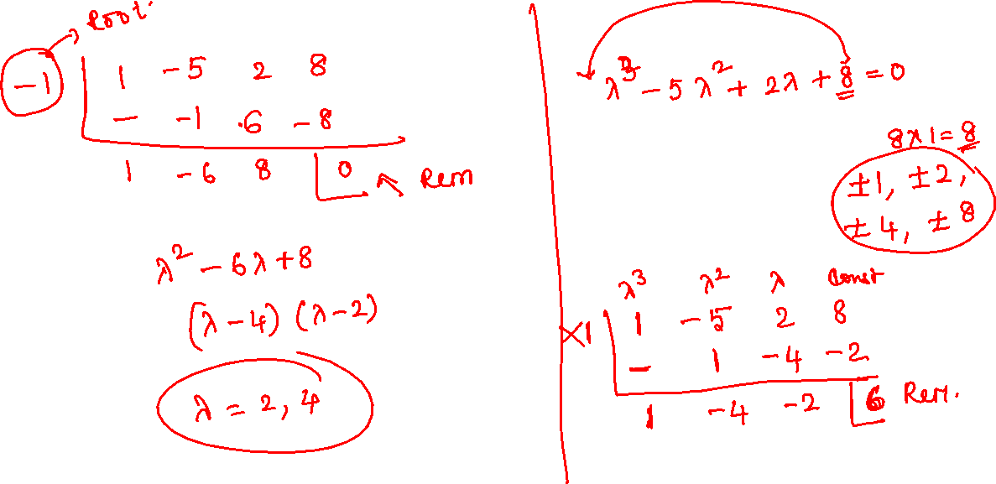

Slide 23
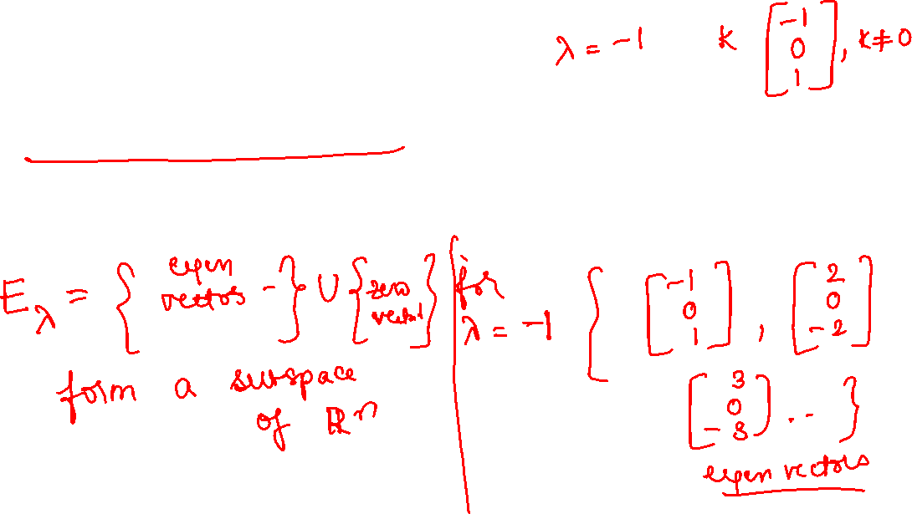
Properties of Eigen pairs
If X is an eigenvector of A associated with an eigenvalue and k is any nonzero scalar, kX is also an eigenvector of A associated with the same eigenvalue.

Slide 24
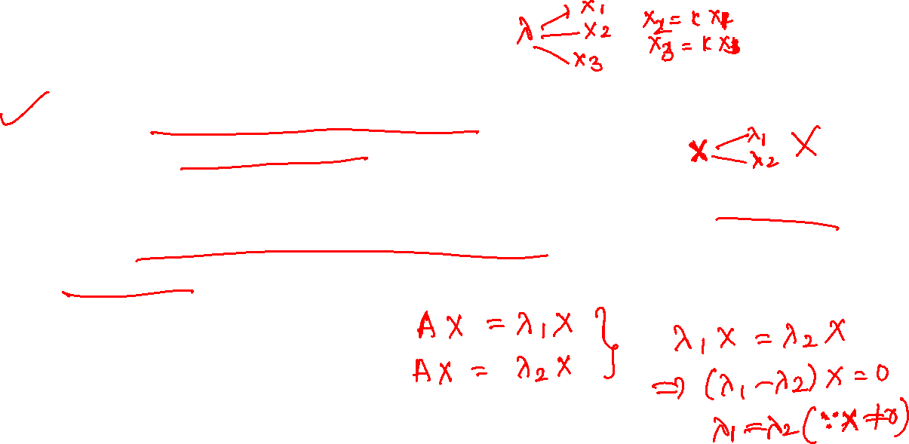
Properties continued
An eigenvector X of A X= λ X cannot correspond to more than one eigenvalue of A.
If A is an upper ( lower) or diagonal, then the eigenvalues of A are the elements of the main diagonal of A.
A and A^{T} have the same eigenvalues.

Slide 25
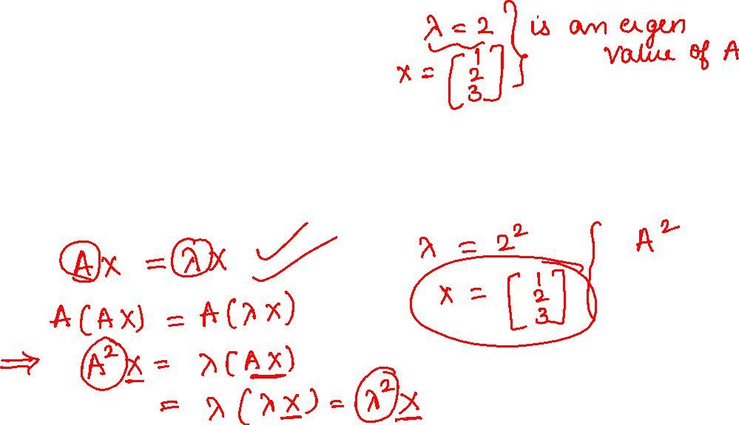
Properties continued
If λ is an eigenvalue of A with associated eigenvector X. Then λ^{k} is an eigenvalue of A^{k} associated with the same eigenvector X.

Slide 26
If λ is an eigenvalue of A with associated eigenvector X. Then 1/ λ is an eigenvalue of A⁻¹ with associated vector X.
The sum of the eigenvalues of A = Trace(A).

Slide 27
If λ =0 is an eigenvalue of A, then A is not invertible.
The determinant of A is the product of the eigenvalues of A.

Slide 28
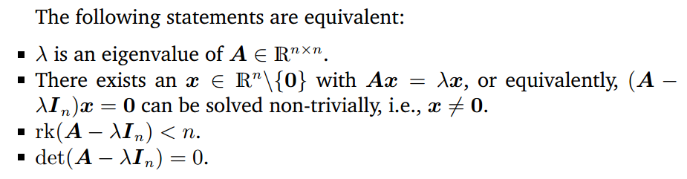


Slide 29
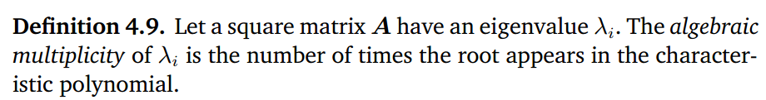
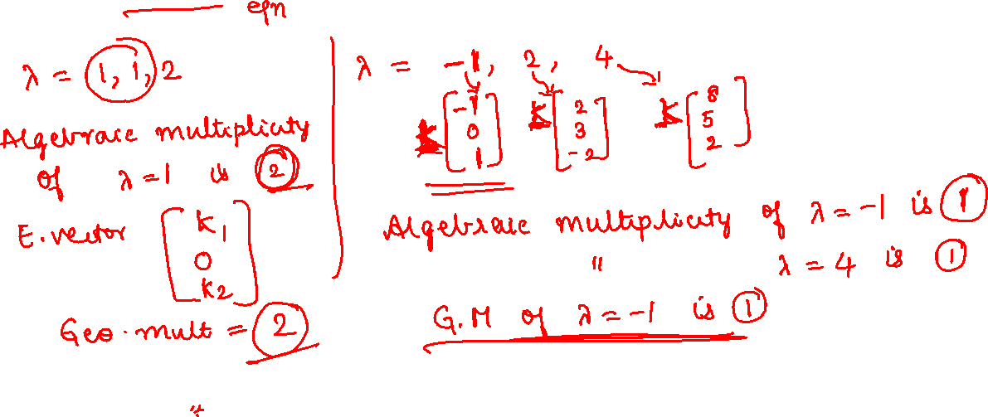

Slide 30
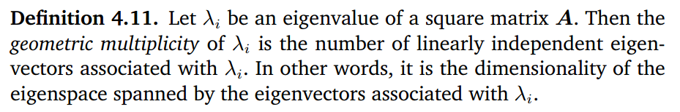
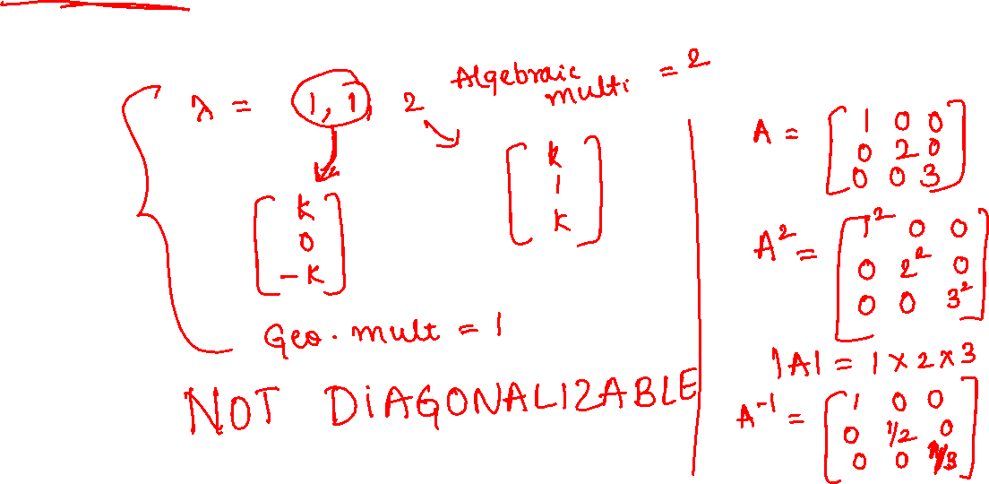

Slide 31
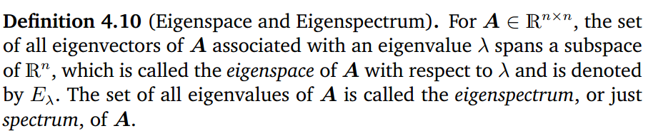
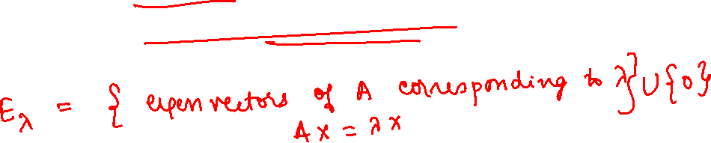

Slide 32
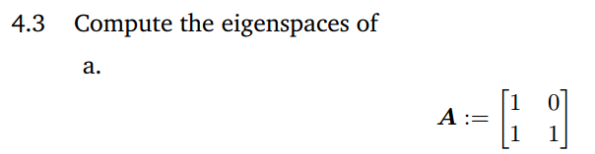
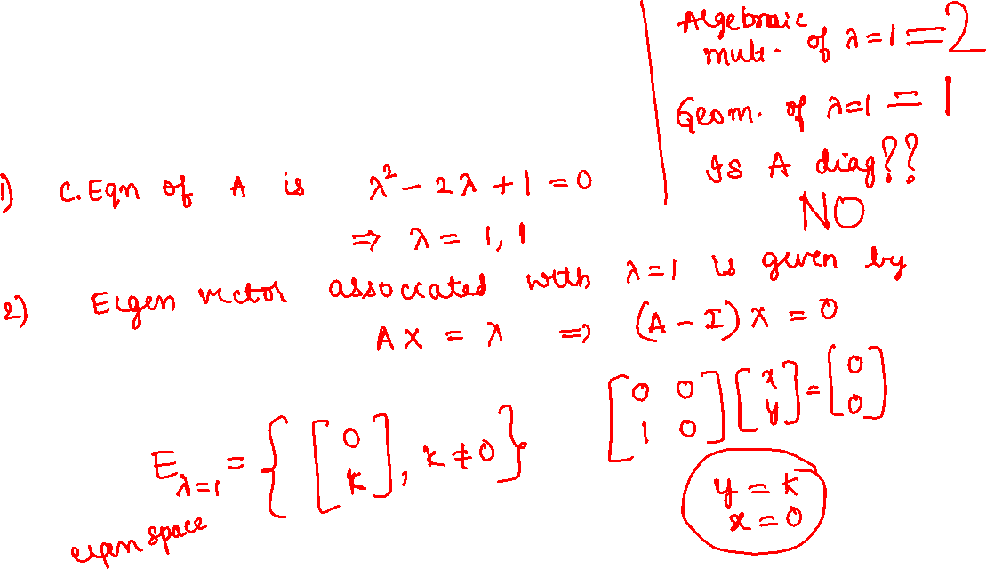

Slide 33
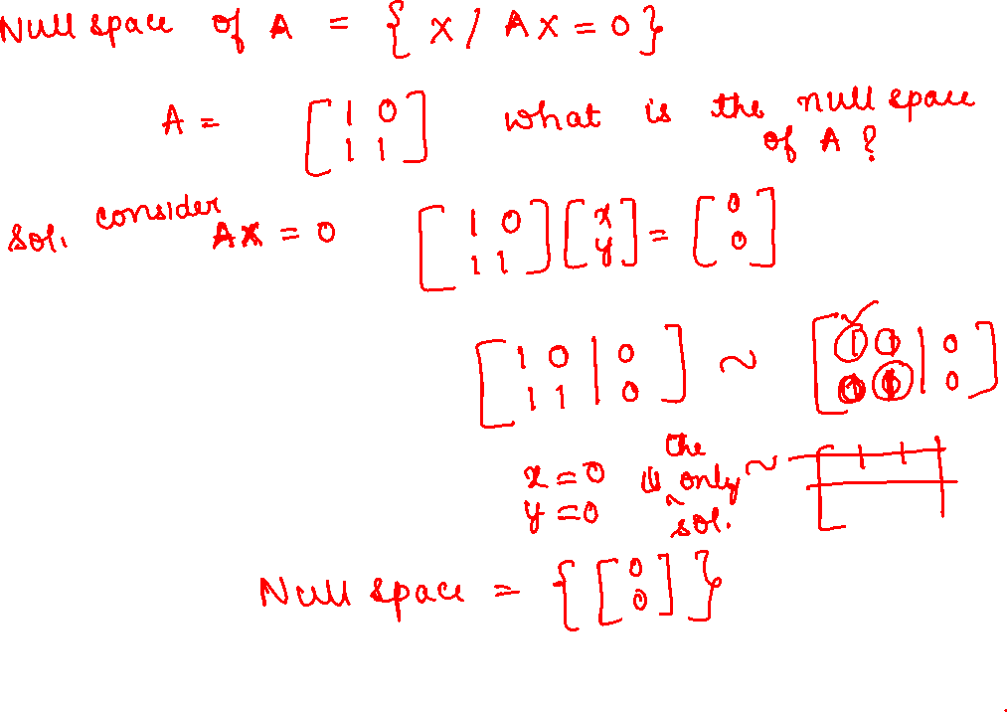

Slide 34
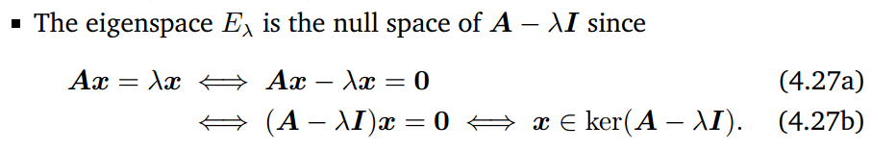
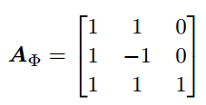
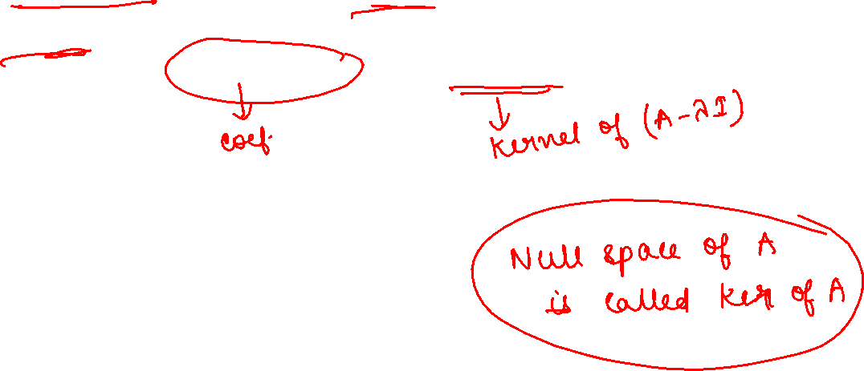

Slide 35
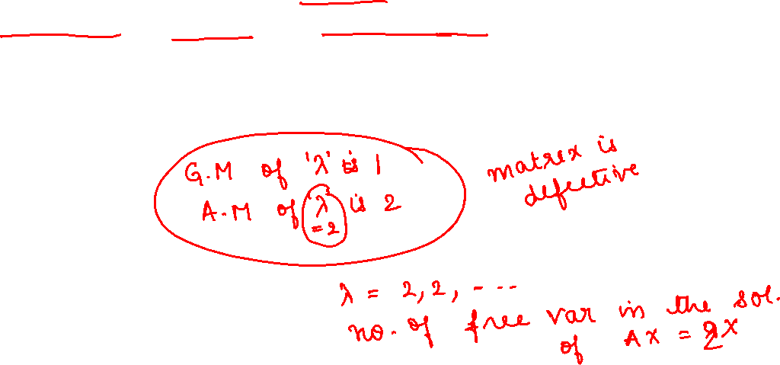


Slide 36
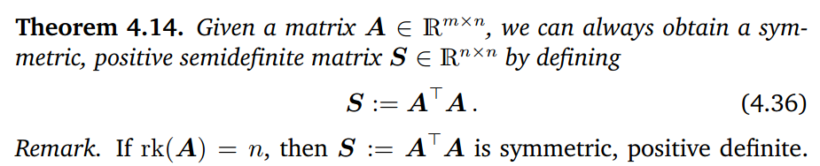
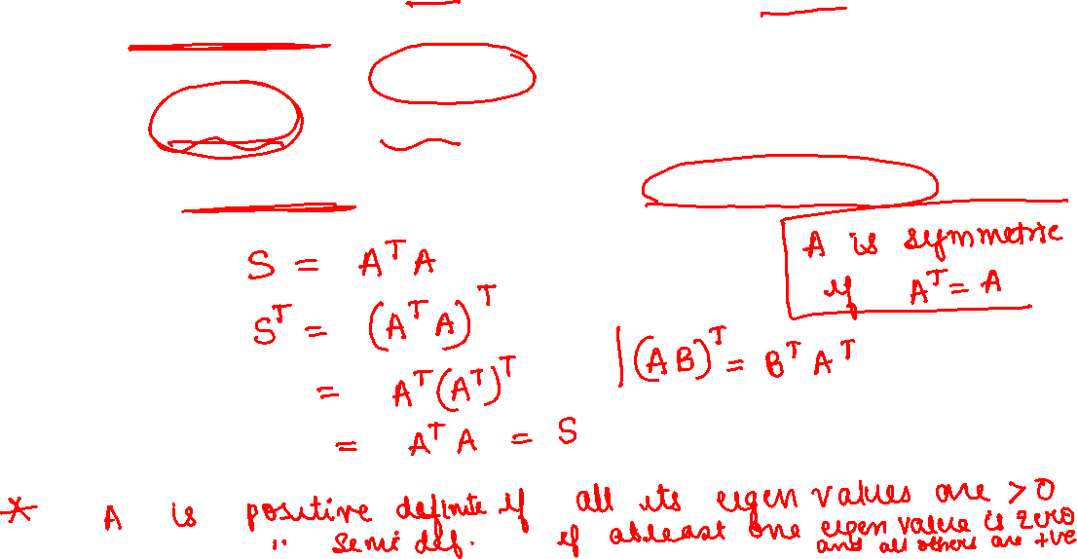

Slide 37
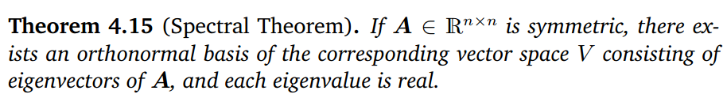
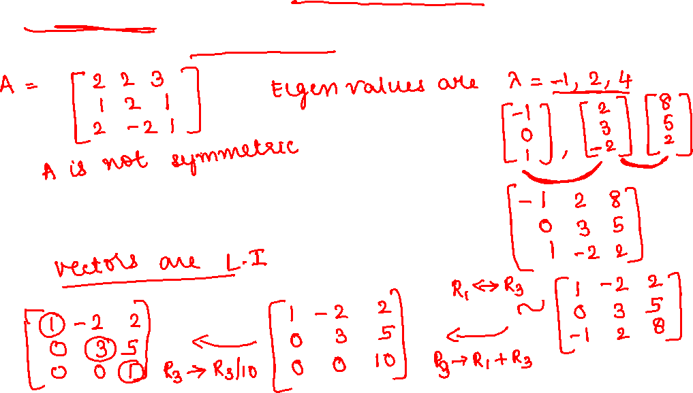

Slide 38
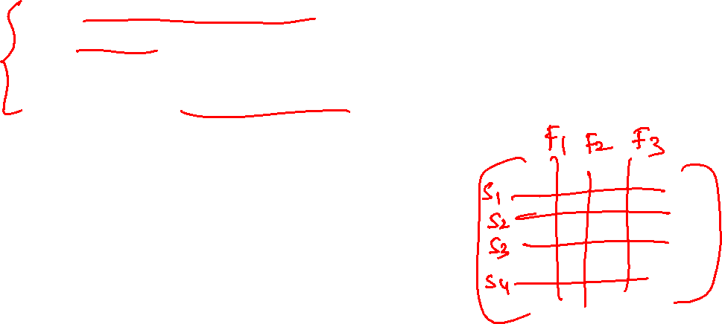
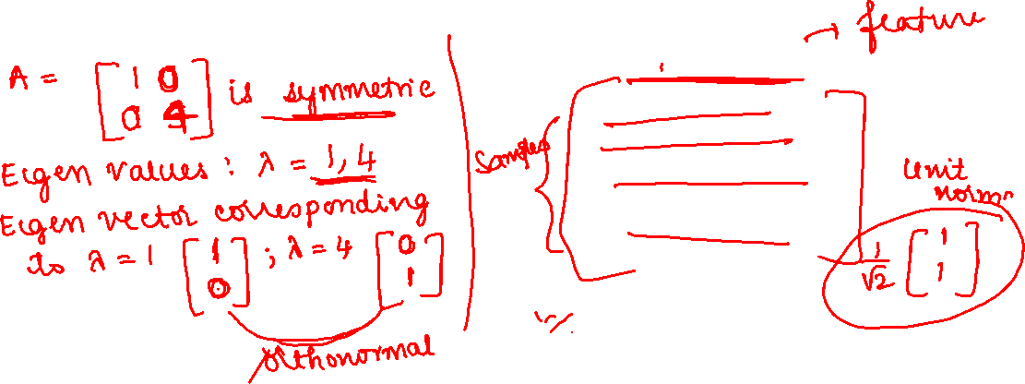
Relevance of Rank, Nullity and Eigenvalues, Eigenvectors in ML
Rank helps us to identify redundant samples in the dataset
Nullity helps us to identify if there are any dependent features in the dataset. Also gives the relation between the features.
Eigenvectors are used for dimensionality reduction.

Slide 39

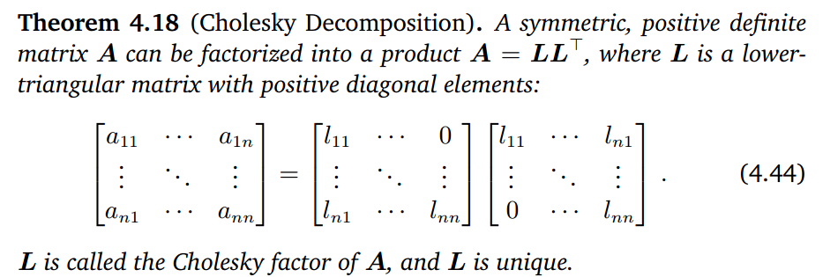


Slide 40


Slide 41



