Slide 1
BITS Pilani presentation
Prof. T S L Radhika
Dept. of Mathematics, Hyderabad Campus

Slide 2
<SS ZC416, MFDS>
Lecture No. 5

Slide 3
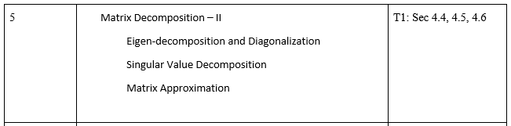

Slide 4
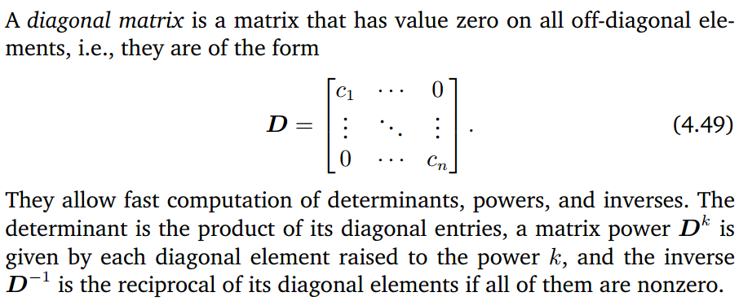
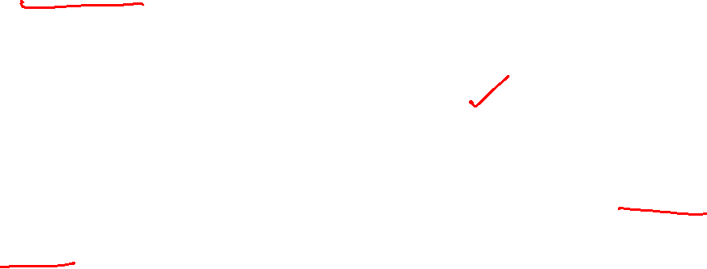

Slide 5
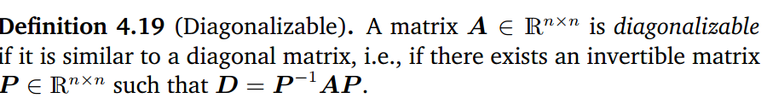
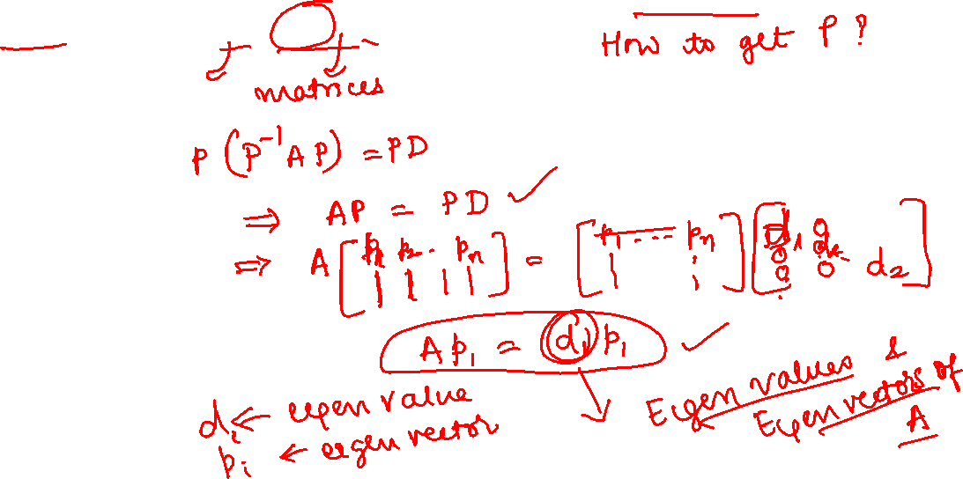

Slide 6
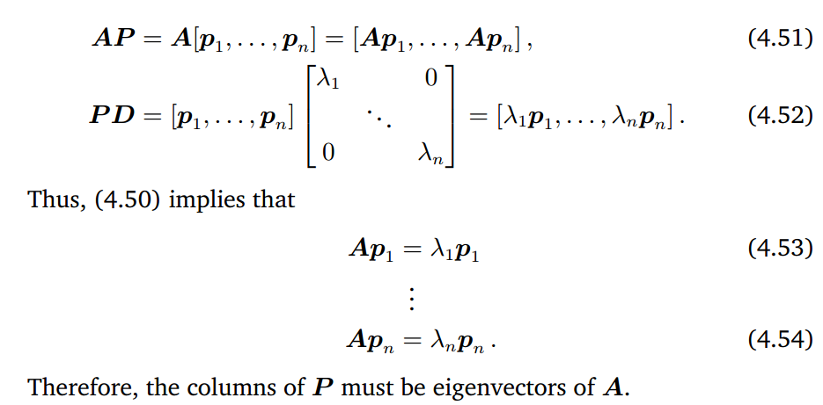
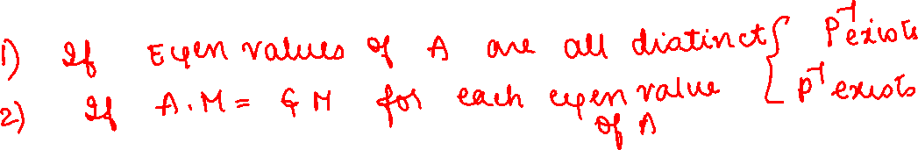

Slide 7
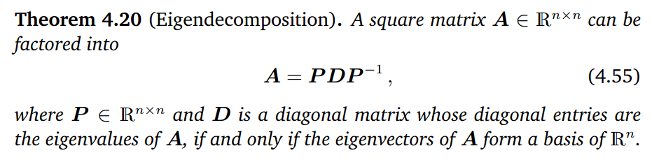
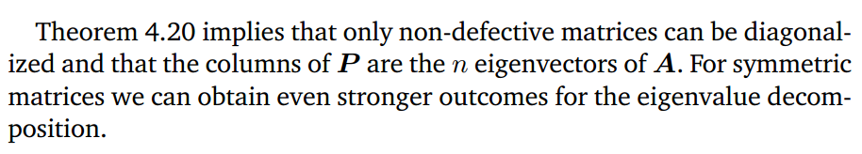
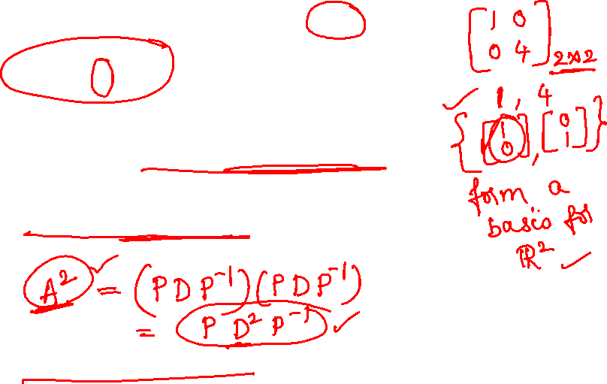

Slide 8
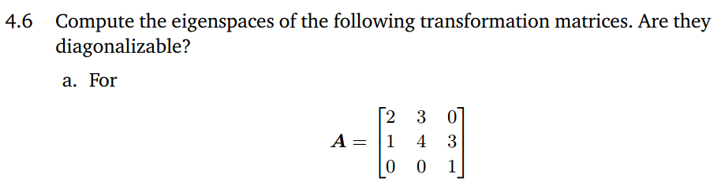
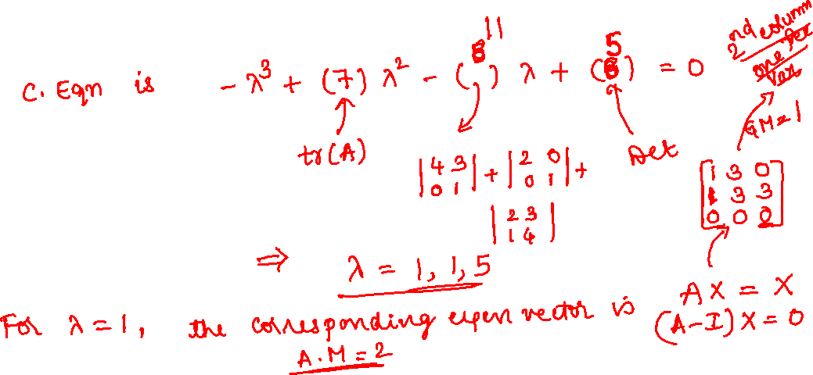

Slide 9

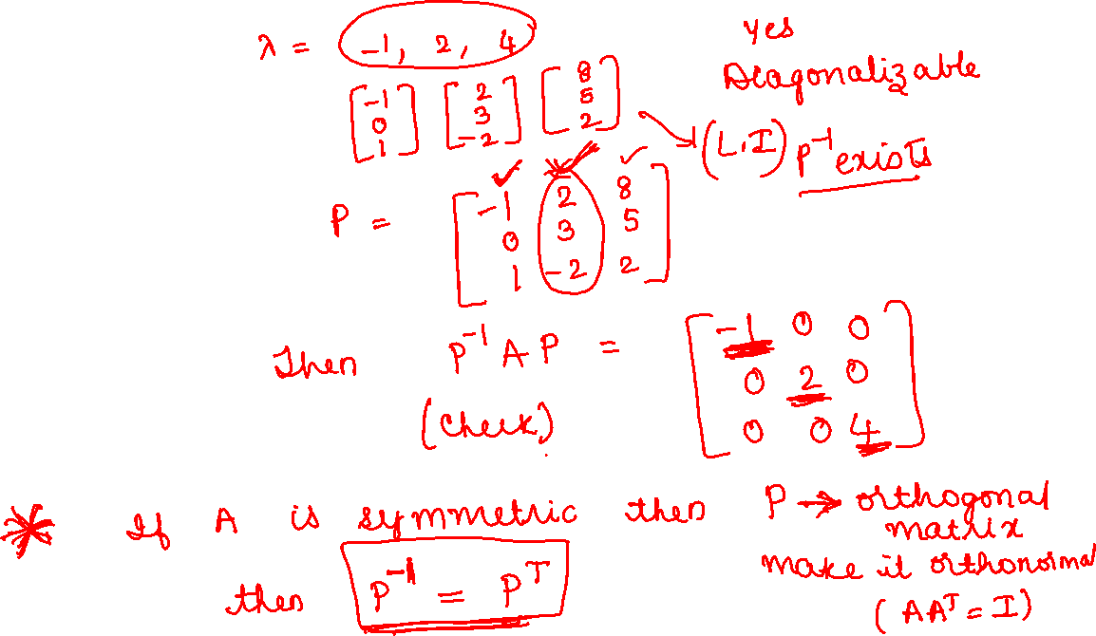

Slide 10

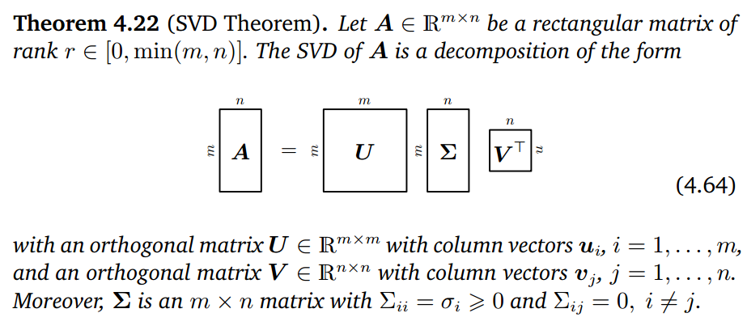
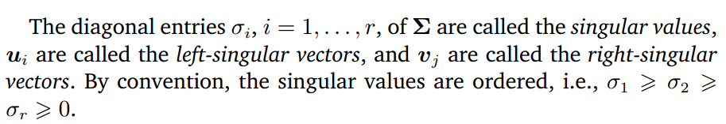
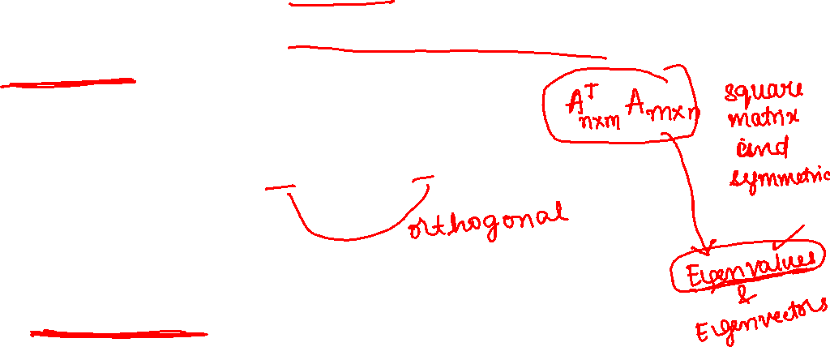

Slide 11
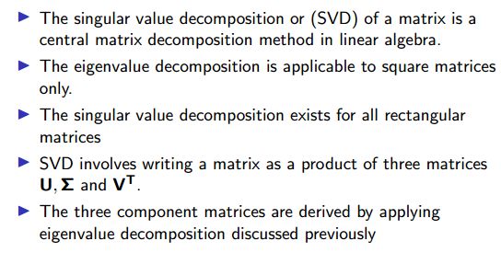
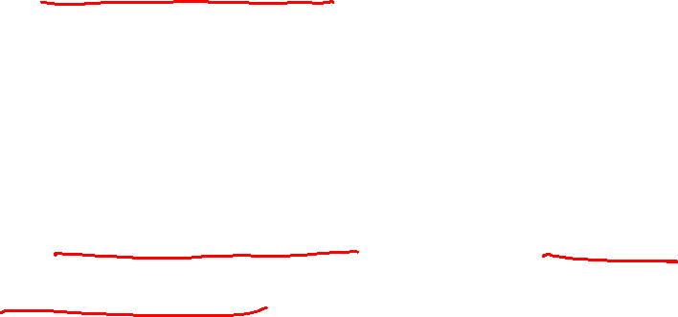

Slide 12
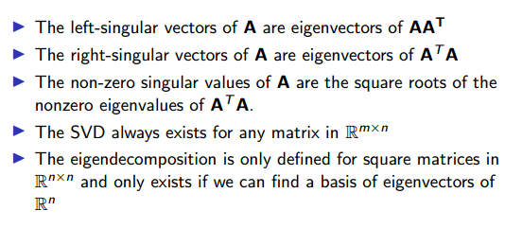
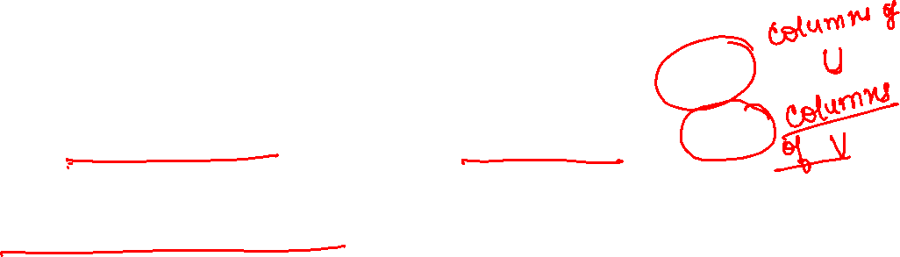

Slide 13
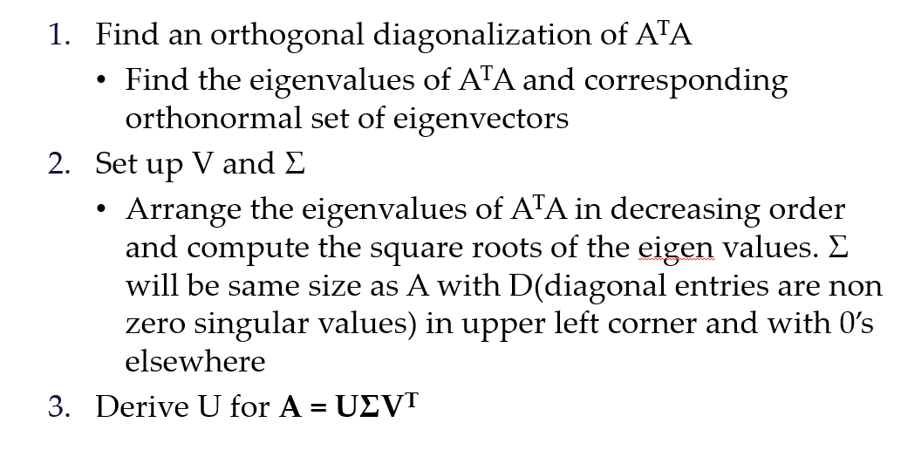

Slide 14

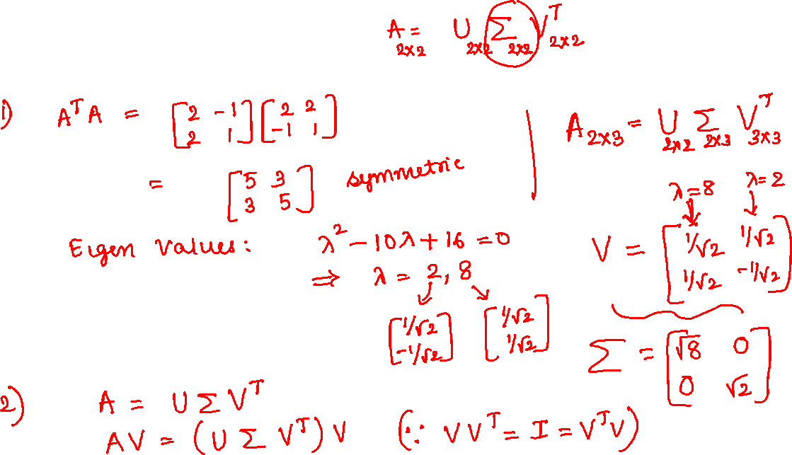

Slide 15
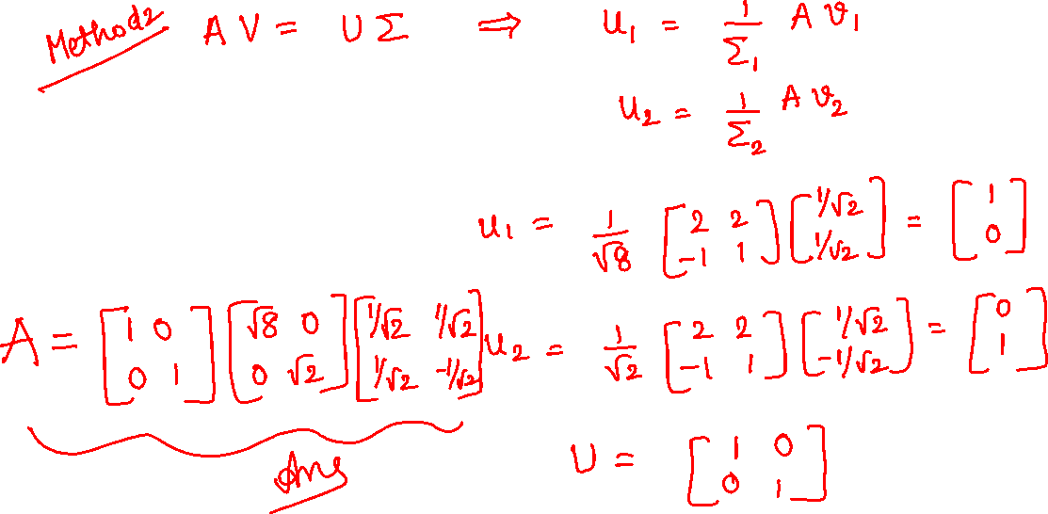

Slide 16
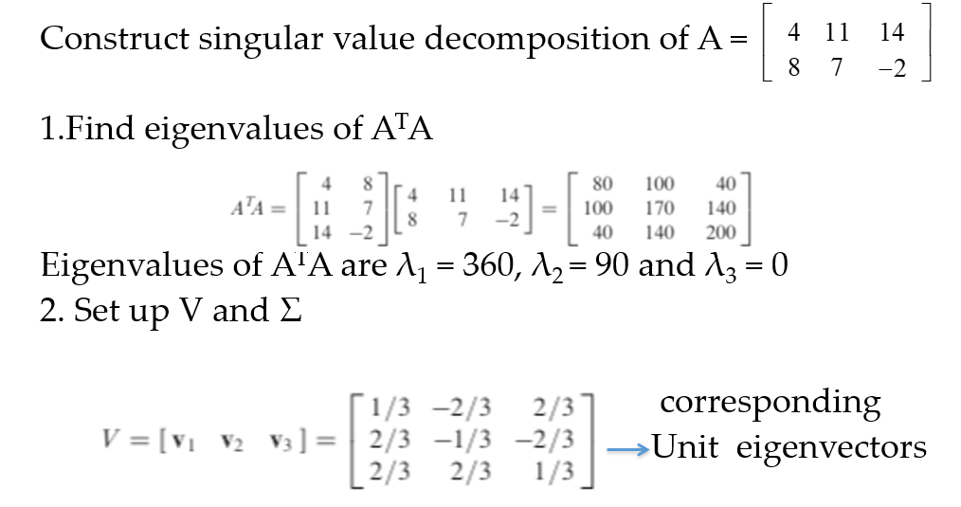
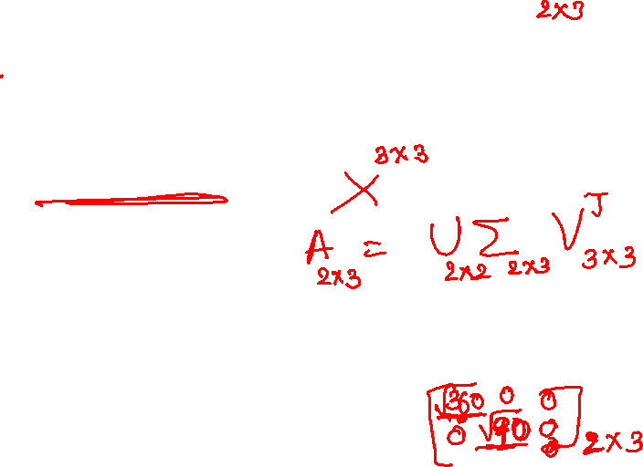

Slide 17
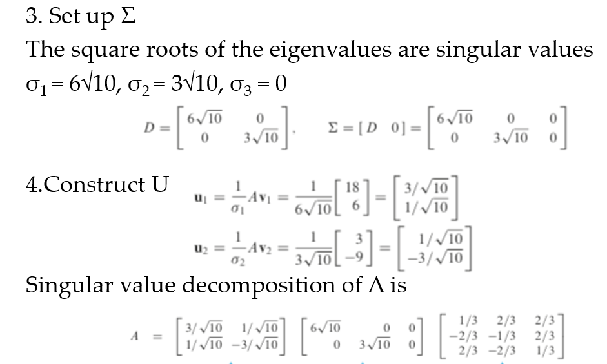

Slide 18

Comparison between Eigenvalue decomposition and SVD
Eigenvalue Decomposition | Singular Value Decomposition
1. Works only for square matrices | Works for matrix of any size
2.Non diagonal matrices P and P⁻¹ are inverses of each other | Non diagonal matrices U and V are not necessarily inverses of each other
3.Entries of D can be any complex number – negative, positive , imaginary | Entries in the diagonal matrix Σ are real and non negative, singular values are decreasing.
4. Vectors in eigenvalue decomposition matrix P are not necessarily orthogonal | Matrices U and V are orthonormal

Slide 19
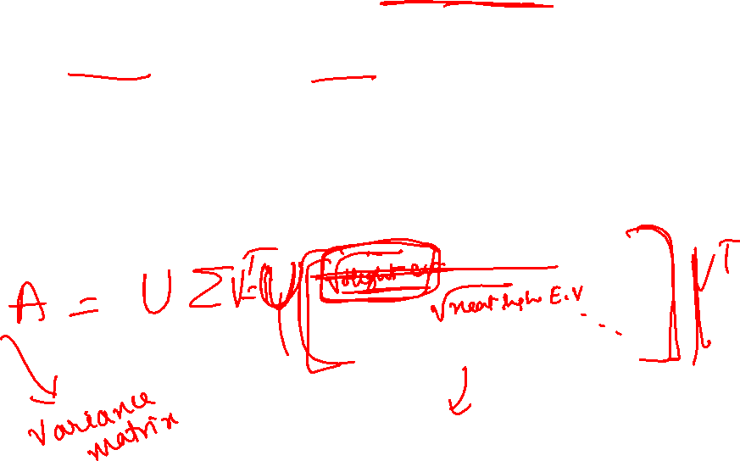
SVD extracts data in the directions with the highest variances.
SVD is used in a wide range of applications, including signal processing, data compression, noise reduction, recommendation systems, and natural language processing.
In image compression, SVD reduces the rank of the image matrix, keeping only the most significant singular values, which reduces the amount of data needed to represent the original image.

Slide 20

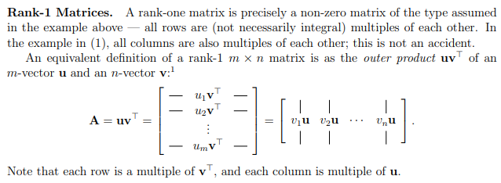
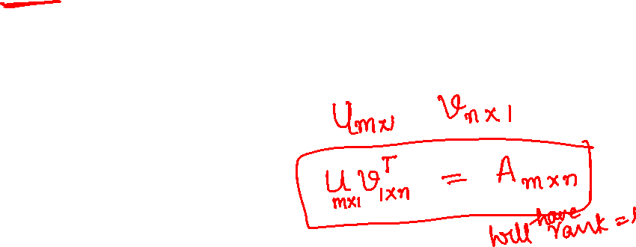

Slide 21
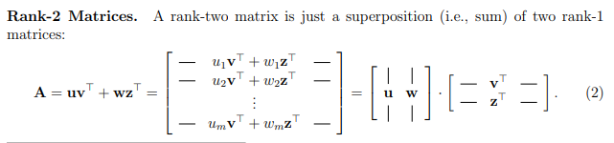
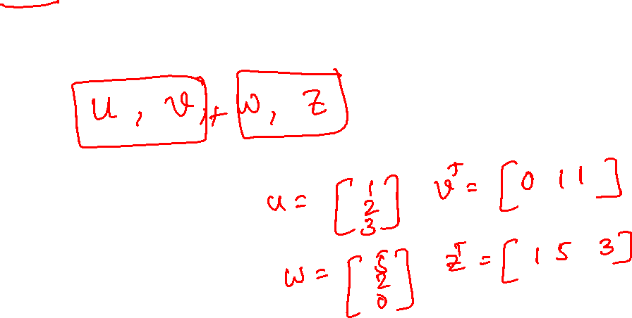

Slide 22


