Slide 1


GUJARAT TECHNOLOGICAL UNIVERSITY
Shri S’ad Vidya Mandal Institute of Technology
affiliated with GTU
Enterprise Resource Planning
PREPARED BY:
HETVI H. PRAJAPATI(210450131031)
SWETA DAS (210450131017)
KASHISH K.SARVAN (220453131008)
ALPESH SUTARIYA(210450131034)
GUIDED BY :
PROF. KRUTI DANGARWALA
PROF. ASHISH PATEL
PROF. VISHAL PATEL
PROF. AKANKSHA MISHRA

Slide 2
Outline
Purpose of College ERP System
Observation:
Research on various ERP System
References
AEIOU
Empathy Mapping / Framework
Mind Mapping/Framework
Ideation Canvas / Framework
Product Development Canvas / Framework

Slide 3
Purpose of College ERP System
Centralized data management
Automation of processes
Student lifecycle management
Financial management

Slide 4
Observation
Mainly we do our observation through following 5 aspects.
It consist of AEIOU framework.
A=Activity
E=Environment
I=Interaction
O=Object
U=User

Slide 5
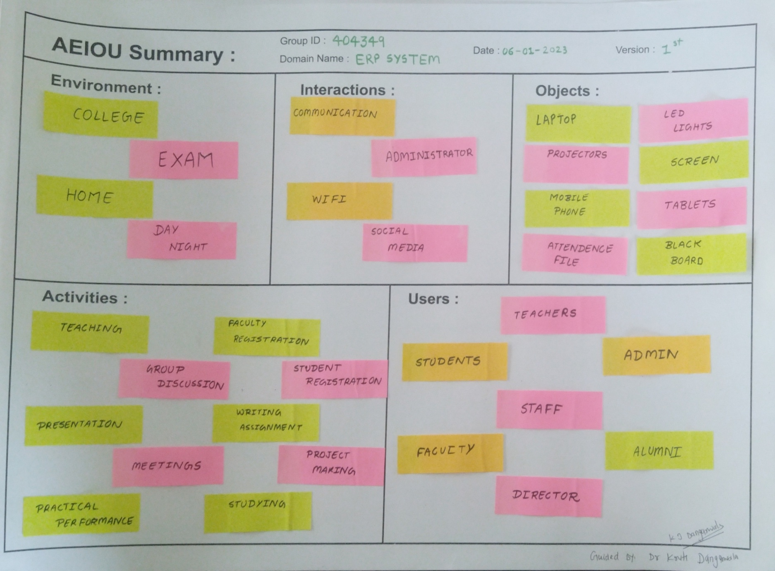

Slide 6
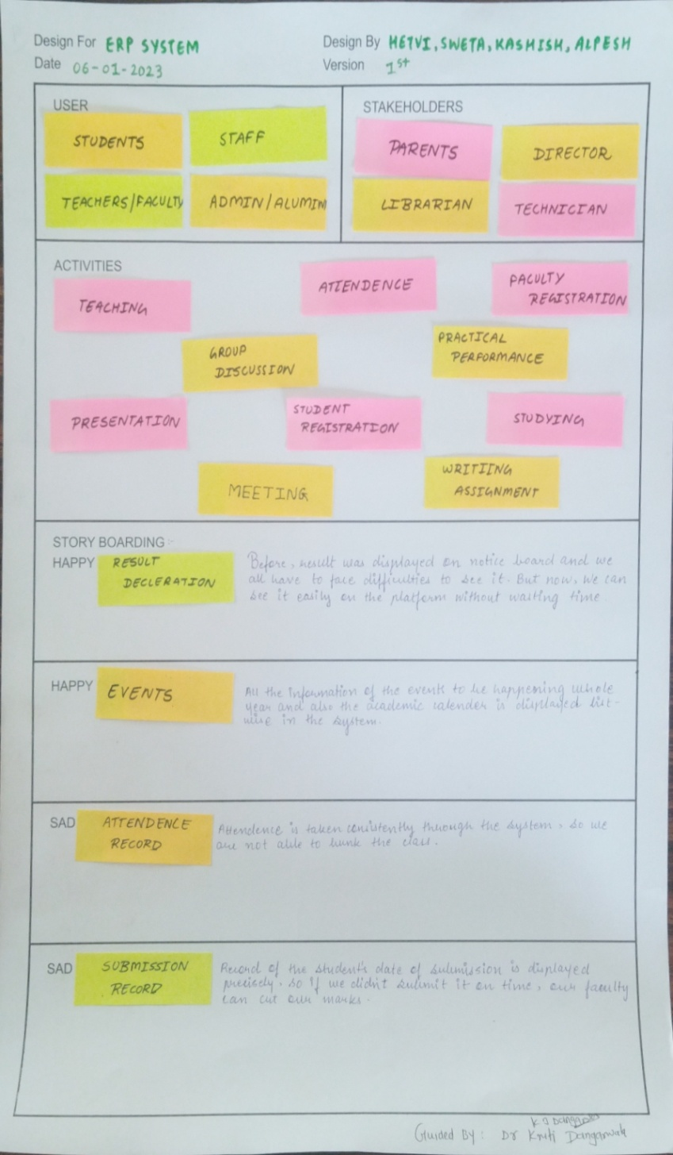
Empathy Mapping / Framework:-
➢ User
➢ Stakeholders
➢ Activities
➢ Story boarding
User :-
Admin
Staff
Students
Stakeholders :-
Parents
Director
Librarian
Technician
Activities :-
Teaching
Presentation
Student Registration
Practical Performance
Writing Assignment
Meeting

Slide 7
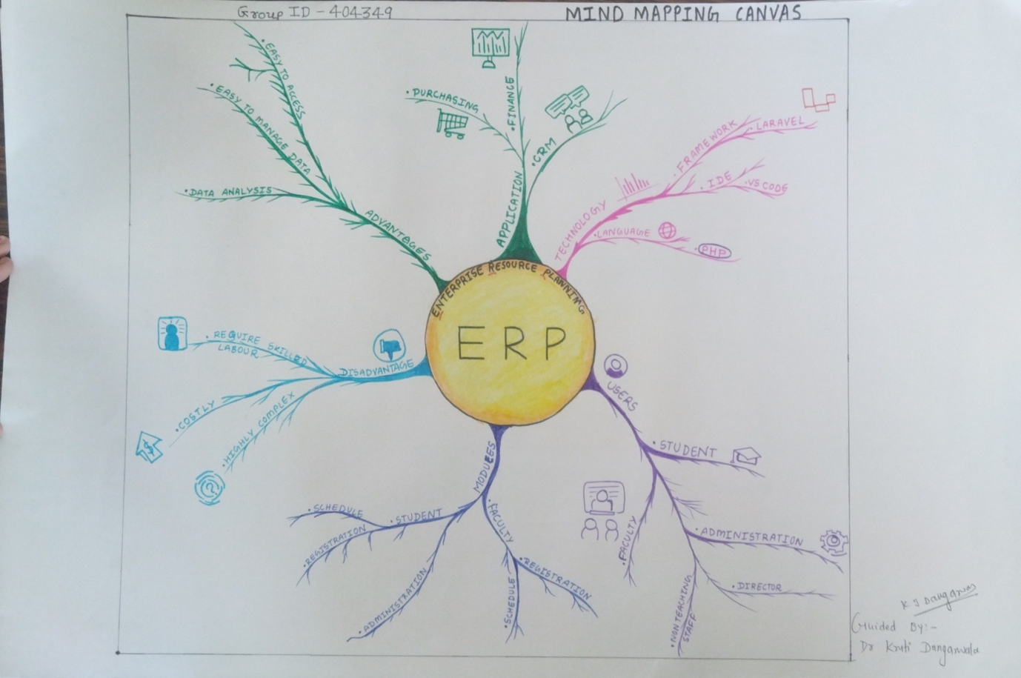
Mind Mapping/Framework:
A Mind Map is an easy way to brainstorm thoughts organically without worrying about order and structure. It allows you to visually structure your ideas to help with analysis and recall.
A Mind Map is a diagram for representing tasks, words, concepts, or items linked to and arranged around a central concept or subject using a non-linear graphical layout that allows the user to build an intuitive framework around a central concept.

Slide 8
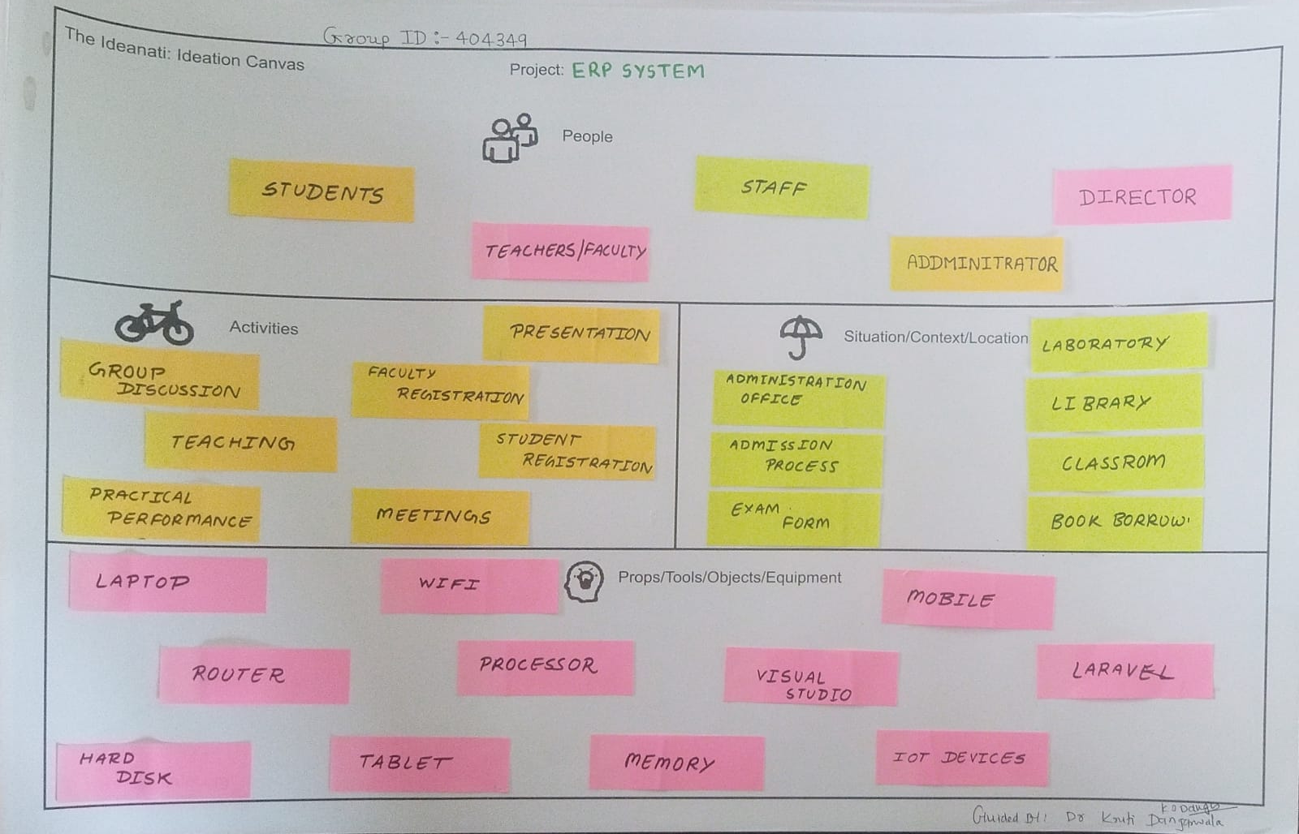
Ideation Canvas / Framework
People
Activities
Situations/context/location
Props/tools/objects/equipment
People:-
Student
Teachers
Staff
Administrator
Activities :-
Group Discussion
Teaching
Student Registration
Faculties Registration
Presentation
Situation/context/location :-
Administration Office
Administration Process
Exam Form
Book Borrow
Props/tools/objects/equipment:-
Computer
Laptop
Mobile
Wi-Fi
Router
Processor
Laravel
Tablet
Memory
Hard Disc

Slide 9
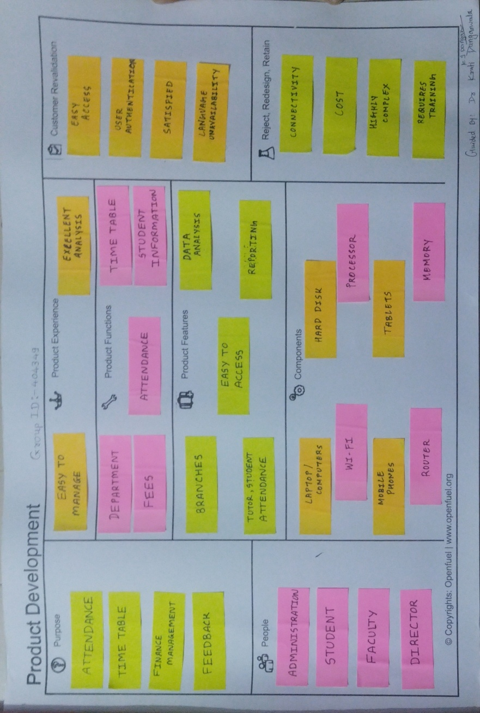
Product Development Canvas / Framework :-
➢ Purpose
➢ People
➢ Product Experience
➢ Product function
➢ Product features
➢ Components
➢ Customer revalidation
➢ Reject/Redesign/Retain
Components :-
Computer
Wi-Fi
Memory
Mobile
Laptop
Purpose :-
Attendance
Time Table
Finance Management
Feedback
People :-
Student
Faculty
Administration
Director
Product Experience:-
Easy To Manage
Excellent Analysis
Product Functions :-
Department
Fees
Attendance
Time Table
Student Information
Product Features :-
Branches
Easy to Access
Tutor , Computer
Data Analysis
Reporting

Slide 10
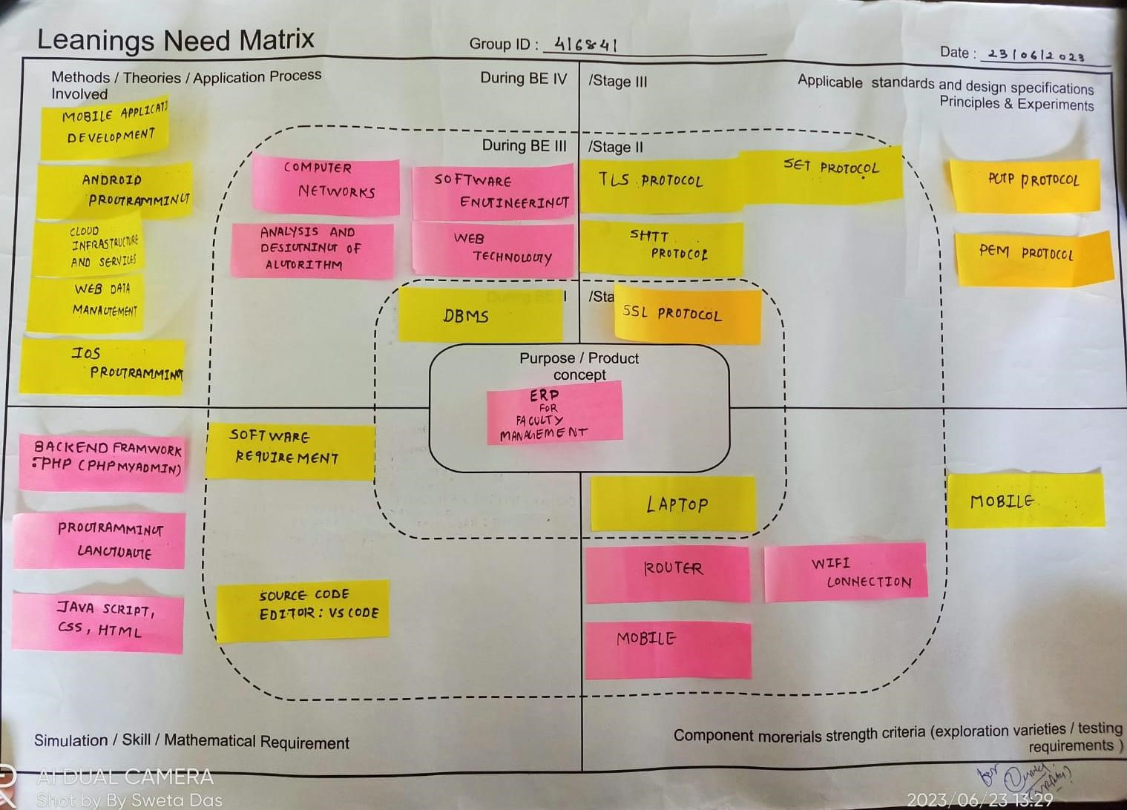
Learnings Need Matrix Canvas:
➢Methods:
• Probability & Statical data
• Learning PHP 7.8
• Web data Programming
• Android Programming
➢Simulation/Skill:
• Java script
• PHP
• Graphical User Interface
➢Components Morerials Strenght Criteria:
• Laptop
• Mobile
• User Interface
➢Applicable Standaeds and Design Specification Principles and Experiments :
• Institution Head Permission
• Faculty Permission

Slide 11
Research on various ERP system
Edusys: The EduSys College software’s responsive & smooth screen layouts help to serve great user experience (UX) to any internet-accessible devices such as smartphones, iPhones, iPad, tablets, phablets, laptops, desktop, AI-embedded-devices and more
Mastersoft: MasterSoft College Management System is an end-to-end solution for colleges to improve operational efficiency & institutional outcomes by automating the Student-Faculty lifecycle & campus administration. This college ERP software is designed keeping in mind the different operations of a college.
Skolaro:
Deskera’s Faculty Management software: Deskera is an all-in-one cloud-based accounting software that helps small business run their business efficiently anytime, anywhere, on any device.

Slide 12
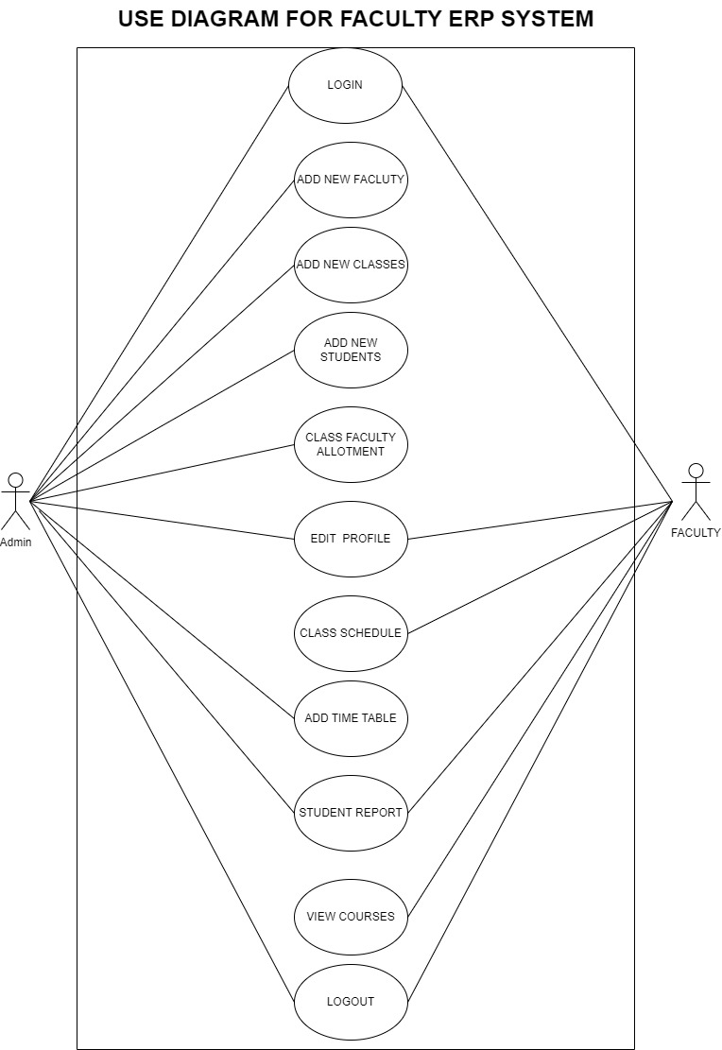
UML DIAGRAMS OF FACULTY ERP SYSTEM
1 USE CASE DIAGRAM
A Use Case Diagram for a Faculty ERP System illustrates interactions between users and the system.
Actors like professors, administrators, and students engage in various use cases, including course registration, grade management, and attendance tracking.
This diagram visually represents how the ERP system serves and connects these stakeholders in a university setting.

Slide 13
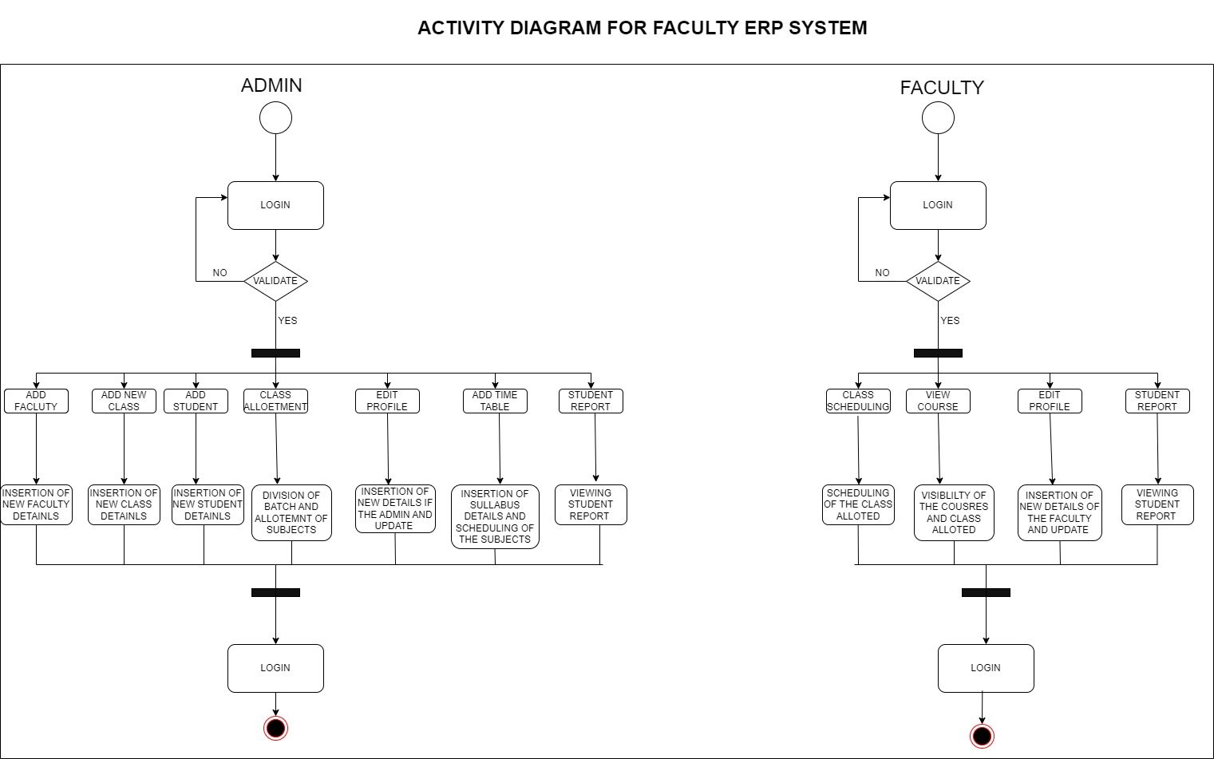
2 ACTIVITY DIAGRA
The activity diagram consists of the the functions that a user can perform
The admin has the most of the access of the dashboard including all the features of the system
The faculty has all the class related and courses view options

Slide 14
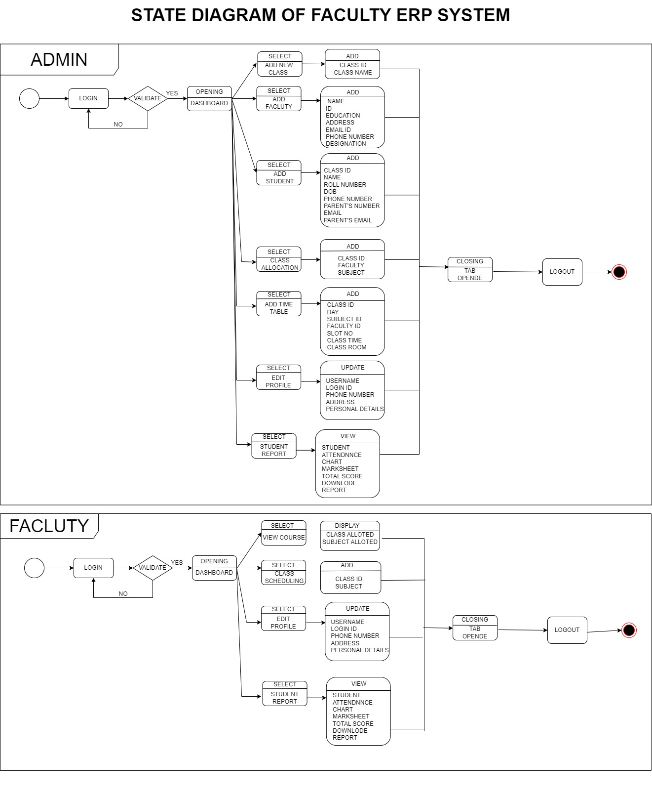
3 STATE DIAGRAM
A State Diagram for a Faculty ERP System outlines the different states a component or entity within the system can exist in and the transitions between these states. For instance, a “Add new Faculty" component may transition from "Open for Registration" to "Closed for Registration." This diagram clarifies the system's behavior and helps in understanding its operational states and transitions.

Slide 15
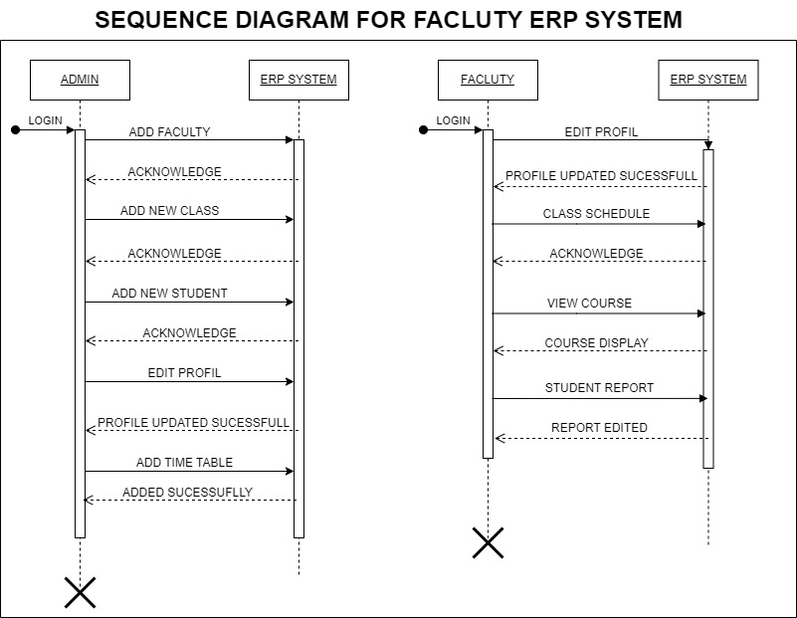
4 SEQUENCE DIAGRAM
A Sequence Diagram for a Faculty ERP System depicts the chronological flow of interactions between various system components, including actors and objects.
It illustrates the specific sequence of messages or actions exchanged during a particular use case, like "Student Course Registration." This diagram provides a dynamic view, highlighting the order and timing of activities in the system, aiding in understanding its functionality and data flow.

Slide 16
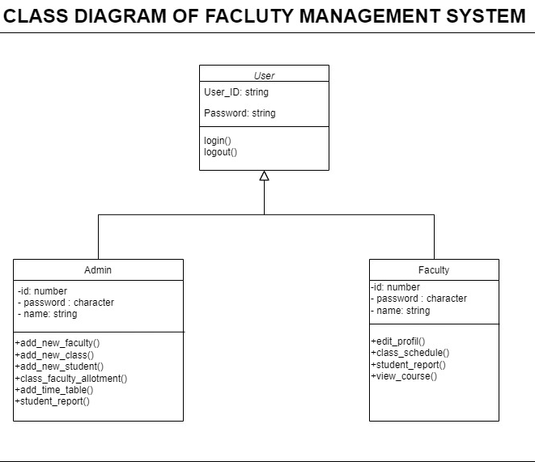
5 CLASS DIAGRAM
A Class Diagram for a Faculty ERP System represents the system's structure and the relationships between its classes or objects.
It identifies the major components, such as "Student," "Professor," "Course," and their attributes and methods. Arrows between classes indicate associations, like a student being enrolled in a course.
This diagram offers a static view, helping to visualize the system's data structure and the way different elements are connected.

Slide 17
DESIGN FOR COST ENVIRONMENTS
Here are the rough estimates in Indian Rupees based on a 75:1 exchange rate:
1. Development Team (5-10 team members): ₹56,25,000 to ₹1,12,50,000 per team member per year.
2. Hardware and Infrastructure: ₹7,50,000 to ₹37,50,000 or more.
3. Software Licenses: ₹3,75,000 to ₹15,00,000 or more.
4. Testing and Quality Assurance: ₹75,000 to ₹1,12,500 for every ₹7,50,000 to ₹11,25,000 of development cost.
5. Security Measures: ₹56,250 to ₹75,000 for every ₹3,75,000 to ₹5,00,000 of development cost.
6. User Training: ₹18,750 to ₹37,500 for every ₹3,75,000 to ₹7,50,000 of development cost.
7. Documentation and Support: Approximately 10% of the total project cost.
8. Project Management: Approximately 10-15% of the total project cost.
So, for a small-scale ERP project, you might be looking at around ₹2,25,00,000 to ₹3,75,00,000 or more in total project costs. For a larger and more complex project, the cost could exceed ₹7,50,00,000 or more.
Remember to verify the current exchange rates and consult with local financial experts or professionals to get precise estimates in Indian Rupees for your specific project.

Slide 18
References
Edusys
https://www.edusys.co/en-in/college-management-software.html
MasterSoft
https://www.iitms.co.in/blog/faculty-management-system-software-becoming-a-necessity.html
Skolaro
https://www.skolaro.com/college-erp
Deskera’s Faculty Management software
https://www.deskera.com/lms/faculty-management

Slide 19
Thank You

