Slide 1
City of Chicago
Crime Analysis 2001 – Present
KrishnaSatya Dudala

Slide 2
Data Set Description
Reported incidents of crime in Chicago from 2001 to present.
Size of dataset is 1.2 GB
Number of records is 5,857,245
Each record has 21 attributes as listed below:
ID | Case Number | Date | Block
IUCR | Primary Type | Description | Location
Arrest | Domestic | Beat | District
Ward | Community | FBI Code | X Coordinate
Y Coordinate | Year | Updated On | Latitude
Longitude

Slide 3
Technologies Used
Hadoop 2.7.0
Pig 0.13.0
Hive 1.2.1
Spark 1.41.
Hbase 1.0.1.1
Mahout 0.10.1

Slide 4
Configurations
Hadoop set up in pseudo distributed mode.
Processes running are NameNode, SecondaryNameNode and DataNode.
Web UI is http://localhost:50070/
Hbase Processes are Hmaster, HRegionServer and HQuorumPeer.
Web UI is http://localhost:16010/

Slide 5
Data Analysis
Crime analysis based on time
Crime analysis based on category/type of crime
Crime analysis based on location

Slide 6
Hadoop MapReduce

Slide 11
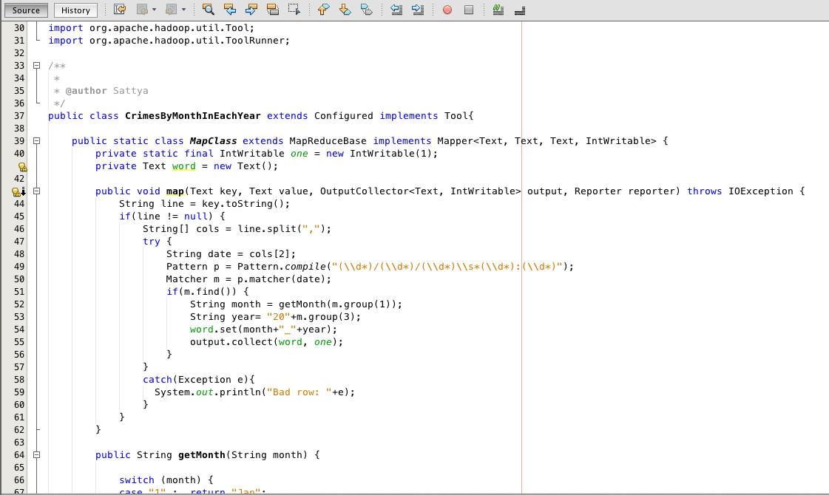
Progression of Crimes by Month
Typical Date format is 7/5/02 14:05

Slide 18
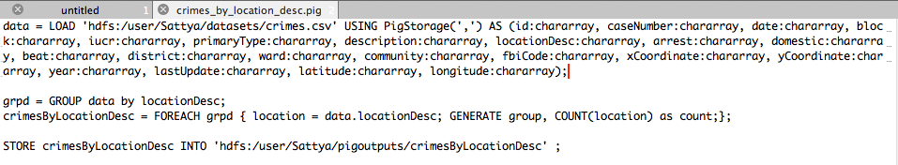
PIG SCRIPTS
Sample Pig script showing loading data from hdfs location and storing data to an output file in hdfs

Slide 26
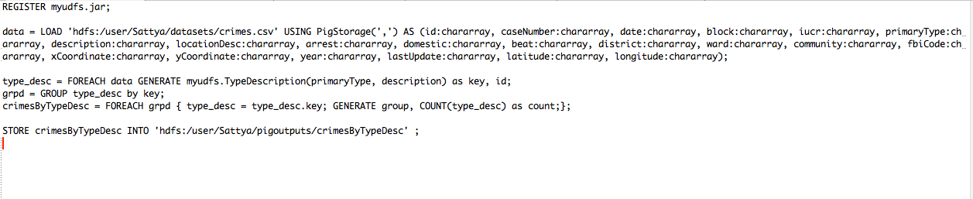
Analyzing Crimes by Sub-Categories

Slide 29
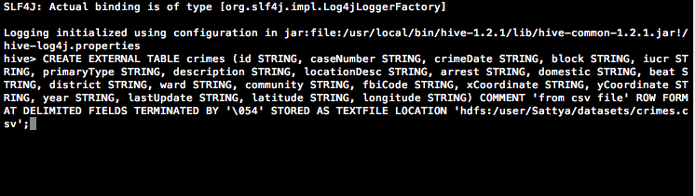
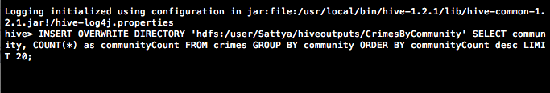
HIVE
Create table in hive:
Sample Query

Slide 32
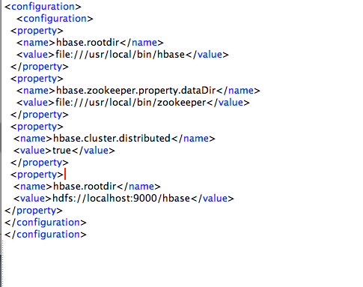
HBASE
HBASE Configuration in conf/hbase-site.xml

Slide 33
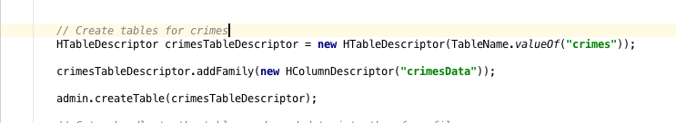
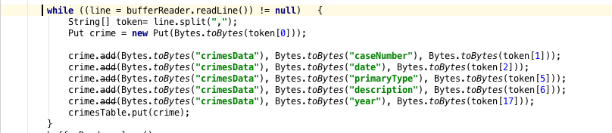
Loading dataset into a hbase table

Slide 34
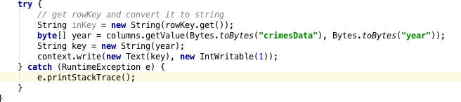
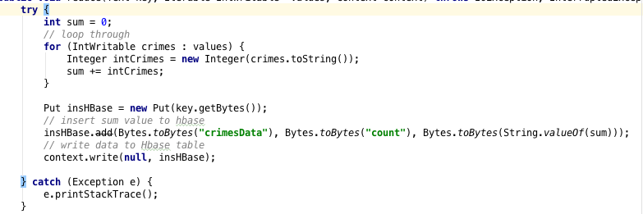
Running MapReduce on HBASE
Mapper:
Reducer :

Slide 35
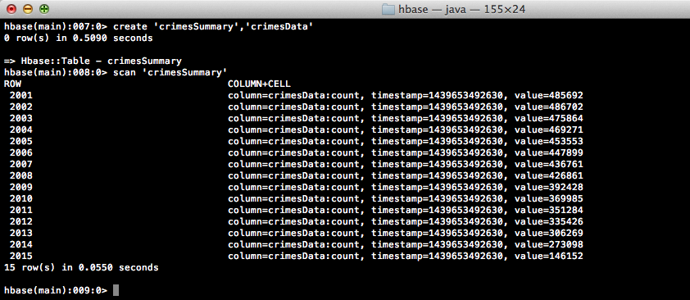
HBASE Map Reduce for Crimes by Year

Slide 36
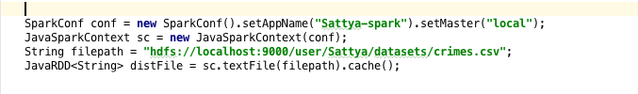
SPARK
Create a Resilient Distributed Dataset
Map Reduce to classify Arrests/No Arrests by Year

Slide 38
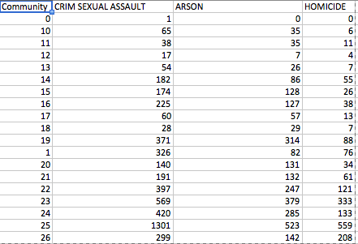
Mahout Clustering(1)
Communities are clustered, using K-Means algorithm, based on the incidences of three violent crimes namely Criminal Sexual Assault, Arson and Homicide.
Map Reduce output is the input to Clustering algorithm.

Slide 39
Mahout Clustering(2)

Slide 40
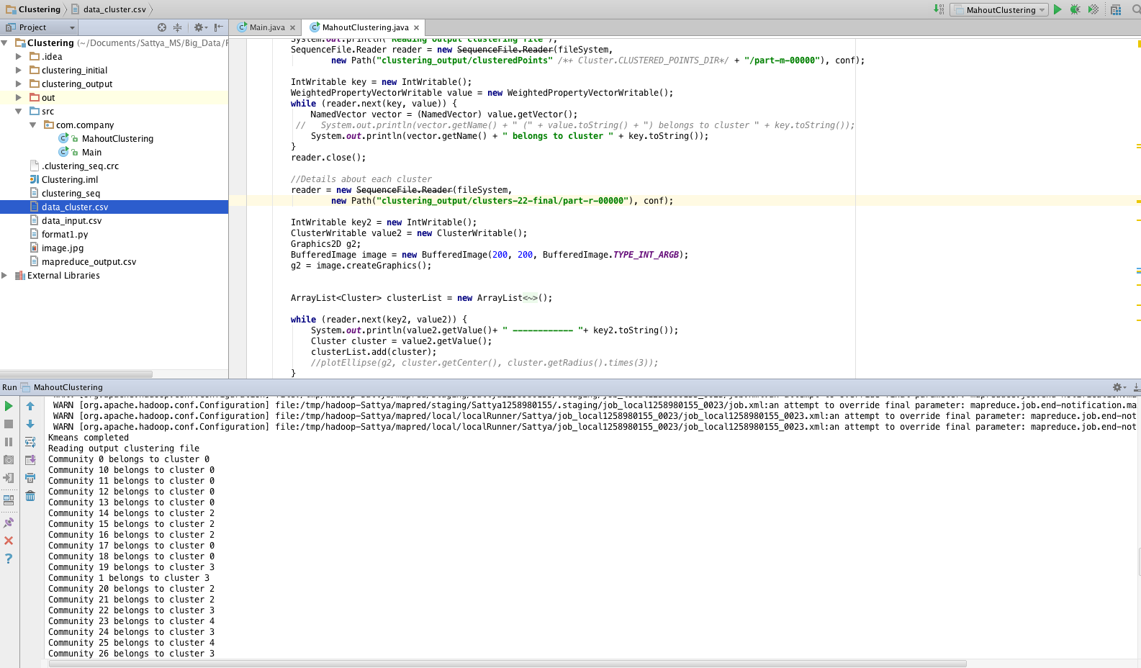
Mahout Clustering(3) - Output

Slide 41
Mahout Clustering(4) - Output
Cluster Centroid details:
{"identifier":"VL-0","r":[20.386,16.339,8.234],"c":[46.045,28.455,12.5],"n":22} ------------ 0
{"identifier":"VL-1","r":[25.399,24.052,15.579],"c":[127.267,50.6,33.8],"n":15} ------------ 1
{"identifier":"VL-2","r":[35.627,41.983,31.75],"c":[199.143,102.143,64.071],"n":14} ------------ 2
{"identifier":"VL-3","r":[51.173,84.842,60.322],"c":[383.353,154.529,145.294],"n":17} ------------ 3
{"identifier":"VL-4","r":[211.914,93.82,92.261],"c":[710.2,290.3,306.7],"n":10} ------------ 4

Slide 43
Thank You

