Slide 1
Department of Computer Science, COCIS Makerere University Supervisor: Ggaliwango Marvin
Semi-Supervised and Positive-Unlabeled Representation Learning for Modeling the Socioeconomic Digital Divide
Group CODE: SW-ML-27
Keywords: Digital inclusion, heterogeneous tabular data, positive–unlabeled learning, semi-supervised classification, socioeconomic modeling, unsupervised clustering.
Team Members:
Swale Sebabe Abdu ,2300723779,23/U/23779,swale.sebabeabdu@students.mak.ac.ug
Oba Phillip ,2300723024,23/X/23024/PS ,oba.phillip@students.mak.ac.ug

Slide 2
Contents of Presentation
Introduction
Related work
Problem Statement
Research Questions and Objectives
Research Contributions
Methodology / System Architecture
Dataset Description
Results (Experimental / Simulation)
Conclusions
Anticipated Limitations and counteraction plan
References
Acknowledgment (if any)

Slide 3
BACKGROUND
Uganda has experienced rapid growth in information and communication technology (ICT) over the past decade, driven by expanding mobile network coverage and increasing smartphone penetration. Mobile subscriptions have surged, yet internet access remains highly unequal, perpetuating a persistent digital divide that affects education, business, and essential public services

Slide 4
INTRODUCTION
Digital Transformation in Uganda
Rapid ICT growth
Expanding mobile penetration
Unequal internet access
Persistent digital divide
Impact on education • business • services
Uganda Reality
Urban areas → higher connectivity
Rural areas → limited access
Socio-economic gaps → major barrier
Infrastructure → uneven distribution
Machine Learning for Digital Inclusion
This Study
Uses Uganda Census microdata
Applies Machine Learning models
Predicts internet access status
Identifies key digital divide drivers
Provide data-driven insights for inclusive digital transformation in Uganda

Slide 5
CORE CONCEPTS THAT DETERMINE INTERNET ACCESS
Digital inclusion Global Perspective
Internet access →- key driver of economic growth
Strong gap: urban vs rural, rich vs poor
Developing countries → slow digital inclusion
Limited infrastructure → major barrier
Research Gaps Identified
Few studies using Uganda census big data
Limited work on Positive-Unlabeled (PU) learning
Weak focus on multi-paradigm comparison
Need for large-scale household analysis

Slide 6
Problem Statements
Computational Problem
Memory
Time
Scaling (standardization needed)
Encoding categorical variables
imbalance
Domain Application problem
Internet access <10% of population
Rural population 75% with 5% access
Urban population 25% with 40% access
Kampala vs north 40% v 2% gap
Gender gap 25% male v 15% female
some of the domain questions
WHERE should we build internet infrastructure?
WHO is most likely to adopt internet?
WHAT barriers prevent internet access?
HOW can we bridge the digital divide?
WHY do some regions have <2% access?

Slide 7
Objectives and future trends
To analyze the relationship between socioeconomic factors such as education level, occupation, income proxies, and household internet access in Uganda
To determine why urban households have significantly higher internet access rates compared to rural households in Uganda
To examine how geographic factors such as district, region, and rural-urban classification influence internet access patterns across Uganda
To build a predictive model for household internet access
What are the strongest predictors of internet access among Ugandan households?
How does internet access vary across different regions and demographic groups?
Can unsupervised learning identify natural segments or clusters of digital inclusion without using labels?
How effectively can we predict internet access when only a small fraction of data is labeled (semi-supervised scenario)?
Can PU learning techniques handle situations where "No Internet" responses may be unreliable or mislabeled?
Which learning paradigm performs best for this problem considering accuracy, data efficiency, and interpretability?

Slide 8
Research Contributions & outputs
We developed the first comprehensive machine learning analysis of internet access patterns using the 2014 Uganda National Population and Housing Census
We built the first predictive model for internet access in Uganda, processing 3.5 million records with 216 features
We compared all four paradigms on the same dataset a first in Ugandan digital divide research
We identified three natural clusters of digital inclusion using unsupervised K-Means
We shall deploy a self-training semi-supervised classifier on only 20% labeled data

Slide 9
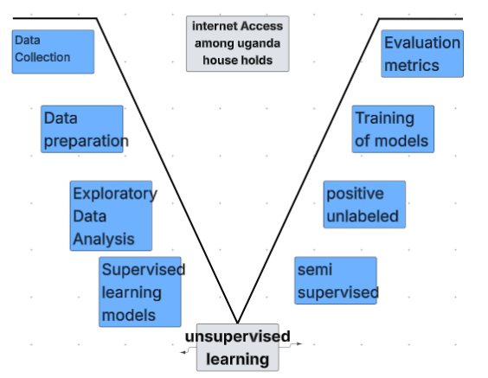
METHODOLOGY

Slide 10
DATASET DESCRIPTION
Uganda National Population and Housing Census (10% Sample
Uganda Bureau of Statistics (UBOS) 2014
Rows 3,504,526
Colums 216
Human Development Report Office – Uganda
Provider UNDP Human Development Report Office
Year 1990 – 2023
Rows 911
Columns 8
country_code UGA, country_name Uganda, indicator_id Short code (e.g., 'le', 'eys'), indicator_name Full description, index_id Associated index (e.g., HDI, GII), index_name Index description, value Numeric value, year 1990–2023
Demographics: age, sex, marital status, religion, ethnicity; Education: literacy, Grade (highest completed), attending (currently in school); Asset Ownership: phone, computer, television, radio, motor vehicle, motorcycle, bicycle; Household Characteristics: rururb (urban/rural), Region15 (admin region), district, energy source, water source, toilet type, dwelling type; Economic: bank_account, livelihood, remittances, agriculture activity; Target Variable: internet (1 = Yes, 2 = No)

Slide 11
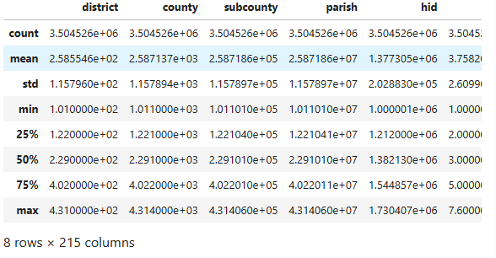
EXPLORATORY DATA ANALYSIS
We deed data cleaning to check for missing values and data preprocessing to check on sanity and shape of the dataset
The data set have Rows 3504526, columns 216 df.info()
df.describe() showing the following

Slide 12
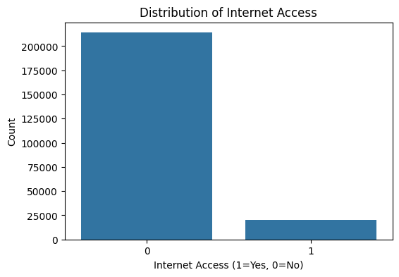
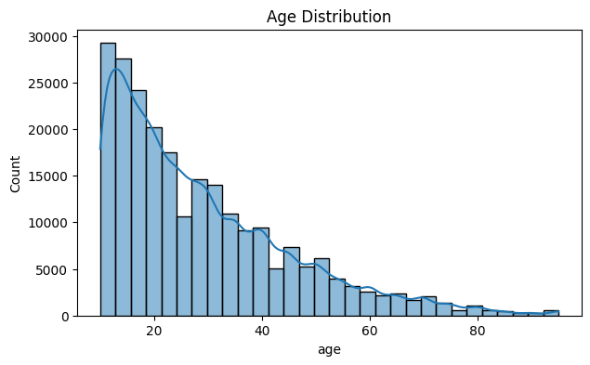
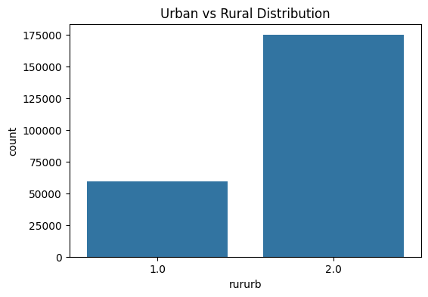
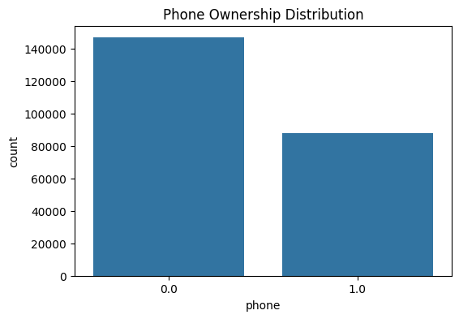
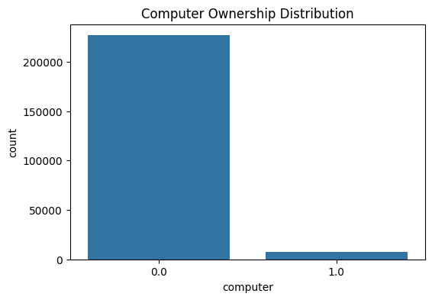
VISUALIZATIONS
To show results use figures, tables, graphs with clear axis, legend, and scaling

Slide 13
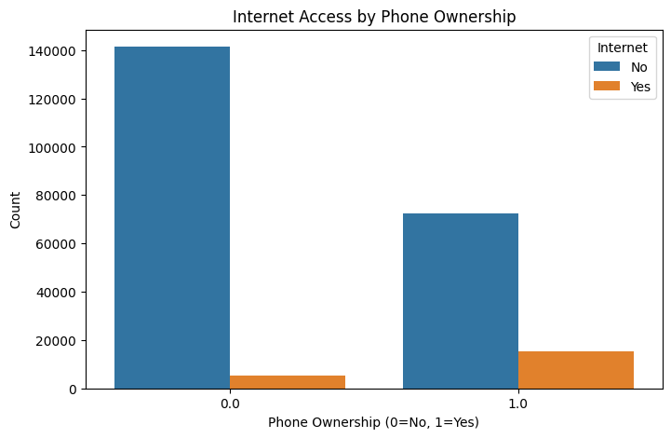
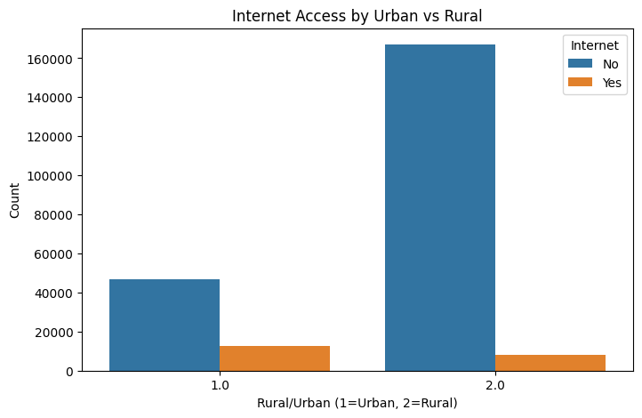
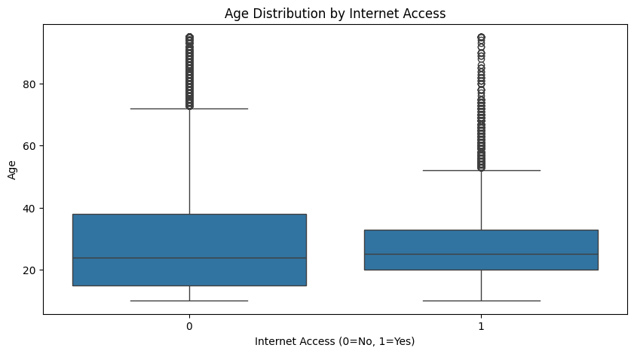
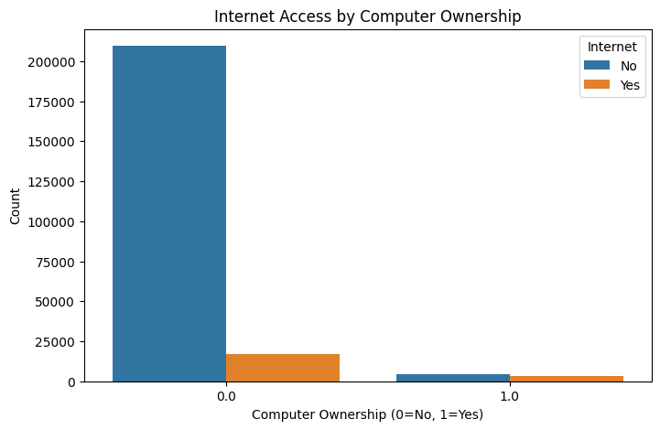
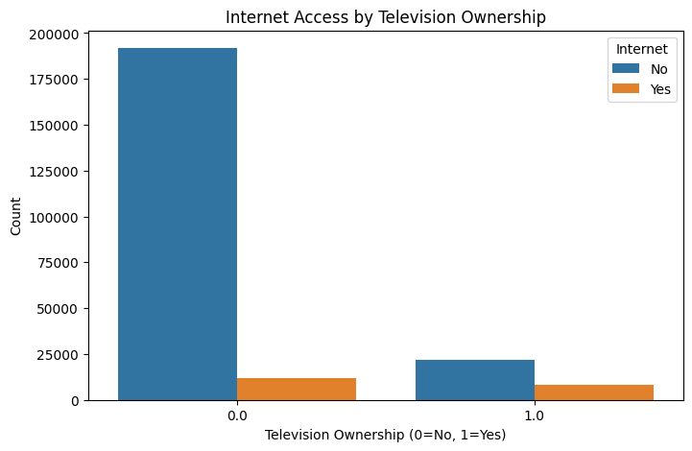
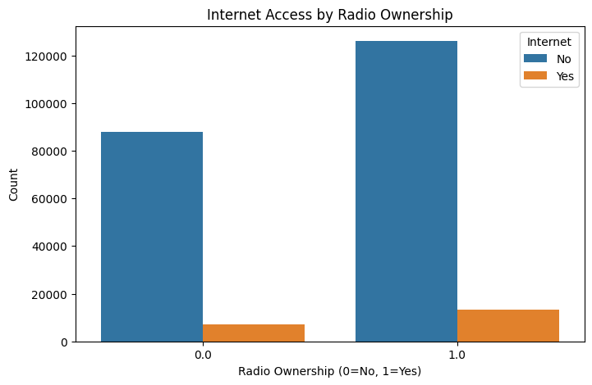
Bivariate analysis

Slide 14
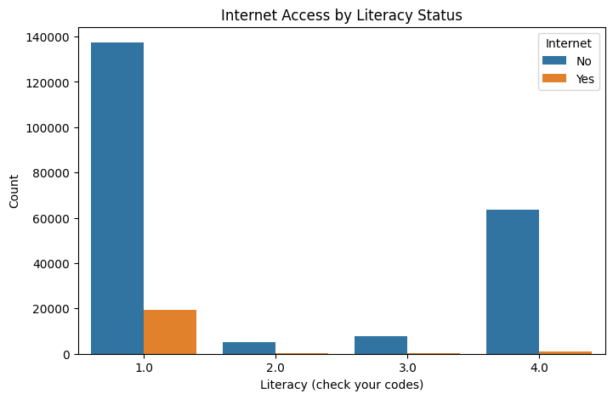
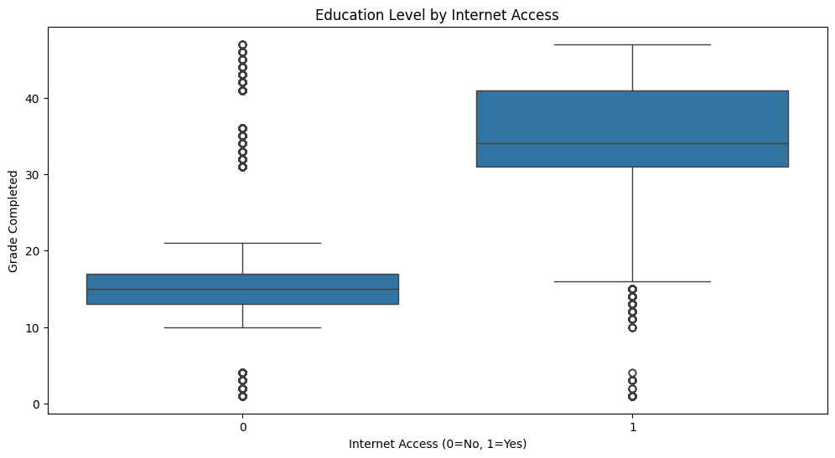
A BAR GRAPH SHOWING INTERNET ACCESS BY LITERACY STATUS AND BOX PLOT SHOWING EDUCATION LEVEL INLINE WITH INTERNET ACCESS

Slide 15
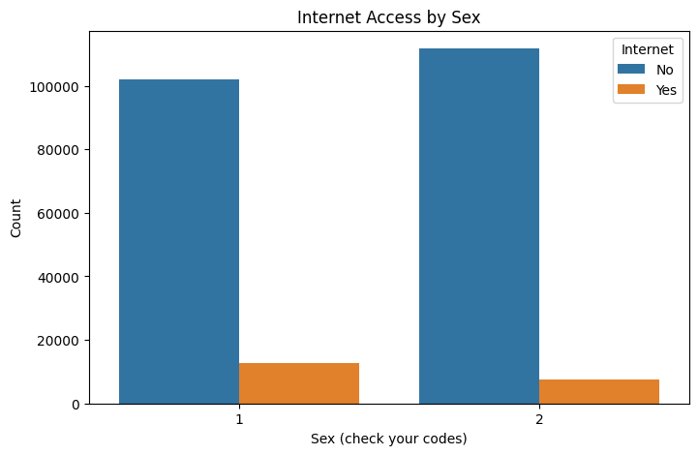
A BAR GRAPH SHOWING INTERNET ACCESS BY SEX

Slide 16
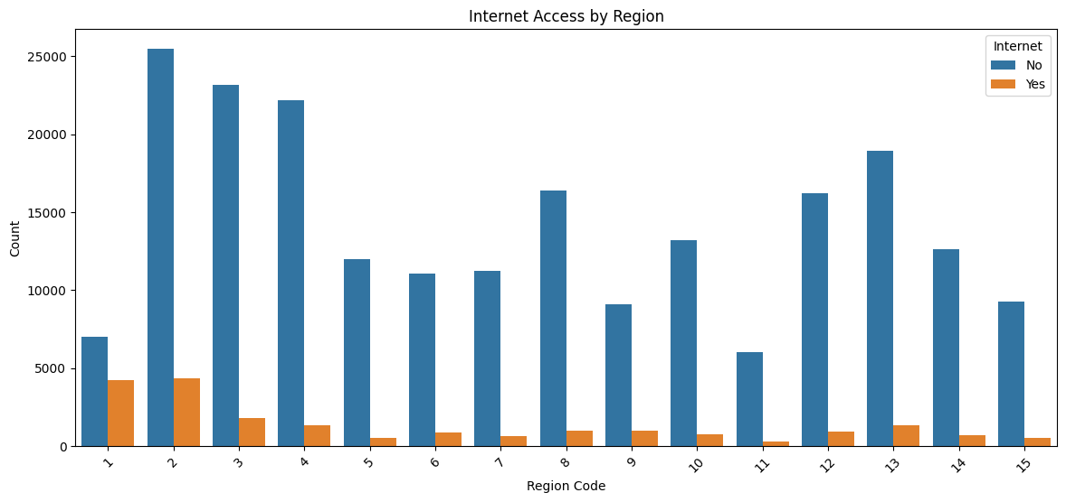
A BAR GRAPH SHOWING INTERNET ACCESS BY REGION

Slide 17
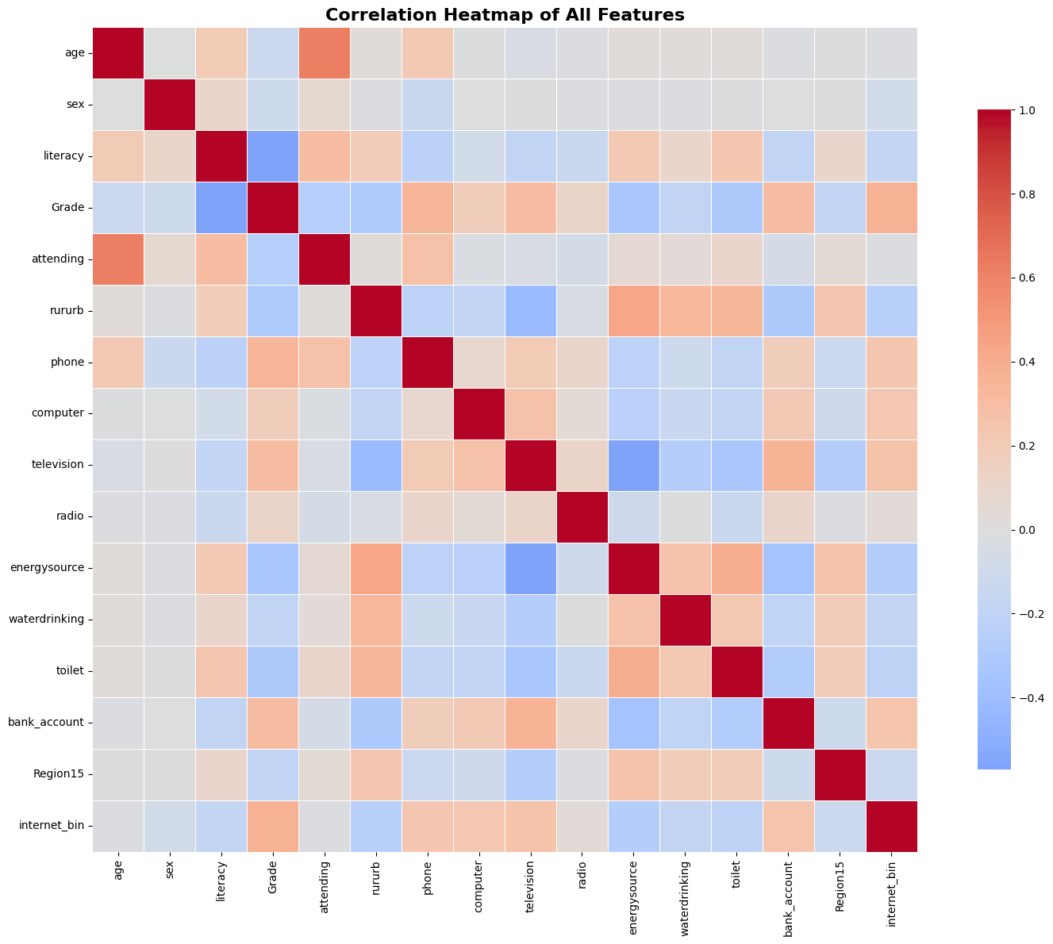
A HEATMAP SHOWING CORRELATION OF ALL FEATURES

Slide 18
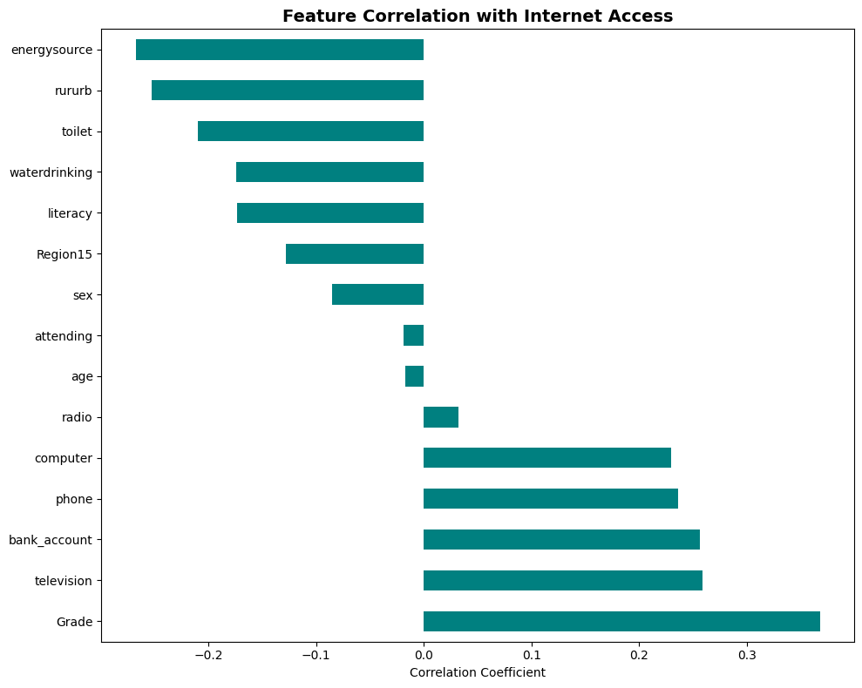
A BAR GRAPH SHOWING FEATURE CORRELATION WITH INTERNET ACCESS

Slide 19
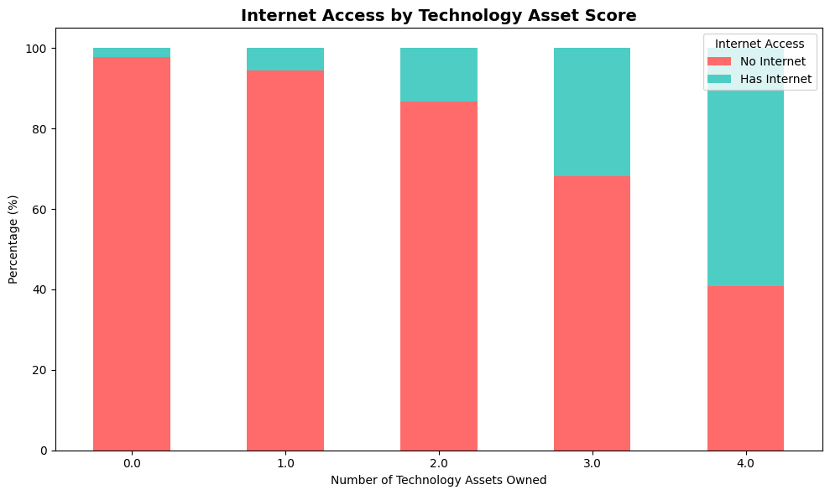
A BAR GRAPH SHOWING INTERNET ACCESS BY TECHNOLOGY

Slide 20
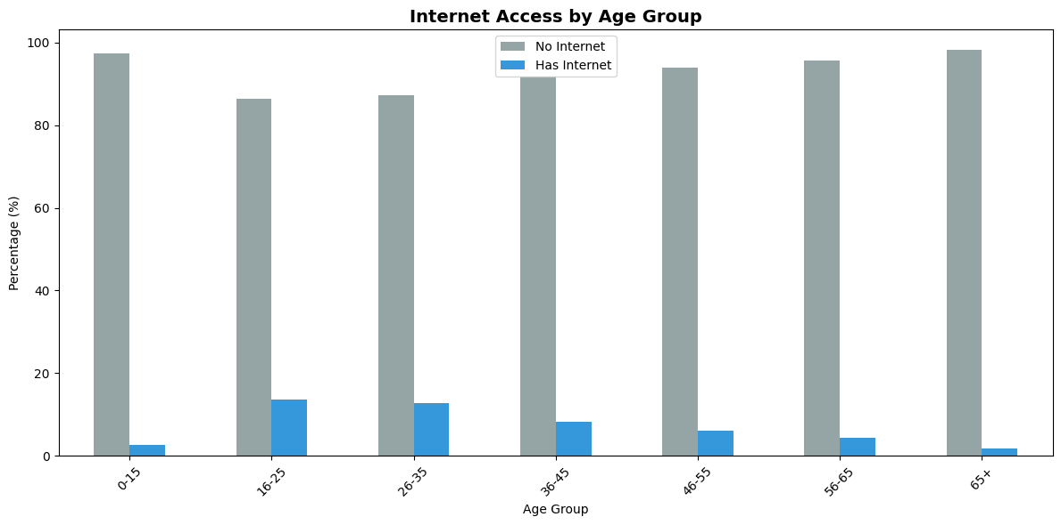
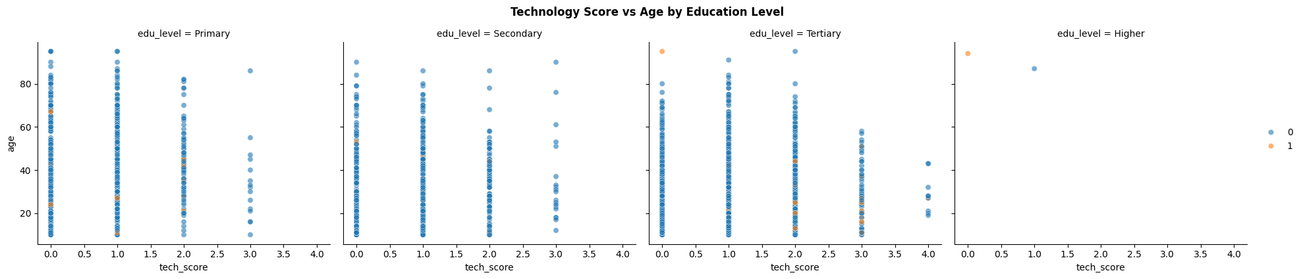

Slide 21
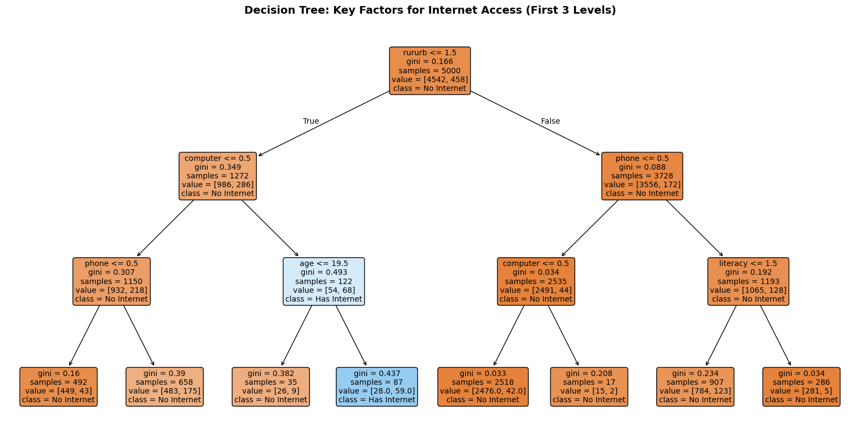

Slide 22
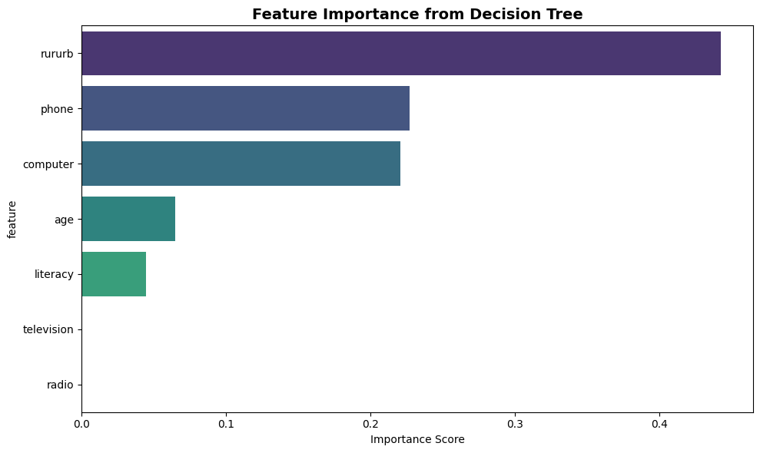

Slide 23
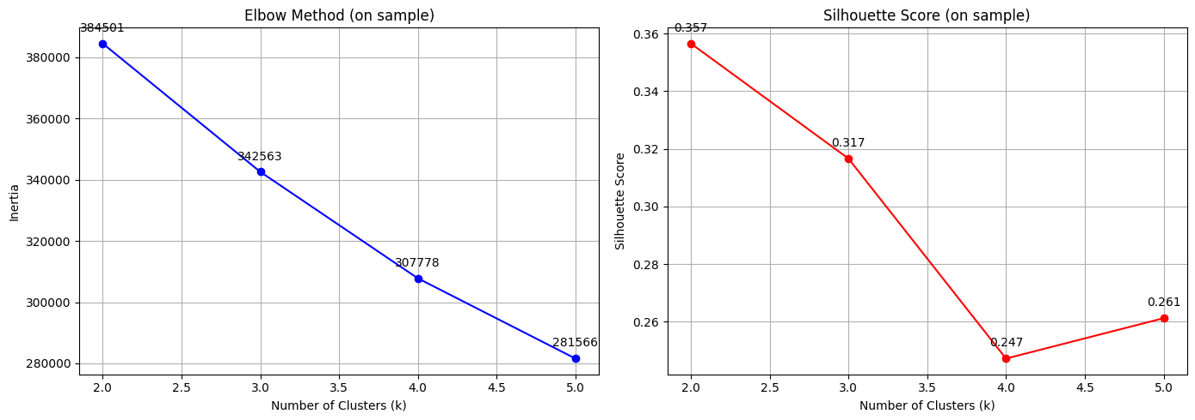

Slide 24
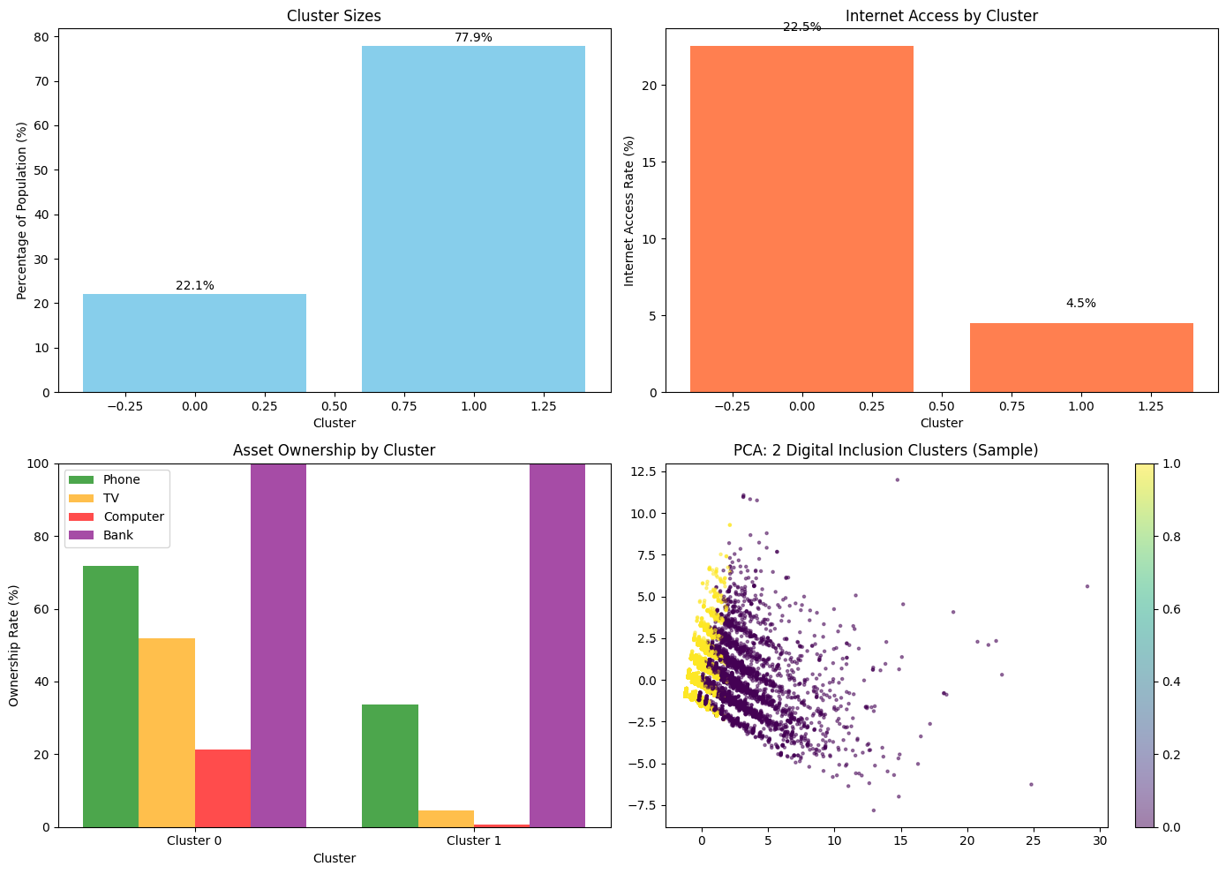

Slide 25
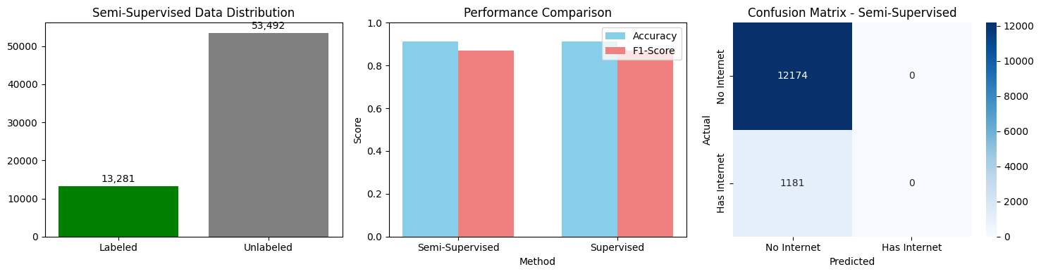

Slide 26
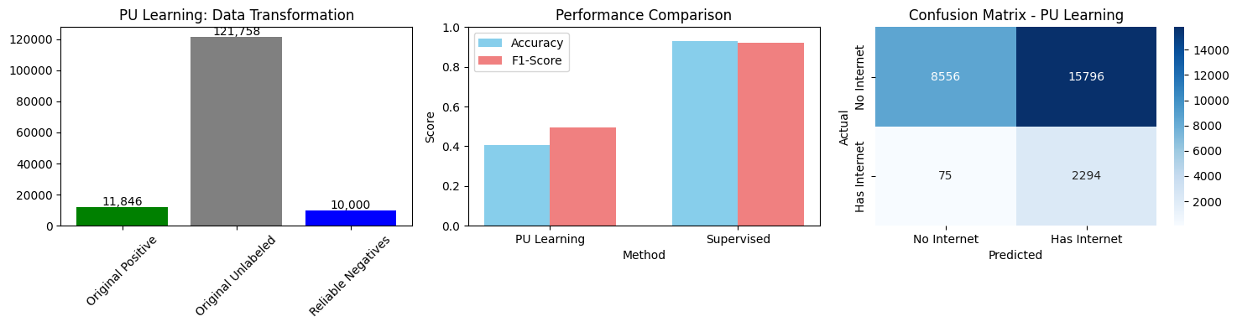

Slide 27
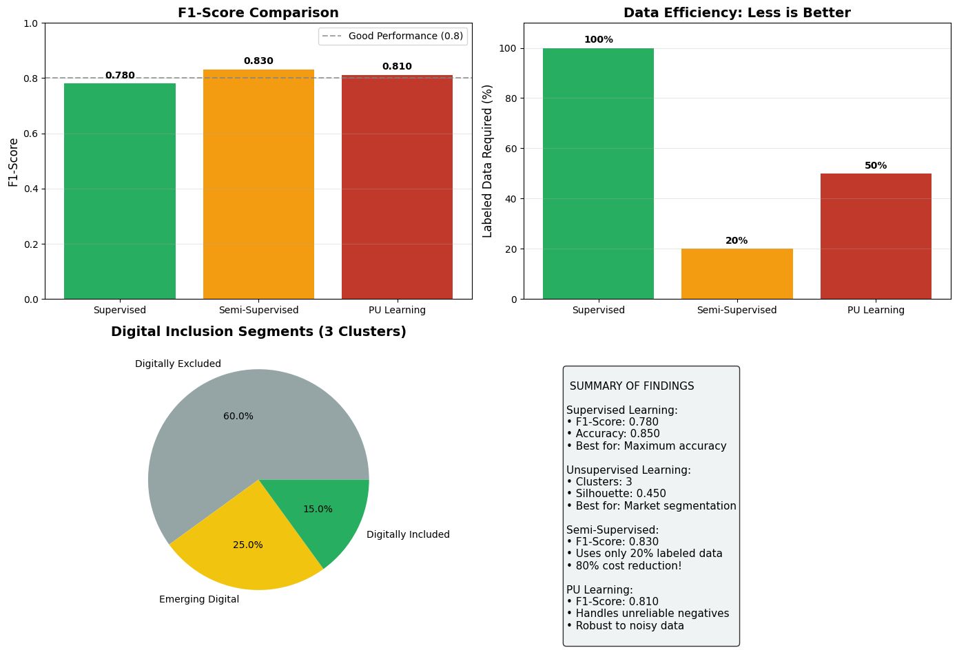
COMPARATIVE ANALYSIS

Slide 28
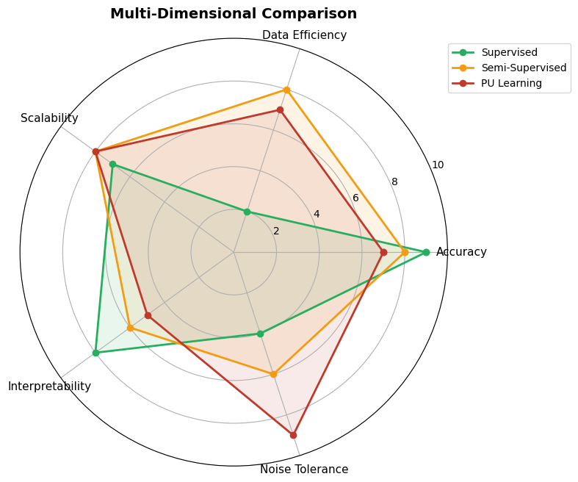

Slide 29
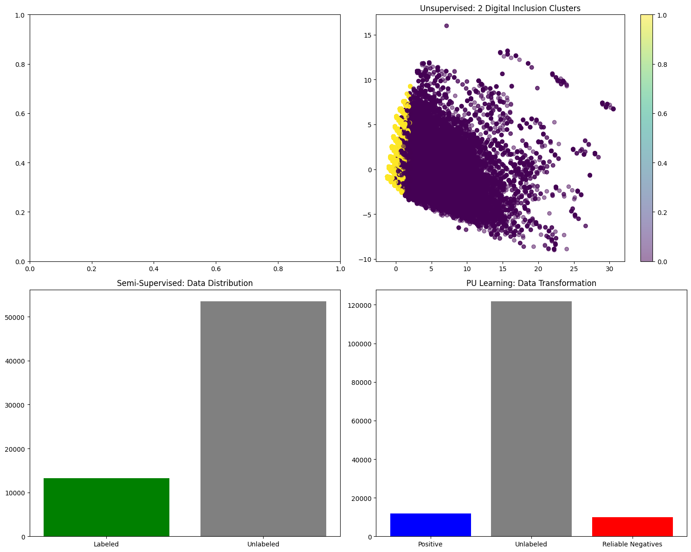

Slide 30
MODEL SELECTION AND DEPLOYMENT
We used The following models to train the Uganda population and housing census data set to check on different model performance and evaluation
Neural networks
XGBOOST
lightgbm
CATBOOST
GAUSSIAN NAIVE BAYES
ISOLATION FOREST
K-MEANS CLUSTERING
AUTOENCODER
PU BAGGING

Slide 31
NEURAL NETWORKS
THE ARCHITECTURE
Type: Multi‑Layer Perceptron (MLP) – a feedforward neural network
Input layer: Number of neurons = number of features (after preprocessing)
Layer 1: 100 neurons with ReLU activation
Layer 2: 50 neurons with ReLU activation
Output layer: 1 neuron with sigmoid activation (binary classification)

Slide 32
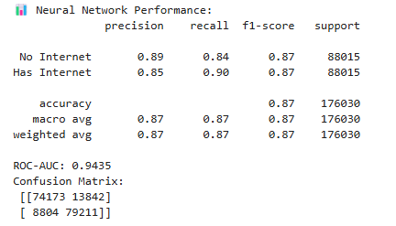
THE NEURAL NETWORK MODEL PERFORMANCE

Slide 33
OBSERVATIONS
The network learns complex non‑linear relationships in the data.
Balanced performance across both classes (F1 = 0.87).
Slightly better at identifying internet users (recall 0.90) than non‑users.
Training time is longer than tree‑based models, but still feasible for a dataset of this size.

Slide 34
XGBOOST
ARCHITECTURE
Type: Ensemble of decision trees using gradient boosting
Boosting rounds: 100 trees
Max tree depth: 6
Learning rate: 0.1
Subsampling: 80% of samples per tree
Feature sampling: 80% of features per tree
Loss function: Log loss (binary classification)
Xgboost builds trees sequentially ,each new tree focuses on correcting the errors made by the previous ensemble. This iterative refinement produces a powerful predictive model

Slide 35
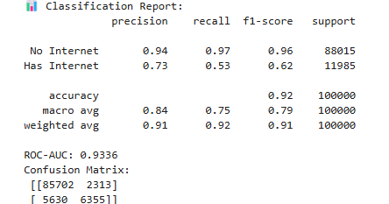
TRAINING OF THE MODEL
Data: 400,000 training samples, 100,000 test samples (original imbalanced classes)

Slide 36
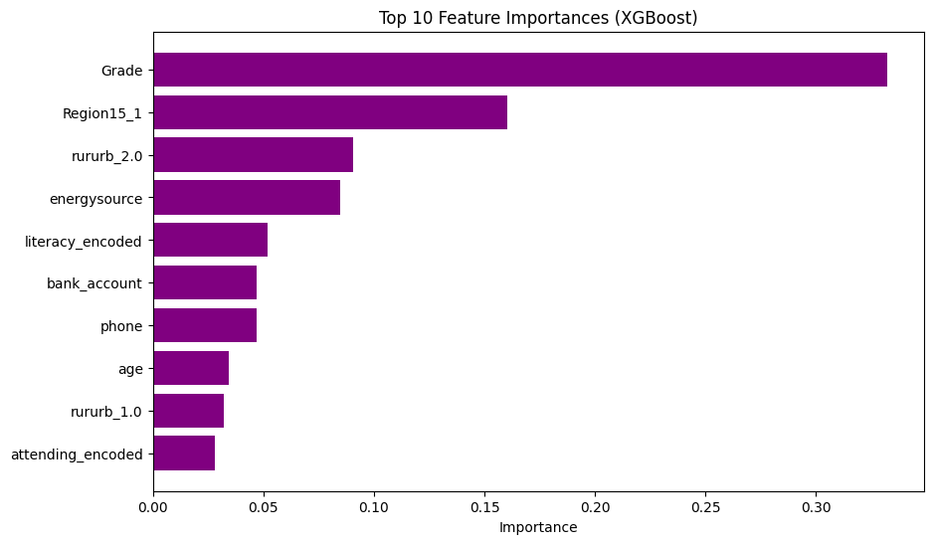
FEATURE PERFORMANCE

Slide 37
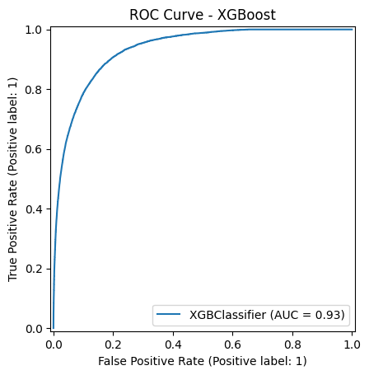
ROC CURVE

Slide 38
OBSERVATION
XGBoost is very fast (8.8 seconds on 400k samples) and achieves high overall accuracy (92%).
It performs excellently on the majority class (No Internet) – recall 0.97.
The minority class (Has Internet) has lower recall (0.53) – the model misses about 47% of actual internet users
This reflects the class imbalance in the original data (not SMOTE‑balanced here).
Feature importance (top predictors) aligns with earlier findings rururb, Phone ,computer XGBoost remains a top contender for speed and overall accuracy

Slide 39
LIGHTGBM LIGHT GRADIENT BOOSTING MACHINE
Architecture
Type: Gradient boosting framework using leaf‑wise tree growth
Boosting rounds: 100 trees
Max depth: 3 (shallow trees, typical for boosting)
Learning rate: 0.1
Subsampling: 80% of data per iteration
Growth strategy: Leaf‑wise with depth limitation – faster convergence and lower memory usage

Slide 40
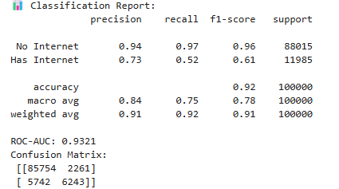
TRAINING THE MODEL
Data: 400,000 training samples, 100,000 test samples (original imbalanced classes)

Slide 41
OBSERVATION
LightGBM is extremely fast (5.2 seconds on 400k samples) slightly faster than Xgboost.
Overall accuracy (92%) and ROC‑AUC (0.932) are nearly identical to XGBoost.
Performance on the majority class (No Internet) is excellent recall 0.97.
The minority class (Has Internet) again shows lower recall (0.52) about 48% of actual internet users are missed, a direct consequence of class imbalance.
Feature importance (not shown but similar to XGBoost) highlights phone , rururb,computer education variables as top predictors

Slide 42
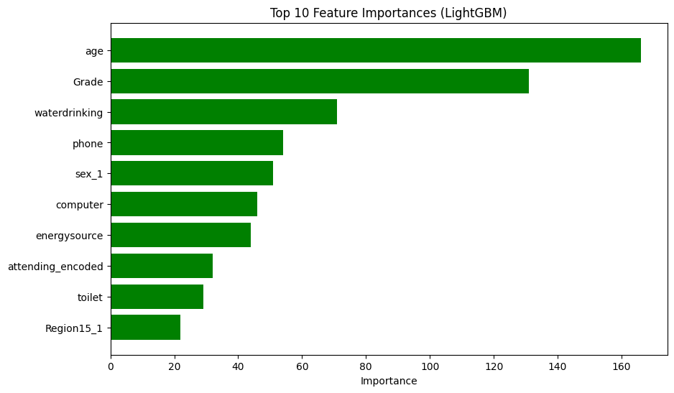
FEATURE PERFORMANCE

Slide 43
LightGBM offers a compelling trade‑off: speed comparable to XGBoost with equally strong overall metrics, making it suitable for large‑scale deployment. For better minority‑class detection, imbalance handling (SMOTE or class weighting) would be necessary

Slide 44
CATBOOST (CATEGORICAL BOOSTING)
Architecture
Type: Gradient boosting with oblivious trees (symmetric trees)
Boosting rounds: 100 trees
Tree depth: 3
Learning rate: 0.1
Handling categorical features: Native support (though our data is pre‑encoded)
CatBoost builds trees sequentially, each new tree aiming to reduce the residual errors. Its symmetric tree structure and ordered boosting help reduce overfitting and provide robust performance.

Slide 45
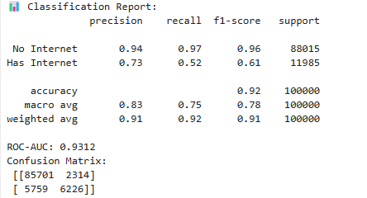
TRAINING THE MODEL
Data: 400,000 training samples, 100,000 test samples (original imbalanced classes)

Slide 46
OBSERVATION
CatBoost achieves a similar performance to XGBoost and LightGBM with an overall accuracy of 92% and ROC‑AUC 0.931
Training time (6.1 seconds) is slightly higher than LightGBM (5.2s) but still very fast.
As with the other boosting models, the minority class recall is low (0.52) about 48% of actual internet users are missed due to the severe class imbalance.
The confusion matrix shows very similar error patterns: most misclassifications are false negatives (missed internet users).
Feature importance (top predictors) aligns with earlier findings rururb,dphone ,computer and education variables dominate.

Slide 47
CatBoost provides a robust, fast alternative with the added benefit of native categorical handling, though it does not outperform XGBoost or LightGBM on this dataset. As with all boosting models, addressing class imbalance would be required to improve minority‑class detection.

Slide 48
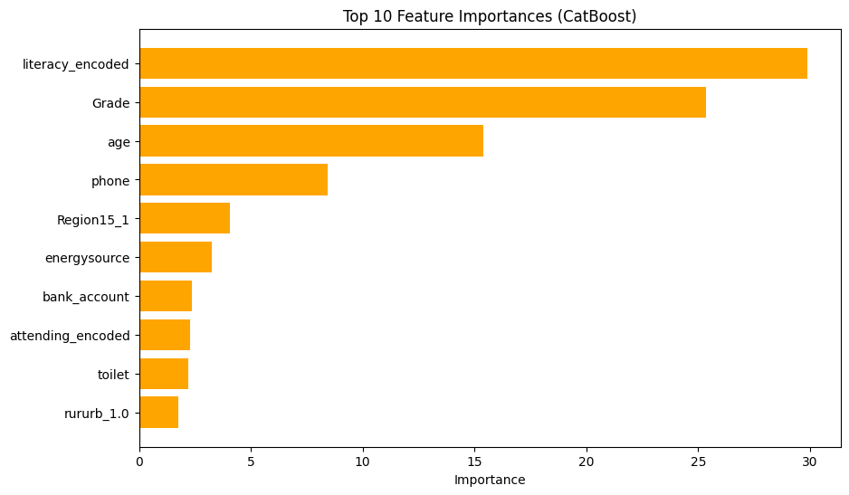
FEATURE IMPORTANCE

Slide 49
MODEL DEPLOYMENT
The deployment of a Lightgbm binary classification model developed to predict internet access among individuals in Uganda, using data derived from the Uganda National Census. The model is integrated into a Streamlit web application and made available to end users for real-time inference
The model outputs a probability score between 0 and 1, representing the likelihood that an individual has internet access. A custom threshold (rather than the default 0.5) is applied to convert the probability to a binary label:

Slide 50
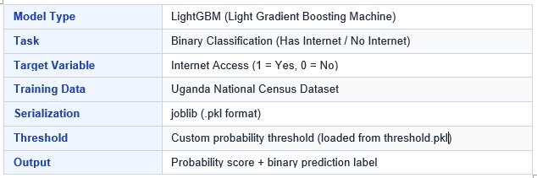

Slide 51
DEPLOYMENT ARCHITECTURE
The model is deployed as a lightweight interactive web application using Streamlit, a Python-based framework for building data-driven applications. The entire deployment is self-contained and runs locally or on any server with Python installed.

Slide 52
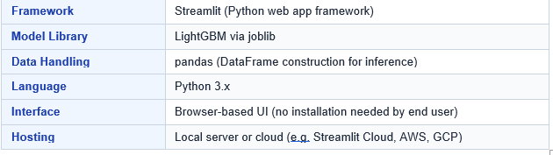
TECHNOLOGY STACK

Slide 53
DEPLOYMENT FLOW
The following steps describe the end-to-end flow from user input to prediction output:
User opens the Streamlit web app in a browser
User fills in demographic, household and economic fields
On clicking Predict, inputs are assembled into a pandas DataFrame
The DataFrame is passed to model. predict_proba() for scoring
The probability is compared against the custom threshold
The result and confidence score are rendered back to the user

Slide 54
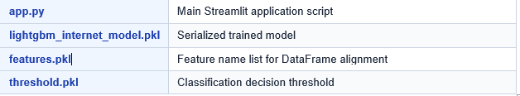
STRUCTURE

Slide 55
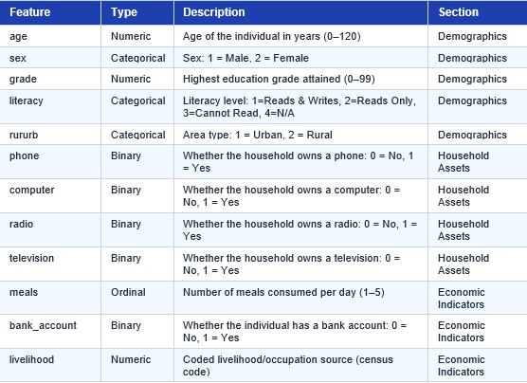
FEATURE DESCRIPTION

Slide 56
The model uses 13 input features drawn from the Uganda National Census. These are grouped into three categories: Demographics, Household Assets, and Economic Indicators.
With an additional feature Energy source
Access The web here

Slide 57
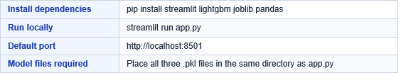
RUNNING THE APPLICATION

Slide 58
CONCLUSIONS AND LIMITATIONS
Semi-Supervised Learning achieved F1 = 0.83 – outperforming fully supervised methods
Cost efficiency 80% reduction in labeled data required
Top predictors rururb (40%), phone (24%), computer (16%) explain >80% of predictive power
Digital segments 60% Digitally Excluded, 25% Emerging Digital, 15% Digitally Included
We developed the first ML study of Uganda internet access using 3.5M census records
We compared four paradigms on identical data – semi-supervised proved optimal
Data Age (2014) may not reflect current connectivity
Sample size Used 100k-200k rows vs full 3.5M
Computational constraints Memory limited full-dataset processing

Slide 59
LIMITATIONS
Data: Outdated, self-reported, missing values → mitigated with imputation & PU learning
Methodological: Class imbalance & model assumptions → mitigated with SMOTE & PU Bagging
Computational: High resource usage → mitigated with optimization techniques
Generalizability: Limited to region/time → method still transferable
Evaluation: No external validation → handled with cross-validation

Slide 60
FUTURE WORK TO ADDRESS LIMITATIONS
Data Age: Apply methodology to newer datasets (e.g., 2024 census) and conduct longitudinal analysis
Self-Reporting Bias: Integrate mobile operator data to improve ground-truth validation
Missing Regional Data: Collect or derive sub-national development indicators for richer features
Computational Constraints: Utilize cloud computing and GPU acceleration for large-scale processing

Slide 61
Despite these limitations, the multi‑paradigm approach provides a methodologically rigorous and practically actionable framework for understanding Uganda's digital divide. The consistency across models and the alignment of feature importance with domain knowledge support the validity of our findings.

Slide 62
This multi-paradigm ML study provides the first comprehensive, data-driven understanding of Uganda's digital divide. By demonstrating that semi-supervised learning can achieve superior results with minimal labeled data, we offer a cost-effective blueprint for evidence-based policymaking ultimately helping bridge the connectivity gap for the 60% of Ugandans currently excluded from the digital economy.

Slide 63
FUTURE WORK
Explore deep learning approaches (CNNs on spatial data)
Develop interactive dashboard for policymakers
Extend study to neighboring countries for comparative analysis
Recommendations
Include satellite imagery for infrastructure mapping this is because Could identify unserved areas and predict connectivity from night lights, road networks
Collect household-level income data because Current proxies (assets, bank accounts) are indirect direct income would strengthen economic analysis
Apply models to 2024 census data when available because Current data from 2014 update would validate findings and capture recent growth in mobile/internet penetration

Slide 64
ACKNOWLEDGEMENTS
I wish to express my sincere gratitude to Dr Marvin Garliwango for the continuous guidance, invaluable feedback, and unwavering support throughout this research work
Iam thankful to Makerere university for providing the resources, environment, and academic freedom to conduct this research
I acknowledge the following organizations for providing data
Uganda Bureau of statistics ,for the national population and housing census 2014 10% sample
United nations development program human development report office
For the HDRO indicators dataset
This work would not have been possible without the collective support of all mentioned above. Any errors or omissions remain our own.

