Slide 1







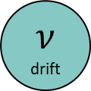

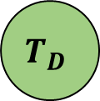

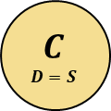
S
$$𝒩\left(D\left(μτ+\left(D+1\right)\frac{a}{2}−az\right), τ\right)$$
$$X$$
identity
$$𝒩(d×S, s_{v})$$
$$μ$$
drift
$$C \\ D=S$$
discriminability
D
$$P_{diffusion} (μ, sz, a)$$
$$p\left(D=S \right|X, Vis, T_{D})$$
d
$$T_{D}$$
$$ν$$
drift
$$Vis$$
$$𝒩(d, σ_{Vis})$$
$$𝒩(ν(T_{D}+τ), s_{Vis}(T_{D}+τ))$$
Manifest to the experimenter, latent to the observer
Latent for both observer and experimenter
Manifest to the observer, latent to the experimenter

Slide 2
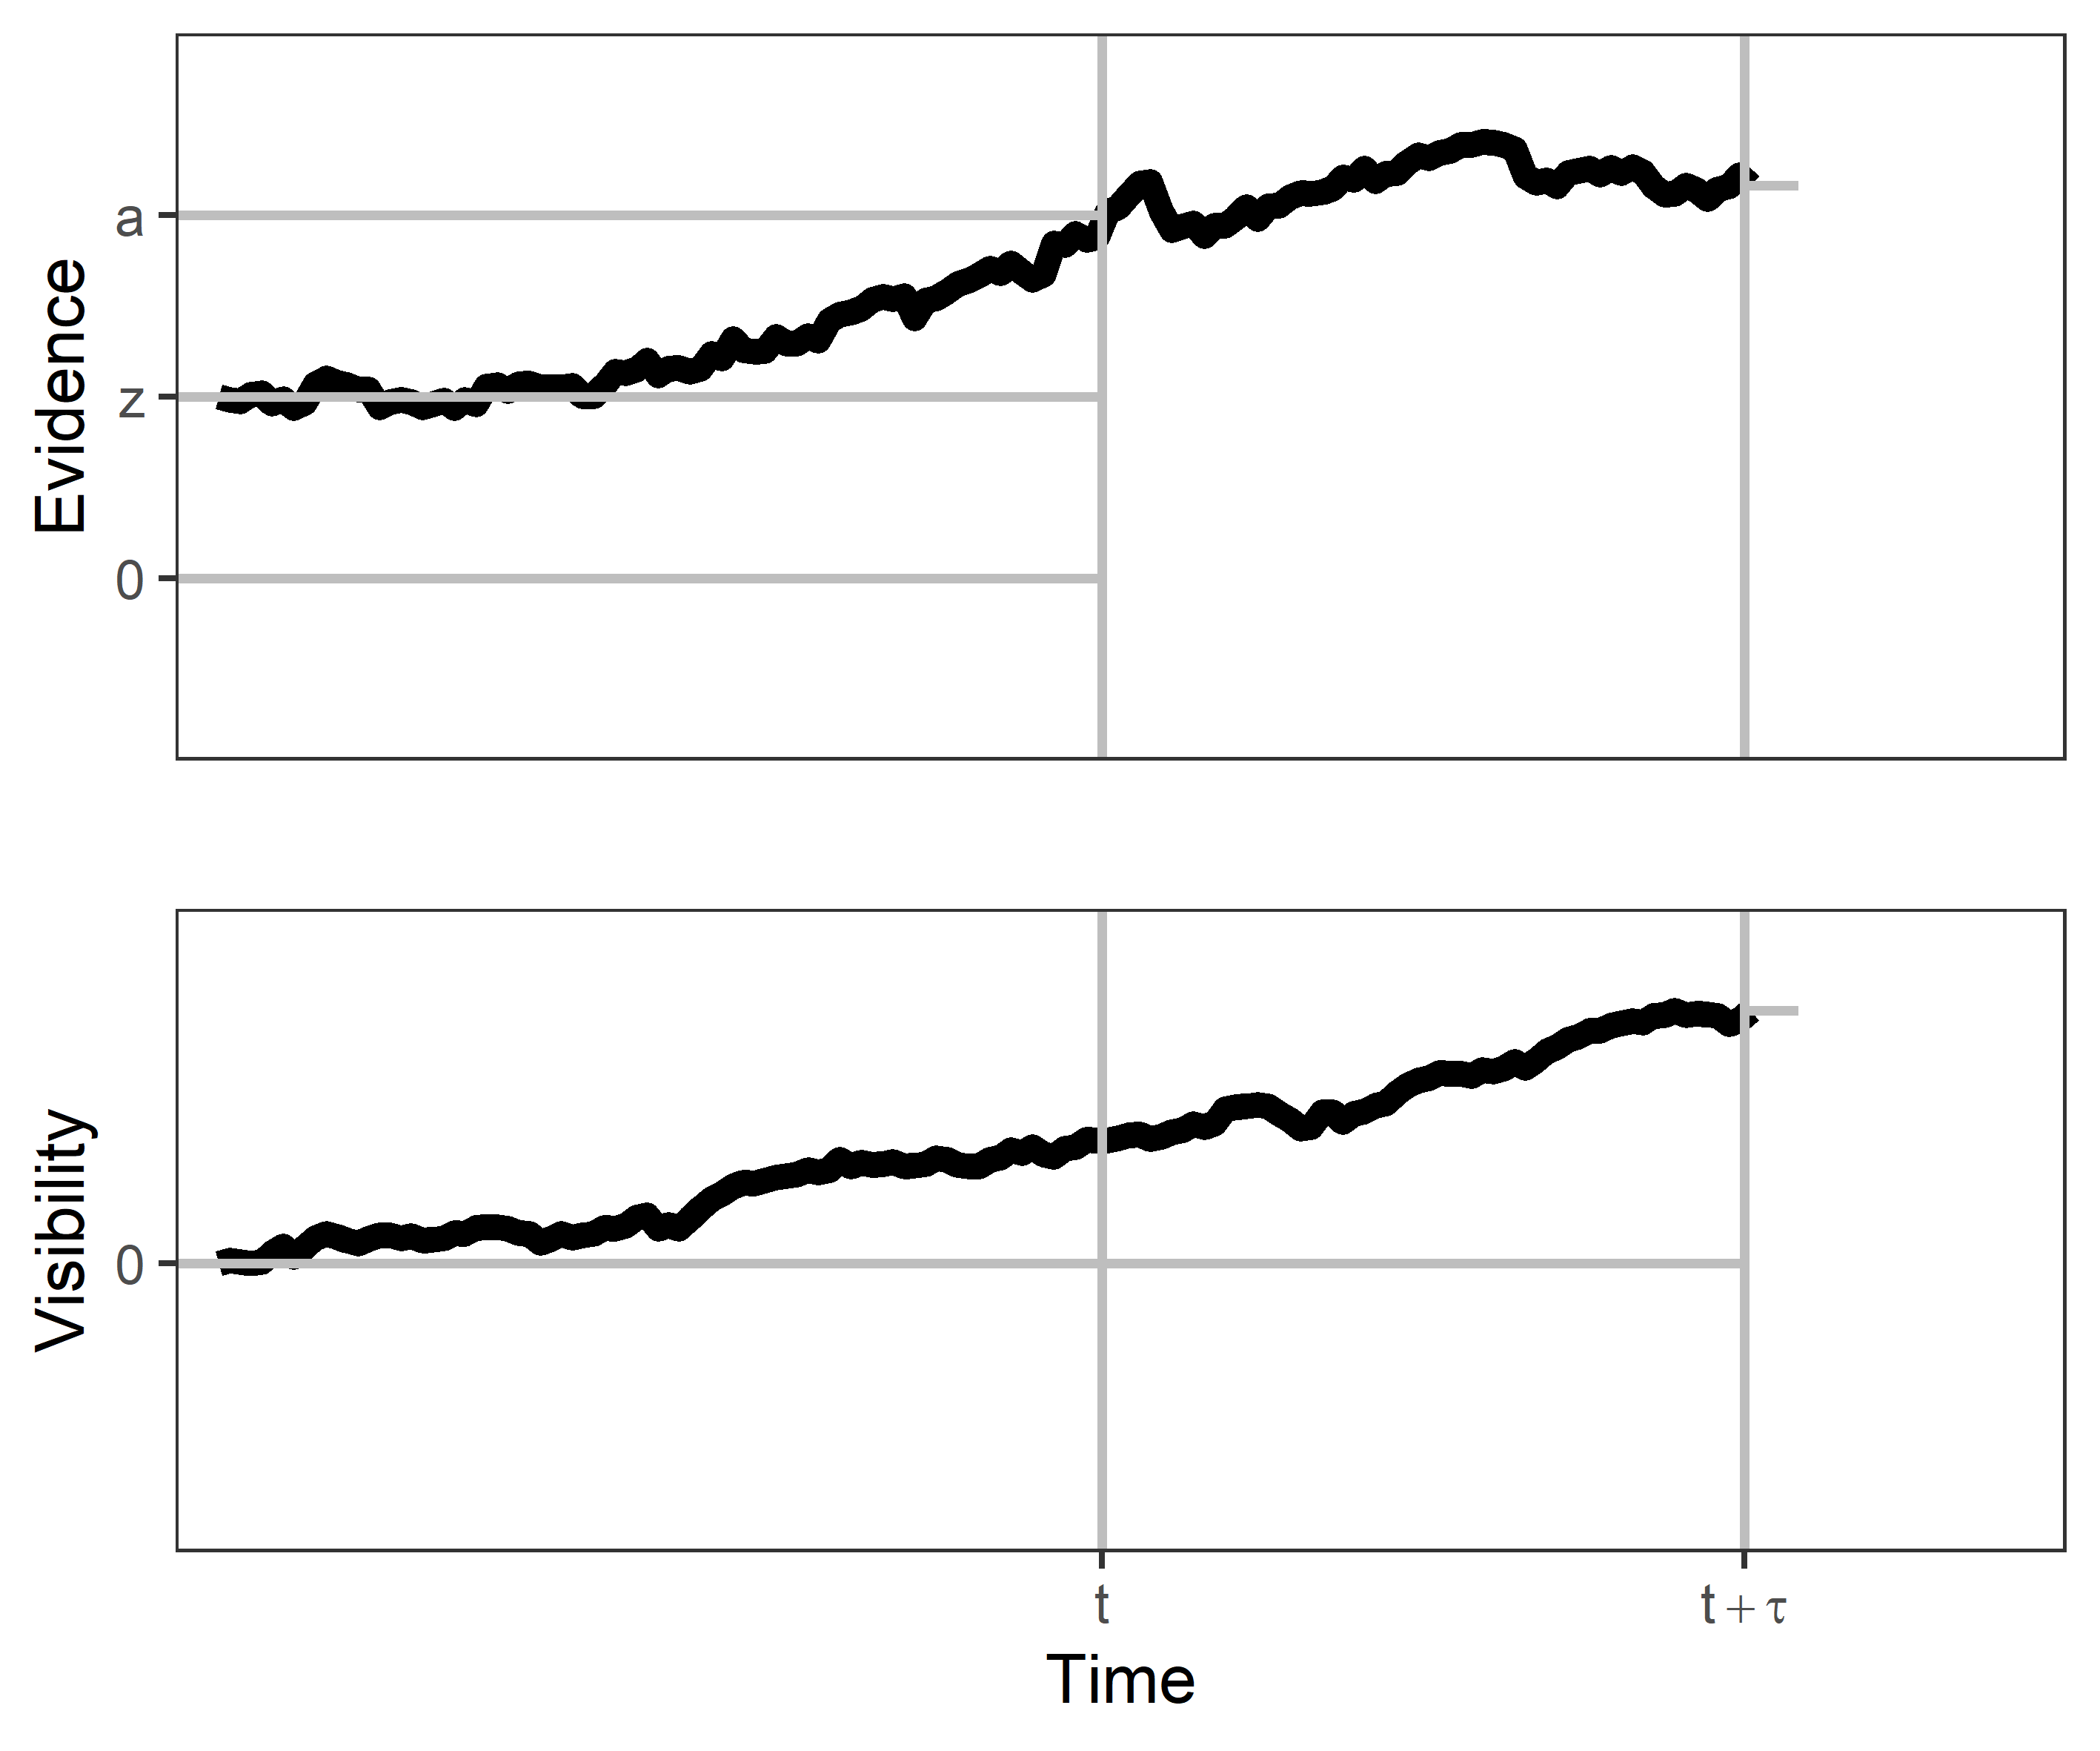






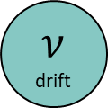

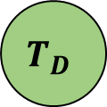

S
$$𝒩\left(D\left(μτ+\left(D+1\right)\frac{a}{2}−az\right), τ\right)$$
$$X$$
identity
$$𝒩(d×S, s_{v})$$
$$μ$$
drift
Decision process
$$C \\ D=S$$
discriminability
D
$$P_{diffusion} (μ, sz, a)$$
$$p\left(D=S \right|X, Vis, T_{D})$$
d
$$T_{D}$$
Visibility process
$$𝒩(d, σ_{Vis})$$
$$ν$$
drift
$$𝒩(ν(T_{D}+τ), s_{Vis}(T_{D}+τ))$$
$$Vis$$
Manifest to the experimenter, latent to the observer
Latent for both observer and experimenter
Manifest to the observer, latent to the experimenter

