Slide 1
Dungeon of Pixels
Team KETER
Yang Se-hoon(PO)
SooYoung Park
Taemin Song
Tom Dubiner
July 26th, 2016

Slide 2
Project Goals
Account creation / log-in system
Real time server-client structure
Basic RPG game structure
Interaction between players

Slide 3
Challenges
Developing without IDE
Following INVEST conditions

Slide 4
Architectures
Server as a mealy machine
State transition
Client
Server
Key input / Server state

Slide 5
Architectures
Account creation / Log-in
Create a file
Client
Server
File
System
Account creation request
Log-in request
Read the file

Slide 6
Architectures
Server management
Data
Recv/send
thread
Monster
Managing
Thread
Data
Recv/send
thread
Data
Recv/send
thread
Data
Recv/send
thread
Data
Recv/send
thread
Main
Thread
Data
Recv/send
thread
Data
Recv/send
thread
Data
Recv/send
thread
Server
Managing
Thread
Data
Recv/send
thread

Slide 7
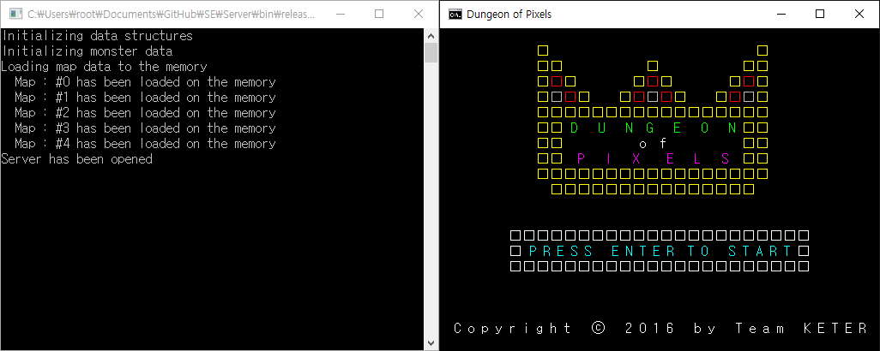
Screenshots
Initial screen (left : server, right : client)

Slide 8
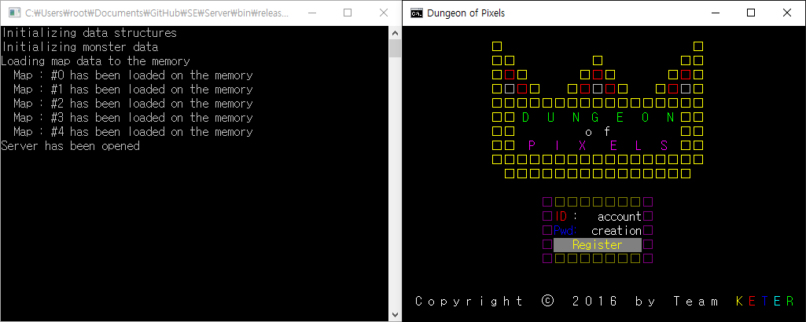
Screenshots
Account creation

Slide 9
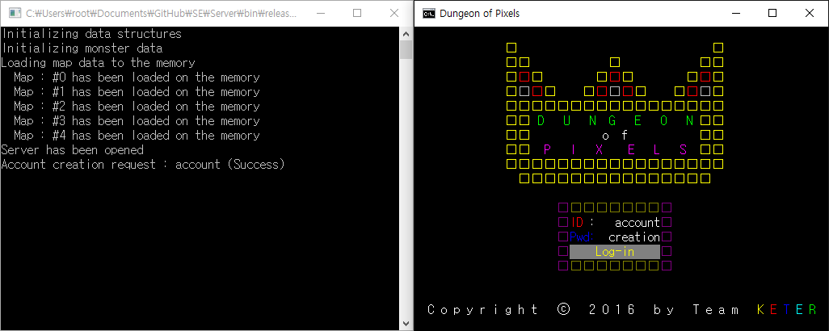
Screenshots
Log-in

Slide 10
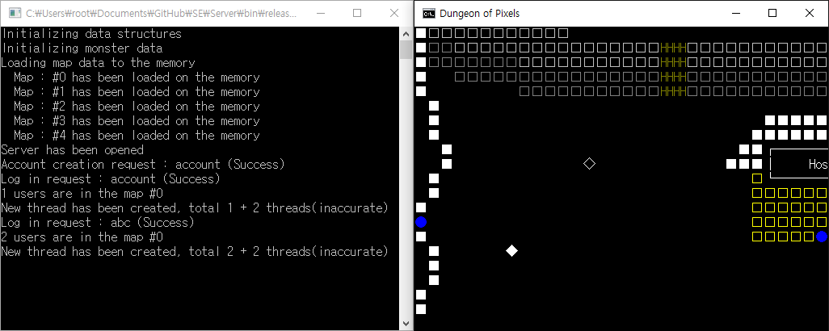
Screenshots
Moving around

Slide 11
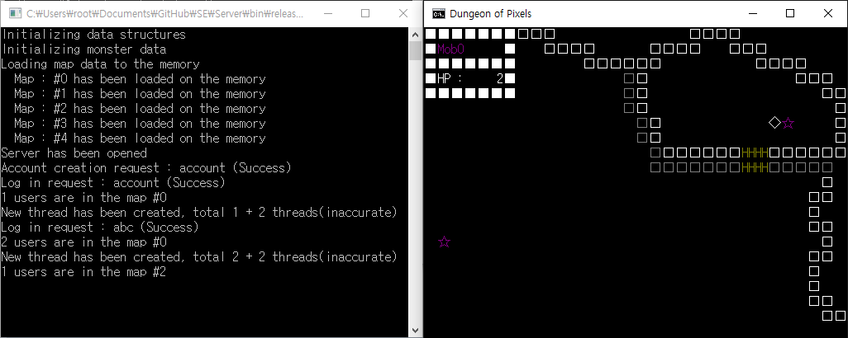
Screenshots
Combat with monster

Slide 12
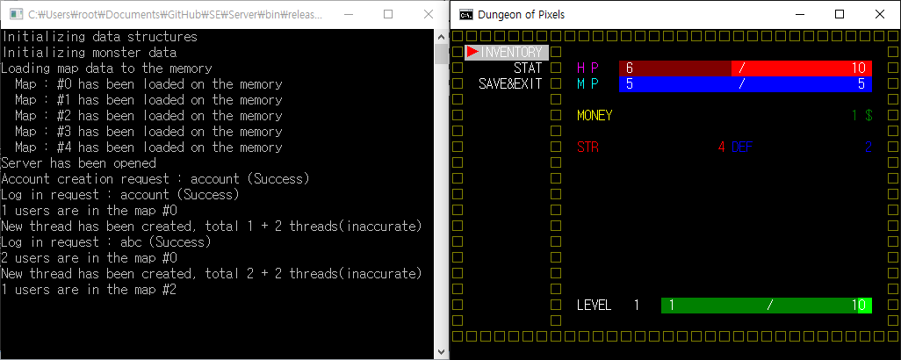
Screenshots
Menu

Slide 13




Technologies
For programming
C
For project management

Slide 14
Lessons
What worked
Scrum meeting
Updating burn-up chart
What did not work
Effective distribution of a workload

Slide 15
Questions

