Slide 1
Main Practical Assignment
Sven Zelch

Slide 2
Content
Problem definition
Reinforcement Learning
  Markov Property
  Markov Deciscion Process
  Q-Learning
Training
Result
Conclusion

Slide 3
Problem definition
Dice game Pig:
  Two player variant
  Six-trigger version
  100 Points
  Random starting player
  Turn based

Slide 4
Reinforcement Learning
Collecting data to make predictions
Feedback at the end of the game
  Reward shaping

Slide 5
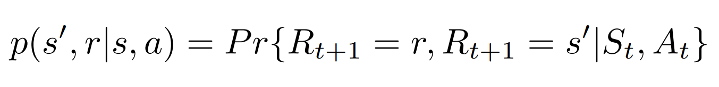
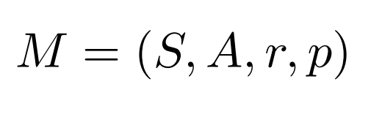
Markov Property and Markov Decision Process

Slide 6
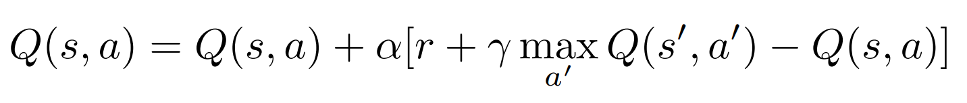
Q-Learning

Slide 7
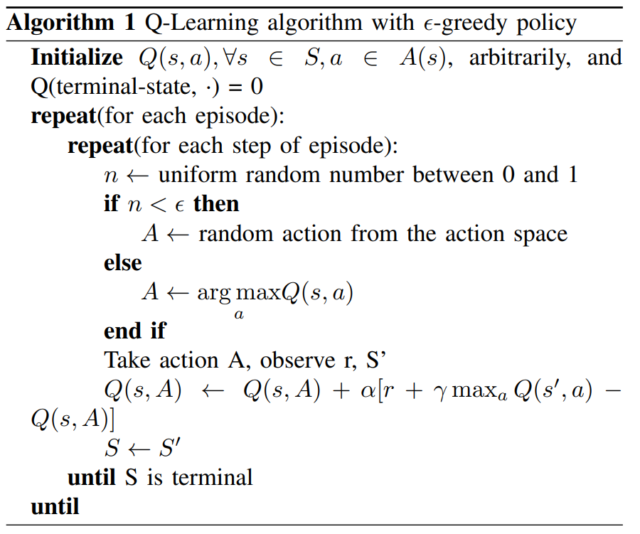
Q-Learning

Slide 8
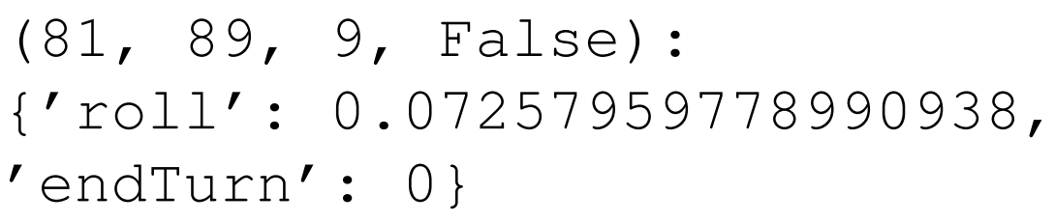
Q-Learning
Q-Learning values
  Learning rate = 0.1
  Discount factor = 0.95
  Exploration rate = 0.1
Q-Table as dictionary
State structure:

Slide 9
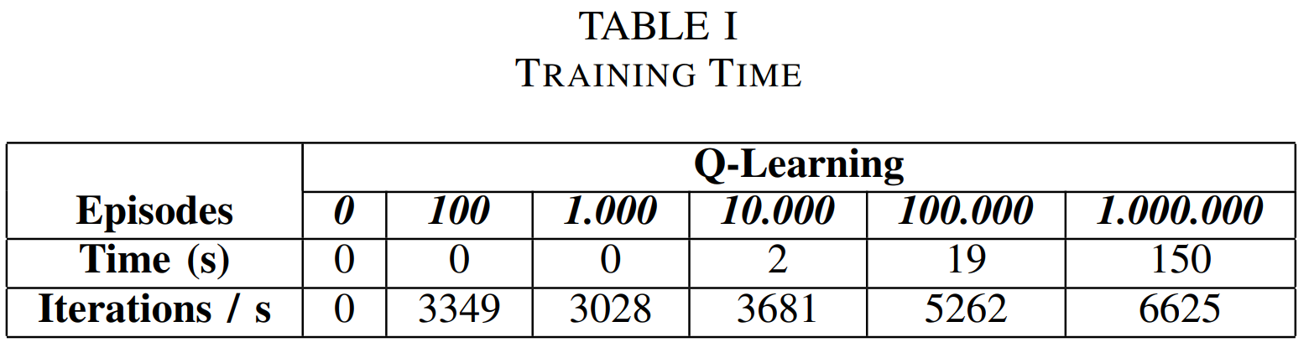
Training

Slide 10
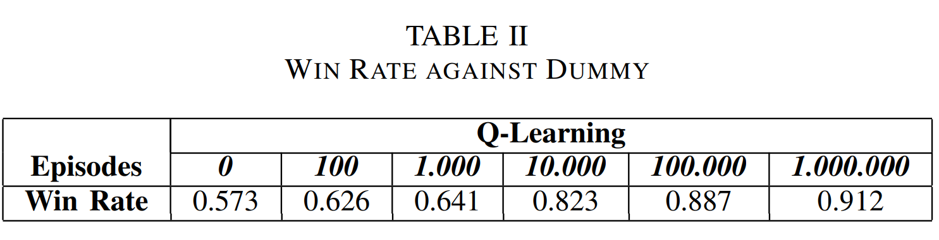
Results

Slide 11
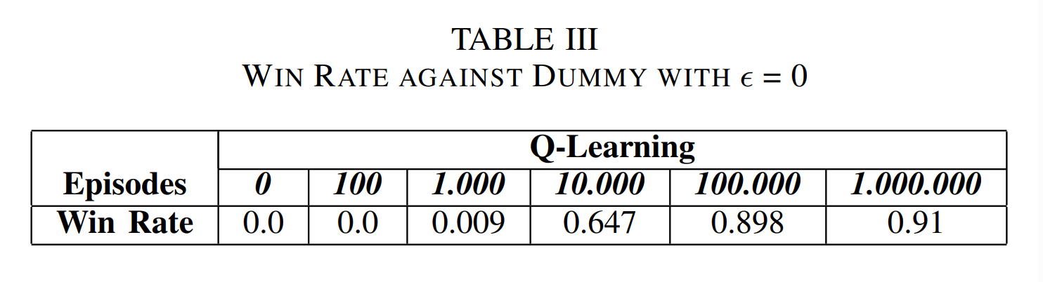
Results

Slide 12
Conclusion
Q-Learning agent with substantially better than random dummy
Agent learned policy
State structure was sufficient
Auxilary reward
Improvement:
  Smaller feature space

Slide 13
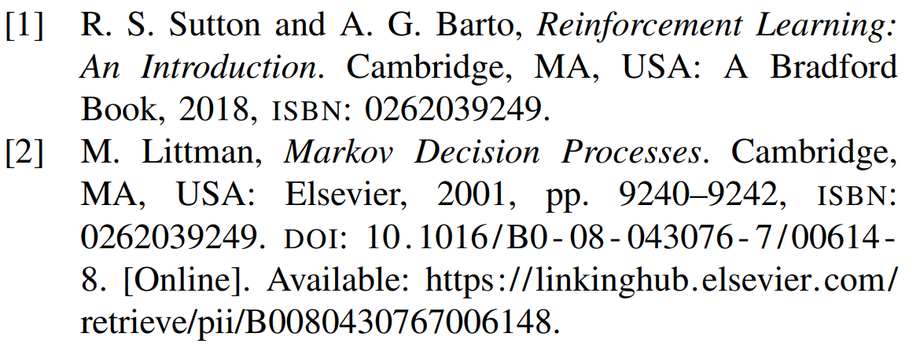
References

Slide 14
Magnus Svenson
62 – 101
Agent end turns at low tun total
  Scoring over risking to lose points
  Auxiliary reward
Agent does not adpat
Agent learned a strategie

Slide 15
Gracias!

