Slide 1
Lecture 2 – Supplement -Cryptographic Algorithms and Protocols
Huang, Xiujie (黄秀姐)
Office: Nanhai Building, #411
E-mail: t_xiujie@jnu.edu.cn
Dept. Computer Science

Slide 2
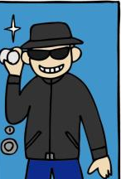
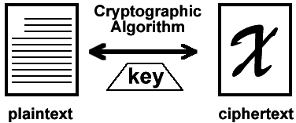
Intuition on Cryptography
Eve/ Oscar
Insecure Channel!!!
Alice
Bob

Slide 3

Symmetric-Key Cryptosystem (SKC)
Alice
Bob

Slide 4
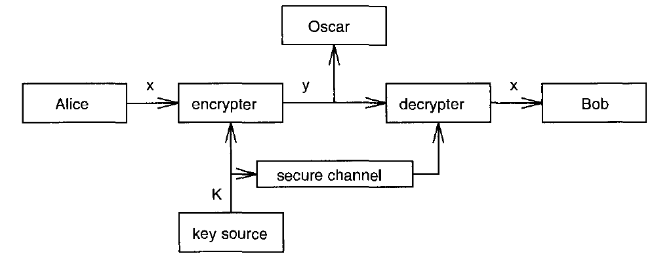
Cryptographic Communication System
Protocol:
A and B choose a random key K by a secure channel
A wants to sent a string message x=x₁x₂…x_{n}
A computes y_{i}=e_{K}(x_{i}) and the resulting string y=y₁y₂…y_{n} is sent over the insecure channel
B receives y=y₁y₂…y_{n} and decrypts x_{i}=d_{K}(y_{i}) to obtain x=x₁x₂…x_{n}

Slide 5
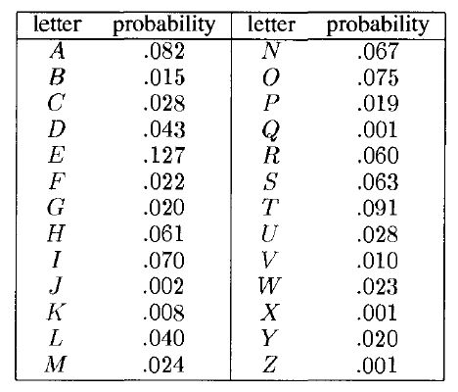
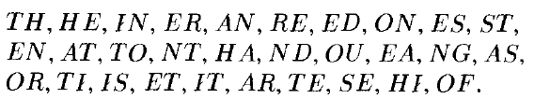

Statistical Properties of the English Language
Beker and Piper’s Table for
Probabilities of occurrence of the 26 letters
The thirty most common digrams:
The twelve most common trigrams:

Slide 6
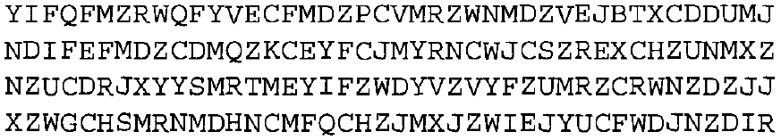
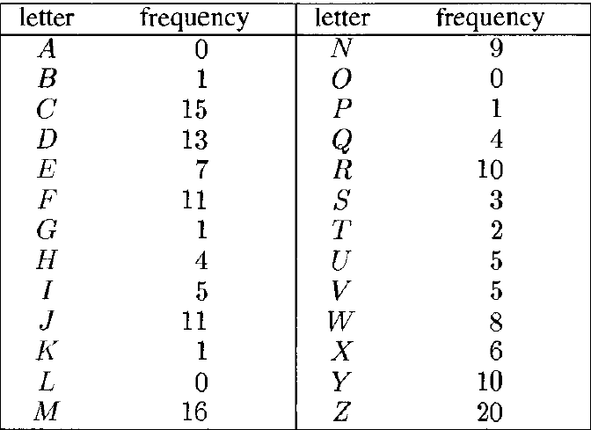


Ciphertext-only attack on the Substitution Cipher
See Example 2.11 on Pages 42-44.
Ciphertext from a substitution cipher:
Stage 2: Look at digrams, especially those of the form –Z or Z-.
Stage 1

Slide 7
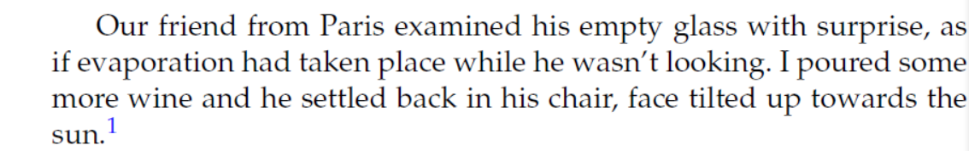
Ciphertext-only attack on the Substitution Cipher
See Example 2.11 on Pages 42-44.
Ciphertext from a substitution cipher:

Slide 8
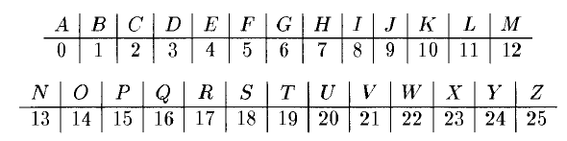
Attack on Shift Cipher
Jack
Key K =1
Lucy
MFUVTNFFUBUFJHIU
MEETING
letusmeetateight

Slide 9
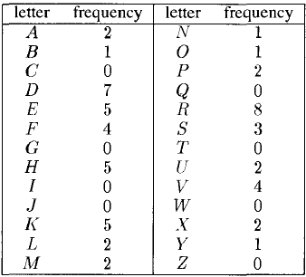
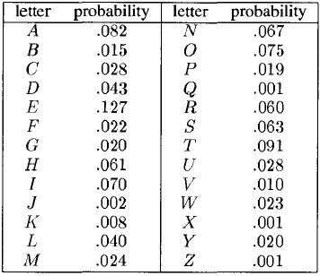
Ciphertext-only attack on the Affine cipher
See Example 2.10 on Pages 41-42.
Ciphertext from an Affine cipher:
Beker and Piper’s statistical table

Slide 10

Ciphertext-only attack on the Affine cipher
See Example 2.10 on Pages 41-42.
Ciphertext from an Affine cipher:
Try 1:
X
X
Try 2:
X
Try 3:
√
Try 4:

Slide 11
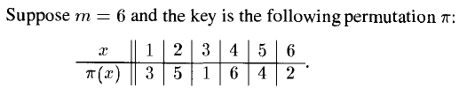
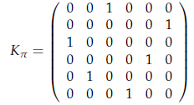


Permutation Cipher - Example 2.7
Plaintext:
Partition:
Encryption:

Slide 12
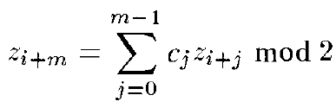
General LFSR of Binary Steam Ciphers
c₀
c₁
c₂
c_{j-1}
c_{m-1}
k₁
k₂
k₃
k_{j}
k_{m}
z₁z₂z₃……

Slide 13
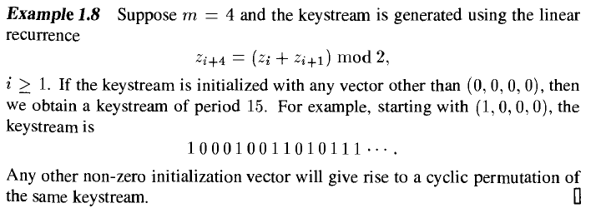
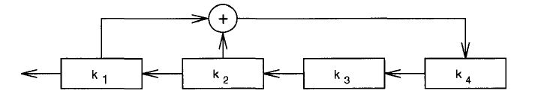
Stream Ciphers - Example 2.8

Slide 14


Known-plaintext attack on the LFSR Stream cipher
Encryption rule:
Keystream generator:
KEY?
(k₁, k₂, …, k_{m}) = (z₁, z₂, …, z_{m})

Slide 15
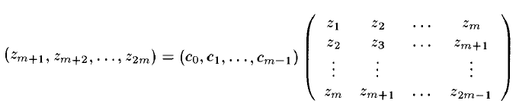
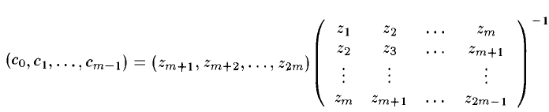
Known-plaintext attack on the LFSR Stream cipher
?

Slide 16

Autokey Cipher - Example 2.9
Plaintext:
Integers of Plaintext:
Keystream:
Encryption:
Ciphertext:

Slide 17
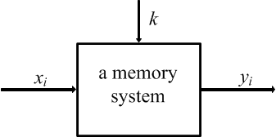
Stream Ciphers
z_{i} is from a keystream generated by the function g

Slide 18
Practical Stream Ciphers
See Section 4.8 on Pages122-131
the idea of LFSR is still used:
Efficiency (in software and hardware)
Large period
Three of the most common methods of generating keystream
Combination generator
Filter generator
Shrinking generator
Cryptanalysis:
Correlation attack on a combination generator
Algebraic attack on a filter generator

Slide 19
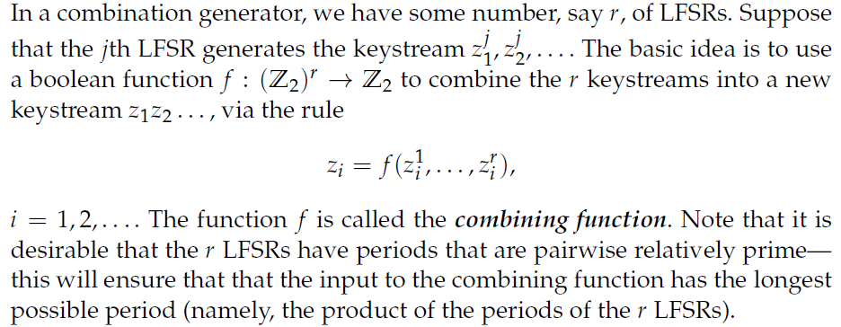
Combination generator
Correlation Attack on a Combination Generator

Slide 20
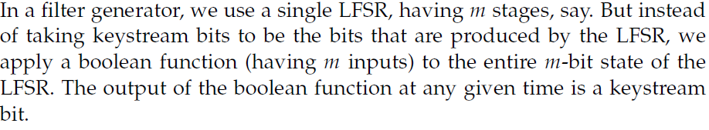
Filter generator
Algebraic Attack on a Filter Generator

Slide 21
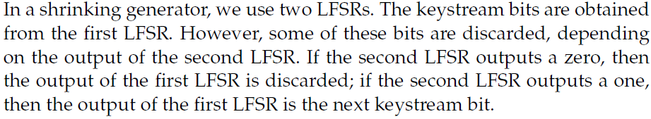
Shrinking generator

Slide 22
Applications of Stream Ciphers
Some already broken but still used stream ciphers：
1. CSS (Content Scramble System)(2 LFSRs): DVD encryption 用于加密DVD的内容扰乱系统
2. A5 (3 LFSRs): GSM encryption
3. E0 (4 LFSRs): Bluetooth encryption
4. RC4:
designed by Ron Rivest in 1987, revealed anonymously in 1994
Used in HTTPS, WEP (IEEE 801.11), WAP, SQL Database

Slide 23
Applications of Stream Ciphers
Some modern stream ciphers：
1. SEAL (8 LFSRs):
designed by Rogaway & Coppermfith in IBM in 1994
Suitable in software
2. Salsa20:
From eStream Project (2005-2008)
Suitable both in software and hardware
https://www.ecrypt.eu.org/stream/e2-salsa20.html
3. Trivium:
Designed by De Canniere and Preneel in 2005
From eStream Project (2005-2008)
https://www.ecrypt.eu.org/stream/e2-trivium.html

Slide 24

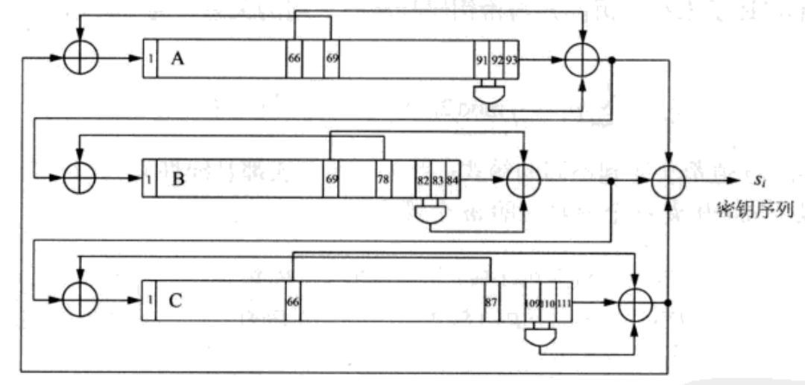
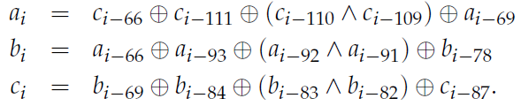
Applications of Stream Ciphers
3. Trivium:
Efficient and secure against known attacks
Key size: 80 bits; IV size: 80 bits; Internal state: 288 bits (93+84+111)
Three registers A , B, C
A
B
C
r_{i}
key stream

Slide 25
The Stream Cipher is an Interesting Topic!
Design keystream generator g:
Randomicity of the keystream: sequence design
Efficiency;
Large period (> 10¹⁶bit);
……
Cryptanalysis:
Evaluation criteria for security;
Attack methods;
……
Some examples of research on stream ciphers:
P. Yadav, I. Gupta, S.K. Murthy, “Study and analysis of eSTREAM cipher Salsa and ChaCha”, IEEE ICETECH 2016
Lin Ding, “Improved Related-Cipher Attack on Salsa20 Stream Cipher”, IEEE ACCESS, 2019

Slide 26
Group Work on Stream Cipher
Topics:
1. What is CSS? Cryptanalysis on CSS.
2. What is A5? Cryptanalysis on A5.
3. What is E0? Cryptanalysis on E0.
4. What is RC4? Cryptanalysis on RC4.
5. Other topics related to Stream Cipher.
Group work:
each group has 2-3 persons;
Clearly claim personal contribution for each member;
Due to 04/03/2024.

