Slide 1
Lecture 3 – Supplement -Cryptographic Algorithms and Protocols
Huang, Xiujie (黄秀姐)
Office: Nanhai Building, #411
E-mail: t_xiujie@jnu.edu.cn
Dept. Computer Science

Slide 2
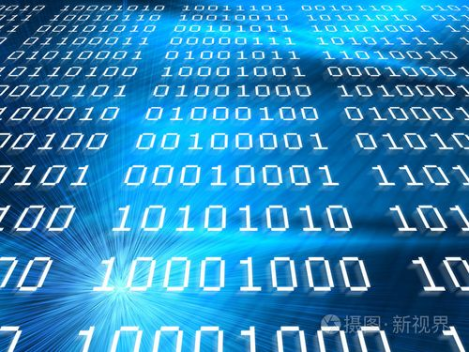
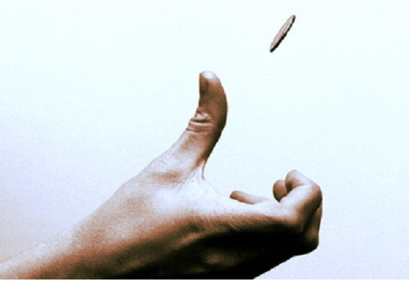
Bit (binary digital) & information
2
Notes:
2

Slide 3
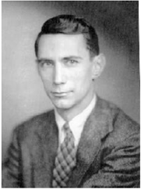
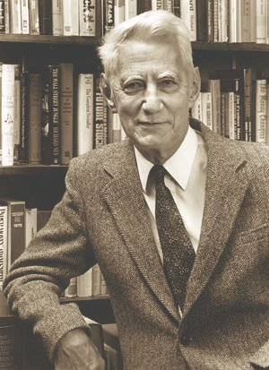
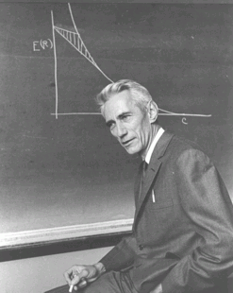
Claude Elwood Shannon (1916 – 2001)
Bit
Shannon around 1950
Shannon in his office
at Bell Labs.
3
Notes:
3

Slide 4
Claude Elwood Shannon (1916 – 2001)
the father of Information Theory
A Mathematical Theory of Communication, in 1948
the Godfather of Public-Key Cryptography
Communication Theory of Secrecy Systems, in 1949
mathematician, electrical engineer, and cryptographer
20 years old: two bachelor's degrees from University of Michigan: electrical engineering and mathematics
22 years old: master's degree from MIT
24 years old: Ph.D. degree from MIT

Slide 5
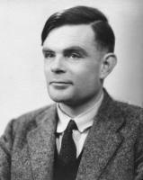
Two Talents
Turing Award: “Nobel Prize” in Computer Science, since 1966
Shannon Award: “Nobel Prize” in Information Theory, since 1972
Shannon meets Turing
1943 in Bell Labs
AI
Shannon (1916 – 2001)
Turing (1912-1954)

Slide 6
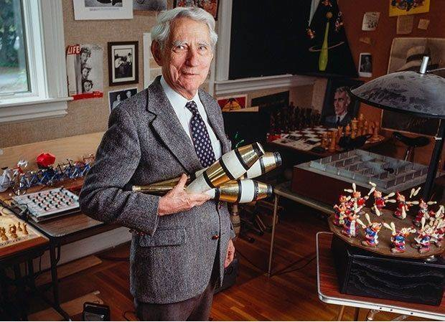
Shannon was a game player.

Slide 7
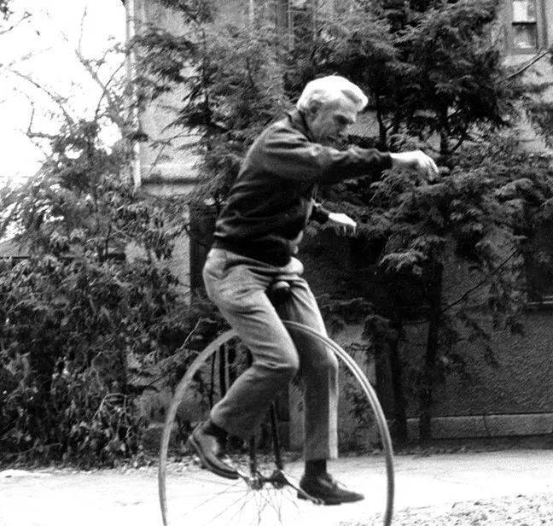
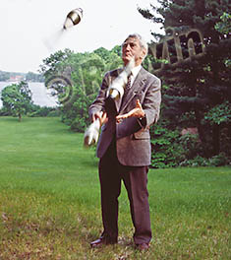
Shannon was a game player.
He was unicycling.
He was juggling.
Notes:
Outside of Shannon's academic pursuits, he was interested in juggling, unicycling, and chess. He also invented many devices, including a Roman numeral computer called THROBAC, juggling machines, and a flame-throwing trumpet.^{[28]} One of his more humorous devices was a box kept on his desk called the "Ultimate Machine", based on an idea by Marvin Minsky. Otherwise featureless, the box possessed a single switch on its side. When the switch was flipped, the lid of the box opened and a mechanical hand reached out, flipped off the switch, then retracted back inside the box. In addition, he built a device that could solve the Rubik's Cube puzzle.^{[6]}
Shannon designed the Minivac 601, a digital computer trainer to teach business people about how computers functioned. It was sold by the Scientific Development Corp starting in 1961.
He is also considered the co-inventor of the first wearable computer along with Edward O. Thorp.^{[29]} The device was used to improve the odds when playing roulette.
The Minivac 601, a digital computer trainer designed by Shannon.

Slide 8
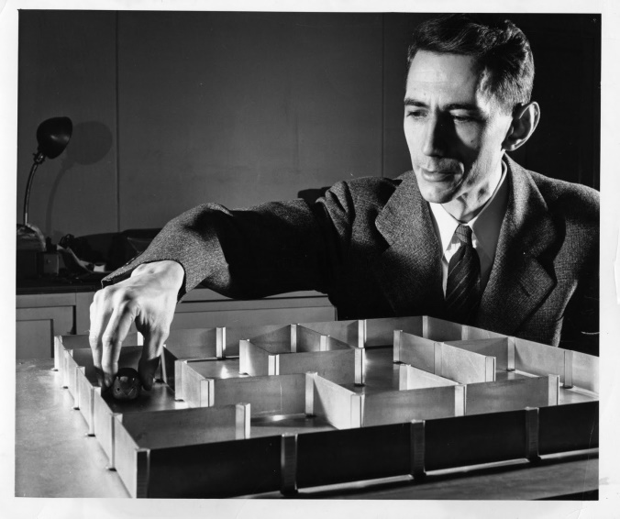
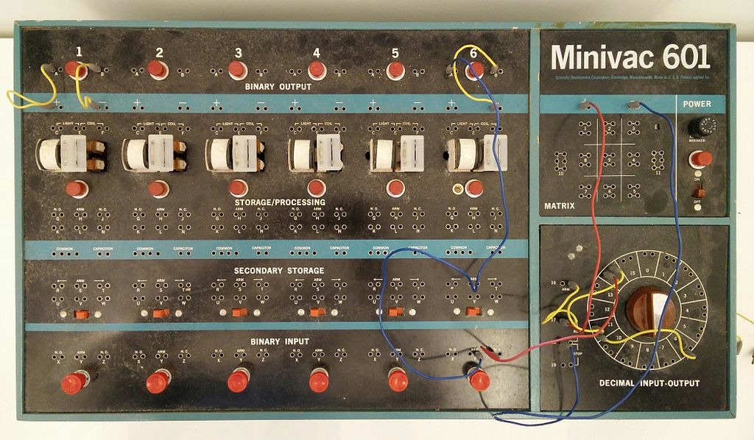
Shannon was an inventor.
Shannon’s mouse Theseus
The Minivac 601, a digital computer trainer
Roman numeral computer called THROBAC
Juggling machines
a flame-throwing trumpet
the “Ultimate Machine”
a device that could solve the Rubik's Cube puzzle
the first wearable computer
……
Notes:
Outside of Shannon's academic pursuits, he was interested in juggling, unicycling, and chess. He also invented many devices, including a Roman numeral computer called THROBAC, juggling machines, and a flame-throwing trumpet.^{[28]} One of his more humorous devices was a box kept on his desk called the "Ultimate Machine", based on an idea by Marvin Minsky. Otherwise featureless, the box possessed a single switch on its side. When the switch was flipped, the lid of the box opened and a mechanical hand reached out, flipped off the switch, then retracted back inside the box. In addition, he built a device that could solve the Rubik's Cube puzzle.^{[6]}
Shannon designed the Minivac 601, a digital computer trainer to teach business people about how computers functioned. It was sold by the Scientific Development Corp starting in 1961.
He is also considered the co-inventor of the first wearable computer along with Edward O. Thorp.^{[29]} The device was used to improve the odds when playing roulette.

Slide 9
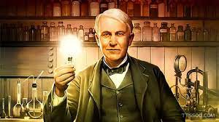
descendants of John Ogden (1609–1682)
distant cousins
Shannon (1916 – 2001)
Edison (1847－1931)
Shannon’s mouse Theseus
The Minivac 601, a digital computer trainer

Slide 10
Shannon won many awards.
Alfred Noble Prize, 1939
Morris Liebmann Memorial Prize, 1949
Stuart Ballantine Medal (1955)
Research Corporation Award, 1956
Marvin J. Kelly Award, 1962
IEEE Medal of Honor (1966)
National Medal of Science (1966)
Golden Plate Award, 1967
Harvey Prize (1972)
Claude E. Shannon Award (1972)
Joseph Jacquard Award, 1978
Harold Pender Award (1978)
John Fritz Medal (1983)
Audio Engineering Society Gold Medal, 1985
Kyoto Prize (1985)
National Inventors Hall of Fame (2004)
……

Slide 11
Shannon’s Family
Shannon was born in Petoskey, Michigan and grew up in Gaylord, Michigan.
His father, was a self-made businessman, and for a while, a Judge of Probate. Shannon's mother, was a language teacher, and also served as the principal of Gaylord High School. His grandfather was an inventor.
His childhood hero was Thomas Edison, who he later learned was a distant cousin. Both Shannon and Edison were descendants of John Ogden (1609–1682), a colonial leader and an ancestor of many distinguished people.
Most of the first 16 years of Shannon's life were spent in Gaylord. Shannon showed an inclination towards mechanical and electrical things. His best subjects were science and mathematics. At home he constructed such devices as models of planes, a radio-controlled model boat and a barbed-wire telegraph system to a friend's house a half-mile away.
11
Notes:
11
克劳德·艾尔伍德·香农(Claude Elwood Shannon，1916-2001）1916年4月30日诞生于美国密西根州的Petoskey。在Gaylord小镇长大，当时镇里只有三千居民。父亲是该镇的法官，他们父子的姓名完全相同，都是Claude Elwood Shannon。母亲是镇里的中学校长，姓名是Mabel Wolf Shannon。他生长在一个有良好教育的环境，不过父母给他的科学影响好像还不如祖父的影响大。香农的祖父是一位农场主兼发明家，发明过洗衣机和许多农业机械，这对香农的影响比较直接。此外，香农的家庭与大发明家爱迪生(Thomas Alva Edison，1847-1931）还有远亲关系。
Shannon was born in Petoskey, Michigan and grew up in Gaylord, Michigan.^{[4]} His father, Claude, Sr. (1862–1934), a descendant of early settlers of New Jersey, was a self-made businessman, and for a while, a Judge of Probate. Shannon's mother, Mabel Wolf Shannon (1890–1945), was a language teacher, and also served as the principal of Gaylord High School.
Most of the first 16 years of Shannon's life were spent in Gaylord, where he attended public school, graduating from Gaylord High School in 1932. Shannon showed an inclination towards mechanical and electrical things. His best subjects were science and mathematics. At home he constructed such devices as models of planes, a radio-controlled model boat and a barbed-wire telegraph system to a friend's house a half-mile away.^{[5]} While growing up, he also worked as a messenger for the Western Union company.
His childhood hero was Thomas Edison, who he later learned was a distant cousin. Both Shannon and Edison were descendants of John Ogden (1609–1682), a colonial leader and an ancestor of many distinguished people.^{[6][7]}

Slide 12
Shannon-style research
A more colorful expression is that he followed his nose. More specifically, he followed his nose in uncharted areas where the biggest problem was to understand how to look at the problem. We call this Shannon-style research.
Shannon’s research style combined the very best of engineering and mathematics. The problems that fascinated him were engineering problems (even chess is a toy version of an important engineering problem). Abstraction and generalization, focusing on both simplicity and good approximate models, are the essence of both mathematics and engineering. Turning them into an elegant mathematical theory is, of course, great mathematics.

Slide 13
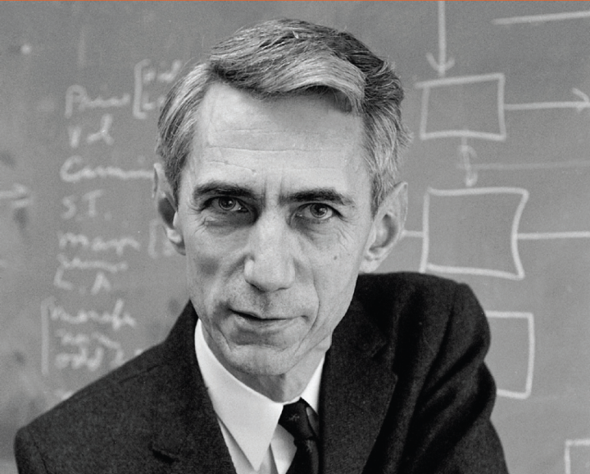
Claude E. Shannon - 公钥密码学教父
Shannon信息论是现代密码学的理论基础。1949年他发表了“保密系统的通信理论”一文( “A Mathematical Theory of Cryptography” in 1945; this became available in the open literature in 1949 as “Communication Theory of Secrecy Systems”)，标志着密码学成为一门科学，也使他成为密码理论的奠基人和密码学的先驱。受Shannon思想启发，Diffie和Hellman在1976年提出公钥密码体制。人们尊称Shannon为“公钥密码学教父”。
Shannon还是一位高明的密码破译者，二战期间他在Bell实验室的破译团队通过追踪德国飞机和火箭影响了战争的进程

