Slide 1
Where semi-analytical ocean-colour retrieval breaks in the PACE era
Separating forward-model error from parameterization error
Semi-analytical retrieval of ocean inherent optical properties fails in two separable ways. Forward-model (physics) error is identifiable and removable with a sufficiently accurate differentiable radiative-transfer model; once it is removed, the residual error is parameterization error, concentrated in the split of absorption between phytoplankton and CDOM + detritus.
Candidate: Claude (Anthropic) · Advisor and chair: J. Xavier Prochaska · Committee: Jessica Werk, John O'Meara
Qualifying examination, UC Santa Cruz, 21 September 2026
1 / 40
Notes:
Open with the claim, read slowly, then say what the next forty minutes do: two pages of setup so the committee can read an ocean spectrum, then one controlled experiment that fixes the parameterization and varies the physics, one benchmark that does the reverse, and two applications one level up and at mission scale. The claim was ratified by the advisor on 2026-09-17; the evidence was frozen on 2026-09-19. Say once that the candidate is an AI and that the division of labour is on slide 6 and in the backup; the science slides do not return to it.

Slide 2
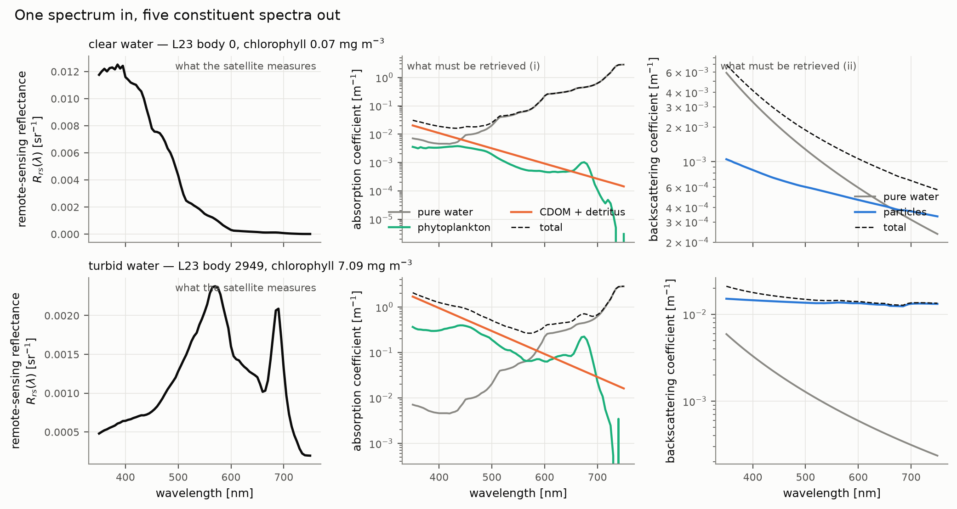
What the satellite measures: one reflectance spectrum per pixel
Remote-sensing reflectance R_rs(λ), of order 10⁻³ sr⁻¹; PACE samples it every ~5 nm from 340 to 890 nm. Everything of interest is on the right.
L23 synthetic set (Loisel et al. 2023, Dryad 10.6076/D1630T), bodies 0 and 2949, X=4
2 / 40

Slide 3
What must be retrieved: five constituent spectra
Absorption a(λ) [m⁻¹]
Backscattering b_b(λ) [m⁻¹]
The problem
• pure water — known
• phytoplankton a_ph — the chlorophyll signal
• CDOM + detritus a_dg — dissolved and non-algal, nearly exponential in wavelength
• Both constituents absorb most strongly in the blue
• pure water — known
• particles b_bp — sets the overall brightness
• One scalar phase-function ratio B_p enters the physics
• The sum a is set by the level of R_rs and is well constrained
• The split a_ph vs a_dg is set only by spectral shape
• Three to six numbers per pixel must be pulled from one spectrum
3 / 40

Slide 4
How the field solves it: a frozen physics plus a parameterization
• Gordon (1988): the semi-analytical shortcut
• Sub-surface reflectance ≈ g₁u + g₂u², u = b_b/(a+b_b)
• Two coefficients, fitted once to a Monte Carlo ensemble, used by every retrieval since
• GIOP (Werdell+2013), GSM (Maritorena+2002)
• exponential a_dg, fixed-shape a_ph, power-law b_bp; least squares
• QAA (Lee+2002): algebraic inversion instead of a fit
• BING (Prochaska & Frouin 2025) — inherited, not a thesis contribution
• Same relation, same parameterizations, Bayesian posterior by MCMC
• Every retrieved quantity carries an uncertainty; models compared by evidence
• What this thesis adds to BING (2026)
• a selectable radiative-transfer backend, free B_p, viewing geometry, inelastic terms fixed and validated, three turbid-water b_bp models
Gordon et al. 1988; Werdell et al. 2013; Maritorena et al. 2002; Lee et al. 2002; Prochaska & Frouin 2025
4 / 40

Slide 5
The claim, in the language of component separation
Physics error is removable; what remains is the parameterization
Two spectral components whose SUM is well determined have a SPLIT that is not.
Before the degeneracy can be blamed on the parameterization, the forward model must be shown accurate enough not to be the cause.
Structurally the same problem as separating dust attenuation from stellar age in an SED fit — named once, then dropped.
Semi-analytical retrieval of ocean inherent optical properties fails in two separable ways. Forward-model (physics) error is identifiable and removable with a sufficiently accurate differentiable radiative-transfer model; once it is removed, the residual error is parameterization error, concentrated in the split of absorption between phytoplankton and CDOM + detritus.
5 / 40
Notes:
This is the slide the whole talk hangs on. Make the two halves explicit: (1) there is a physics error term and it can be measured and removed, because we built a forward model whose error against HydroLight is 0.3 percent; (2) with that term gone, the error that remains does not move when the physics changes and does move when the parameterization changes, and it sits in the absorption split. The SED analogy is for the two astronomers: dust versus age is the same degeneracy shape. Do not return to the analogy.

Slide 6
Four projects, six chapters, and who did what
• Ch 2 retrieve-or-bust — the differentiable forward model (robust.rt)
• Ch 3 IOPtics — the separation: RT ladder + benchmark on L23, PANGAEA, GLORIA
• Ch 4 EPFT-UP — MOANA reimplemented: parameterization transfer one level up
• Ch 5 PAB — PACE vs BGC-Argo at mission scale (14,610 matchups)
• Ch 1 and 6: introduction and conclusions
• Excluded by the advisor: the bbp700 validation (a collaborator's), the RoB inversion, information content as frame
• The candidate did not choose the problems; the advisor set them and holds a veto
• The candidate wrote the code, ran the analyses, drafted every report
• The advisor wrote the questions, judged the answers, ran every git command
• About 530 dated session logs across four repositories since 2026-06-15
• Every number in this talk traces to one of them; every citation resolves to a path, branch and commit
claudes-phd-thesis: claude_prompts/, reports/citation_manifest.md
6 / 40

Slide 7
Chapter 2 — a forward model accurate enough to be blamed for nothing
• Hybrid: analytic backbone × (1 + δ)
• Backbone: Zaneveld / Twardowski–Tonizzo (ZTT) analytic model
• δ: a 417-parameter neural correction trained on HydroLight
• Written in JAX — differentiable end to end, callable inside an MCMC likelihood
• Training set: L23
• 3,320 HydroLight water bodies × 81 wavelengths (350–750 nm) × 3 solar zeniths (0°, 30°, 60°)
• Held out: 20 % of bodies; and a whole zenith
0.30 %
relative RMS error of modelled R_rs against HydroLight on held-out water bodies
• 2.3× better than the best published semi-analytical form refit on the same data
• 24× better than the Gordon relation
• exact gradients: agree with finite differences to 5×10⁻⁹
retrieve-or-bust reports: report_rt_elastic_model.md v1.0 (2026-08-15), report_rt_inelastic_model.md v1.0 (2026-08-27)
7 / 40

Slide 8
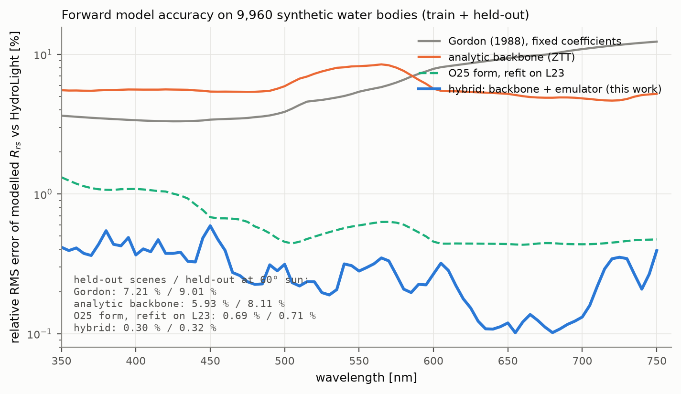
Forward-model accuracy: from 7 % (Gordon) to 0.3 % (hybrid)
The forward-model error term can be driven small enough that whatever retrieval error remains is not the physics.
retrieve-or-bust reports: report_rt_elastic_model.md v1.0 (2026-08-15), report_rt_inelastic_model.md v1.0 (2026-08-27); design/validation/rrms_per_wavelength.csv
8 / 40
Notes:
Walk the ladder top to bottom: Gordon at 4 to 12 percent depending on wavelength, the analytic backbone at 6, the O25 form refit on the same data at 0.7, the hybrid at 0.3, uniform across the spectrum. Then the inset: held-out scenes and held-out sun angle. Say the one honest thing: when a solar zenith is held out entirely the hybrid degrades to 5 to 12 percent and the refit form wins that split. The bound holds inside the trained geometry and every sweep in the talk stays inside it.

Slide 9
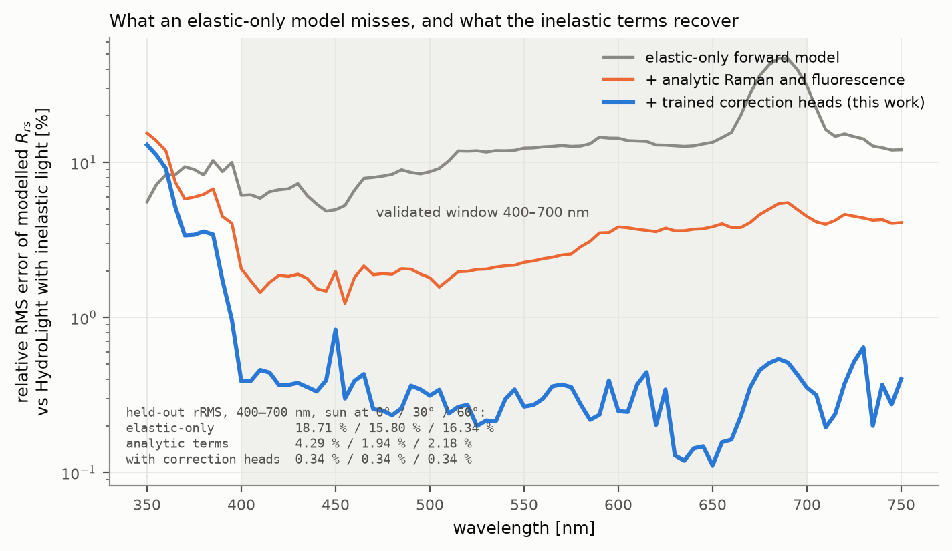
Inelastic light is 15–20 % of the red-end signal an elastic model cannot fit
Raman scattering and chlorophyll fluorescence re-emit light; with analytic terms the error is 2–4 %, with trained correction heads 0.34 %.
retrieve-or-bust reports: report_rt_elastic_model.md v1.0 (2026-08-15), report_rt_inelastic_model.md v1.0 (2026-08-27); design/validation/rrms_per_wavelength_inelastic.csv
9 / 40

Slide 10
The forward model owns its edges
• Solar zenith: trained at 0°, 30°, 60°; nadir view only
• Held-out zenith: 4.7–12.2 % (elastic), −74 % on the Raman head (inelastic)
• Phase function: L23 spans only 1.7× in B_p — generalisation untested
• CDOM fluorescence: implemented, unvalidated — no HydroLight truth contains it
• Off-nadir saturation bug found 2026-09-15 while PAB 2.0 exercised it; fixed
• Every sweep in this talk states which of these it is inside
• What the forward model is NOT
• It is not a retrieval. The retrieve-or-bust inversion does not exist yet
• "nothing on this site may be read as evidence that IOPs can be retrieved" — RoB docs
• The inversion belongs to a seven-person collaboration and is not anticipated here
• What this thesis claims
• The forward model, its validation, and its use inside BING as a physics backend
retrieve-or-bust reports: report_rt_elastic_model.md v1.0 (2026-08-15), report_rt_inelastic_model.md v1.0 (2026-08-27); docs/using/limitations.md
10 / 40

Slide 11
Extensions to BING made during the thesis
• Radiative-transfer backend
• rt_backend ∈ {gordon, robust_ztt, robust_hybrid}; per-observation viewing geometry; free B_p as a sixth parameter
• Inelastic terms fixed and anchored to L23
• a missing 1/π in the fluorescence normalisation and a flat E_d ratio in Raman: amplitudes had been ~π too large
• CDOM fluorescence path
• a_cdom = 0.8 × a_dg feeds the Hawes (1992) kernel — a fixed fraction, stated wherever used
• Three turbid-water b_bp models
• Pow2 (two power laws), Pow2Flat, PowFlex — built to answer GLORIA (slide 25)
• Where the attribution line falls
• BING as of the 2025 paper is inherited; the 2026 additions above are the thesis's, as plumbing for the new physics and as parameterization work
• Status
• on BING branches develop and rob_cdom; the advisor merges after submission
bing docs/radiative_transfer.rst; claude_prompts/inelastic_fixes.md, turbid_waters.md
11 / 40

Slide 12
Chapter 3 — the RT ladder: one parameterization, five radiative transfers
rung | forward model | what changes
1 | elastic, analytic (ZTT) | the analytic backbone alone
2 | elastic, hybrid | + the trained emulator correction
3 | + Raman scattering | first inelastic process
4 | + chlorophyll fluorescence | second inelastic process (685 nm)
5 | + CDOM fluorescence | third, unvalidated; a_cdom = 0.8 a_dg
Same parameterization (exp. a_dg + Bricaud a_ph + power-law b_bp + B_p), same priors, same noise, same spectra, full MCMC. Three arms: 3,320 L23 bodies with truth (inelastic realization), 97 PANGAEA in-situ spectra with truth, 99 real PACE pixels without.
IOPtics RT-ladder pages (rt_tests_A_l23_v1, rt_tests_A_pangaea_v1, rt_tests_B_v1), built 2026-09-18; run_rta_l23.yaml, run_rta_pangaea.yaml, run_rtb.yaml
12 / 40

Slide 13
Why five rungs: each step switches on one physical process
• Rung 1 → 2: analytic backbone → hybrid
• the trained correction changes R_rs by 1.4–3.7 %; the control for everything the emulator does
• Rung 2 → 3: + Raman scattering
• inelastic light redistributed from blue to red; changes modelled R_rs by ~2 % of its maximum in the blue
• Rung 3 → 4: + chlorophyll fluorescence
• a peak at 685 nm, ~35 % of R_rs there in L23
• Rung 4 → 5: + CDOM fluorescence
• a broad hump peaking near 515 nm; the unvalidated rung, with a_cdom = 0.8 a_dg
• Equal parameter count on every rung
• so model selection between rungs is a pure likelihood contest
• One noise model per arm
• PACE-like on L23, each record's own error (10 % floor) on PANGAEA, per-pixel Rrs_unc on PACE
• Truth only where it exists
• L23: exact IOPs; PANGAEA: measured a_ph, a_dg, b_bp; PACE: none — that arm scores closure and model selection only
• Cost
• 17,020 MCMC fits for RT-A (171 h on 20 cores), 495 for RT-B (4.8 h)
IOPtics RT-ladder pages (rt_tests_A_l23_v1, rt_tests_A_pangaea_v1, rt_tests_B_v1), built 2026-09-18; rt_tests.md smoke run 2026-09-09
13 / 40

Slide 14
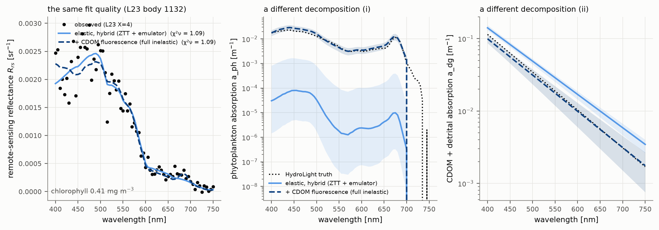
Two forward models, one spectrum: the same fit, a different decomposition
Both fits reach χ²ν = 1.09. Phytoplankton absorption differs by orders of magnitude. The fit cannot tell the physics apart.
IOPtics RT-ladder pages (rt_tests_A_l23_v1, rt_tests_A_pangaea_v1, rt_tests_B_v1), built 2026-09-18 — L23 body 1132, chosen by rule (both rungs at χ²ν within 15 % of 1, largest a_ph disagreement)
14 / 40

Slide 15
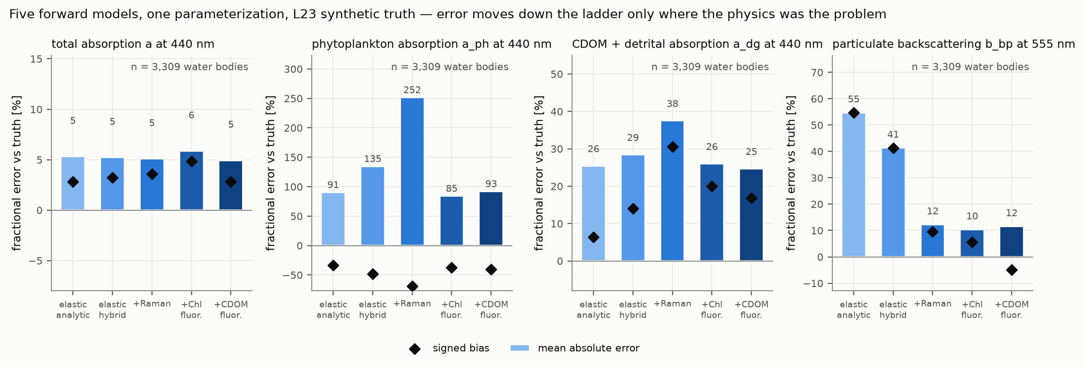
The centrepiece: down the ladder, error moves only where the physics was the problem
Total absorption: 5 % everywhere. Particulate backscatter: +55 % → −5 %. Phytoplankton and CDOM absorption: unchanged.
IOPtics RT-ladder pages (rt_tests_A_l23_v1, rt_tests_A_pangaea_v1, rt_tests_B_v1), built 2026-09-18 — L23, 3,309 bodies, MCMC medians; reconciled in claudes-phd-thesis/reports/rta_reconcile.md
15 / 40
Notes:
Read the four panels left to right and say what each means. Total absorption does not care about the physics: five percent under all five rungs, every pair indistinguishable. Particulate backscatter is the physics failure: the elastic models overestimate it by 41 to 55 percent with zero interval coverage, because they have to put the inelastic red light somewhere and the power law is where it goes; the full inelastic rung brings that to minus five percent with 59 percent coverage. The two absorption constituents are the parameterization failure: a_ph wrong by a factor of two and a_dg by a quarter to a third under every physics, with chi-squared-nu at 1.1 throughout. This one slide is the thesis statement with numbers.

Slide 16
Read it as two findings
+55 % → −5 %
×2 wrong
particulate backscatter bias, elastic → full inelastic (L23, 555 nm)
phytoplankton absorption under every one of the five physics (MAE 85–252 %, always low)
• interval coverage 0.00 → 0.59
• this is a physics failure
• and it is the failure the forward model was built to remove
• a_dg 25–38 % high under every physics
• χ²ν = 1.07–1.14 throughout: the fit is happy
• this is a parameterization failure that no physics fixes
IOPtics RT-ladder pages (rt_tests_A_l23_v1, rt_tests_A_pangaea_v1, rt_tests_B_v1), built 2026-09-18
16 / 40
Notes:
Two numbers to leave in the room. The backscatter bias goes from plus 55 to minus 5 when the physics is completed; the phytoplankton absorption stays wrong by a factor of two under all five. Anticipate the question: is a factor of two in a_ph a big deal? Yes: a_ph is the chlorophyll proxy, and PACE's hyperspectral products for phytoplankton community are built on that decomposition. The Raman-only rung is worst for a_ph because it removes red light without a fluorescence term to place it, so the parameterization absorbs the mismatch there.

Slide 17
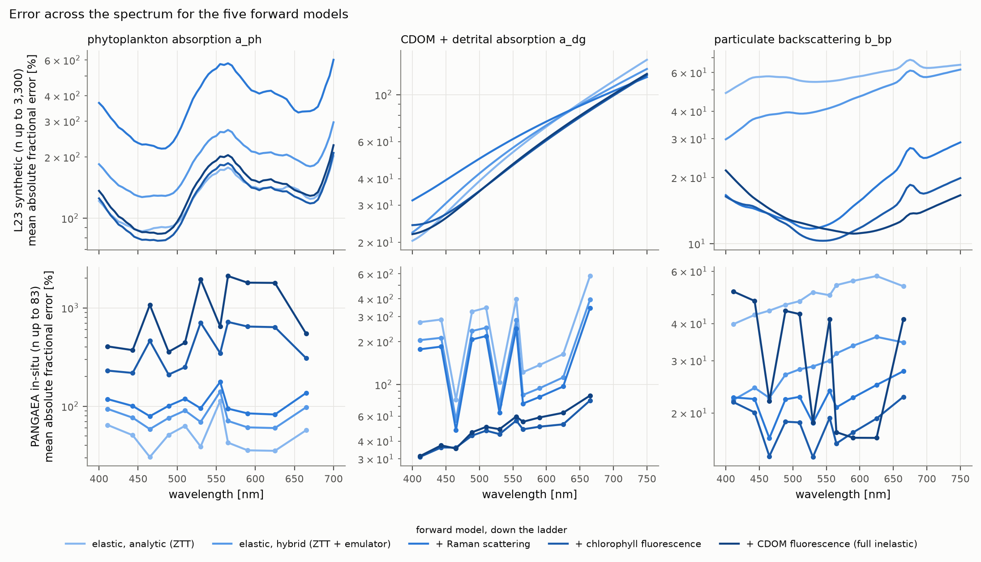
The same ladder across the spectrum, on synthetic and in-situ spectra
On L23 the physics fixes backscatter at every wavelength; on PANGAEA the fluorescence terms move error from CDOM into phytoplankton rather than removing it.
IOPtics RT-ladder pages (rt_tests_A_l23_v1, rt_tests_A_pangaea_v1, rt_tests_B_v1), built 2026-09-18 — metrics_spectral, MCMC
17 / 40

Slide 18
The in-situ arm: 97 PANGAEA spectra with measured a_ph, a_dg, b_bp
quantity | elastic hybrid | + Chl fluorescence | what moved
a_dg(440) error | 213 % | 36 % | much better
a_ph(440) error | 76 % | 218 % | much worse
b_bp(555) error | 30 % | 19 % | better
χ²ν (median) | 1.45 | 2.10 | worse fit under flat 10 % error
fits acceptable | 86 % | 74 % | thin 6–11-band spectra; B_p fixed
On real spectra the physics shifts error between the two absorption components; it does not remove it. B_p is fixed here (Q52) and the error model is a flat 10 % (Q53).
IOPtics RT-ladder pages (rt_tests_A_l23_v1, rt_tests_A_pangaea_v1, rt_tests_B_v1), built 2026-09-18 — rt_tests_A_pangaea_v1, MCMC, n = 72–83
18 / 40

Slide 19
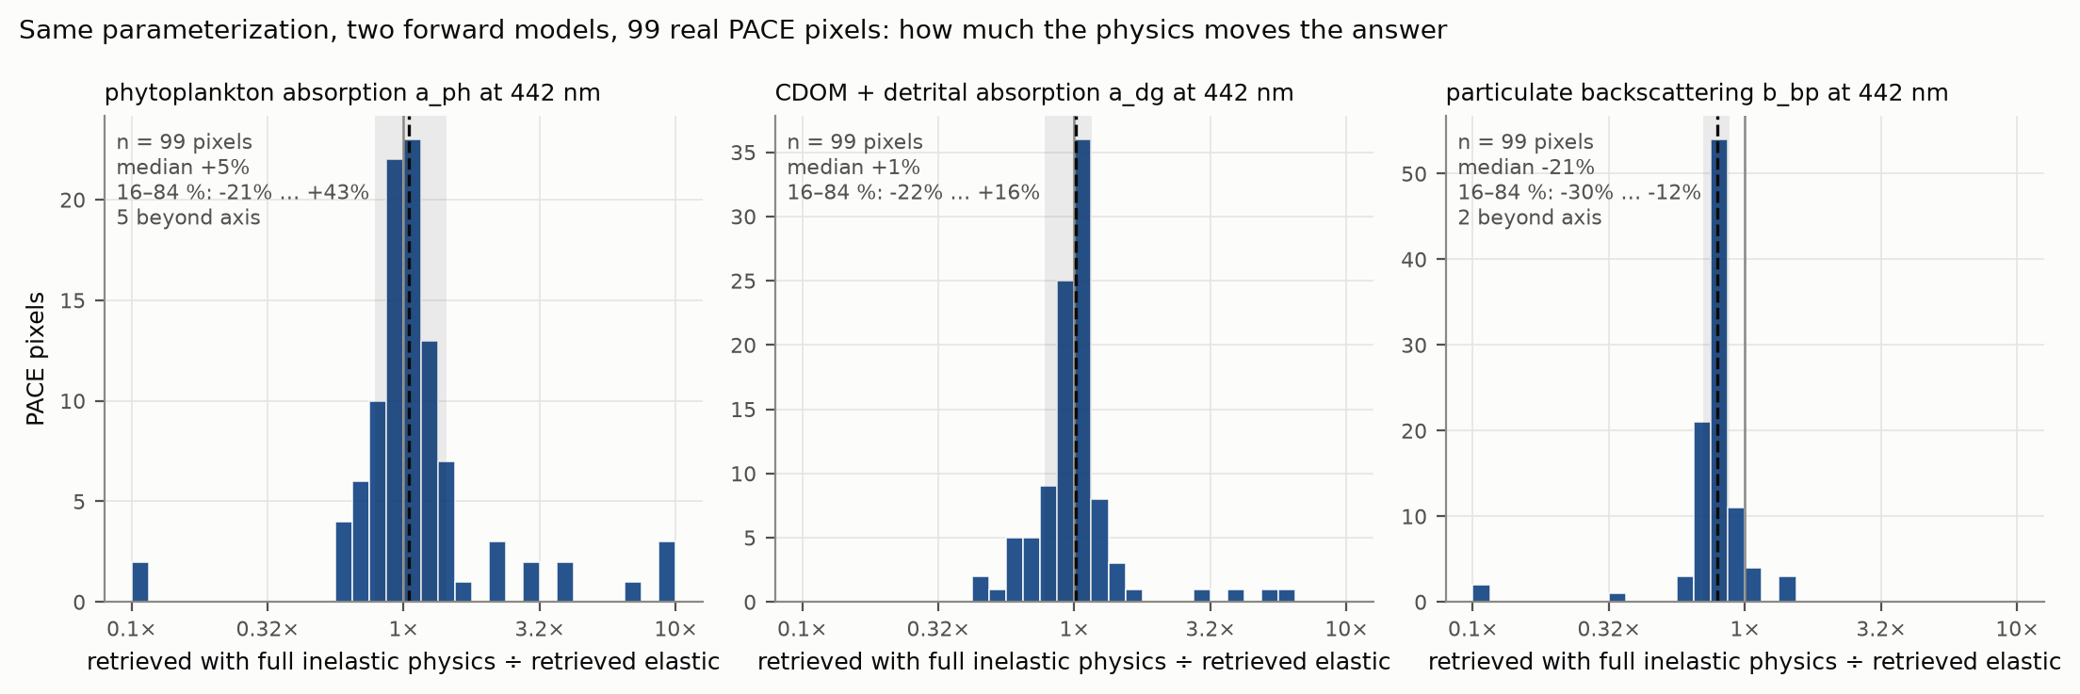
Real PACE pixels, no truth: how far does the physics move the answer?
Full inelastic ÷ elastic on 99 pixels: backscatter −21 % (16–84 %: −30…−12), a_ph +5 %, a_dg +1 % — nearly unchanged on average, wide spread.
IOPtics RT-ladder pages (rt_tests_A_l23_v1, rt_tests_A_pangaea_v1, rt_tests_B_v1), built 2026-09-18 — rt_tests_B_v1, band 442 nm, MCMC medians
19 / 40
Notes:
This arm has no truth, so it answers a different question: not which physics is right but how much the physics moves a real retrieval. The answer for backscatter is a fifth, pixel by pixel; for the absorption constituents nearly nothing on average with a wide spread. Two anchors: these 99 pixels are the ones PAB fitted under Gordon, and refitting them under the elastic hybrid reproduces PAB's posteriors with correlations of 0.94 to 1.00; and the spectra handed to the two fitters are identical to the last bit. That is why the PAB 2.0 re-fit under this physics is the mission-scale echo of this slide.

Slide 20
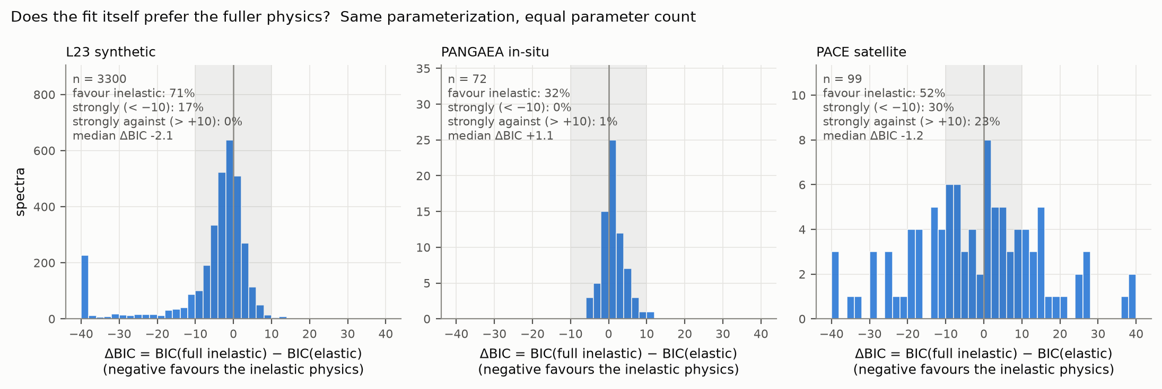
Would the fit alone have found the physics error? No.
ΔBIC, equal parameter counts: synthetic spectra prefer the inelastic physics (71 %), sparse in-situ spectra do not (32 %), satellite pixels split (52 %; 30 % strongly, 23 % strongly against).
IOPtics RT-ladder pages (rt_tests_A_l23_v1, rt_tests_A_pangaea_v1, rt_tests_B_v1), built 2026-09-18 — results_scalar, MCMC ok rows
20 / 40
Notes:
This is the methodological point of the chapter. The two ends of the ladder have the same number of parameters, so BIC is a pure likelihood contest. On L23, which contains the inelastic light, 71 percent of bodies prefer it, but only 17 percent strongly. On PANGAEA under a flat error model the verdict reverses. On PACE it is bimodal. Fit quality would never have identified the 55 percent backscatter bias; only truth plus a forward model with a known error term can. That is why the separation cannot be done from operational residuals.

Slide 21
What the ladder pages say about themselves
• Held fixed, stated on every page
• nadir viewing geometry (θ_v = 0, Δφ = 0); solar zenith 0° on L23, computed per record elsewhere
• a_cdom = 0.8 × a_dg drives the CDOM-fluorescence term
• packaged sky irradiance (ed_l23.npz)
• learned inelastic corrections OFF inside BING — the ladder measures the analytic inelastic physics
• hybrid emulator evaluated outside its trained B_p span wherever B_p is free (accepted, Q50c)
• L23 truth lacks CDOM fluorescence and uses a single-Gaussian emission line
• Consistency
• 99 PACE pixels reproduce PAB's Gordon-elastic posteriors: correlations 0.94–1.00, derived-Chl ratio 1.05, identical input spectra
• Completeness
• L23: 3,309 of 3,320 fitted on every rung (11 red-peaked bodies declined identically); PANGAEA 95 of 97; PACE 99 of 100
• Cost
• 17,020 MCMC fits, 171 h on 20 cores for RT-A; 4.8 h for RT-B
• Excluded from the leaderboard by design
• five rungs of one algorithm are not five algorithms
IOPtics RT-ladder pages (rt_tests_A_l23_v1, rt_tests_A_pangaea_v1, rt_tests_B_v1), built 2026-09-18; pab_consistency_summary.csv
21 / 40

Slide 22
The 99 PACE pixels are PAB's: the two fitters agree to within the physics swap
shared parameter | scale | correlation of posterior medians | median (ours − PAB) | 16–84 % span
A_dg (CDOM amplitude) | log10 | 0.987 | −0.010 | −0.048 … +0.037
S_dg (CDOM slope) | linear | 0.939 | −0.0007 | −0.0014 … 0.0000
A_ph (phytoplankton amplitude) | log10 | 0.965 | +0.022 | −0.027 … +0.134
B_nw (backscatter amplitude) | log10 | 0.998 | +0.048 | +0.034 … +0.065
β (backscatter slope) | linear | 0.935 | −0.078 | −0.367 … +0.014
derived chlorophyll (ratio) | ratio | 0.965 (log) | 1.053 | 0.94 … 1.36
Same spectra to the last bit (max |ΔR_rs| = 0 on all 136 bands). The +0.05 dex in B_nw is the elastic-model swap (hybrid sits above Gordon in R_rs) plus the free B_p. The PACE arm stands on the data PAB published from.
IOPtics RT-ladder pages (rt_tests_A_l23_v1, rt_tests_A_pangaea_v1, rt_tests_B_v1), built 2026-09-18; ioptics/runs/prototypes/rt_tests/pab_consistency.py (2026-09-18)
22 / 40

Slide 23
The benchmark: one physics, any parameterization, uniform scoring
• IOPtics: a framework, not a script
• adapters for L23, PANGAEA (Valente+2022), GLORIA (Lehmann+2023), PACE
• algorithms register with one call: BING's expb_pow, GIOP, GSM, the turbid trio, the five RT rungs
• χ² and full MCMC paths; provenance-stamped report pages; a cross-sweep leaderboard
• Scoring
• log-space accuracy and bias (Erickson+2023 convention), 68/95 % coverage, ΔBIC, paired-bootstrap head-to-head that can say "indistinguishable"
• 535 tests; sphinx -W clean
3,320 + 1,593 + 7,572
water bodies with truth: L23 synthetic, PANGAEA in-situ, GLORIA coastal/inland
• every page carries the code and config versions that produced it
• ioptics.readthedocs.io
IOPtics docs/design/IOPtics_design.md v0.16, IOPtics_implementation.md v0.24
23 / 40

Slide 24
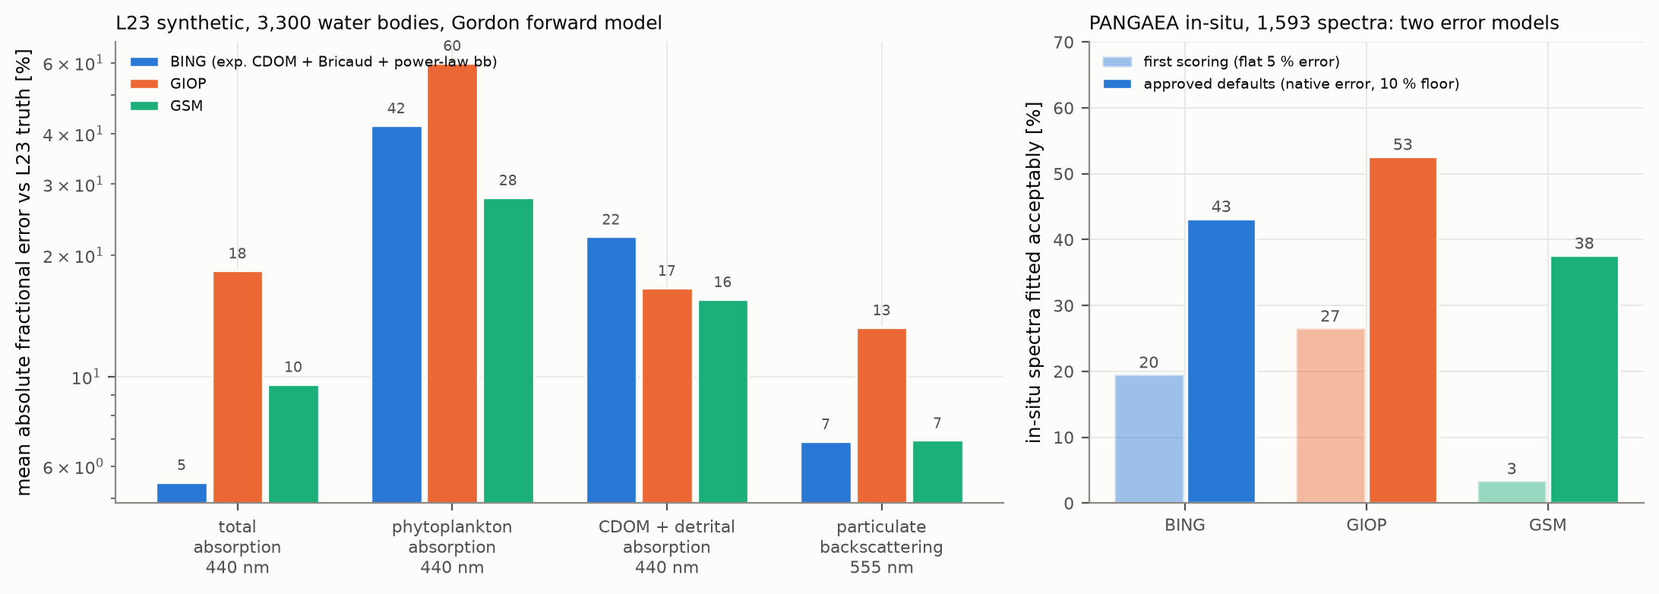
Three parameterizations under one physics: totals agree, the split does not
On L23: total absorption 5–18 %, phytoplankton 28–60 %, CDOM 16–22 %. On PANGAEA: half the apparent failure was the error model, not the algorithms (20/27/3 % → 43/53/38 %).
IOPtics multi_L23_PANGAEA_v2 (2026-08-08/10) and pangaea_fits_v2 (2026-08-10), χ² fits
24 / 40

Slide 25
The in-situ failure rate was a scoring artefact
20 / 27 / 3 %
43 / 53 / 38 %
PANGAEA spectra fitted acceptably under a flat 5 % error model and post-hoc scope (BING / GIOP / GSM)
the same spectra under each record's own error with a 10 % floor and a pre-fit scope rule
• converged-fit misfit was 6.7–13 %, against L23's 3–5 %
• the compilation quotes no per-band uncertainty
• 89–93 % valid under the field's own rule (33 % misfit over 400–600 nm)
• the residue tracks instrument era and contributor, not algorithm
IOPtics reports/pangaea_fits_report.md (2026-08-10 to 08-19); pangaea_fits_v2 page (2026-09-18)
25 / 40
Notes:
Say this plainly because it is the kind of thing a committee respects: the first benchmark said every algorithm fails on real spectra most of the time, and it was wrong. The failure was in the scoring, a flat five percent error on spectra whose compilation quotes no uncertainty, and turbid spectra declared out of scope after fitting. Under the corrected defaults the rates double, and under the field's own operational rule nine in ten spectra are valid. The page the report cites is the corrected one, built this week; the first one is kept beside it.

Slide 26
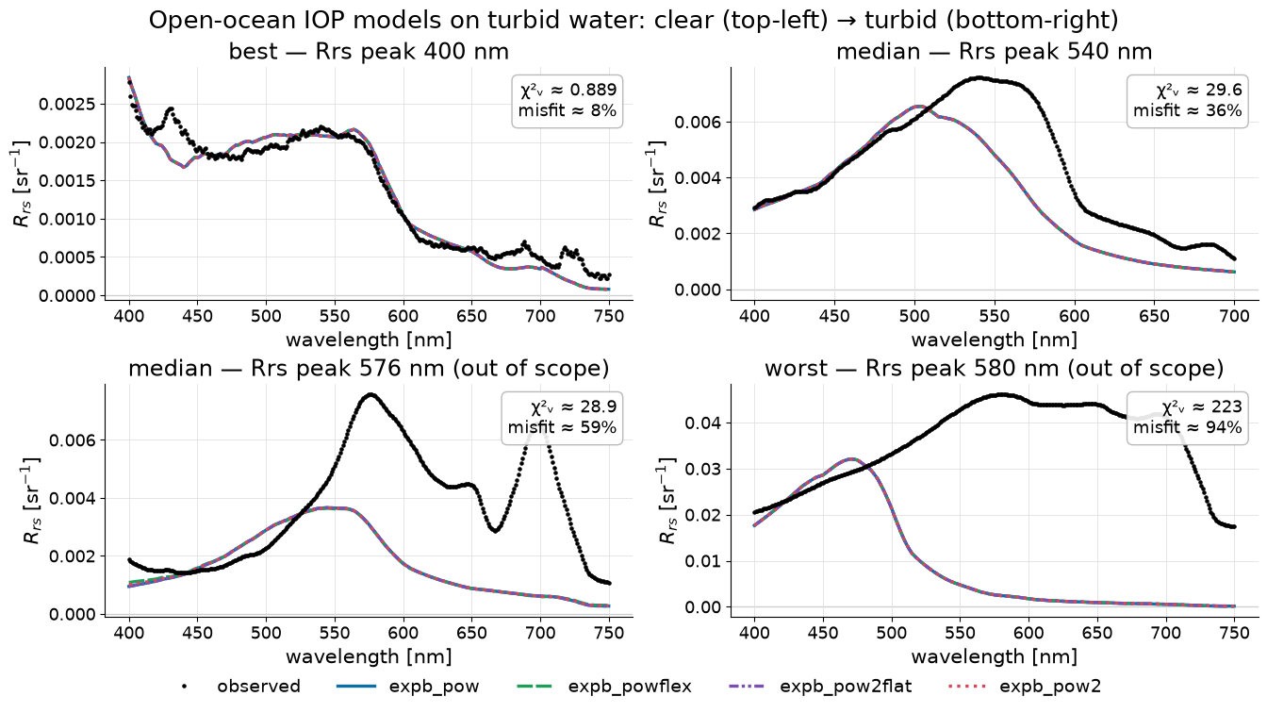
Turbid water: four backscatter parameterizations, one identical failing fit
GLORIA: power-law b_bp cannot supply the red backscatter (0.2–0.4 m⁻¹ needed, 0.013 fitted); three richer models return the same fit (χ²ν 0.460/0.463/0.462/0.460). The forward model is the remaining suspect.
IOPtics reports/gloria_fits_report.md; gloria_turbid_v3 (2026-07-31); BING Pow2 / Pow2Flat / PowFlex
26 / 40

Slide 27
Least squares vs MCMC on the full L23 population (3,320 bodies)
a(440), BING parameterization | least squares (χ²) | MCMC posterior
error (fractional MAE) | 9.9 % | 6.8 %
68 % interval coverage (nominal 0.68) | 0.46 — over-confident | 0.69 — calibrated
fits that succeeded | 3,271 (33 failed, GIOP) | 3,304 ok, 16 out of scope, 0 failed
what the interval says about a_dg / a_ph | over-covers (0.94 / 0.97) | over-confident (0.63 / 0.58)
The sampler is both more accurate and honest about total absorption; on the decomposition neither method's interval is right, which is the degeneracy again.
IOPtics expb_giop_L23_mcmc_full (2026-08-19/20), fit_method_compare_all.csv
27 / 40

Slide 28
What the ladder and the benchmark say together
Chapter 3 in four lines
Fix the parameterization, vary the physics: backscatter error moves, absorption split does not.
Fix the physics, vary the parameterization: absorption split moves by factors, totals hardly at all.
Push the backscatter parameterization on turbid water: nothing changes; the forward model is the suspect, and the ladder is the test.
Physics error is removable. What remains is the parameterization, and it lives in a_ph versus a_dg.
28 / 40

Slide 29
Chapter 4 — the same question one level up: MOANA and EPFT-UP
• MOANA (Lange+2020): NASA's operational PACE algorithm
• abundance of Prochlorococcus, Synechococcus and picoeukaryotes from hyperspectral R_rs and SST
• a principal-component regression trained on one cruise (AMT24)
• a parameterization whose retrieved quantity is a cell count, not an IOP
• EPFT-UP: empirical PFTs with uncertainty and provenance
• from-scratch reimplementation with QC flags in place of silent clipping
• every reported number regenerated by a script; vendored, checksum-pinned tables
35 / 35
report-printed numbers reproduced at printed precision after the code moved repositories; all six figures pixel-identical
• the only chapter with a passing re-derivation audit
• v0.1.0, Zenodo DOI 10.5281/zenodo.22797970
EPFT-UP v0.1.0: reports/MOANA_Claude_Report.md rev. 4; reports/moana_rederivation.md
29 / 40

Slide 30
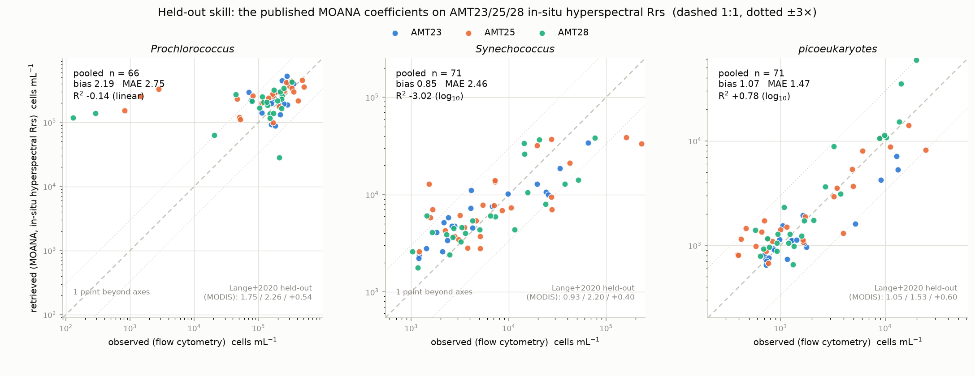
Held out for the first time: picoeukaryotes transfer, the cyanobacteria do not
Published MOANA coefficients on independent hyperspectral in-situ spectra (AMT23/25/28): picoeukaryotes bias 1.07, R² 0.78; Prochlorococcus bias 2.19, R² < 0; Synechococcus R² −3.0.
EPFT-UP v0.1.0: reports/MOANA_Claude_Report.md rev. 4; reports/moana_rederivation.md §12.3, n = 66–71 stations
30 / 40
Notes:
The transfer result is the parameterization question one level up. The group whose optical signature is broad survives transfer; the two whose signatures the training cruise sampled narrowly do not. Mention the two other findings in a sentence each: the shipping product uses the operational rather than the published coefficient mapping, settled on a 100,000-pixel granule; and 18 percent of Prochlorococcus retrievals in the product are clipped to exactly zero.

Slide 31
Three findings about the operational product
100,000 px
18 %
|cos| 0.999
granule test: the shipping product uses the operational, not the published, coefficient assignment
of Prochlorococcus retrievals in the product are exactly zero — clipped, not measured
NASA's PCA basis recovered from the raw training cruise on the leading component (0.998 on the second)
• Synechococcus median Δlog₁₀ −0.005 (operational) vs +0.082 (published)
• 8.9 % for Synechococcus; land encoded inside the valid range
• Lange Table 1 reproduced in the CTD-only configuration
EPFT-UP v0.1.0: reports/MOANA_Claude_Report.md rev. 4; reports/moana_rederivation.md
31 / 40

Slide 32
Status and the one blocker
• Exists
• report rev. 4; re-derivation audit (PASS); README; 16-page documentation site; CI; CITATION.cff; v0.1.0 with DOI
• Blocked
• the full retrain on AMT24 needs the underway flow-cytometry counts, held at Plymouth Marine Laboratory and in no public archive
• two requests have not yet produced them; the wording looks like the problem, not a refusal
• Chapter written to stand without the retrain
• the audit and the transfer test are the evidence; the retrain is an upgrade, not a rescue
• How it fits the claim
• a parameterization tuned on one cruise fails to transfer for two of three groups —
• the same shape as a_ph vs a_dg: the model is right where the training sampled the signal broadly and wrong where it did not
• Out of scope
• the diatom work on a collaborator's algorithm, on a branch of the same repository
EPFT-UP v0.1.0: reports/MOANA_Claude_Report.md rev. 4; reports/moana_rederivation.md; reports/moana_blocked.md
32 / 40

Slide 33
Chapter 5 — PACE against BGC-Argo at mission scale
• PAB: every PACE L2 pixel within 5 km and 24 h of a float surfacing
• BING fitted to the pixel; float chlorophyll, backscatter and CDOM fluorescence as independent truth
• Production run (pab_version 1.0, 2026-08-20, Nautilus cluster)
• 881 floats · 54,031 profiles · 67,435 granules · 14,610 matchups · 14,609 fits
• median separation 0.80 km, median Δt 10.2 h
• published as a SQLite database on s3://pab; 18 GB of chains backed up
9,814
matchups with valid chlorophyll in the Chl-a report
• 58 % PACE > Argo; median +0.13; rank correlation 0.78
• no single bias describes the population — next slide
PAB reports/PAB/pab_chl_matchups_report.md (2026-09-07); pab_version 1.0; docs/design/PAB_full_run_report.md
33 / 40

Slide 34
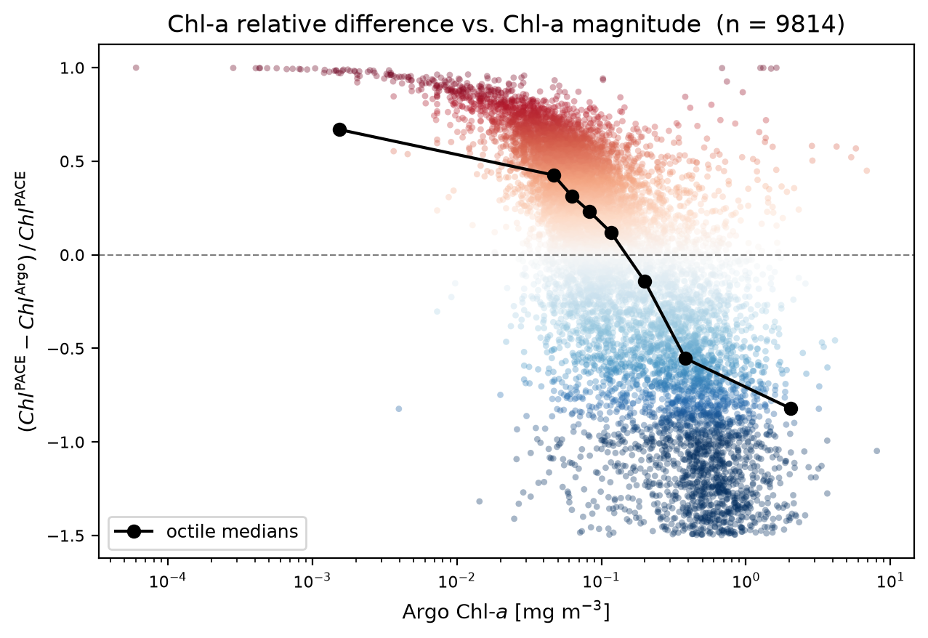
The chlorophyll bias changes sign with concentration
Octile medians +0.65 in the clearest water to −0.8 in the richest, zero crossing near 0.1–0.2 mg m⁻³. Geometry and PACE quality ruled out: the highest-quality subset is more biased (+0.22).
PAB reports/PAB/pab_chl_matchups_report.md (2026-09-07); pab_version 1.0 §3, n = 9,814
34 / 40
Notes:
This is the degeneracy at mission scale. The bias is flat in time and distance separation and gets worse, not better, in the highest-quality subset, so it is not the matchup and not PACE data quality. It is uncorrelated with the backscatter bias, so the mechanism is not shared. And it correlates with the fitted a_dg amplitude at rho of minus 0.24, the sign expected if dissolved absorption is being aliased into the phytoplankton term where a_dg is high. That is the a_ph versus a_dg split from slide 14, seen in 9,814 real matchups.

Slide 35
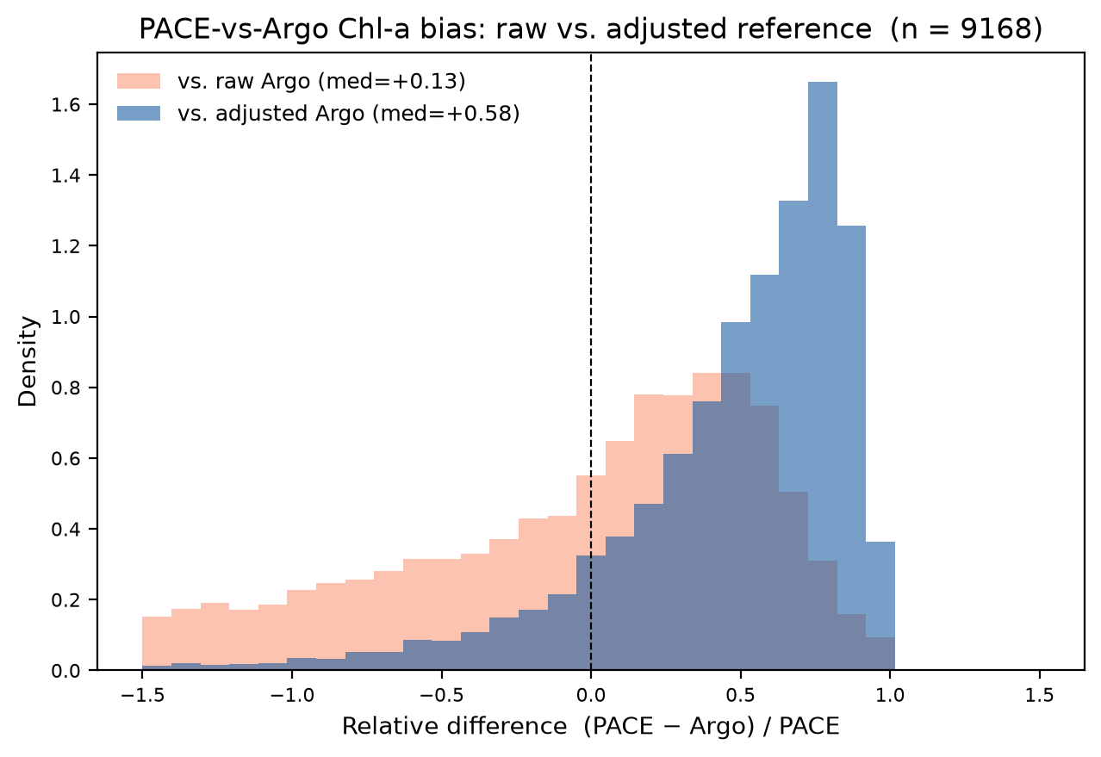
The in-situ reference is itself ambiguous, by a factor of ~4.5
Scoring against delayed-mode-adjusted rather than raw Argo chlorophyll moves the median from +0.13 to +0.58. Ruling: adjusted is the headline, raw the sensitivity band.
PAB reports/PAB/pab_chl_matchups_report.md (2026-09-07); pab_version 1.0 §6; chla_adjusted populated for 93.4 %
35 / 40

Slide 36
What else the matchups say, and what is excluded
• Ruled out as drivers
• time separation (+0.05 to +0.35 by octile), distance (+0.10 to +0.15), PACE flags (quality subset +0.22)
• Structure that remains
• Southern Ocean −0.53 against +0.14 to +0.35 elsewhere; season +0.15–0.20 (Mar–Oct) vs +0.03–0.09
• AOML-processed floats +0.06 vs +0.25 for all other data centres
• Mechanism candidate
• bias vs fitted a_dg: ρ = −0.24 — dissolved absorption aliased into the phytoplankton term at high a_dg
• CDOM: qualitative by design
• float measures fluorescence in relative units; BING retrieves an absorption; the fleet's CDOM sensors carry an unapplied 5.6× correction
• rank correlation +0.13 on 3,676 restricted matchups — that is all that is claimed
• Excluded
• PACE-vs-Argo backscatter validation is a collaborator's thesis
• A NASA GIOP retrofit over all 14,609 matchups: BING and GIOP agree on sign and share a low-concentration overestimate — the boundary condition taken from it
PAB reports/PAB/pab_chl_matchups_report.md (2026-09-07); pab_version 1.0; pab_cdom_matchups_report.md v1.0; claude_prompts/pace_giop_gsm.md
36 / 40

Slide 37
PAB 2.0: the mission-scale echo of the RT ladder, under way
• What it is
• re-fit of every matchup under the inelastic forward model of Chapter 2 (robust_hybrid + Raman + Chl fluorescence)
• per-pixel solar and sensor geometry read from the PACE L1B granule (the L2 product carries none)
• free B_p; version-aware ids; separate 2.0 database
• Status (2026-09-17)
• pipeline built; image validated in-cluster; backfill of 1,690 never-attempted profiles planned
• first 60 real fits: 2.0 retrieves 26 % less b_bp(700) than 1.0
• What it will answer
• does the chlorophyll sign change survive the physics? (the claim says yes)
• does mission-scale backscatter move as the ladder predicts? (the claim says yes, by about a fifth)
• What it will not claim
• the bb_p(700) comparison is reported in PAB's own run report and offered to the collaborator, not claimed here
• Caveat carried everywhere
• population statistics are for the matched set until the backfill runs
PAB claude_prompts/v2/run_full_inelastic.md; build_v2_prompt_3.md Task 6 (2026-09-17)
37 / 40

Slide 38
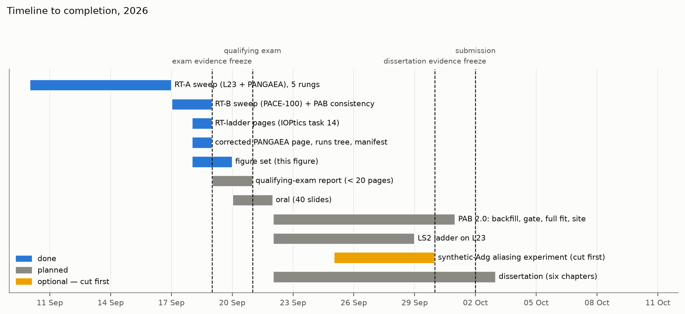
Timeline to completion
Everything shown today existed by the 19 September freeze. PAB 2.0, LS2 and the synthetic-a_dg test follow before the 30 September dissertation freeze; the last is cut first.
claudes-phd-thesis claude_prompts/qual_exam_prompts.md prompts 6–15
38 / 40

Slide 39
Risks, and what retires each
risk | consequence | what retires it
aliasing hypothesis falsified | PAB mechanism section rewritten; claim stands on L23 + GLORIA | synthetic-a_dg experiment; a null is reported
PAB 2.0 full run misses 09-30 | Ch 5 reports the gate and v1.0 | backfill + gate the week of 09-22
Argo reference ambiguous (~4.5×) | headline +0.13 or +0.58 | ruling: adjusted headline, raw sensitivity
forward model off its zenith grid | bounds hold inside 0–60° only | stated; denser HydroLight zeniths are future work
CDOM fluorescence unvalidated | rung 5 is a plausibility test | flagged; rung 4 is the like-for-like
EPFT-UP retrain blocked (PML) | Ch 4 cannot reproduce training | chapter stands on audit + transfer
1,690 PAB profiles never attempted | rates are for the matched set | the 2.0 backfill; footnoted until then
citations on branches (47 of 62) | main does not yet resolve them | advisor merges after submission; manifest records branch + commit
claudes-phd-thesis reports/citation_manifest.md; qual_report.tex §8
39 / 40

Slide 40
Conclusions
The claim, restated
Semi-analytical retrieval of ocean inherent optical properties fails in two separable ways. Forward-model (physics) error is identifiable and removable with a sufficiently accurate differentiable radiative-transfer model; once it is removed, the residual error is parameterization error, concentrated in the split of absorption between phytoplankton and CDOM + detritus.
Established today: forward-model error → 0.3 %; with the parameterization fixed, physics removes the backscatter error and leaves the absorption split; with the physics fixed, parameterizations move the split by factors and totals hardly at all; the same degeneracy one level up and at mission scale.
Falsifiable, and two tests remain: LS2 should match BING on totals and be unable to touch the split; PAB 2.0 should move backscatter and leave the chlorophyll sign change.
On the candidate: the arrangement produced a complete provenance trail, and its characteristic failure — treating the repository as the world — which the record shows and the advisor corrected.
40 / 40
Notes:
Close on the claim, then the three sentences of what is established, then the two falsification tests so the committee hears that the claim can lose. End on the candidate honestly: the provenance trail is the strength; the weakness the record shows is inferring absence of work from absence of commits, twice, and the correction came from the advisor and from re-checking the disk. Then stop and take questions; the backup section is ordered by the four questions most likely to be asked.

Slide 41
Backup
After the end
Ordered by the questions this evidence most invites:
1. How do you know the forward model is right?
2. Why is a_ph wrong by a factor of two, and should anyone care?
3. What would falsify the claim?
4. What did the candidate do, and what did the advisor do?
5. The ladder numbers, in full. 6. Where every citation lives.
backup 1

Slide 42
B1 — How do you know the forward model is right?
• Against what
• HydroLight, the numerical radiative-transfer solution that generated L23; 9,960 samples (3,320 bodies × 3 zeniths)
• Held out how
• 20 % of bodies by scene: 0.30 % rRMS; the 60° zenith when trained on 0/30: 4.7–12.2 % (5 seeds) — reported, not gated
• Cross-checked
• inelastic terms match BING's reference implementation to 10⁻¹³–10⁻¹⁶; gradients to 5×10⁻⁹
• Not shown right
• phase function (1.7× span in B_p), off-nadir view, CDOM fluorescence, λ < 400 nm (13 % at 350)
• Where the ladder stands relative to those edges
• L23 arm at 0° zenith, inside the grid; PANGAEA/PACE zeniths computed per record, inside 0–60°
• B_p free on L23 and PACE — posteriors near 0.027, above the trained span [0.010, 0.018]: DomainWarning on every hybrid fit, accepted with the caveat; the analytic ZTT rung is the control
• The honest answer
• right to 0.3 % inside the trained domain, degrading to ~10 % on unseen sun angle; every result in the talk is inside the domain
retrieve-or-bust reports: report_rt_elastic_model.md v1.0 (2026-08-15), report_rt_inelastic_model.md v1.0 (2026-08-27); IOPtics RT-ladder pages (rt_tests_A_l23_v1, rt_tests_A_pangaea_v1, rt_tests_B_v1), built 2026-09-18
backup 2

Slide 43
B2 — Why is a_ph wrong by a factor of two, and should anyone care?
• Why
• a_ph and a_dg both absorb most in the blue; their sum is set by the reflectance level, their split by shape alone
• BING's a_ph is a fixed Bricaud shape scaled by one amplitude; a_dg an exponential with one amplitude and one slope
• the physics changes what light is available in the red; the parameterization decides where it goes — and it goes into a_ph
• GIOP and GSM under the same physics: 60 % and 28 % — different parameterizations, same disease (slide 23)
• Should anyone care
• a_ph is the chlorophyll proxy; PACE's phytoplankton community products are built on the decomposition
• at mission scale it appears as a chlorophyll bias that changes sign with concentration and tracks a_dg (slide 33)
• one level up it appears as a species algorithm that transfers for one group and not two (slide 29)
• What would fix it
• not physics. Either more information (Kd, as LS2 uses) or a parameterization that admits it cannot split — which is the dissertation's LS2 test
IOPtics RT-ladder pages (rt_tests_A_l23_v1, rt_tests_A_pangaea_v1, rt_tests_B_v1), built 2026-09-18; PAB reports/PAB/pab_chl_matchups_report.md (2026-09-07); pab_version 1.0
backup 3

Slide 44
B3 — What would falsify the claim?
• If completing the physics had fixed a_ph / a_dg
• the claim would be wrong; it did not, on 3,309 synthetic bodies (slide 14)
• If the LS2 comparison shows a semi-analytical form that recovers the split from R_rs alone
• the "parameterization" half is wrong; LS2 (Loisel+2018) declines to split and should match BING on totals — the dissertation runs the three-rung ladder (true Kd + true b_p; true Kd + OC4 b_p; NN Kd + OC4 b_p)
• If PAB 2.0 removes the chlorophyll sign change
• the mission-scale mechanism is the physics after all; the claim says the sign change survives and backscatter moves by ~20 %
• If the synthetic-a_dg experiment shows no aliasing
• the PAB mechanism section is rewritten; the L23 ladder and GLORIA stand on their own
• If GLORIA turbid spectra are fitted by a richer b_bp under the new physics
• then the turbid failure was parameterization after all; today four b_bp models give one fit and the forward model is the suspect
• Already retired
• "RT-B may not run" — it ran on 2026-09-17
qual_report.tex §6 and §8
backup 4

Slide 45
B4 — What did the candidate do, and what did the advisor do?
• The advisor
• chose the four problems and the exclusions; wrote every numbered prompt and every Q&A answer (55 questions in the RT tests alone)
• judged acceptance at every gate (design docs, coding stages, sweep launches, the 100-matchup PAB gate)
• ran every git command; owns the machines, the data, the cluster and the Drive
• is the author of BING and the 2025 paper the thesis stands on
• The candidate (Claude: Opus 4.6–5, Fable 5–5.1, over eight months)
• wrote the packages: IOPtics (12.6k lines, 535 tests), robust.rt (8.3k, 537 tests), PAB (8.9k, 140–208 tests), EPFT-UP; the BING extensions
• designed and ran the sweeps; wrote the reports, the pages, the figures, this deck and the written report
• The record
• ~530 dated session logs since 2026-06-15; every result traces to one; every citation to a path, branch and commit
• The failure mode the record shows
• inferring absence of work from absence of commits — twice; corrected by the advisor and by re-checking the disk
claudes-phd-thesis claude_prompts/profx_inventory.md; start_up.md ## Report
backup 5

Slide 46
B5 — The L23 ladder in full (MCMC, 3,309 bodies, fractional error / bias)
rung | a(440) | a_ph(440) | a_dg(440) | b_bp(555) | b_bp(670) | χ²ν
elastic, analytic | 5.3 / +2.8 | 91 / −33 | 26 / +6 | 55 / +55 | 68 / +68 | 1.12
elastic, hybrid | 5.2 / +3.2 | 135 / −48 | 29 / +14 | 41 / +41 | 60 / +60 | 1.14
+ Raman | 5.1 / +3.6 | 252 / −69 | 38 / +31 | 12 / +10 | 26 / +26 | 1.14
+ Chl fluorescence | 5.9 / +4.9 | 85 / −38 | 26 / +20 | 10 / +6 | 18 / +16 | 1.07
+ CDOM fluorescence | 5.0 / +2.8 | 93 / −40 | 25 / +17 | 12 / −5 | 13 / +6 | 1.08
Percent. Coverage of the 68 % interval on b_bp(555): 0.00, 0.02, 0.52, 0.63, 0.59 down the ladder. Every cell reconciled against the IOPtics page (reports/rta_reconcile.md, 0 discrepancies).
IOPtics RT-ladder pages (rt_tests_A_l23_v1, rt_tests_A_pangaea_v1, rt_tests_B_v1), built 2026-09-18
backup 6

Slide 47
B6 — Where every citation lives
• 62 artefacts cited; 47 not yet on main
• RoB inelastic-rt (14), IOPtics rt-tests (18), PAB full-inelastic (6) + hyper_matchups (1), BING rob_cdom (3), this repository's qualifying-exam branch (4)
• EPFT-UP and ocpy: everything on main
• The manifest records, for each, the path, the branch and the last-touching commit
• the advisor has undertaken to make main resolve them after submission
• Sweep outputs are not in git
• parquet + chains under $OS_COLOR/IOPtics/runs on the canonical workstation; each page stamps the code and config that produced it
• Repositories
• github.com/ocean-colour/{IOPtics, retrieve-or-bust, PAB, bing, EPFT-UP, ocpy}
• github.com/Sea-Meets-the-Stars/claudes-phd-thesis
• Documentation sites
• ioptics.readthedocs.io · retrieve-or-bust.readthedocs.io · pab-report.readthedocs.io · epft-up.readthedocs.io
• DOI
• EPFT-UP v0.1.0: 10.5281/zenodo.22797970; others after submission
claudes-phd-thesis reports/citation_manifest.md, reports/merge_checklist.md (2026-09-18)
backup 7

